Slide 1
MACHINE LEARNING PROJECT REPORT
Feature Importance Analysis in Diabetes Prediction Using Random Forest and XGBoost
Mosangi Vijaya Lakshmi 2520090201
Potlabathini Shashanth 2520090211
D Pawan Kumar 2520090102
Under the guidance of I V Sai Haritha Asst.Professor,Dept.of CS&IT
Department of Computer Science and Information Technology
College / University: KL University, Bachupally Campus
Academic Year: 2026-27

Slide 2
2. Introduction
Background, domain and why the project is needed
1
Background of the project
THE DOMAIN
Diabetes is a highly prevalent chronic disease; undiagnosed cases risk cardiovascular disease, kidney failure, and nerve damage.
Healthcare meets machine learning
2
Brief overview of the domain
Glucose
BMI
Insulin
Machine learning on clinical data enables early screening. Ensemble models like Random Forest and XGBoost are accurate but often act as “black boxes.”
Blood Pressure
Age
Pregnancies
3
Why the project is needed
Lack of interpretability limits clinical adoption — practitioners need to know why a model predicts what it predicts.
Clinical parameters used to classify patients as diabetic or non-diabetic.

Slide 3
3. Problem Statement
What is wrong today, why it is hard, and who it affects
1
Existing problem
2
Limitations / challenges
3
Who is affected
Diabetes often goes undetected until complications appear
Manual screening is slow and depends on clinician experience
High-accuracy ML models give predictions without reasons
Black-box ensemble models lack transparency
Clinical data has missing or zero values
Class imbalance between diabetic and non-diabetic cases
Patients: delayed diagnosis and treatment
Doctors: cannot trust unexplained predictions
Healthcare systems: rising cost of late-stage care

Slide 4
4. Motivation
Why this project, why now
Why you selected this project
THE MOTIVATION
1
Diabetes is one of the most common chronic diseases, and explainable ML is a growing need in healthcare.
Accurate models are not enough. Clinicians need to know why.
Real-world need
2
Doctors need transparent risk factors, not just a yes/no prediction, to trust and act on AI output.
Research / industry motivation
Accuracy
Trust
Adoption
3
Explainable AI is a major focus of medical research and health-tech; feature importance and SHAP are widely used.

Slide 5
5. Objectives
One main objective, four specific objectives
Classify patients as diabetic / non-diabetic
MAIN OBJECTIVE
1
Build an accurate and interpretable diabetes prediction system using Random Forest and XGBoost.
Compare Random Forest vs. XGBoost performance
2
Rank clinical features by predictive importance
3
Deliver interpretable, clinically relevant insights
4

Slide 6
6. Existing System
How diabetes is predicted today
1
Current approach
2
Existing technologies
3
Limitations
Clinical diagnosis using blood tests (fasting glucose, HbA1c)
Rule-based risk scores and doctor judgement
Single-model ML predictors focused only on accuracy
Logistic Regression and Decision Trees
Support Vector Machines and Neural Networks
Random Forest / XGBoost used as black boxes
Little explanation of why a prediction was made
Accuracy and interpretability treated separately
Hard for clinicians to trust and adopt
Feature rankings rarely compared across models

Slide 7
7. Proposed System
Our solution and how it fixes the limitations
PROPOSED SOLUTION
An ML system that classifies patients using Random Forest and XGBoost, and explains every prediction with Gini-based and gain-based feature importance.
LIMITATION
HOW THE PROPOSED SYSTEM ADDRESSES IT
Black-box predictions
Gini and gain-based importance explain the key factors
Accuracy vs. interpretability trade-off
Two ensemble models compared on accuracy and explainability
Poor data quality
Preprocessing handles missing values, scaling and train/test split

Slide 8
8. System Architecture / Block Diagram
Input → Processing → Models → Output
Input
Processing / Modules
Algorithms / Models
Output
Clinical parameters
Glucose, BMI, Insulin
Blood Pressure, Age, Pregnancies
CSV dataset
Handle missing values
Normalize features
Train / test split
Random Forest (bagging)
XGBoost (boosting)
Importance scoring
Diabetic / non-diabetic
Evaluation metrics
Feature importance ranking

Slide 9
9. Methodology / Workflow
Step-by-step project workflow
1
2
3
4
5
6
7
Data Collection
Preprocessing
Train / Test Split
Model Training
Evaluation
Feature Importance
Interpretation
Load the Pima Indians Diabetes dataset (CSV)
Handle missing values, normalize features
Split data into training and testing sets
Train Random Forest and XGBoost classifiers
Accuracy, precision, recall, F1-score, ROC-AUC
Gini-based (RF) and gain-based (XGBoost) scores
Rank features, compare models, derive insights
Two algorithms, one goal: accurate classification with transparent, clinically usable reasoning.

Slide 10
10. Technology Stack
Tools and technologies used to build the prediction pipeline
P
F
L
D
H
Programming Languages
Frameworks
Libraries
Database
Hardware / Cloud
Python 3.x
Scikit-learn
XGBoost
Pandas & NumPy
Matplotlib / Seaborn
SHAP (optional)
CSV file
Pima Indians Diabetes Dataset
Google Colab / Jupyter
Standard laptop or PC

Slide 11
11. System Modules / Components
Eight modules that make up the system
1
2
3
4
User Interface
Data Collection
Data Preprocessing
Core Processing / ML Module
Input form or notebook cells for patient data
Loads the Pima Indians dataset from CSV
Cleans, scales and splits the data
Random Forest and XGBoost training
5
6
7
8
Database
Prediction / Decision Module
Visualization / Reporting
Authentication / Security
Stores the dataset and trained results
Classifies a patient as diabetic or not
Importance charts, metrics and plots
Protects access to sensitive patient data

Slide 12
12. Implementation
Important steps, with a code and output example
Load and explore the dataset using Pandas
1
CODE / OUTPUT EXAMPLE
rf = RandomForestClassifier(n_estimators=100)
xgb = XGBClassifier(learning_rate=0.1)
rf.fit(X_train, y_train)
xgb.fit(X_train, y_train)
print(rf.feature_importances_)
Clean data, replace invalid zeros and scale features
2
Train Random Forest and XGBoost using Scikit-learn and XGBoost
3
# Glucose 0.31 | BMI 0.22 | Age 0.18
Extract importance scores and plot them with Matplotlib
4
Screenshots of the screens: see Section 16

Slide 13
13. Dataset / Input Data
Pima Indians Diabetes Dataset (CSV)
768
Number of records
8
Input features
2
Classes: diabetic / non-diabetic
FEATURES
DATA PREPROCESSING
Pregnancies
Glucose
Blood Pressure
Skin Thickness
Replace invalid zero values with the median
Normalize / scale numerical features
Stratified train / test split (80 / 20)
Insulin
BMI
Diabetes Pedigree
Age
Highlighted: the 6 key clinical features analysed. Target label: Outcome (0 / 1).

Slide 14
14. Algorithm / Model
The two ensemble models and why they were selected
Random Forest
XGBoost
ALGORITHM USED
ALGORITHM USED
Bagging ensemble of decision trees
Gradient boosting, sequential tree building
WHY IT WAS SELECTED
WHY IT WAS SELECTED
Robust to overfitting and easy to interpret
Higher accuracy through the boosting mechanism
MODEL ARCHITECTURE
MODEL ARCHITECTURE
Many trees on bootstrap samples, majority vote
Each tree corrects the previous errors
IMPORTANT PARAMETERS
IMPORTANT PARAMETERS
n_estimators = 100, max_depth, random_state = 42
learning_rate = 0.1, n_estimators = 100, max_depth = 4

Slide 15
15. Results
Performance metrics, importance charts and comparison
Comparison with existing methods: both ensembles beat single baselines such as Logistic Regression and Decision Tree, and add feature-level explanations.

Slide 16
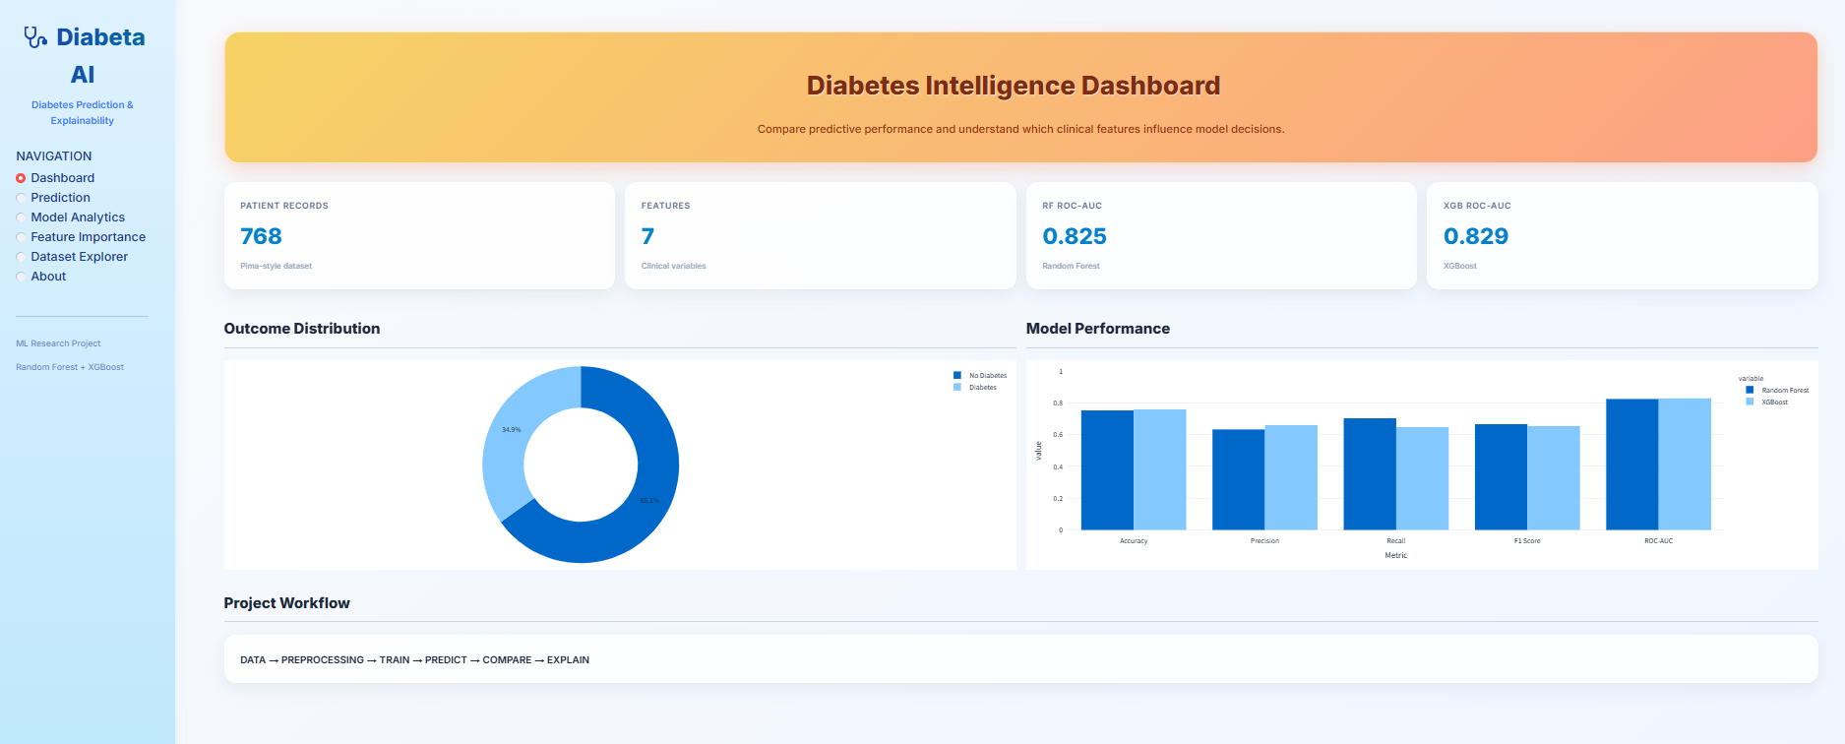
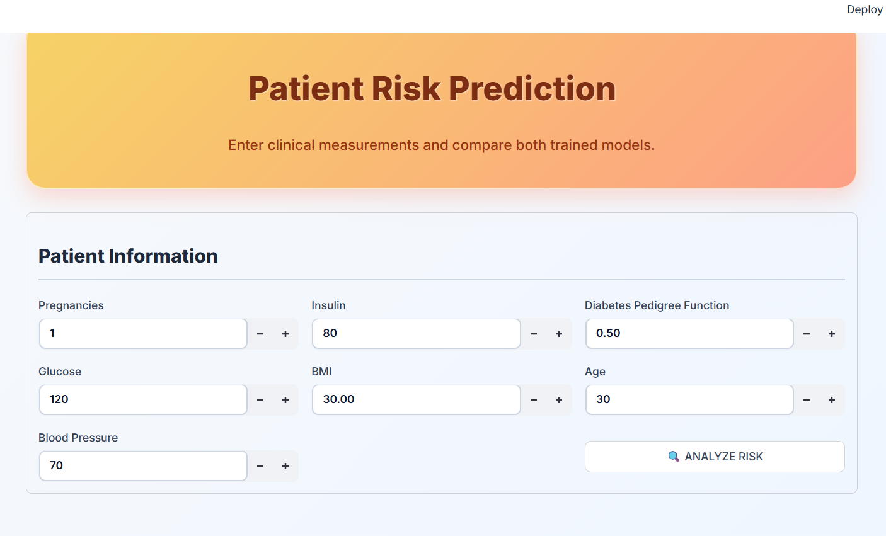
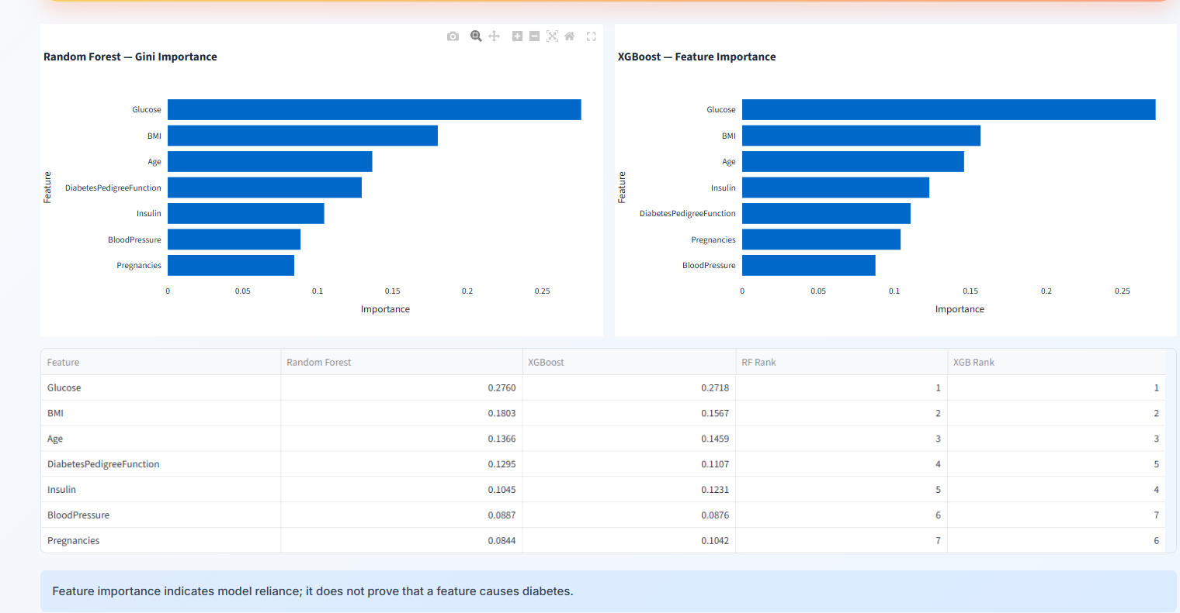
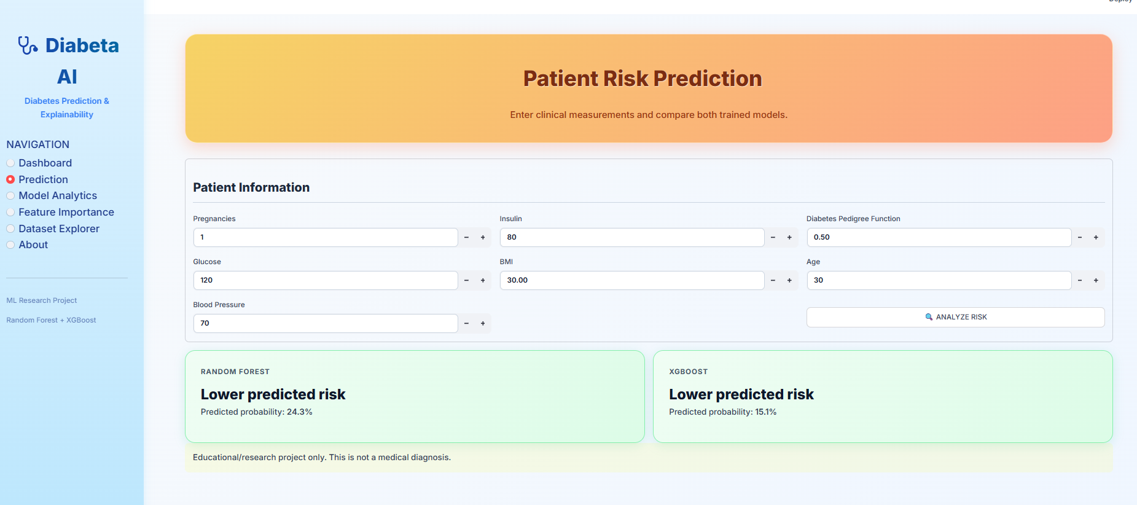
16. Screenshots / Demo
Replace each frame with a screenshot from your project
Project overview
1
Home page
2
Input screen
3
Processing screen
4
Output / result screen
Patient data / dataset load
Training and preprocessing
Prediction and importance plot

Slide 17
17. Advantages
Benefits and improvements over the existing approach
BENEFITS OF THE PROPOSED SYSTEM
IMPROVEMENTS OVER EXISTING APPROACH
Accurate diabetic vs. non-diabetic classification
Explains predictions instead of black-box output
Transparent, interpretable feature rankings
Combines accuracy with clinical interpretability
Fast and low-cost: runs on free tools like Colab
Cross-model feature ranking gives stronger insight
Two models compared for reliable conclusions
Structured preprocessing handles missing values

Slide 18
18. Applications
Real-world uses and target users
TARGET USERS / INDUSTRIES
REAL-WORLD APPLICATIONS
Doctors & clinicians
Hospitals
Early diabetes risk screening
Clinical decision support
Diagnostic labs
Health-tech startups
Patient risk stratification
Insurance companies
Medical researchers
Public health and preventive-care programs

Slide 19
19. Limitations
Current limitations and dataset / technical constraints
CURRENT LIMITATIONS
DATASET / TECHNICAL CONSTRAINTS
Prototype runs in a notebook; no live clinical interface
Small dataset (768 records) limits generalization
Not clinically validated on real patient data
Only Pima Indian female patients aged 21+
Importance shows correlation, not causation
Missing / zero values need imputation
XGBoost is sensitive to hyperparameter tuning
Class imbalance between diabetic and non-diabetic

Slide 20
20. Future Scope
Where the project can go next
01
02
03
Possible improvements
Additional features
Deployment / scaling
Tune with GridSearch or Optuna
Try LightGBM, CatBoost and deep learning
Use larger multi-source datasets
Web / mobile app with patient input form
SHAP-based per-patient explanations
Login and role-based access
Deploy with Flask or Streamlit on the cloud
Integrate with hospital EHR systems
Real-time monitoring with wearable data

Slide 21
21. Conclusion
Combining robust ensemble models with explainability techniques enhances both the accuracy and clinical relevance of ML-based diabetes prediction, enabling informed, interpretable decision-making in diabetes screening.
PROJECT AT A GLANCE
2
Models Compared
What was achieved
6
Key Clinical Features
Built and compared Random Forest and XGBoost for diabetes prediction
Key outcome
Glucose, BMI and age are the strongest predictors; XGBoost slightly leads
5
Evaluation Metrics
Overall contribution
Feature importance analysis bridges accuracy and interpretability
Department of Computer Science and Information Technology

