Slide 1
Global State of a Distributed System
Cant stop the process and see the global snapshot and neither can we synchronise all the systems and ask them to take a snapshot at a particular instant.
Not necessary a state the system has visited but is one state that the system could have visited
Application: Check Pointing Recovery, Deadlock needs understanding current state to measure if a true deadlock.
Issues: We need to know both node and channel states as some msgs might be in transit
Assumption: System can not be stopped to take global state. Also no global clock to do the same.

Slide 2
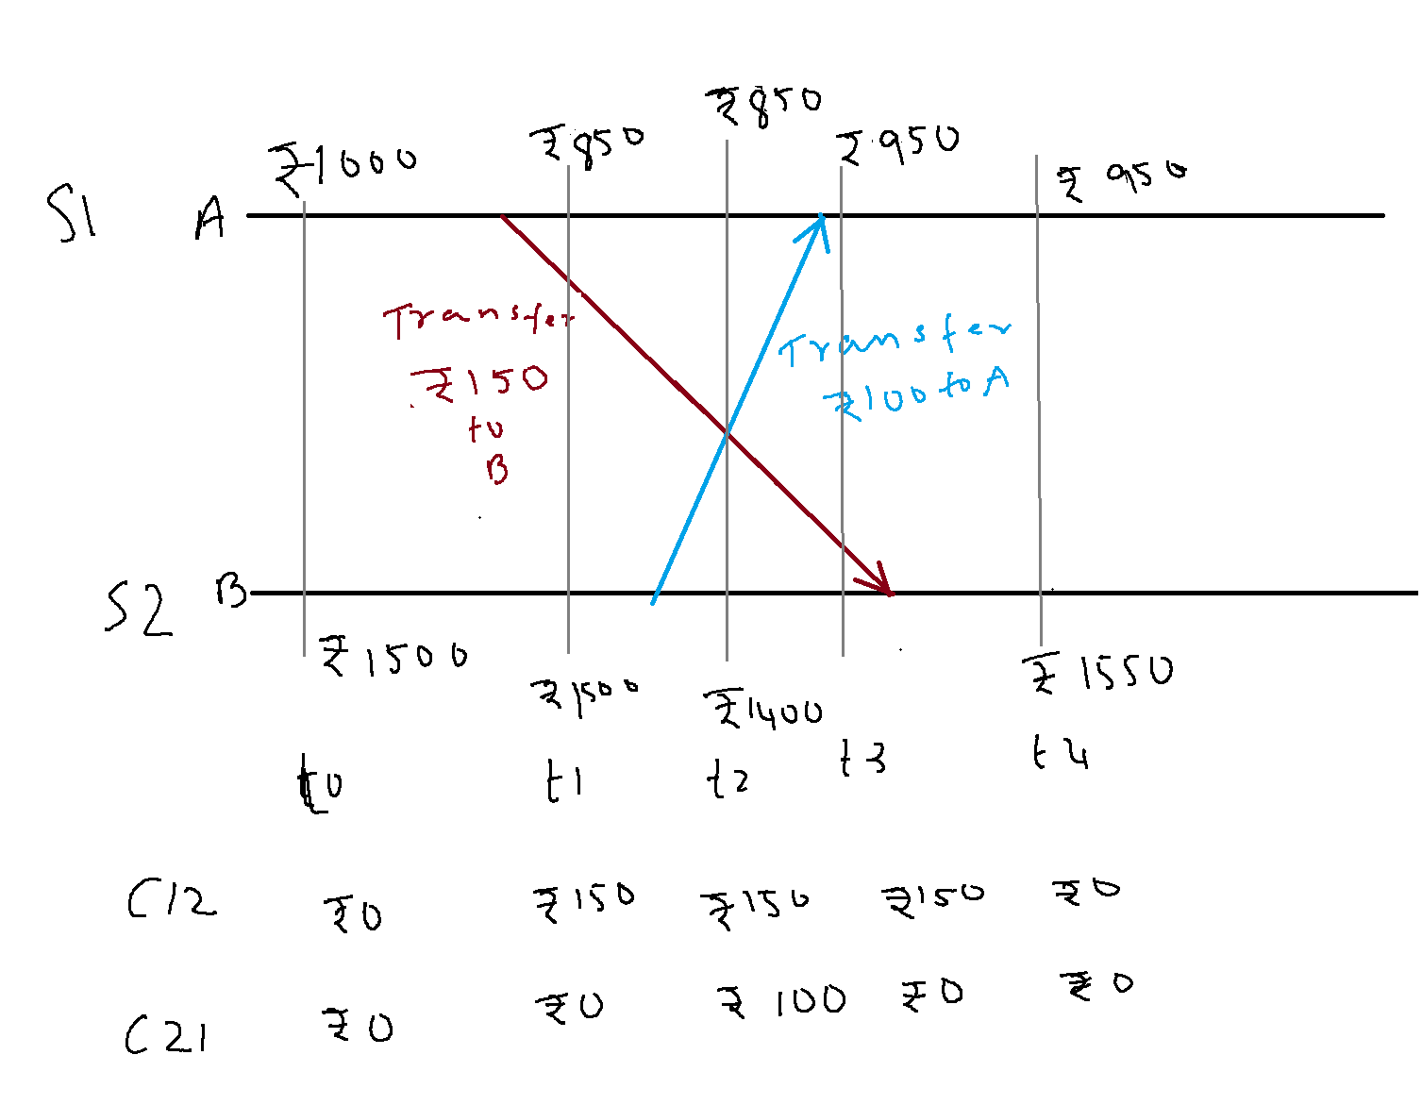
Global States and Snapshots
Consider the distributed execution shown above.

Slide 3
Global States and Snapshots
If the state of the account A is recorded at time t0 and the state of account B and that of the channels C12 and C21 are recorded at t2, what is the total money in the system?

Slide 4
Global States and Snapshots
Initially 1000+1500=2500
At check point 1000(A) +1400(B)+150(C₁₂)+100(C₂₁)= 2650
If this state is used for checkpointing, then there is trouble!
An extra 150 Rs !!!.

Slide 5
Global State of a Distributed System
One can think of the collection of local states as the global state.
Recall that the local state of a process, P_{i}, is the contents of the processor registers, stack, local memory, etc.
The state of a channel is the set of messages in transit in the channel.
Events lead to changes in the state of local process(es).

Slide 6
Global States and Snapshots
Recording the global state of a distributed system on-the-fly is an important paradigm.
The lack of globally shared memory, global clock and unpredictable message delays in a distributed system make this problem non-trivial.
Building on the definition consistent global states we discuss issues to be addressed to obtain consistent distributed snapshots.
Then several algorithms to determine on-the-fly such snapshots are presented for several types of networks.

Slide 7
Global State of a Distributed System
At any instant the state of a process Pi denoted by LS_{i}, is a result of the sequence of all events executed by p_{i} upto that instant. State of a Channel C_{ij} is denoted as SC_{ij}
The msgs in transit on the channel C_{ij} are denoted as
SC_{ij} ={m_{ij} | send (m_{ij}) ∈ LS_{i} and rec(m_{ij}) ∉LS_{j}}
To formalize, let LS^{x}_{i} denote the local state of process P_{i} after the occurrence of all events until event e^{x}_{i}
  LS⁰_{i} is the initial state of P_{i}

Slide 8
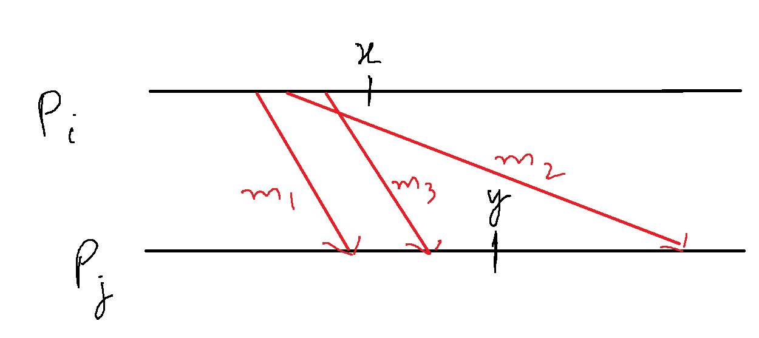

Global State of a Distributed System
We use the above to capture the state of a channel C_{ij}, denoted SC^{x,y}_{i,j} as follows.
  SC^{x,y}_{i,j} = {m_{ij} | send(m_{ij}) <= LS^{x}_{i} and recv(m_{ij}) LS^{y}_{j}}
In words, the state of SC^{x,y}_{i,j} denotes all messages that have been sent by P_{i} up to event e^{x}_{i} and not received by P_{j} up to event e^{y}_{j}.

Slide 9
Conditions for Consistent Global States
The global state of a distributed system is a collection of the local states of the processes and the channels.
Notationally, global state GS is defined as,
  GS = { U_{i}LS_{i} , U_{i,j} SC_{ij}}
A global state GS is a consistent global state iff it satisfies the following two conditions :
C1: send(m_{ij})∈ LS_{i} ⇒ m_{ij} ∈ SC_{ij} ⊕ rec(m_{ij})∈LS_{j}. (⊕ is the Exclusive-OR operator)
C2: send(m_{ij})∉ LS_{i} ⇒ m_{ij} ∉ SC_{ij} Ʌ rec(m_{ij}) ∉ LS_{j}.

Slide 10
Conditions for Consistent Global States
A global state GS is a consistent global state iff it satisfies the following two conditions :
C1: send(m_{ij})∈ LS_{i} ⇒ m_{ij} ∈ SC_{ij} ⊕ rec(m_{ij})∈LS_{j}. (⊕ is the Exclusive-OR operator)
C1 states the law of conservation of messages.
  Every message that is recorded as sent in the local state of some process is either captured in the state of the channel or is captured in the local state of the receiver.
C2: send(m_{ij})∉ LS_{i} ⇒ m_{ij} ∉ SC_{ij} Ʌ rec(m_{ij}) ∉ LS_{j}.
C2 states that for every cause there is an effect.
  If a message is not recorded as sent in the local state of a process P_{i}, then the message cannot be included in the state of the channel C_{ij} or be captured as received by P_{j}.

Slide 11
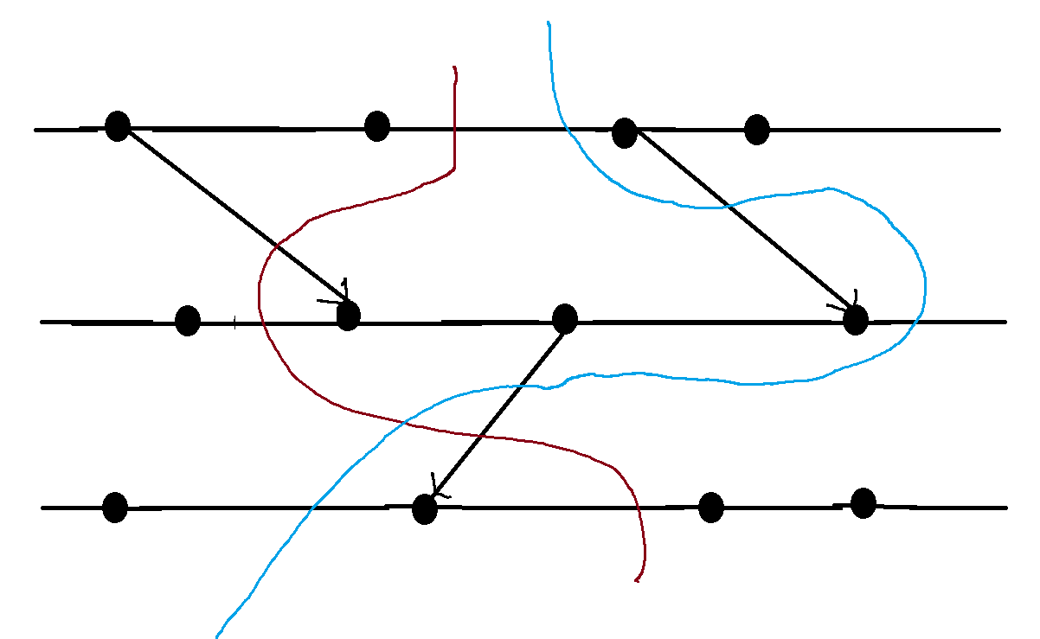
Interpretation in terms of cuts
A cut in a space-time diagram is a line joining an arbitrary point on each process line that slices the space-time diagram into a PAST and a FUTURE.
A consistent global state corresponds to a cut in which every message received in the PAST of the cut was sent in the PAST of that cut.
Such a cut is known as a consistent cut.

Slide 12
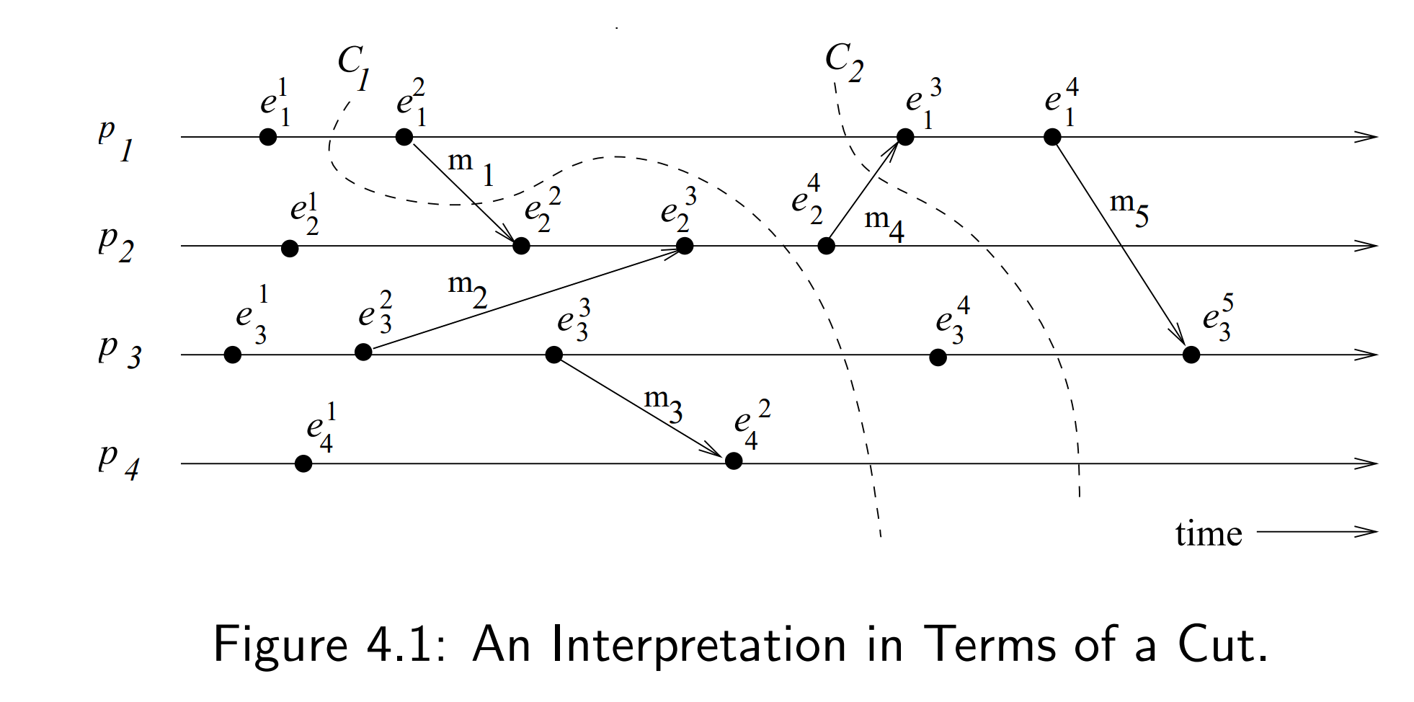
Interpretation in terms of cuts – Example
Cut C₁ is inconsistent because message m₁ is flowing from the FUTURE to the PAST.
Cut C₂ is consistent and message m₄ must be captured in the state of channel C₂₁.

Slide 13
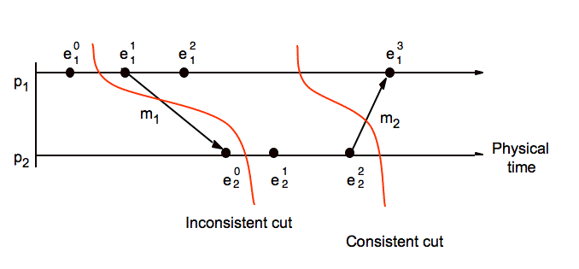
Consistent and Inconsistent Cut

Slide 14
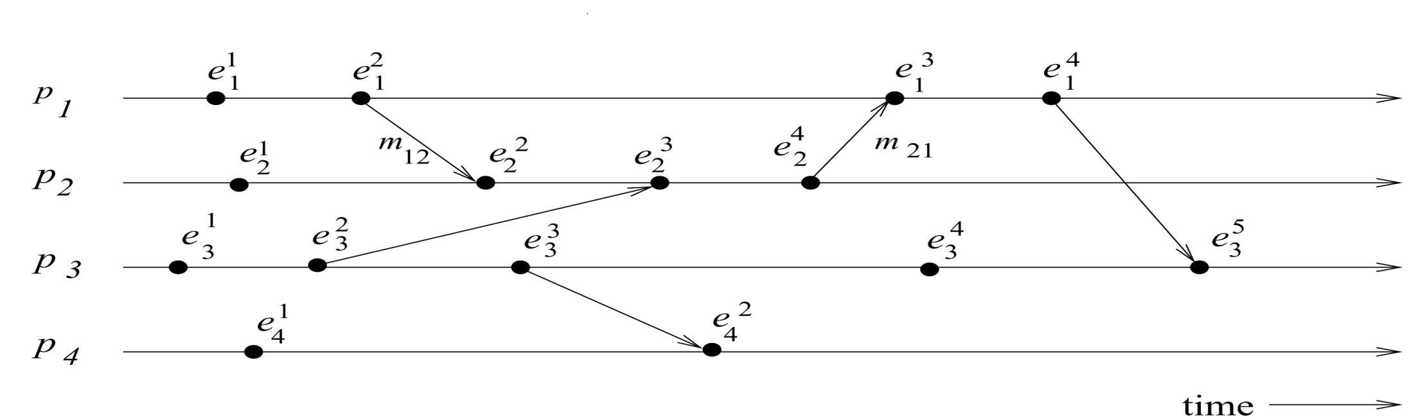
Example
Which global states are consistent?
{LS¹₁, LS³₂, LS³₃, LS²₄}
{LS²₁, LS⁴₂, LS⁴₃, LS²₄}
{LS²₁, LS¹₂, SC²²₁₂, LS³₃, LS²₄}
  SC^{x,y}_{i,j} = {m_{ij} | send(m_{ij})<= LS^{x}_{i} and recv(m_{ij}) LS^{y}_{j}}

Slide 15
Example
Which global states are consistent?
{LS¹₁, LS³₂, LS³₃, LS²₄} -inconsistent
{LS²₁, LS⁴₂, LS⁴₃, LS²₄} - consistent
{LS²₁, LS¹₂, SC²²₁₂, LS³₃, LS²₄} - consistent
  SC^{x,y}_{i,j} = {m_{ij} | send(m_{ij})<= LS^{x}_{i} and recv(m_{ij}) LS^{y}_{j}}

Slide 16
Difficulty of Taking a Snapshot
Issue 1: How to distinguish between the messages to be recorded in the snapshot from those not to be recorded.
  Any message that is sent by a process before recording its snapshot, must be recorded in the global snapshot (from C1).
  Any message that is sent by a process after recording its snapshot, must not be recorded in the global snapshot (from C2).
Issue 2: How to determine the instant when a process takes its snapshot.
    A process p_{j} must record its snapshot before processing a message m_{ij} that was sent by process p_{i} after recording its snapshot.

Slide 17
A Distributed Program in Execution
Let us now model message delivery.
Several ways are possible
  Non-FIFO : Message can be reordered in transit
  FIFO : Messages are NOT reordered in transit.
  Causal : Slightly stronger than FIFO. Messages destined for the same destination are not reordered. In symbols,
  for any two messages m_{ij} and m_{kj},
  if send(m_{ij}) → send(m_{kj}) then recv(m_{ij}) → recv(m_{kj}).
  Causal degenerates to FIFO when sent from same process.
  FIFO ⊂ Non-FIFO.

Slide 18
Data Structures Week 1
Global Snapshots for FIFO channels
– Chandy lamports Algorithm

Slide 19
Chandy-Lamport’s Algorithm
Uses special marker messages.
One process acts as initiator, starts the state collection by following the marker sending rule below.
Marker sending rule for process P:
    P records its state and
    For each outgoing channel C from P on which a marker has not been sent already, P sends a marker along C before any further message is sent on C

Slide 20
Chandy Lamport’s Algorithm contd..
When Q receives a marker along a channel C:
  If Q has not recorded its state then Q records its state and also records the state of C as empty; Q then follows the marker sending rule
  If Q has already recorded its state, it records the state of C as the sequence of messages received along C after Q’s state was recorded and before Q received the marker along C
INDIAN INSTITUTE OF TECHNOLOGY KHARAGPUR

Slide 21
Chandy Lamport’s Algorithm contd..
  If Q has already recorded its state, it records the state of C as the sequence of messages received along C after Q’s state was recorded and before Q received the marker along C
  Say a marker is received from Pj from say Pi where Pj has already recorded its state. Now there can be no messages sent from Pi to Pj from when Pi records the state to when Pi sends out the markers. Hence this msg received was sent before Pi marked its state and received after Pj marked its state. Thus, this msg belongs to the transit messages in Channel (Pi, Pj)
INDIAN INSTITUTE OF TECHNOLOGY KHARAGPUR

Slide 22
Notable Points
Markers sent on a channel distinguish messages sent on the channel before the sender recorded its states and the messages sent after the sender recorded its state
The state collected may not be any state that actually happened in reality, rather a state that “could have” happened
INDIAN INSTITUTE OF TECHNOLOGY KHARAGPUR

Slide 23
Process having received a marker
Once a process P receives a marker for the first time he records his state. Lets look at what kinds of msgs he can now receive
From the initiator – a msg sent before the marker
From the initiator – the marker msg
Msg from some process that has not received a marker yet
Msg from some process that has received its marker and is sending marker to P
Msg from some process that has received its marker and has already sent a marker to P and is now sending some other msg
INDIAN INSTITUTE OF TECHNOLOGY KHARAGPUR

Slide 24
Process having received a marker
Lets analyse what should be the state of the channel in each case
From the initiator – a msg sent before it sent the marker
The initiator sent this before marking its global state and the msg is reaching after P marked its state. Hence the msg should be a transit msg
From the initiator –the marker
The initiator sent this after marking its global state and the msg is reaching after P marked its state. Hence the msg is not in transit at the global snapshot
Msg from some process K that has not received a marker yet
Msg sent before K marked its snapshot and received after P marked its snapshot so should be a transit msg
Msg from some process that has received its marker and is sending one to P – non transit msg
Msg from some process that has received its marker and has already sent a marker to P and is now sending some other msg – non transit msg
INDIAN INSTITUTE OF TECHNOLOGY KHARAGPUR

Slide 25
Notable Points
Markers sent on a channel distinguish messages sent on the channel before the sender recorded its states and the messages sent after the sender recorded its state
The state collected may not be any state that actually happened in reality, rather a state that “could have” happened
Will it work if not FIFO channels?
Message complexity ?
INDIAN INSTITUTE OF TECHNOLOGY KHARAGPUR

Slide 26
Notable Points
Markers sent on a channel distinguish messages sent on the channel before the sender recorded its states and the messages sent after the sender recorded its state
The state collected may not be any state that actually happened in reality, rather a state that “could have” happened
Message complexity ?O(|E|), where E = no. of links
INDIAN INSTITUTE OF TECHNOLOGY KHARAGPUR

Slide 27
Chandy-Lamport algorithm – FIFO Channels
This algorithm presented by Mani Chandy and Leslie Lamport works for FIFO channels.
If channel was not FIFO then the msgs sent after marker would reach before marker and get put into the transit messages list.

Slide 28
Chandy-Lamport algorithm – FIFO Channels
The Chandy-Lamport algorithm uses a control message, called a marker whose role in a FIFO system is to separate messages in the channels.
After a site has recorded its snapshot, it sends a marker, along all of its outgoing channels before sending out any more messages.
A marker separates the messages in the channel into those to be included in the snapshot from those not to be recorded in the snapshot.
A process must record its snapshot no later than when it receives a marker on any of its incoming channels.

Slide 29
Chandy-Lamport algorithm – FIFO Channels
The algorithm can be initiated by any process by executing the “Marker Sending Rule” by which it records its local state and sends a marker on each outgoing channel.
A process executes the “Marker Receiving Rule” on receiving a marker.
If the process has not yet recorded its local state, it records the state of the channel on which the marker is received as empty and executes the “Marker Sending Rule” to record its local state.

Slide 30
Termination Condition
The algorithm terminates after each process has received a marker on all of its incoming channels.
All the local snapshots get disseminated to all other processes and all the processes can determine the global state.

Slide 31
Correctness and Complexity
Correctness
Due to FIFO property of channels, it follows that no message sent after the marker on that channel is recorded in the channel state. Thus, condition C2 is satisfied.
When a process p_{j} receives message m_{ij} that precedes the marker on channel C_{ij} , it acts as follows: If process p_{j} has not taken its snapshot yet, then it includes m_{ij} in its recorded snapshot. Otherwise, it records m_{ij} in the state of the channel C_{ij} . Thus, condition C1 is satisfied.
Complexity
The recording part of a single instance of the algorithm requires O(e) messages.

Slide 32
Properties of the recorded global state
The recorded global state may not correspond to any of the global states that occurred during the computation.
This happens because a process can change its state asynchronously before the markers it sent are received by other sites and the other sites record their states.
  But the system could have passed through the recorded global states in some equivalent executions.
  The recorded global state is a valid state in an equivalent execution and if a stable property (i.e., a property that persists) holds in the system before the snapshot algorithm begins, it holds in the recorded global snapshot.
  Therefore, a recorded global state is useful in detecting stable properties.

Slide 33
Recorded Global State
Data Structures Week 1
Say S1 initiates right after t1.
This marker received by S2 after t4.
S2 marks its state and sends marker to S1.
Global State= 850(S1)+1550(S2) +
C12=0 (as when it received the marker
S2 had not marked its state) + C21=100 (msg
received btwn S1 marking its state and marker
received from S2)
Total=2500
Say S1 initiates right after t0.
This marker received by S2 after t2.
S2 marks its state and sends marker to S1.
This marker from S2 to S1 can reach only after msg with
transfer of Rs 100 (FIFO order)
Global State= 1000(S1)+1400(S2) +
C12=0 (as when it received the marker
S2 had not marked its state) + C21=100 (msg
received btwn S1 marking its state and marker
received from S2). Total=2500
Neither are true global states

Slide 34
Data Structures Week 1
Multiple processes can initiate the algorithm concurrently- Read page 94 (H.W)

Slide 35
Snapshot for non-FIFO Channels
In a non-FIFO system, a marker cannot be used to delineate messages into those to be recorded in the global state from those not to be recorded in the global state.
In a non-FIFO system, either some degree of inhibition or piggybacking of control information on computation messages to capture out-of-sequence messages.

Slide 36
The Lai-Yang Algorithm
uses coloring scheme on messages
Every process is initially white and turns red while taking a snapshot. It then sends a red msg to every other process.
Every message sent by a white (red) process is colored white (red).
Thus, a white (red) message is a message that was sent before (after) the sender of that message recorded its local snapshot.
Every white process takes its snapshot at its convenience, but no later than the instant it receives a red message

Slide 37
The Lai-Yang Algorithm
Every white process records a history of all white messages sent or received by it along each channel.
When a process turns red, it sends these histories along with its snapshot to the initiator process that collects the global snapshot.
The initiator process evaluates transit(LS_{i}, LS_{j}) to compute the state of a channel C_{ij.} HOW ?

Slide 38
The Lai-Yang Algorithm
Every white process records a history of all white messages sent or received by it along each channel.
When a process turns red, it sends these histories along with its snapshot to the initiator process that collects the global snapshot.
The initiator process evaluates transit(LS_{i}, LS_{j}) to compute the state of a channel C_{ij} as given below:
SC_{ij} = white messages sent by pi on C_{ij} − white messages received by pj on C_{ij}
C_{ij} = {send(m_{ij})|send(m_{ij}) ∈ LS_{i} } − {rec(m_{ij})|rec(m_{ij}) ∈ LS_{j} }.

Slide 39
The Lai-Yang Algorithm
What is the advantage of Lai-Yangs method over Chandy Laports ?
Issues ?

Slide 40
Data Structures Week 1
The Lai-Yang Algorithm works in case of non FIFO messages?
What about storage?

Slide 41
Data Structures Week 1
The Lai-Yang Algorithm works in case of non FIFO messages?
It does. Channel trasmit msgs are white msgs sent before snapshot and have not reached by the time other process has taken its snapshot. They are hence truly in transit and can reach in any order
Storage
Storage is heavy as each process has to remember all msgs he has sent received until snapshot

Slide 42
Snapshots in a Causal Channels
Acharya-Badrinath and Alagar-Venkatesan
In both these algorithms recording of process state is identical and proceed as follows :
An initiator process broadcasts a token, denoted as token, to every process including itself.
Let the copy of the token received by process p_{i} be denoted token_{i}.
A process p_{i} records its local snapshot LS_{i} when it receives token_{i} and sends the recorded snapshot to the initiator.
The algorithm terminates when the initiator receives the snapshot recorded by each process.

Slide 43
Snapshots in a Causal Channels
  Is it possible that
  send(m_{ij}) ∉ LS_{i} but rec(m_{ij}) ∈ LS_{j}

Slide 44
Snapshots in a Causal Channels
The correctness of the approach depends on the following observation.
For any two processes p_{i} and p_{j}, the following property is satisfied:
  send(m_{ij}) ∉ LS_{i} ⇒ rec(m_{ij}) ∉ LS_{j}.
  This is because a send after process i received the token can reach process j only after process j received the token and hence would have marked its state(by causal property as the instant of token broadcast was before the send msg to process j).
  Channel state recording is done differently in different algorithms. Check Acharya-Badrinath and Alagar-Venkatesan for examples. Their task is to identify msgs sent before the snapshot Pi and received after the snapshot of Pj as transit for Cij

Slide 45
Acharya – Badrinath Algorithm
How can I measure the transit messages?
Anything similar to Lai Yang ?

Slide 46
Acharya – Badrinath Algorithm
Each process pi maintains arrays SENT_{i}[1, ...N] and RECD_{i}[1, ..., N].
SENT_{i}[j] is the number of messages sent by process pi to process p_{j}.
RECD_{i} [j] is the number of messages received by process p_{i} from process p_{j}.
Channel states are recorded as follows:
When a process p_{i} records its local snapshot LS_{i} on the receipt of token, it includes arrays RECD_{i} and SENT_{i} in its local state before sending the snapshot to the initiator.

Slide 47
Acharya – Badrinath Algorithm
When the algorithm terminates, the initiator determines the state of channels as follows:
The state of each channel from the initiator to each process is empty.
The state of channel from process p_{i} to process p_{j} is the set of messages whose sequence numbers are given by {RECD_{j}[i] + 1, . . ., SENT_{i}[j]}.
That is, sent 10 msgs but received 5 msgs so 6,7,8,9,10 are not received. Due to causal order they will appear at receiving end in that order itself.
Complexity:
This algorithm requires 2n messages

Slide 48
Data Structures Week 1
Will Acharya Badrinath Algorithm work for FIFO Channels?

