Slide 1

Presentation on C++ Project MADAL
Submitted By
Vijay Shrestha
Supervisor
Tej Bahadur Shahi

Slide 2
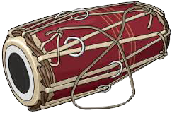
Introduction
MADAL is the digital version of real life Madal.
Madal is the most popular hand drum in Nepal.
Object Oriented Programming
Simple DirectMedia Layer (SDL)

Slide 3
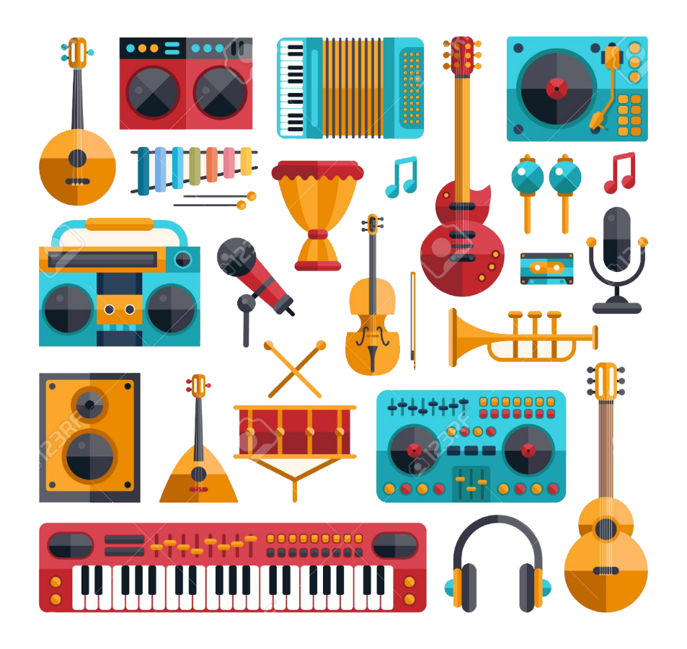
Problem Statement
Nepal is rich in culture and tradition
Modernization

Slide 4
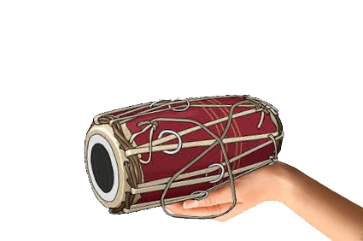
Problem Statement
Our Responsibility
Modernizing our culture and tradition

Slide 5
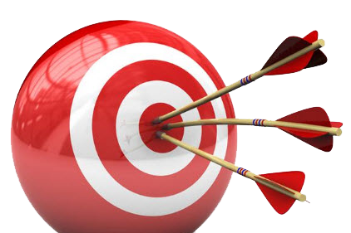
Objectives
Bring Madal in Digital World
Encourage new generation to use Madal

Slide 6
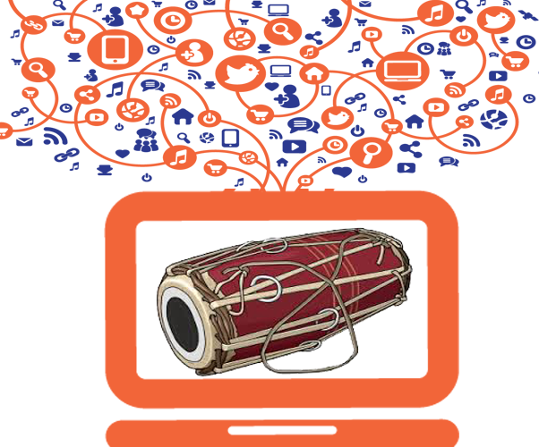
Objectives
Easy to use
Promote and Preserve culture & tradition

Slide 7
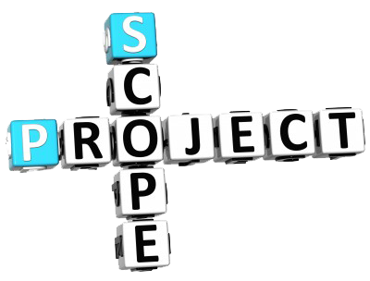
Scope & Limitation
Assist anthropologist to preserve our culture
Assist creative musicians.

Slide 8
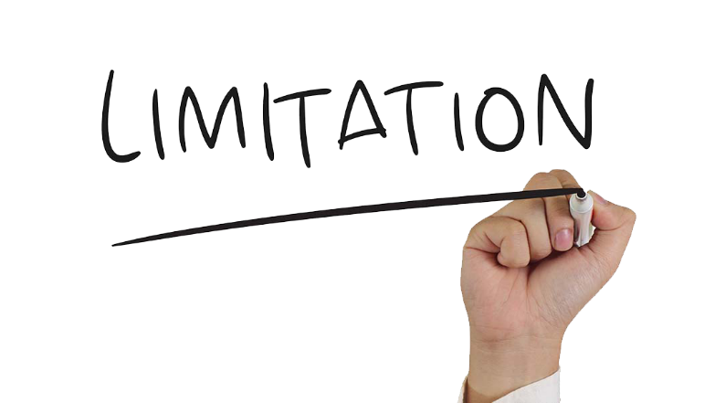
Scope & Limitation
Cannot Record any beats
Noticeable noise in sound

Slide 9
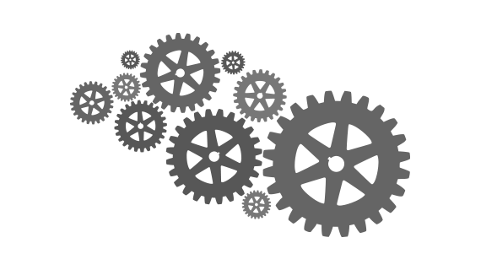
Implementation
Fundamentals of Madal
Concepts of OOP
Simple DirectMedia Layer (SDL)

Slide 10
Implementation
SDL.h
SDL_Window, SDL_Surface, SDL_Event, SDL_PollEvent, SDL_QUIT, SDL_LoadBMP(file), SDL_BlitSurface(),SDL_MOUSEBUTTONDOWN, SDL_GetMouseState, SDL_KEYDOWN, SDL_UpdateWindowSurface, SDL_DestroyWindow
SDL_mixer.h
Mix_OpenAudio(44100,MIX_DEFAULT_FORMAT,2,2048), Mix_LoadWAV(filename), Mix_PlayChannel(-1,var,0)

Slide 11
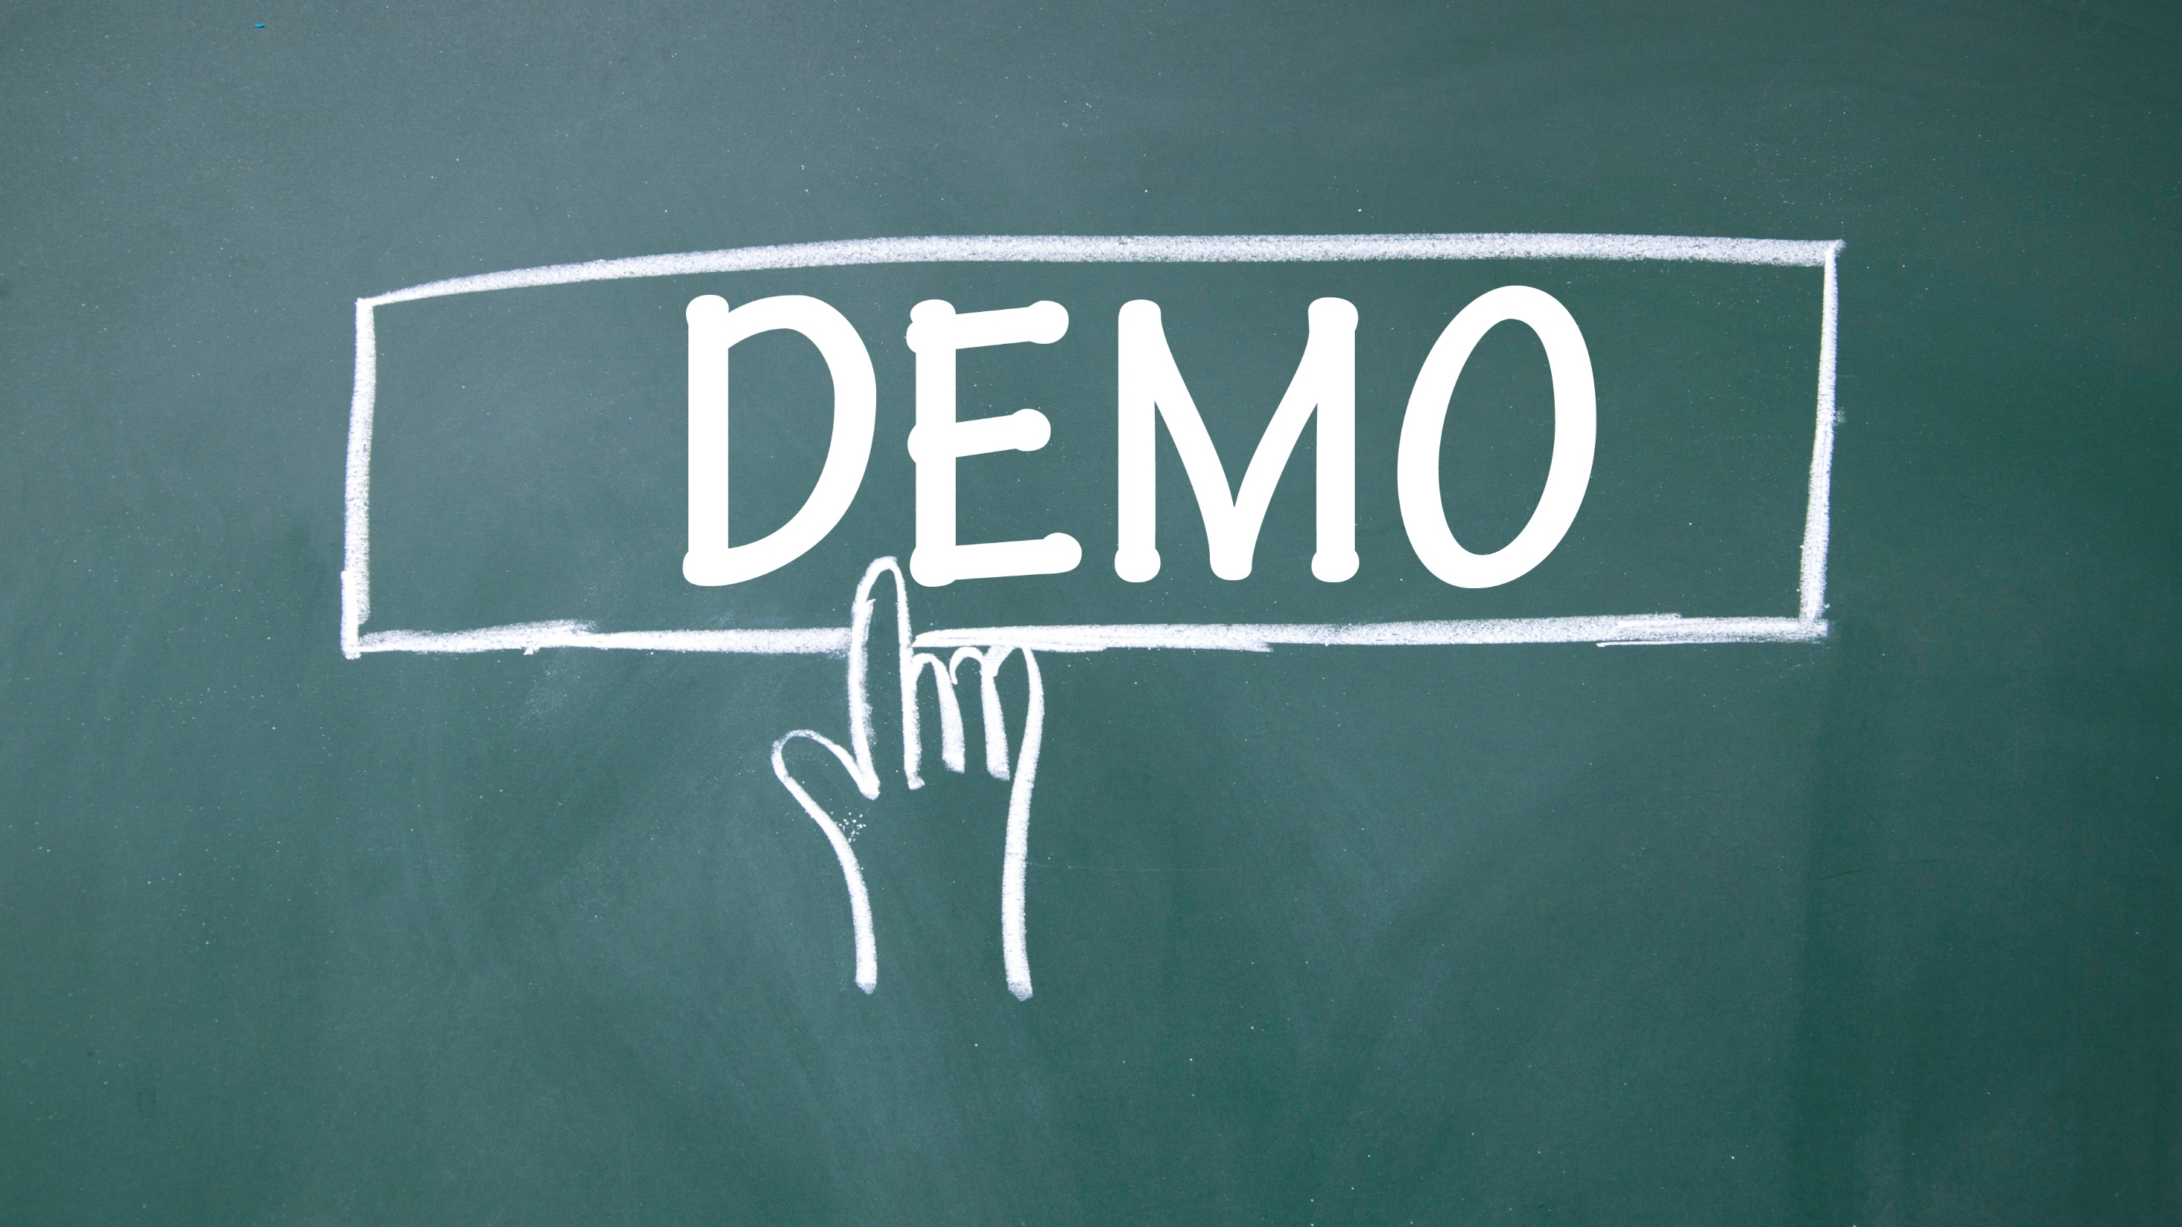

Slide 12

Conclusion & Enhancements
Peculiar approach to conserve our culture
We can improve the sound clarity & UI

Slide 13


