Slide 1
Stable Marriage Problem

Slide 2
Content
Introduction
Results
Conclusion

Slide 3

Introduction

Slide 4
Introduction
Gale, Shapley (1962)
Nobel Prize in Economics

Slide 5
Introduction
Single men propose to their favorite women
Women react:
women accept their favorite suitor or their only suitor
if a woman has a fiancé and a suitor, she chooses the one she likes better
if a woman rejects a man, then the next woman on the rejected man’s list is his new favorite
Repeat until all men and women are engaged

Slide 6
Introduction
A set of marriages is called unstable if under it there are a man and a woman who are not married to each other but prefer each other to their actual mates.

Slide 7
Introduction
Jack
Amanda
Rosie
Amanda
Jack
John
Jack & Rosie
John & Amanda

Slide 8
Introduction
A stable assignment is called optimal if every man is at least as well off under it as under any other assignment.

Slide 9
Introduction
Optimality index: Sum over all ranks of the actual partners in the preference list of their respective partners, divided by two times the number of men/women squared

Slide 10
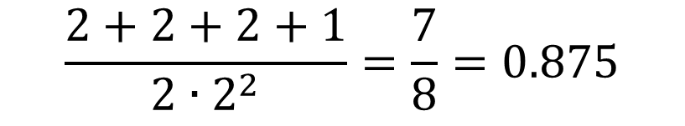
Introduction
Jack
Amanda
Rosie
Amanda
Jack
John
John
Amanda
Rosie
Rosie
John
Jack
Jack & Rosie
John & Amanda
$$\frac{2+2+2+1}{2{∙2}^{2}}=\frac{7}{8}=0.875$$

Slide 11
Introduction
Modifications:
No complete information
Preference changes

Slide 12
Introduction
4 | 6 | 5 | 8 | 2 | 1 | 7 | 3
7 | 6 | 8 | 5 | 1 | 2 | 3 | 4
1 | 6 | 5 | 7 | 3 | 4 | 2 | 8
8 | 1 | 3 | 2 | 5 | 7 | 6 | 4
2 | 1 | 7 | 3 | 5 | 8 | 4 | 6
1 | 7 | 5 | 4 | 3 | 2 | 6 | 8
7 | 1 | 3 | 6 | 4 | 2 | 8 | 5
7 | 8 | 2 | 3 | 5 | 1 | 6 | 4
2 | 4 | 6 | 5 | 0 | 0 | 0 | 0
8 | 1 | 4 | 5 | 7 | 0 | 0 | 0
8 | 7 | 0 | 0 | 0 | 0 | 0 | 0
7 | 1 | 8 | 3 | 0 | 0 | 0 | 0
1 | 8 | 2 | 3 | 7 | 0 | 0 | 0
1 | 7 | 5 | 6 | 3 | 0 | 0 | 0
8 | 7 | 6 | 0 | 0 | 0 | 0 | 0
4 | 1 | 6 | 0 | 0 | 0 | 0 | 0

Slide 13
Introduction
4 | 6 | 5 | 8 | 2 | 1 | 7 | 3
7 | 6 | 8 | 5 | 1 | 2 | 3 | 4
1 | 6 | 5 | 7 | 3 | 4 | 2 | 8
8 | 1 | 3 | 2 | 5 | 7 | 6 | 4
2 | 1 | 7 | 3 | 5 | 8 | 4 | 6
1 | 7 | 5 | 4 | 3 | 2 | 6 | 8
7 | 1 | 3 | 6 | 4 | 2 | 8 | 5
7 | 8 | 2 | 3 | 5 | 1 | 6 | 4
2 | 4 | 6 | 5 | 0 | 0 | 0 | 0
8 | 1 | 4 | 5 | 7 | 0 | 0 | 0
8 | 7 | 0 | 0 | 0 | 0 | 0 | 0
7 | 1 | 8 | 3 | 0 | 0 | 0 | 0
1 | 8 | 2 | 3 | 7 | 0 | 0 | 0
1 | 7 | 5 | 6 | 3 | 0 | 0 | 0
8 | 7 | 6 | 0 | 0 | 0 | 0 | 0
4 | 1 | 6 | 0 | 0 | 0 | 0 | 0

Slide 14
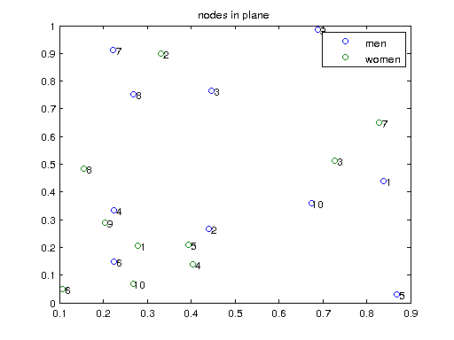
Introduction

Slide 15
Introduction

Slide 16
Introduction
4 | 6 | 5 | 8 | 2 | 1 | 7 | 3

Slide 17
Introduction
4 | 6 | 5 | 8 | 2 | 1 | 7 | 3
4 | 6 | 5 | 2 | 8 | 1 | 7 | 3

Slide 18
Introduction
Input parameters:
Input size
Visibility radius
Preference change rate
Changes only for men, women or both

Slide 19
Introduction
Output variables:
Number of instabilities
Number of singles
Optimality index

Slide 20
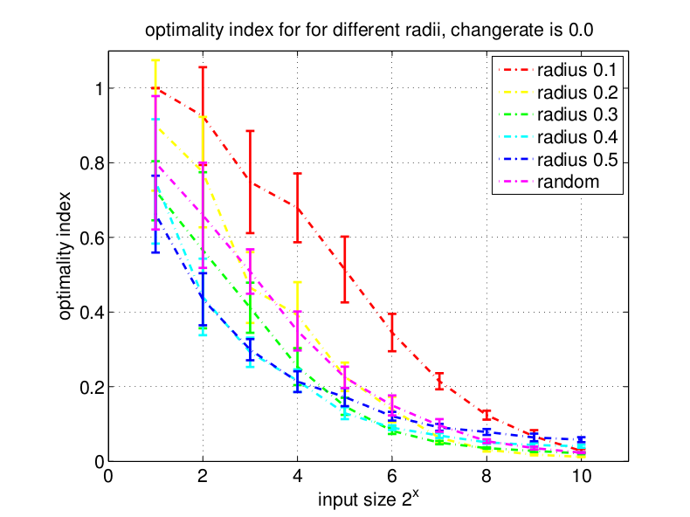
Results Optimality

Slide 21
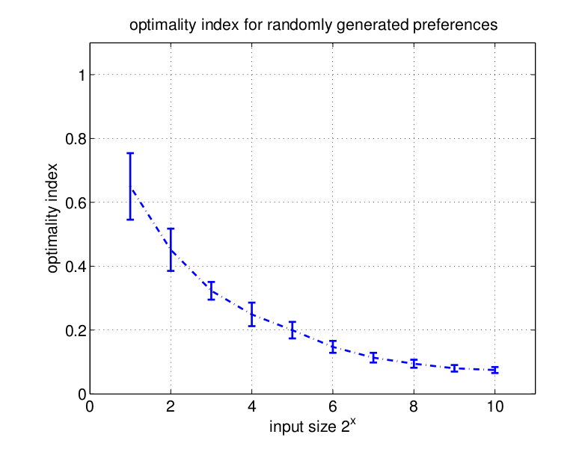
Results Optimality

Slide 22
Results Singles
No influence:
Change of preferences:
Probability for a change to happen
Whether only men, only women or both change their mind

Slide 23
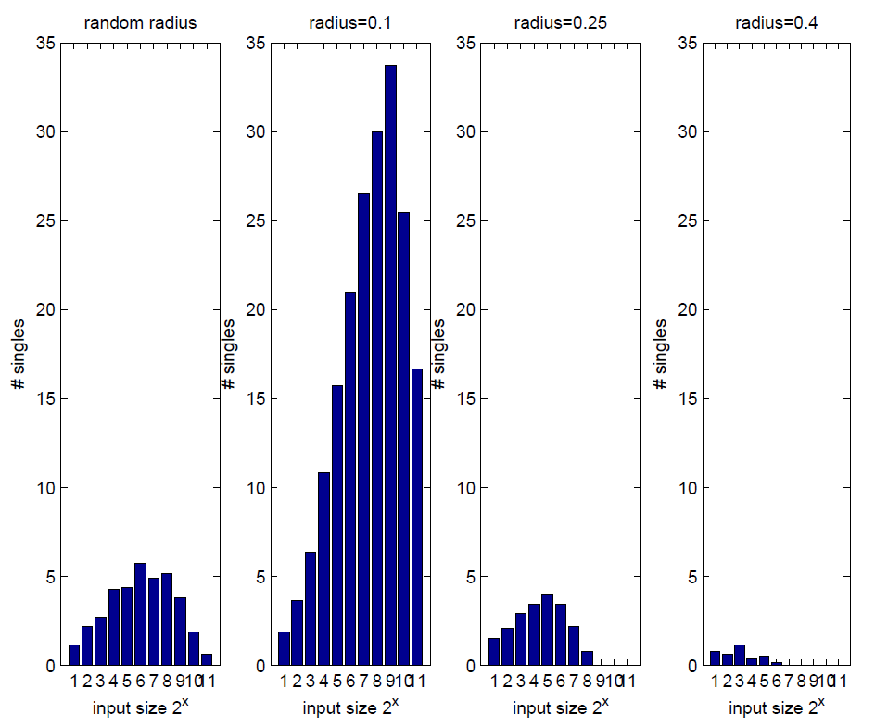
Results Singles

Slide 24
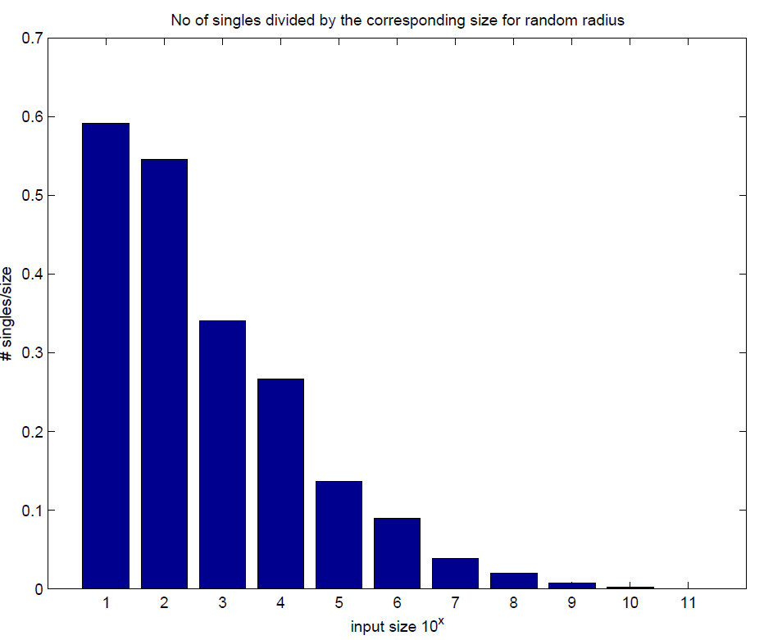
Results Singles

Slide 25
Results Stability
Effects of visibility radius:
For big radii, practically no instability

Slide 26
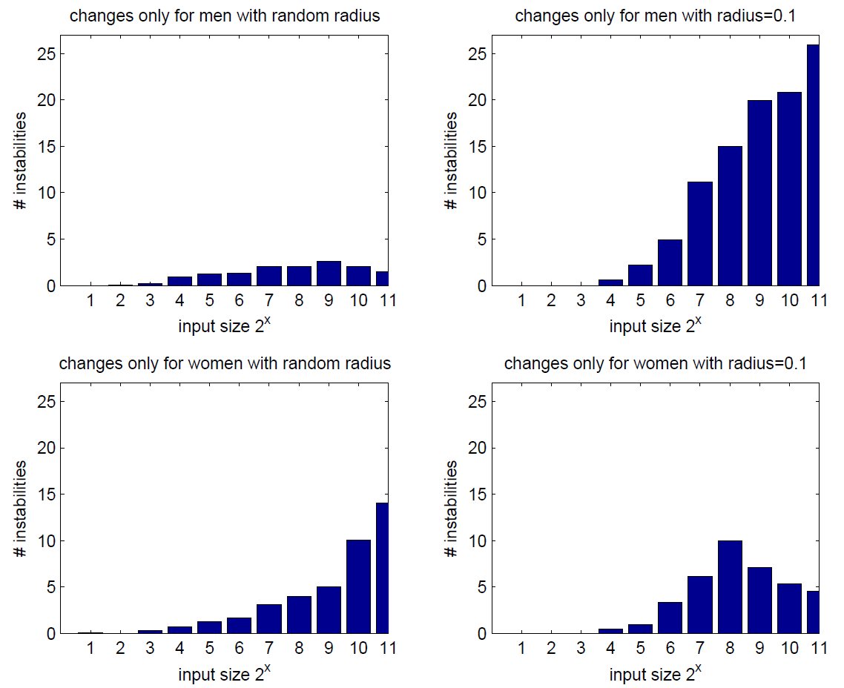
Results Stability

Slide 27
Conclusion
Optimality:
Change of preferences → no effect
Non-complete information → no effect
Input size → related by a power law

Slide 28
Conclusion
Singles:
Change of preferences → no influence
Small radii → more single persons
Big input size → practically no single persons

Slide 29
Conclusion
Stability:
No change of preferences → it holds
Big radii → practically no instability
Men change their mind → more instabilities than women

Slide 30
Conclusion
What’s next?

Slide 31
A goodbye word
“-Le monde a soif d’amour, tu viendras l’apaiser.”
(Rimbaud, Soleil et chair, 1870)
“The World thirsts for love: you’ll bring it bliss-”
(Rimbaud, Sun and Flesh, Transl. A. S. Kline, 2008)

Slide 32
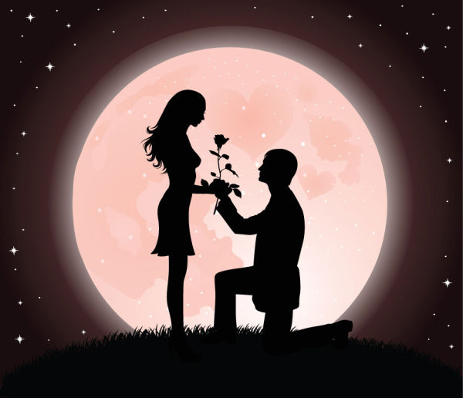
Thank you for your attention!
Questions?

