Slide 1
DTUhub|Student to Student Marketplace
Ramdev Sehrawat (2K11/CO/90)
Ravi (2K11/CO/93)
Saurabh singh (2k11/CO/101)
Vijay kumar kharwar (2K11/CO/124)

Slide 2
Introduction
The purpose of the website is to provide a college student friendly set of web pages that are easy to navigate and at the same time provides sufficient depth and information about college syllabus and question paper respective their college.
Two potential groups of viewers exist:
Students interested in BE, M.TECH or MBA seeking more in-depth information about a College syllabus.
Students that are in that college but are seeking for some information for other colleges syllabus.
The website will be authenticated and the site provides a safe environment for online users.
It may fall short of certain requirements and may require some additional functionality if it is to be used for General Audience.

Slide 3
System Requirement & Specification
Platform:
Operating Systems: Microsoft Windows
Technologies Used:
▪ Front End: HTML and CSS
▪ Web designing language: PHP
▪ RDBMS(Back end): MySQL
▪ Ajax
▪ Javascript

Slide 4
Software Requirements:
▪ PHP 5.3.0
▪ APACHE HTTP Server
▪ Linux
▪ Xampp

Slide 5
Hardware Requirements
▪ Intel Pentium IV processor or equivalent or higher
▪ 512 MB Ram or Higher
▪ 20 GB HDD or Higher
▪ Network Connectivity

Slide 6
TECHNOLOGY OVERVIEW
Major features of the website include the following pages/subsections:
SELECT CATEGORY :
Books.
Student Resources.
Gadgets and Vehicles.
Housing and Furnitures.
Apparel and Accessories.
Other services.
Search Engine.

Slide 7
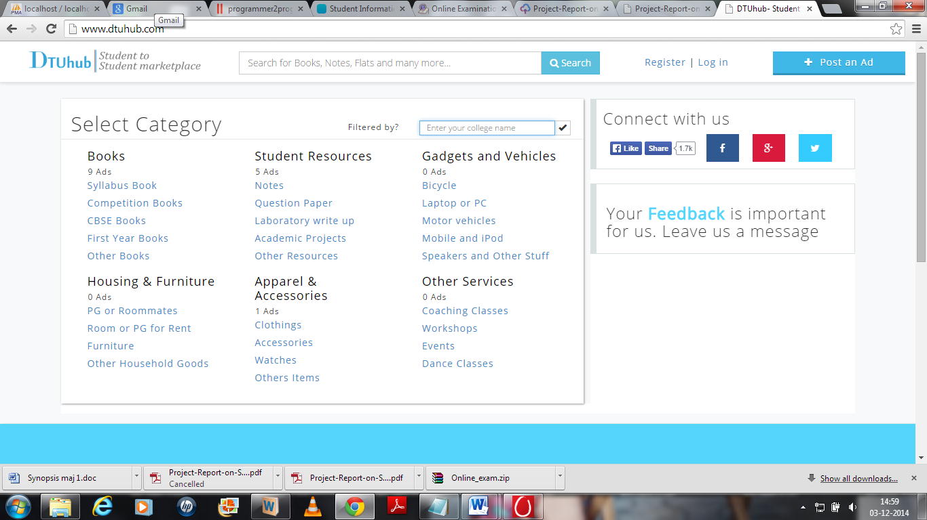

Slide 8
PROJECT DISCRIPTION
PROBLEM DOMAIN
The basic problem faced by students is inconvenience of visiting college for each and every requirement viz syllabus, question papers and many things.
For such details a student is required to visit college in their vacations which is really time consuming and hectic for students living out of station as they have to travel so long for general formalities.
The website gives flexibility to students so that they can obtain the respective information right from their desk about syllabus and papers

Slide 9
PROJECT DISCRIPTION
SOLUTION DOMAIN
The website is user friendly and it doesn’t requires any training or extra effort to understand it properly. It provides a number of facilities on a single click of mouse.
This system is aimed at the smooth functioning of the college filtered management procedure. In order to achieve this website contains following features:

Slide 11
SYSTEM DOMAIN
Platform Specification:
Software Implementation Software:
Windows Operating System.
Mozilla Firefox, Google Chrome, Opera, Internet Explorer
XAMPP Server

Slide 12
APPLICATION DOMAIN
This system is aimed at the smooth functioning of the College students materials.
Maintaining a teen friendly site is deemed of highest priority in order to hold student attention and guide the viewer to retrieve information about the college.
A user-friendly college site where any kind of information about the college is provided on a single click.
Maintaining a feedback column will help website to frequently change according to user need.
Website is aimed toward students who wish to selling or purchase books from other students.

Slide 13
Our Homepage

Slide 14
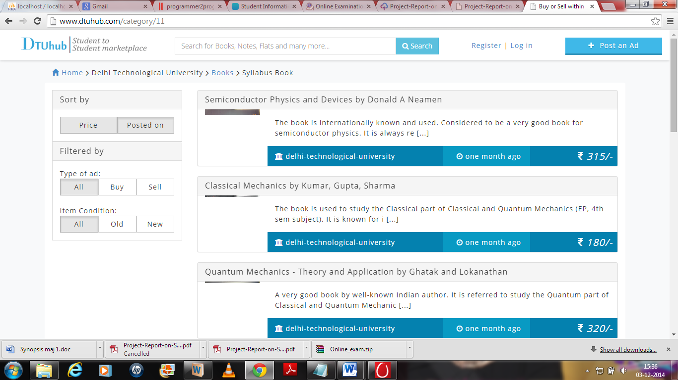
Syllabus & books

Slide 15
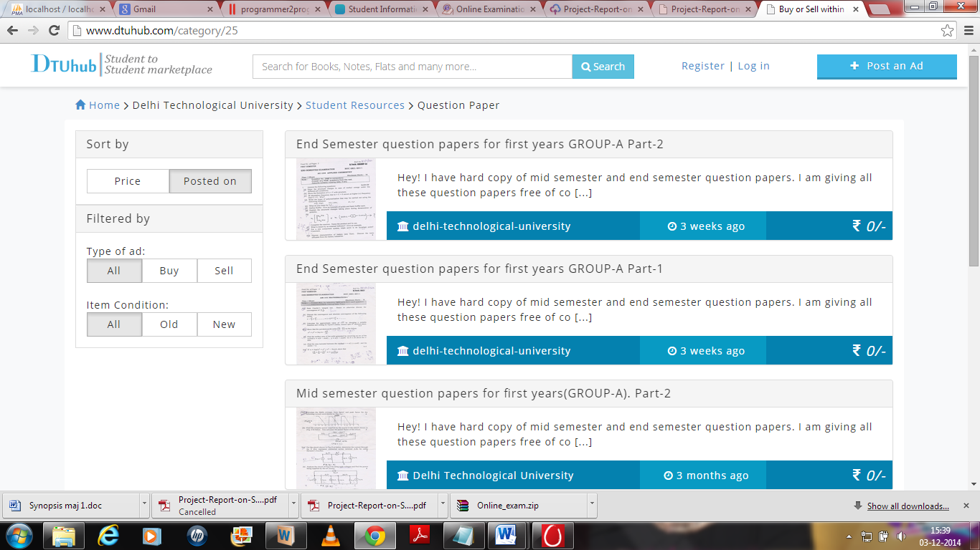
QUESTION PAPERS

Slide 16
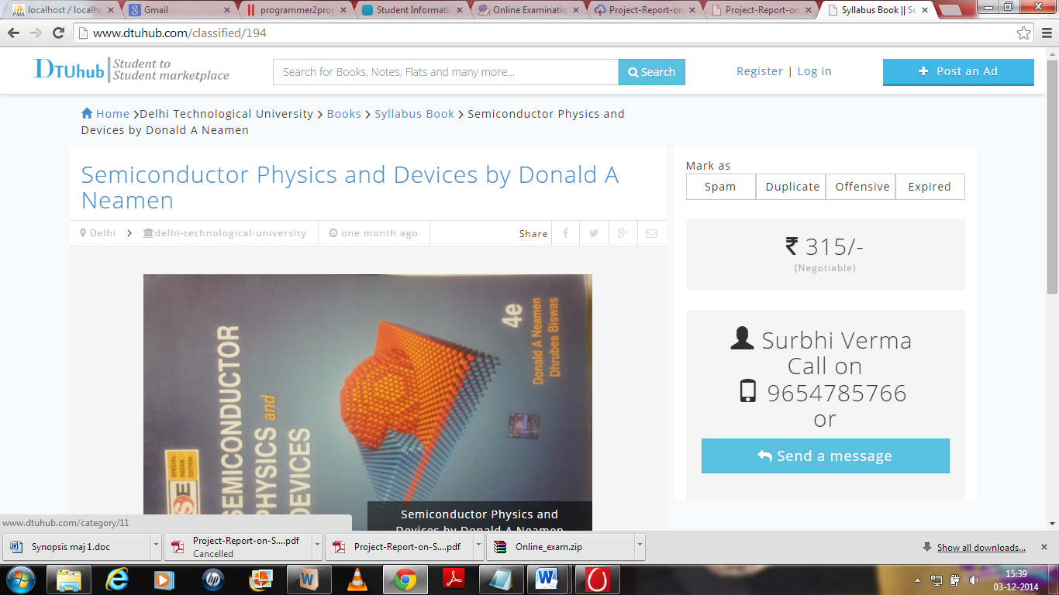
SELLING BOOKS

Slide 17
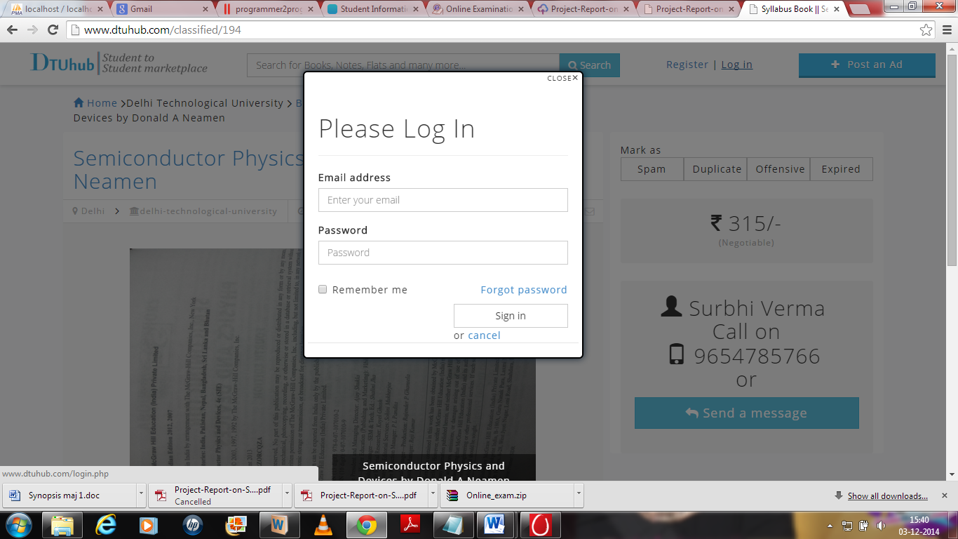
LOGIN PAGE
Every user have to be registered for login passcode via E-mail.

Slide 18
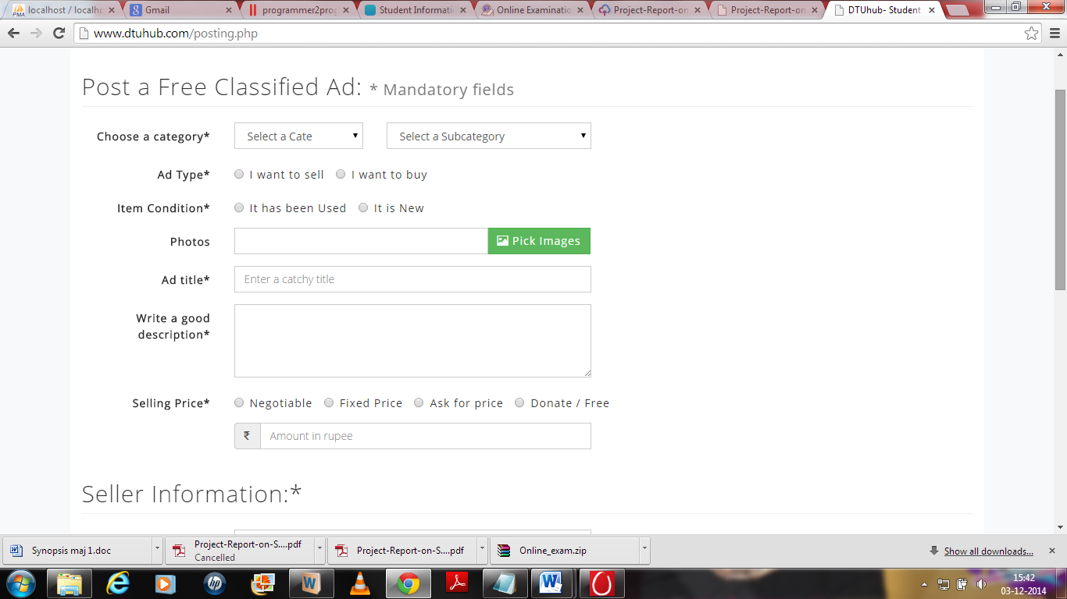
POST NEW ADVERTISEMENT
User can post the new advertisement for selling the books and other
Products here even any merchant can advertise their products.

Slide 19
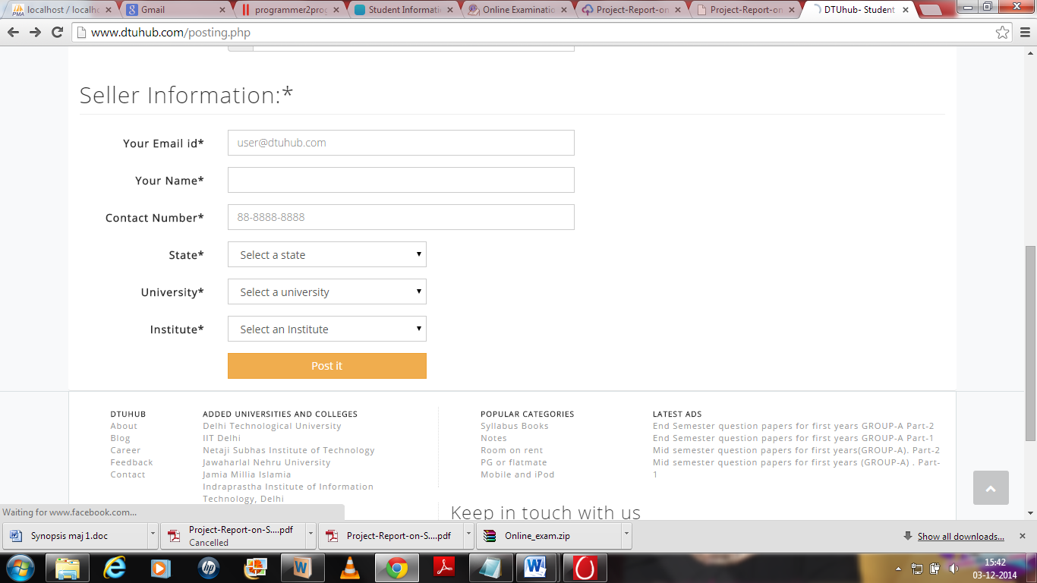

Slide 20
Scope of project
It is the DTU HUB ,student to student market place, where the student can find
The academic related materials and place for accommodations.
This website also provide the facility for merchants where they can sell and
Advertise their products. For the future this website will be upgraded on the basis of geo space of colleges. which is automatically detect the location of
Nearest colleges and provide the information for those colleges.
It is the student to student market place website where every students of any college can interact with other students. Like if student of Delhi Technological
University want to sell their things on this website then student of Indian institute of technology can buy those thing by the help of this website

Slide 21
Bibliography
http://forum.codecall.net/forum/158-php-tutorials/
http://php.net/urlhowto.php
http://www.w3schools.com/php/php_intro.asp
http://www.w3schools.com/js/js_function_closures.asp
www.c4learn.com/c-programming/source-vs-object-code/ source code and object code
https://github.com/codybutz/codehub/blob/master/views/forum/layout.jade
http://www.codeproject.com/Articles/654298/How-to-Run-Grid-based-Web-Applications-and-Databas

Slide 22


