Slide 1
Artificial Neural Network
ANN’s are a family of models inspired from the biological neural networks.
Any Neural net is specified using the following 3 things:
Architecture
Activation Function
Learning Rule
Implementation in the project:
A neural network trained with backpropagation in an attempt to use input to predict output.

Slide 2
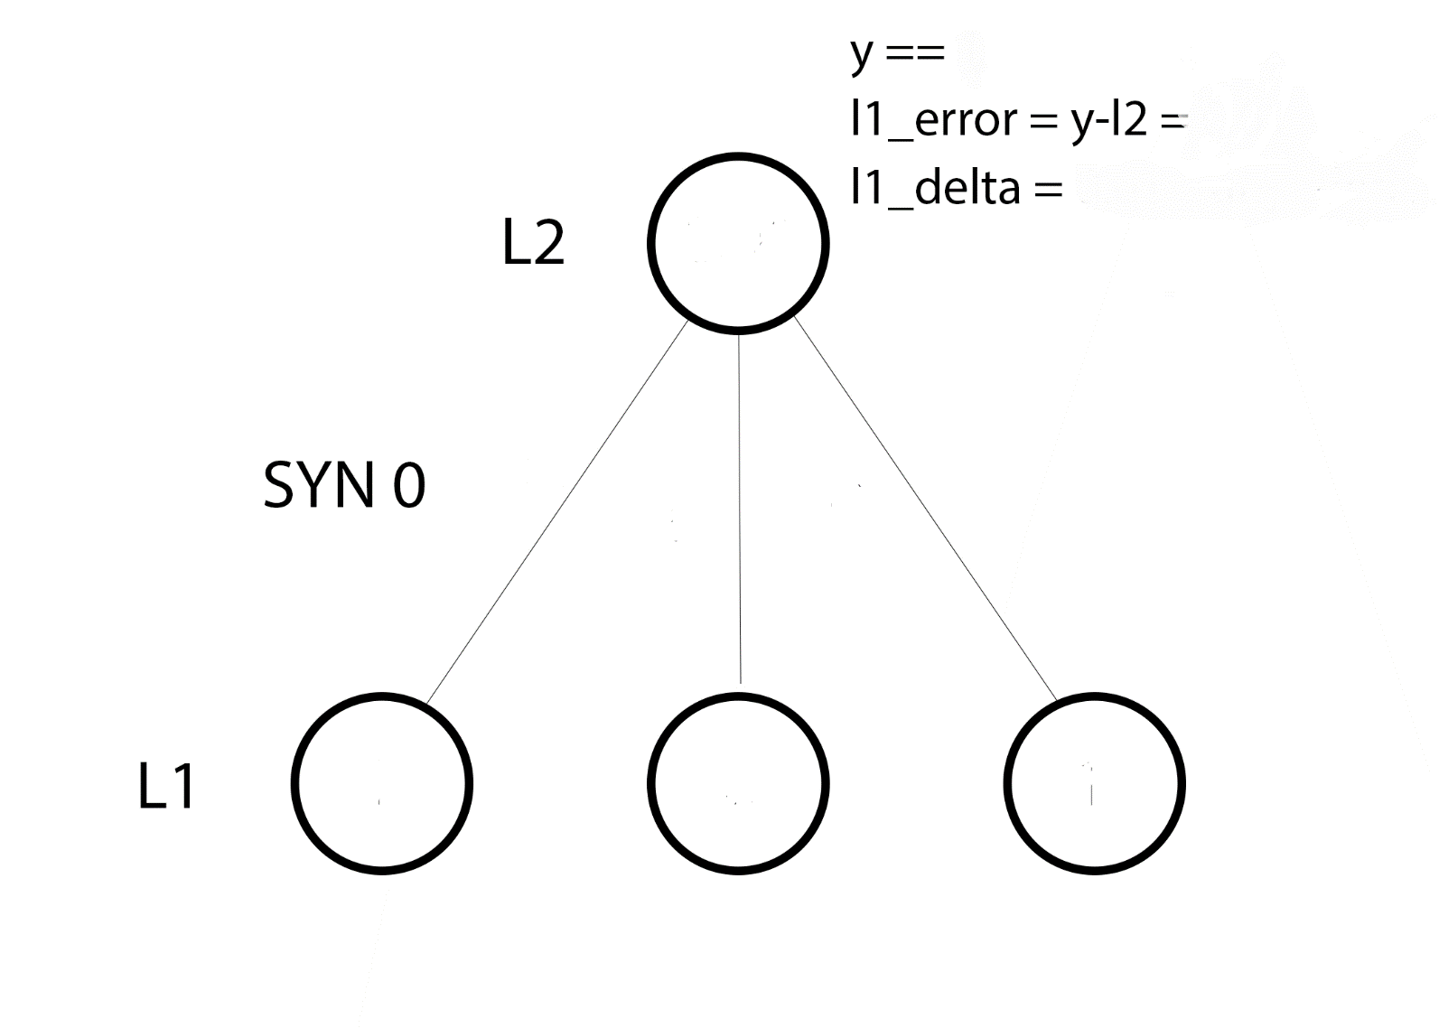

Architecture
Input is the training data matrix: inp
Randomly initialize weights: w
Matrix multiplication of inp and w to obtain intermediate output: x
Apply the sigmoid function on x to get output: out
out
w₁
w₂
w₃
x₁
x₂
x₃
source: iamtrask.github.io

Slide 3
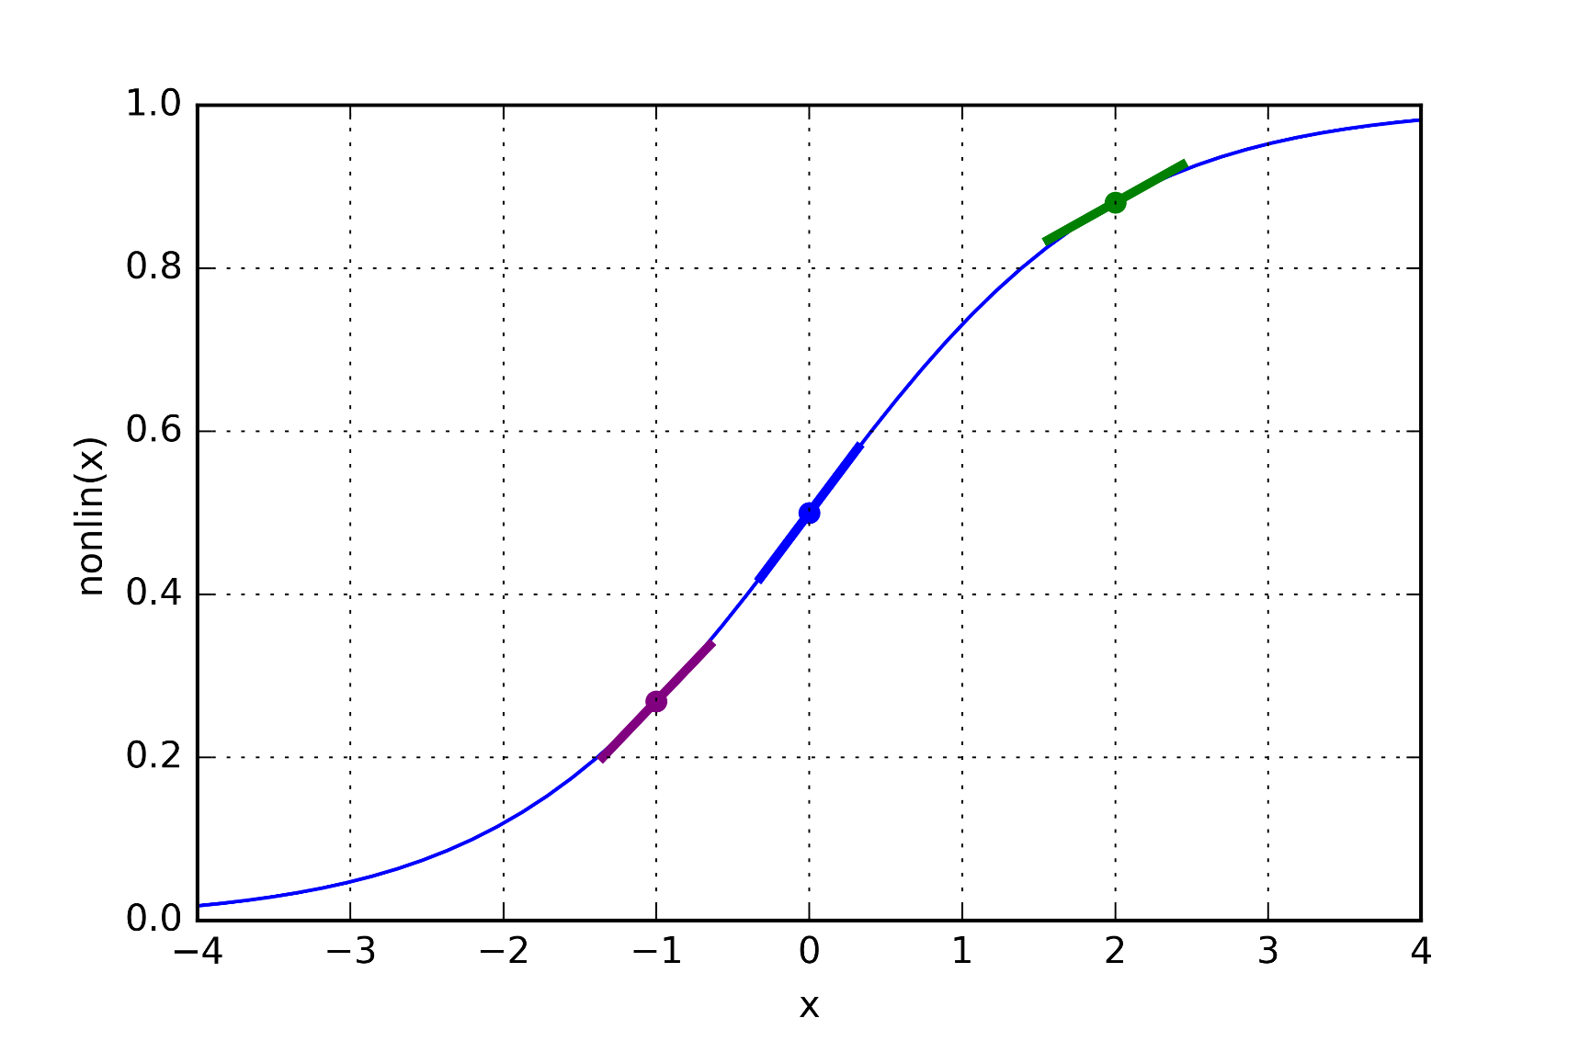
Activation Function: Sigmoid
3 main reasons to use the sigmoid function:
Maps all input values between 0 and 1 (probability)
A continuous derivative exists over R.
Derivative exists in terms of input.
source: iamtrask.github.io

Slide 4
Learning Strategy
The ANN used here follows the Backpropogation learning algorithm.
Activation Function: Sigmoid
Goal: To calculate the gradient of the error in output layer with respect to all the weights in the network
The gradient is in turn used to update the weights, in an attempt to minimize the absolute error
l1_error: ||y-out||
Calculate the update value delta
Update the weights w
Calculate the absolute error and stop once threshold error is reached.

Slide 5
Feature Selection
The features are obtained from the Term Document Matrix
To avoid bias and to get a good set of features, we use the following technique:
Filter the training data based on the Indicator (Yes/No)
Get the Term Document matrix for each
Select the top 100 features from each of the matrices
Pick out unique features. This helps us to obtain the feature set in a way that each feature strongly correlates with either Yes/No

Slide 6
Parameters
Input: [sentences X features]
Weight Matrix: [features X 1]
y: [sentences X 1]
error threshold: 0.1
Testing
The final output needed while testing the data, is the weight matrix, as these are the feature vectors which are trained on the data.

Slide 7
Results
AUC = 0.896
Sensitivity = 85%
Accuracy = 87%

