Slide 1
Analysis of XYZ Inc. Business Performance Insights and Recommendations

Slide 2
Agenda
Introduction
Findings and Insights
Recommendations
Forecasts and Projections

Slide 3
Introduction
This presentation aims to provide a comprehensive analysis of XYZ Inc.'s business performance based on the dataset provided. We will delve into key insights, actionable recommendations, and future sales projections to optimize profits.
The analysis covers several aspects including sales distribution, product performance, customer segments, and geographical trends. It offers a holistic view of XYZ Inc.'s current standing in today’s market

Slide 4
Findings and Insights

Slide 5
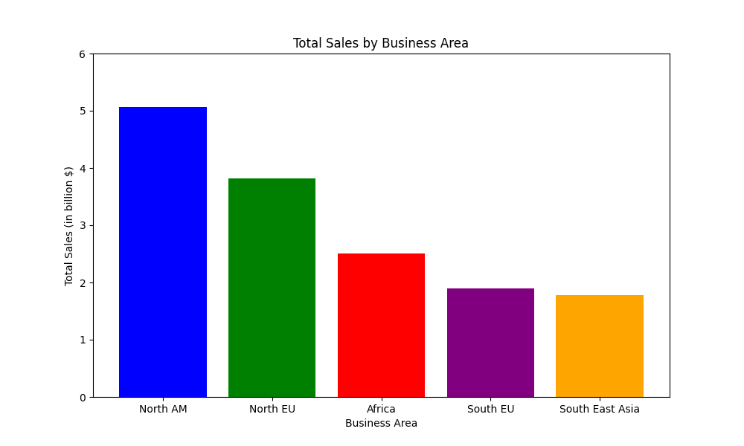
Top Performing Business Areas
The analysis reveals that XYZ Inc.'s top-performing business areas, namely North America, North Europe, South Europe, Africa, and South East Asia, significantly contribute to the company's overall sales.

Slide 6
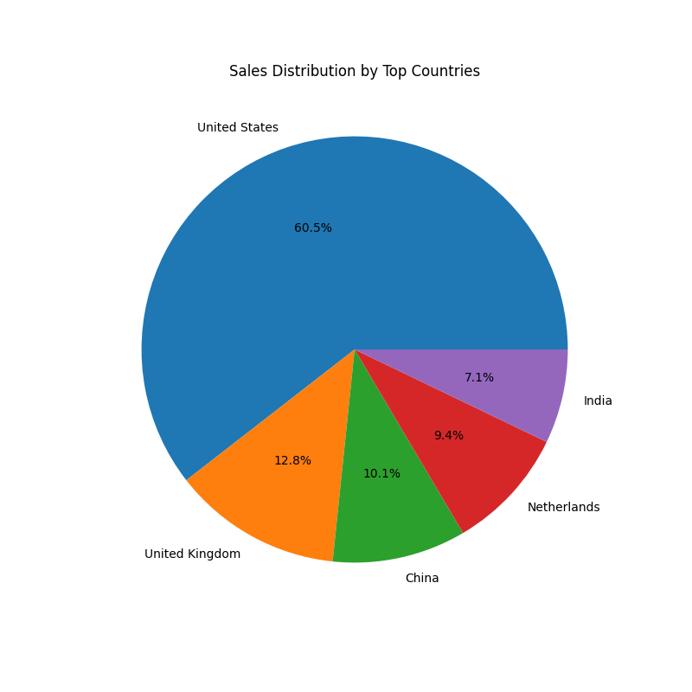
Sales Distribution by Countries
The majority of sales are generated from the United States, the United Kingdom, China, Netherlands and India, highlighting key markets for XYZ Inc.'s products.

Slide 7
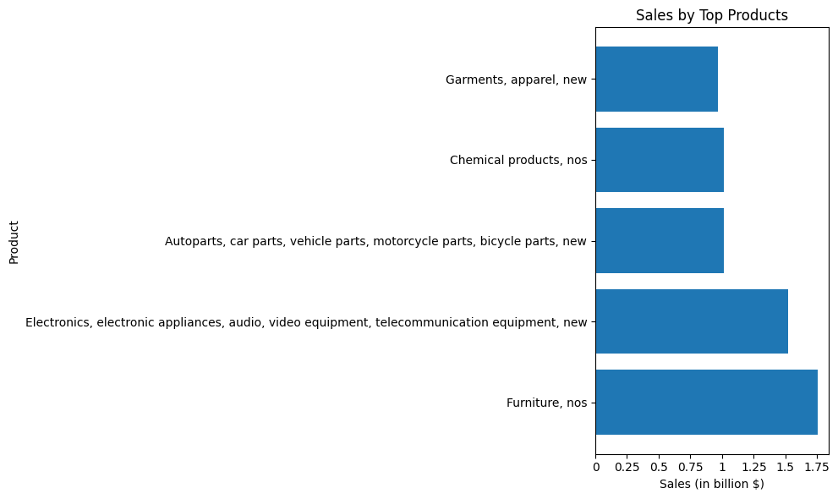
Top Selling Products
The top 5 selling products, as depicted in the graph, represent the most popular products in XYZ Inc.'s portfolio.

Slide 8
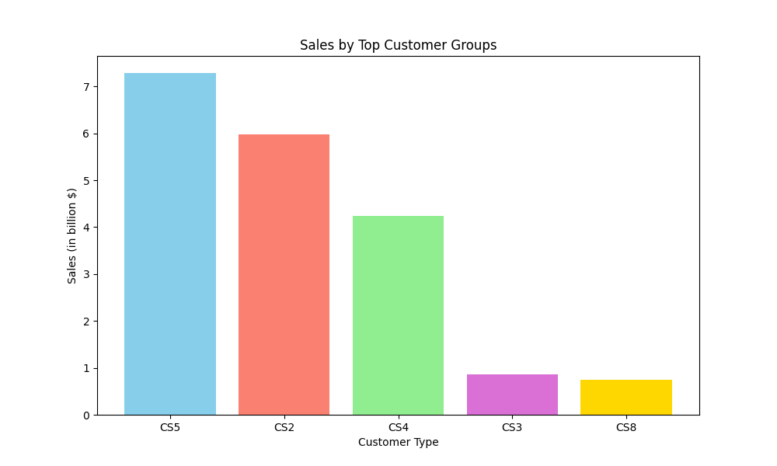
Customer Segment Analysis
The top customer segments by sales, including CS2, CS3, CS4, CS5, and CS8, indicate key target groups for marketing and sales efforts.

Slide 9
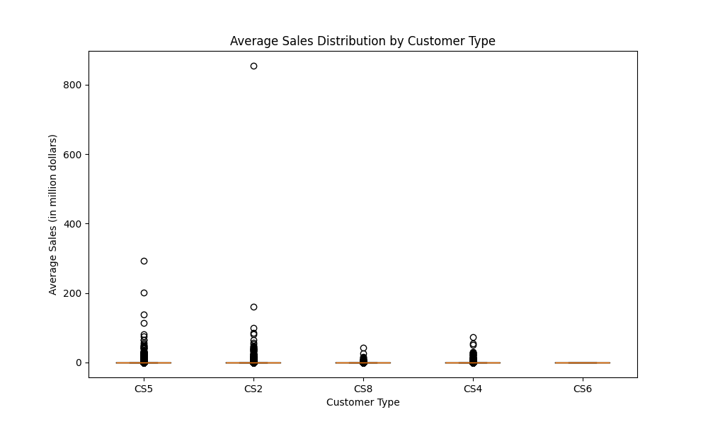
Average Sales Distribution by Customer Type

Slide 10
Recommendations

Slide 11
Focus on High-Margin Products
Plastic, plastic articles, used: This product category has shown a remarkable profit margin of 86.49%, indicating strong potential for increased marketing efforts and sales strategies.
Paper: With a profit margin of 95.34%, focusing on expanding the market for paper products could lead to substantial profit growth.
Salmon/Trout, ULT(-60C/-76F), fish: This product segment has a profit margin of 94.01%, suggesting a lucrative market that should be capitalized on.

Slide 12
Expand Marketing Efforts in Continents
North America (United States): Total Sales of $4.74 Billion. Increasing marketing efforts in this region can leverage the already strong sales base.
North Europe (United Kingdom): Total Sales of $1.01 Billion. Further marketing efforts in the UK can lead to increased market penetration and sales growth.
Far East Asia (China): Total Sales of $0.79 Billion. With a growing market in China, expanding marketing efforts can tap into this potential for higher sales.

Slide 13
Improve Services for Customer Groups
CS6: Total Sales of $0.09 Million. Focusing on enhancing services for this customer segment can lead to improved customer satisfaction and loyalty.
CS7: Total Sales of $0.26 Million. Investing in services tailored to this segment can help increase sales and customer retention.
CS1: Total Sales of $349.31 Million. This segment represents a significant portion of total sales, making improvements in services crucial for maintaining market share and growth.

Slide 14
Forecasts and Projections

Slide 15
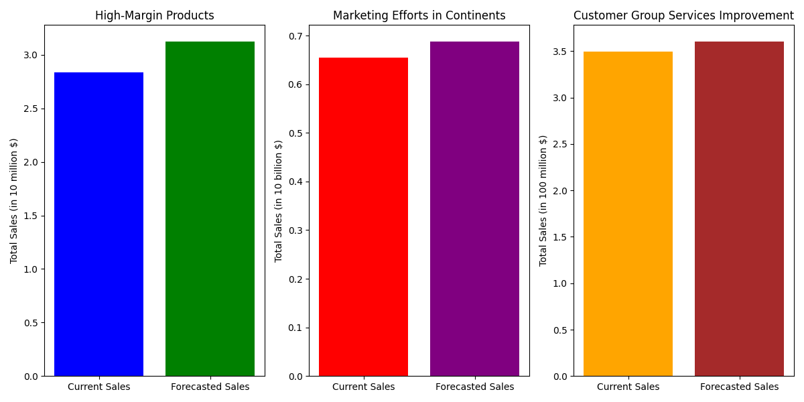
High-Margin Products: With a focused marketing strategy, high-margin product sales are projected to increase by approximately 12% from current levels.
Marketing Efforts in Continents: By increasing marketing efforts, sales in key continents are forecasted to grow by around 11% in the next year.
Customer Group Services Improvement: Enhanced services are expected to drive a sales increase of about 8.5% from the current sales levels for targeted customer groups.

Slide 16
Thank you
Vishant Kalwani
Lead Consultant at XYZ Inc.

