Slide 1
CS 354N Minor Project
IDENTIFYING DOG BREEDS USING TRANSFER LEARNING
UMANG JAIN
SARAL SHIKHAR
VANSH KATHNAWAL

Slide 2
Why CNN for Image Classification? Neural Networks come under Deep Learning. Deep learning process information work the same way as the brain, on a smaller scale. In Image Classification, we extract features from the image and try to see the pattern in a dataset. For images CNN is useful because of the following layers: The convolution layer is responsible for the main processing of the image. To accomplish this, we establish a filter that determines the size of the partial images we will examine and a step size that determines the spacing between calculations. This helps to greatly reduce the image's dimensionality. Next comes the pooling layer, which performs a similar function to the convolution layer. The difference is that we only extract either the average or maximum value from the output, depending on the intended purpose. This preserves small but critical features in a few pixels that are essential to solving the problem. Lastly, we have the fully-connected layer, which is similar to what we see in regular neural networks. With the image's dimensions significantly reduced, we can use tightly interconnected layers. Here, we link the individual sub-images to recognize connections and perform classification.

Slide 3
Algorithms of our project To improve the performance of the image classification we will try to implement various techniques such as: Data augmentation: Using various techniques such as rotation, translation, random zooms, random brightness shifts etc to introduce variations in the dataset to improve performances. In this context it can also be called data wrapping. Transfer learning: This method uses an already pretrained model(‘transfer’ the learning) and change the last or last few layers of the model to suit it for the specific topic. We will use some pretrained image classification model such as MobileNetV2, InceptionV3, NASNet etc. Dropout: This technique randomly drops out the contribution of some neurons towards the final output. This helps in reducing overfitting.

Slide 4
About datasets used
The dataset we used is the 70 breeds dataset. We implemented the project for the 70 breeds dataset because of it being smaller in size and hence being suitable for the scale of our project and resources.
Dataset contains around 9400 images and 70 breeds.
Overall the 70 breeds dataset is easier to apply a workable model to because of smaller size so it can be used to create the model. We extend the dataset’s size by augmenting it.

Slide 5
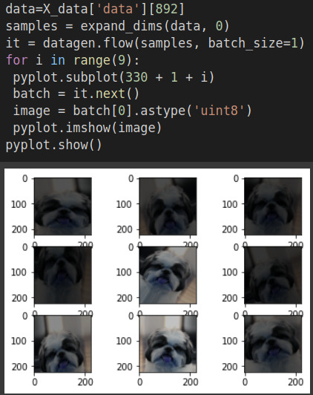
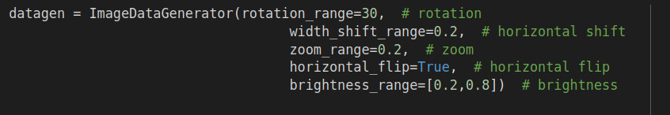
To perform this augmentation we used the following transforms:
This is an example of data augmentation. We will perform data augmentation during the training in real time so that we don’t have to store the augmented text(storage restrictions).

Slide 6
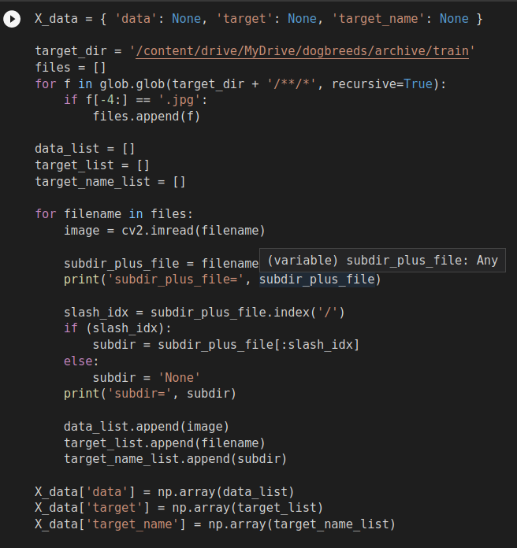
Preprocessing steps
First step is dividing the data into train,test and validation parts
Next step is going through the data and converting the images to numpy arrays along with their labels(the dog breeds)
Link to colab for code: https://colab.research.google.com/drive/1PiqHgJz_7czLe1-6qESAwXtMak8hphMq#scrollTo=QKtO0tgqawLr

Slide 7
FLOW OF THE MODEL
Dataset
Split
Training set
Testing set
Pre-processing
Data augmentation
Classification
Training the model
Output
Final model

Slide 8
Performance Measurement Criteria
There are many possible performance criterias that can be used to measure the performance of a machine learning model. The ones we used are:
ACCURACY:-
This is the most commonly used performance measurement criteria. It is percentage of correctly classified images. We will evaluate accuracy on both training and testing dataset.
LOSS:-
Loss refers to the difference between the predicted output and the actual output for a given input. It is a measure of how well a machine learning algorithm is performing on a particular task. We check loss in both training and testing.

Slide 9
Models used
We used pre trained models VGG16, and InceptionV3 for the transfer learning step.
Transfer learning eliminates the topmost layers of the models leaving only the convolutional layers that are used for feature extraction. Then we use a custom built sequential model to process the features and classify them.
We tried multiple models and approaches on the normal dataset as well as the augmented data for the best accuracy. Currently the best accuracy we achieve is around 60% for VGG16 features and 94% for InceptionV3 features.

Slide 10
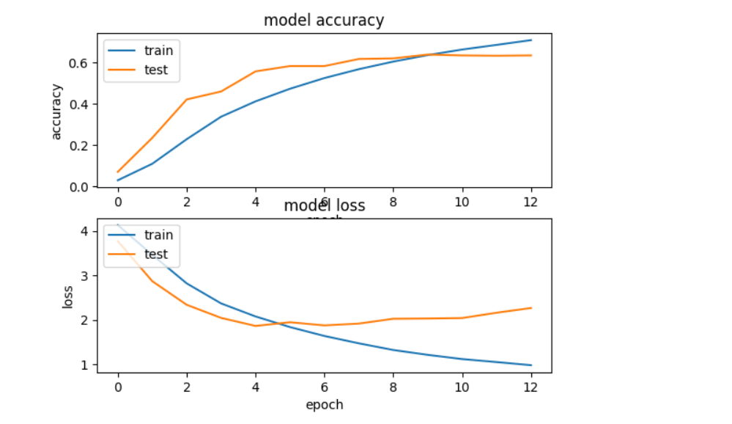
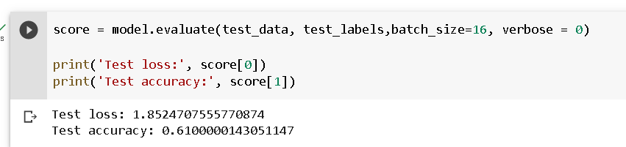
VGG16
VGG-16 -> VGG16 is a deep convolutional neural network model , The VGG16 architecture consists of 16 layers, including 13 convolutional layers and 3 fully connected layers. The convolutional layers have small 3x3 filters, which are applied with a stride of 1 and a padding of 1 to maintain the spatial resolution of the input.
VGG16 was trained on the ImageNet dataset, which consists of over 1 million images belonging to 1000 different classes. It achieved top-5 accuracy of 92.7% on the validation set of this dataset, which was the best result at the time it was introduced. We used VGG16 for transfer learning in our model by extracting image features using it. Here are the training statistics of the model we trained on those features:

Slide 11
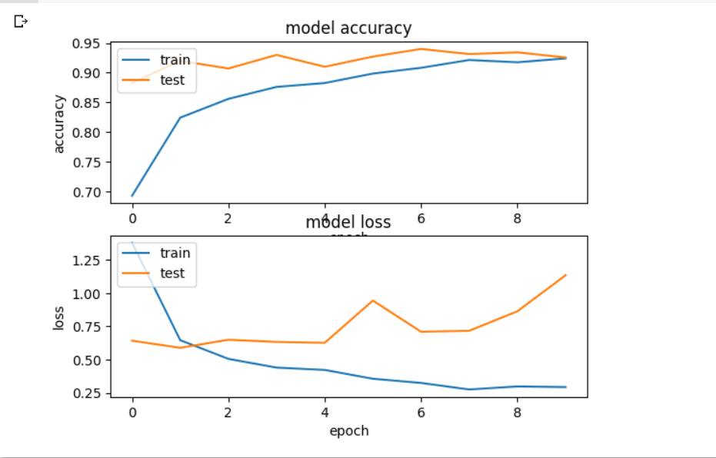
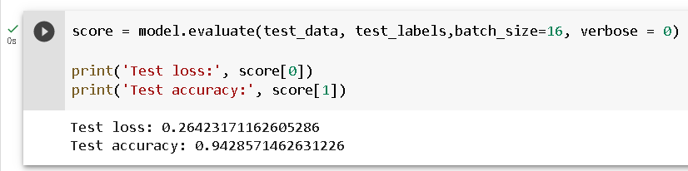
InceptionV3
Inception -> The Inception V3 architecture consists of 42 layers, including both convolutional and fully connected layers. One of the key features of Inception V3 is the use of "Inception modules," which are network blocks that allow for multiple parallel convolutional operations to be performed at different spatial scales. These modules help to improve the efficiency and accuracy of the model by reducing the computational cost of performing convolutions at each layer. We used InceptionV3 for transfer learning in our model by extracting image features using it. Here are the training statistics of the model we trained on those features:

