Slide 1
Cross Site Scripting (XSS)
Reflected & Stored XSS Vulnerabilities | DVWA

Slide 2
Introduction to XSS
Cross-Site Scripting (XSS) is a web security vulnerability that allows attackers to inject malicious scripts into web applications.
Types of XSS:
• Reflected XSS
• Stored XSS
• DOM-based XSS

Slide 3
Reflected XSS (Low Security)
Example:
<h1> Vivek </h1>
This payload executes directly when injected into the URL or input field.
It is reflected back immediately in the response.

Slide 4
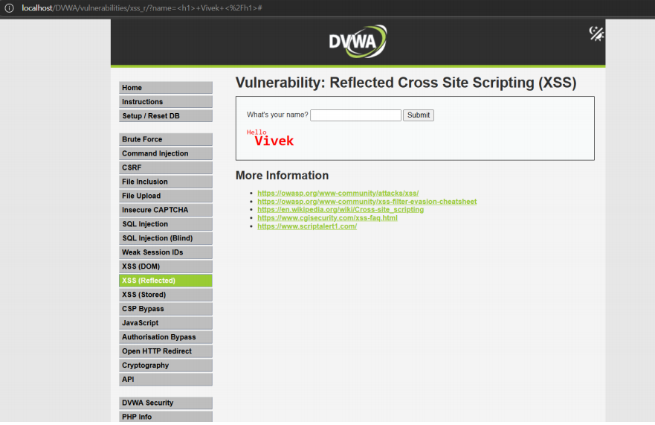

Slide 5
Reflected XSS (Medium & High Security)
Medium Example:
<body onload=alert("Welcome")>
High Example:
<IMG SRC=/ onerror="alert('Your Website has been hack')"></img>
These payloads bypass simple filters and demonstrate higher attack sophistication.

Slide 6
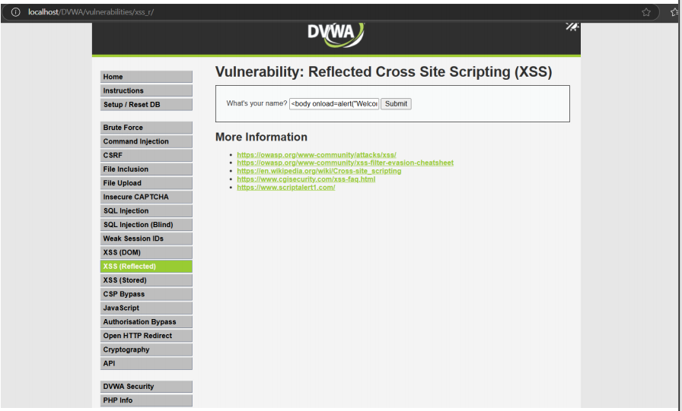
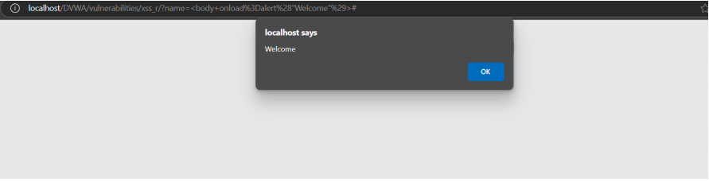

Slide 7
Stored XSS (Low Security)
Example:
<script>alert(document.cookie)</script>
This payload is permanently stored on the server and executed whenever a user visits the infected page.

Slide 8
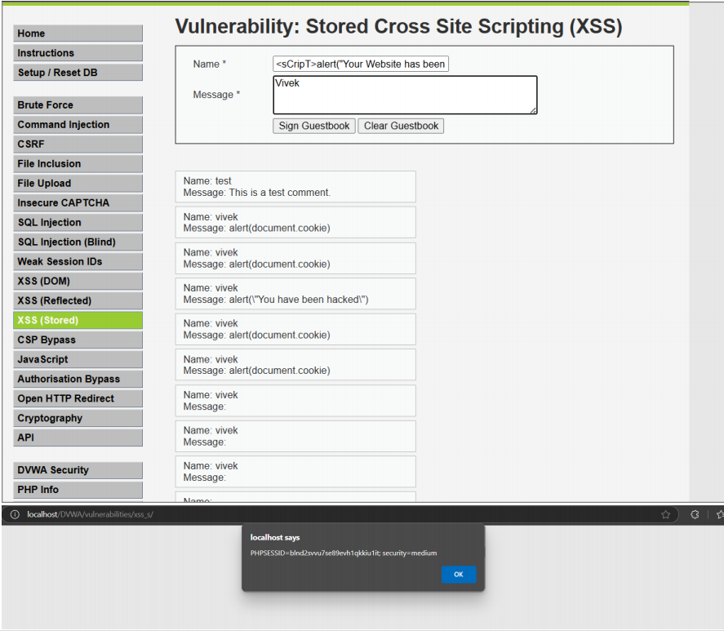

Slide 9
Stored XSS (Medium & High Security)
Medium Example:
<sCripT>alert("Your Website has been hack")</scRipt>
High Example:
<IMG SRC=/ onerror="alert('Your Website has been hack')"></img>
These payloads demonstrate how attackers persist malicious scripts in web apps.

Slide 10
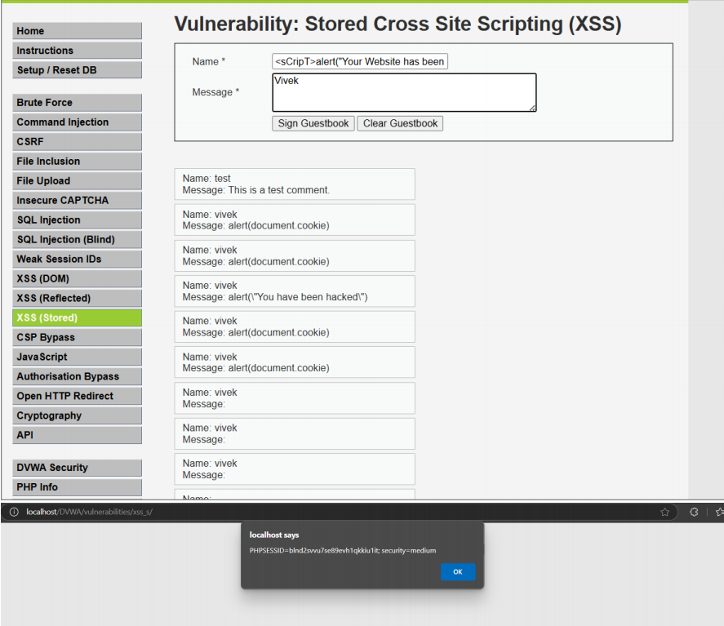

Slide 11
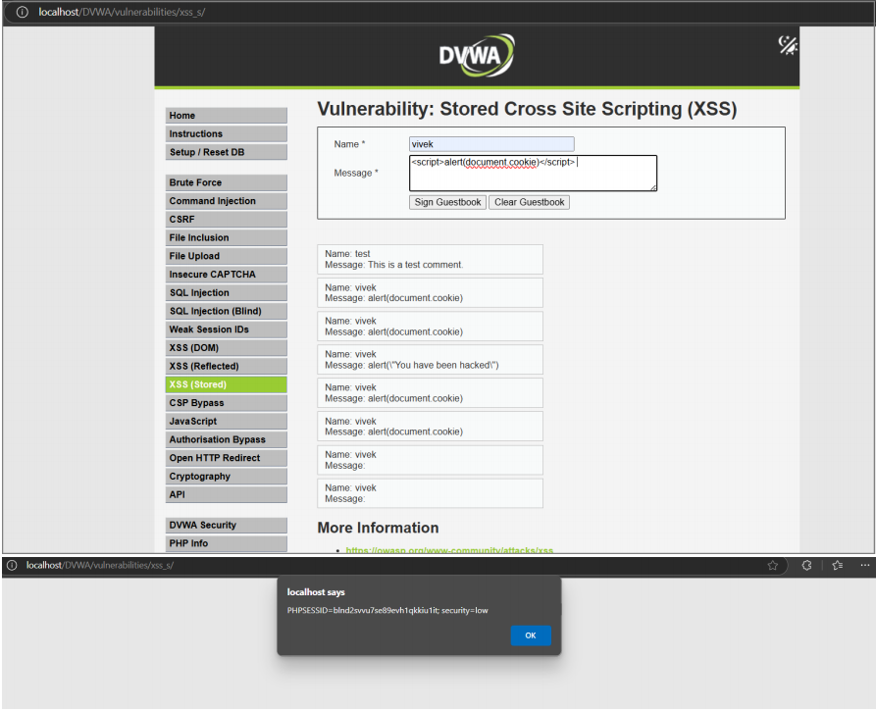

Slide 12
Impact of XSS Attacks
• Theft of cookies and session data
• Defacement of websites
• Redirection to malicious sites
• Full account takeover

Slide 13
Mitigation Strategies
• Validate and sanitize user inputs
• Encode output before rendering on browsers
• Use Content Security Policy (CSP)
• Implement secure frameworks with built-in XSS protection

