Slide 1
INFORMATION HUB
Group Members
Name | Roll No.
Vinay Kumar Yadav | 1301CS45 ( Group Representative)
Sandip Mandal | 1301CS40
Alok Kumar | 1301CS06
Ramayan Kumar | 1301CS36
Kuntal Das | 1301CS25

Slide 2
Goal and Specification
Goals
(i) Leave Management System
Generally, employees apply for leaves in an application based manner which takes a decent amount of time to be processed. It is also difficult for an employee to keep track of his leaves in this manner. So he generally runs to the concerned person to know about his leaves – history, balance and requests.
We aim to provide employees an easier way to manage their leaves with our leave management module so that they can manage these affairs in an efficient way.

Slide 3
Goals
(ii) Resource sharing
Students generally have to browse a lot for searching suitable contents for their courses. Some find them and generously mail it to all other concerned students. The problem with this is is that it leads to a lot of redundancy and unnecessary use of server memory.
With our module, students will be able to share the useful contents they found on the web thus saving time of other students and also the server memory.

Slide 4
Goals
(iii) Attendance Management System
Currently attendance is taken using pen and paper due to which the computation of attendance becomes quite cumbersome. So it becomes difficult for the faculties to depict the regularity of students in the class. Sometimes students also remain in doubt about their attendance. This creates a lot of problem for both faculty and the student.
Our Attendance Management Module would enable faculties to take attendance on an online platform which would also be available to students so that they remain in loop about their attendance.

Slide 5
Goals
(iv) Marks Management System Everyone likes to keep track of their numbers but due to our traditional way of marking it is not possible. Teachers also feel it difficult to analyse the performance of students due to this. Students also have to run again and again to the teachers to know their marks.
We aim to enable students to view their performance from anywhere using the web. Also the faculties can also work on the system from wherever they feel to.

Slide 6
Specifications
(I)Features for faculties
(a) Attendance Management System
Faculties can take attendance online.
Attendance excel sheets can be uploaded and downloaded.
Attendance can also be uploaded if taken using excel sheet downloaded from the module .
Attendance can also be downloaded in pdf format .
Graphs are also provided to help in analysis of the attendance.

Slide 7
Specifications
(I)Features for faculties
(b) Leave Management
Faculties can apply for a new leave.
They can cancel their leave if the leave has not started.
They can view their leave history.
They can also see their remaining leaves.
Faculties can also see their rejected leaves.
They can also view their pending leaves.

Slide 8
Specifications
(I)Features for faculties
(c) Marks Management System
Faculties can add and modify marks online.
Marks excel sheets can be uploaded and downloaded.
Marks can also be fed if taken using excel sheet downloaded from the module .
Marks can also be downloaded in pdf format .
Attendance can also be downloaded in pdf format .
(d) Courses
Faculty can see his or her courses.
Faculty can see the details of student by selecting the courses and groups.

Slide 9
Specifications
(II)Features for Admin
(a) Managing Employees and Students
Admin can add new employee , students and other admins or
delete and modify them.
They can view employee, student and other admin details
directly or can search by their username.
They can search employee and update or delete their details.
Group number can be allotted to the students for different subjects.
They can add ,delete or update different types of leave.
Admin can see leave history and remaining leaves of faculties.
They can see the student details of particular semester just by
selecting the department id and semester number.
They can also see the details just by searching student id and can increment their semester.

Slide 10
They can create new department and assign their department id. They can also see current department details.
Admin can add new courses also.
(b) Admin Home Page
Notifications and news can be added.
Notifications and news can also be customized and deleted.
They can reset the passwords but can’t see the password .
They can also change their own login password.

Slide 11
Specifications
(iii)Features for Leave mediator
Leave mediator can see the leave requests sent by faculties.
They can forward it to Leave approver or reject the leave.
They can also see the leave history ,remaining leaves of the selected employee and leaves of other employee during same dates.
(iv)Features for Leave Approver
Leave approver can see the leave requests forwarded by the leave mediator.
They can accept or reject the Leave .
They can also see the leave history ,remaining leaves of the selected employee and leaves of other employee during same dates.

Slide 12
Specifications
(V)Features for students:
(a) Current courses
Students can view the all the courses of their current semester, along with the name of the course instructor and the corresponding L-T-P-C values.
(b) Marks
Students can check the marks of any particular exam of any particular course of the current semester and also the average and the maximum marks in those exams.
(c) Attendance
Students can check their attendance of each course.
(d) Resource sharing
Any student can upload file for any course.
Other students can download files verified by the respective faculties for any course.

Slide 13
Design

Slide 14
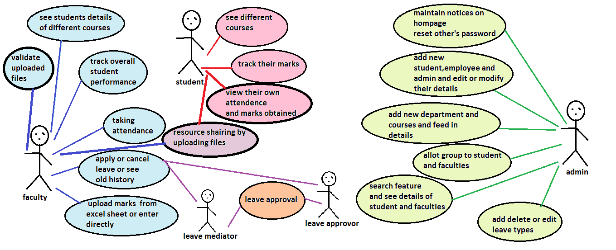
Use Case Diagram
Use Case Diagram

Slide 15
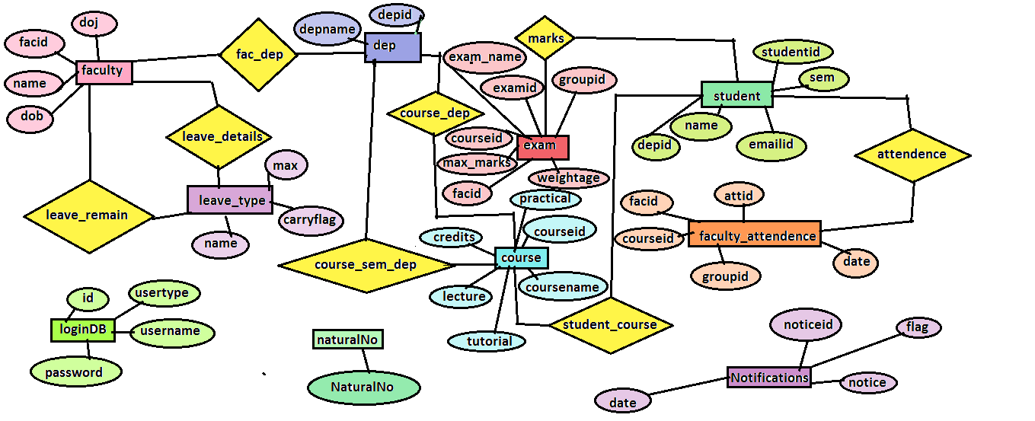
ER Diagram

Slide 16
Planning
The software development cycle we followed for our software project is Evolutionary Model. This was the first web designing experience for all of us. So we required feedback at every stage. Any other SDLC would not have been as beneficial for us given our experience and knowledge. We kept adding functionalities to all are modules as per the suggestions given by the users.

Slide 17
Planning
Since our project is all about data flow we did not require any additional hardware for our software. It can easily be used on any device capable of web browsing.
We used ASP.NET framework for our project.
We laid huge emphasis on our database because we had to provide too many functionalities which required proper synchronization of data.
We used to keep our objectives on week basis and analysed the work done after completion of the week.

Slide 18
Testing
After adding each functionality the person who did it used to test it followed by some other group member who used to counter check it.
We also used to test the synchronization of different functionalities.
Before applying any new strategy we used to discuss its correctness and feasibility.
We also invited other students to test and review our work for security and errors.
Sometimes we also used to follow pair programming for testing.

Slide 19
Accomplishment
We did a lot to complete the proposed modules, kept adding functionalities to our modules according to user requirements and our quite satisfied with what we have achieved given that we started from nowhere. It is a universal fact that nothing is 100 % complete. There is always some scope for improvement in everything. We feel the same for our project too. We feel that it is Partially Complete. We had to complete our project within the given time constraints plus there were a lot of functionalities to implement.
We do feel that our GUI could have been better. Some of the functionalities could also have been manipulated to make them more useful. Apart from that we feel our project has met its objectives.

Slide 20
Lesson Learned
(i)Technical skills :
We learned C#, HTML 5.0, SQL, JavaScript, Bootstrap, xml and CSS.
We learned how to generate graphs.
We learned how to upload and download excel files.
We learned certain GUI techniques.
(ii)Improvement in software Engineering skills :
We learned the way to design our project.
We learned how to solve different kind of problems.
We leaned the way to leverage to existing code.
(iii)Team work :
We learned how to work in a team.
One team member learned a thing and made it easy for others to implement it.
In difficult times, team members worked together as a unit and kept the moral high.
It helped in improving our communication skills.
We used to test each other’s work which helped in minimising errors.
We also followed pair programming at times.

