Slide 1
Digital Portfolio
STUDENT NAME:B.Monika
REGISTER NO AND NMID: 212401614&A0C965508D8CE13979140431V86DF690
DEPARTMENT: BCA
COLLEGE: Thirumurugan Arts and science college for women
kosavanpalayam,thirpupasur,thiruval Thiruvallur,univ university of madras.
STUDENT NAME: M.Prathipa
REGISTER NO AND NMID: 212401639&asunm21724ca22
DEPARTMENT:BCA
COLLEGE:THIRUMURUGAN ARTS AND SCIENCE COLLEGE FOR WOMEN,KOSAVAMPALAYAM,
THIRUPACHUR,THIRUVALLUR
UNIVERSITY OF MADRAS.

Slide 2
PROJECT TITLE
CLOUD
COMPUTING

Slide 3


AGENDA
Problem Statement
Project Overview
End Users
Tools and Technologies
Portfolio design and Layout
Features and Functionality
Results and Screenshots
Conclusion
Github Link
3/21/2024 Annual Review

Slide 4

PROBLEM STATEMENT
Traditional IT infrastructure requires high investment in
hardware , software, and maintenance. This leads to scalability
issues ,resource underutilization, and increased costs.
Organizations also face difficulties in data
management, security, and ensuring continuous availability of
services.
Cloud computing provides a solution by offering
on-demand access to computing resources ,scalability
,cost-effectiveness ,and improved data management through
virtualization and distributed systems.

Slide 5

PROJECT OVERVIEW
The project focuses on the use of cloud computing
technology , which provides scalable and cost-effective access to
computing resources through the internet. Cloud computing allows
users to store data, run applications, and use services without
investing in physical hardware or software.
In this project, the aim is to study and implement cloud
services such as infrastructure as a service(laaS), Platform as a
service(PaaS),and Software as a service(SaaS). The project also
highlights, including reduced cost ,flexibility,easy scalability, and
global accessibility.

Slide 6

WHO ARE THE END USERS?
End users in Digital Computing :
End users are the people or
organizations who directly use digital systems. They include individuals
using computer and apps, businesses, using e-commerce and cloud
services,students and teachers using e-learning, governments offering
users like doctors and patients.
They are the final consumers of digital
technology.

Slide 7

TOOLS AND TECHNIQUES
TOOLS AND TECHNIQUES
Tools:
Tools are the physical or software resources used by
end users to perform task. Example:Computers, Mobiles,
Operating systems.
Techniques:
Techniques are the methods or process followed to
use the tools effectively. Example:programming methods,
Data analysis, Data mining.

Slide 8
POTFOLIO DESIGN AND LAYOUT
The layout has a light
cream background with a neet blue gradient
border all around . The text is in black and
blue colours, where the title is highlighted the
blue . The corners have diagonal line patterns
in blue and black, which make the design look
modern and stylish.overall , the layout is
clean, professional, and attractive.
8

Slide 9
FEATURES AND FUNCTIONALITY
Features:
1.Accuracy- Performs operations with high precision.
2.Speed-Processes data very fast.
3.Automation-Works automatically once programmed.
Functionality:
1.Input-Accepts data from input devices.
2.processing-CPU processes the data.
3.output-Displays the result through output devices.

Slide 10
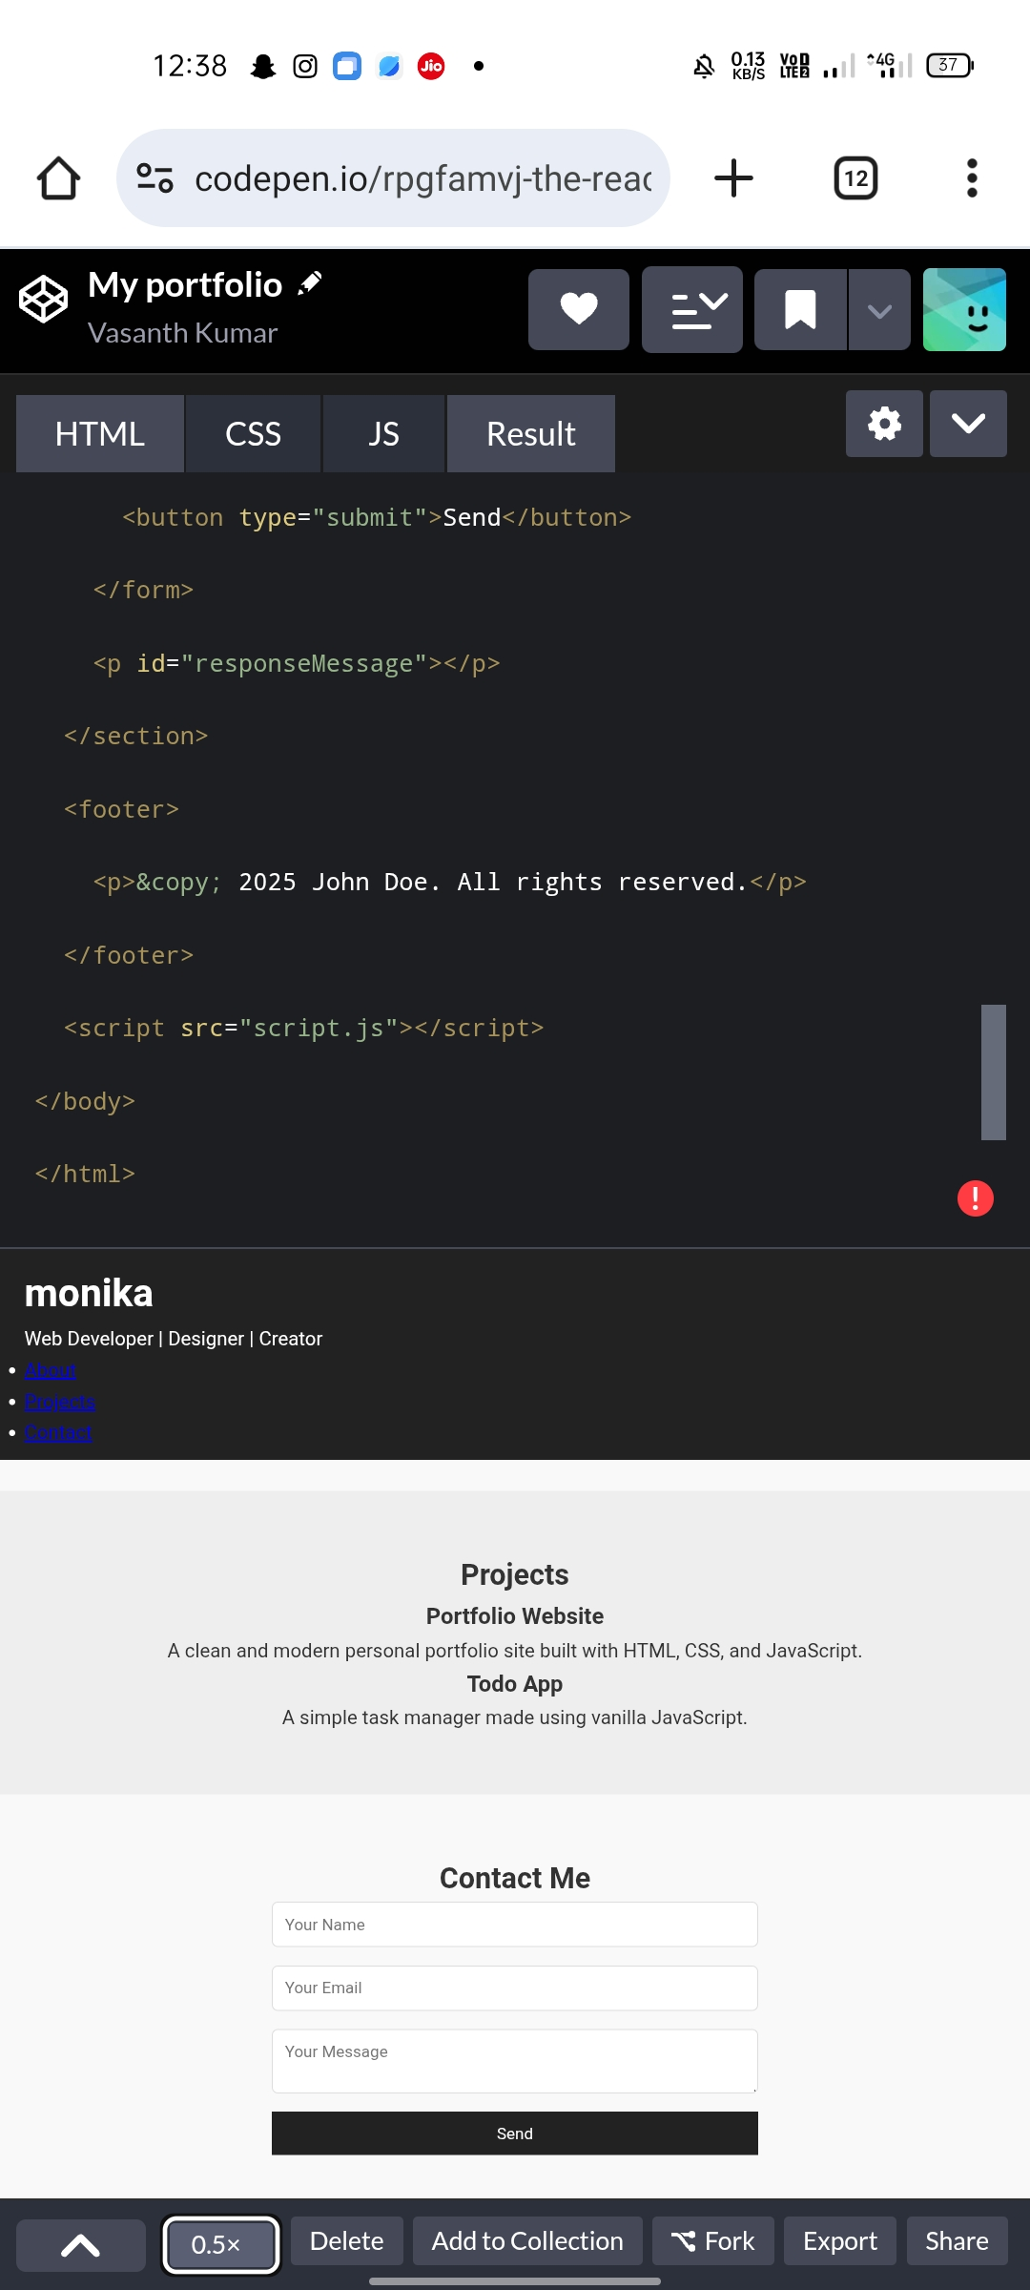
RESULTS AND SCREENSHOTS
Result:
A clean summary or answer sheet
style(like what you’d write in an exam).
Screenshot:
A visual representation (like a chart,
table, or diagram image) showing the features and
functionality of digital computing.
3/21/2024 Annual Review
10

Slide 11
CONCLUSION
Cloud computing is a modern
technology that provides on-demand access to
computing resources like storage, applications,
and processing power over the internet .
It offers flexibility, scalability,
cost-effectiveness, and easy accessibility. By
reducing the need for physical infrastructure
,cloud computing enables businesses and
individuals to focus more on innovation and
productivity. It is a key driver for digital
transformation in today’s world.
11

