Slide 1
US Accidents Data Analysis
By Aditya Anal

Slide 2
Project Details
Dataset: The dataset for this project will consist of the US Accidents dataset, which includes the following information:
ID: Unique identifier for the accident.
Weather_Condition: Shows the weather condition during the accident.
City, County, State, Zipcode: Location details of the accident.
Description: Natural language description of the accident.
Start_Time, End_Time: Start and end time of the accident.
Source: Indicates source of the accident report.

Slide 3
Outcomes
Task 1: Ingest the US-ACCIDENTS research data into Hadoop using Apache Sqoop, process it using Apache Spark, and store the results in Hive.
Task 2: Spark code and SQL queries to analyze the US Accidents research data.
Task 3: Data Visualization Outcome: Create visualizations of the research trends and gaps using a tool like Apache Superset, Tableau, or Power BI.

Slide 4
Index
Architecture flow
Use tools like Apache sqoop for batch data ingestion.
Spark code and SQL queries to analyze the US Accidents research data
Connection between hive and power BI
Data Visualization

Slide 5





Data Pipeline

Slide 6
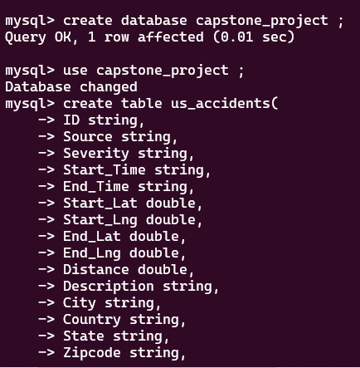
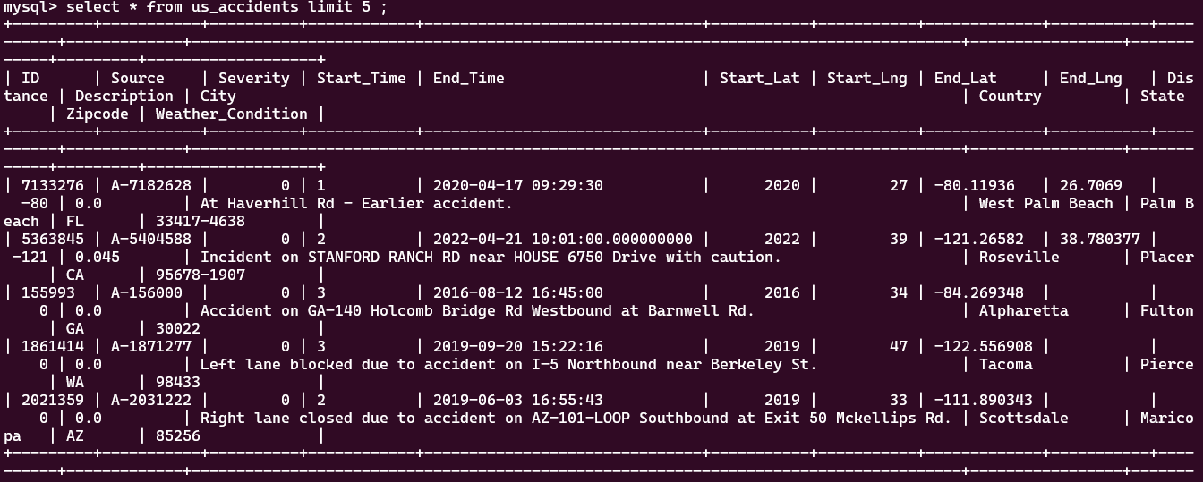

Task1:Create a mysql table
Run query when data come mysql
Create a table
Load data local to mysql table

Slide 7
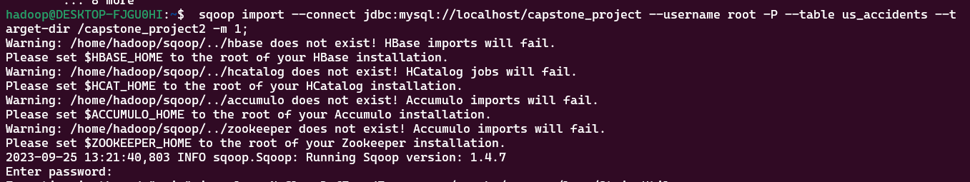
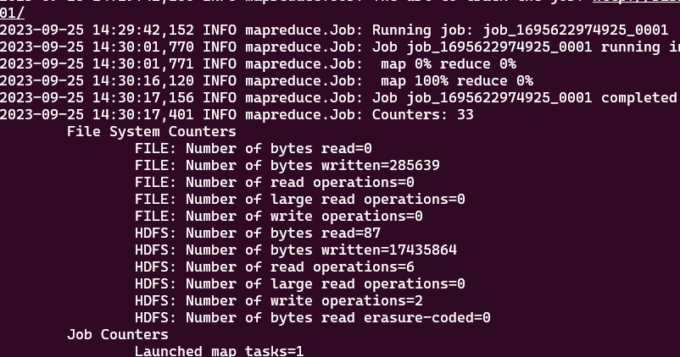
Task1: use sqoop commands to send data mysql to hdfs
Run sqoop to send data mysql to hdfs
Map reduce job

Slide 8
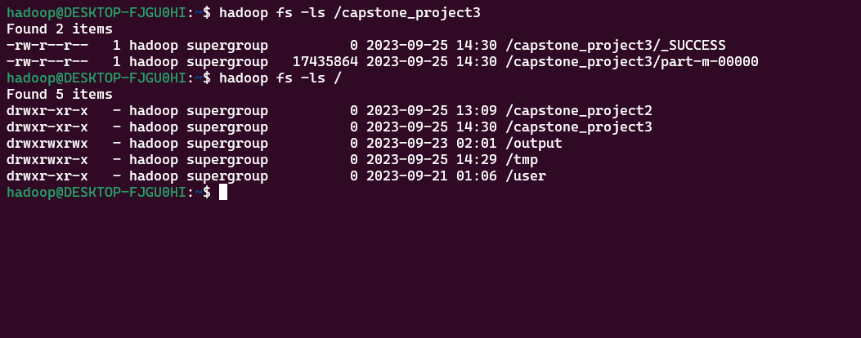
Output 1: Data in HDFS
Property and directory
Data in /data directory in hdfs

Slide 9
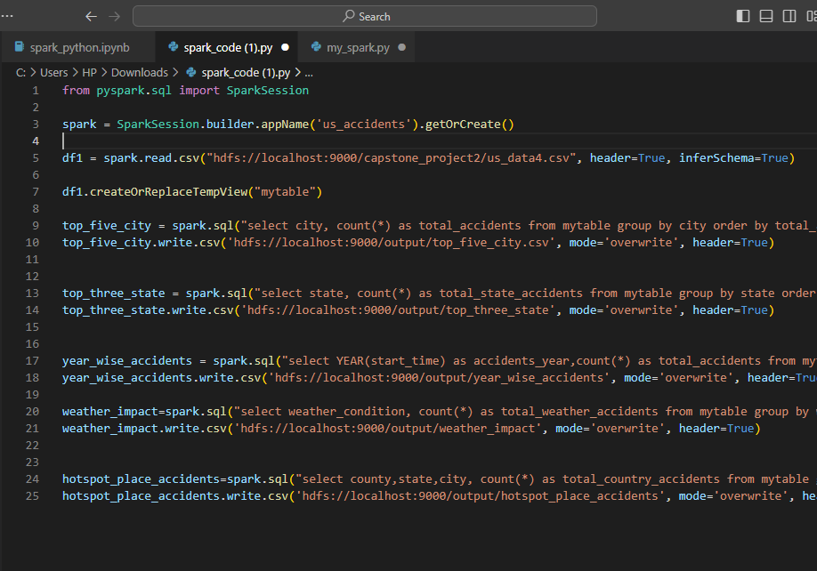
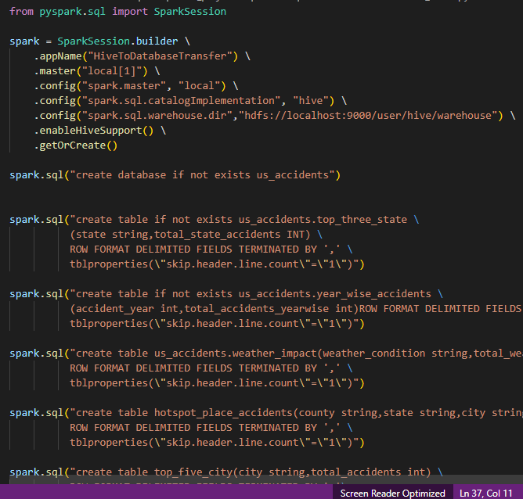
Spark and Hive Code
Spark Code
Hive Code

Slide 10
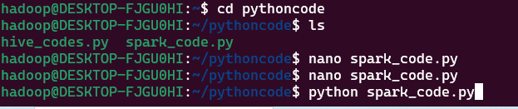
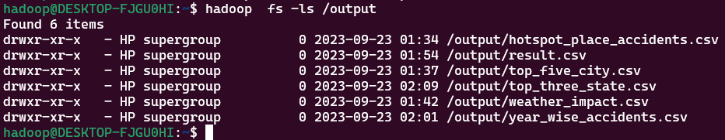
Outcomes of spark code
Commands for running python code
Spark Code output

Slide 11
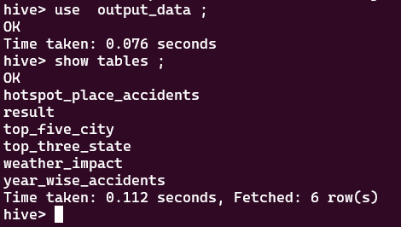

Outcomes of Hive Code
Commands for running python code
Hive code Output

Slide 12
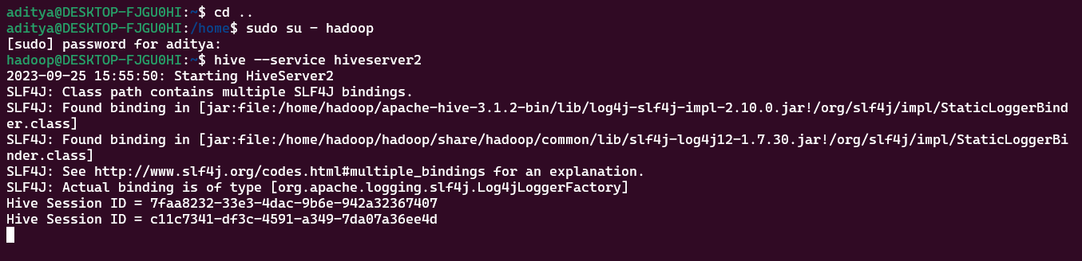
Connection between hive and power BI
For connection between hive and power BI we have to start hiveserver2 : hive --service hiveserver2
Start power bi go to Get Data section and select odbc connector and select sample cloudera hive dsn and press enter after that loading the databases from hive start and go to covid_data databases and select all table and load the table in power bi

Slide 13
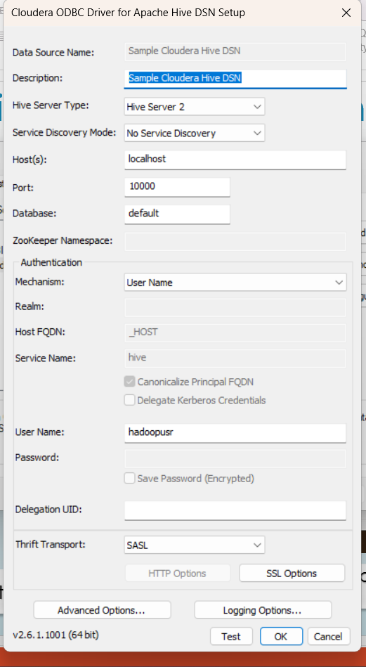
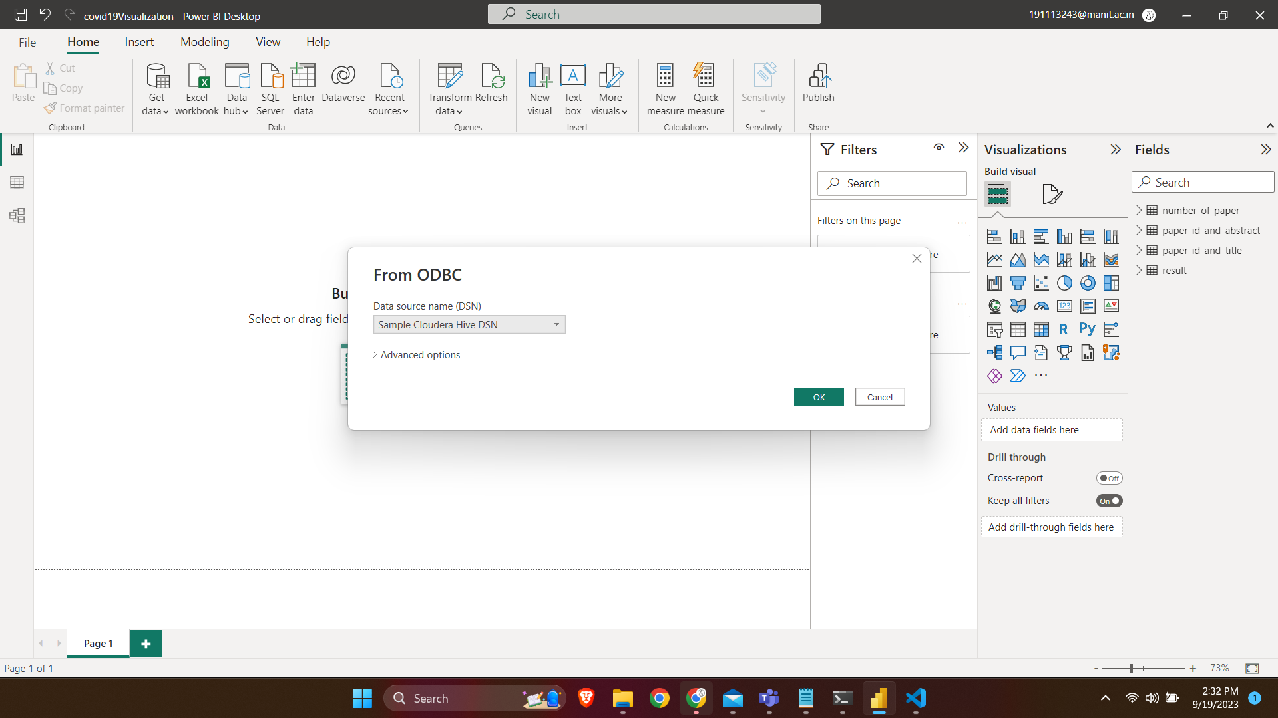
Connection between hive and power BI
Set host and port for connection in odbc
Select sample cloudera hive dsn

Slide 14
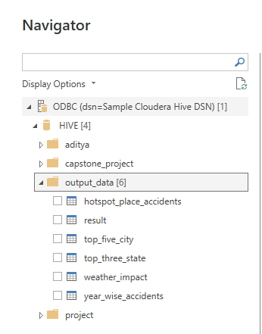
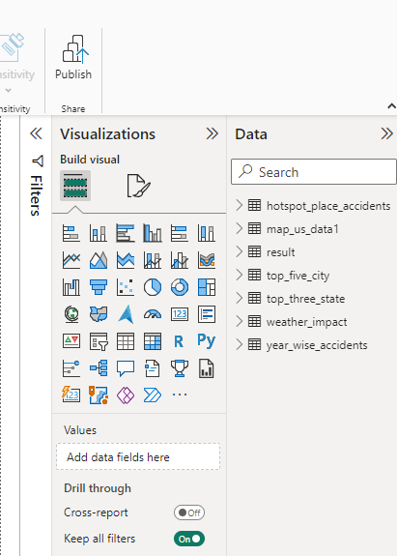
Connection between hive and power BI
Load the data

Slide 15
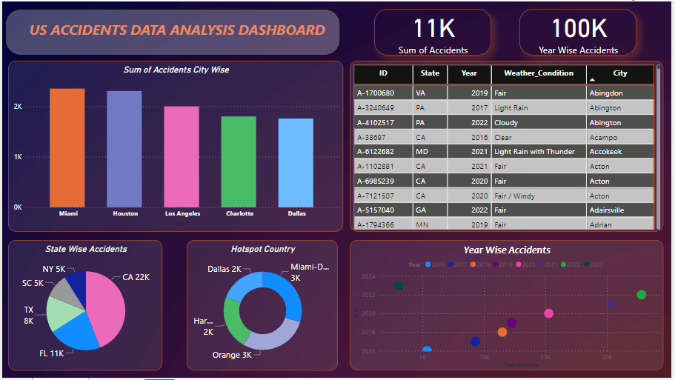
Power BI Visualization

Slide 16
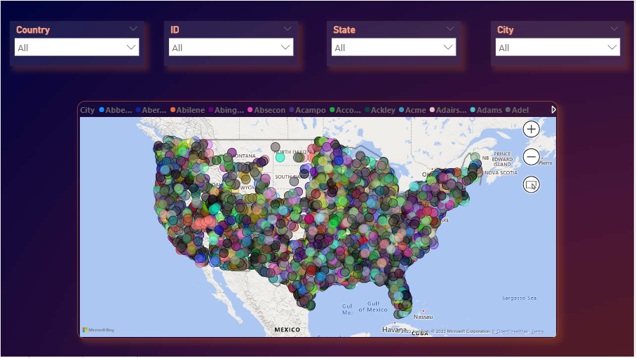
Location dashbaord

Slide 17
Thank you

