Slide 1
H M S · H O T E L M A N A G E M E N T S Y S T E M
A C A D E M I C P R O J E C T · 2 0 2 6
B . T E C H ( Information Technology ) · M I N I P R O J E C T
Hotel Management
System
A C++ console application for seamless rooms, dining, billing
and staff operations.
P R E S E N T E D B Y
Vaibhav Kumar & Shreyansh Tiwari
B.Tech (Information Technology)
Guru Ghasidas Vishwavidyalaya
C O U R S E
C O L L E G E
P H OTO G R A P H Y — U N S P L A S H
0 1 / 1 5

Slide 2




Meet the Hotel Management System.
I N T R O D U C T I O N
A C++ console application that replaces fragmented hotel registers with one connected record store.
W H A T I T I S
A role-based console application for hotel operations. Guests browse rooms, book stays, order food and settle bills; administrators manage inventory, pricing, staff and payroll from one menu-driven system.
02
R O L E S
05
W O R K F L O W S
07
R E C O R D F I L E S
B U I L T F O R
G U E S T
Browse rooms, book a stay, order food and settle the bill.
F R O N T D E S K
Check availability, manage bookings and process checkout.
A D M I N I S T R AT O R
Control rooms, menu, prices, staff and revenue.
O N E S Y S T E M · F I V E W O R K F L O W S
Rooms, dining, billing, staff and records share one source of truth.
B . T E C H ( I T ) M I N I P R O J E C T · C + + 1 7 · T E X T - F I L E P E R S I S T E N C E · T W O R O L E S
02 / 1 5

Slide 3

Fifteen slides. One clear story.
C O N T E N T S
01
Problem Statement
Why fragmented registers break hotel operations
02
The Solution
Objectives, roles and the end-to-end system flow
From the problem statement to the conclusion — six chapters that follow a guest from booking to checkout.
Access & Reservations
Login, dashboards, room inventory and booking
03
04
Dining & Billing
Menu, room orders, itemized folio and checkout
One record store. Five workflows.
Zero duplicate entry.
05
People & Platform
Staff, payroll, C++ engineering and persistence
06
Impact & Conclusion
What works, what is next, and the closing note
15
S L I D E S
06
C H A P T E R S
05
W O R K F L O W S
N E X T → P R O B L E M S T A T E M E N T
03 / 1 5

Slide 4
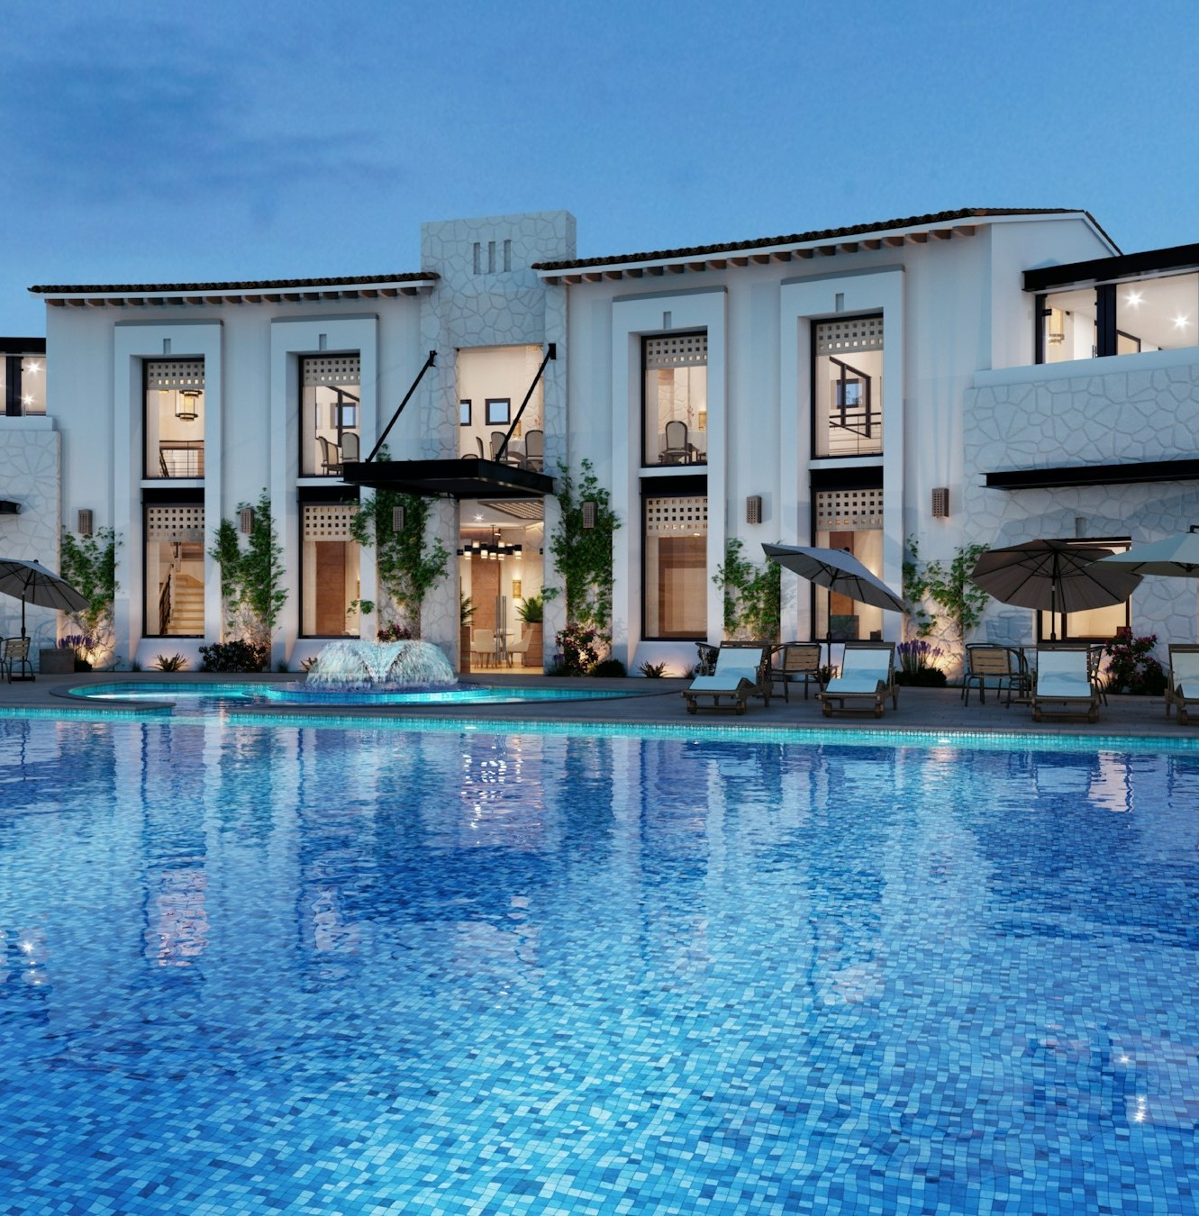




Five registers. No shared source of truth.
0 1 · P R O B L E M S T A T E M E N T
Room availability, guest details, food orders, bills and payroll live in separate places — so every handoff costs time, accuracy and revenue.
P R O B L E M S T A T E M E N T
Hotel records live in separate registers. Availability, guest details, food orders, bills and payroll disagree — so every manual handoff creates delays, duplicate entry and revenue leakage.
No single view of availability
Double bookings, missed inventory and rooms left unsold.
Guest data scattered across registers
Slower check-in, repeated questions and a weaker welcome.
Charges calculated by hand
Billing errors, disputes and revenue leakage at checkout.
T H E C O S T O F M A N U A L
Attendance and payroll kept on paper
Salary mistakes, delayed payments and avoidable friction.
A single missed update can cascade from the front desk to the final bill.
T H E F I X → O N E S Y S T E M · O N E R E C O R D S T O R E · Z E R O D U P L I C AT E E N T R Y
A unified record store removes the gaps.
04 / 1 5

Slide 5










Eight capabilities. Two roles. One system.
0 2 · T H E S O L U T I O N
Every module maps to a daily hotel task — and to a core C++ concept the project is designed to demonstrate.
Rooms & rates
01
Guest registry
02
Reservations
03
Dining
04
Room types, daily prices and live availability.
Profiles, Aadhaar format checks and login.
Availability checks, stay duration and booking records.
C++ · VECTORS
Menu, prices and food orders tied to a room.
C++ · CL ASSES
C++ · ENCAPSUL ATION
C++ · COMPOSITION
Billing
05
Staff records
06
Attendance & payroll
07
File persistence
08
Itemized folio, checkout and room release.
IDs, roles and daily wages in one directory.
Daily presence, salary calculation and payments.
C++ · TEMPL ATES
Text-file storage that survives a restart.
C++ · OPERATOR OVERLOAD
C++ · STRUCTS
C++ · FSTRE AM
C U S T O M E R
Browse, book, dine, settle.
View rooms · Book a stay · My bookings Order food · View bill & checkout · Logout
A D M I N I S T R A T O R
Run inventory, pricing and people.
Manage rooms & food · Update prices
View bookings · Bills · Revenue · Staff & salaries
S C O P E Online payments, housekeeping and OTA/channel integrations are outside this prototype.
05 / 1 5

Slide 6














From launch to ledger in six steps.
0 2 · S Y S T E M F L O W
A single menu loop keeps state predictable: load, authenticate, act and save.
0 1
0 2
0 3
0 4
0 5
0 6
Launch
Start main()
Load records
Read text files
Authenticate
Register or login
Role dashboard
Open the right menu
Perform task
Rooms, food, billing
Save & exit
Persist changes
S Y S T E M M A P · M O D U L E S C O N N E C T E D T O O N E T E X T - F I L E S T O R E
Access
MODULE
Rooms
MODULE
Dining
MODULE
Billing
MODULE
Staff
MODULE
Reports
MODULE
T E X T - F I L E S T O R E
rooms.txt · food.txt · customers.txt · bookings.txt · staff.txt · attendance.txt · payments.txt
P E R S I S T ↔ R E L O A D
state survives restarts
GUARDRAILS · Menu loops and exceptions (invalid_argument, runtime_error) keep bad input out of the system.
06 / 1 5

Slide 7


One login. Two tailored command centers.
0 3 · A C C E S S & R O L E S
Customers see the hotel. Administrators run it. Role-based menus keep the two experiences separate.
C U S T O M E R
Register → login → dashboard
A D M I N I S T R A T O R
adminLogin() → dashboard
View rooms
Book a room
Manage rooms & food
Update prices
My bookings
Order food
View bookings
Generate bills
View bill & checkout
Secure logout
View revenue
Staff & salaries
REGISTER · username + 12-digit Aadhaar + password (6+ characters). The username “admin” is reserved; checkPassword() verifies the login.
DEMO LOGIN · admin / admin123. adminLogin() checks hard-coded credentials; production should use hashed passwords and stronger authentication.
H O W A C C E S S W O R K S
01 Register a customer or use the seeded admin
02 Authenticate with checkPassword() / adminLogin()
03 Route to the dashboard allowed for that role
07 / 1 5

Slide 8
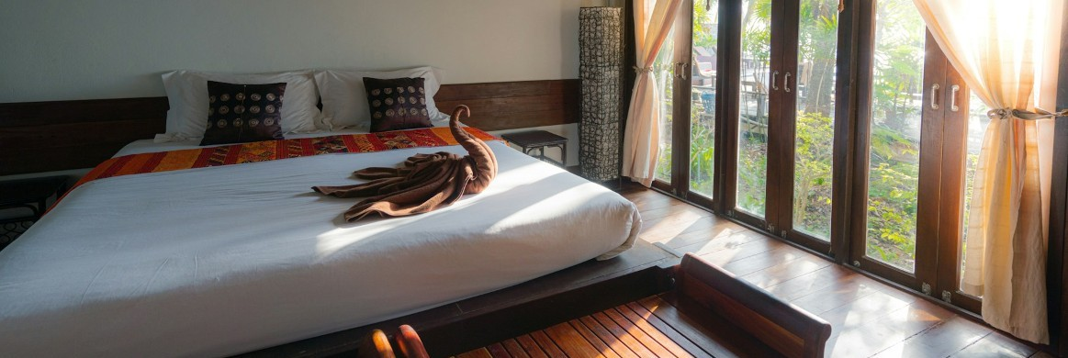
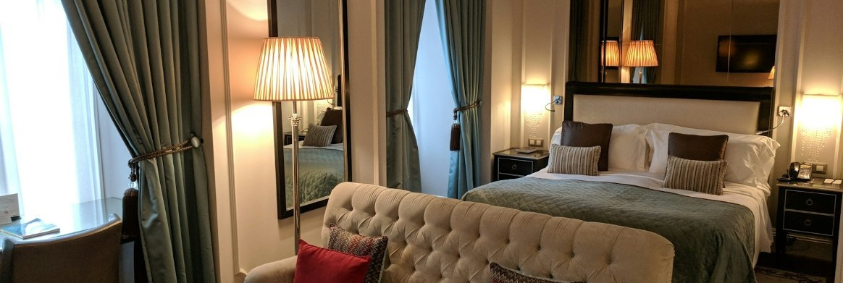
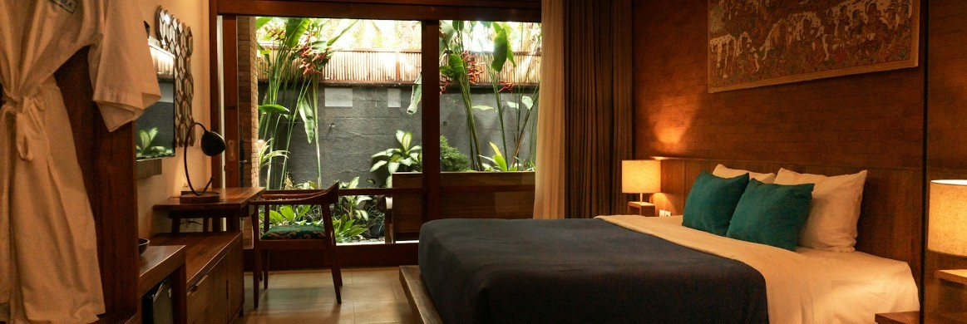
Every room, every status, one source of truth.
0 3 · R O O M S & R E S E R V A T I O N S
Room records carry inventory, pricing, occupancy, guest and food data — so availability and billing never drift apart.
AVAILABLE
BOOKED
AVAILABLE
Standard
R O O M 1 0 1
₹1/ ,N5I0G H0T
Deluxe
R O O M 1 0 2
₹2/ ,N5I0G H0T
Suite
R O O M 1 0 3
₹4/ ,N0I0G H0T
L I V E AVA I L A B I L I T Y · s h o w R o o m s ( )
ALL ROOMS
B O O K I N G F L O W · b o o k R o o m ( )
ROOM | TYPE | RATE / DAY | STATUS
101 | Standard | ₹1,500 | Available
102 | Deluxe | ₹2,500 | Booked
103 | Suite | ₹4,000 | Available
01
Show available rooms
02
Enter room number
03
Check availability
04
Nights + guest name
05
Record booking & save
R O O M C O S T
Daily price × number of nights
₹1,500 × 3 = ₹4,500
ROOM CLASS · number · type · daily price · status · owner · guest · stay · food quantities
availableOnly = false → all rooms | true → only available rooms
VALIDATION · addRoom() rejects duplicate or ≤ 0 room numbers, empty types and non-positive prices; changePrices() saves immediately.
08 / 1 5

Slide 9
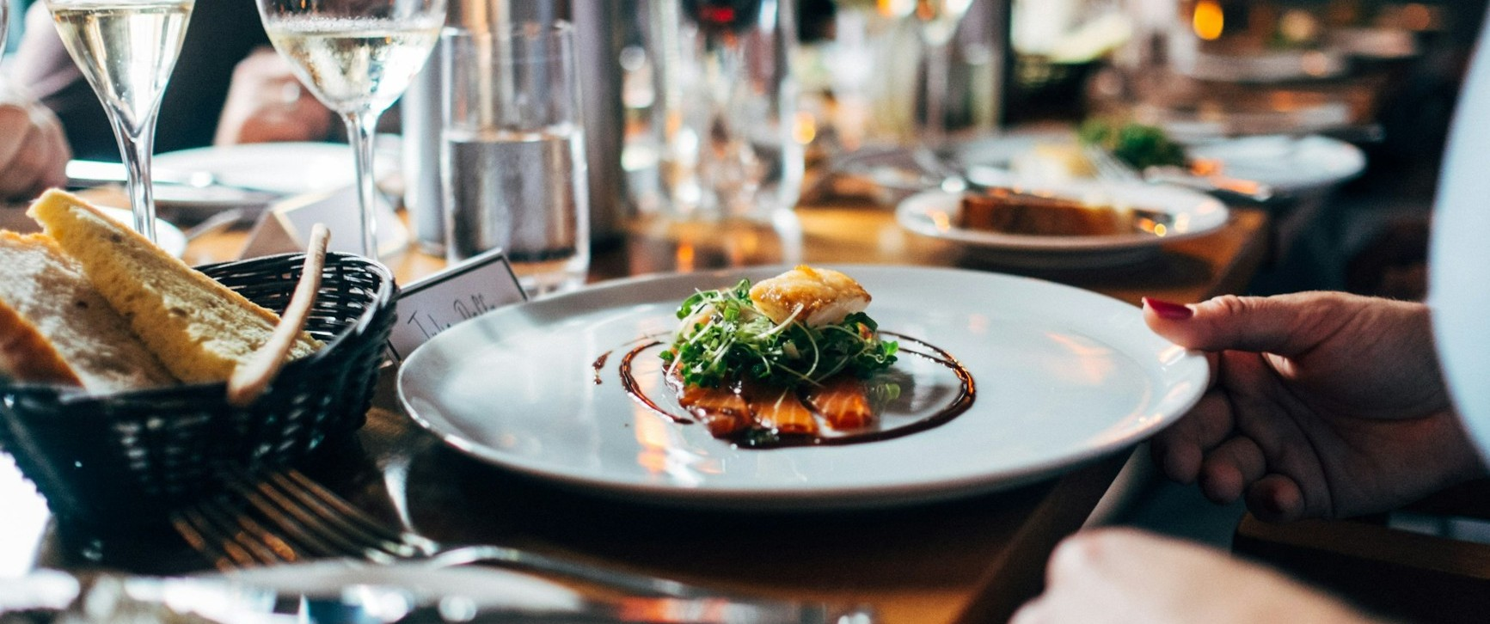





From menu to room service, without a paper ticket.
0 4 · D I N I N G
FoodItem keeps the menu and prices; orders attach directly to the guest's room folio.
R O O M S E R V I C E M E N U
showFood()
Pizza
Wood-fired, mozzarella, bas il
₹250
Burger
House patty, cheddar, fries
₹100
Sandwich
Grilled vegetables, pesto
₹120
I N - R O O M D I N I N G · C H A R G E S P O S T TO T H E R O O M F O L I O
Biryani
Aromatic rice, raita
₹180
O R D E R F L O W · o r d e r F o o d ( )
Coffee
Filter coffee, hot
₹50
01 Enter room number | 02 | Validate active booking
03 Display food menu | 04 | Select item & quantity
05 Update food record | 06 | Save booking data
Admin can add items and update prices; changes persist to food.txt.
+ ADD ITEM
₹ UPDATE PRICE
FoodItem · name + price
F O O D C O S T
Item price × quantity
2 × ₹100 + 1 × ₹50 = ₹250
09 / 1 5

Slide 10
A transparent folio, settled in a single step.
0 4 · B I L L I N G & C H E C K O U T
checkout() consolidates room and dining charges, prints the bill and releases the room back to inventory.
Hotel Bill
C H E C K O U T, S T E P B Y S T E P
F O L I O # H M S - 1 0 4 2
01 Verify an active booking for the room
G U E S T
Aarav Sharma
ROOM 101 · 3 NIGHTS
02 Compute room charges + food charges
I S S U E D
28 OCT 2026
03 Display the itemized bill
Room charges
₹1,500 × 3 nights
Food & beverage
2 burgers + 1 coffee
₹4,500
₹250
04 Confirm checkout with the guest
05 Release the room and save all records
Subtotal
₹4,750
₹4,750
R E V E N U E R E P O R T
R O O M
₹4,500
T O T A L D U E
Room charges + food charges
F O O D
₹250
T O TA L
₹4,750
Confirm checkout to release room 101 back to inventory.
Room + food revenue is held in the Hotel object; totals reset when the program restarts.

Slide 11

Attendance and payroll that add up automatically.
0 5 · S T A F F & P A Y R O L L
Staff records, daily attendance and salary payments share one flow — from shift to payslip.
S TA F F R E C O R D · S t a f f c l a s s
S TA F F I D
101
N A M E
Ravi
R O L E
Front Desk
D A I LY WA G E
₹500
ADD
VIEW
COUNT
ATTENDANCE
SALARY
PAYMENT
M O N T H LY AT T E N STAFF | D A N C E · a t t e n d a n c e . t PRESENT | x t ABSENT | SALARY | STATUS
Ravi | 24 | 2 | ₹12,000 | Paid
Priya | 26 | 0 | ₹13,000 | Pending
P E O P L E & P A Y R O L L
S A L A R Y F O R M U L A
Present days × daily wage
24 × ₹500 = ₹12,000
Great service starts with a team that is paid right.
Payment status recorded in payments.txt · salary and payment functions update the record.
ATTENDANCE · Staff ID + date (YYYY-MM-DD) + present/absent; duplicate entries are rejected.

Slide 12





C++ fundamentals, applied with real-world rigor.
0 5 · E N G I N E E R I N G
The project turns classroom concepts into a working system — with validation and file persistence at every step.
O O P I N P R A C T I C E
P E R S I S T E N C E · T E X T F I L E S
Encapsulation
Abstraction
FILE | PURPOSE
rooms.txt | Room details and availability
food.txt | Menu items and prices
customers.txt | Customer records and credentials
bookings.txt | Bookings and food quantities
staff.txt | Staff information and wages
attendance.txt | Daily attendance records
payments.txt | Salary payment history
Data and behavior stay together
A clean public interface
Inheritance
Polymorphism
Shared user behavior
One interface, many forms
room.h
class Room {
int number; string type; double price; bool booked;
public:
bool isAvailable() const;
void book(string guest, int days);
};
I N P U T V A L I D AT I O N · E R R O R H A N D L I N G
Invalid menu choices
Non-positive prices
Duplicate room numbers
Invalid food quantities
G++ · C++ 17
Short passwords
Duplicate attendance
Duplicate payments
Caught as invalid_argument / runtime_error; menu loops recover gracefully.
Invalid room numbers
Vectors and structs hold collections; templates and operator overloading keep APIs expressive.

Slide 13



What works, what is limited, what comes next.
0 6 · I M P A C T & R O A D M A P
The prototype proves the operating model. The roadmap turns it into a production-ready platform.
W H A T W O R K S T O D A Y | C U R R E N T L I M I T S | N E X T H O R I Z O N
One system for five workflows | Console-only interface | GUI front end (Qt or web)
Automatic room + food billing | Plain-text storage, no database | SQLite / MySQL persistence
File-backed records survive restart | Revenue totals reset on restart | Hashed passwords + role-based access
Attendance and salary in one flow | No online booking or payment | Persistent revenue history
C++ OOP demonstrated in practice |  | Booking dates + online payments
T H E P R I N C I P L E
Keep the single record store; upgrade the interface, the database and the authentication around it.

Slide 14
One record store. A measurably better hotel.
0 6 · C O N C L U S I O N
The prototype meets its objective: unify the hotel's daily operations in one working, file-backed C++ system.
01
Fewer handoffs
Availability, bookings and bills share one record, so the front desk stops reconciling duplicates.
02
Accurate billing
Room and food charges are computed once, itemized and settled in a single checkout step.
03
A platform to scale
The same model moves cleanly to a GUI, a database and online payments.
F I N A L W O R D
Centralizing the record — not adding staff — is what makes service faster, bills accurate and payroll dependable.
N E X T → T H A N K Y O U & D I S C U S S I O N
The prototype is complete; the roadmap defines what follows.

Slide 15

Thank you.
H M S · H O T E L M A N A G E M E N T S Y S T E M
0 6 · C L O S I N G N O T E
Questions & discussion
P R E S E N T E D B Y
Vaibhav Kumar & Shreyansh Tiwari
B.Tech (Information Technology)
Guru Ghasidas Vishwavidyalaya
PROJ E C T · H OT EL M A N AG EM EN T S YS T EM
T H E T A K E A W A Y
One system. One record store. Better hospitality.
P H O T O G R A P H Y — U N S P L A S H
1 5 / 1 5

