Slide 1


Margin Analysis of “Alpha Mart” (A Data driven approach to boost profitability)
Presented By:
Vimal Kumar
Roll: 22ds1000184

Slide 2
Executive summary
Project objective: Analyze sales data of Alpha Mart to identify avenues for maximizing profitability and increasing revenue, supporting the owner's goal of expanding the business.
Organisation in review: A B2C grocery store, Alpha Mart, offering a wide range of kirana products.
Methods: Leverage descriptive analysis, market basket analysis, profitability analysis, and customer segmentation techniques
Outcome: generate data-driven insights and recommendations to boost margins, optimize product mix, and gain deeper insights into high-margin product categories and valuable customer segments

Slide 3


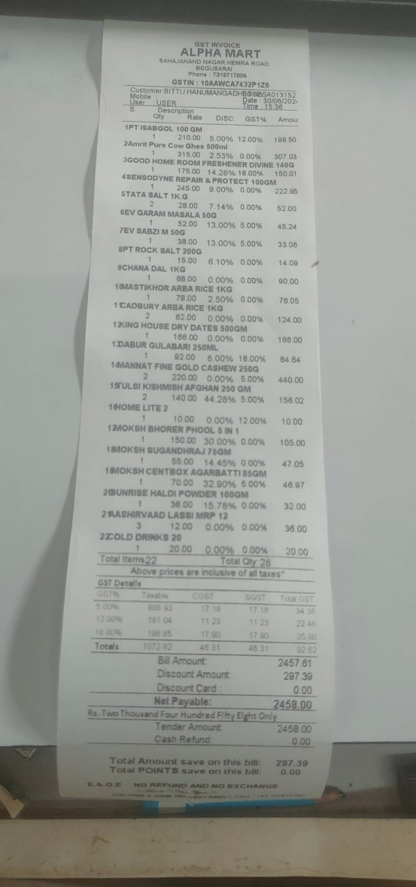
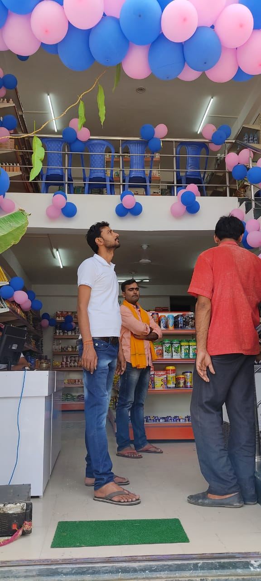
About Alpha Mart
• Small grocery store in Begusarai, Bihar • Established: April 17, 2022 • Product range: 2,500+ items • Annual turnover: ~₹35 lakh • Employees: 5 (including owner)
Data sources:
1. Stock dump (2,683 products) 2. Sales transactions (26,822 records, Feb-Apr 2024)
Tools used: Python (NumPy, Pandas, Matplotlib, Seaborn)
Notes:
Data files and supporting documents are shared for review. https://drive.google.com/drive/folders/1FgH8RvF3rxsSqQ6iTecI0iOiGYipOc51?usp=sharing

Slide 4
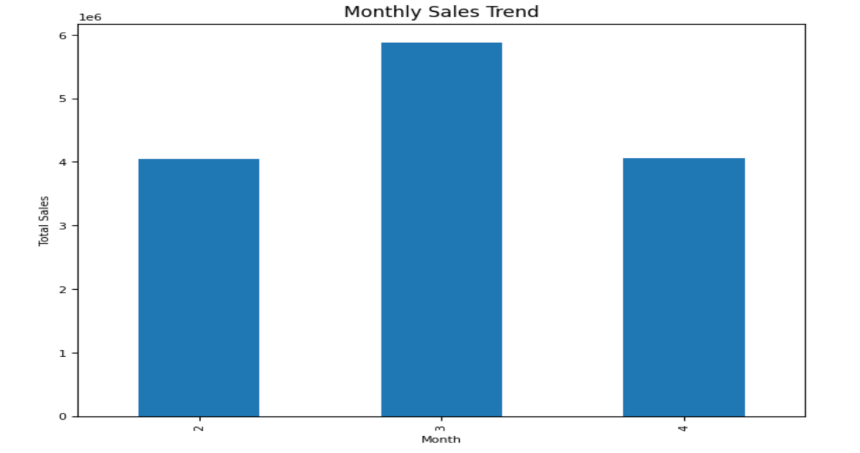
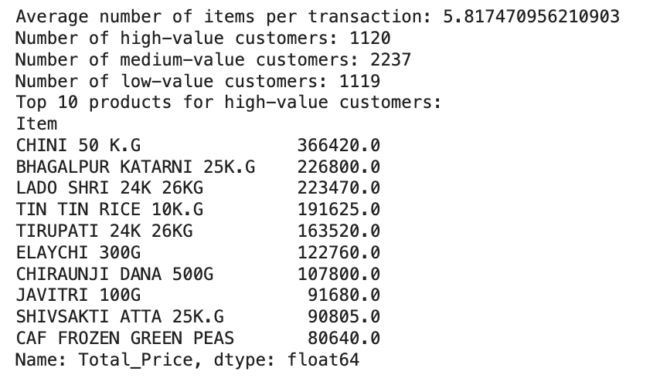
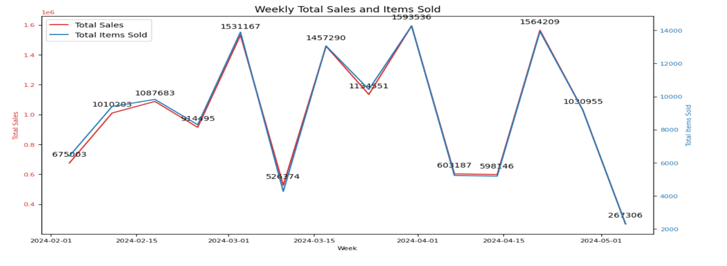
EDA & Descriptive Analytics
Variable | Mean | Median | Std Dev | Min | Max
Quantity | 4.69 | 4.00 | 2.59 | 1 | 9
MRP | 140.22 | 75.00 | 228.27 | 1 | 3350
Sale_price | 139.70 | 75.00 | 227.82 | 0 | 3350
Total_Price | 521.13 | 315.00 | 668.23 | 0 | 13400

Slide 5
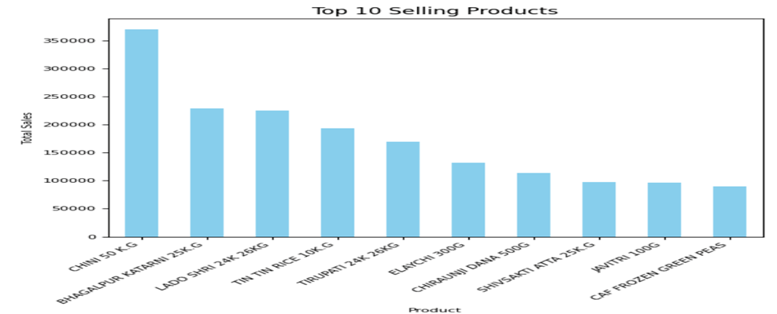
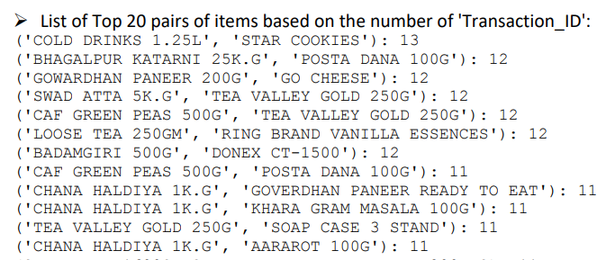
Data Analysis Methods
Profitability Analysis: For evaluate the profitability of individual products and product categories by analyzing factors such as cost price, selling price, discounts, and profit margins.
Market Basket Analysis: With the help of association rule mining algorithms, we were able to uncover frequently co-purchased item combinations.

Slide 6
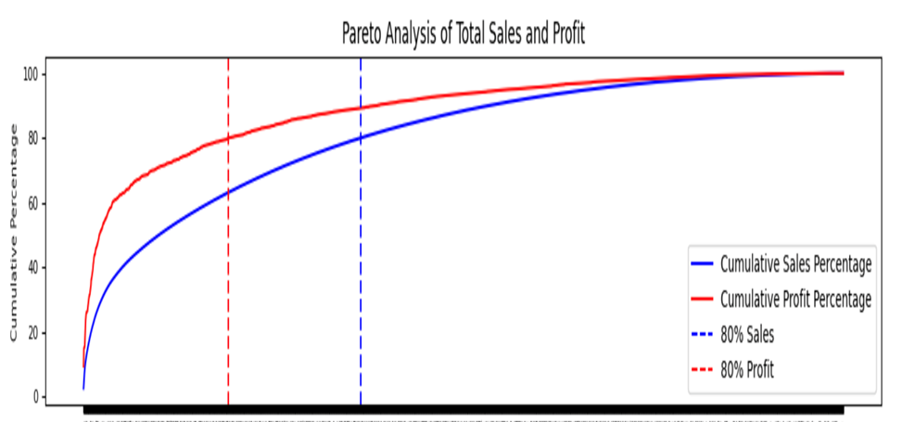
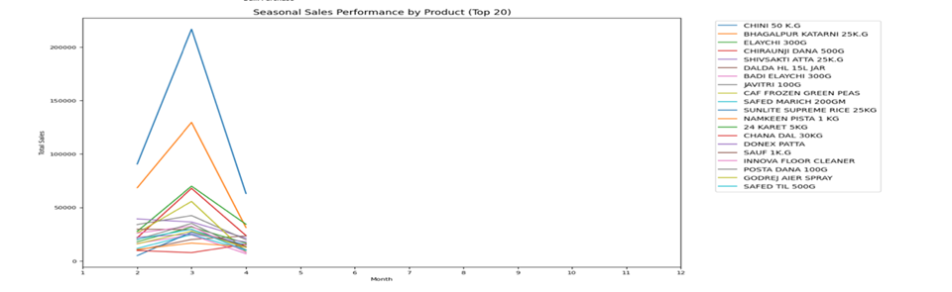
Data Analysis Methods (Contd.)
Pricing Optimisation: This is aimed to balance competitiveness with profitability by examining demand elasticity, customer price sensitivity. This analysis was critical in identifying areas where Alpha Mart could adjust pricing to increase margins without losing customers.
Pareto Analysis: This highlights top 20% of products account for 80% of profit.

Slide 7
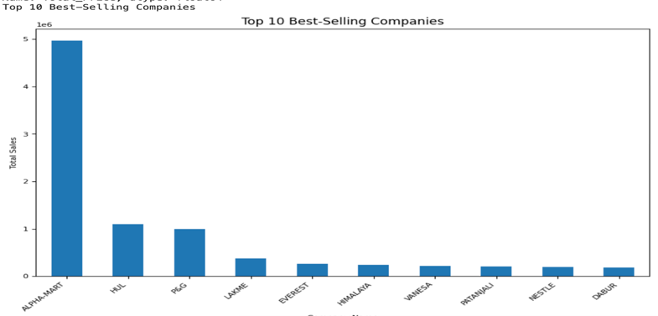
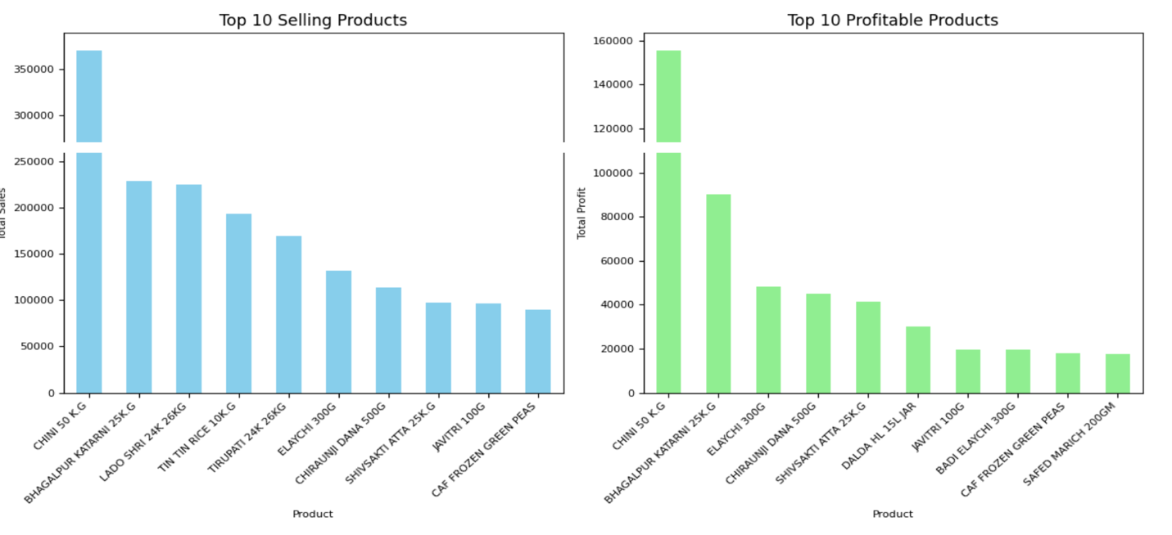
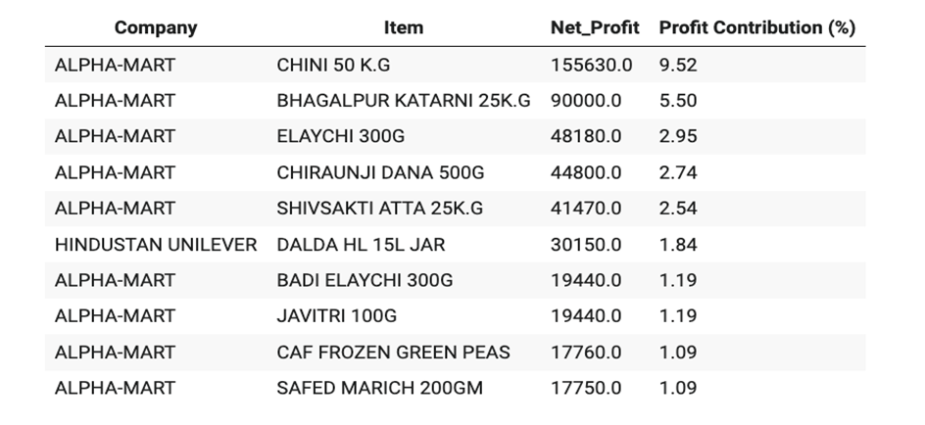
KEY FINDINGS
SELF-Branded Products (ALPHA-MART)
Product Name | Total Profit | Profit Margin (%)
CHINI 5.0KG | 50,000 | 25.0
ELAICHI 300GM | 45,000 | 112.5
AJANTA BAKING POWDER | 40,000 | 100.0
GOOD DAY BISCUITS | 38,000 | 95.0
CHIRAUNJI DANA 500G | 36,000 | 90.0

Slide 8
Interpretation of Results and Recommendations
Prioritize high-margin products (e.g. CHINI 5.0 KG, ELAICHI 300GM)
Optimize pricing for staples with inelastic demand
Enhance cross-selling based on market basket insights
Implement seasonal promotions, similar to March spike
Improve inventory management for fast-moving items
Develop customer loyalty program
Expand self-branded product offerings

Slide 9
Expected outcome & Conclusion
Embracing a data-driven approach has unveiled actionable insights for Alpha Mart, enabling increased profitability, optimized operations, and a competitive edge in the local market.
Implementing the recommended strategies is expected to drive significant outcomes: 15-20% boost in overall profitability within the first year
Improved inventory turnover and reduced holding costs
Continued data analysis and adaptation to market changes are crucial for long-term success and sustained growth.
With a solid foundation laid by this project, Alpha Mart is well-positioned to achieve its expansion goals and maintain a strong competitive advantage in the local grocery market.

Slide 10

“Q&A”
Thank You.

