Slide 1
Docker Enterprise Edition on Azure
Architecture

Slide 2


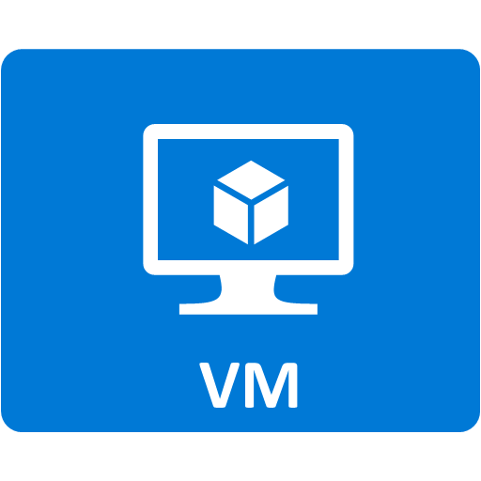


Resource Group
PIP
PIP
PIP
PIP
UCP LB
DTR LB
Linux LB
Win LB
VHD + DTR
Storage Account
Managers Availability Set
DTR Availability Set
Linux Workers Availability Set
Windows Workers Availability Set
Nodes Subnet
Virtual Network

