Slide 1
How to find customers for UVW
Report by XYZ Corporation

Slide 2
Target customers
We are targeting at people with salary less then 50K.
We need to find the feature of people who earn less than 50K
We study the age, sex, marital-status etc.

Slide 3
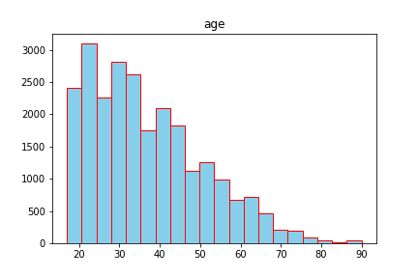
Age
The majority of our target customers are around 25 years’ old.

Slide 4
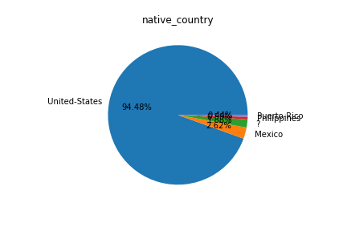
Native-country
The majority is United States, follow with Mexico

Slide 5
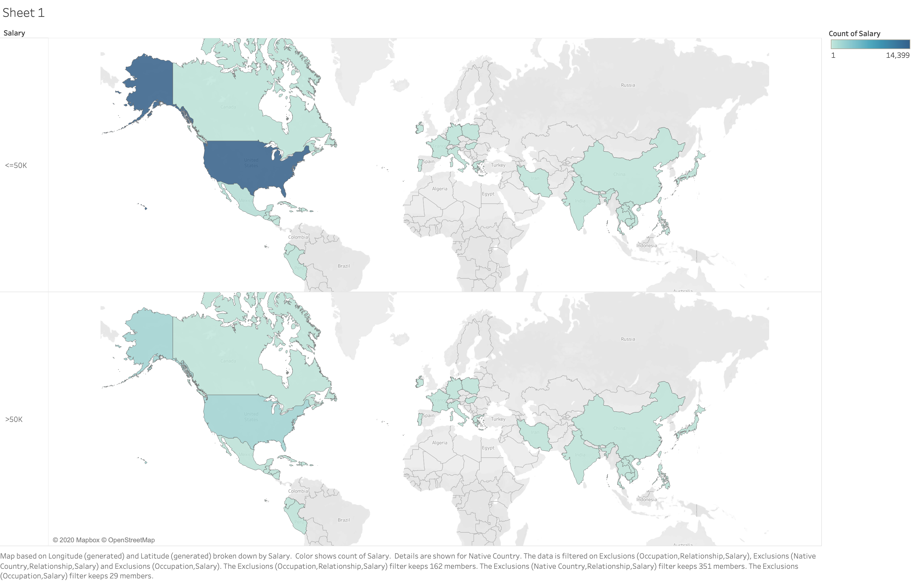

Slide 6
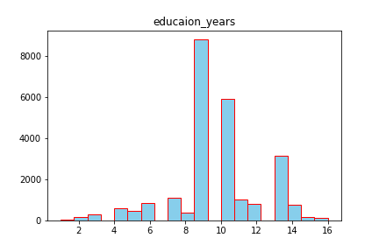
Education years
We should focus at people who has got 9 years’ education

Slide 7
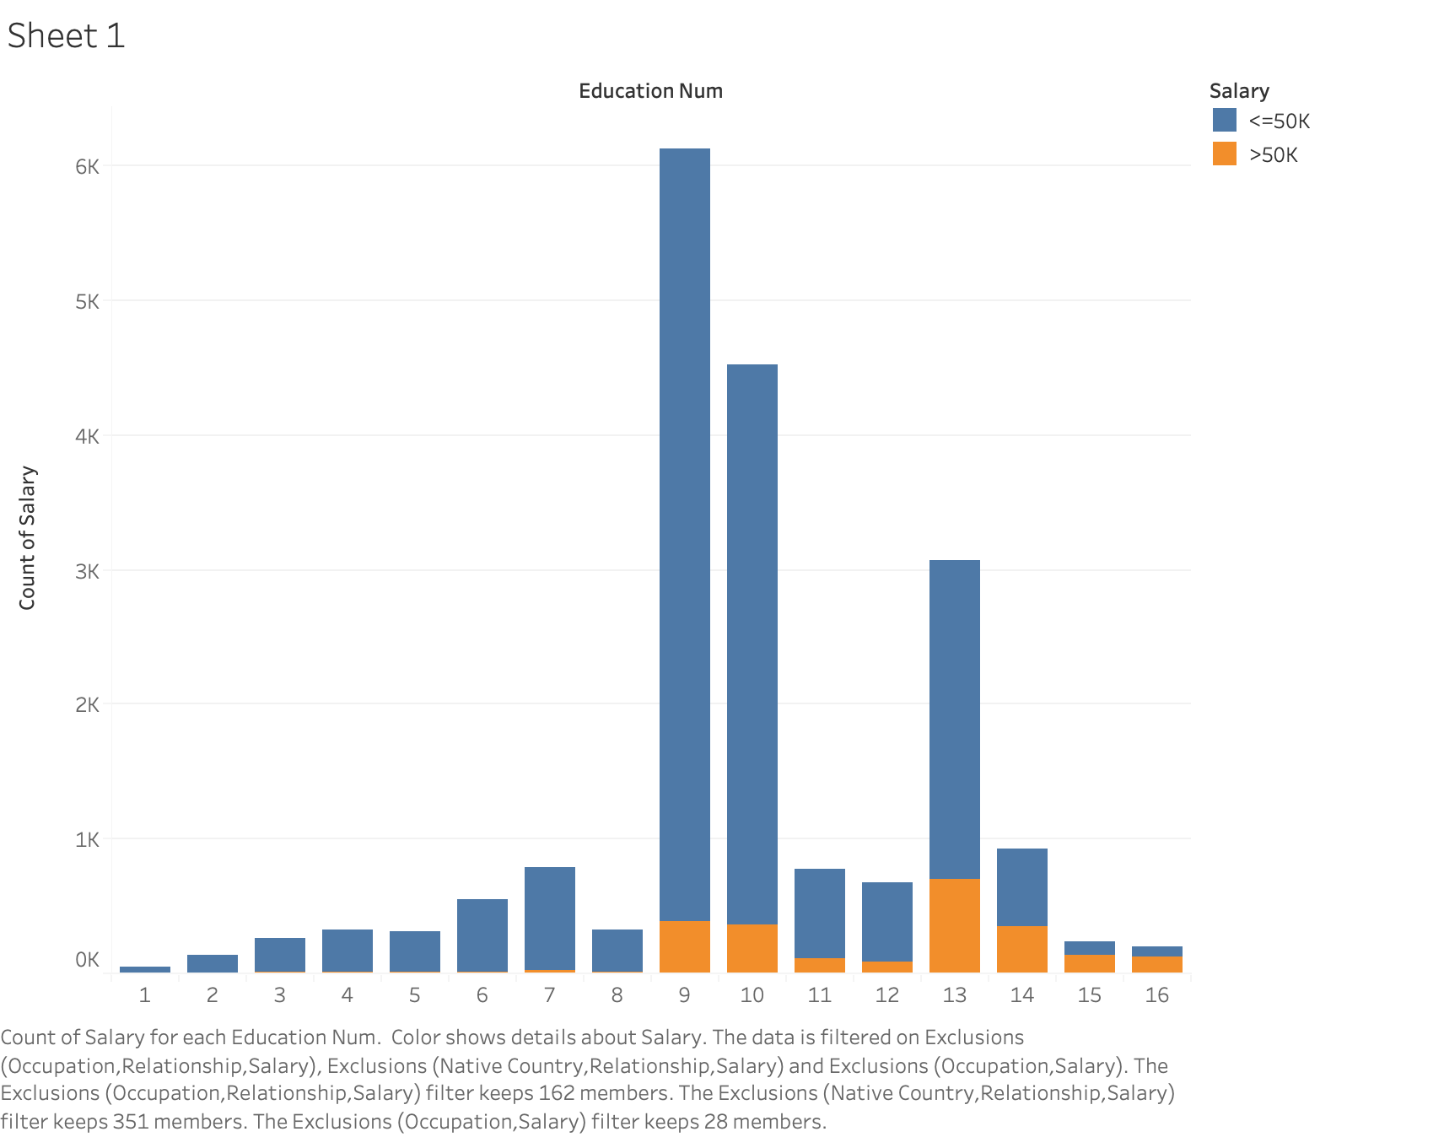
We don’t need to focus on people with high education years

Slide 8
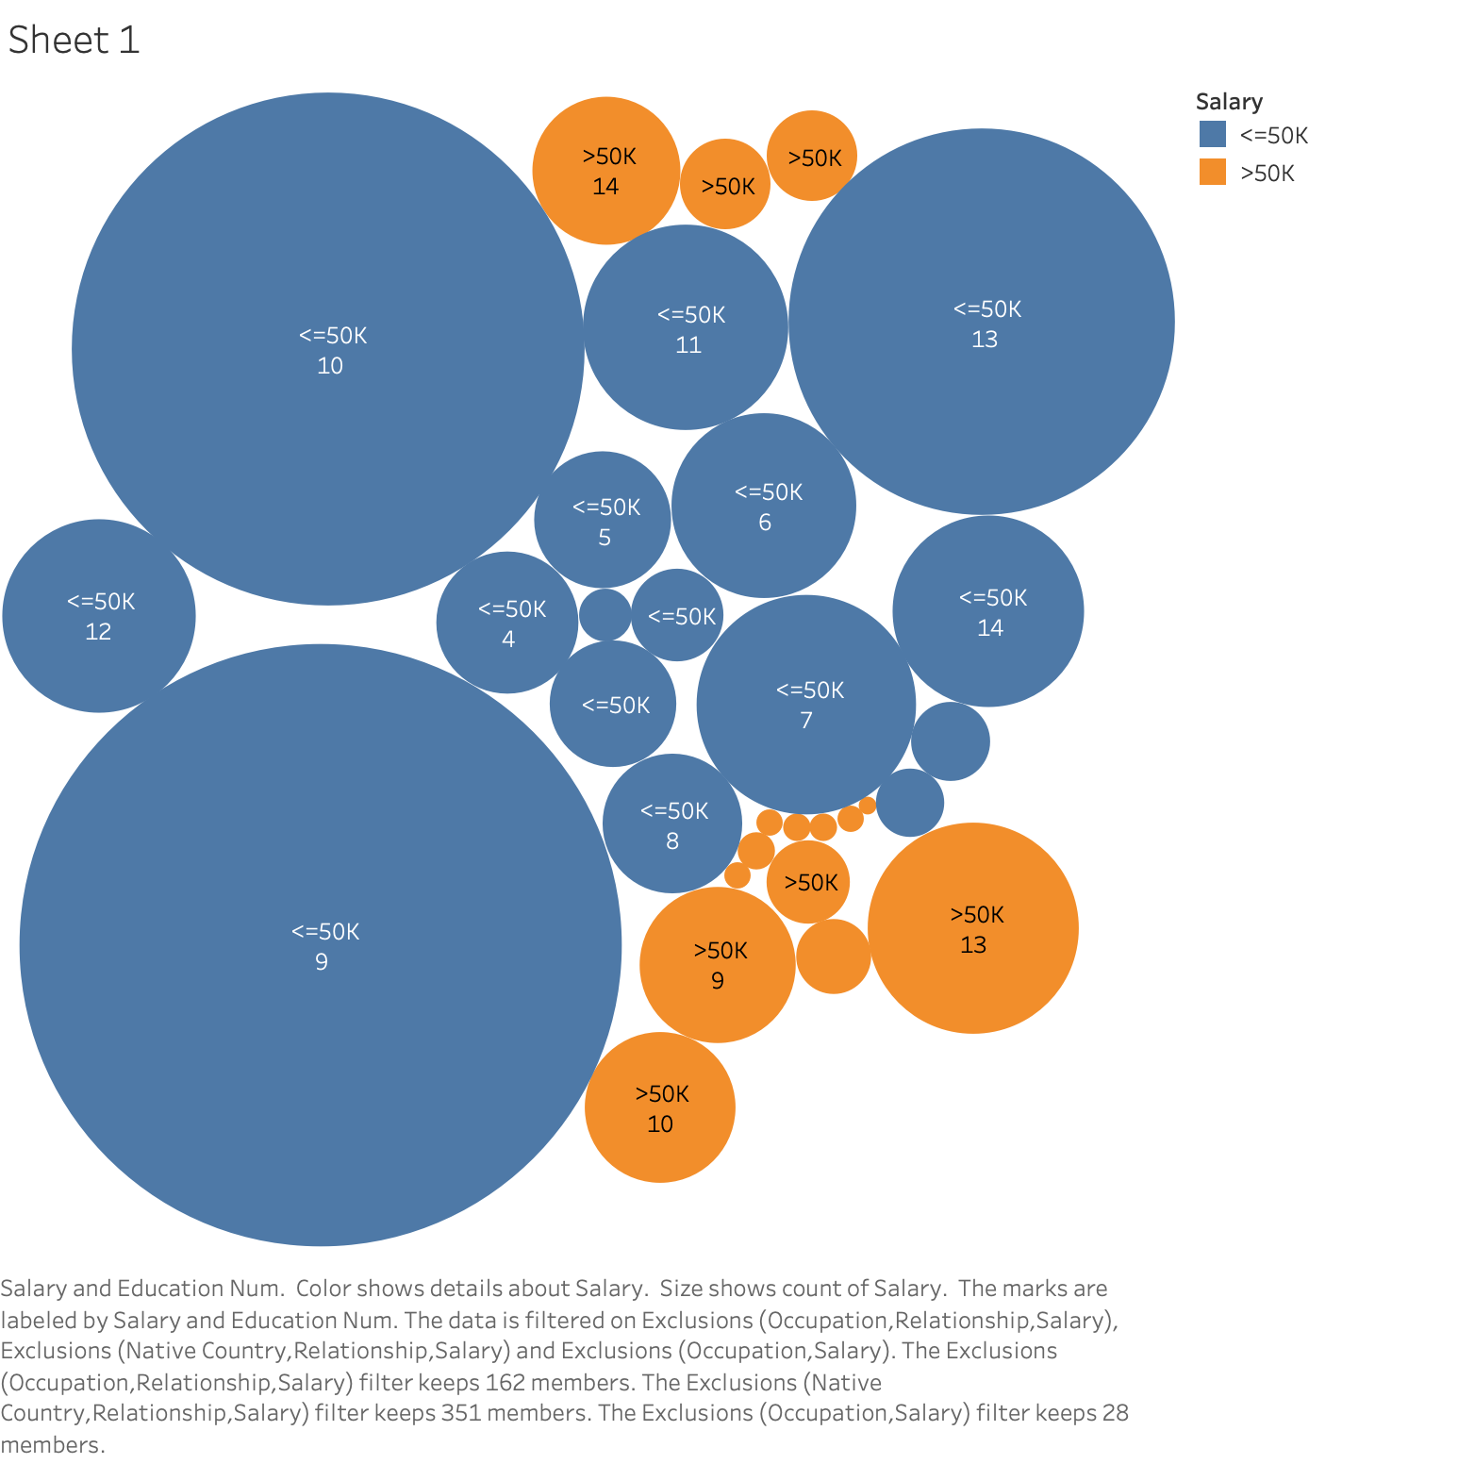

Slide 9
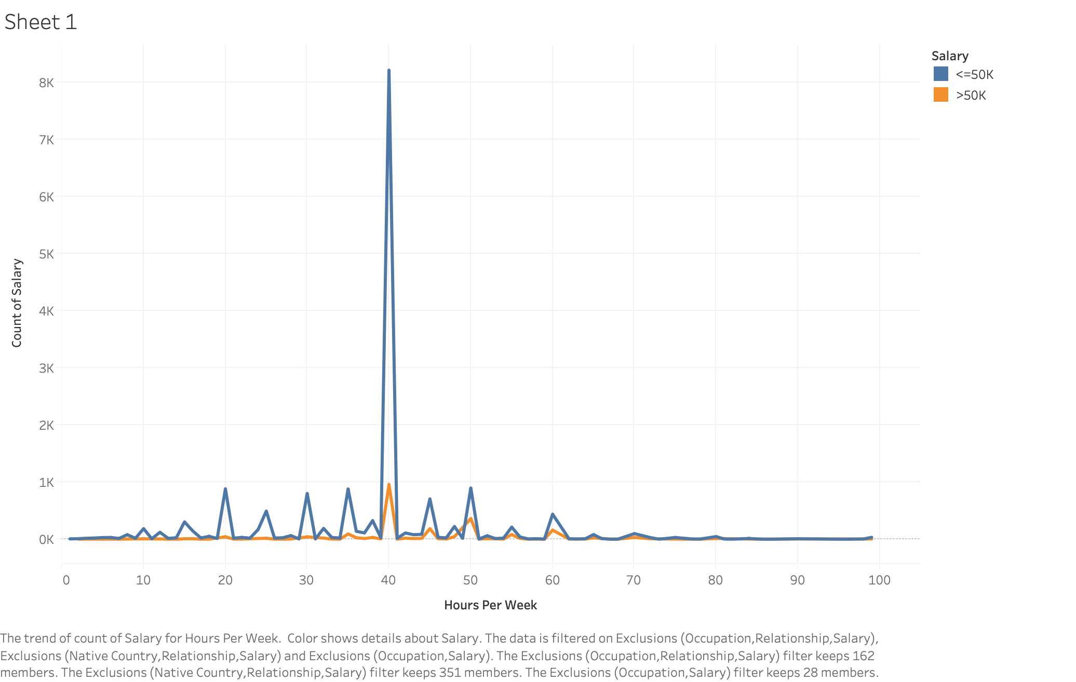
Working hours
Most people work around 40 hours, but majority of people who work less time earn less than 50K

Slide 10
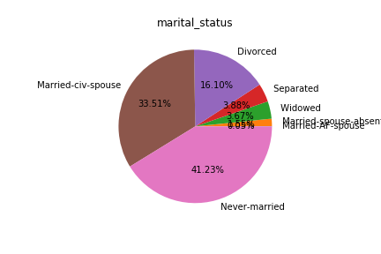
Marital Status
Most of the people who earn less than 50K has never married.

Slide 11
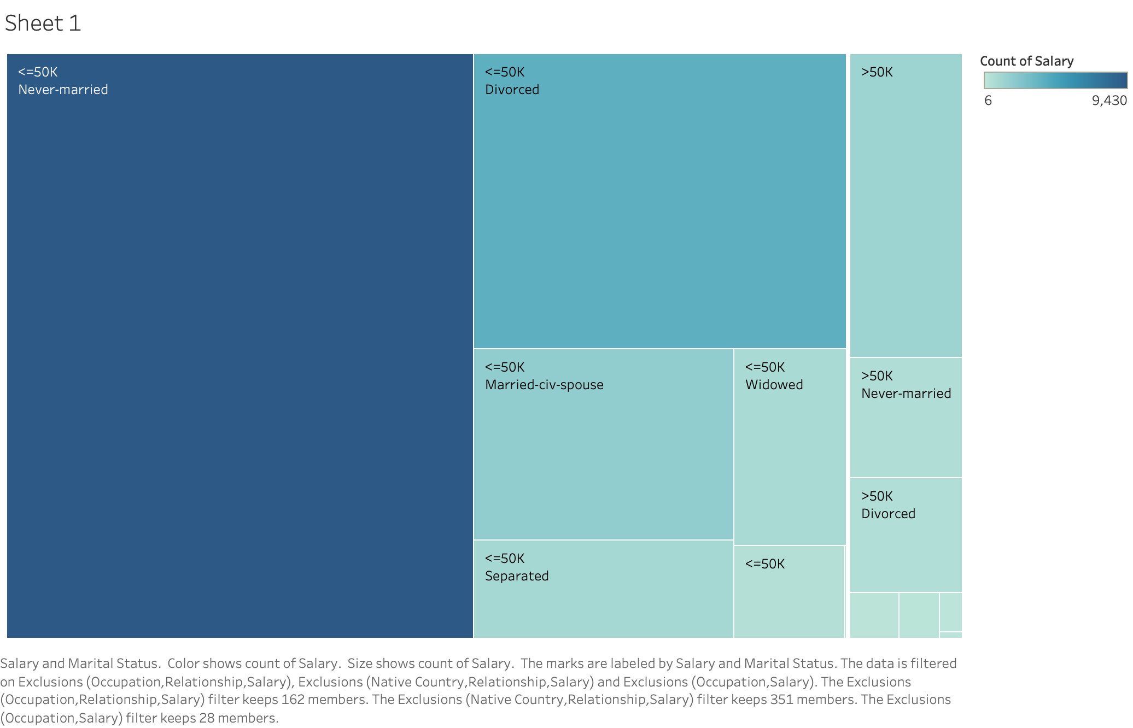

Slide 12
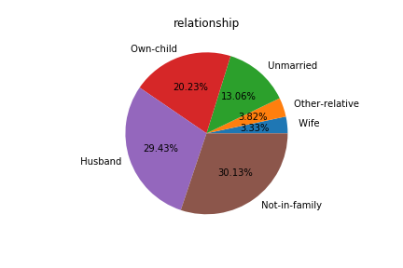
Relationship
Most are not in family

Slide 13
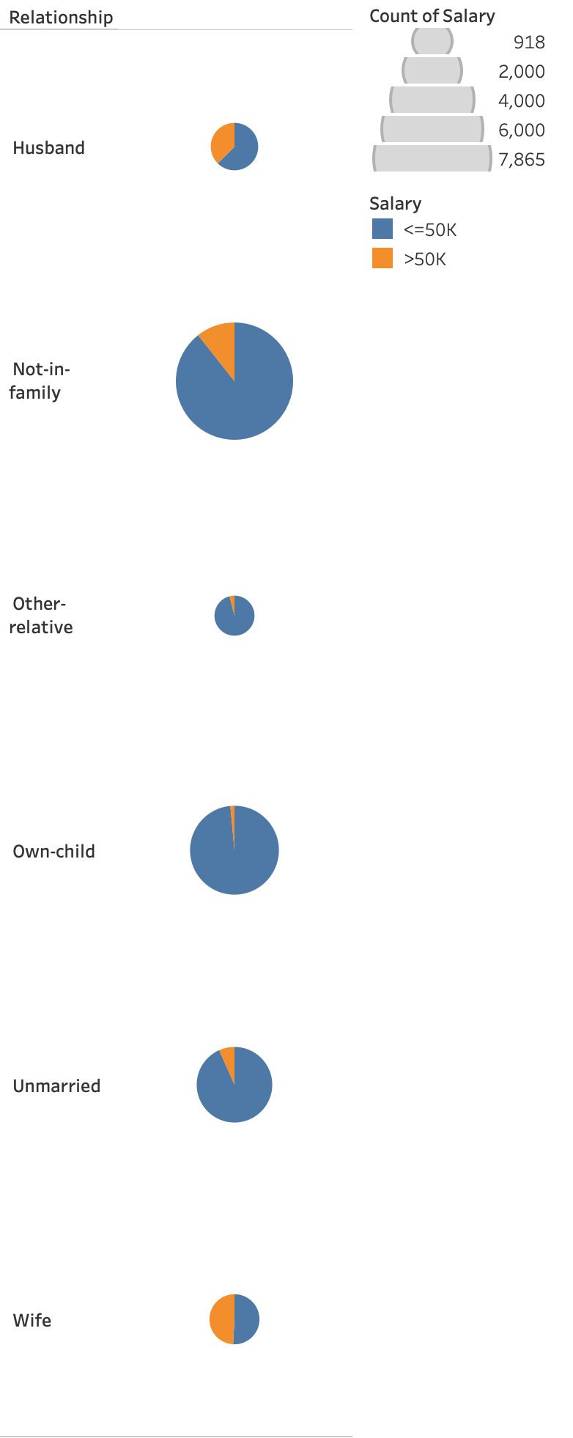

Slide 14
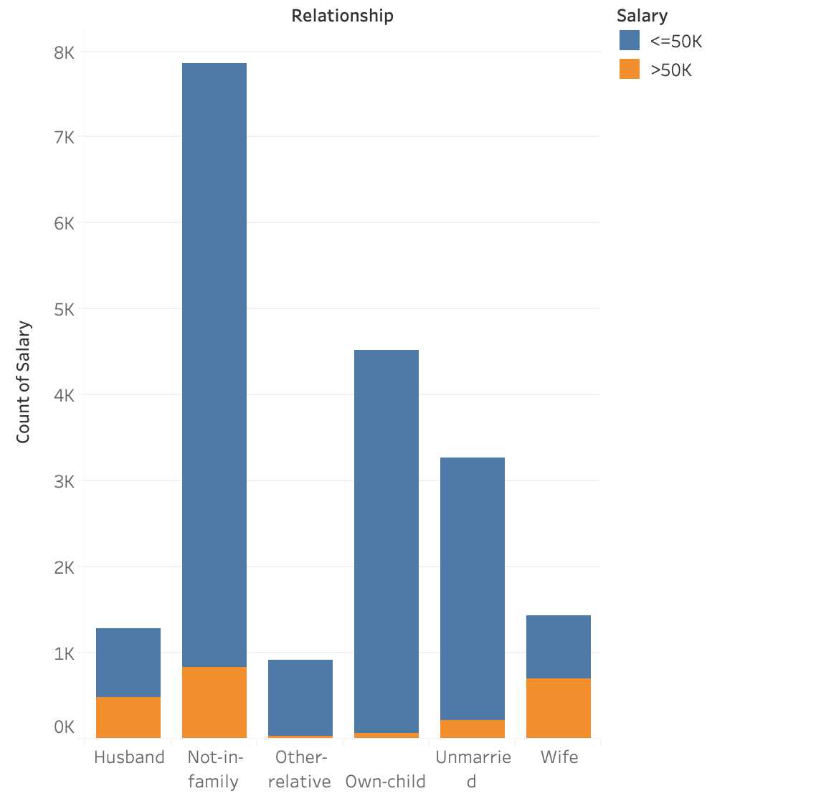

Slide 15
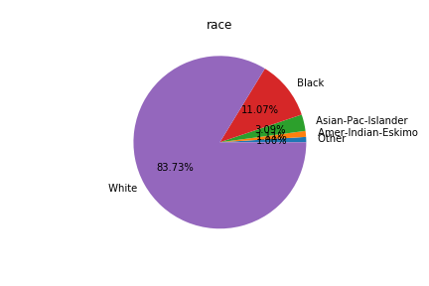
Race
Most people are white, but in each race group, black has the highest racio who earn less than 50K

Slide 16
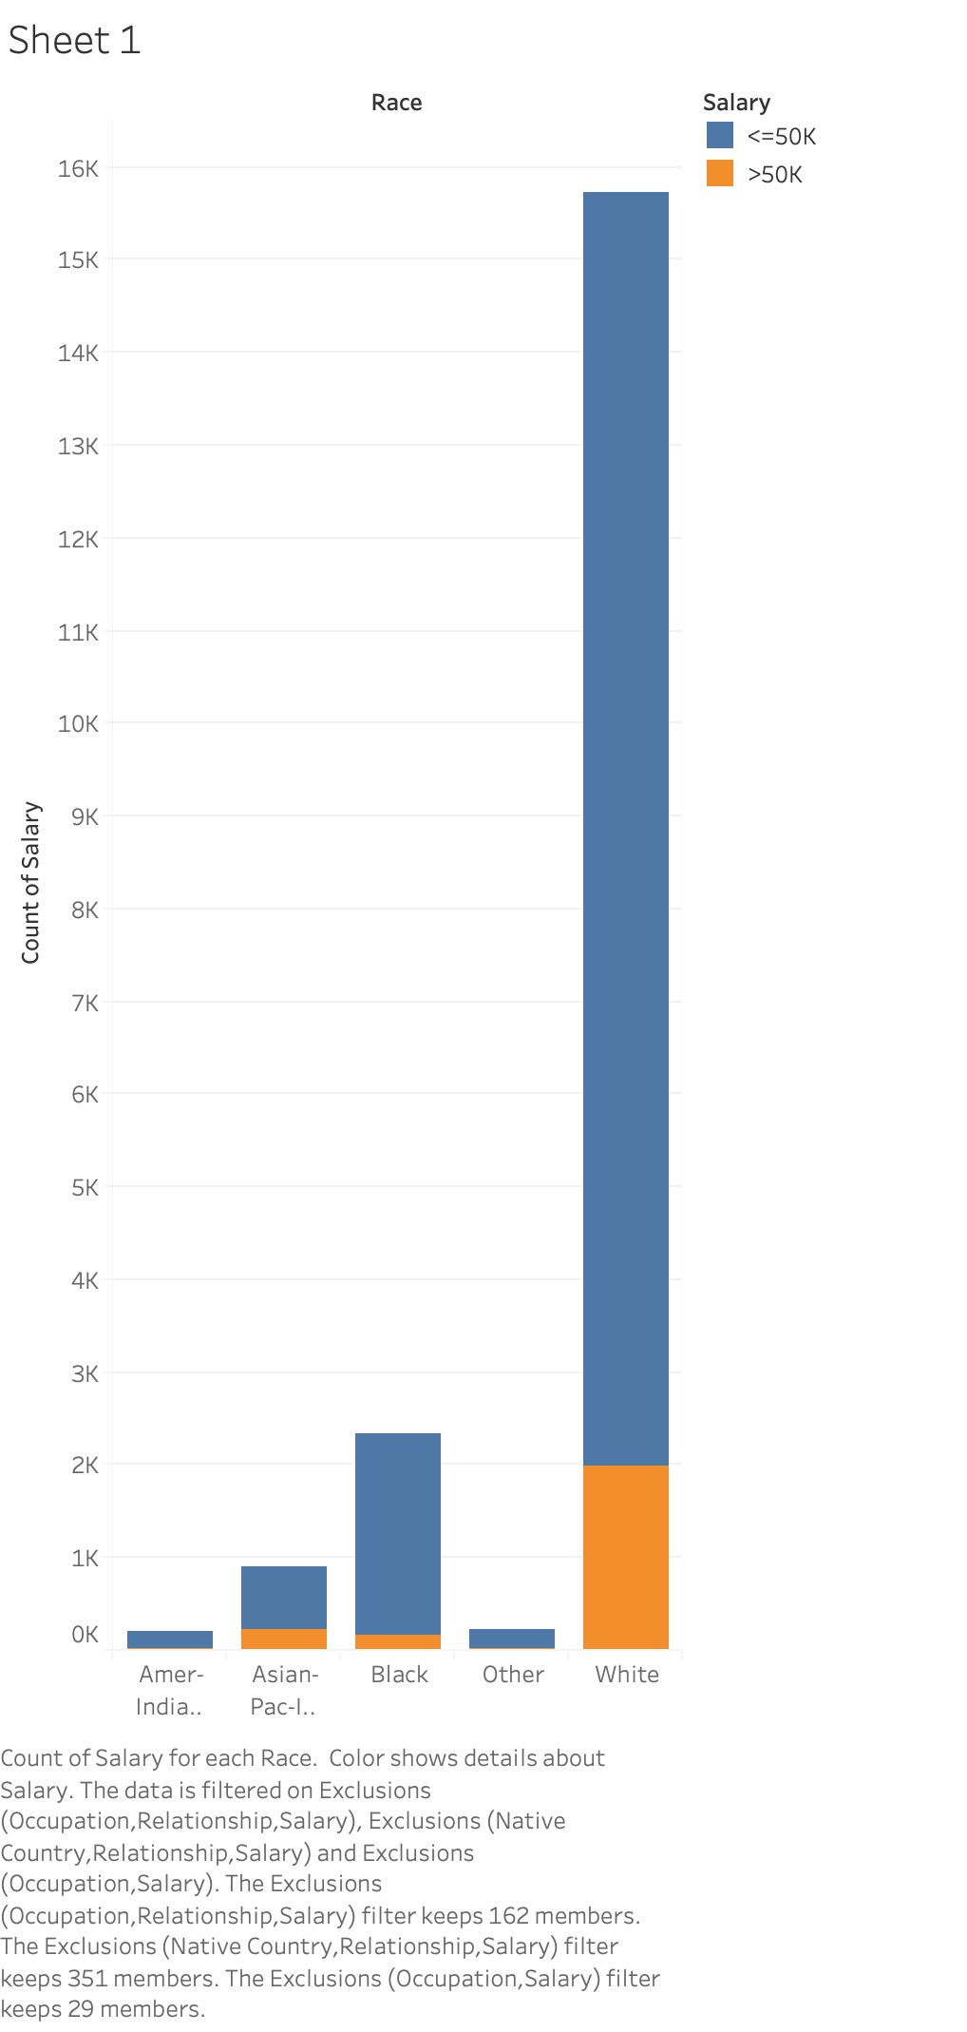

Slide 17
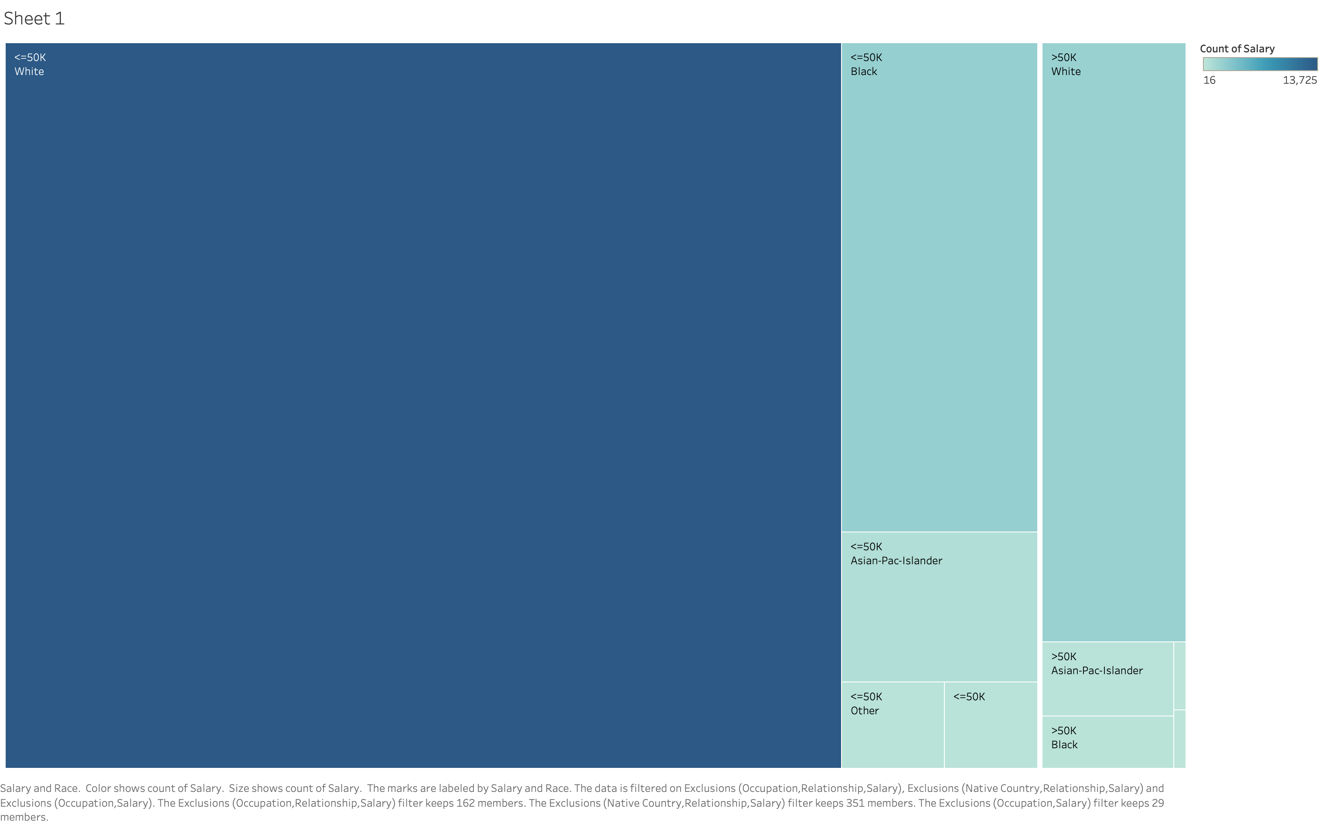

Slide 18
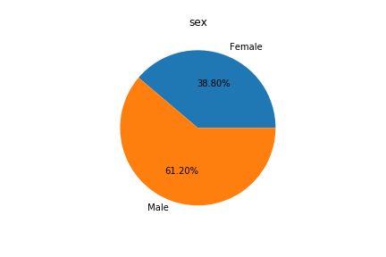
Sex
Most people are man.

Slide 19
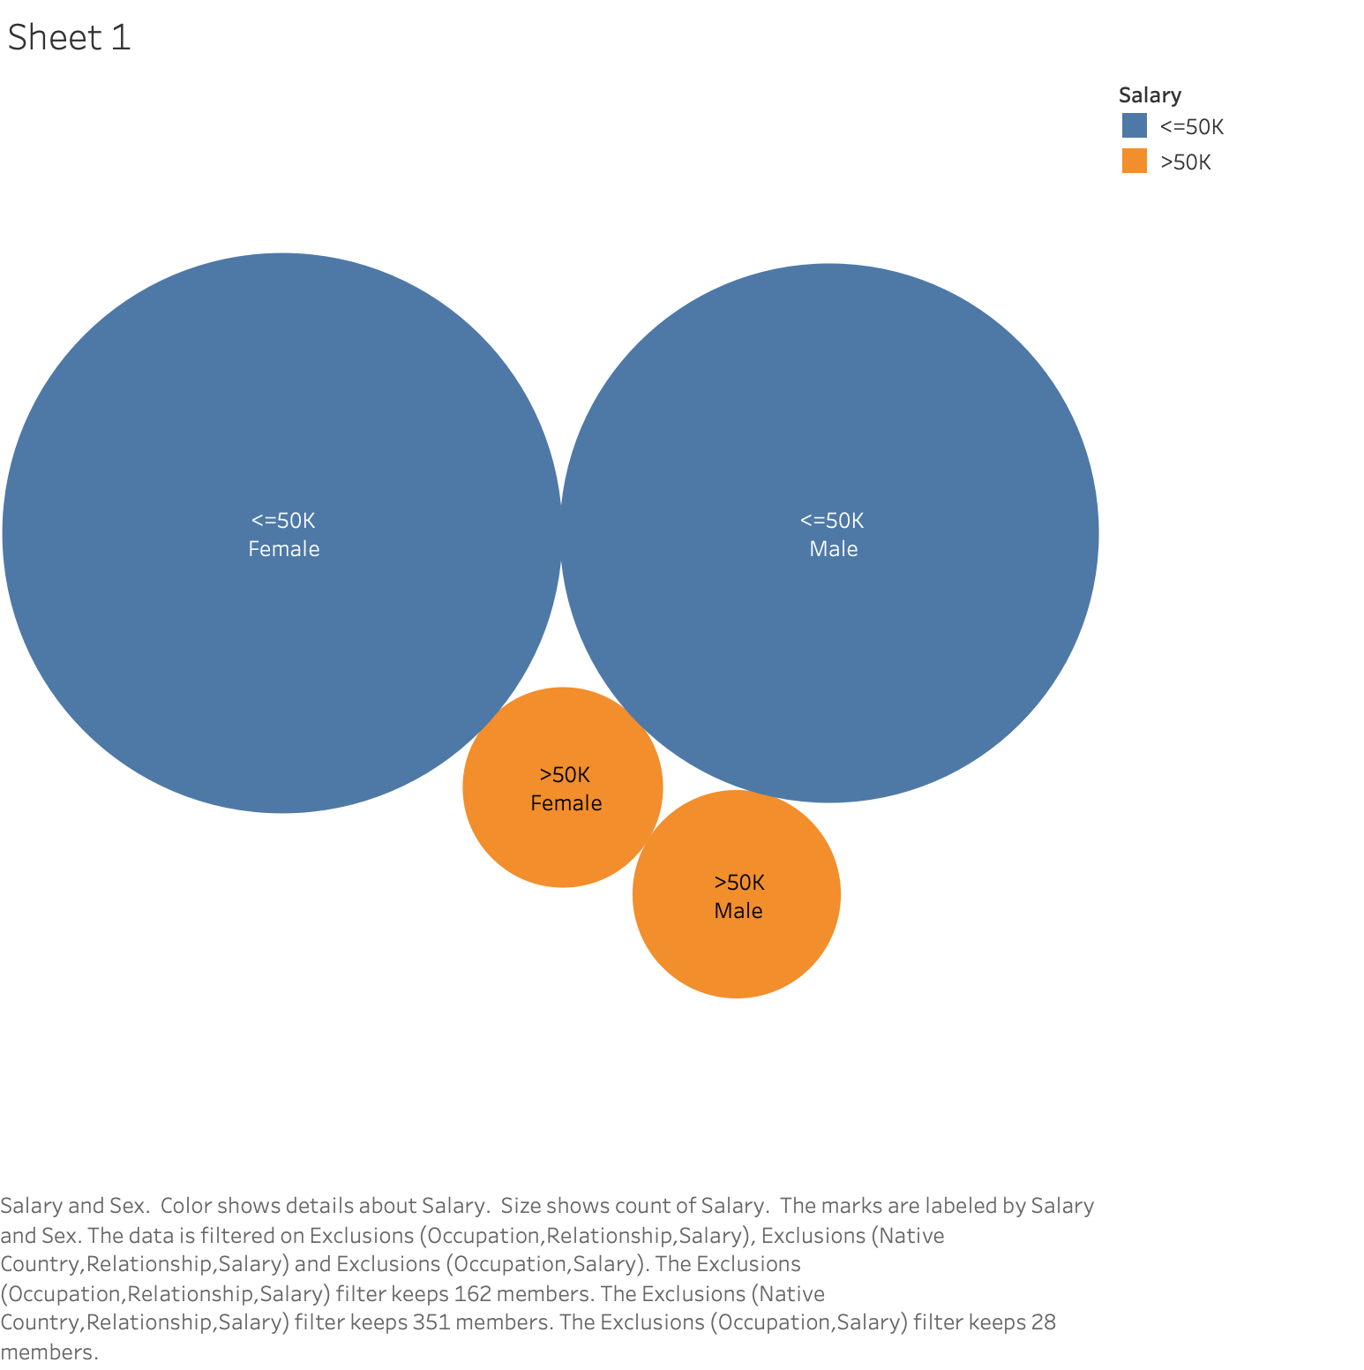

Slide 20
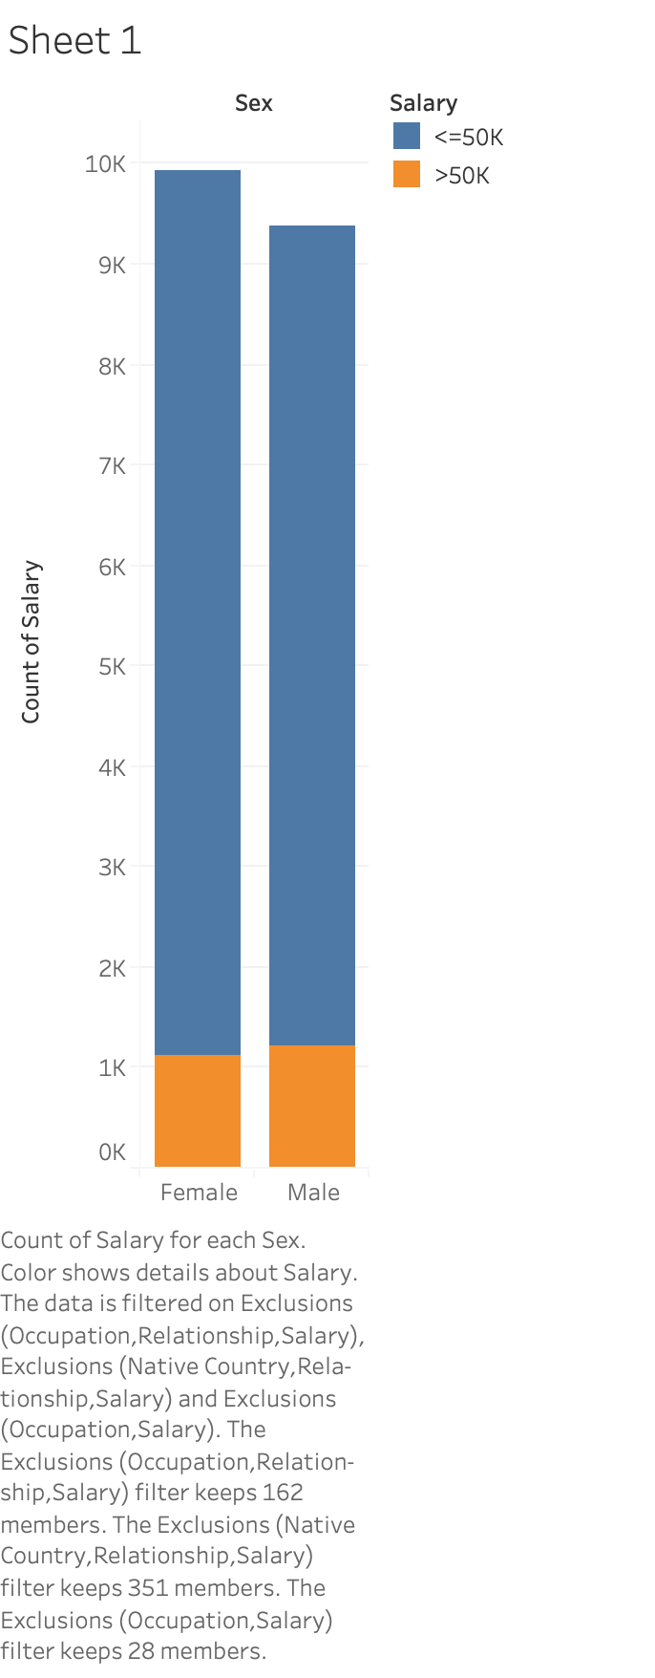

Slide 21
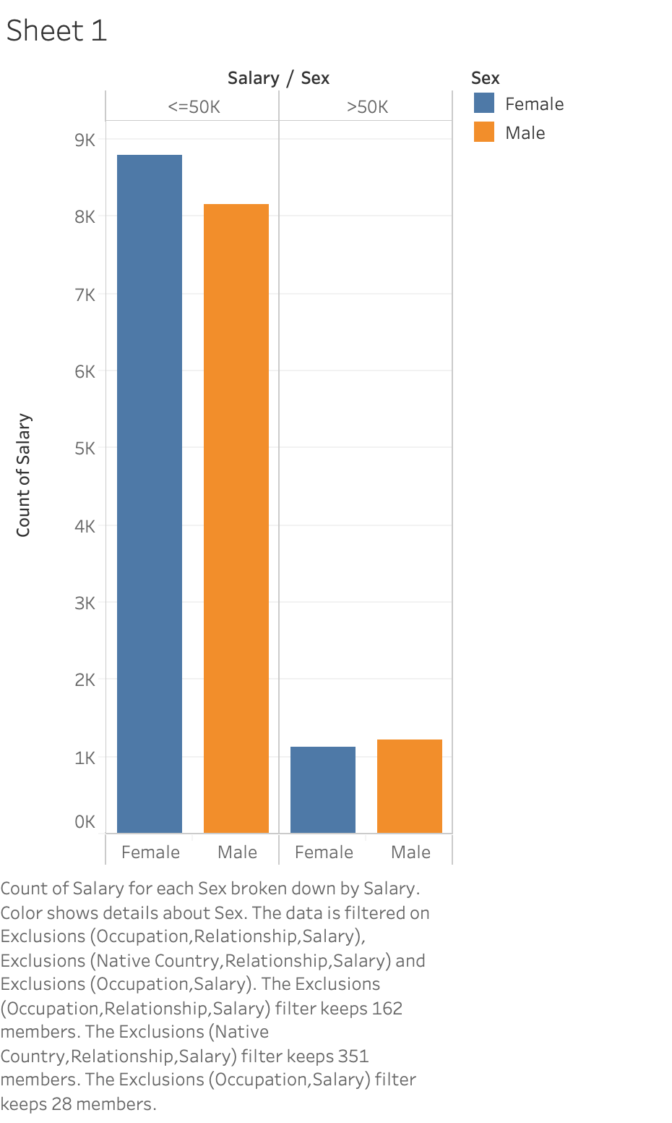

Slide 22
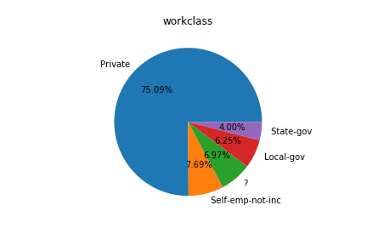
Work class
Most people are private

Slide 23
