Slide 1


Introduction to the summer school mini-app code
Vasileios Karakasis
Swiss National Supercomputing Center (CSCS)
Slides prepared by Ben Cumming

Slide 2
Overview
What is a mini-app?
An overview of our mini-app
First look at the code.
Run the code and visualize output

Slide 3
HPC Mini-Apps
Full HPC applications have complicated behavior
diﬃcult to model or understand performance behavior
Mini applications (mini-apps) are smaller codes that aim to characterize larger applications
typically a few hundred to a few thousand lines of code
Are simpler to test and understand than full applications
Used to test diﬀerent hardware and programming languages
Good for learning new techniques!

Slide 4
Our Mini-App
Throughout the summer school we will be using a mini-app to reinforce the lessons
During talks there will be small programming exercises to test out what you learn
Then you will get the opportunity to apply the techniques to the mini-app
We will start with a serial version that has no parallel optimizations
By the end of the course we will have several diﬀerent versions, one for each technique

Slide 5
The Application
The code solves a reaction diﬀusion equation known as Fisher’s Equation
Used to simulate travelling waves and simple population dynamics
The species s diﬀuses
And the population grows to a maximum of s=1

Slide 6





Initial and boundary conditions
The domain is rectangular, with ﬁxed value of s=0 on each boundary, and a circular region of s=0.1 in the
lower left corner initially.
s=0
x-width =1
s=0
s=0
s=0.1
s=0

Slide 7
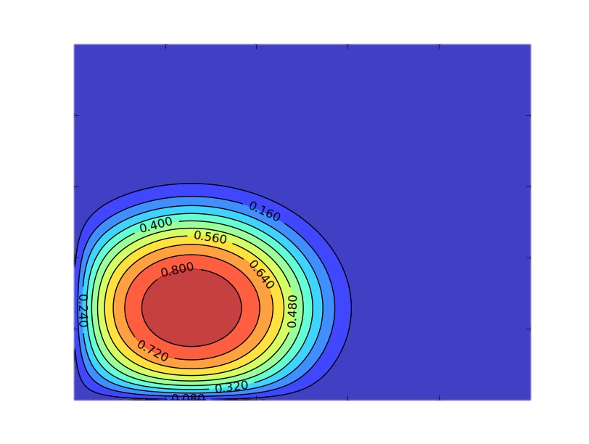
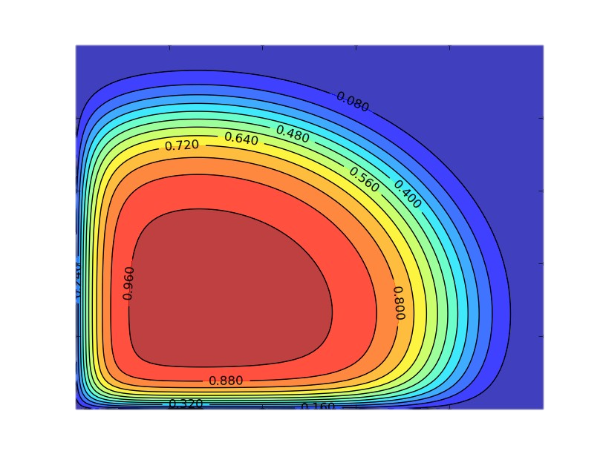
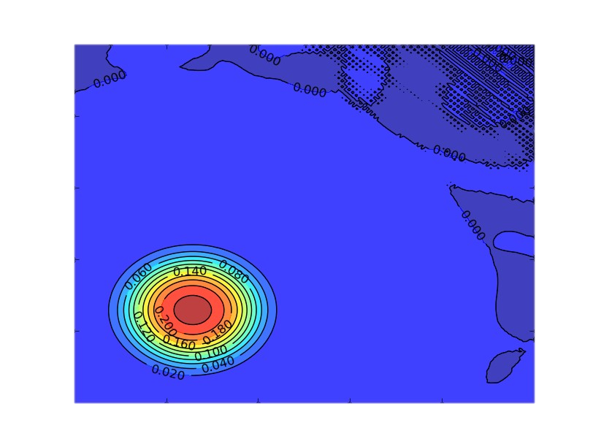
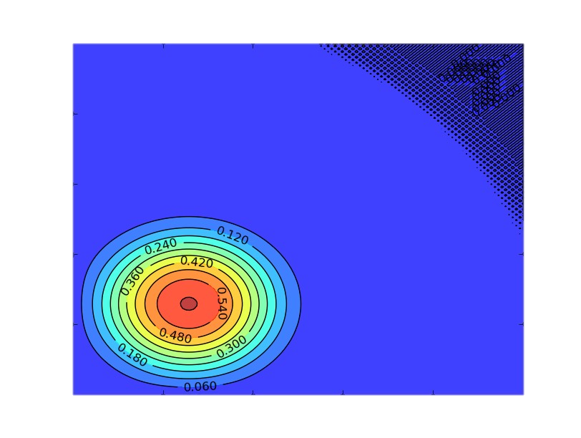


Time Evolution of Solution
t=0.005
t=0.003
t=0.001
t=0.01
For most cases we will run the solution until t=0.01.
- Long enough for something interesting to happen
- Will clearly show if there is a problem

Slide 8
Numerical Solution
The rectangular domain is discretized with a grid of dimension nx*ny points
A ﬁnite volume discretization and method of lines gives the follow ordinary diﬀerential equation for each grid point
Which we can express as the following nonlinear problem…

Slide 9
Numerical Solution
One nonlinear equation for each grid point
together they form a system of N=nx*ny equations
Solve with Newton's method
Each iteration of Newton's method has to solve a linear system
Solve with matrix-free Conjugate Gradient solver
Solve the nonlinear system at each time step
This requires in the order of between 5–10 conjugate gradient iterations

Slide 10
Don’t worry if you don't understand it all!
We don’t need a deep understanding of the mathematics or domain problem to optimize the code
I often work on codes with little domain knowledge
The mini-app has a handful of kernels that can be parallelized
And care was taken when designing it to make parallelization as easy as possible
So let’s look a little closer at each part of the code

Slide 11
The Code
There are two versions of the code
– C++
Fortran90
Both codes have the same structure
Pick whichever version you are most comfortable with
The code could be faster
Fortran version is faster than the C++ version
We avoided aggressive optimization to make it as easy as possible to understand.
Neither are they ﬁne examples of design, which would get in the way of understanding.
Tested with both Cray, GNU, Intel and PGI compilers

Slide 12


Code Walkthrough
There are three modules of interest
main.f90/main.cpp : initialization and main time stepping loop
linalg.f90/linalg.cpp : the BLAS level 1 (vector-vector) kernels and conjugate gradient solver
operators.f90/operators.cpp : the stencil operator for the ﬁnite volume discretization
the vector-vector kernels and diffusion operator are the only kernels that have to be parallelized

Slide 13
Linear algebra: linalg.f90/cpp
This ﬁle deﬁnes simple kernels for operating on 1D vectors, including
dot product : x•y : ss_dot
linear combination : z=alpha*x + beta*y : ss_lcomb
The kernels of interest start with ss_xxxxx
ss == summer school
For each parallelization approach that we will see (OpenMP, MPI, CUDA, ... etc), each of these kernels will have to be considered.

Slide 14


Stencil operator: operator.f90/cpp
This ﬁle has a function/subroutine that deﬁnes the stencil operator
interior points
for j=2:ydim-1
for i=2:xdim-1
end
end

Slide 15









































Stencil: Interior Grid Points
interior points have all neighbours available
interior points
for j=2:ydim-1
for i=2:xdim-1
end
end

Slide 16


































Stencil: Boundary Grid Points
boundary points are missing
1 or 2 neighbours
create 4 halo buffers, that hold "ghost" buffers
bndN, bndE, bndS, bndW
east
boundary
i=xdim
for j=2:ydim-1
si+1,j
bndE_{i}
end

Slide 17


Testing the code
Get the code, by checking it out from github
> git clone https://github.com/eth-cscs/SummerSchool2017.git > cd SummerSchool2017/miniapp/serial > ls cxx fortran
> | cd | cxx | I | choose | the | C++ | version | here
Compile and run
> make
> srun -Cgpu --reserv=summer –n1 ./main 128 128 100 0.01 yes

Slide 18
Testing continued...
Compile
> make
It is possible to choose parameters that will make
Run
the simulation fail to converge! The code should tell you gracefully that it was unable to
> srun -Cgpu –-res=summer –n1 ./main 128 128 100 0.01
the grid is 128 x 128 grid
take 100 time steps
run simulation for t=0.01
points
converge.
Or run batch job
> sbatch job.daint
... when job is finished ...
> cat job.out
increasing resolution increasing
the spatial may require the number of
time steps

Slide 19
Exercise
Compile using the cray programming environment.
– get time to solution for, note time to solution and total conjugate iterations in each case
• 128 128 100 0.01
• 256 256 200 0.01
• 1024 1024 ??? 0.01
Recompile using the GNU programming environment
– this will require make clean to remove previous build:
> module swap PrgEnv-cray PrgEnv-gnu
> make clean
> make
– rerun tests above and compare time to solution and the number of conjugate iterations for each case

Slide 20
Output
The number of conjugate gradient iterations, which should always be constant for a given mesh size and time parameters.
Can be used to check that changes to the code are still getting the correct result. There will be small variations due to the imprecise nature of floating point operations.
============================================================== Welcome to mini-stencil!
version :: C++ serial
mesh :: 128 * 128 dx = 0.00787402
time :: 100 time steps from 0 .. 0.01
iteration :: CG 200, Newton 50, tolerance 1e-06
==============================================================
step 1 required 4 iterations for residual 7.22702e-07
step 2 required 4 iterations for residual 7.96536e-07
...
step 99 required 11 iterations for residual 9.7171e-07
step 100 required 11 iterations for residual 9.76976e-07
--------------------------------------------------------------
simulation took 1.04899 seconds
7714 conjugate gradient iterations, at rate of 7353.72 iters/second
871 newton iterations
--------------------------------------------------------------
Goodbye!
time to solution
best way to compare different implementations

Slide 21

Visualize the answer
The application generates two data ﬁles with the ﬁnal solution: output.bin and output.bov
There is a Python script that will show a contour plot of the solution
> ls output.* output.bin output.bov
requires X-windowing
make sure you connect with "ssh -Y"
> /path/to/summerschooolrepo/scripts/plot.sh
> display output.png

Slide 22
Exercise
Visualize the output from the previous exercise
– now is a good time to see if X-windows is working!
If that worked properly, try visualizing output from diﬀerent ﬁnal times
– srun -Cgpu --res=summer -n1 ./main 128 128 100 0.0025
– srun -Cgpu --res=summer -n1 ./main 128 128 100 0.005
– srun -Cgpu --res=summer -n1 ./main 128 128 100 0.01

Slide 23
Questions?
You will become more familiar with the mini-app code over the summer school.

