Slide 1
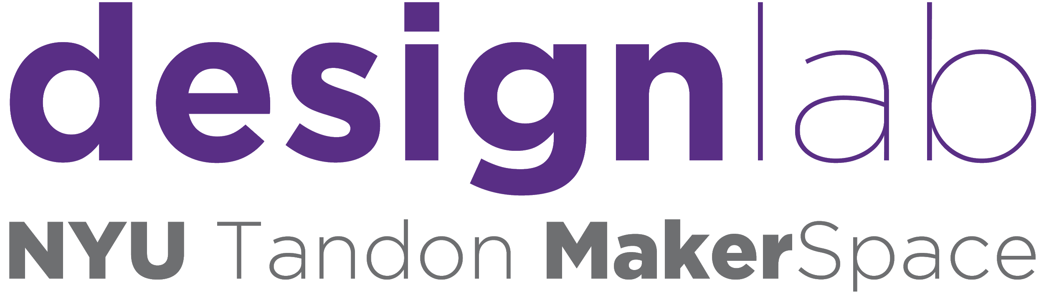
Workshop Promotion Strategy and
Fall 2020 Performance
Pooja Shah | Forum Doshi | Vivek Karicheti | Pranay Bihani

Slide 2
What is the MakerSpace Design Lab?

Slide 3
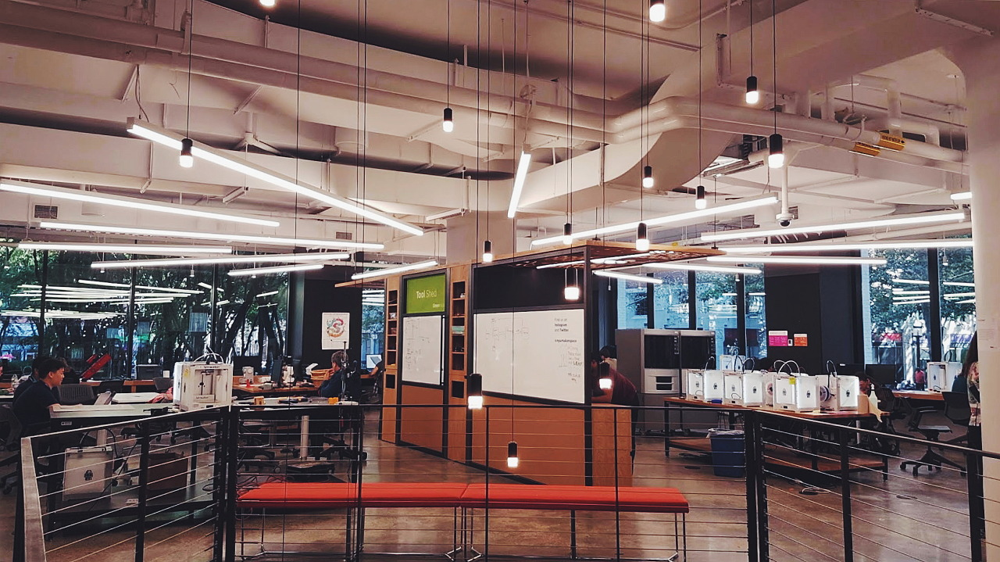

Slide 4
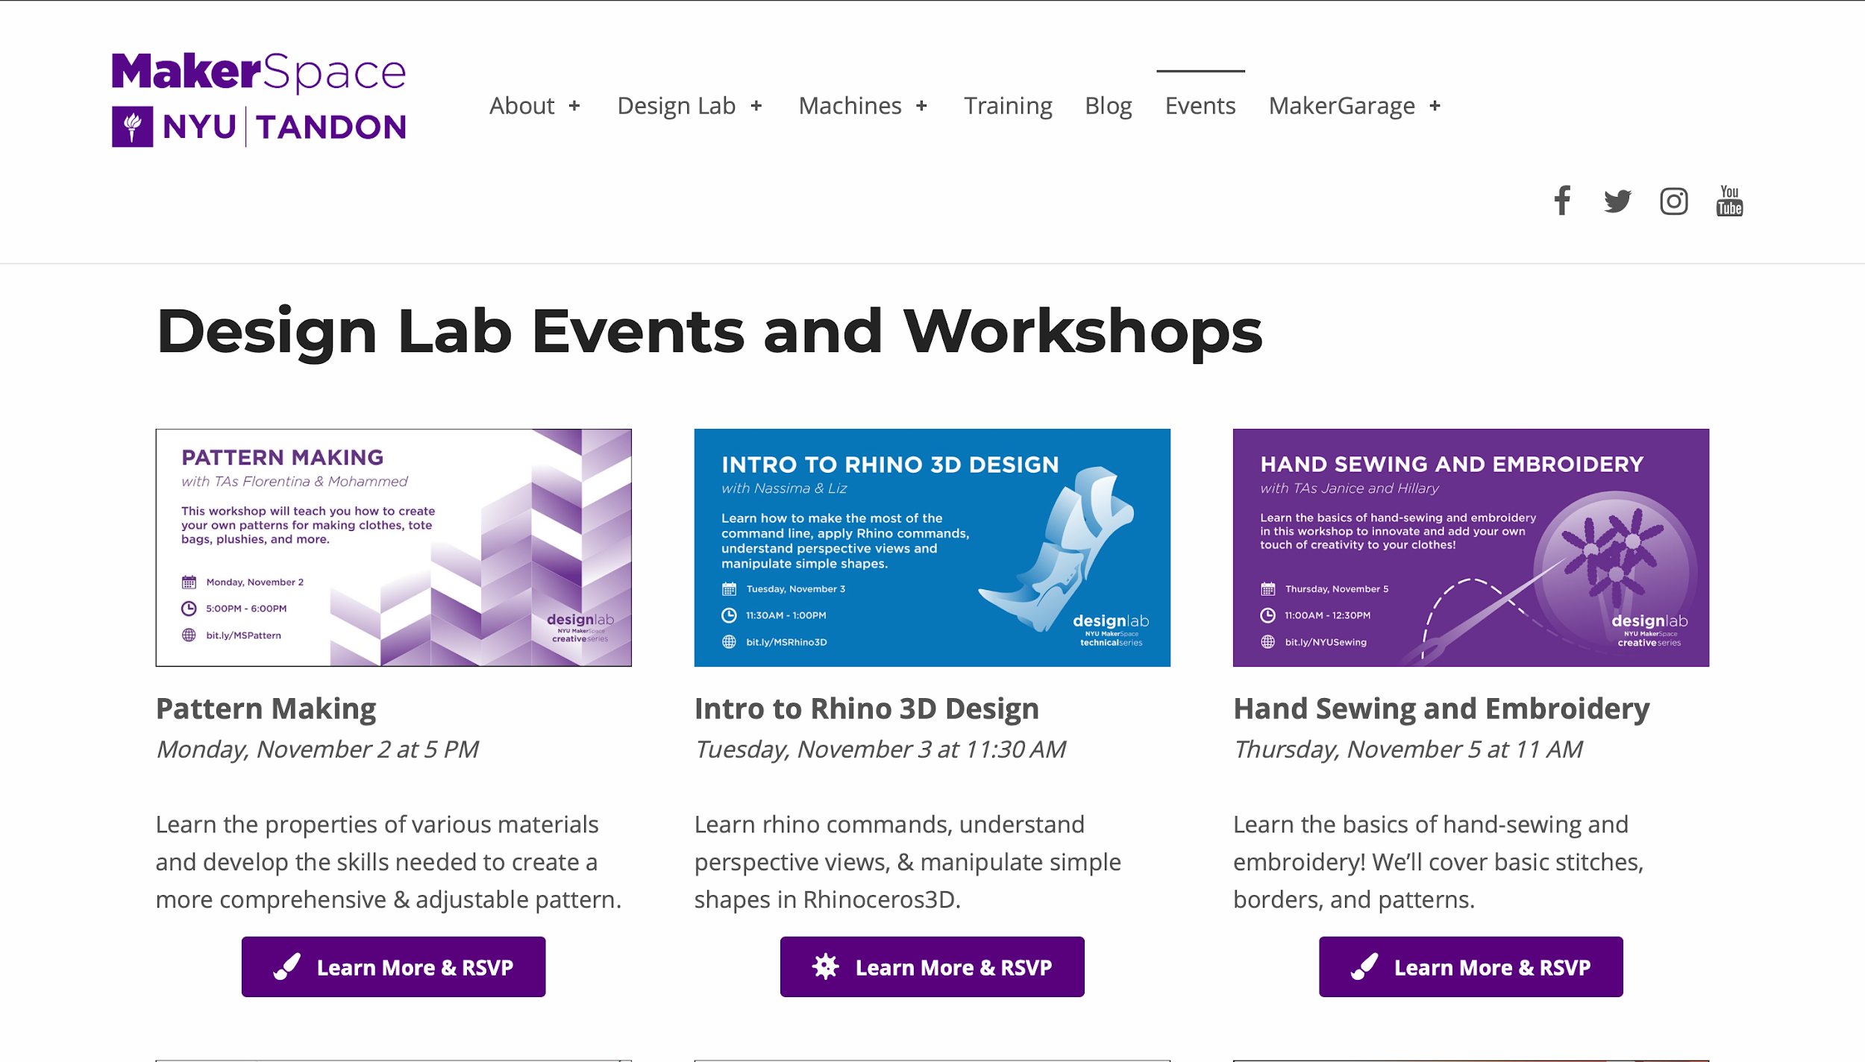

Slide 5

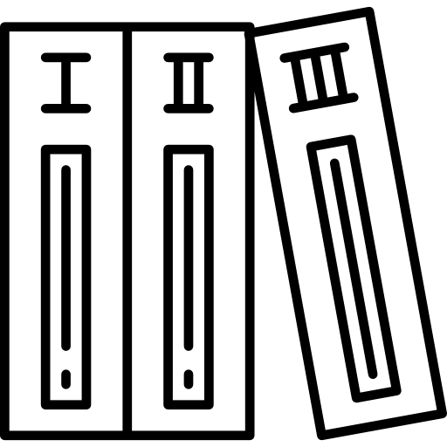


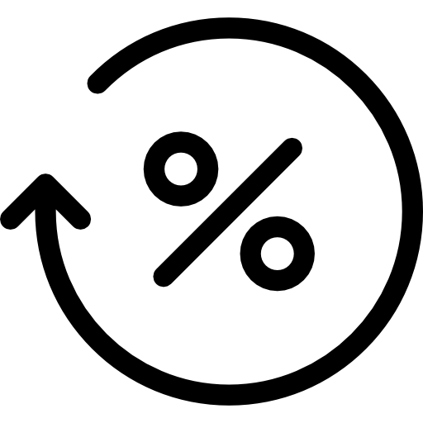
Executive Summary - Fall 2020
The MakerSpace Design Lab by Numbers
44
Workshops
6
Series
849
Participants
2036
Sign Ups
42%
Participation Rate
The NYU MakerSpace is a prototyping lab located at the Tandon School of Engineering in Brooklyn, NY. It offers workshops to students to build their technical skills and discuss topics related to engineering, technical software, sustainability, creativity, and design.

Slide 6
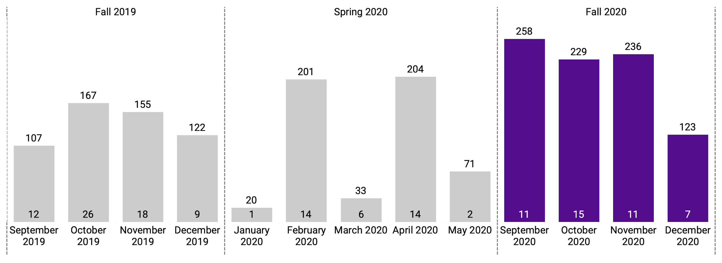
COVID-19 and Workshops
Online Workshops: Boon or Bane?
The number of participants has risen with the shift from in-person workshops to online workshops.
Notes:
It would be recommended to pursue hybrid workshop opportunities in a time after COVID-19 to maintain high levels of engagement.

Slide 7
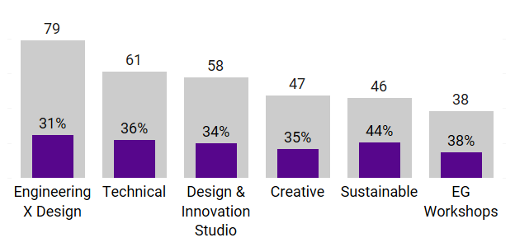
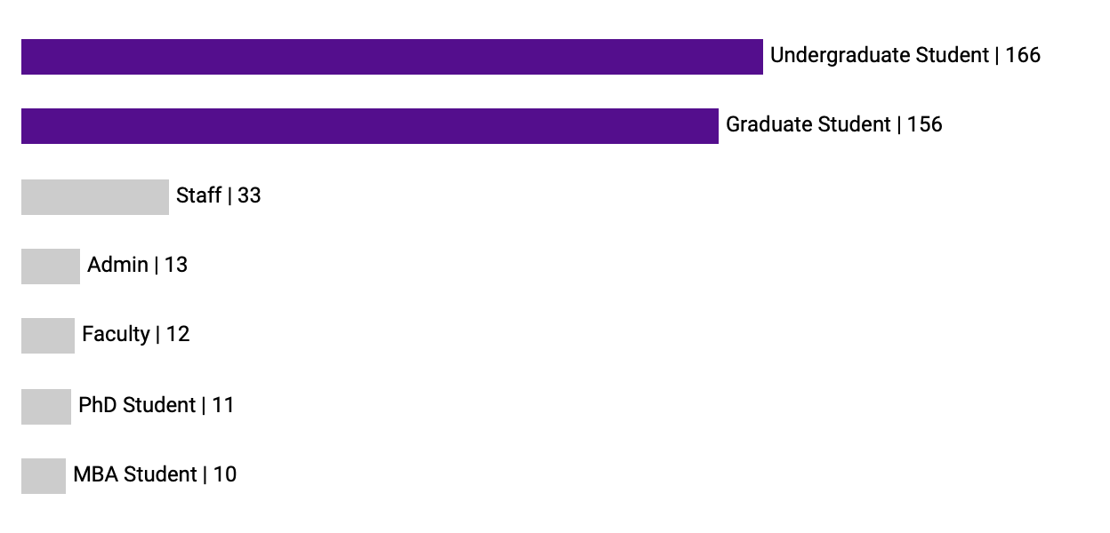
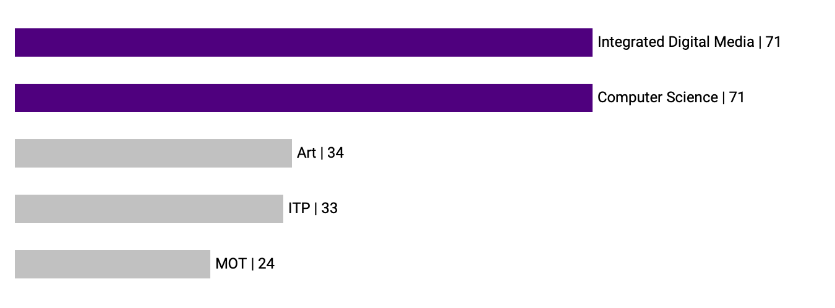
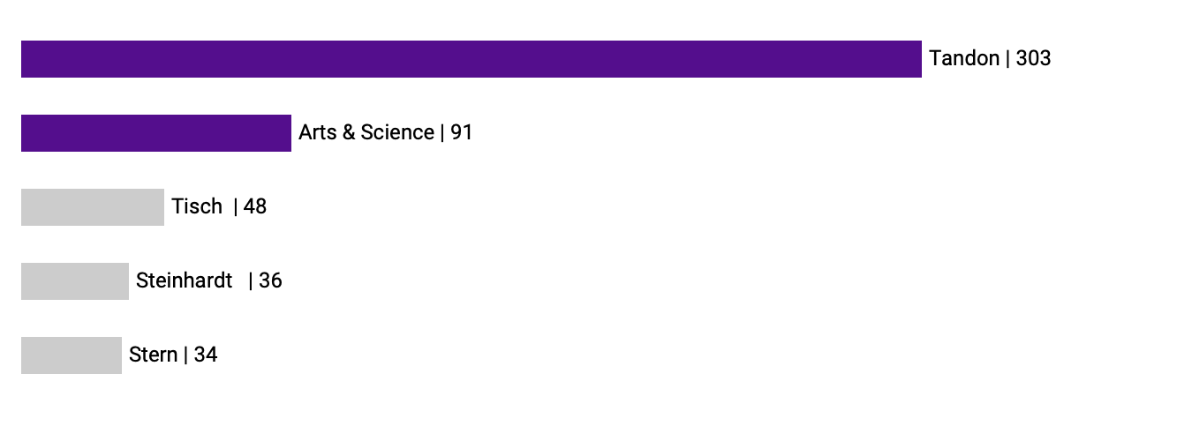
Demographics
Who are our participants?
Average Participation by Average Sign Ups
Participation by NYU Affiliation
Participation by NYU Major
Participation by NYU School

Slide 8
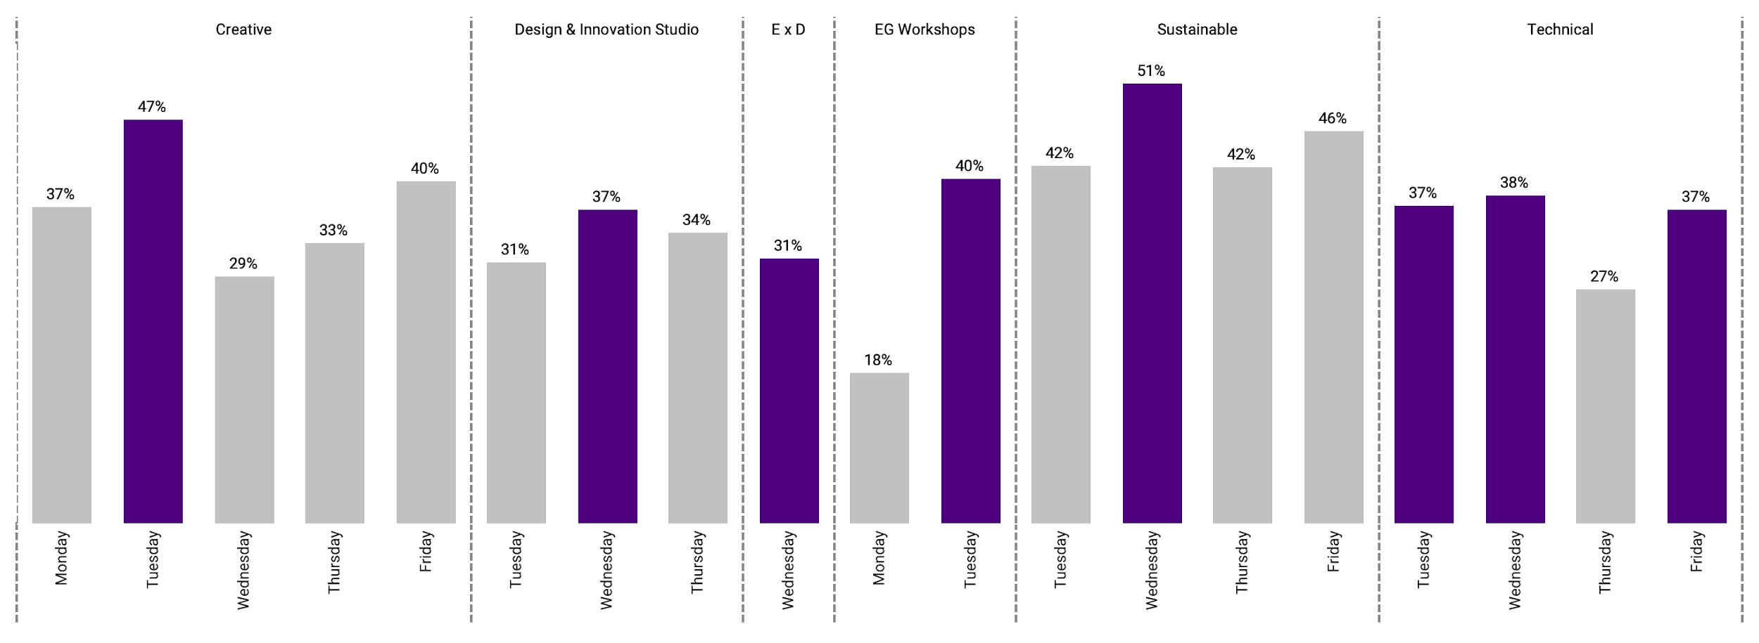
Day-Series Breakdown for Participation Rate
Which days are best for participation?
Participation Rate
Sustainable workshops see the highest participation rates on Wednesday as compared to all others.
Tuesdays and Wednesdays seem to be the best days for higher participation rates across all series.

Slide 9
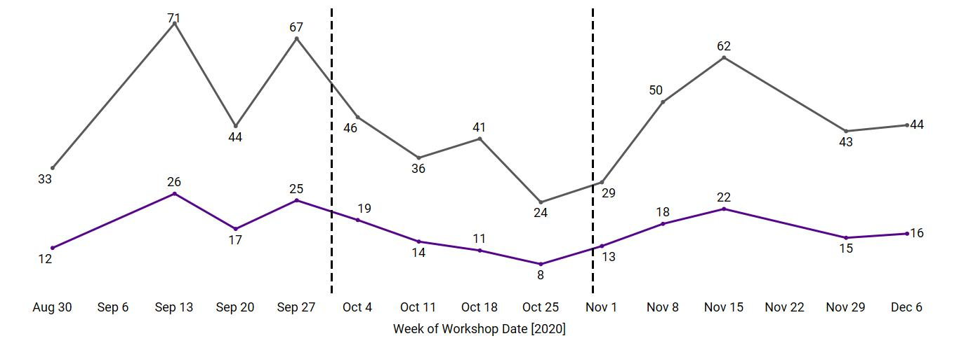
Month-Wise Participation Comparison
Why did performance drop in October?
11 Workshops in September
15 Workshops in October
11 Workshops in November
Decrease in Sign Ups and Participation in October 2020
Average
Sign Ups
Decrease in Sign Ups and Participation in October 2020
Average Participation
October saw the least participation, but also had the most workshops. The dip in participation can be associated with the occurrence of mid semester exams.

Slide 10
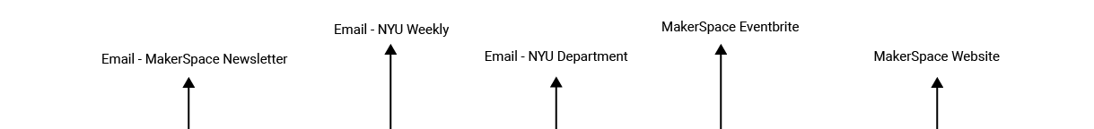
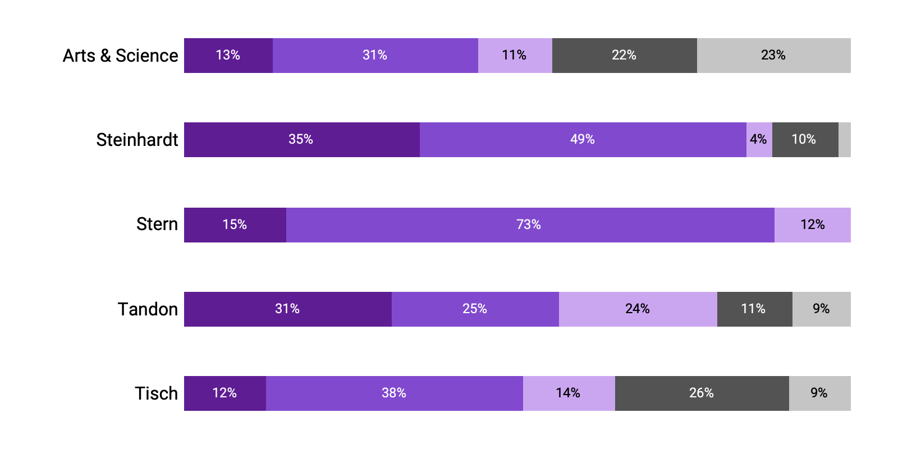
Top 5 Promotion Channels Based on School
What is the best form of communication?
A comparison of participation based on different medium of event marketing reveals that emails are the most effective. Different schools see some channels working better than others.

Slide 11
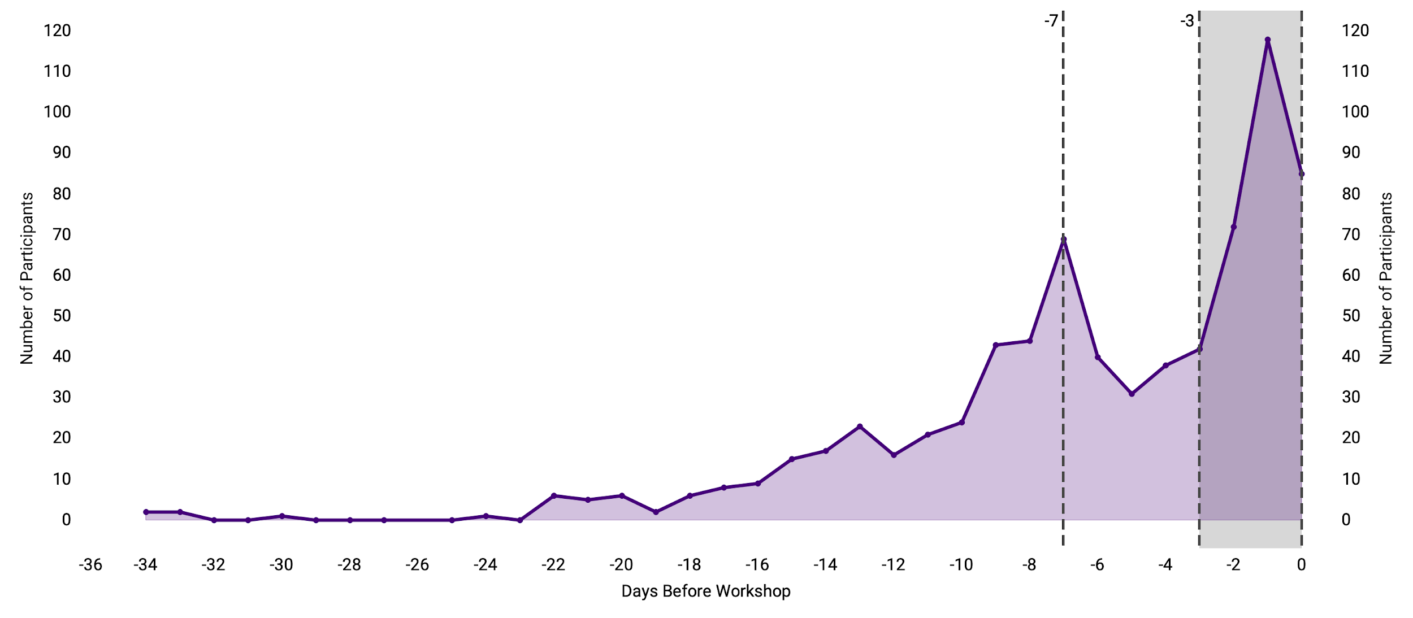
Correlation between Order Date and Workshop Date
When do participants like to sign up?
Participants are most likely to sign up for workshops either 7 days prior to the workshop, or in the last 3 days leading up to it - including the same day of the workshop.

Slide 12
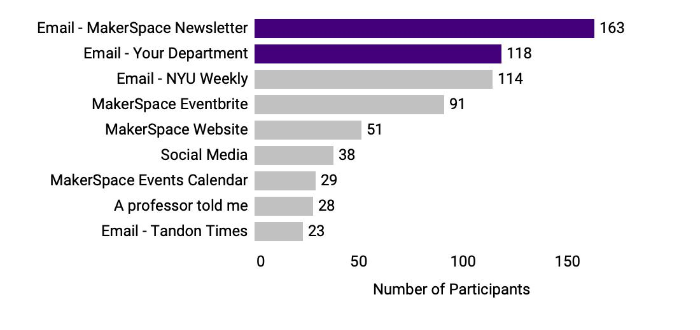
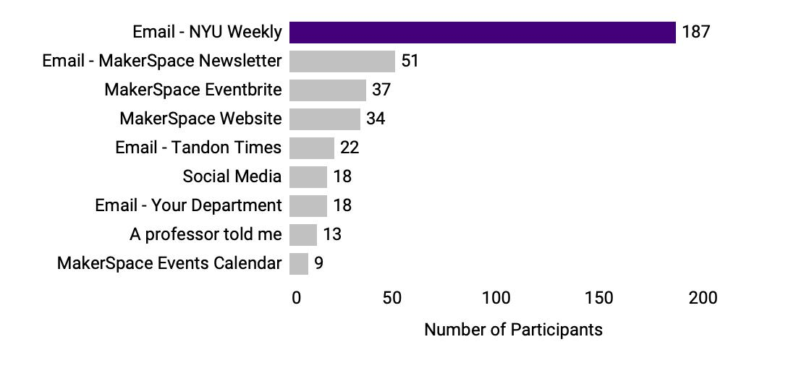
Digging Deeper into Promotion Channels
How must we time our communication?
Before the last 3 days leading up to the workshop
During the last 3 days leading up to the workshop
Different promotion channels are efficient to attract participants based on the day leading up to the workshop. The NYU Weekly newsletter is the most efficient in the last 3 days, but the MakerSpace email newsletter, and the department emails are most efficient prior to the last 3 days.

Slide 13




Summary of Recommendations
What can we do to promote future workshops?
01
02
03
04
Encourage hybrid workshops post COVID-19 to maintain high levels of participation.
Tuesdays and Wednesdays seem to be the best days to get a high participation rate.
Workshops during the month of midterms must be reduced in order to allocate resources more efficiently.
Workshops must be promoted via email to attract the most number of participants.

Slide 14
Appendix

Slide 15
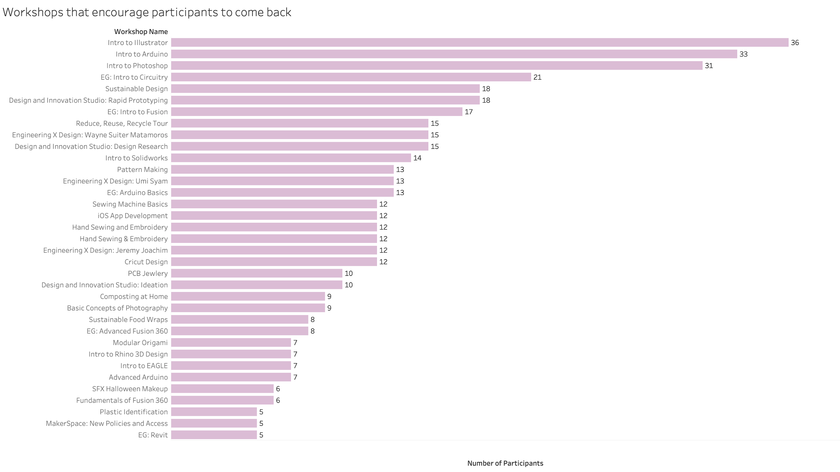
Repeated Participants
What workshops bring students back?
Participants that have attended more than one workshop have attended Intro to Illustrator, Arduino, and Photoshop the most. The format and topic of these workshops seem to reduce churn rate.

Slide 16

What is the MakerSpace Design Lab ?

Slide 17
Rules
Formatting Rules
HEX c50f3c
HIGHLIGHT COLOR
57068c
PRIMARY COLOR
SECONDARY COLOR
TERTIARY COLOR - FOR LINES AND BORDERS
Formatting:
ROBOTO
Chart - 9(axis), 14(reference lines, data labels) , black
Slides - 14, 18, black. Add NYU logo on top right
Remove titles from all charts
Exclude analysis for ‘other’ series of workshops

