Slide 1

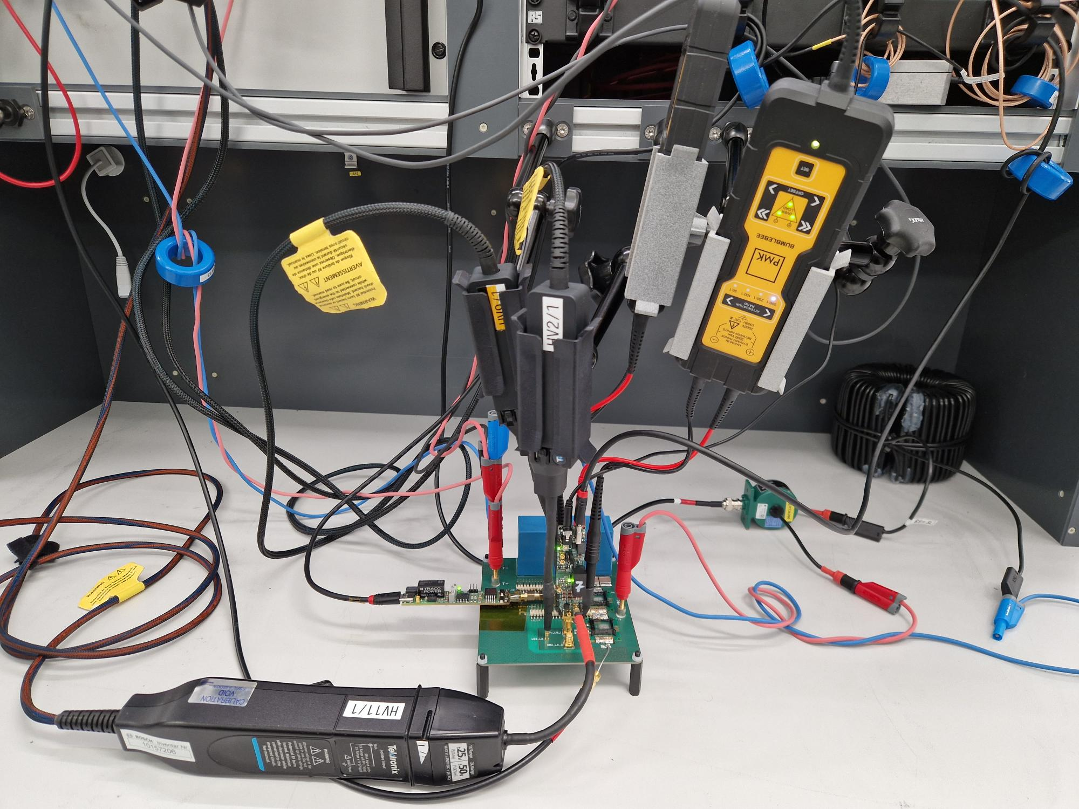
Institute of Electrical Energy Conversion
Hardware Implementation of Gate-Current Optimization Techniques for Switching Loss and Electromagnetic Emission Reduction in SiC MOSFETs
Karthikeyan Vijayakumar, 05.02.2026,
Master Thesis, M.Sc. Electrical Engineering.
Supervisors - Jochen Streit, M.Sc. (Robert Bosch GmbH), Ole Bauer, M.Sc.
Examiners - Jun.-Prof. Dr.-Ing. Stefan Mönch, Prof. Dr.-Ing. Ingmar Kallfass

Slide 2
Background
Fixed Gate resistance driving
Modern power electronics applications demand converters to operate
High efficiency (reduced losses)
High blocking voltage capability
High power density
Solution : transition from bipolar Si technologies e.g., IGBTs to unipolar WBG devices, SiC and GaN MOSFETs.
MOSFET switching speed
Traditional methodology in industry
Using fixed R_{G} driving
Start with a low R_{G} value (e.g., 1 Ω) and increase it until EMC/EMI compliance (e.g., CISPR 25) is met.
Slow
Fast
Higher switching loss
Higher dv/dt and di/dt lead to EME

Slide 3
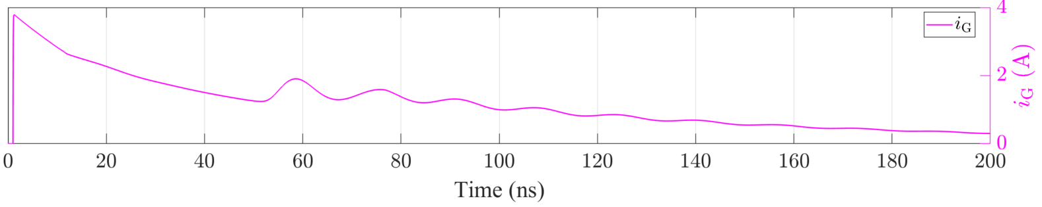
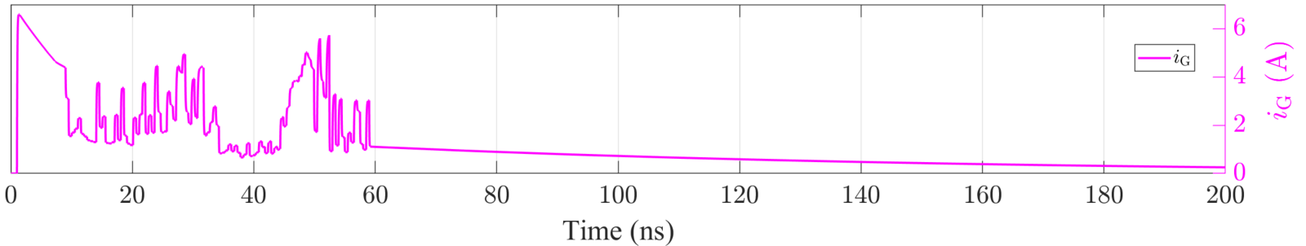
Problem
MOSFET switching speed
Fixed R_{g} driving : Inefficient switching
Trade-off between switching loss and EME
Gate-charge delivery limited by a single chosen R_{g} value
Slow
Fast
Higher switching loss
Higher dv/dt and di/dt lead to EME
Solution: Active gate driving techniques (E.g. Current source gate driving)
Difficult to realize theoretically derived optimal gat current waveforms in real hardware
i_{G} waveform of Fixed R_{g} gate driving operation (Turn ON)
Example of an Optimum i_{G} waveform with respect to switching loss and EME (Turn ON)

Slide 4
Research Questions
How does existing literature define an “optimal” hard switching event in terms of switching losses and EME?
How can existing optimization algorithms be employed and tuned in simulation to derive near-optimal gate-current waveforms under practical constraints?
What technical constraints and challenges arise when implementing these optimized gate-current profiles in real-world power electronic systems?
Configuring a State-Space simulation Model for DPT simulation
Optimization of Gate Current Waveform using Genetic Algorithm
Hardware and Experimental setup
Comparison of Esw, EME between Fixed Resistance GTRs and EG120 GTR implementation
Limitations of EG120 gate driver

Slide 5
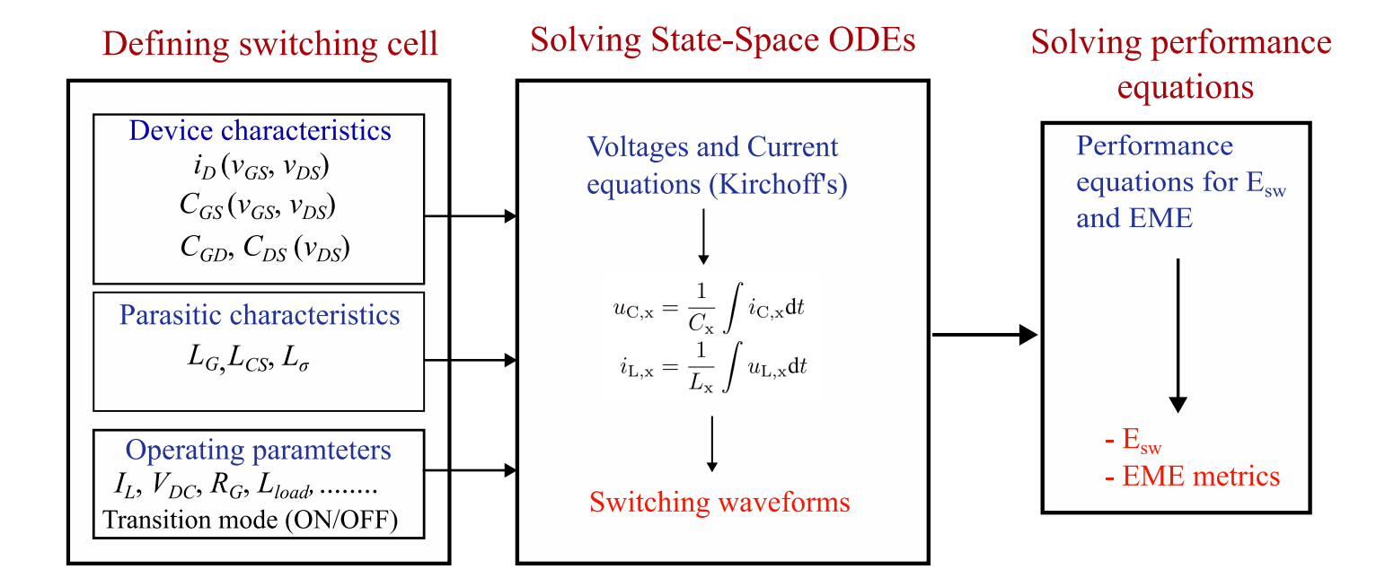
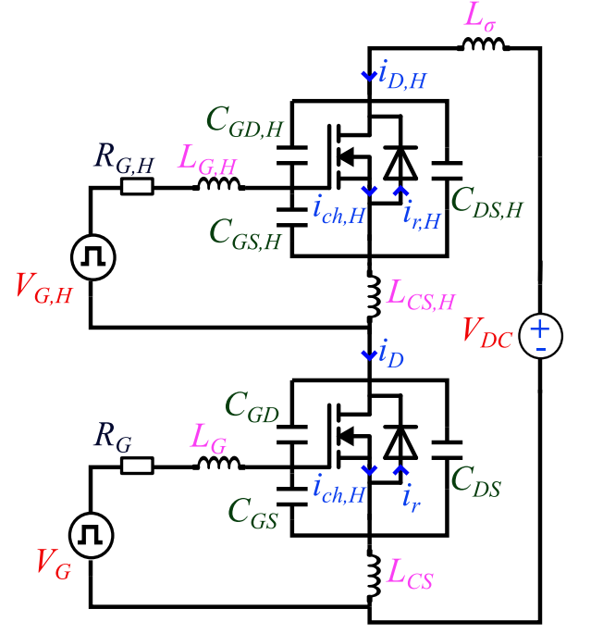
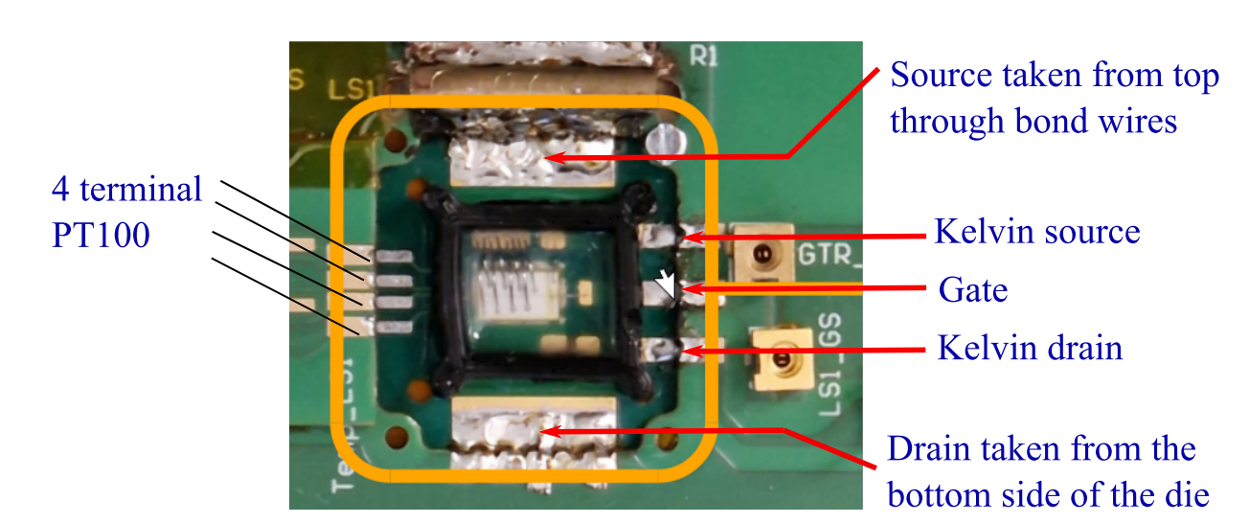

State-Space Simulation Framework
Extracting switching waveforms
Bosch State Space Simulation Model
Bosch bare-die SiC MOSFET (BT2M1200009BOA)

Slide 6
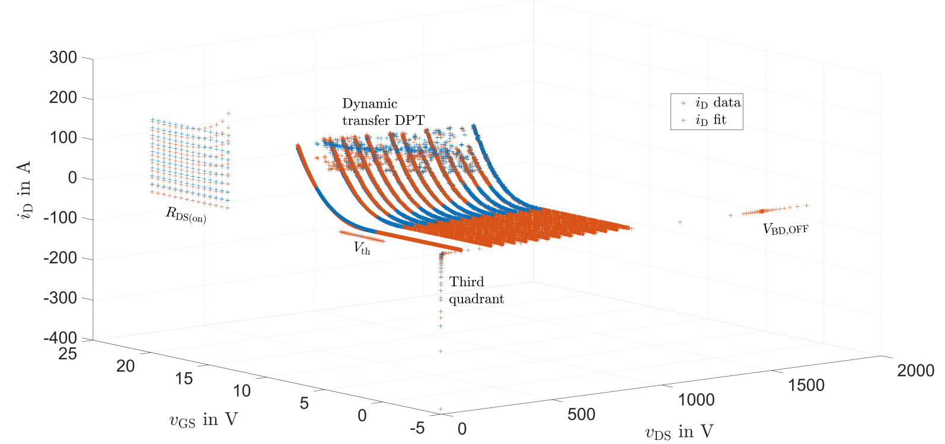
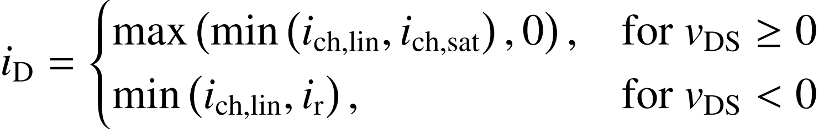
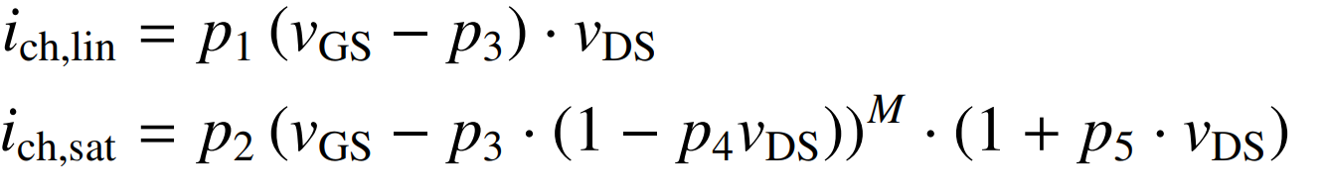
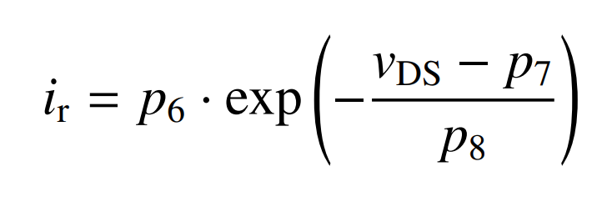
Drain current (i_{D})
State-Space Simulation Framework
Analytical curve Fit:
Using experimental data to create a mathematical equation that represents I-V characteristics of a MOSFET

Slide 7
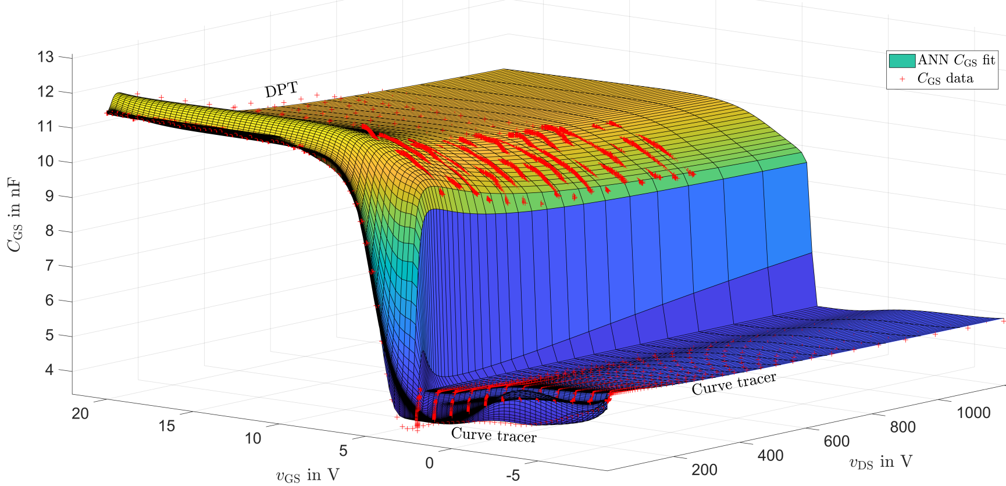
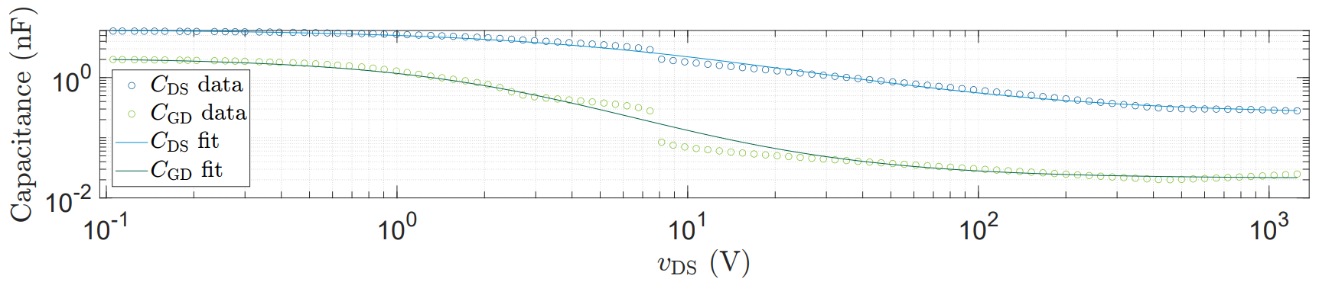
Device capacitances (C_{GS}, C_{DS}, C_{GD})
State-Space Simulation Framework
C_{GS} ANN Fit:
ANN trained iteratively on preprocessed data (v_{GS}, v_{DS} → C_{GS})
Feedforward neural network implemented using MATLAB fitrnet.
Robust fitting with bisquare weighting ensures stable convergence.
C_{DS} and C_{GD} Tanh Fit:
Tanh-based nonlinear analytical model with respect to v_{DS}.
Parameter optimization via nonlinear least-squares fitting.

Slide 8
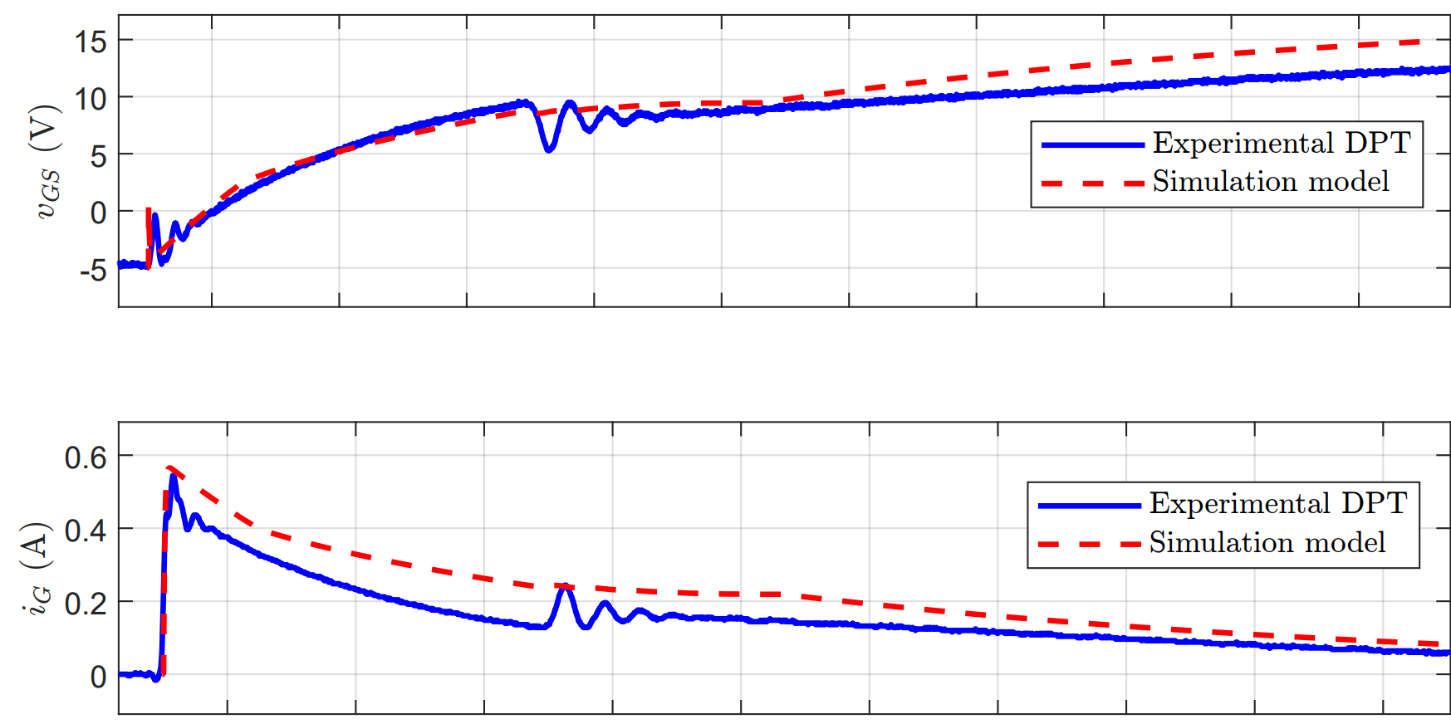
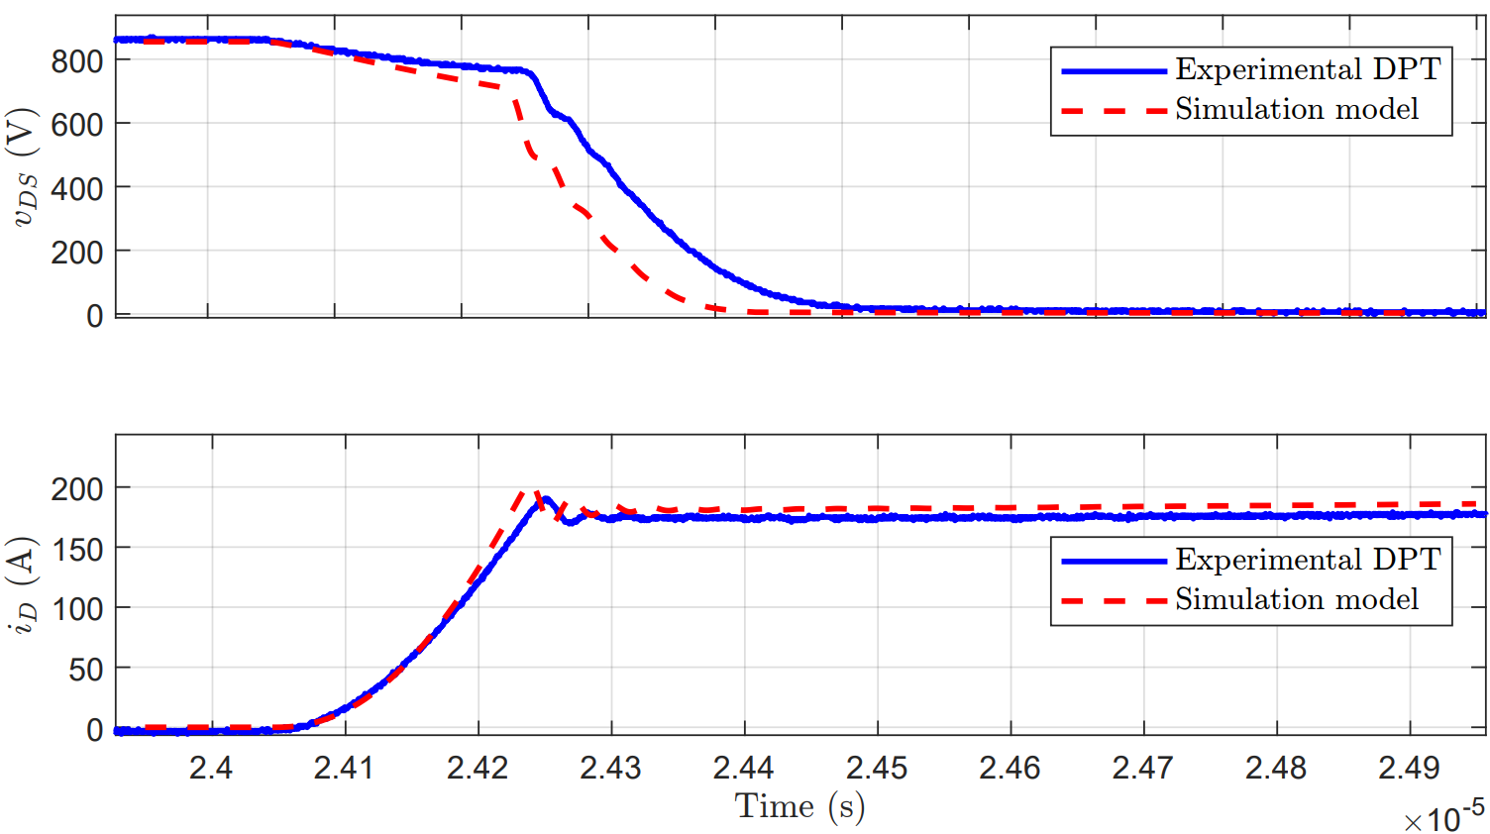
Comparison of Simulation vs Real DPT
Simulation Framework
Steeper simulated v_{DS} fall :
  inaccurate C_{GS} modeling, leading to an incorrect C_{GS}/C_{GD} (Miller ratio) and dv_{DS} /dt prediction.
v_{GS} dip during Miller plateau:
  caused by common-source inductance (L_{CS}) coupling high di_{D}/dt into the gate loop.
Smaller and oscillatory i_{G}:
  indicates unmodeled gate-loop inductance (L_{G}), causing resonance with input capacitance during v_{DS} transition.

Slide 9
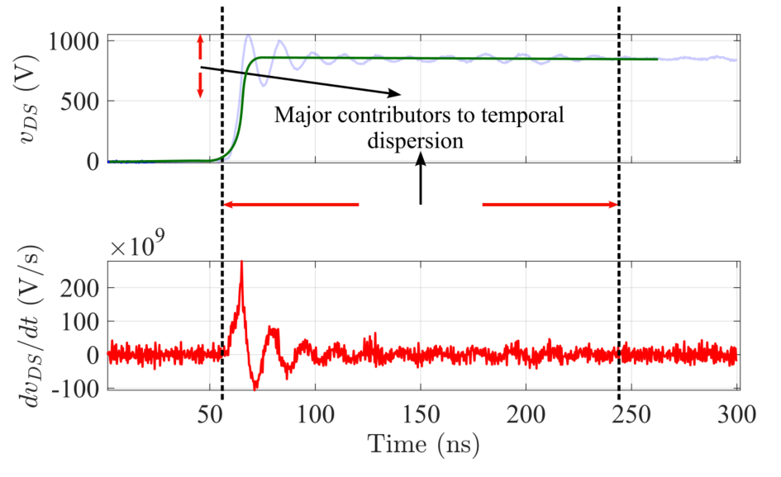
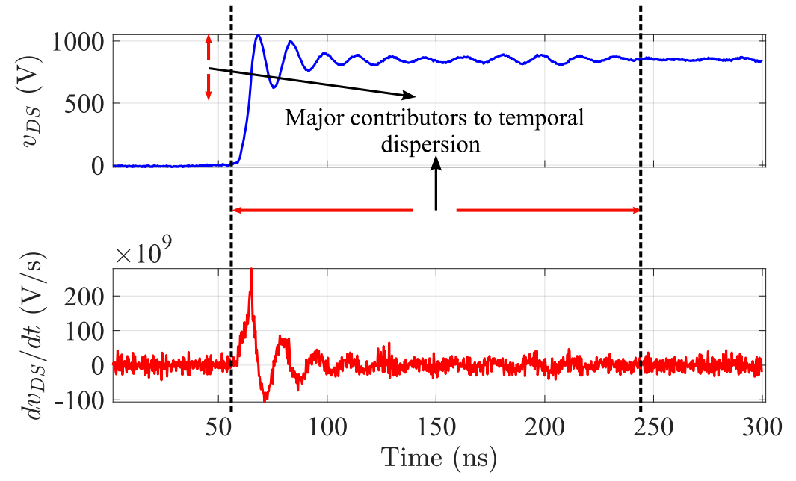
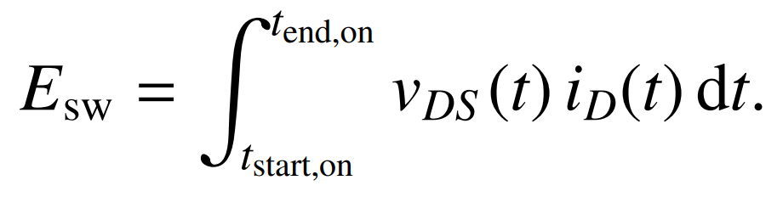
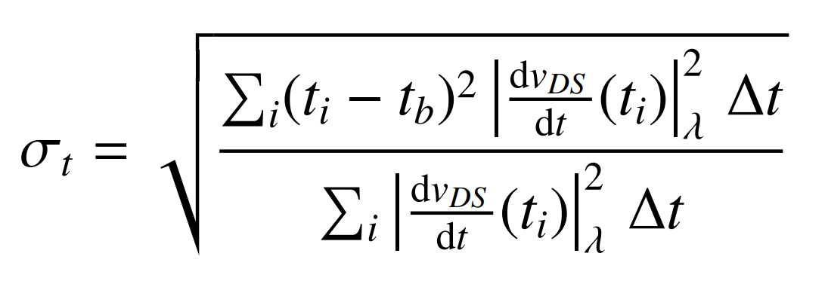
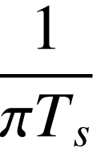
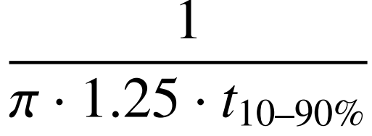
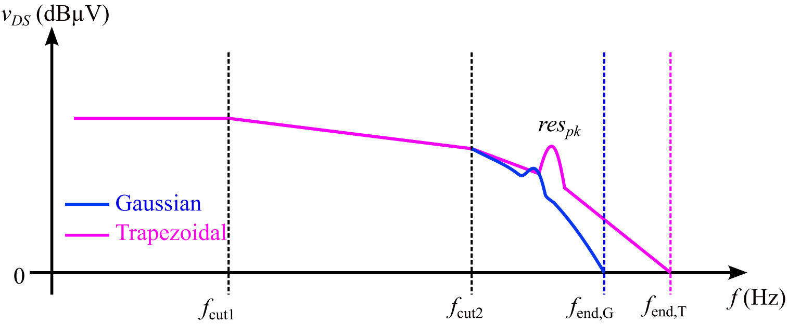
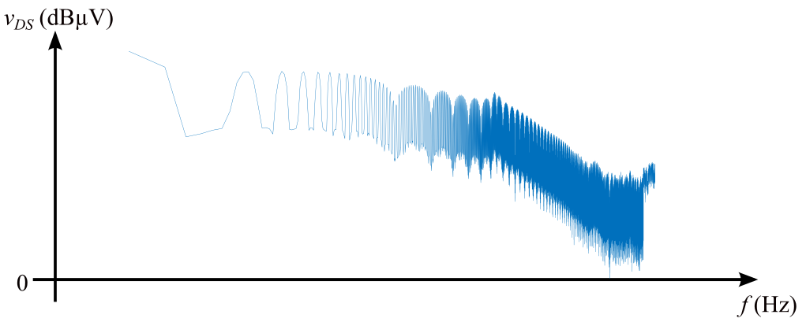
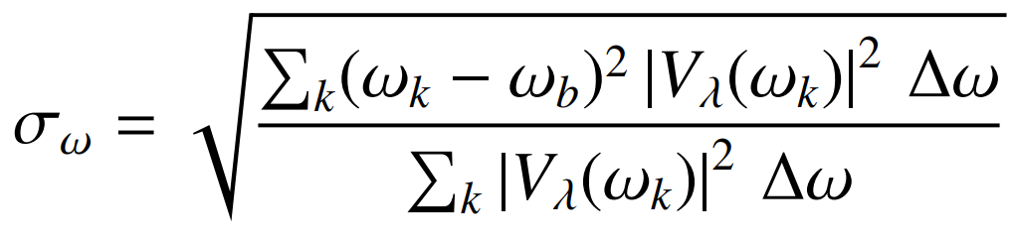
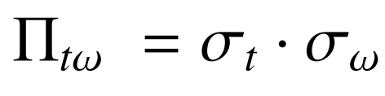
Performance equations definition
State-Space Simulation Framework
Switching loss
10% of v_{GS} to 3% of v_{DS}
EME
Total dispersion of the signal (LS v_{DS} and HS v_{DS}) in time and frequency domain.
Temporal dispersion,
Frequential dispersion,
EME FOM (HGI):

Slide 10
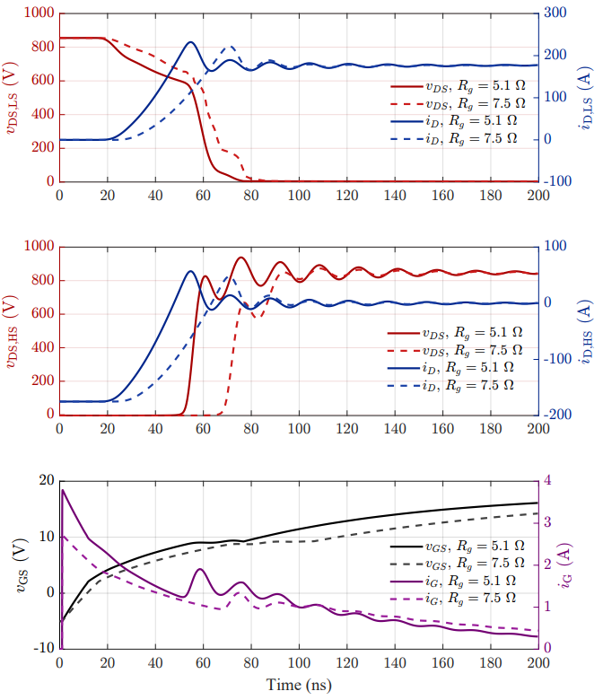
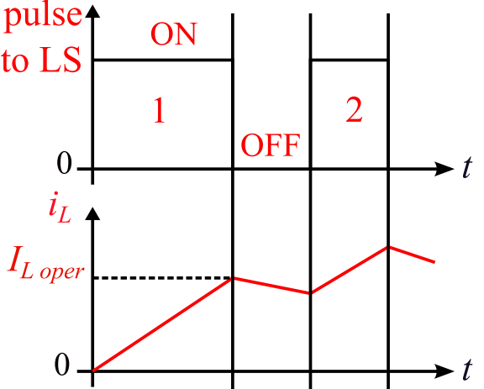
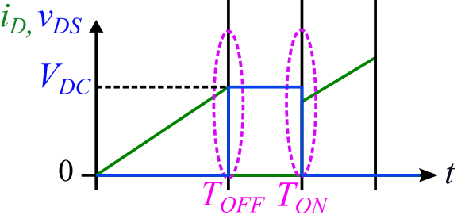
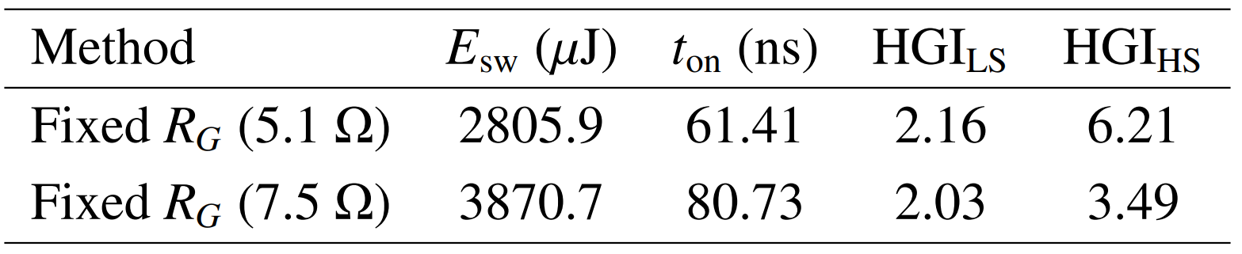
Fixed R_{G} results – 5.1Ω, 7.5Ω
Simulation Framework
Parameter | Value
L_{σ} | 20nH
R_{G,ON} | 5.1Ω / 7.5Ω
R_{G,OFF} | 15Ω
V_{DC} | 850V
I_{LOAD} | 175A
L_{LOAD} | 56µH
V_{GS,high} | 18V
V_{GS,low} | -5V

Slide 11
Flow of the thesis
Configuring a State-Space simulation Model for DPT simulation
Optimization of Gate Current Waveform using Genetic Algorithm
Hardware and Experimental setup
Comparison of performance (E_{sw}, EME) between Fixed R_{G} GTR and EG120 GTR implementation
Limitations of EG120 gate driver

Slide 12
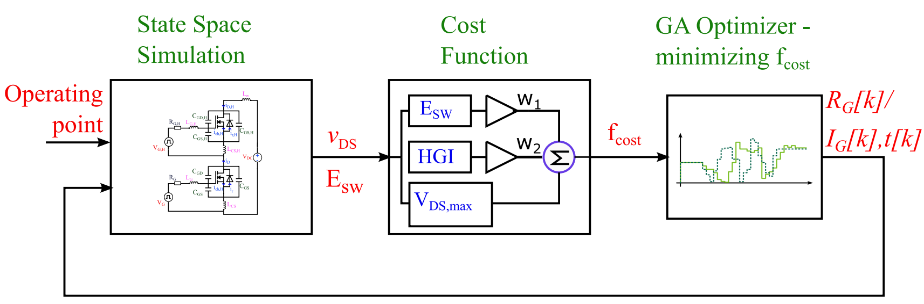
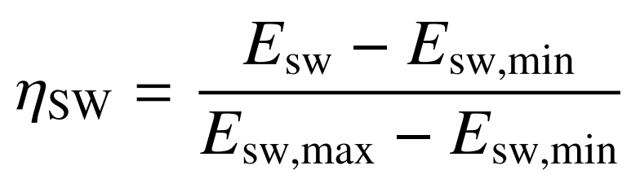
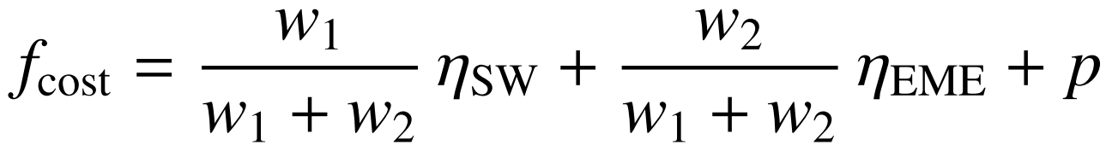
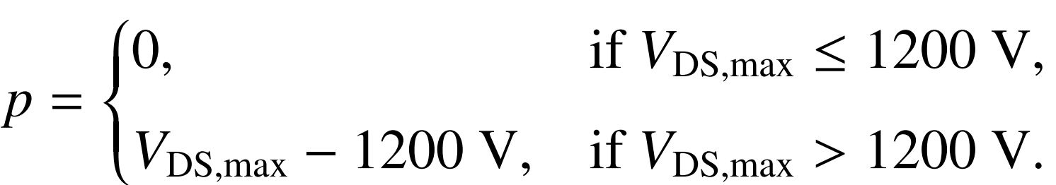
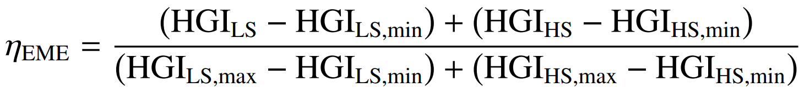
Genetic algorithm based optimization
Optimization Framework
Optimiser output
Method 1 :
Continous R_{G} profile - discretized
Method 2 :
Discrete i_{G} profile
“ga” Optimizer in MATLAB

Slide 13
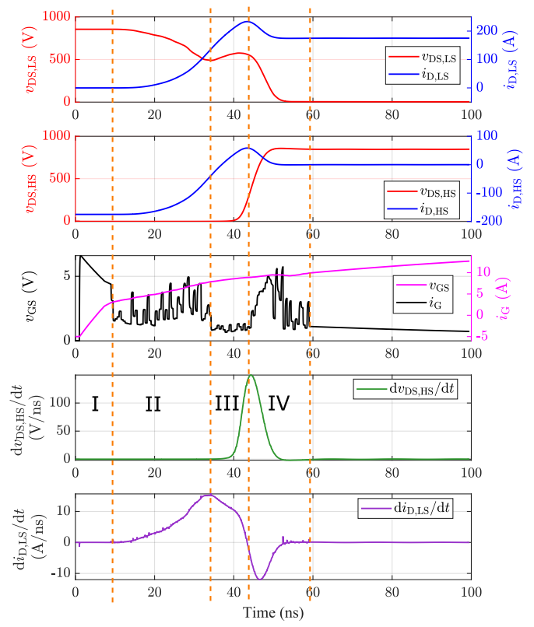
Method 1: Continuous R_{G} Profile
Optimization Framework
100 time segments over 50 ns → 100 corresponding R_{i} variables determined by the GA optimizer.
Each Rᵢ bounded by Rᵢ,min to Rᵢ,max.
E_{sw},min / E_{sw},max computed based on Rᵢ,min / Rᵢ,max.
HGI,min = 0.5 (uncertainty bound) and HGI,max obtained using MATLAB Bayesian Optimization for given L_{σ} .
GA setup: Population size - 200, Generations - 50.
R_{G} PROFILE - 13.16627, 8.946023, 17.47686, 17.51341, 14.24253, 16.80328, 13.2847, 18.38633, 11.86958, 14.96309, 19.67738, 13.38128, 15.13849, 18.73336, 17.96077, 5.286494, 16.20955, 15.12322, 13.18948, 4.832937, 13.3693, 18.36895, 8.575329, 13.2167, 7.14058, 18.60288, 10.52645, 12.14032, 17.33067, 16.89373, 6.921956, 8.676838, 11.72019, 19.48421, 11.69946, 4.126141, 17.26529, 15.14803, 6.956249, 8.5961, 10.7912, 16.96573, 6.796645, 18.73618, 5.609466, 19.45349, 11.51097, 5.10422, 11.99338, 5.337054, 12.34263, 6.882301, 9.563267, 19.67025, 14.04658, 9.562943, 4.204216, 6.057934, 5.085025, 5.782906, 7.860378, 6.881475, 4.995323, 5.418137, 6.035327, 4.762876, 6.641337, 2.901193, 2.989494, 6.927798, 3.12265, 5.004782, 4.175473, 2.5, 3.239289, 4.6951, 6.519241, 5.159111, 3.164565, 3.139378, 4.473974, 5.852876, 5.343677, 5.552575, 7.017246, 7.342865, 8.133253, 8.433628, 16.94832, 9.725828, 7.532234, 10.45489, 12.01557, 9.171213, 8.183744, 16.84581, 12.32247, 10.04835, 5.662855, 3.468142

Slide 14
Inference from Optimised i_{G} waveform
Optimization Framework
Phase I: i_{G} follows fixed R_{G} behavior until LS MOSFET turn-ON begins.
Phase II: A bell-shaped i_{G} pulse rapidly charges the gate, accelerates i_{D,LS} commutation → increased inductive voltage drop at v_{DS,LS} .
Phase III: i_{G} is reduced and held constant to control di_{D,LS}/dt, decreasing inductive effects and flattening the v_{DS,LS} waveform.
Phase IV: A second bell-shaped i_{G} pulse accelerates v_{DS,LS} commutation, shortening the switching event and reducing switching energy without overshoot or ringing in v_{DS,HS}.

Slide 15
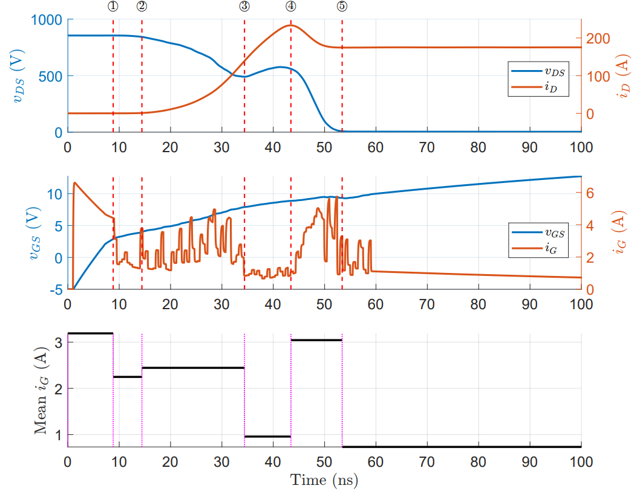
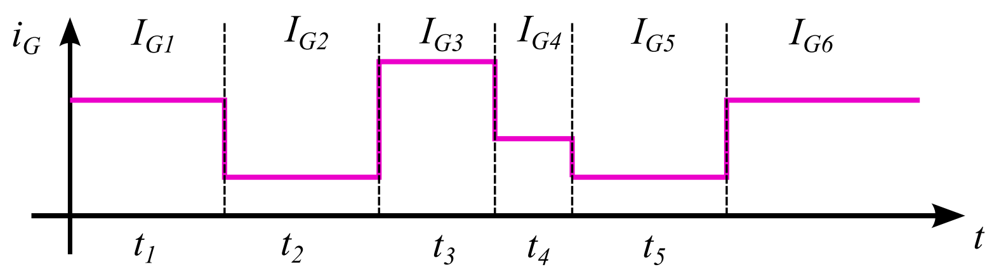
Method 2: Discrete i_{G} Profile
Optimization Framework
EG120 Gate Current Profile
Event 1: v_{GS} exceeds threshold → channel forms
Event 2: i_{D,LS} > 0.5% of I_{L} → current commutation starts
Event 3: Peak di_{D,LS}/dt → current slew begins to decrease
Event 4: i_{D,LS} commutation complete
Event 5: v_{DS,LS} < 1% of V_{DC} → voltage commutation complete

Slide 16
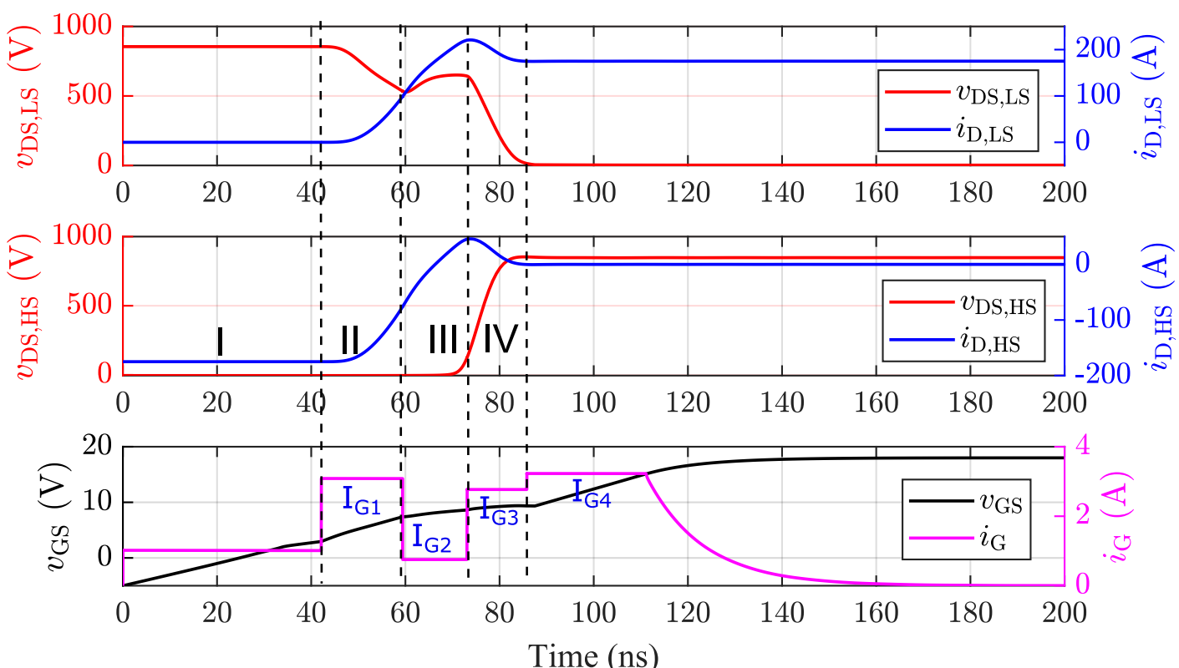
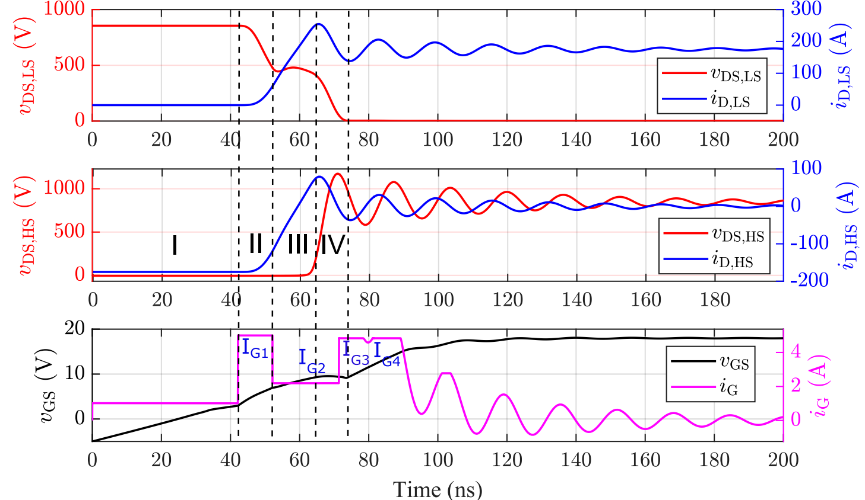
Method 2: Discrete I_{G} Profile
Optimization Framework
The GA directly optimizes a discrete gate-current profile I_{G[k]}, constrained by the EG120 capabilities.
i_{G} → 4 segments with constant levels I_{G1} - I_{G4} for time segments t₁–t₃
I_{G[k]} bounds: I_{G[k]},min = 0.1 A, I_{G[k]},max = 5 A,
Δtmin = 10 ns (hardware-feasible).
Reduced variable count → faster GA convergence (smaller population), optimization time ↓ from ~20 h to ~6 h Vs Method 1.
[1,9]
[9,1]

Slide 17
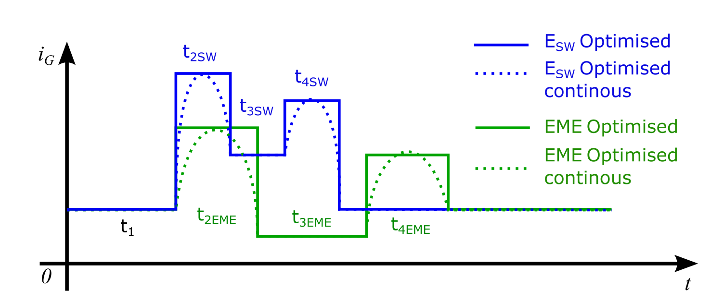
Comparison of all simulation results
Optimization Framework
Method | E_{SW} (µJ) | E_{SW} change | HGI_{LS} | HGI_{HS} | HGI_{HS} Change | V_{DS,HS} OS (V)
Fixed R_{G} – 5.1Ω | 2805.9 | - | 2.16 | 6.21 | - | 78
Fixed R_{G} – 7.5Ω | 3870.7 | +38% | 2.03 | 3.49 | -43.8% | 22
GA cont. [1,1] R_{G} profile | 2011.6 | -28.3% | 2.51 | 0.52 | -91.6 | 7
GA EG120 [1,9] i_{G} profile | 2468.2 | -12% | 3.03 | 0.53 | -91.5 | 3
GA EG120 [9,1] i_{G} profile | 1396.7 | -50.2% | 9.99 | 3.06 | -50.7 | 324
[1,9]
[9,1]
R_{G},cont.

Slide 18
Comparison of all simulation results
Optimization Framework
Method | E_{SW} (µJ) | E_{SW} change | HGI_{LS} | HGI_{HS} | HGI_{HS} Change | V_{DS,HS} OS (V)
Fixed R_{G} – 5.1Ω | 2805.9 | - | 2.16 | 6.21 | - | 78
Fixed R_{G} – 7.5Ω | 3870.7 | +38% | 2.03 | 3.49 | -43.8% | 22
GA cont. [1,1] R_{G} profile | 2011.6 | -28.3% | 2.51 | 0.52 | -91.6 | 7
GA EG120 [9,1] i_{G} profile | 2468.2 | -12% | 3.03 | 0.53 | -91.5 | 3
GA EG120 [1,9] i_{G} profile | 1396.7 | -50.2% | 9.99 | 3.06 | -50.7 | 324
[1,9]
[9,1]
R_{G},cont.

Slide 19
Flow of the thesis
Configuring a State-Space simulation Model for DPT simulation
Optimization of Gate Current Waveform using Genetic Algorithm
Hardware and Experimental setup
Comparison of performance (E_{sw}, EME) between Fixed R_{G} GTR and EG120 GTR implementation
Limitations of EG120 gate driver

Slide 20
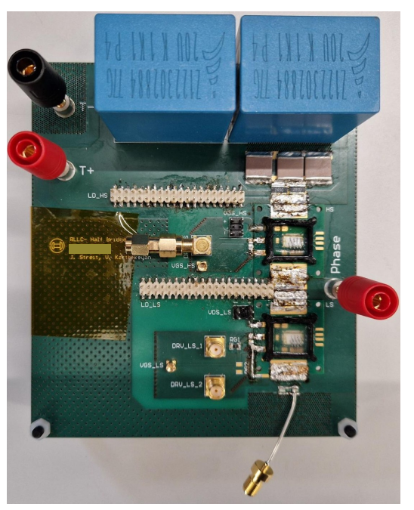
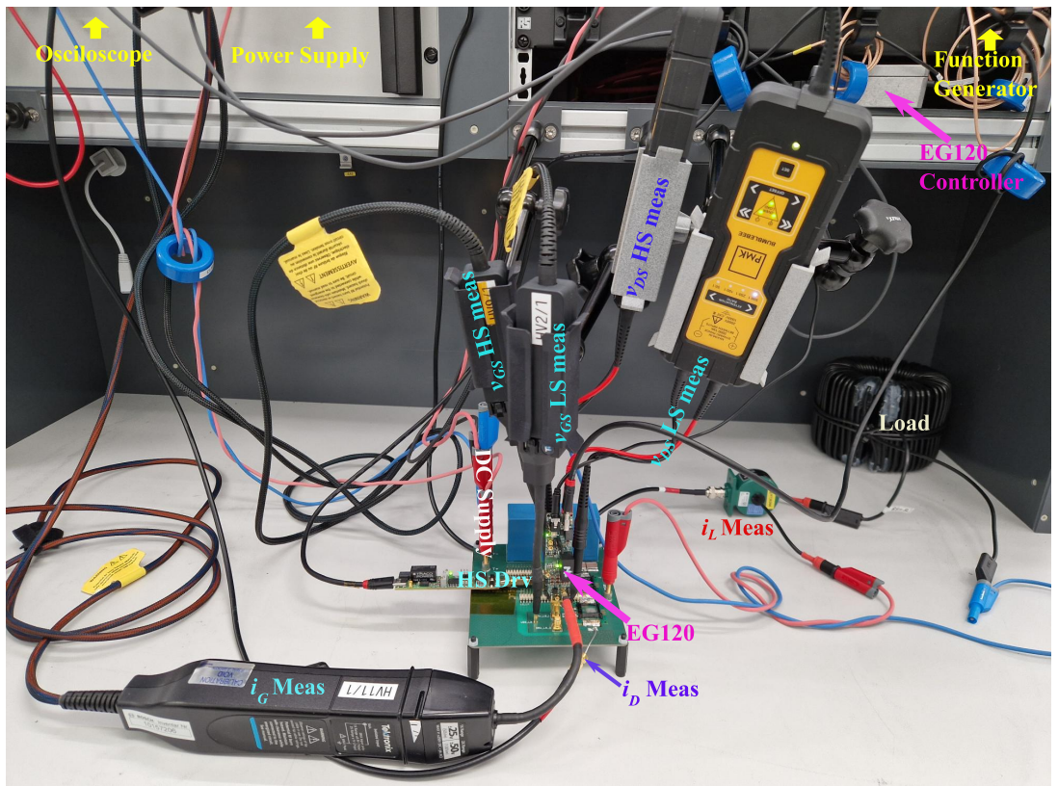
Hardware and Experiment setup

Slide 21
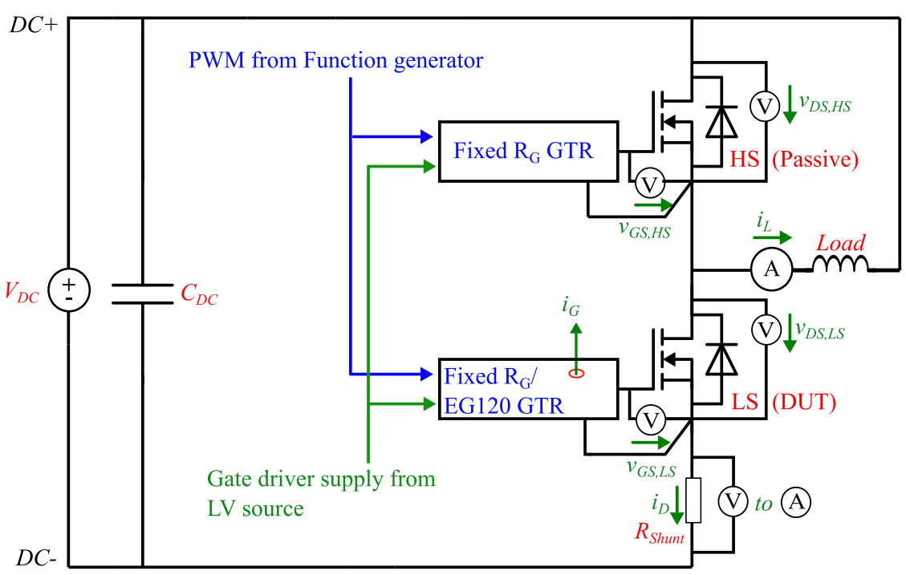
Test Procedure
Hardware and Experiment setup
Parameter | Value
L_{σ} | 20nH
V_{DC} | 850V
I_{LOAD} | 175A
L_{LOAD} | 56µH
V_{GS,high} | 18V
V_{GS,low} | -5V
Operating modes :
Fixed gate-resistor driver with R_{G} = 5.1 Ω.
Fixed gate-resistor driver with R_{G} = 7.5 Ω.
EG120 gate driver – E_{SW} optimized ([9,1]).
EG120 gate driver – EME optimized ([1,9]).

Slide 22
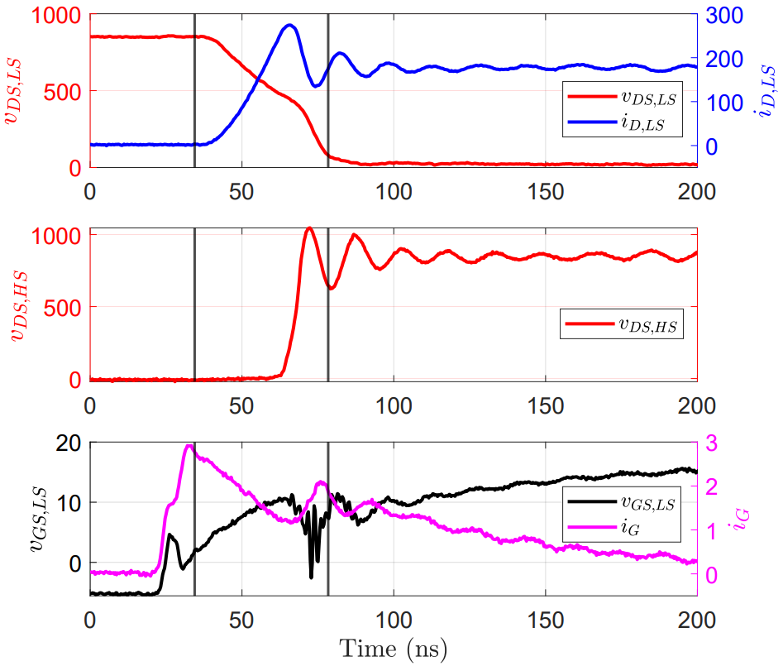
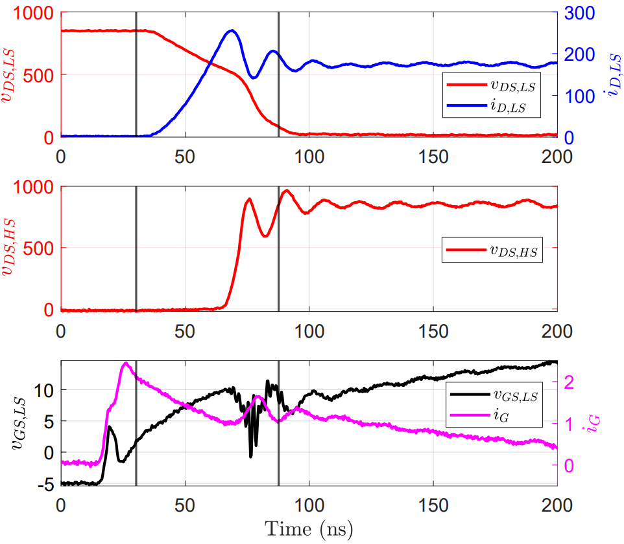
Fixed R_{G} Waveforms
Hardware and Experiment setup
43.98ns
57.42ns
5.1Ω
7.5Ω

Slide 23
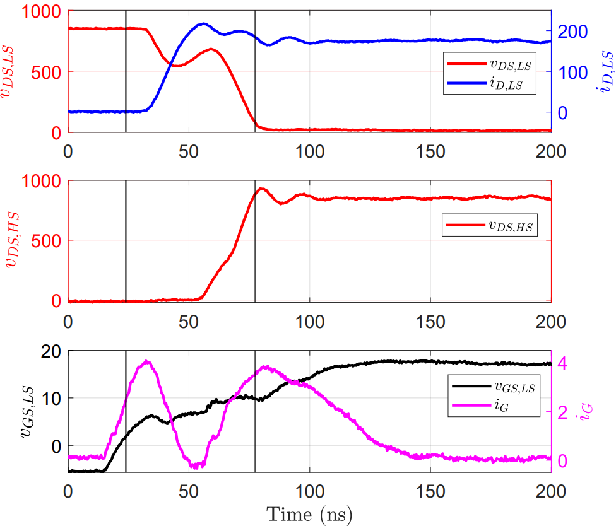
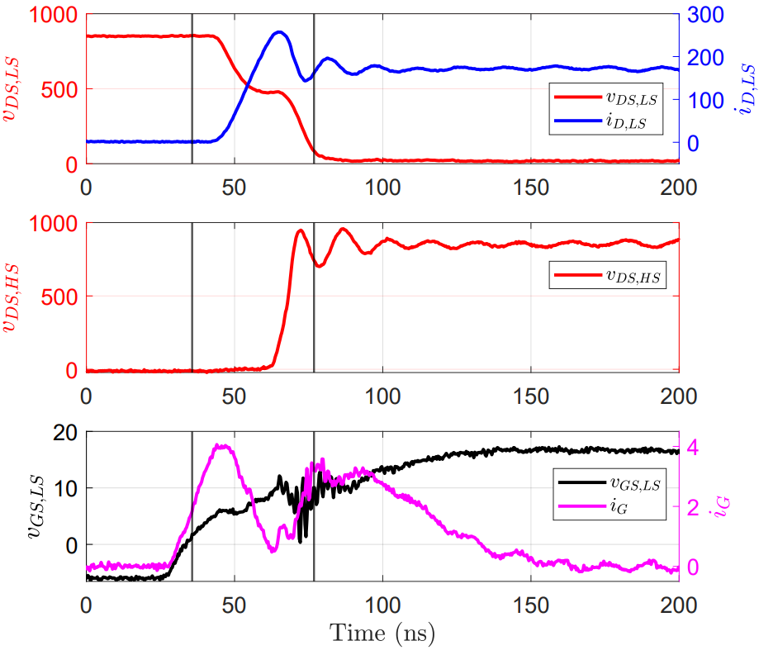
EG120 Waveforms
Hardware and Experiment setup
53.60ns
41.12ns
I
II
III
IV
I
II
III
IV
[1,9], EME Opt.
[9,1], E_{SW} Opt.

Slide 24
Flow of the thesis
Configuring a State-Space simulation Model for DPT simulation
Optimization of Gate Current Waveform using Genetic Algorithm
Hardware and Experimental setup
Comparison of performance (E_{sw}, EME) between Fixed R_{G} GTR and EG120 GTR implementation
Limitations of EG120 gate driver

Slide 25
Comparison of all experiment results
Method | t_{ON}(ns) | E_{SW} (µJ) | E_{SW} change
Fixed R_{G} – 5.1Ω | 43.98 | 2580.3 | -
Fixed R_{G} – 7.5Ω | 57.42 | 3309.8 | +28.3%
GA EG120 [9,1] i_{G} profile | 41.12 | 2209.0 | -14.4%
GA EG120 [1,9] i_{G} profile | 53.60 | 3775.3 | +46.3%
Reference
Method | HGI_{LS} | HGI_{HS} | HGI_{HS} Change | V_{DS,HS} OS (V) | V_{DS,HS} OS change
Fixed R_{G} – 5.1Ω | 22.47 | 25.54 | - | 196 | -
Fixed R_{G} – 7.5Ω | 13.12 | 18.82 | -26.2% | 117 | -40.3%
GA EG120 [9,1] i_{G} profile | 15.03 | 19.99 | -21.7 | 103 | -47.4%
GA EG120 [1,9] i_{G} profile | 1016 | 10.58 | -58.6 | 79 | -59.7
Reference

Slide 26
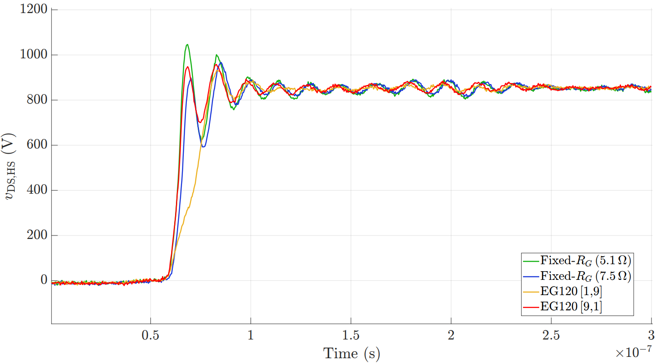
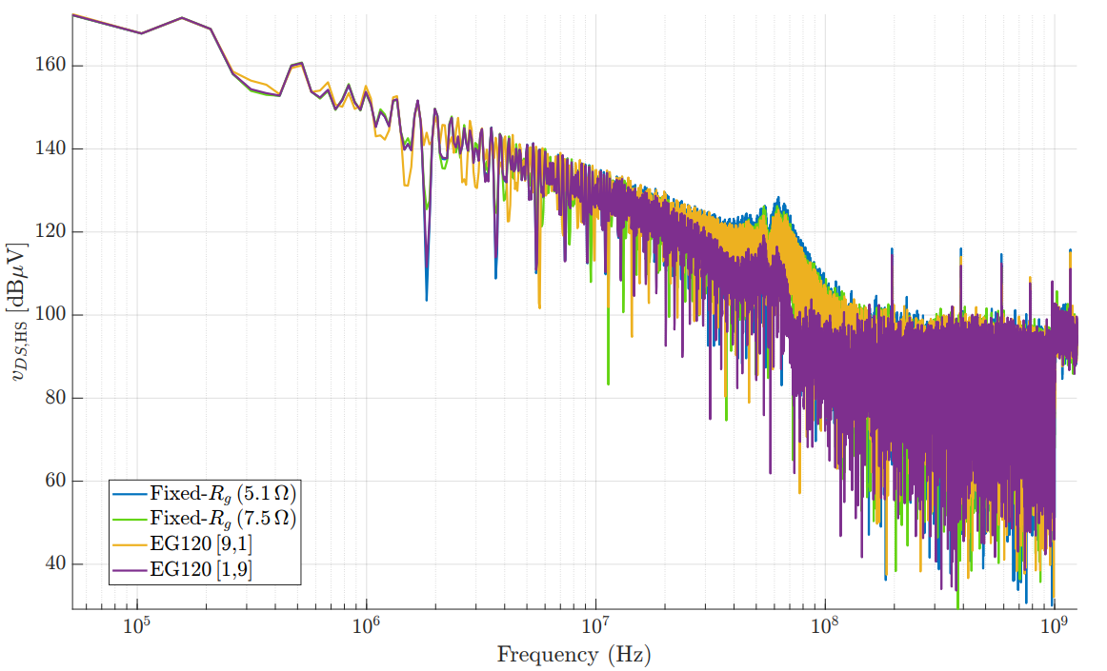
Improvement in EME perfomance
Comparison of all experiment results
Method | t_{10-90%} - v_{DS,HS} (ns) | σ_{t} (ns) | σ_{ω}(MHz) | HGI_{HS} | f_{cut2} (MHz)
Fixed R_{G} – 5.1Ω | 4.8 | 68.5 | 37.3 | 25.54 | 53.50
Fixed R_{G} – 7.5Ω | 6.08 | 54.5 | 34.6 | 18.82 | 41.88
GA EG120 [9,1] i_{G} profile | 5.76 | 60 | 33.3 | 19.99 | 44.21
GA EG120 [1,9] i_{G} profile | 17.28 | 59.1 | 17.9 | 10.58 | 14.74

Slide 27
Flow of the thesis
Configuring a State-Space simulation Model for DPT simulation
Optimization of Gate Current Waveform using Genetic Algorithm
Hardware and Experimental setup
Comparison of performance (E_{sw}, EME) between Fixed R_{G} GTR and EG120 GTR implementation
Limitations of EG120 gate driver

Slide 28
EG120 Waveforms
Limitations of EG120 driver
53.60ns
41.12ns
I
II
III
IV
I
II
III
IV
[1,9], EME Opt.
[9,1], E_{SW} Opt.

Slide 29
Limitations of EG120 Gate driver
Simulation i_{G} profile :
Sim. Method | i_{G1} (A) | i_{G2} (A) | i_{G3} (A) | i_{G4} (A)
[9,1] E_{SW} Opt. | 4.998 | 2.192 | 4.835 | 4.835
[1,9] EME Opt. | 3.08 | 0.753 | 2.768 | 3.22
i_{G} profile transitions do not occur at the correct phases
Sim. method | t₁ (ns) | t₂ (ns) | t₃ (ns)
[9,1] E_{SW} Opt. | 10.0 | 18.26 | 9.01
[1,9] EME Opt. | 17.4 | 13.71 | 12.01
Finite EG120 gate-current rise time prevents ideal rectangular transitions → altering t_{[k]} values.
Larger programmed I_{G[k]} needed to achieve effective current levels (e.g., 8 A required for ~4 A peak).
Timing mismatches due to internal delays and dynamic effects within the EG120 driver.
Experiment i_{G} profile to EG120 :
Lab Method | i_{G1} (A) | i_{G2} (A) | i_{G3} (A) | i_{G4} (A) | i_{G5} (A) | i_{G6} (A)
[9,1] E_{SW} Opt. | 9.00 | 2.70 | 7.00 | 2.78 | 2.78 | 2.78
[1,9] EME Opt. | 8.00 | 1.847 | 6.55 | 1.345 | 1.345 | 1.345
Lab Method | t₁ (ns) | t₂ (ns) | t₃ (ns) | t₄ (ns) | t₅ (ns)
[9,1] E_{SW} Opt. | 12.0 | 15.00 | 25.10 | 10.0 | 147.0
[1,9] EME Opt. | 14.4 | 20.0 | 20.8 | 9.98 | 147.0
Manual tuning of I_{G[k]} and t_{[k]} required for each use case to match with the simulation i_{G} profile

Slide 30
Summary
A physics-based, experimentally calibrated state-space model combined with a multi-objective GA derived optimal gate-current profiles under real-world implementation constraints, and the resulting profile was successfully validated in hardware.
Simulation results:
  i_{G} profile optimized for E_{sw} => 50.2% ↓ in E_{SW} vs. R_{G} = 5.1 Ω operation, but very high voltage overshoot
  i_{G} profile optimized for EME => 91.5% ↓ in EME (HGI) and 12 % ↓ in E_{SW} vs. R_{G} = 5.1 Ω operation.
Experimental results:
  i_{G} profile optimized for E_{sw} => 14.4% ↓ in E_{SW} and 21.7% ↓ in EME (HGI) vs. R_{G} = 5.1 Ω operation.
  i_{G} profile optimized for EME => 58.6% ↓ in EME (HGI) compared to fixed RG = 5.1 Ω.
Conclusion
In high-commutation-inductance systems (e.g., multilevel inverters), the performance advantage becomes even more pronounced compared to uniformly slowing switching.
Future work: practical realizations of theatrical optimal gate profiles using voltage-source techniques (instead of dedicated current source drivers), balancing performance gains against circuit complexity, cost, and reliability.

Slide 31
👋
THANK YOU

Slide 32
Method 1: Continuous R_{G} Profile
Optimization Framework
Gate current waveform divided into 100 time segments within a total duration of 50 ns, with the MATLAB GA optimizer determining 100 corresponding gate resistance variables (Rᵢ).
Each Rᵢ bounded by Rᵢ,min to Rᵢ,max;
Eₛw,min / Eₛw,max computed based on Rᵢ,min / Rᵢ,max.
HGI,min = 0.5 (uncertainty bound) and HGI,max obtained using MATLAB Bayesian Optimization for given L_{σ} .
GA setup: Population size - 200, Generations - 50.
R_{G} PROFILE - 13.16627, 8.946023, 17.47686, 17.51341, 14.24253, 16.80328, 13.2847, 18.38633, 11.86958, 14.96309, 19.67738, 13.38128, 15.13849, 18.73336, 17.96077, 5.286494, 16.20955, 15.12322, 13.18948, 4.832937, 13.3693, 18.36895, 8.575329, 13.2167, 7.14058, 18.60288, 10.52645, 12.14032, 17.33067, 16.89373, 6.921956, 8.676838, 11.72019, 19.48421, 11.69946, 4.126141, 17.26529, 15.14803, 6.956249, 8.5961, 10.7912, 16.96573, 6.796645, 18.73618, 5.609466, 19.45349, 11.51097, 5.10422, 11.99338, 5.337054, 12.34263, 6.882301, 9.563267, 19.67025, 14.04658, 9.562943, 4.204216, 6.057934, 5.085025, 5.782906, 7.860378, 6.881475, 4.995323, 5.418137, 6.035327, 4.762876, 6.641337, 2.901193, 2.989494, 6.927798, 3.12265, 5.004782, 4.175473, 2.5, 3.239289, 4.6951, 6.519241, 5.159111, 3.164565, 3.139378, 4.473974, 5.852876, 5.343677, 5.552575, 7.017246, 7.342865, 8.133253, 8.433628, 16.94832, 9.725828, 7.532234, 10.45489, 12.01557, 9.171213, 8.183744, 16.84581, 12.32247, 10.04835, 5.662855, 3.468142

Slide 33
Method 2: Discrete I_{G} Profile
Optimization Framework
The GA directly optimizes a discrete gate-current profile I_{G}[k], constrained by the EG120 programmable gate-driver capabilities.
i_{G} → 4 segments with constant levels I_{G}₁–I_{G}₄ for time segments t₁–t₃
I_{G}[k] bounds: I_{G},min = 0.1 A, I_{G},max = 5 A,
Δtmin = 10 ns (hardware-feasible).
Reduced variable count enables faster GA convergence with a smaller population, cutting optimization time from ~20 h (Method 1) to ~6 h.
[1,9]
[9,1]

