Slide 1
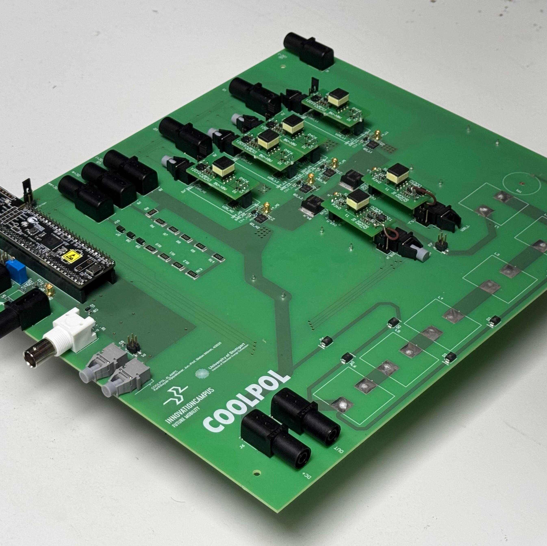
Institute of Electrical Energy Conversion
Design and Characterization of a 1.2 kV Hybrid GaN/SiC Four-Level ANPC Converter
Karthikeyan Vijayakumar, 23.06.2024
Research Thesis, M.Sc. Electrical Engineering
Supervisors - M.Sc. Adrian Söllner, M.Sc. Ines Bennour

Slide 2
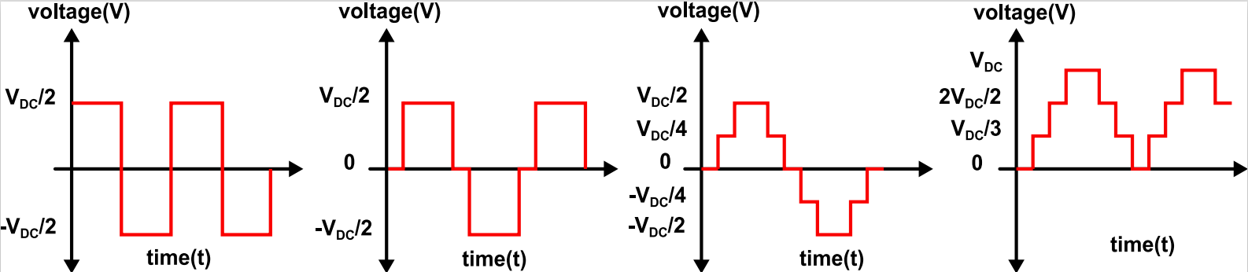
Background
Multilevel converters
Modern EV and renewable systems are increasing DC-link voltages (400 V to 1.2 kV+)
In 2L converters
Overall losses ↓
Cable sizes ↓
Component weight ↓
Voltage stress on switches ↑
Total harmonic distortion (THD) ↑ ,
Switching frequency demand ↑
2L
Solution : Multilevel converters
Waveform closer to sine wave.
4L with
Ground reference
3L
5L
Notes:
Modern EVs: Same power → lower current in the system→ smaller cables & losses
2L converter: Large voltage steps → high dv/dt → more voltage stress & THD
Solution: Multilevel = smoother waveform → lower stress & THD

Slide 3
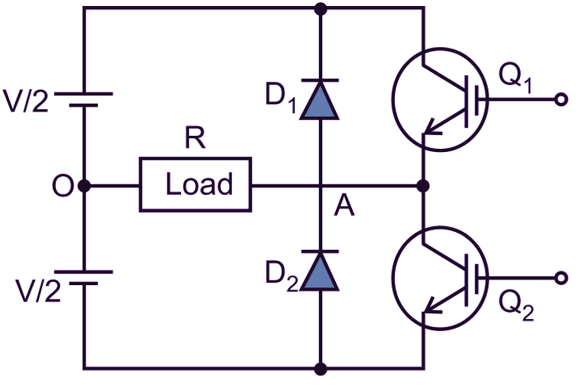
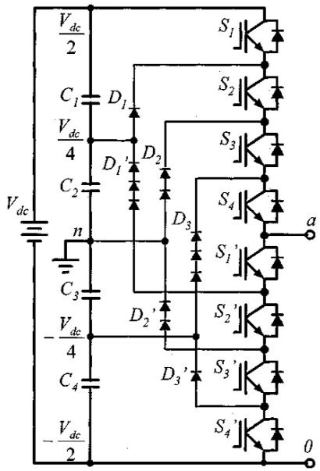
Problem
Compared to 2L, in Multilevel converters
  System size and cost ↑
  Control strategy - Complex
  PCB hardware design - Challenging
2L
Research Questions
Which multilevel topology balances performance, efficiency and complexity for high voltage applications(>1.2kV)?
How can control techniques like hysteresis current control be effectively applied to multilevel converters?
What PCB layout strategies enable efficient, low-parasitic, and reliable design for multilevel power converters?
5L
Notes:
Challenge in MCs: 2L; 5L problem is very obvious= → many switches, drivers, compoents- complex
My thesis addresses:
Optimal topology choice
Effective control (hysteresis)
Reliable, low-parasitic PCB layout

Slide 4
Contents
1.2 kV hybrid GaN/SiC four-level ANPC converter
WHY 4L ANPC Topology
Simulation of 4L ANPC Converter
HW Design
Experimental validation
Related Works and Project Contributions
Summary and Conclusion
Notes:
Basic overview of the presentation as well as my research thes – starting from
Choosing a topology,
simulation,
HW design and
experimental validation

Slide 5
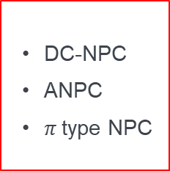
WHY 4L ANPC
Multilevel topolgies
Multilevel converters
NPC
Flying capacitor
Cascaded H- Bridge
  DC-NPC
  ANPC
  $π$type NPC
Notes:
These are the common multilevel topologies
Among those npc is popular nowadays , due to its simpler structure and few comp count
Lets discuss abt prominent NPC topologies and chose one

Slide 6
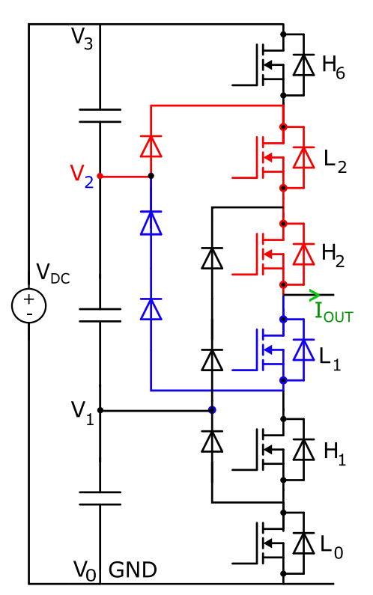
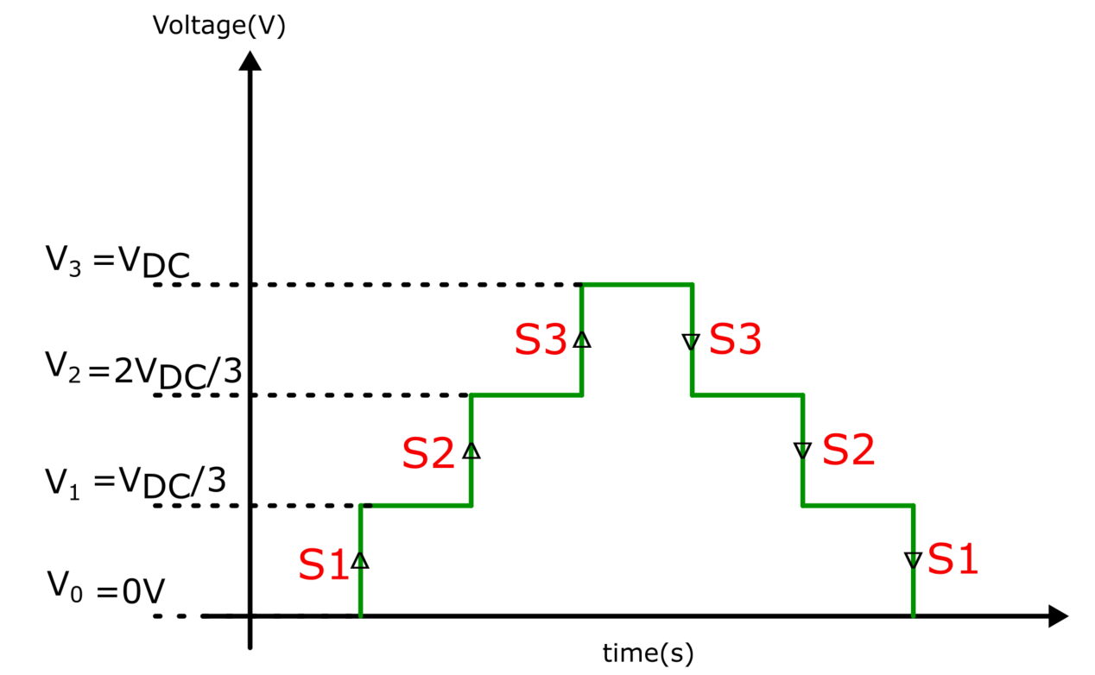
WHY 4L ANPC
Diode – Clamped Neutral Point Converter (DC-NPC)
❌
Switch conduction paths vary with output current direction
D₁
Problem :
Requires (m − 1)(m − 2) clamping diodes for an m-level converter.
Higher levels (e.g., 7-level)
↓
Higher diode count (30)
↓
Higher losses and complexity
D₂
(1200V)
(800V)
D₃
(400V)
4L converter output waveform
Notes:
(V0–V3 for 1.2 kV) – 0 400 800 1200V
Clamping diodes: Used to calmp discrete voltage levels to output
Conduction path depends on output current direction → red = positive current , blue = negative current
Problem: High diode count → complex, losses (e.g., 7-level needs ~30 diodes)
Conclusion: Not suitable for my thesis —

Slide 7
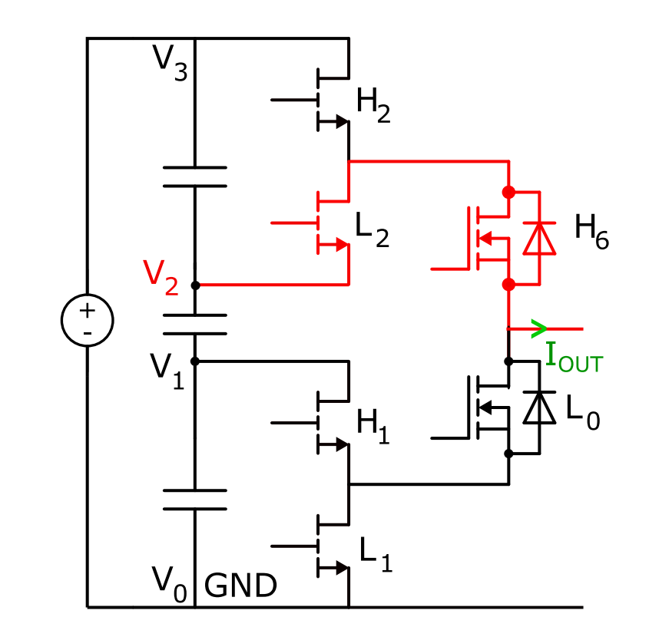
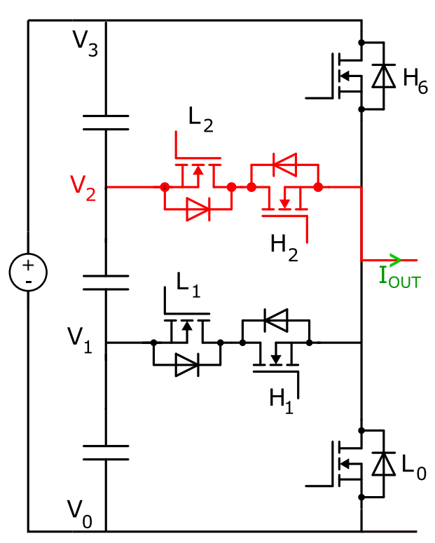
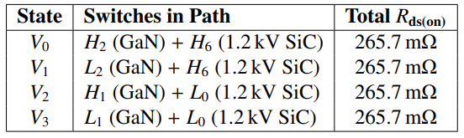
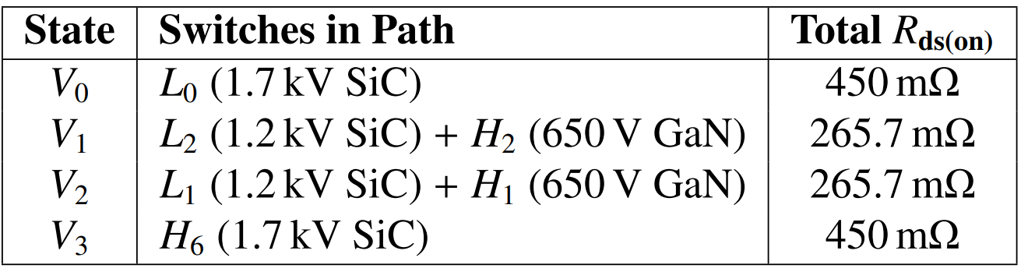
WHY 4L ANPC
✅
❌
ANPC converter
$π$ type 4L Converter
400V
(GaN, 650V rating,150mΩ)
1.2kV
(SiC, 1.7kV rating, 450mΩ)
(SiC, 1.2kV rating, 115.7mΩ)
800V
(SiC, 1.2kV rating,
115.7mΩ)
800V
(GaN, 650V rating, 150mΩ)
1.2kV
400V
400V
800V
1.2kV
Notes:
ANPC and Pi-type topology: Uses active switches instead of clamping diodes
Conduction path for V2: Same for both + and – load current
Voltage blocking: H6 must block full 1.2 kV → needs high-voltage-rated switch
4 Gan in ANPC and only 2 SiC switches in PI for 1.2 kV
Rough conduction loss calc : Higher conduction losses (e.g., in V3 path)
Conclusion: Due to loss and complexity, ANPC is selected for 1.2 kV system

Slide 8
SIMULATION

Slide 9
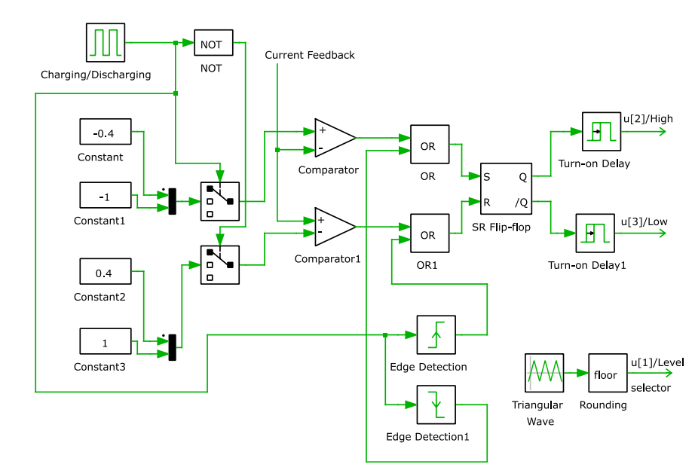
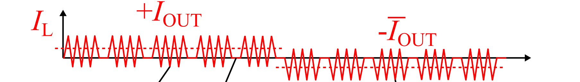

Simulation of 4L ANPC Converter
Hysteresis two level control
Notes:
Hysteresis control: Maintains current within upper and lower bands
Load capacitor: Charges/discharges → simulates electrocaloric heating/cooling cycles
Two bands: Define current limits for cahrgin and discharging]
High low output
Output level selector: which siwthc the L and H has to be sent

Slide 10
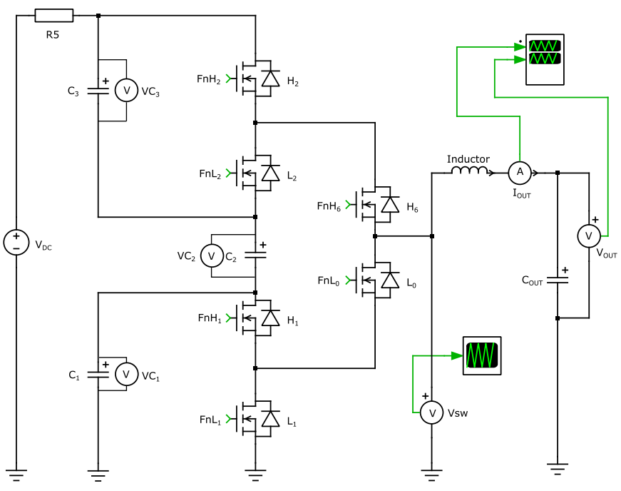
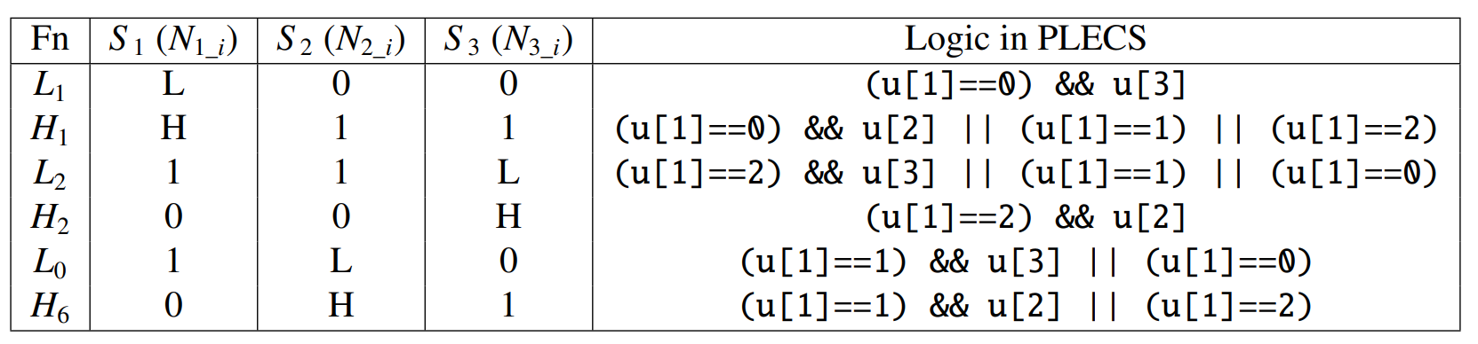
Simulation of 4L ANPC Converter
V₃
V₂
V₁
V₀
Gate logic table of 4L ANPC converter
Notes:
Power circuit (simulation): Generates 4 voltage levels (V0–V3)
Switch S1: Controls transition from V0 to V1; S2 → V1 to V2, etc.
Example – S1 path: Includes L2 → passive role, doesn’t affect control
Benefit: L2 helps minimize switching events for next transition

Slide 11
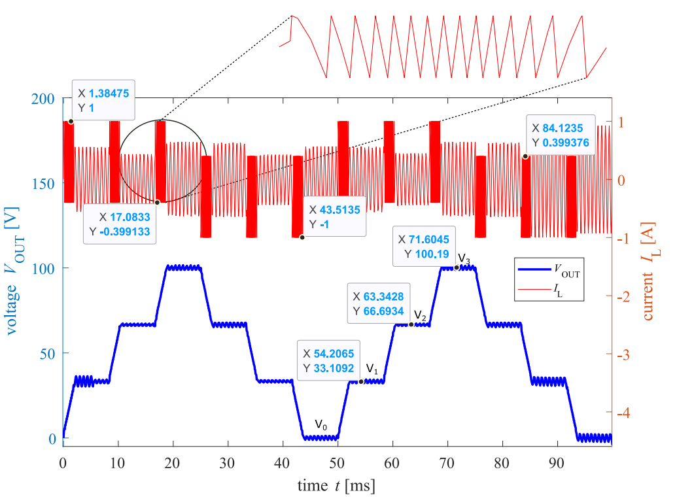
Simulation Results
Notes:
Current is regulated within the hysteresis band
DC-link voltage: 100 V, So Output votlage split into four levels → V0 = 0 V, V1 = 33 V, V2 = 66 V, V3 = 100 V

Slide 12
HW DESIGN

Slide 13
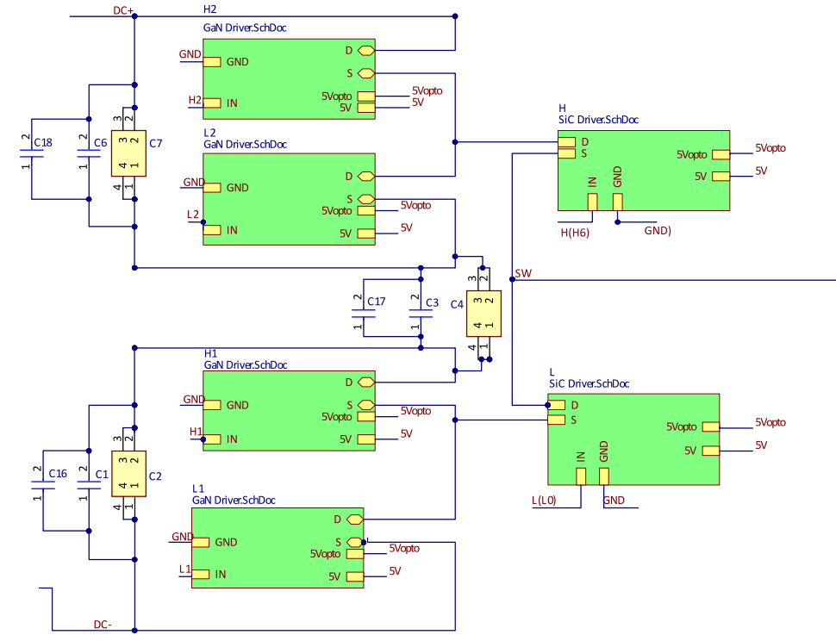

Circuit Design Considerations
Power circuit
Switch | V_{DS} max | R_{DS}ON
GaN (GS-065-011-1-L) | 650 V | 150mΩ
SiC (IMBG120R116M2H) | 1200V | 115.7mΩ
H₂/GaN
H/SiC
L₂/GaN
3x DC-link buffer capacitors – 700 V, 110 μF
Load inductors and load capacitors are connected externally.
H₁/GaN
L/SiC
  .
L₁/GaN
Notes:
Smaller DC link cap – helps in pcb desing as they can be placed closer to witches

Slide 14
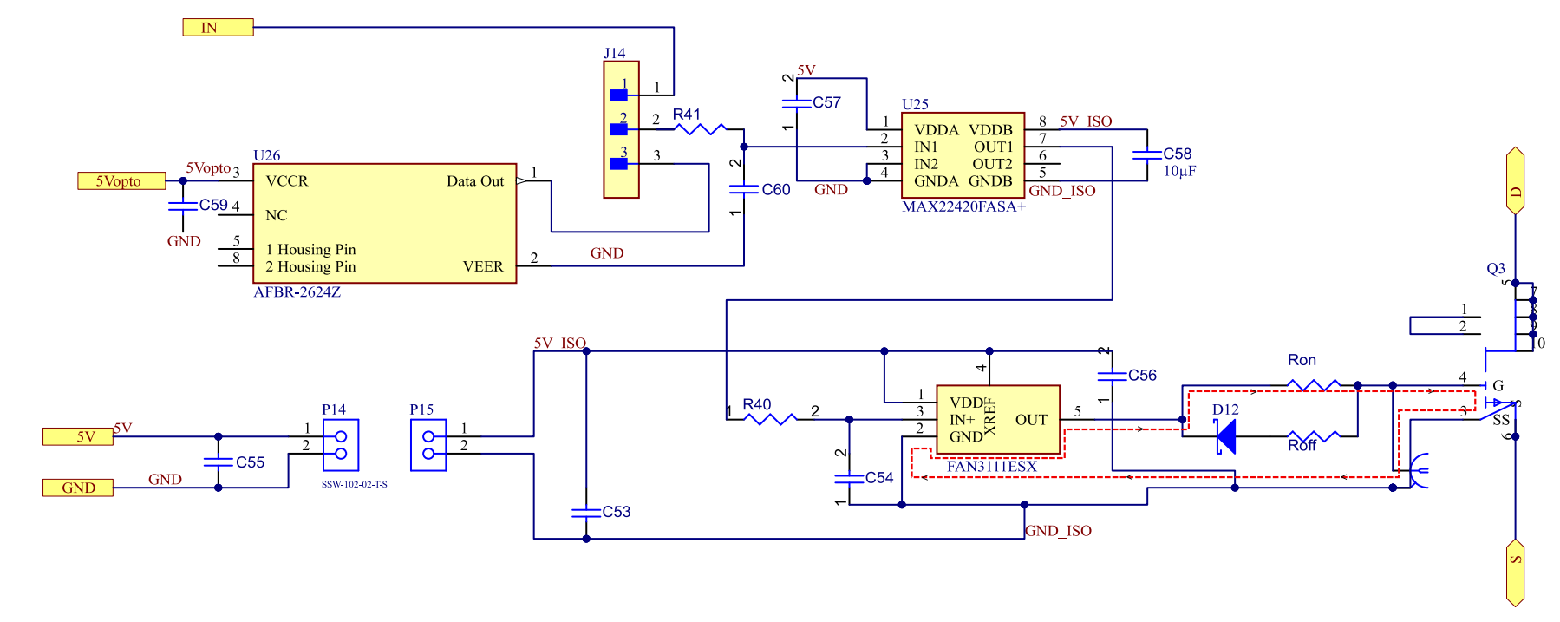
Circuit Design Considerations
Switch | Ron | Roff
SiC | 15 Ω | 2.2 Ω
GaN | 22.2 Ω | 2.2 Ω
Gate driver circuit
1 kΩ ,10 pF
Input from SoC
Input from external controller
10 µF
Notes:
Low pass – HF noise. Decoup – stabilize voltage
The ron and roff values are considered based on the recommendations from data sheet

Slide 15
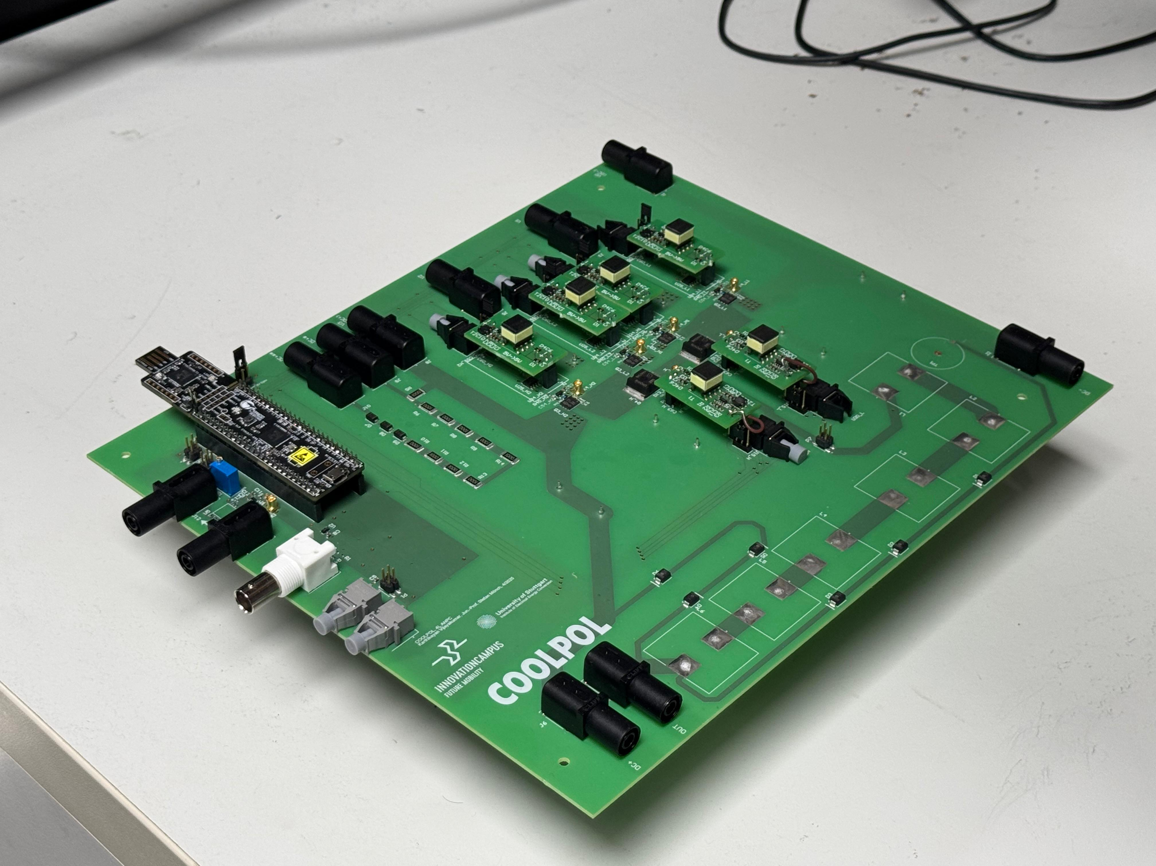
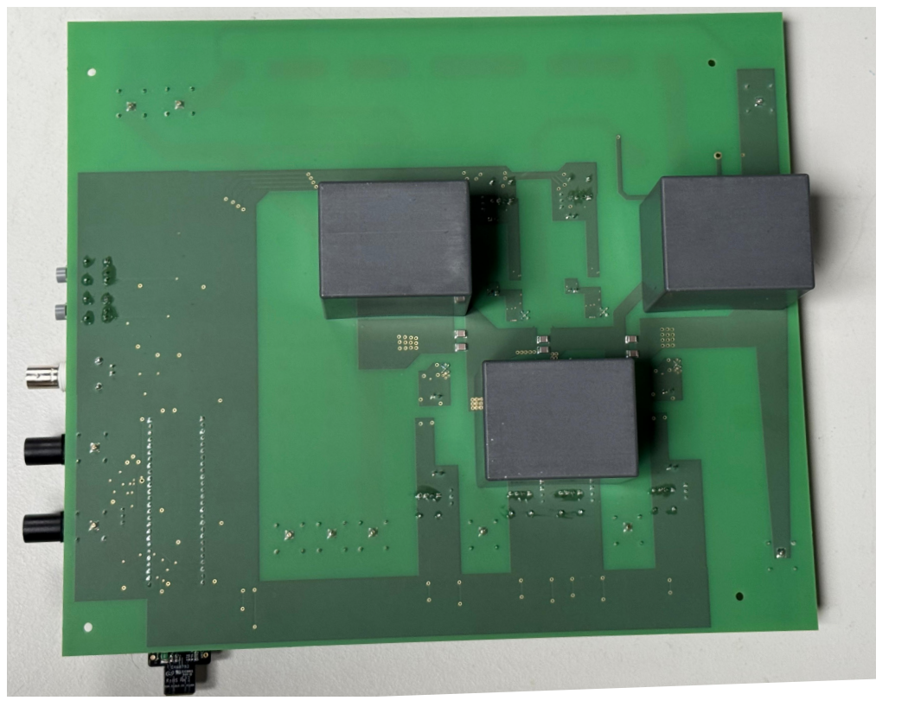
PCB Design Considerations
H₂
L₂
H₁
L₁
Things to be considered
  Placement of switches, gate drivers and capacitors
  High voltage isolation
  Overlapping of signal and power lines
_{H}
L
C₇
C₁
C₄
Top view
Bottom view
Notes:
4gan 2 SiC, empty space – capacitor below
HV isolation is ensured by mainting adequate distance between components where the net voltage diff is very high

Slide 16
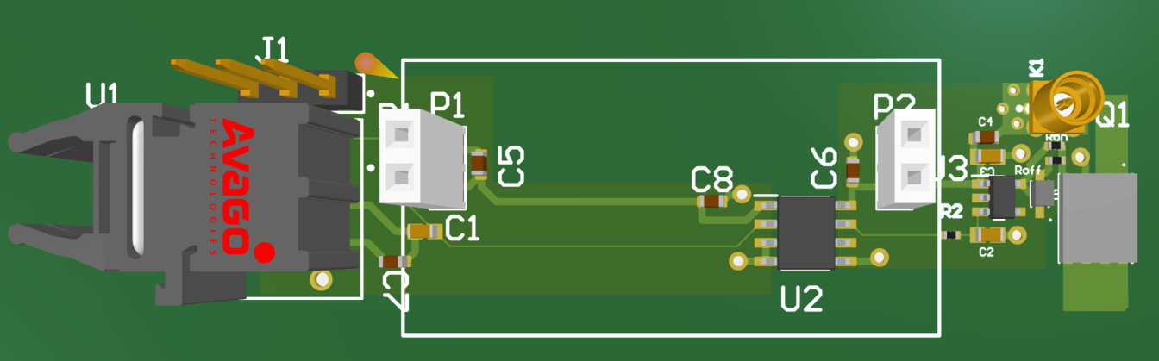

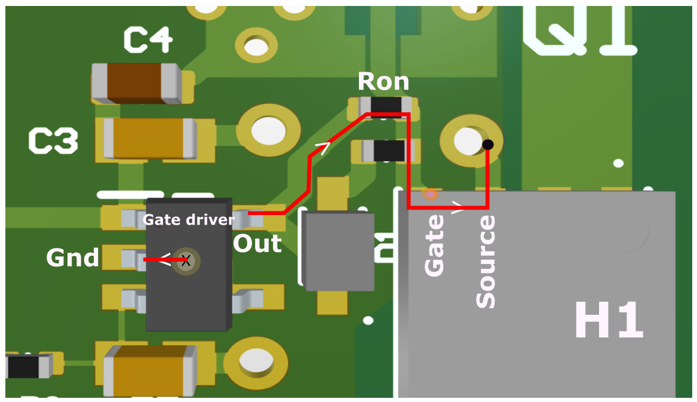
PCB design considerations
Gate loop
Gate loop parasitics can cause:
  Gate overvoltage during ON state
  False turn ON during OFF state
Design strategies to minimize gate loop inductance:
  Gate driver ICs & gate resistors - close to switches.
  Vias route gate return path to second layer (solid ground plane) for low-impedance path.
  Decoupling capacitors positioned near driver IC supply pins
Gate loop design in PCB
Notes:
Lateral structure for placement of drives one next to the other
Gate loop prasitics – just read
Lets zoom in
path
Just read the design strategies

Slide 17
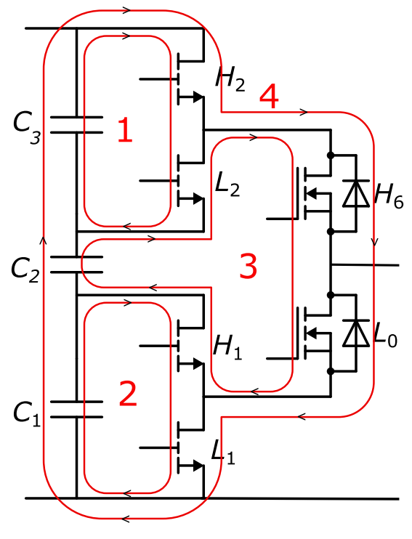
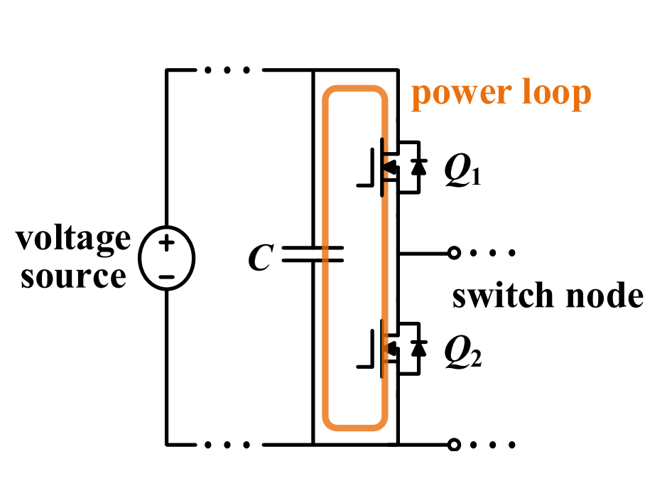
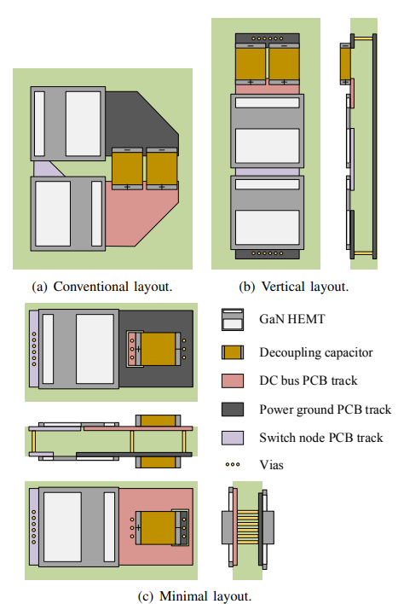
PCB Design Considerations
Power loop
Common parasitic inductance minimization strategies:
Loop Length Minimization
Magnetic Flux Cancellation
Q₁
C₁
C₂
Q₂
Notes:
Conventional half-bridge layout: Large loop area, no flux cancellation. No flux cancellation and a larger loop
Improved (vertical) layout: Switches and capacitor aligned vertically → loop height = PCB thicknessEven better layour – minimal layout – here the conduction is reduced further
Minimal layout: Further reduces loop length and inductanceOne or other loops bcomeing larger
Challenge with 4L ANPC: Complex topology → hard to optimize all loops simultaneously; improving one may enlarge another – make some tradeoffs

Slide 18
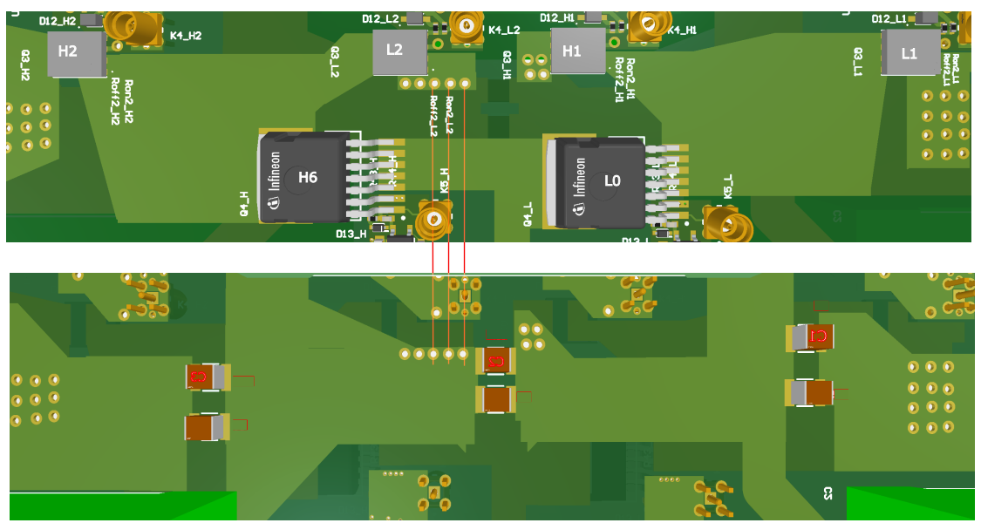
PCB Design Considerations
Power loop
Flux Cancellation
Top and bottom layer with aligned current paths
Notes:
power layout: Top & bottom view with 4 GaN and 2 SiC switches
Result of trial-and-error across multiple layout strategies including those in prev slides
Small DC-link cap placed so return path runs directly beneath forward path → minimizes loop area
Let’s now examine each power loop individually

Slide 19
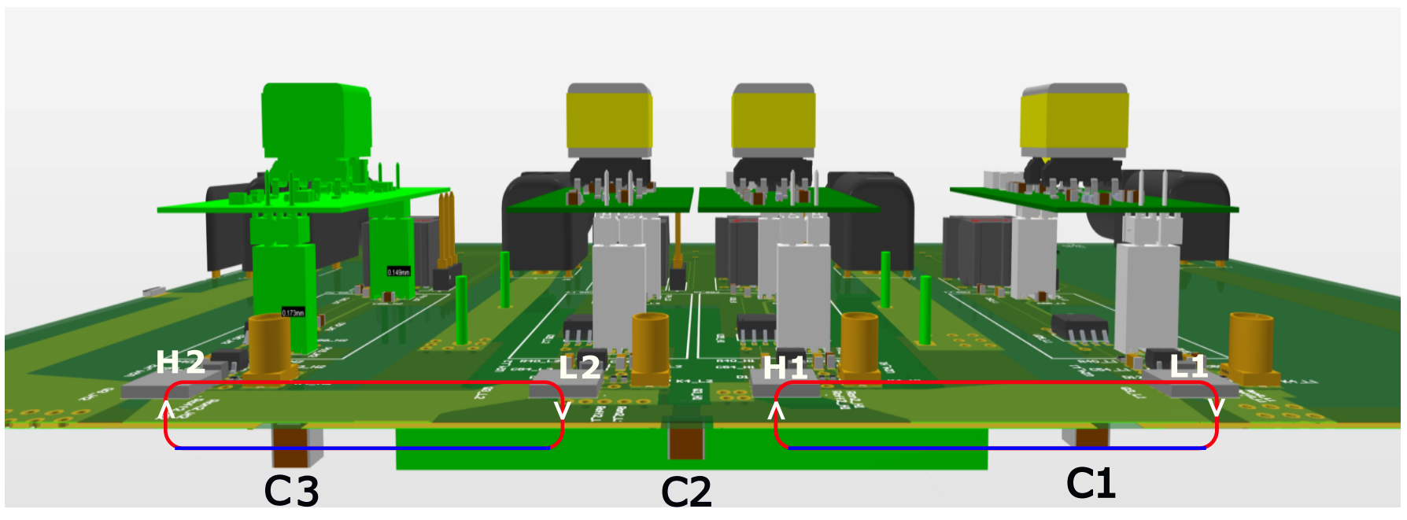
PCB Design Considerations
Power loops 1 and 2 –
✅
✅
Minimal vertical layout
Notes:
Loop 1 nd 2 – similar to the minimal layout that we discussed- red fw patha nd blue reurtn path, on top of each and the loop is only yhe thickness of the PCB

Slide 20
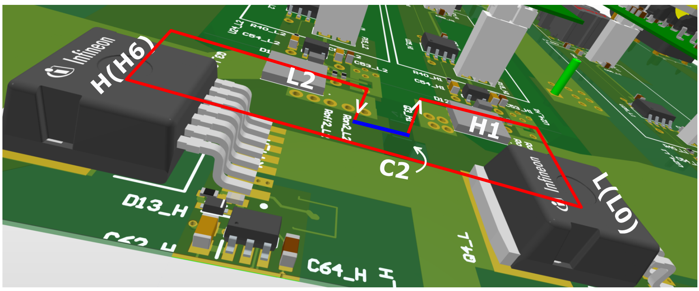
PCB Design Considerations
Power loop 3
✅
Including a lateral layout
Notes:
Loop 3 – has a a lateral compoenet in it, due to unavoidable component constraints – due to the natur of the loop
In figure

Slide 21
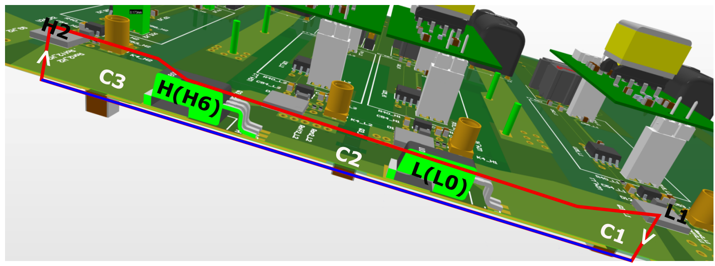
PCB design considerations
Power loop 4 - Minimal vertical layout
✅
Minimal vertical layout
Compact, reduced parasitic PCB design for 4L ANPC
Notes:
Loop 4 again- minimal vertical layout
So overall, a compact reduced parasitic pCB design is made for 4L anpc

Slide 22
EXPERIMENT

Slide 23
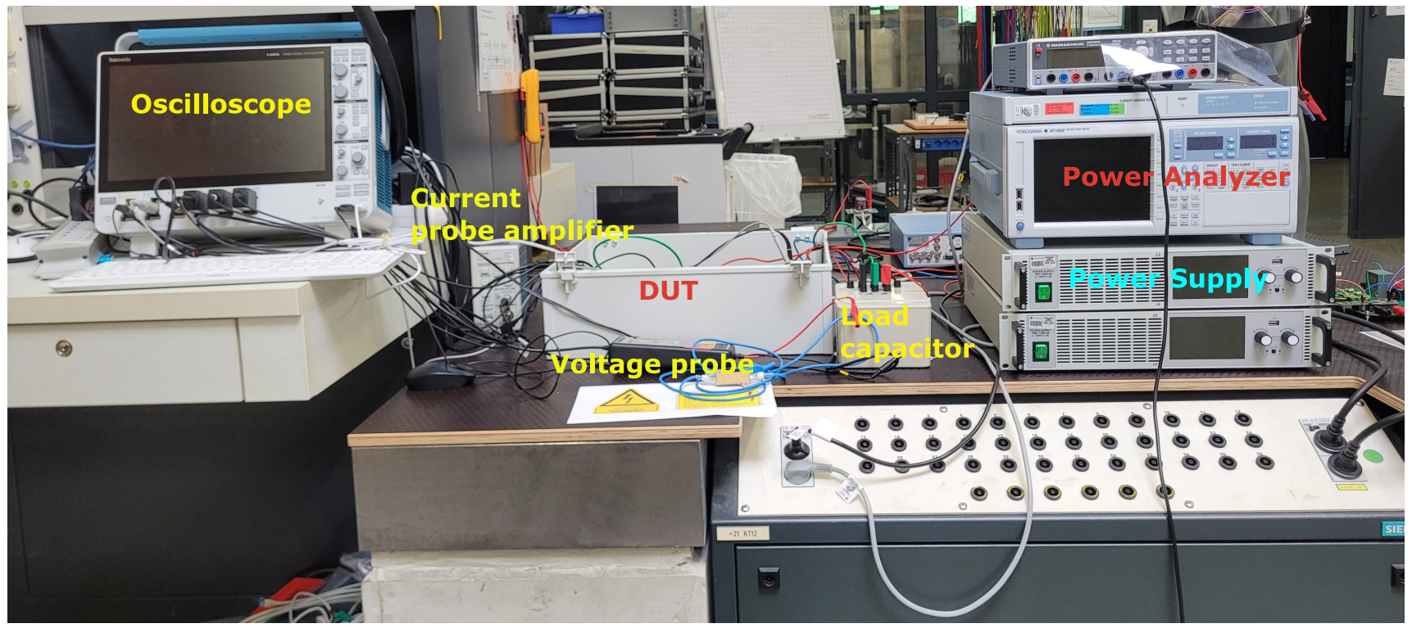
Experiment setup
Ideal
Notes:
Shows the complete exp setup including power analysers, power supply, oscilloscope and probes, the DUT is the placed in this voltage isolation box

Slide 24
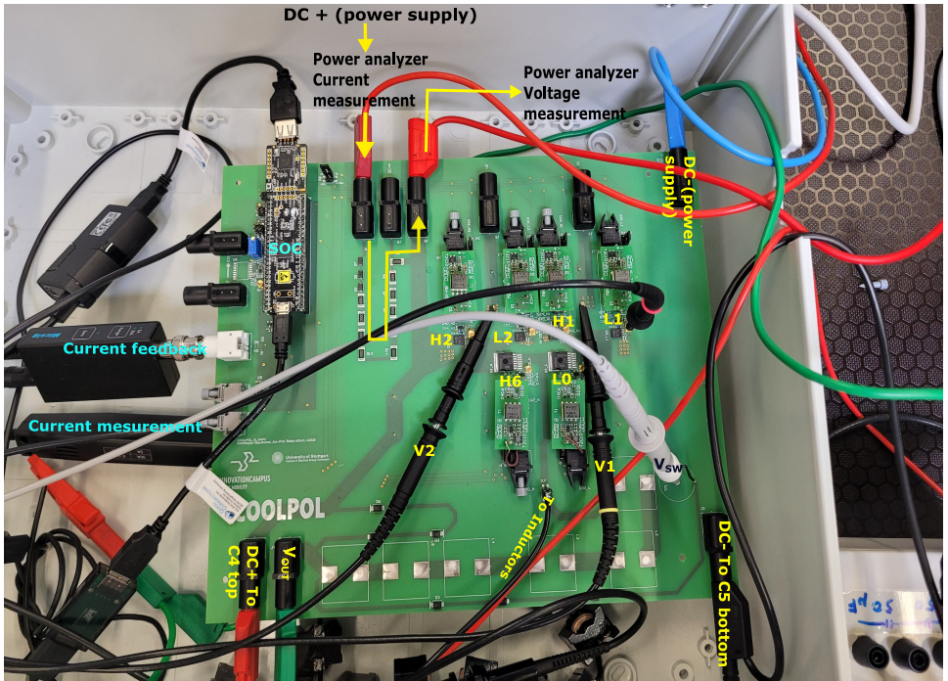
Experiment setup
DUT connections
Notes:
We can see her the supply and measurement connections to various points in the DUT,
To get a better idea lts look into the experiment schematic

Slide 25
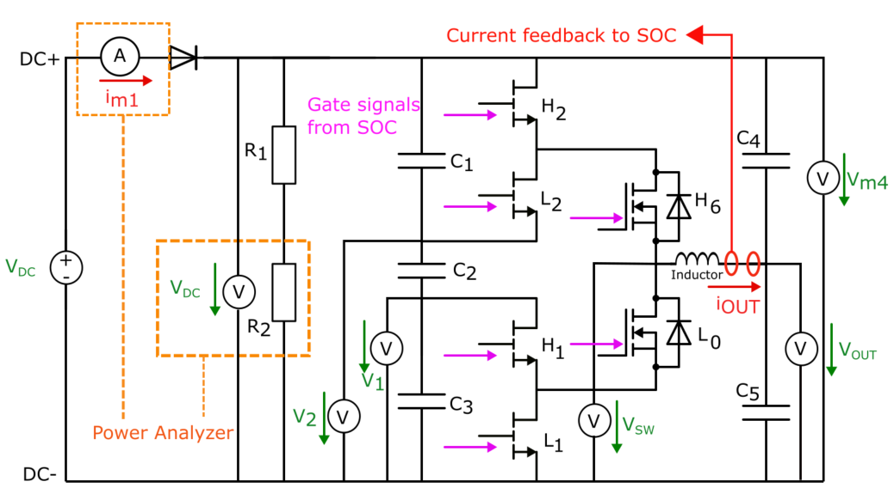
Experiment setup
Setup schematic
Notes:
Power analyzer Measures input current, DC-link voltage, Volage probes and current probes intermediate node voltages, inductor current, and output voltage
Gate signals: Provided by SoC, same way as in simulation
Converter role: Charge and discharge output capacitor (C5)
Ideally: Only energy transfer between buld DC link and output cap C5→ no net power draw
In reality: Losses occur → extra input power drawn = converter loss, measured using the power analyzer

Slide 26
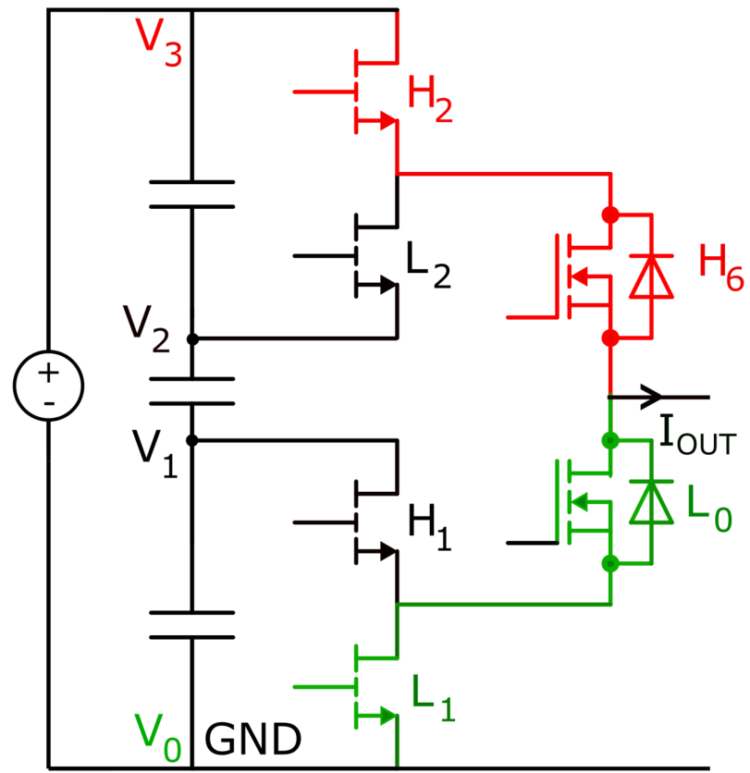
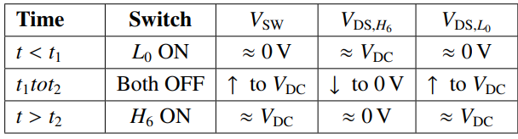
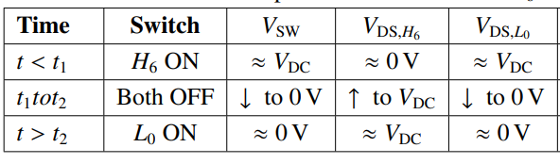
Deadtime Optimization and ZVS
Optimal ZVS for 2L mode
Dead time (t₁-t₂) must be set so the switch turns on exactly when its voltage drops to zero, enabling ZVS.
Optimal ZVS Transition: L₀ OFF → H₆ ON
Optimal deadtimes
Calculation
Experimental
H₂,H₆ -> High level
L₁, L₀ -> Low level
L₂, H₁-> OFF all the time
Optimal ZVS Transition: H₆ OFF → L₀ ON
Operation in 2L mode
Notes:
2L operation: switches H6 (high) and L0 (low) turn ON/OFF as needed
Turn ON only at zero V_DS after deadtime > t2
Optimal deadtime found by calculation or experiments adjusting for minimal losses

Slide 27
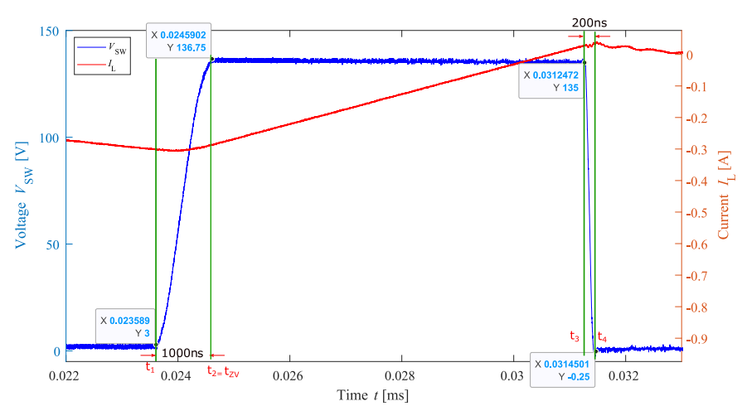
Deadtime Optimization and ZVS
Optimal ZVS for 2L mode
Optimum deadtimes for :
  V_{SW} Rising transition – 1000ns
  V_{SW} Falling transition – 200 ns
Deadtime :
Low – Hardswitching
High – Third quadrant Conduction losses.
High Ron
Low Roff
Optimum deadtime switching for 2L mode
Notes:
Rsing edge t1 and t2 of 1000 ns
Important: use V_sw (switch voltage), not V_DS, to time switching
So the switch H6 is turned on here, exactly when switch voltage is zero
Falling deadtime ~200 ns, rising time > falling time due to R_on and roff effect
Impoper deadtime

Slide 28
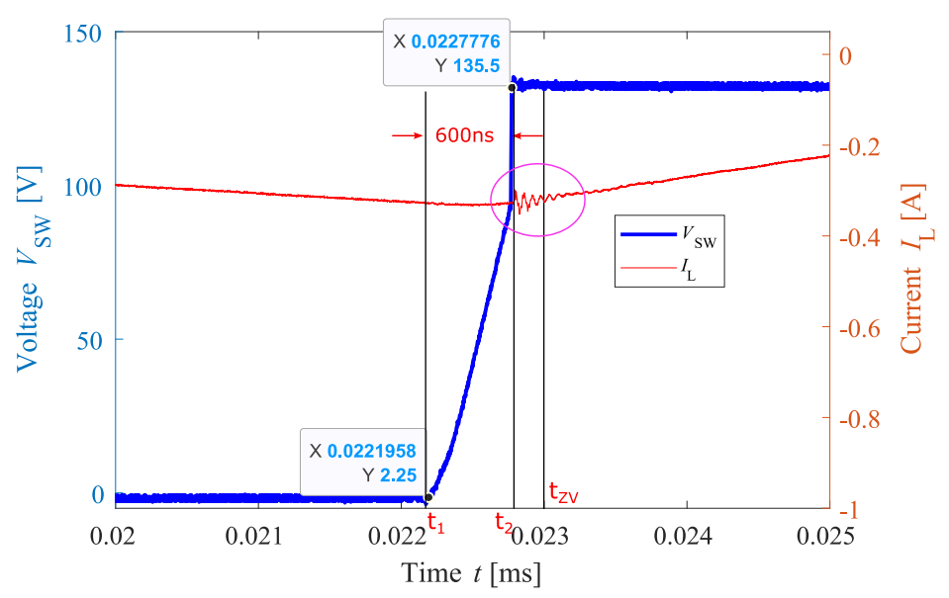
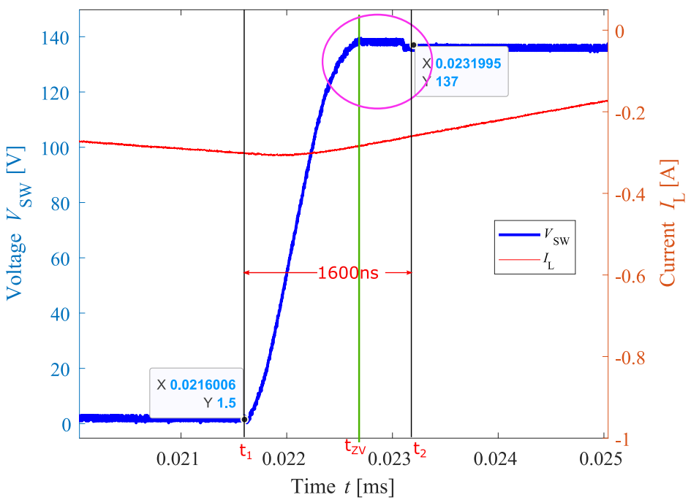
Deadtime Optimization and ZVS
Improper tuning of deadtimes
Hard switching – low deadtime
Third quadrant loss – high deadtime
Notes:
Hard switching at 600 ns (instead of 1000 ns) causes sudden V_sw rise and current ringing
Third quadrant loss ~1600 (units) due to MOSFET reverse conduction during deadtime
Reverse recovery causes voltage bulge when switch turns ON
Both effects reduce efficiency and should be avoided

Slide 29
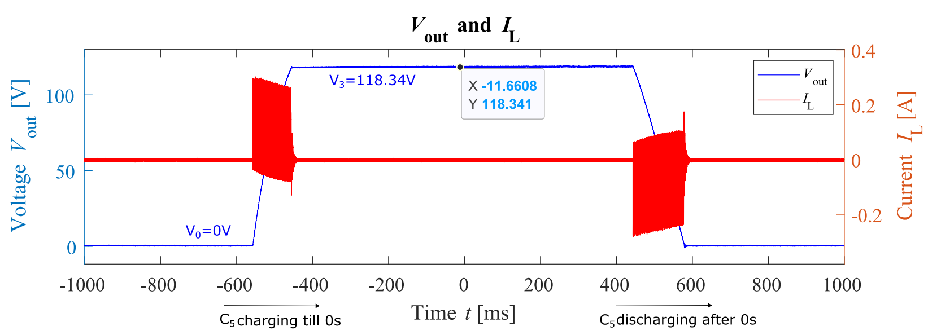
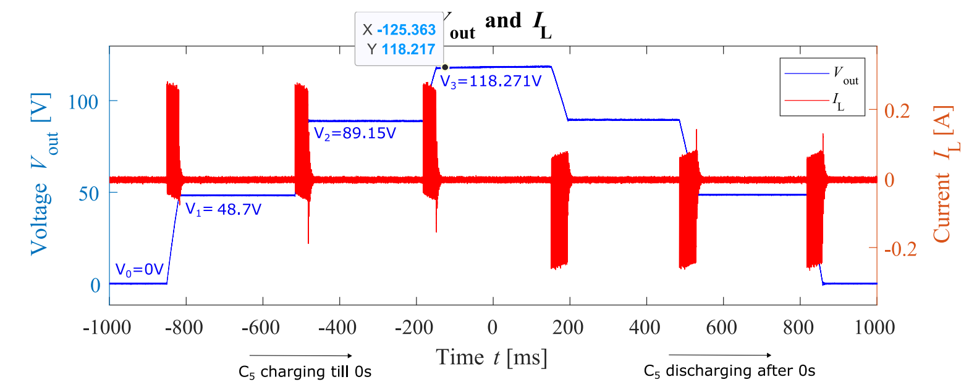
Experiment results
Output waveforms in 2L and 4L mode
Output waveforms in 2L mode
Output waveforms in 4L mode
Notes:
2l and 4l mode - current stayes wihting the hysteresis band in both acses, 4L output is clearly visble

Slide 30
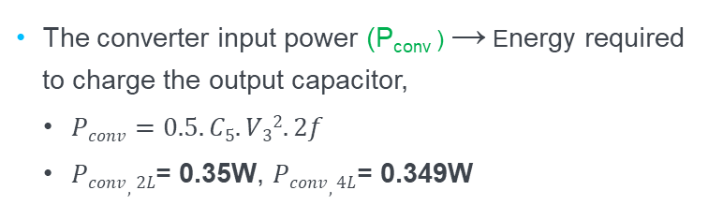
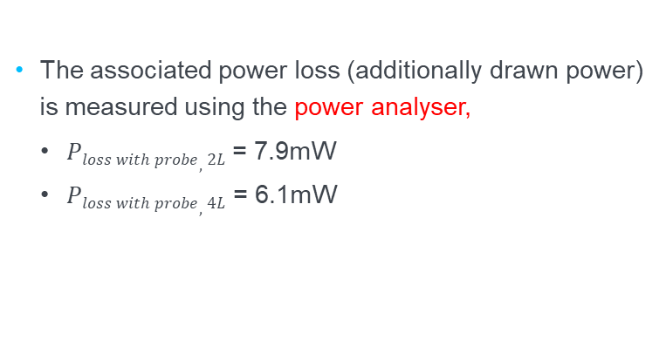
Experiment results
Efficiency measurement
The converter input power (P_{conv} ) → Energy required to charge the output capacitor,
  $Pconv=0.5.C5.V32. 2f$
  $Pconv,2L$= 0.35W, $Pconv,4L$= 0.349W
Parameter | Description | Value
C₅ | Output capacitor | 50 μF
f | System frequency | 0.5 Hz
V_{3,2L} | Max Cap voltage | 118.34 V
V_{3,4L} | Max Cap voltage | 118.22 V
The associated power loss (additionally drawn power) is measured using the power analyser,
  $Ploss with probe,2L$ = 7.9mW
  $Ploss with probe,4L$= 6.1mW
Notes:
As we discussed ealier , the pinput can be cal by – read
2f – we only consider the charging part so half of the entire cycle
Conver input power for both 2l and 4l operation mode is 0.35 W
Power loss is measured by power analyzer, but this power loss also include porbe losses, so we need to sub tract them

Slide 31
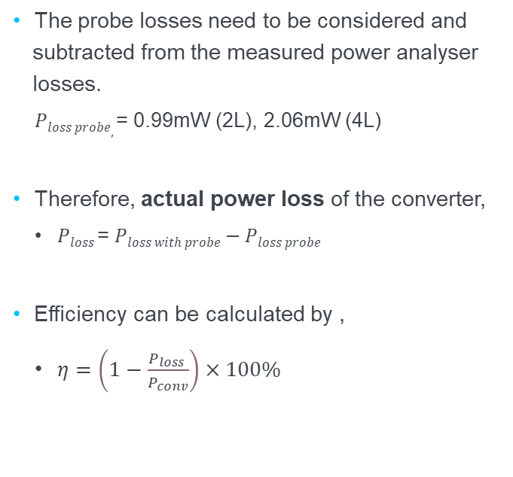
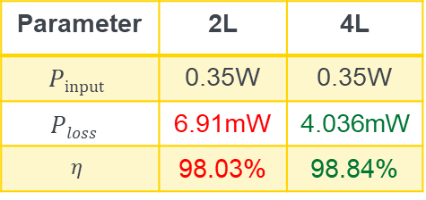
Experiment results
Efficiency measurement
The probe losses need to be considered and subtracted from the measured power analyser losses.
  $Ploss probe,$= 0.99mW (2L), 2.06mW (4L)
Therefore, actual power loss of the converter,
  $Ploss$= $Ploss with probe−Ploss probe$
Efficiency can be calculated by ,
  $η=\left(1−\frac{P_{loss }}{P_{conv}}\right)×100\%$
Parameter | 2L | 4L
$$Pinput$$ | 0.35W | 0.35W
$$Ploss$$ | 6.91mW | 4.036mW
$$η$$ | 98.03% | 98.84%
- 41.6%
Notes:
Probes losses are measuremd and calculated for 2L and 4l, so the final lsose are obtained to be read the values milli watt
The efficiney is obtained to be – read
41.6 percent

Slide 32
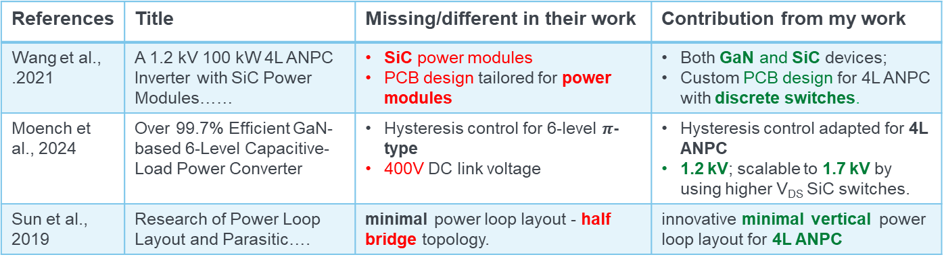
Related Work and Project Contribution
References | Title | Missing/different in their work | Contribution from my work
Wang et al., .2021 | A 1.2 kV 100 kW 4L ANPC Inverter with SiC Power Modules…… | SiC power modules PCB design tailored for power modules | Both GaN and SiC devices; Custom PCB design for 4L ANPC with discrete switches.
Moench et al., 2024 | Over 99.7% Efficient GaN-based 6-Level Capacitive-Load Power Converter | Hysteresis control for 6-level $π$-type 400V DC link voltage | Hysteresis control adapted for 4L ANPC 1.2 kV; scalable to 1.7 kV by using higher V_{DS} SiC switches.
Sun et al., 2019 | Research of Power Loop Layout and Parasitic…. | minimal power loop layout - half bridge topology. | innovative minimal vertical power loop layout for 4L ANPC
Notes:
These are the some of the previous works done related to my research,
He main continuation by my work is the usage of Gan sic devices,
Curosmpcb design for discreter switches .
Bilinf a 1.2 kv support converter, which can be further expanding to 1.7kv by just replacing the SiC switches

Slide 33
Summary and Conclusion
Summary:
  Which multilevel topology?
  ✅ 4L ANPC topology – hybrid GaN/SiC design (lower voltage blocking)
  How can hysteresis current control be adapted?
  ✅ Gate logic table for efficient 2L hysteresis – PLECS + Experimental validation
  What PCB layout strategies needed?
  ✅ Vertical power loop and efficient gate loop layout, HV isolation ensured, minimal interference
  What performance is achieved?
  ✅ ZVS at optimized dead times; 98.84% efficiency (4L) vs. 98.03% (2L); ~41.6% loss reduction in 4L
Conclusion:
  This work contributes to the advancement of next-gen multilevel converters suitable for EVs, renewable energy, and electrocaloric heat systems.
Notes:
All he research questions mentione earlier were answered in the course of this thesis
chossing ANPC l topology
makng a logic table for efficie 2 L hytseris control and validatin it in plecs nd experiment
developeing a innvovatib=ve vertical power loop layout and efficine tgate loop layout,
achieving a effiiceincu y og 98,84 in 4L with 41.6 loss reduction compared to 2L
Conclusion - read

Slide 34
👋
THANK YOU

Slide 35
WHY 4L ANPC
Multilevel topolgies
Nowadays, NPC converters are the widely used multilevel converters because of their simple structure, fewer components count, and relatively easy control methodology.
Diode calmped NPC
ANPC
Pi type

Slide 36
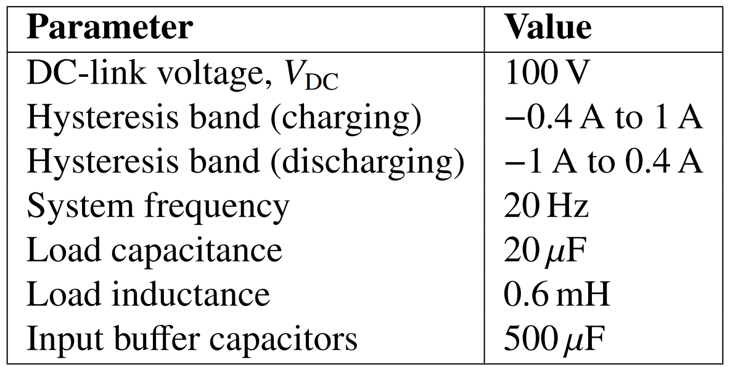
Simulation Results
Simulation operating point
Simulation output waveforms

Slide 37
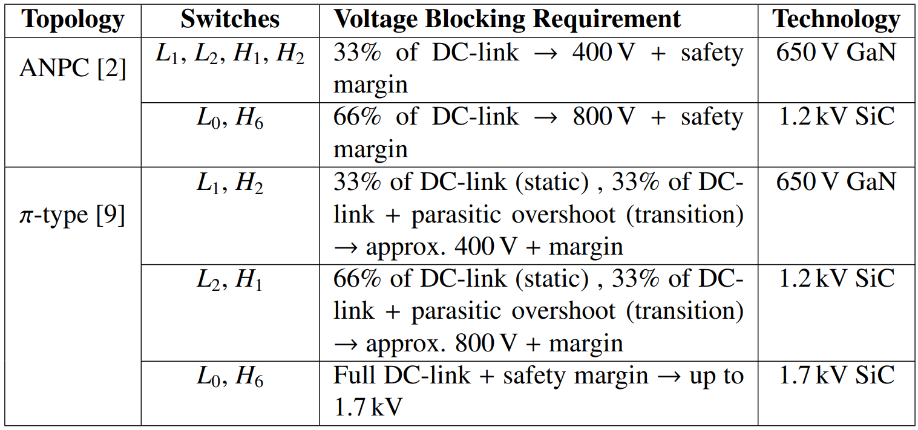
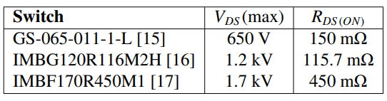

WHY 4L ANPC
ANPC 4L vs $π$ type
Voltage-blocking Requirements for ANPC and π-Type Topologies in a 1.2 kV System for 4L Operation
ANPC topology voltage paths
$π$ type topology voltage paths
Switches used for comparison

Slide 38
Deadtime Optimization and ZVS
Optimal ZVS for 2L mode
Optimum deadtimes for :
  V_{SW} Rising Edge Transition – 1000ns
  V_{SW} Falling edge transition – 200 ns
Improper deadtime tuning leads to hard switching and third-quadrant conduction losses.
Optimum deadtime switching for 2L mode

Slide 39
PCB Design Considerations
Power loop
A hybrid vertical + minimal layout method is used for all loops. Loop 3 includes a partially lateral routing due to unavoidable component placement constraints.
Snubber capacitors on bottom layer, aligned below top-layer switches.
Return path is directly under forward path, thereby
  reducing loop area (just the board thickness) and
  enhancing flux cancellation
Power loop design strategies for a simple totem pole topology

Slide 40
Circuit Design Considerations
Gate circuit
Selectable control of gate signals either from onboard SoC or external controller via optical receiver
RC low pass filters (1 kΩ ,10 pF) suppress high frequency noise
Decoupling capacitors (10 µF) stabilizes the supply voltage during switching
Gate resistors:
  GaN HEMT- Ron= 22.2 Ω, Roff = 2.2
  SiC MOSFETs - Ron= 15 Ω, Roff = 2.2 Ω
Gate driver circuit of one of the
GaN HEMTs

Slide 41
Approach
1.2 kV hybrid GaN/SiC four-level ANPC converter
  The 4L ANPC topology is selected for its balance of multilevel benefits and manageable complexity.
  The 4L ANPC converter using a two-level hysteresis current control is simulated in PLECs, verifying the gate signal logic table for hardware implementation.
  Hardware design is carried out, including component selection, schematic and innovative PCB layout.
  Experimental validation is conducted through waveform analysis and efficiency measurements, comparing performance between 2-level and 4-level modes.

Slide 42
Background
Multilevel inverters
Modern EV and renewable systems are increasing DC-link voltages (400 V to 1.2 kV+) to reduce losses, reduce cable sizes, and lower component weight.
However, this raises voltage stress on switches, Total Harmonic Distortion (THD), and switching frequency demands on traditional two-level (2L) converters.
Multilevel converters address these issues by producing stepped output voltage waveform closer to sine waves.
Multilevel topologies offer
  Lower THD and improved waveform quality
  Reduced switching losses and filtering needs
  Use of lower voltage WBG devices (GaN and SiC) in HV systems
2L
3L
5L
4L with
Ground reference

Slide 43
Problem
Despite their benefits, multilevel converters require many switches, gate drivers, and control circuits, leading to:
  Increased system size and cost
  Greater control strategy complexity
  Challenging PCB hardware design - especially for high-efficiency operation
Research Questions
Which multilevel NPC converter topology offers the best trade-off between efficiency, compactness, and complexity for high voltage applications (>1.2kV)?
How can control techniques like hysteresis current control be effectively applied to multilevel converters?
What PCB layout strategies enable efficient, noise resilient and reliable converter design?
5L Diode Clamped converter

Slide 44
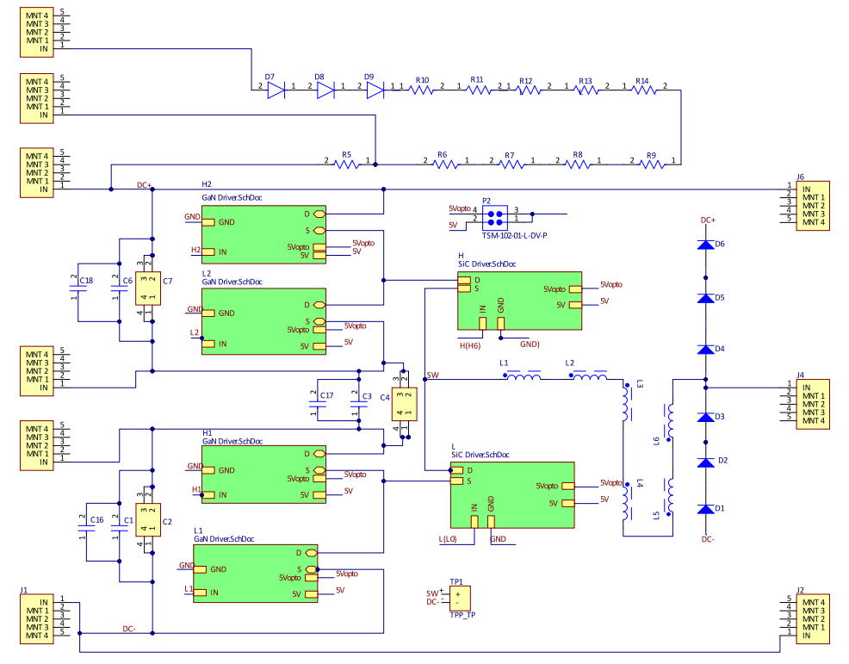
Circuit Design Considerations
Power circuit
Switch | Position | V_{DS} max | R_{DS}ON
GaN (GS-065-011-1-L) | L₁, L₂, H₁, H₂ | 650 V | 150mΩ
SiC (IMBG120R116M2H) | L₀, H₆ | 1200V | 115.7mΩ
H₂
3x DC-link buffer capacitors – 700 V, 110 μF
Snubber capacitors (33nF) suppress spikes and HF noise, and their compact size allows placement near switches on the PCB.
Load inductors and load capacitors are connected externally.
_{H}
L₂
H₁
L
  .
L₁
Power circuit of 4L ANPC

Slide 45
Summary and Conclusion
Summary:
  Selected 4L ANPC topology for its performance and support for hybrid GaN/SiC integration with lower voltage blocking requirements.
  Constructed a gate signal logic table for an efficient 2-level hysteresis current control and validated via PLECs simulations
  Designed a compact PCB with hybrid minimal/vertical loop layout to reduce parasitics, ensure voltage isolation, and optimize component placement.
  Achieved ZVS at optimized dead times
  Validated experimentally to confirm a higher efficiency of 98.84% in 4L vs. 98.03% in 2L with ~41.6% power loss reduction in 4L mode.
Conclusion:
  This work contributes to the advancement of next-gen multilevel converters suitable for EVs, renewable energy, and electrocaloric heat systems.
  Future work can implement SVVPWM or advanced gate logic for capacitor voltage balancing under non-ideal capacitive load conditions
Which multilevel NPC converter topology offers the best trade-off between efficiency, compactness, and complexity for high voltage applications (>1.2kV)?
How can control techniques like hysteresis current control be effectively applied to multilevel converters?
What PCB layout strategies enable efficient, noise resilient and reliable converter design?

Slide 46
Approach
1.2 kV hybrid GaN/SiC four-level ANPC converter
  Four-level (4L) ANPC topology is chosen for its balance of multilevel benefits and manageable complexity.
  Gate logic tables for 2L and 4L modes is designed to minimize switching events among switches.
  Strategies like Vertical PCB layout methods, high voltage isolation, minimal overlapping of signal and power lines ensure reliable operation
  Dead times were optimized to maximize efficiency.

Slide 47
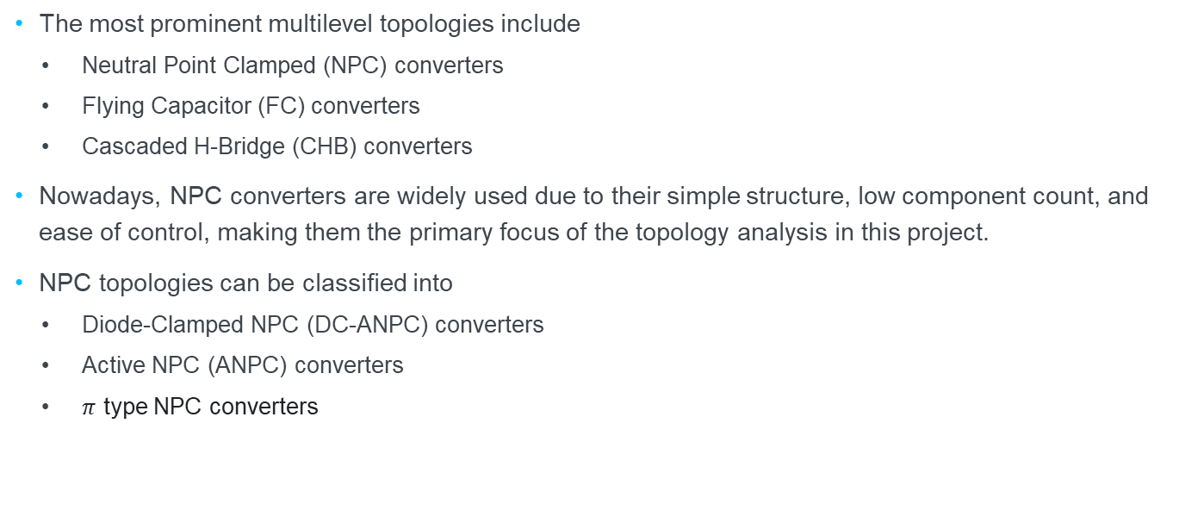
NPC Topologies
The most prominent multilevel topologies include
  Neutral Point Clamped (NPC) converters
  Flying Capacitor (FC) converters
  Cascaded H-Bridge (CHB) converters
Nowadays, NPC converters are widely used due to their simple structure, low component count, and ease of control, making them the primary focus of the topology analysis in this project.
NPC topologies can be classified into
  Diode-Clamped NPC (DC-ANPC) converters
  Active NPC (ANPC) converters
  $π$ type NPC converters

Slide 48
Current feedback provision:
  MCR1101-5-5 Hall Sensor: for real-time embedded control
  MicSig CP1003B Probe: for high-speed waveform analysis (used in the experiment)

Slide 49


Experiment results
Buffer capacitor selection
Buffer capacitor voltages when C_{OUT} =50 µF
Buffer capacitor voltages when C_{OUT} =5 µF

Slide 50
Summary and Conclusion
Summary:
  Selected 4L ANPC topology for its performance and support for hybrid GaN/SiC integration with lower voltage blocking requirements.
  Constructed a gate signal logic table for an efficient 2-level hysteresis current control and validated via PLECs simulations
  Designed a compact PCB with hybrid minimal/vertical loop layout to reduce parasitics, ensure voltage isolation, and optimize component placement.
  Achieved ZVS at optimized dead times
  Validated experimentally to confirm a higher efficiency of 98.84% in 4L vs. 98.03% in 2L with ~41.6% power loss reduction in 4L mode.
Conclusion:
  This work contributes to the advancement of next-gen multilevel converters suitable for EVs, renewable energy, and electrocaloric heat systems.

Slide 51
Contributions
The main contributions of this work [to society/ the research field]
  [List some using bullet points]

Slide 52
Related work
[Show a few (2- max. 5) of the MOST RELATED works, idealy those works investigate similar questions as you do, but there is one thing missing or done differently/missing, which you adress now!]

Slide 53

Experiment results
Output waveforms in 2L and 4L mode
Output waveforms in 2L mode
Output waveforms in 4L mode
Operation point of the experiment

