Slide 1
Android Basics
Credit goes to Google

Slide 2
Agenda
Mobile Application Development (MAD)
Intro to Android platform
Platform architecture
Development tools
Hello Android

Slide 3
Few reasons to go MAD…
Millions of mobile users
E-Commerce
Internet access anywhere
Social networking
Games
Etc.

Slide 4
Introduction to Android
Open software platform for mobile development
A complete stack – OS, Middleware, Applications.
Fast application development in Java
Open source under the Apache 2 license

Slide 5


Slide 6
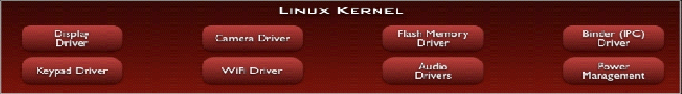
Linux Kernel
Device drivers
Memory management
Process management
Networking

Slide 7
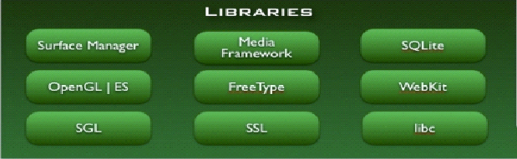
Libraries
C/C++ libraries
Interface through Java
Surface manager – Handling UI Windows
2D and 3D graphics
Media codecs, SQLite, Browser engine

Slide 8
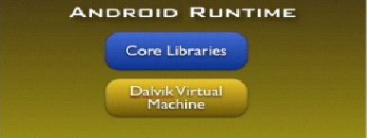
Android Runtime
Dalvik VM
  Dex files
  Compact and efficient than class files
  Limited memory battery power
Core Libraries
  Java 5 Std edition
  Collections, I/O etc…and

Slide 9
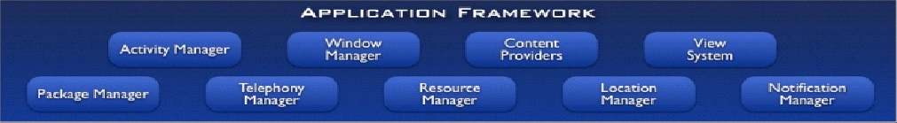
Application Framework
API interface
Activity manager – manages application life cycle.

Slide 10
Applications
Built in and user apps
Can replace built in apps

Slide 11
Development Tools
Eclipse
Android SDK 1.0-2.0
  developer.android.com

Slide 12
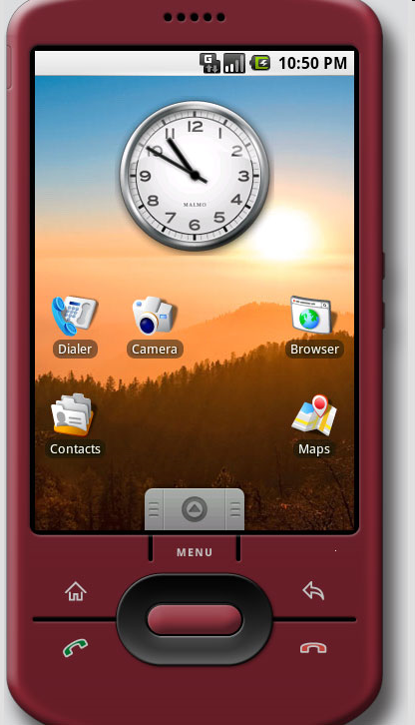
The Emulator
A Virtual Environment to execute android apps.
Runs the same image as the device

Slide 13
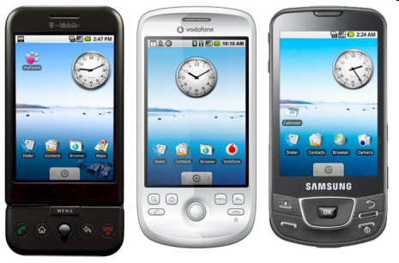
Devices

Slide 14
Lets execute android application….

