Slide 1
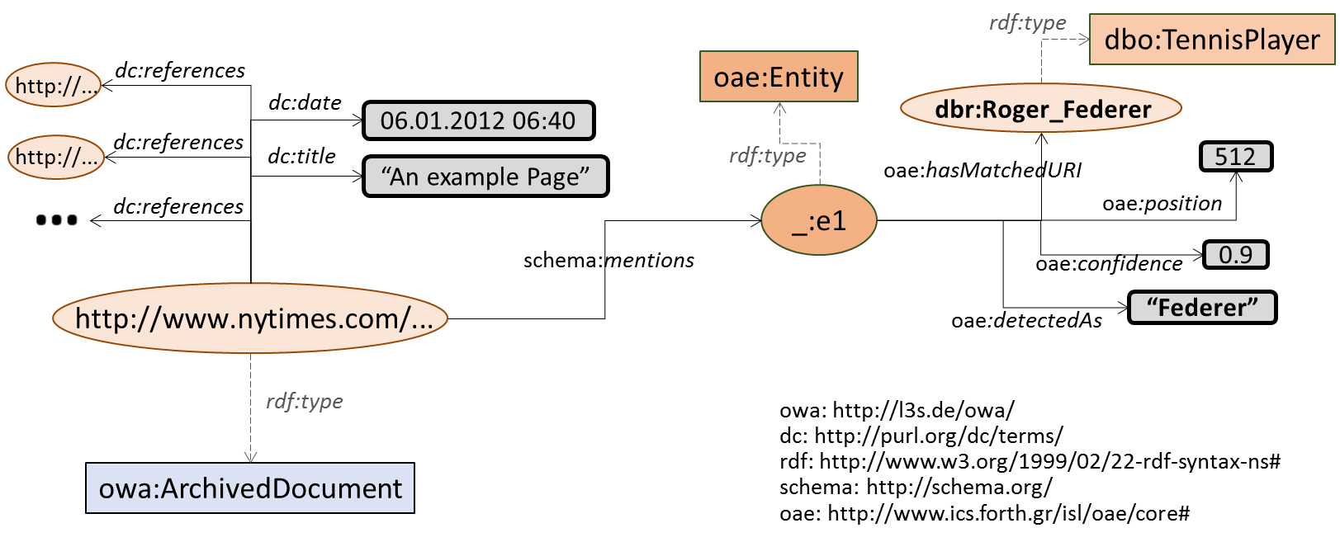
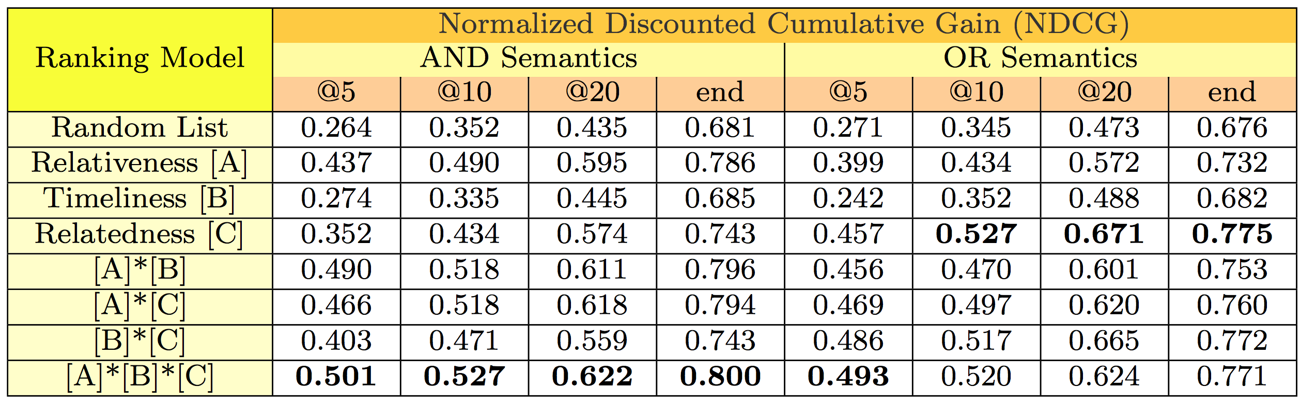



Ranking Archived Documents for Structured Queries over Semantic Layers
Vaibhav Kasturia, Pavlos Fafalios, Wolfgang Nejdl
L3S Research Center, University of Hannover, Germany
{kasturia,fafalios,nejdl}@l3s.de
1. Motivation
5. Problem Definition
How to explore archives in a more advanced and exploratory way?
Find documents discussing about a specific category of entities (e.g., philanthropists), or about entities sharing some characteristics (e.g., born in Germany before 1960)?
How to explore archives by integrating information from existing knowledge bases, like DBpedia?
Ranking Documents for Structured Queries over Semantic Layers
Consider a semantic layer over a collection of archived documents D published within a set of time periods T of fixed granularity (e.g., day), and a set of entities E mentioned in documents of D.
Given a SPARQL query Q requesting documents from D published within a time period 𝑻_{𝑸}⊆𝑻 and related to one or more Entities of Interest (EoI) 𝑬_{𝑸}⊆𝑬 with logical AND (mentioning all EoI) or OR (mentioning at least one EoI) semantics, the problem is how to rank the returned documents 𝑫_{𝑸}⊆𝑫 that match Q.
2. Semantic Layer
RDF repository describing metadata and annotation information for a collection of archived documents.
Allows running advanced, entity-centric SPARQL queries that combine metadata of the documents (e.g., publication date) and semantic information (e.g., mentioned entities)
More at: Fafalios et al., "Building and Querying Semantic Layers for Web Archives", JCDL'17
Example for a news article:
6. Baseline Probabilistic Modeling
What makes an archived document important for one or more entities of interest (EoI)?
Relativeness: the document should talk about the EoI (as its main topic)
Timeliness: the document should have been published in an important (for the EoI) time period
Relatedness: the document should discuss the relation of the EoI with other important (for the EoI) entities
Relativeness
Consider the frequency of the EoI in the document d
Probability to select a document given only the query entities
“AND” (conjunctive) semantics
“OR” (disjunctive) semantics
Timeliness
Consider the number of documents mentioning the EoI during time period t
Probability to select a document given only its publication date
“AND” (conjunctive) semantics
“OR” (disjunctive) semantics
where
Avg. percentage of EoI in articles of t
Example SPARQL queries over Semantic Layers
SELECT DISTINCT ?article WHERE {
?article dc:date ?date FILTER(year(?date) = 1990) .
?article schema:mentions ?entity1, ?entity2 .
?entity1 oae:hasMatchedURI dbr:Nelson_Mandela .
?entity2 oae:hasMatchedURI dbr:F._W._de_Klerk }
Relatedness
Consider the number of co-occurrences of e with the EoI in important time periods
Avoid over-emphasizing common and general entities
Probability to select a document given only other entities mentioned in the retrieved documents
Retrieve articles of 1990 discussing about Nelson Mandela and F. W. de Klerk
“AND” (conjunctive) semantics
“AND” (conjunctive) semantics
where
SELECT DISTINCT ?article WHERE {
?article dc:date ?date FILTER(year(?date) = 1990) .
?article schema:mentions ?entity .
?entity oae:hasMatchedURI ?entURI .
?entURI dc:subject dbc:State_Presidents_of_South_Africa }
“OR” (disjunctive) semantics
where
Avg. percentage of EoI in articles of e
Retrieve articles of 1990 discussing about state presidents of South Africa
“OR” (disjunctive) semantics
Joining the models:
3. The Problem
7. Evaluation
The results returned by a SPARQL query:
can be numerous
all equally match the query
How to rank them for identifying and promoting the most important ones?
What makes an archived document important for a given query?
We create ground truth consisting of 28 queries (14 AND, 14 OR Semantics)
Articles in ground truth are judged on a graded relevance score from 0 to 3 depending upon importance of article to query entities.
NDCG for different rankings and their combinations was calculated
4. Related Work
Ranking of archived documents (for free-text queries)
Time-aware Retrieval and Ranking [Kanhabua and Anand, 2016]
Tempas [Holzmann and Anand, 2016], HistDiv [Singh et al., 2016]
Works by Kanhabua et al. (2016), Vo et al. (2016)
Ranking in knowledge graphs
Learning to rank for RDF entity search [Dali et al., 2012]
Swoogle [Ding et al., 2005], SemRank [Anyanwu et al., 2005]
NAGA [Kasneci et al., 2008], DING [Delbru et al., 2010],
ReconRank [Hogan et al., 2006], Noc-order [Graves et al., 2008]
Our approach: Ranking archived documents for structured queries in knowledge graphs
Availability of metadata and entity annotations
No access to full contents!
NDCG for different ranking models and their combinations
8. Next Steps
Evaluate a Random Walk with Restart (RWR) model for each query graph
Nodes consist of documents returned for SPARQL query, entities mentioned in the returned documents and entities of interest
Edge traversal possible between documents to their mentioned entities and vice-versa
http://alexandria-project.eu

