Slide 1


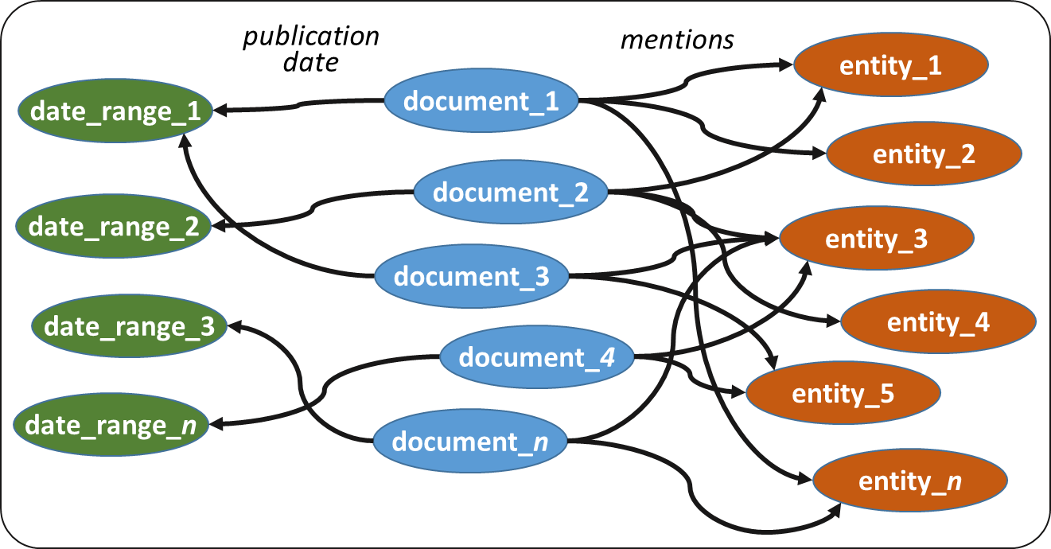

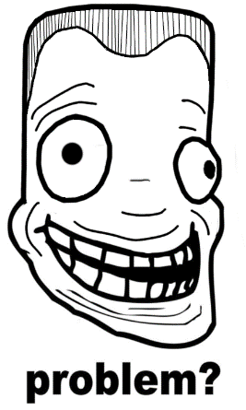

Towards a Ranking Model for Semantic Layers over Digital Archives
Pavlos Fafalios, Vaibhav Kasturia, Wolfgang Nejdl
Semantic Layer over an archived corpus:
SPARQL query over the semantic layer:
SELECT DISTINCT ?article WHERE {
?article dc:date ?date FILTER(year(?date) = 1990) .
?article schema:mentions ?entity .
?entity oae:hasMatchedURI ?entURI .
?entURI dc:subject dbc:State_Presidents_of_South_Africa }
Find articles of 1990 discussing about state presidents of South Africa
triples
The Problem:
The results returned by a SPARQL query:
can be numerous
all equally match the query
How to rank them?
What makes an archived document important, given:
a date range
one or more entities of interest
Notes:
Hi everyone. I am Pavlos. I would like to ask you to pass by my poster and help me with my problem.
So, a semantic layer is a graph describing information about a collection of archived documents.
Specifically, the graph contains some documents which are connected with some metadata and some entities mentioned in their contents.
Now, we can run some interesting queries, like: give me documents of 1990 discussing about state presidents of south Africa.
But, the results returned by a SPARQL query can be numerous and all equally match the query.
So, the question is: how should we rank them?

