Slide 1
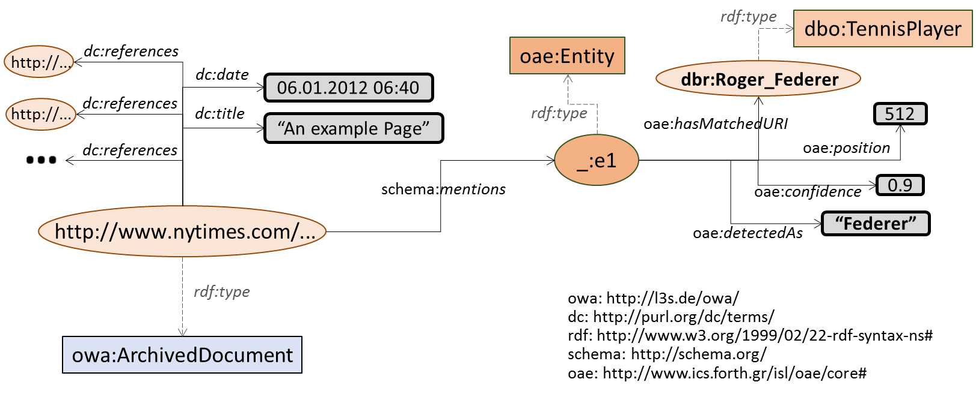
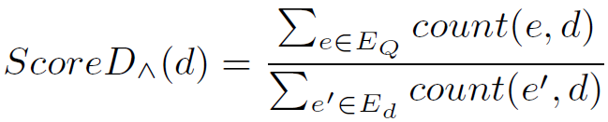
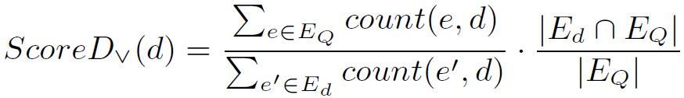
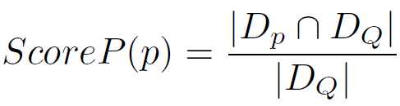
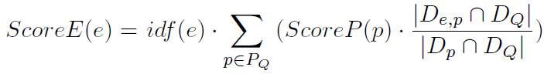





Towards a Ranking Model for Semantic Layers over Digital Archives
Pavlos Fafalios, Vaibhav Kasturia, Wolfgang Nejdl
L3S Research Center, University of Hannover, Germany
{fafalios,kasturia,nejdl}@l3s.de
1. Motivation
4. Related Work
How to explore archives in a more advanced and exploratory way?
Find documents discussing about a specific category of entities (e.g., philanthropists), or about entities sharing some characteristics (e.g., born in Germany before 1960)?
How to explore archives by integrating information from existing knowledge bases, like DBpedia?
Ranking of archived documents (for free-text queries)
Time-aware Retrieval and Ranking [Kanhabua and Anand, 2016]
Tempas [Holzmann and Anand, 2016], HistDiv [Singh et al., 2016]
Works by Kanhabua et al. (2016), Vo et al. (2016)
Ranking in knowledge graphs
Learning to rank for RDF entity search [Dali et al., 2012]
Swoogle [Ding et al., 2005], SemRank [Anyanwu et al., 2005]
NAGA [Kasneci et al., 2008], DING [Delbru et al., 2010],
ReconRank [Hogan et al., 2006], Noc-order [Graves et al., 2008]
Our approach: Ranking archived documents for structured queries in knowledge graphs
Availability of metadata and entity annotations
No access to full contents!
2. Semantic Layer
RDF repository describing metadata and annotation information for a collection of archived documents.
Allows running advanced, entity-centric SPARQL queries that combine metadata of the documents (e.g., publication date) and semantic information (e.g., mentioned entities)
More at: Fafalios et al., "Building and Querying Semantic Layers for Web Archives", JCDL'17
Example for a news article:
5. Problem Definition
Ranking Documents for Structured Queries over Semantic Layers
Consider a semantic layer over a collection of archived documents D published within a set of time periods T of fixed granularity (e.g., day), and a set of entities E mentioned in documents of D.
Given a SPARQL query Q requesting documents from D published within a time period 𝑻_{𝑸}⊆𝑻 and related to one or more Entities of Interest (EoI) 𝑬_{𝑸}⊆𝑬 with logical AND (mentioning all EoI) or OR (mentioning at least one EoI) semantics, the problem is how to rank the returned documents 𝑫_{𝑸}⊆𝑫 that match Q.
6. Towards a Ranking Model
Example SPARQL queries over Semantic Layers
What makes an archived document important for one or more entities of interest (EoI)?
Relativeness: the document should talk about the EoI (as its main topic)
Timeliness: the document should have been published in an important (for the EoI) time period
Relatedness: the document should discuss the relation of the EoI with other important (for the EoI) entities
SELECT DISTINCT ?article WHERE {
?article dc:date ?date FILTER(year(?date) = 1990) .
?article schema:mentions ?entity1, ?entity2 .
?entity1 oae:hasMatchedURI dbr:Nelson_Mandela .
?entity2 oae:hasMatchedURI dbr:F._W._de_Klerk }
“AND” (conjunctive) semantics
Retrieve articles of 1990 discussing about Nelson Mandela and F. W. de Klerk
Relativeness (of a document d)
Consider the frequency of the EoI in d
SELECT DISTINCT ?article WHERE {
?article dc:date ?date FILTER(year(?date) = 1990) .
?article schema:mentions ?entity .
?entity oae:hasMatchedURI ?entURI .
?entURI dc:subject dbc:State_Presidents_of_South_Africa }
“OR” (disjunctive) semantics
“AND” (conjunctive) semantics
“OR” (disjunctive) semantics
Retrieve articles of 1990 discussing about state presidents of South Africa
Timeliness (of a time period p)
Consider the number of documents mentioning the EoI during p
3. The problem
Relatedness (of an entity e to the EoI)
Consider the number of co-occurrences of e with the EoI in important time periods
Avoid over-emphasizing common and general entities
The results returned by a SPARQL query:
can be numerous
all equally match the query
How to rank them for identifying and promoting the most important ones?
What makes an archived document important for a given query?
Joining the models:
7. Next Steps
Create a ground truth for the problem at hand
Evaluate our baseline ranking model and the effect of each component
Define and evaluate more advanced models (learning to rank, stochastic, etc.)
Investigate the case of web archives (where documents have versions and publication dates are not usually available)
http://alexandria-project.eu

