Slide 1
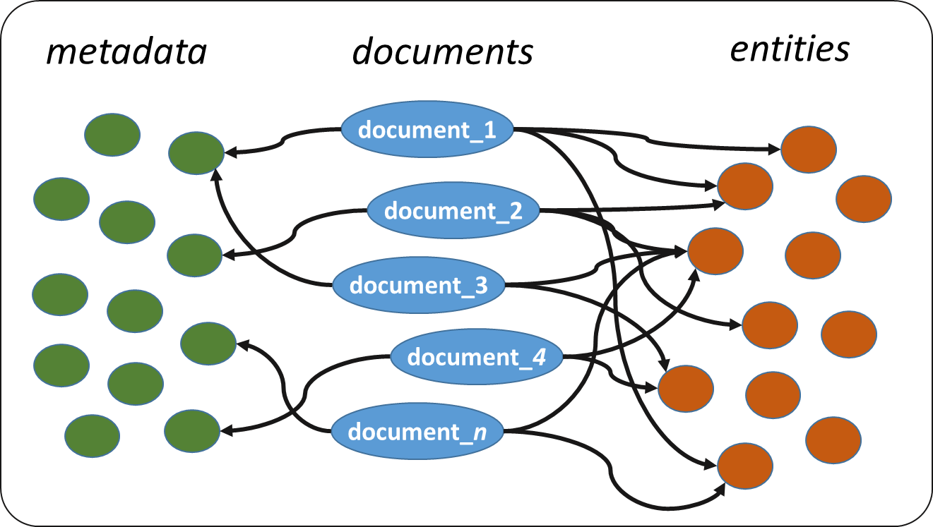
Semantic Layers
Building Semantic Layers
RDF/S data model: “Open Web Archive”
Construction process
Open source framework: “ArchiveSpark2Triples”
Case Studies and Query Capabilities
Semantic Layer over a Web Archive (versioned)
Semantic Layer over a News Archive (non-versioned)
Semantic Layer over a Social Media Archive
Evaluation
Problems and Limitations
Notes:
So, in the next slides, we will see a data model, the process as well as a framework for constructing semantic layers.
I will also present 3 case studies and query examples that demonstrate the capabilities offered by a semantic layer.
Finally, I will present some evaluation results, as well as problems and limitations.

Slide 2
RDF/S data model: Open Web Archive
http://l3s.de/owa/
oae:confidence
rdfs:Literal
dc:date
rdfs:Literal
dc:date
oae:hasMatchedURI
rdfs:Resource
dc:title
rdfs:Literal
dc:title
oae:Entity
oae:detectedAs
rdfs:Literal
schema:mentions
oae:position
dc:hasVersion
rdfs:Literal
owa:ArchivedDocument
oa:hasBody
owa:VersionedDocument
oa:Annotation
oa:hasTarget
owa:firstCapture
rdfs:Literal
owa:lastCapture
rdfs:Literal
owa: http://l3s.de/owa/
oa: http://www.w3.org/ns/oa#
oae: http://www.ics.forth.gr/isl/oae/core# dc: http://purl.org/dc/terms/
schema: http://schema.org/ rdfs: http://www.w3.org/2000/01/rdf-schema#
owa:numOfCaptures
rdfs:Literal
Notes:
The main component of our modeling is an archive document which may have or may not have some versioned documents, that is, captures in different time periods.
For those familiar with the Memento Framework, an Archived document actually corresponds to an “Original Resource” and a versioned document to a Memento.
Each archived or versioned document is associated with some basic metadata values, like publication or capture date, and title.
In case an archived document has versions, it is associated with 3 properties representing the date of first capture, the date of last capture, as well as the total number of captures.
Now, an archived or versioned document has a set of entity annotations, that is entities that are mentioned in the document, extracted using an entity linking system. For this we make use of the Open Annotation Data Model which associates annotations to resources. For simplicity, we can also directly associate a document to an entity through the property “mentions” of schema.org. This can highly reduce the number of derived triples.
Finally, an entity has a position in the document, a mention name, as well as a link to an entity in a knowledge base with a specific confidence score. Using this link, we can now retrieve more information about the entity like properties and associations with other entities.
Note that in our modeling we make use of several established vocabularies, like Dublin Core and RDF/S.

Slide 3
Open Web Archive – Example of Non-versioned Web Page
06.01.2012 06:40
dc:date
rdf:type
dbo:TennisPlayer
dc:title
oae:Entity
“An example Page”
oae:hasMatchedURI
rdf:type
dbr:Roger_Federer
schema:mentions
_:e1
http://www.nytimes.com/...
oae:confidence
0.9
rdf:type
oae:position
schema:mentions
512
_:e2
oae:detectedAs
owa:ArchivedDocument
“Federer”
schema:mentions
…
owa: http://l3s.de/owa/
dc: http://purl.org/dc/terms/ rdf: http://www.w3.org/1999/02/22-rdf-syntax-ns# schema: http://schema.org/
oae: http://www.ics.forth.gr/isl/oae/core#
Notes:
Let’s see an example of a non-versioned web page.
Consider an article of New York Times. The article is associated with some metadata, like its publication date and its tile, as well as a set of entities mentioned in the article. In our example, we see that the article mentions the entity name “Federer” which probably corresponds to the Tennis Player Roger Federer.

Slide 4
Open Web Archive – Example of Versioned Web Page
dbo:SoccerTournament
owa:firstCapture
dc:date
06.01.2008 06:40
06.01.2008 06:40
rdf:type
owa:lastCapture
22.05.2014 18:01
owa:VersionedDocument
dc:title
dbr:UEFA_Euro_2008
owa:numOfCaptures
“An example Page”
:v1
rdf:type
oae:hasMatchedURI
17
728
dc:hasVersion
schema:mentions
_:e1
http://archive.org/1/...
oae:position
http://www.example.com/
dc:Event
oae:confidence
0.85
dc:hasVersion
rdf:type
rdf:type
http://archive.org/2/...
“Euro 2008”
oae:detectedAs
owa:ArchivedDocument
owl:sameAs
dc:hasVersion
http://archive.org/3/...
owa: http://l3s.de/owa/
dc: http://purl.org/dc/terms/ rdf: http://www.w3.org/1999/02/22-rdf-syntax-ns# schema: http://schema.org/
oae: http://www.ics.forth.gr/isl/oae/core#
owl:http://www.w3.org/2002/07/owl#
dc:date
06.01.2012 06:40
Notes:
Here is an example of a versioned web page. In this case, a web page has several versions, while we know the date of first capture, the date of last capture and the total number of captures. Now, each version has its own metadata and extracted entities. For instance, in this example we see that a mention of the 2008 euro soccer tournament was identified in the first version of this web page.
An important characteristic is that we can specify same-as relationships for defining that a specific version of a web page is exactly the same as a previous version. Thereby, we can avoid storing identical information for same crawled versions.

Slide 5











The construction process
Extraction of main content and metadata
Entity Extraction and Linking
Schema-based Generation of RDF triples
Web Archive
WARC/CDX
NITF
AIDA
STORAGE
Entity Enrichment
(optionally)
Publication
(optionally)
Linked Open Data
Storage
Notes:
Here is the process that we can follow for constructing a semantic layer.
First is extraction of main content and desired metadata. This of course depends on the format of the data. For the case of web archives the standard format is WARC and CDX, while for news is NITF. Then, we apply entity extraction and linking in the main content of each document. State-of-the-art entity linking systems include TagMe, AIDA and Babelfy.
The next step is to generate the RDF triples that describe metadata and annotation information about our collection. For this we can exploit the proposed Open Web Archive data model or any other vocabulary required for describing our data and metadata.
Optionally, we can enrich the entities with more information coming from other knowledge bases, like DBpedia. Finally, we store the triples in a semantic repository, for instance Virtuoso, and we can also publish them as Linked Open Data or through a SPARQL endpoint.

Slide 6
Case Studies – Query Capabilities
Information Exploration and Integration
Articles of summer 1989 mentioning New York lawyers born in Brooklyn (and for each lawyer show its birth date and a description in French)
Semantic Layer
over NYT articles
SELECT DISTINCT ?article ?title ?date ?nylawyer ?birthDate ?abstr WHERE {
SERVICE <http://dbpedia.org/sparql> {
?nylawyer dc:subject dbc:New_York_lawyers ;
dbo:birthPlace dbr:Brooklyn .
OPTIONAL {
?nylawyer dbo:birthDate ?birthDate ;
dbo:abstract ?abstr FILTER(lang(?abstr)='fr') } }
?article dc:date ?date FILTER(?date >= "1989-06-01"^^xsd:date &&
?date <= "1989-08-31"^^xsd:date)
?article schema:mentions ?entity .
?entity oae:hasMatchedURI ?nylawyer .
?article dc:title ?title } ORDER BY ?nylawyer
44 lawyers
Result: 184 articles
Notes:
Now we will see some query examples that demonstrate how we can satisfy our 6 motivating functionalities.
This query over the NYT semantic layer requests articles of summer 1989 mentioning New York lawyers born in Brooklyn.
Notice that, by directly accessing DBpedia knowledge base, the query retrieves the entities that satisfy the query as well as some addition information for each entity, specifically the birth date and a description in France of each lawyer.
The result is 184 articles mentioning in total 44 different lawyers.

Slide 7
Case Studies – Query Capabilities
Information Exploration and Integration
Popular tweets (with >50 re-tweets) posted during the summer of 2016, mentioning basketball players of the NBA team Los Angeles Lakers
Semantic Layer
over tweets collection
SELECT DISTINCT ?tweet ?count ?date ?entityUri WHERE {
SERVICE <http://dbpedia.org/sparql> {
?entityUri dc:subject dbc:Los_Angeles_Lakers_players }
?t a tw:Tweet ; dc:date ?date FILTER(?date>="2016-06-01"^^xsd:dateTime &&
?date<="2016-08-31"^^xsd:dateTime)
?t tw:retweetCount ?count FILTER (?count > 50) .
?t schema:text ?tweet ; schema:mentions ?entity .
?entity oae:hasMatchedURI ?entityUri }
7 players
Result: 14 tweets
Notes:
Here is another query example over the tweets semantic layer.
The query requests popular tweets of more than 50 re-tweets posted during the summer of 2016, mentioning basketball players of the NBA team Los Angeles Lakers.
Again here we access Dbpeda at query-execution time for getting the players of Los Angeles Lakers. The result is 14 tweets mentioning 7 different players.

Slide 8
Case Studies – Query Capabilities
Information Inference / Knowledge Discovery
Most discussed journalists in Occupy Movement collection
Semantic Layer
over Occupy Movement
SELECT ?journ (COUNT(DISTINCT ?page) AS ?num) WHERE {
SERVICE <http://dbpedia.org/sparql> {
?journ a yago:Journalist110224578 }
?page a owa:ArchivedDocument ; dc:hasVersion ?version .
?version schema:mentions ?entity .
?entity oae:hasMatchedURI ?journ
} GROUP BY ?journ ORDER BY DESC(?num)
Ralph Nader
Chris Hedges
Dylan Ratigan
Notes:
This query demonstrates how we can infer interesting information by exploiting the contents of a web archive.
The query asks for the most discussed journalists in the Occupy movement collection. Again, we exploit at real time DBpedia.
The result contains Ralph Nader, Chris Hedges and Dylan Ratigan as three of the most discussed journalists.

Slide 9
Case Studies – Query Capabilities
Information Inference / Knowledge Discovery
Number of articles per year mentioning Nelson Mandela
Semantic Layer
over NYT articles
SELECT ?year (COUNT(DISTINCT ?article) AS ?num) WHERE {
?article dc:date ?date ; schema:mentions ?entity .
?entity oae:hasMatchedURI dbr:Nelson_Mandela
} GROUP BY (year(?date) AS ?year) order by ?year
1988 | 54
1989 | 80
1990 | 509
1991 | 193
1992 | 142
1993 | 157
1994 | 282
1995 | 172
1996 | 130
released from prison
become president
(South African multiracial general election)
Notes:
This query over the NYT semantic layer requests the number of articles per year mentioning Nelson Mandela. We notice that in 1990 and 1994, the number of articles is much higher compared to the other years, meaning that these years were probably important for Nelson Mandel. Indeed, in 1990 Nelson Mandela was released from prison and in 1994 he became a president.

Slide 10
Case Studies – Query Capabilities
Information Inference / Knowledge Discovery
Most discussed Drugs in 1987 (left) and 1997 (right)
Semantic Layer
over NYT articles
SELECT DISTINCT ?drug (count(DISTINCT ?article) as ?numOfArticles) WHERE {
SERVICE <http://dbpedia.org/sparql> { ?drug a dbo:Drug }
?article dc:date ?date FILTER(year(?date) = "1987") .
?article schema:mentions ?entity . ?entity oae:hasMatchedURI ?drug .
} GROUP BY ?drug ORDER BY DESC(?numOfArticles)
Drug | Num of articles (1987)
http://dbpedia.org/resource/Cocaine | 778
http://dbpedia.org/resource/Heroin | 248
http://dbpedia.org/resource/Aspirin | 63
http://dbpedia.org/resource/Zidovudine | 53
http://dbpedia.org/resource/Furosemide | 53
Drug | Num of articles (1997)
http://dbpedia.org/resource/Cocaine | 462
http://dbpedia.org/resource/Heroin | 275
http://dbpedia.org/resource/Nicotine | 125
http://dbpedia.org/resource/Fluoxetine | 61
http://dbpedia.org/resource/Caffeine | 58
Notes:
Here is a query requesting the most discussed drugs in NYTimes articles. You can see the top-5 results in two different time periods, in 1987 and in 1997
We notice that the top-2 drugs are the same, however the remaining three are different. For example, we see that Nicotine is highly discussed in 1997 but not in 1987.

Slide 11
Evaluation – Results
Disambiguation error
Information need | 1 | 2 | 3 | 4 | 5 | 6 | 7 | 8 | 9 | 10 | 11 | 12 | 13 | 14 | 15 | 16 | 17 | 18 | 19 | 20
Num of results | 27 | 34 | 37 | 16 | 11 | 14 | 18 | 8 | 11 | 15 | 15 | 12 | 13 | 16 | 15 | 12 | 15 | 13 | 16 | 15
Num of relevant results | 27 | 27 | 33 | 16 | 9 | 14 | 2 | 8 | 1 | 14 | 1 | 8 | 13 | 15 | 9 | 10 | 13 | 11 | 15 | 15
SPARQL
GOOGLE NEWS
Num of results | 8 | 1 | 0 | 0 | 0 | 1 | 1 | 1 | 0 | 0 | 0 | 0 | 0 | 2 | 0 | 6 | 1 | 1 | 1 | 1
Num of relevant results returned by SPARQL | 0 | 0 | 0 | 0 | 0 | 0 | 0 | 0 | 0 | 0 | 0 | 0 | 0 | 0 | 0 | 0 | 1 | 0 | 0 | 0
Num of relevant results not returned by SPARQL | 0 | 1 | 0 | 0 | 0 | 0 | 0 | 0 | 0 | 0 | 0 | 0 | 0 | 0 | 0 | 0 | 0 | 0 | 0 | 1
HISTDIV
Num of results | 0 | 3 | 1 | 0 | 0 | 0 | 0 | 4 | 0 | 0 | 0 | 0 | 0 | 0 | 0 | 25 | 2 | 0 | 0 | 0
Num of relevant results returned by SPARQL | 0 | 2 | 0 | 0 | 0 | 0 | 0 | 0 | 0 | 0 | 0 | 0 | 0 | 0 | 0 | 3 | 1 | 0 | 0 | 0
Num of relevant results not returned by SPARQL | 0 | 1 | 0 | 0 | 0 | 0 | 0 | 3 | 0 | 0 | 0 | 0 | 0 | 0 | 0 | 3 | 0 | 0 | 0 | 0
Information needs and full results available at: http://l3s.de/owa/semanticlayers/SemLayerEval.zip
Notes:
Here are the results for SPARQL queries. In the 2nd row we can see the number of results returned by the SPARQL query and in the 3rd row the corresponding number of RELEVANT results.
We notice that, for most cases, the majority of results are relevant. However for 3 information needs, almost all results are not relevant. This is due to disambiguation error of the entity linking system.
Here you can see the case of Google News. We notice that, for the majority of information needs, Google returned very few results and the majority of them are not relevant.
In the third row, we can see that the number of relevant results returned by Google but not by SPARQL. We notice that for 2 information needs, Google returned one relevant result that SPARQL did not manage to return. This reveals again a possible disambiguation problem.
HistDiv managed to retrieve some more relevant results compared to Google. Specifically, we notice that for 3 information needs, HistDiv returned totally 7 relevant results that SPARQL did not manage to retrieve.
These results show that the effectiveness of keyword-based search systems is very poor for a bit more advanced information needs.
The reason for this poor performance is the fact that each information need describes a category of entities which refers to a possible big number of entities that may be unknown to the user.
For achieving a better performance, the user should probably first find entity names belonging to the corresponding information need and then submit many queries, which however may be infeasible in case of large number of entities of interest.

