Slide 1
NLP Basics

Slide 2
Regular Expressions

Slide 3
Example
Search the string to see if it starts with "The" and ends with "Spain":
import re txt = "The rain in Spain" x = re.search("^The.*Spain$", txt)

Slide 4




What is Regular Expression
A Regular Expression (RegEx) is a sequence of characters that defines a search pattern. For example,
^a…s$
The above code defines a RegEx pattern. The pattern is: any five letter string starting with a and ending with s.

Slide 5
Meta Characters
Metacharacters are characters with a special meaning:
Character | Description | Example
[] | A set of characters | "[a-m]"
\ | Signals a special sequence (can also be used to escape special characters) | "\d"
. | Any character (except newline character) | "he..o"
^ | Starts with | "^hello"
$ | Ends with | "planet$"
* | Zero or more occurrences | "he.*o"
+ | One or more occurrences | "he.+o"
? | Zero or one occurrences | "he.?o"
{} | Exactly the specified number of occurrences | "he.{2}o"
| | Either or | "falls|stays"
() | Capture and group

Slide 6
Special Sequences
A special sequence is a \ followed by one of the characters in the list below, and has a special meaning:
Character | Description | Example
\A | Returns a match if the specified characters are at the beginning of the string | "\AThe"
\b | Returns a match where the specified characters are at the beginning or at the end of a word (the "r" in the beginning is making sure that the string is being treated as a "raw string") | r"\bain" r"ain\b"
\B | Returns a match where the specified characters are present, but NOT at the beginning (or at the end) of a word (the "r" in the beginning is making sure that the string is being treated as a "raw string") | r"\Bain" r"ain\B"
\d | Returns a match where the string contains digits (numbers from 0-9) | "\d"
\D | Returns a match where the string DOES NOT contain digits | "\D"
\s | Returns a match where the string contains a white space character | "\s"
\S | Returns a match where the string DOES NOT contain a white space character | "\S"
\w | Returns a match where the string contains any word characters (characters from a to Z, digits from 0-9, and the underscore _ character) | "\w"
\W | Returns a match where the string DOES NOT contain any word characters | "\W"
\Z | Returns a match if the specified characters are at the end of the string | "Spain\Z"

Slide 7
SET
A set is a set of characters inside a pair of square brackets [] with a special meaning:
Set | Description
[arn] | Returns a match where one of the specified characters (a, r, or n) is present
[a-n] | Returns a match for any lower case character, alphabetically between a and n
[^arn] | Returns a match for any character EXCEPT a, r, and n
[0123] | Returns a match where any of the specified digits (0, 1, 2, or 3) are present
[0-9] | Returns a match for any digit between 0 and 9
[0-5][0-9] | Returns a match for any two-digit numbers from 00 and 59
[a-zA-Z] | Returns a match for any character alphabetically between a and z, lower case OR upper case
[+] | In sets, +, *, ., |, (), $,{} has no special meaning, so [+] means: return a match for any + character in the string

Slide 8




python has a module named re to work with regular expression. Here’s an example:
import re
pattern = ‘^a…s$’
test_string = ‘abyss’
result = re.match(pattern, test_string)
if result:
print(“Search successful.”)
else:
print(“Search unsuccessful”)
Here, we used re.match function to grab pattern within the test_string.
The method returns a match object if th search is successful. If not, it returns No
e

Slide 9
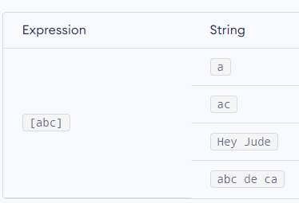
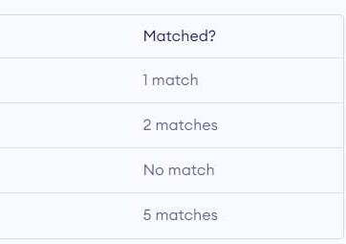
Specify Pattern Using RegEx:
To specify regular expressions, metacharacters are used. In the above example, ^ and $ are metacharacters.
Meta characters:
Metacharacters are characters that are interpreted in a special way by a RegEx engine. Here's a list of metacharacters:
[] . ^ $ *
[] – Square brackets:
Square brackets specifies a set of char cters you wish to match.

Slide 10
Above, [abc] will match if the string you are trying to match contains any of the a, b or c.
You can also specify a range of chara ters using – inside square brackets.
[a-e] is the same as [abcde].
[1-4] is the same as [1234].
[0-39] is the same as [01239].
You can complement (invert) the cha acter set by using caret ^ symbol at the start of a square-bracket.
[^abc] means any character except a or b or c.
[^0-9] means any non-digit character.
c
r

Slide 11
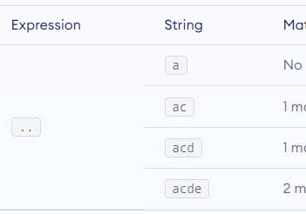
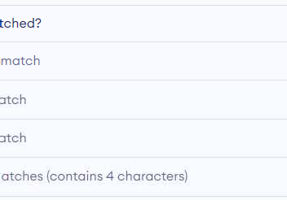
– Period:
period matches any single character (ex ept newline ’\n’).
c

Slide 12
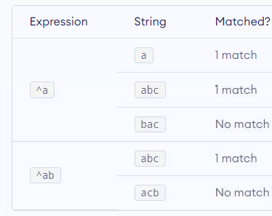
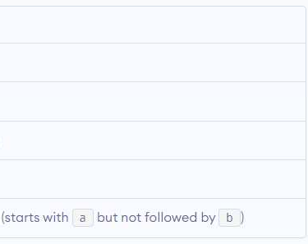
^ – Caret:
The caret symbol ^ is used to check if a string starts with a certain character.

Slide 13
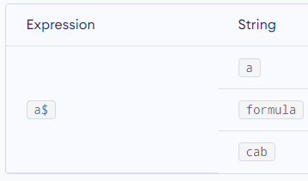

$ – Dollar:
The dollar symbol $ is used to check if a string ends with a certain character.

Slide 14
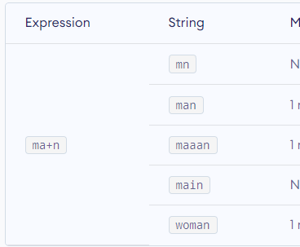
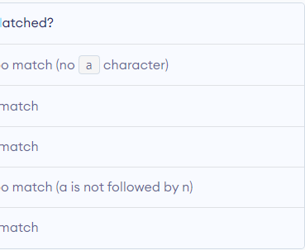
+ – Plus:
The plus symbol + matches one or
m
ore occurrences of the pattern left to it.

Slide 15



Python RegEx
Python has a module named re to work with regular expressions. To use it, we need to import the module.
import re
The module defines several functions and constants to work with RegEx.

Slide 16
RegEx Functions
The re module offers a set of functions that allows us to search a string for a match:
Function | Description
findall | Returns a list containing all matches
search | Returns a Match object if there is a match anywhere in the string
split | Returns a list where the string has been split at each match
sub | Replaces one or many matches with a string

Slide 17




re.findall()
The re.findall() method returns a list of strings containing all matches
Example:
#program to extract numbers from a string
import re
string = ‘hello 12 hi 89. Howdy 34 pattern = ‘\d+’
result = re.findall(patern, string) print(result)
#Output: [‘12’, ‘89’, ‘34’]
If the pattern is no found, re.findall() returns an empty list.

Slide 18



re.split()
The re.split method splits the string where there is a match and returns a list of strings where the splits have occurred.
Example:
import re
String = ‘Twelve:12 Eighty nine:89’ pattern = ‘\d+’
result = re.split(pattern, string) Print( result )
#Output: [ ‘Twelve:’, ‘ Eighty nine:’, ‘ . ’ ]
If the pattern is no found, re.split() returns a list containing an empty string.

Slide 19






re.sub()
The syntax of re.sub() is:
re.sub(pattern, replace, string)
Example:
#program to remove all white spaces Import re
string = ‘abc 12\ de 23 \n f4 6’
#matches all whitespace characters pattern = ‘\s+’
#empty string replace = ‘ ’
new_string = re.sub(pattern, replace, string)
If the pattern is no found, re.sub() returns the original string.

Slide 20




re.subn()
e
The re.subn() is similar to re.sub() expect it returns a tuple of 2 items containing the new string and the number of substitutions made.
Example:
#program to remove all whitespac s Import re
#multiline string
string = ‘abc 12\ de 23 \n f45 6’
# matches all whitespace characters pattern = ‘\s+’
#empty string replace = ‘ ’
new_string = re.subn(pattern, replace, string) print(new_string)
#Output: ( ‘abc12de23f456’, 4 )

Slide 21


re.search()
The re.search() method takes two arguments: a pattern and a string. The method looks for the first location wher the RegEx pattern produces a match with the string. If the search is successful, re.search() returns a match object; if not, it returns None.
e
match = re.search(pattern, str)

Slide 22




Example:
import re
String = “Python is fun”
#check if ‘Python’ is at the beginning match = re.search(‘\APython’, string)
if match:
print(“pattern found inside the string”) else:
print(“pattern not found”)
#Output : pattern found inside the string
Here, match contains a match object.

Slide 23




Math Object
You can get methods and attributes of a match object using dir() function. Some of the commonly used methods and attributes of match objects are:
Import re
String = ‘ 39801 356, 2102 1111 ’
#Three digit number followed by pace followed by two digit number Pattern = ‘ (\d{3}) (\d{2}) ’
#match variable contains a Match object. Match = re.search(pattern, string)
If match: print(match.group())
Else:
print(“ pattern not found ”) # Output: 801 35
s

Slide 24



Here, match variable contains a match object.
ur pattern (\d{3}) (\d{2}) has two subgroups (\d{3}) and (\d{2}). You can get th art of the string of these parenthesized subgroups. Here's how:
>>> match.group(1) ‘801’
>>> match.group(2) ‘35’
>>> match.group(3) (‘801’, ‘35’)
>>> match.group() (‘801’, ‘35’)

Slide 25





match.start(), match.end() and match.span()
The start() function returns the index of he matched substring. Similarly, end() returns the end index of the matched substring.
t
>>> match.start() 2
>>>match.end() 8
The span() function returns a tuple containing start and end index of the matched part.
>>> match.span() (2, 8)

Slide 26



match.re and match.string
The re attribute of a matched object ret rns a regular expression object. Similarly, string attribute returns the passed string.
u
)
>>> match.re
Re.compile(‘ (\\d{3}) (\\d{2}) ’
>>> match.string
‘ 39801 356, 2102 1111 ’

Slide 27
PREPROCESSING TECHNIQUES
TOKENIZATION
LEMMATIZATION
STEMMING
STOP WORDS REMOVAL

Slide 28
MODELS
BAG OF WORDS
TF IDF
WORD2VEC
DEEP LEARNING (NN)

Slide 29
Tokenization
Fundamental to Natural Language Processing (NLP), IR, deep Learning and AI
Parsing (chopping up) the document into basic units that are candidates for later indexing
What parts of text to use and what not
Issues with
Punctuation
Numbers
Special characters
Equations
Formula
Languages
Normalization (often by stemming)

Slide 30
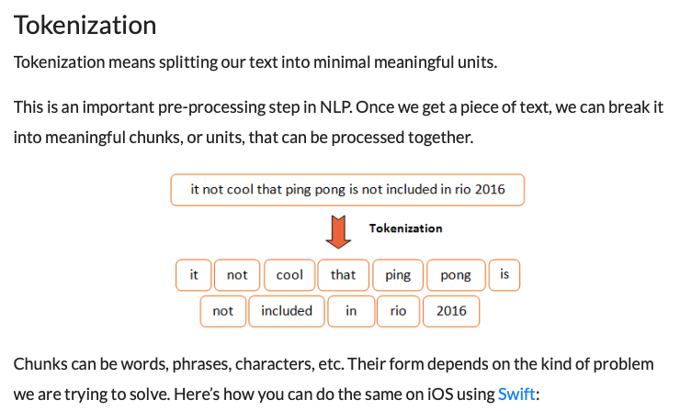
Sometimes called ”parsers”

Slide 31

Natural Language Toolkit (NLTK)
A suite of Python libraries for symbolic and statistical natural language programming
Developed at the University of Pennsylvania
Has its own tokenization
Developed to be a teaching tool and a platform for research NLP prototypes
Data types are packaged as classes
Goal of code is to be clear, rather than fastest performance
Online book: http://www.nltk.org/book/
Authors: Edward Loper, Ewan Kline and Steven Bird

Slide 32
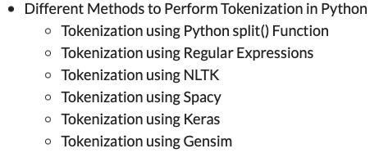
Lots of tokenizers out there

Slide 33
Tokenization example
Input: “Friends, Romans and Countrymen”
Output: Tokens
friends
romans
countrymen
Each such token is now a candidate for an index entry, after further processing
Described below
But what are valid tokens to emit?

Slide 34
Stemming and Morphological Analysis
Goal: “normalize” similar words
Morphology (“form” of words)
Inflectional Morphology
E.g,. inflect verb endings and noun number
Never change grammatical class
dog, dogs
Derivational Morphology
Derive one word from another,
Often change grammatical class
build, building; health, healthy

Slide 35
Stemming
Morphological variants of a word (morphemes). Similar terms derived from a common stem:
engineer, engineered, engineering
use, user, users, used, using
Stemming in Information Retrieval. Grouping words with a common stem together.
For example, a search on reads, also finds read, reading, and readable
Stemming consists of removing suffixes and conflating the resulting morphemes. Occasionally, prefixes are also removed.

Slide 36
Lemmatization
Reduce inflectional/variant forms to base form
E.g.,
am, are, is → be
car, cars, car's, cars' → car
the boy's cars are different colors → the boy car be different color
Lemmatization implies doing “proper” reduction to dictionary headword form

Slide 37
Stemming
Reduce terms to their “roots” before indexing
“Stemming” suggest crude affix chopping
language dependent
e.g., automate(s), automatic, automation all reduced to automat.
for exampl compress and
compress ar both accept
as equival to compress
for example compressed
and compression are both
accepted as equivalent to
compress.

Slide 38
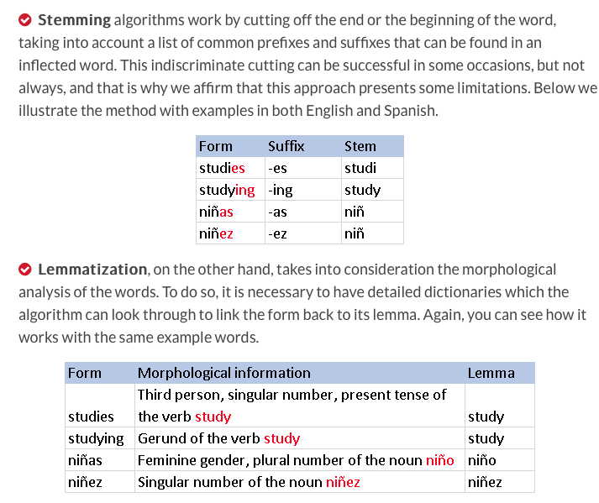

Slide 39
Stop words
With a stop list, you exclude from the dictionary entirely the commonest words. Intuition:
They have little semantic content: the, a, and, to, be
There are a lot of them: ~30% of postings for top 30 words
But the trend is away from doing this:
Good compression techniques (IIR 5) means the space for including stop words in a system is very small
Good query optimization techniques (IIR 7) mean you pay little at query time for including stop words.
You need them for:
Phrase queries: “King of Denmark”
Various song titles, etc.: “Let it be”, “To be or not to be”
“Relational” queries: “flights to London”
Notes:
Nevertheless: “Google ignores common words and characters such as where, the, how, and other digits and letters which slow down your search without improving the results.” (Though you can explicitly ask for them to remain.)

Slide 40
Summary of Text
Text is reduced to tokens (terms)
Stop words can be removed
Tokenizer has many features
Stemmers widely used for token generation
Porter stemmer most common

Slide 41
Selection of tokens, weights, stop lists and stemming
Special purpose collections (e.g., law, medicine, monographs)
Best results are obtained by tuning the search engine for the characteristics of the collections and the expected queries.
It is valuable to use a training set of queries, with lists of relevant documents, to tune the system for each application.
General purpose collections (e.g., web search)
The modern practice is to use a basic weighting scheme (e.g., tf.idf), a simple definition of token, a short stop list and no stemming except for plurals, with minimal conflation.
Web searching combine similarity ranking with ranking based on document importance.

Slide 42
Bag of Words and TF IDF

Slide 43






Slide 44
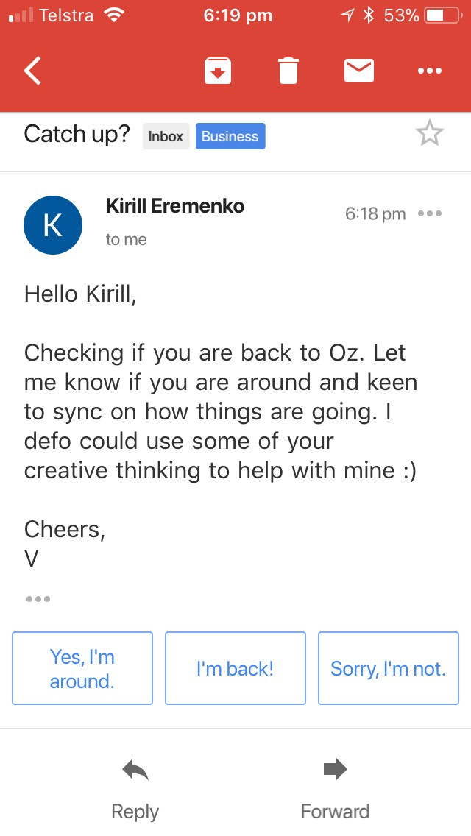

Slide 45










Slide 46

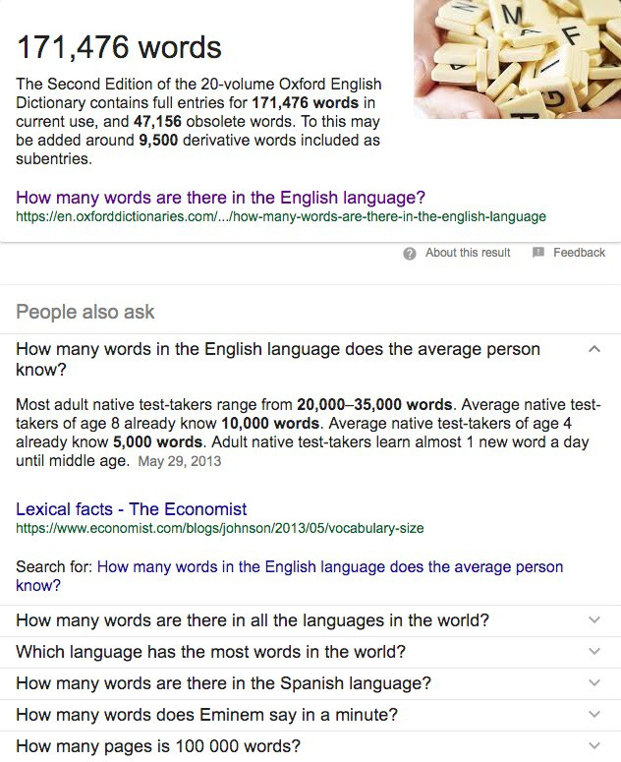




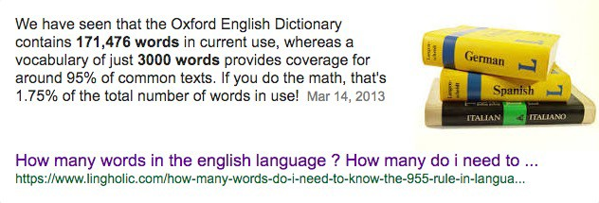
[0, 0, 0, 0, 0, 0, 0, 0, 0, 0, 0, 0, 0, 0, 0, 0, 0, 0, 0, 0, 0, 0, 0, 0, 0, ... , 0]
20,000 elements long
if
badminton
table

Slide 47



[0, 0, 0, 0, 0, 0, 0, 0, 0, 0, 0, 0, 0, 0, 0, 0, 0, 0, 0, 0, 0, 0, 0, 0, 0, ... , 0]
20,000 elements long
SOS
EOS
Special Words

Slide 48
Hello Kirill, Checking if you are back to Oz. Let me know if you are around … Cheers, V
[0, 0, 0, 0, 0, 0, 0, 0, 0, 0, 0, 0, 0, 0, 0, 0, 0, 0, 0, 0, 0, 0, 0, 0, 0, ... , 0]
20,000 elements long

Slide 49











Hello Kirill, Checking if you are back to Oz. Let me know if you are around … Cheers, V
[1, 1, 0, 0, 1, 0, 2, 0, 1, 0, 0, 0, 0, 0, 1, 2, 0, 0, 0, 1, 0, 0, 1, 0, 0, ... , 3]
20,000 elements long

Slide 50




Hello Kirill, Checking if you are back to Oz. Let me know if you are around … Cheers, V
[1, 1, 0, 0, 1, 0, 2, 0, 1, 0, 0, 0, 0, 0, 1, 2, 0, 0, 0, 1, 0, 0, 1, 0, 0, ... , 3]
20,000 elements long

Slide 51
















Hello Kirill, Checking if you are back to Oz. Let me know if you are around … Cheers, V
[1, 1, 0, 0, 1, 0, 2, 0, 1, 0, 0, 0, 0, 0, 1, 2, 0, 0, 0, 1, 0, 0, 1, 0, 0, ... , 3]
20,000 elements long
Training Data:
Hey mate, have you read about Hinton’s capsule networks? Did you like that recipe I sent you last week?
Hi Kirill, are you coming to dinner tonight?
Dear Kirill, would you like to service your car with us again? Are you coming to Australia in December?
…

Slide 52













Hello Kirill, Checking if you are back to Oz. Let me know if you are around … Cheers, V
[1, 1, 0, 0, 1, 0, 2, 0, 1, 0, 0, 0, 0, 0, 1, 2, 0, 0, 0, 1, 0, 0, 1, 0, 0, ... , 3]
20,000 elements long
Training Data:
[1, 1, 0, 0, 0, 1, 0, 0, 1, 1, 0, 0, 0, 0, 0, 1, 0, 1, 0, 1, 0, 0, 1, 0, 0, ... , 2]
[1, 1, 0, 0, 0, 0, 0, 1, 0, 0, 0, 0, 0, 0, 0, 2, 0, 0, 0, 1, 0, 0, 1, 0, 0, ... , 0]
[1, 1, 0, 0, 0, 0, 0, 1, 0, 0, 1, 0, 0, 0, 0, 1, 0, 0, 0, 1, 0, 0, 0, 0, 1, ... , 1]
[1, 1, 0, 0, 0, 0, 0, 1, 0, 0, 1, 0, 0, 0, 0, 1, 1, 0, 1, 0, 0, 0, 0, 0, 0, ... , 1]
[1, 1, 0, 0, 0, 0, 0, 0, 1, 0, 0, 0, 0, 0, 0, 1, 0, 0, 1, 1, 0, 0, 0, 1, 0, ... , 1]
…

Slide 53
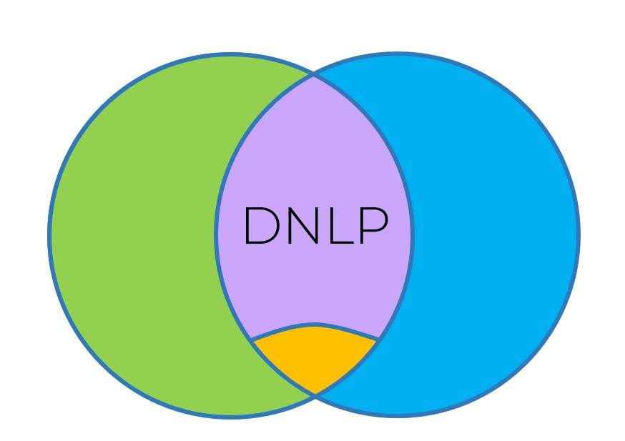













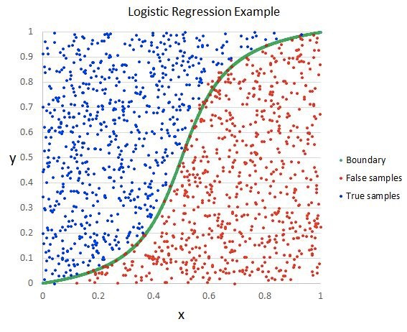
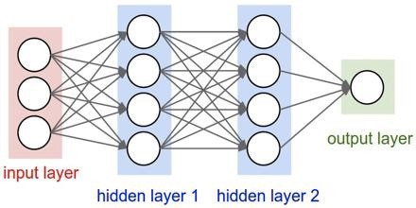



NLP
DL
Hello Kirill, Checking if you are back to Oz. Let me know if you are around … Cheers, V
[1, 1, 0, 0, 1, 0, 2, 0, 1, 0, 0, 0, 0, 0, 1, 2, 0, 0, 0, 1, 0, 0, 1, 0, 0, ... , 3]
20,000 elements long
Training Data:
[1, 1, 0, 0, 0,
1, 0, 0, 1, 1, 0, 0, 0, 0,
0, 0, 1, 0, 0, 0, 0, 0, 0
0, 0, 1, 0, 0, 1, 0, 0, 0,
0, 0, 1, 0, 0, 1, 0, 0, 0,
0, 0, 0, 1, 0, 0, 0, 0, 0
0, 1, 0, 1, 0, 1,
0, 0, 1, 0, 0, ... , 2]
1, 0, 0, 1, 0, 0, ... , 0]
, 0, 0, 0, 0, 1, ... , 1]
0, 0, 0, 0, 0, ... , 1]
, 0, 0, 0, 1, 0, ... , 1]
[1, 1, 0, 0, 0,
[1, 1, 0, 0, 0,
[1, 1, 0, 0, 0,
[1, 1, 0, 0, 0,
, 0, 2, 0, 0, 0,
0, 1, 0, 0, 0, 1
0, 1, 1, 0, 1, 0,
, 0, 1, 0, 0, 1, 1
Imag…e Source: www.helloacm.com

Slide 54
Term Weighting
“Aboutness”
To what degree is this term what document is about?
Within document measure
Term frequency (tf): # occurrences of t in doc j
“Specificity”
How surprised are you to see this term?
Collection frequency
Inverse document frequency (idf):

Slide 55
Bag of Words and TF-IDF Problems
Semantic information is not stored
TF-IDF gives importance to uncommon words
Chance of overfitting

Slide 56
word2vec
Word2Vec uses neural network to learn associations from a large corpus of text
Can detect synonymous words or
Suggest additional words for partial sentence.
Each distinct work is represented with a particular list of numbers called a vector

Slide 57
Solution for BoW and TF IDF – Word2Vec
Each word is basically represented as a vector of 32 or more dimensions instead of a single number
Here the semantic information and relation between different words is also preserved

Slide 58
Steps to create Word2Vec
Tokenization of the sentences
Create Histograms
Take most frequent words
Create a matrix with all the unique words
It also represent the occurrence relation between the words

Slide 59
STOCK SENTIMENT ANALYSIS USING NEWS HEADLINES
The dataset is a combination of the world news and stock price shifts available on Kaggle
There ae 25 columns of top news headlines for each day in the data frame
Data ranges from 2008 to 2016 and the data from 2000 to 2008 was scrapped from Yahoo finance
Labels are based on the Dow Jones Industrial Average Stock Index
Class 1 – the stock price increased
Class 0 – the price stayed the same or decreased

