Slide 1
McDonald’s Corporation Case Study
Analysis of Strategies, Value Chain, and Business Model

Slide 2
Introduction to McDonald’s Corporation
McDonald’s Corporation is one of the largest fast-food industries in the world.
Founded in 1948 by the McDonald brothers, it has grown to over 36,000 locations globally.
McDonald’s has achieved success through its franchising model and continuous innovation in business strategies.

Slide 3
History of McDonald’s Corporation
McDonald’s was founded by Richard and Maurice McDonald in 1948.
Ray Kroc joined in 1954 and opened the first franchise in 1955, later acquiring the company in 1961.
McDonald’s core values include quality, service, cleanliness, and value, reflected in their global operations.

Slide 4
McDonald’s Business Model
McDonald’s business model is depicted by the 'three-legged stool,' which includes owners, operators, and employees.
This model ensures the organization performs adequately to achieve continuous growth and profitability.
McDonald’s adheres to its core values while continuously innovating its marketing techniques.

Slide 5
The Extended Value Chain
McDonald’s value chain includes inbound logistics, manufacturing, outbound logistics, marketing, and service delivery.
The company imports raw materials, produces goods, ensures quality control, and uses extensive marketing to promote products.

Slide 6
Support Activities in the Value Chain
Support activities include human resources, research and development, finance, information systems, and technology.
These activities ensure efficient operations and continuous innovation to meet customer demands.

Slide 7
Conclusion
McDonald’s Corporation has achieved sustained success through strategic innovation, a robust business model, and an extended value chain.
Continuous adaptation to market demands and a focus on core values ensure McDonald’s remains a leader in the fast-food industry.

Slide 8
Balanced Scorecard: A Strategic Management Tool
Kaplan and Norton's Framework for Measuring Business Performance

Slide 9
Introduction to the Balanced Scorecard
The Balanced Scorecard was introduced by Kaplan and Norton in 1996 as a tool for measuring performance that drives business success.
It provides a framework for translating business strategies into measurable outcomes.

Slide 10
Four Perspectives of the Balanced Scorecard
The Balanced Scorecard measures organizational performance from four perspectives:
1. Financial Perspective: Financial outcomes and stakeholder value
2. Customer Perspective: Customer satisfaction and market share
3. Internal Business Processes: Efficiency and quality of operations
4. Learning and Growth: Employee capabilities and long-term growth

Slide 11
Financial Perspective
The Financial Perspective focuses on the economic consequences of decisions and includes measures like:
• Cost and profit measures
• Return on investment (ROI)
• Cash flow and shareholder value
This perspective summarizes the financial outcomes of the organization's strategy.

Slide 12
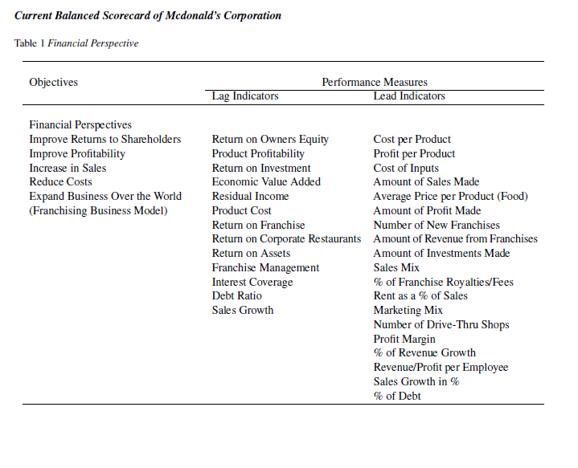

Slide 13
Customer Perspective
The Customer Perspective identifies the target customer segments and measures performance in these segments. Key measures include:
• Customer satisfaction
• Customer profitability
• Market share
• Customer retention
This perspective focuses on meeting customer needs and expectations.

Slide 14
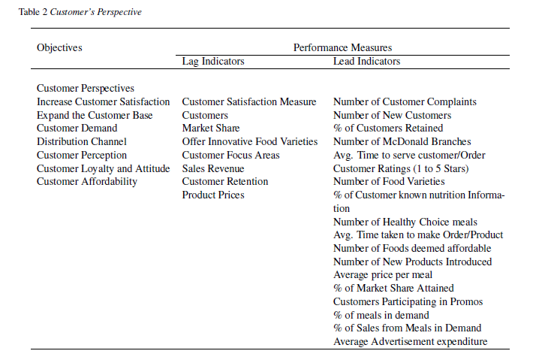

Slide 15
Internal Business Processes
The Internal Business Processes Perspective focuses on the efficiency and quality of internal operations. Key measures include:
• Product development and innovation
• Process improvement
• Cost and quality measures
• Time-based approaches
This perspective links internal processes to customer and financial outcomes.

Slide 16
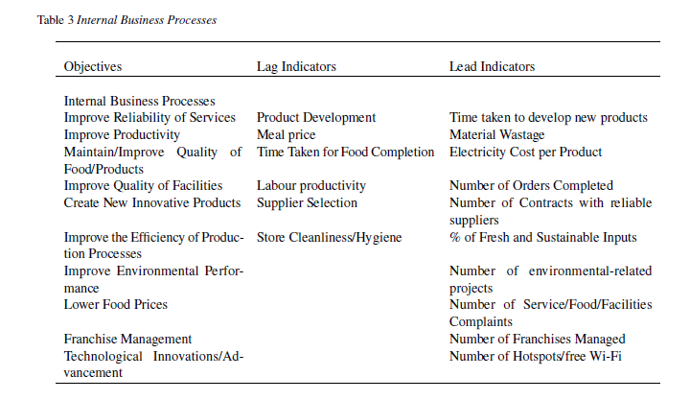

Slide 17
Learning and Growth Perspective
The Learning and Growth Perspective focuses on the organization's ability to adapt and innovate. Key measures include:
• Employee satisfaction and training
• Skills and information capabilities
• Technical capabilities
This perspective drives long-term growth and improvements in internal processes.

Slide 18
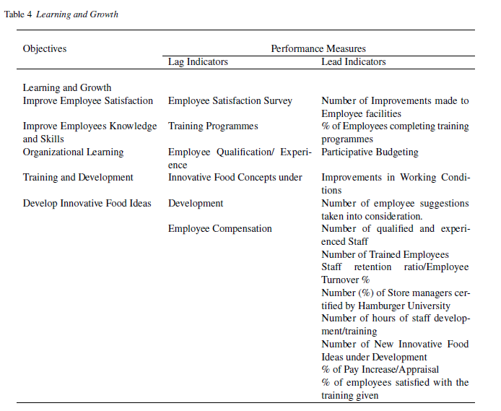

Slide 19
Causal Relationships in the Balanced Scorecard
The Balanced Scorecard establishes causal relationships between the four perspectives:
• Learning and Growth drives improvements in Internal Business Processes
• Improved processes enhance Customer Satisfaction
• Customer satisfaction leads to better Financial outcomes
These relationships create a strategy map linking objectives to outcomes.

Slide 20
Conclusion
The Balanced Scorecard provides a comprehensive framework for measuring and managing business performance.
By integrating financial and non-financial measures,
it ensures that all aspects of the organization's strategy are aligned and contribute to long-term success.

Slide 21
Strategies Used by McDonald’s Corporation
Analysis and Application of Strategic Models

Slide 22
Introduction to McDonald’s Strategies
McDonald’s Corporation is one of the largest fast-food industries globally, known for its successful franchising model and continuous innovation.
This presentation highlights McDonald’s strategies, including the application of Michael Porter's models and the Balanced Scorecard.

Slide 23
Competitive Advantage (Porter's Theory)
Michael Porter's Dynamic Theory of Strategy emphasizes that competitive advantage leads to higher and long-term financial performance.
McDonald’s achieves competitive advantage through cost leadership and product differentiation.

Slide 24
Cost Leadership Strategy
McDonald’s primary strategy is cost leadership, achieved through economies of scale, leading to lower costs and prices.
The successful franchising model plays a crucial role in maintaining cost leadership while sustaining market leadership.

Slide 25
Product Differentiation Strategy
Product differentiation at McDonald’s includes offering a wide variety of food, healthier choices, innovative packaging, and fast service.
This strategy helps McDonald’s attract new customers and retain existing ones in a competitive market.

Slide 26
Application of Porter’s Five Forces Model
Porter’s Five Forces Model highlights the competitive environment in which McDonald’s operates:
1. Threat of New Entrants: Low due to McDonald’s established brand and capital requirements.
2. Bargaining Power of Buyers: High as customers have many choices.
3. Threat of Substitutes: High with alternatives like home-cooked meals and nutritious food.
4. Intense Rivalry: High with competitors like Burger King and KFC.

Slide 27
Balanced Scorecard Application
McDonald’s uses the Balanced Scorecard to align its vision and strategies with performance measures.
The four perspectives
Financial,
Customer, Internal
Business Processes, and
Learning and Growth
are integral to McDonald’s strategic management.

Slide 28
Financial Perspective
McDonald’s financial perspective focuses on revenue from corporate-owned restaurants, franchise royalties, and rent
Key ratios include profit margin, revenue growth, return on assets, and debt-to-assets ratio.

Slide 29
Customer Perspective
The customer perspective emphasizes quick service, quality, freshness, and sustainability.
McDonald’s works to attract new customers while retaining existing ones by focusing on customer satisfaction and market share.

Slide 30
Internal Business Processes Perspective
McDonald’s focuses on quality improvements, process innovations, and technological advancements.
These internal processes support customer satisfaction and financial goals.

Slide 31
Learning and Growth Perspective
McDonald’s prioritizes employee satisfaction, training, and development to enhance internal processes.
Happy and skilled employees lead to better customer service and financial performance.

Slide 32
Conclusion
McDonald’s success lies in its ability to adapt to market changes, innovate, and maintain a strong brand.
By applying strategic models like Porter’s Five Forces and the Balanced Scorecard, McDonald’s continues to sustain its competitive advantage.

