Slide 1

Notes:
SPDX-FileCopyrightText: (C) 2026 Intel Corporation SPDX-License-Identifier: Apache-2.0

Slide 2
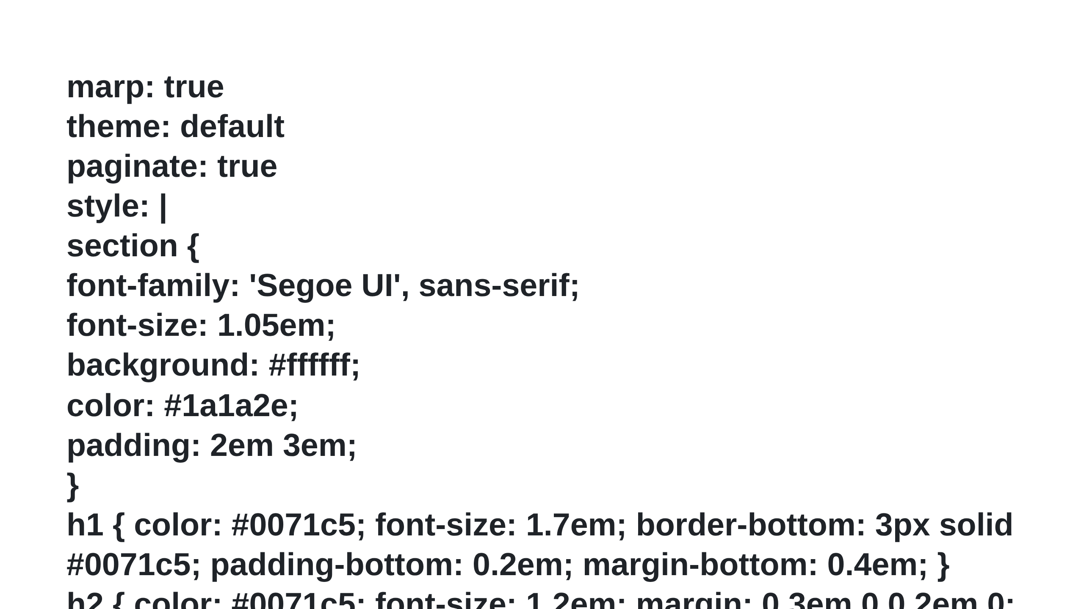

Slide 3
