Slide 1

PROJECT
Avancer Software Solutions Pvt. Ltd

Slide 2

TITLE
Healthcare Predictor using ML Algorithm

Slide 3
AGENDA
Abstract & Objective
1
Literature Review
2
Issues in Existing Work
3
Methodology
4
Advantages
5
Requirements
6

Slide 4
ABSTRACT
Healthcare is the maintenance or improvement of health via the prevention, diagnosis, and treatment of disease, illness, injury, and other physical and mental impairments in human beings.
Health care is generally delivered by health professionals (providers or practitioners) in allied health fields.
It includes work done in providing primary care, secondary care, and tertiary care, as well as in public health.
Sometimes, it might have happened so many times that you or someone yours need doctors help immediately, but they are not available due to some reason.
At that time we need a online care and support.

Slide 5
OBJECTIVES
So, we are proposing a system named the Healthcare Prediction system.
It is an end user support and online consultation project.
It allows users to get instant guidance on their health issues through an intelligent health care system online.
Here we are using the machine learning technique mainly the supervised learning techniques to make the system more intelligent.
Initially, the system is fed with various symptoms and the disease or illness associated with those.
Then it trains the model (mainly random forest model) on symptoms on dataset and tune its parameters.
Finally the system allows user to share their symptoms and issues then it predict most accurate illness that associated.

Slide 6
LITERATURE
Combination data mining methods with new medical data to predicting outcome of Coronary Heart Disease – “Yanwei Xing, Jie Wang” , “Zhihong Zhao”:
They started prediction on Coronary heart disease (CHD).
The goal of this paper is to develop data mining algorithms for predicting survival of CHD patients based on 1000 cases.
They used SVM as model to predict the CHD with an accuracy of 79.1%.
They also tried using Neural networks which gives a poor accuracy than SVM.
An Incremental Decision Tree Learning Methodology Regarding Attributes in Medical Data Mining- “SAM CHAO”, “FAI WONG”:
In this paper, they used i+Learning (Intelligent, Incremental and Interactive Learning) theory is proposed to complement the traditional incremental decision tree learning algorithms

Slide 7
LITERATURE
But, many researches have been reported that decision trees with incremental learning ability, which is able to address the learning task with a stream of training instances only.
APRIORI algorithm based medical data mining for frequent disease identification – Gitanjali:
Here data mining is used to analyse a huge data from different perspectives and summarizing it into useful information.
In this paper, authors developed a method to identify frequency of diseases in particular geographical area at given time period with the aid of association rule based Apriori data mining technique.
Some researchers worked previously on predictive analytics in health care to predict the chronic kidney diseases using decision tree algorithm. (CSIT-2016 paper).

Slide 8
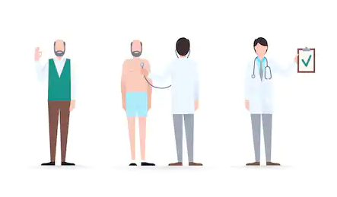
EXISTING CONS
The system is not fully automated, it needs doctors for full diagnosis.
We have to go to hospital for every small reason.
Disease diagnosis time is more.
User can’t discuss their illness to doctors immediately.
User need to wait for doctor until doctor come.
ML models cannot have user friendly nature to use by user.

Slide 9

METHODOLOGY

Slide 10
METHODOLOGY
Here we propose a system that allows users to get instant guidance on their health issues through an intelligent health care model online. (web application)
The machine learning model is fed with various symptoms and the disease or illness associated with it.
The front end interface allows user to share their symptoms and issues.
It then processes user’s symptoms to check for various illness that could be associated with it.
Here we use Random Forest a ensemble learning algorithm to predict the most accurate illness that could be associated with patient’s symptoms.

Slide 11
METHODOLOGY
If the system is not able to provide suitable results means it informs the user about the type of disease or disorder it feels.
If user’s symptoms do not exactly match any disease in dataset developed, is shows the diseases user could probably have judging by his/her symptoms.
It also consists of doctor address, contacts along with Feedback and administrator dashboard for system operations.

Slide 12
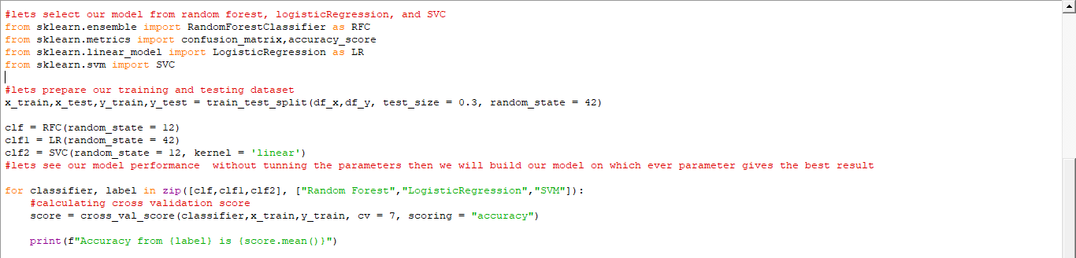
Screenshots

Slide 13
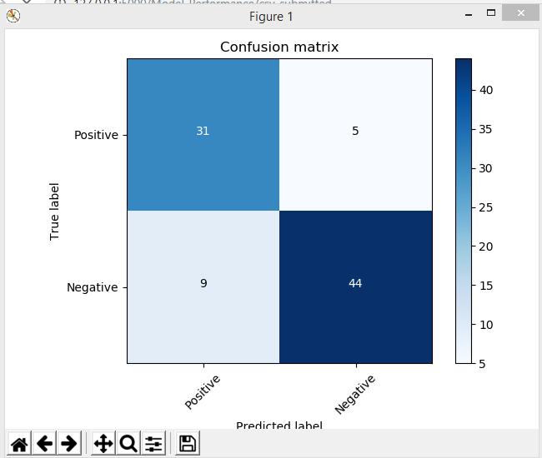

Slide 14
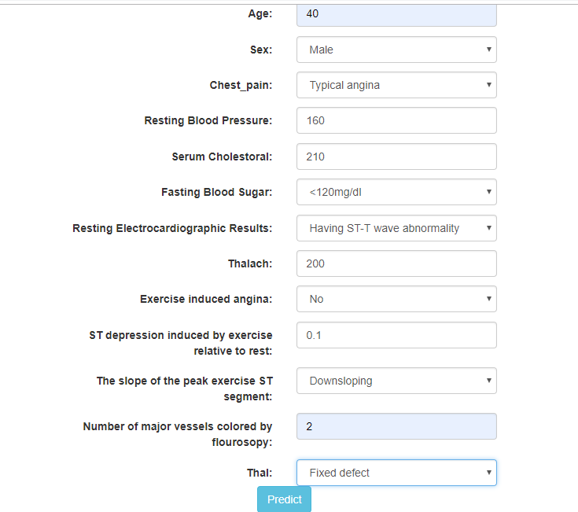

Slide 15
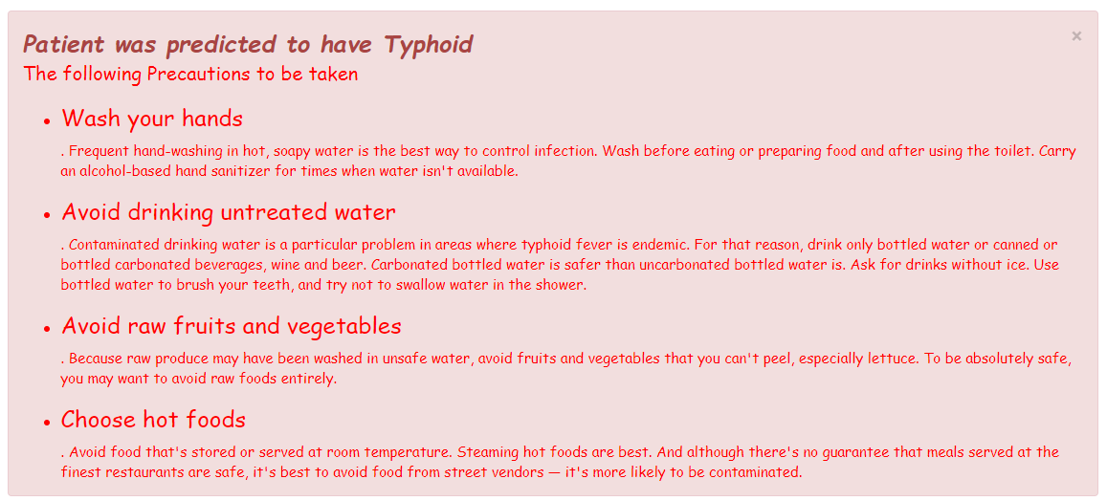

Slide 16
ADVANTAGES
User can search for doctor’s help at any point of time and instantly.
Disease diagnosis time is less.
User can talk about their illness openly to machine model.
Doctors get more clients through online.
People will familiar with medicines what they consumed.

Slide 17
REQUIREMENTS
OS : WINDOWS 8/10
RAM : 4GB or MORE
Script : Python 3+
Editor : Anaconda
Libraries : NP, PD, Matplotlib, SK-Learn
Seaborn, Flask, Pymysql.
Front End : HTML5,CSS3, BOOTSTRAP3
Database : MySQL

Slide 18
PLAN OF ACTION
STEP - 1
STEP - 2
STEP - 3
Draft the Project Requirements.
Learn the Python and required data analysis libraries and front end technologies
Collecting Data Set and learning SK-Learn.
Performing Data Wrangling and Transformation to use in data modelling
Developing the Machine Learning Model.
Improving the models performance and giving the results to user.
1
2
3

Slide 19
TEAM
Dr K Kartheeban (Guide)
Associate Prof. - CSE
“Alone we can do so little, together we can do Wonders.”
--Helen Keller
Malasree
IV-CSE-B
Nagalakshmi
IV-CSE-B
Vamshikrishna
IV-CSE-C

Slide 20

Venue:
Department of Computer science
Kalasalingam Academy of Research and Education
Krishnankoil, Tamilnadu.

