Slide 1



Walmart Superstore
View in Power BI
Last data refresh:
12/14/2023 6:16:50 AM UTC
Downloaded at:
12/14/2023 6:28:42 AM UTC

Slide 2
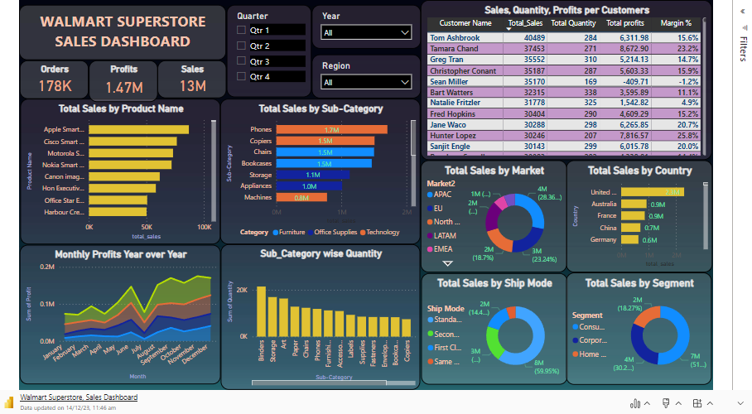
Sales Dashboard
Notes:
textbox
No alt text provided
Total Sales by Product Name
No alt text provided
Profits
No alt text provided
Sales
No alt text provided
Total Sales by Ship Mode
No alt text provided
Total Sales by Sub-Category
No alt text provided
Monthly Profits Year over Year
No alt text provided
Total Sales by Country
No alt text provided
Total Sales by Segment
No alt text provided
Total Sales by Market
No alt text provided
Orders
No alt text provided
slicer
No alt text provided
slicer
No alt text provided
slicer
No alt text provided
Sub_Category wise Quantity
No alt text provided
Sales, Quantity, Profits per Customers
No alt text provided

Slide 3
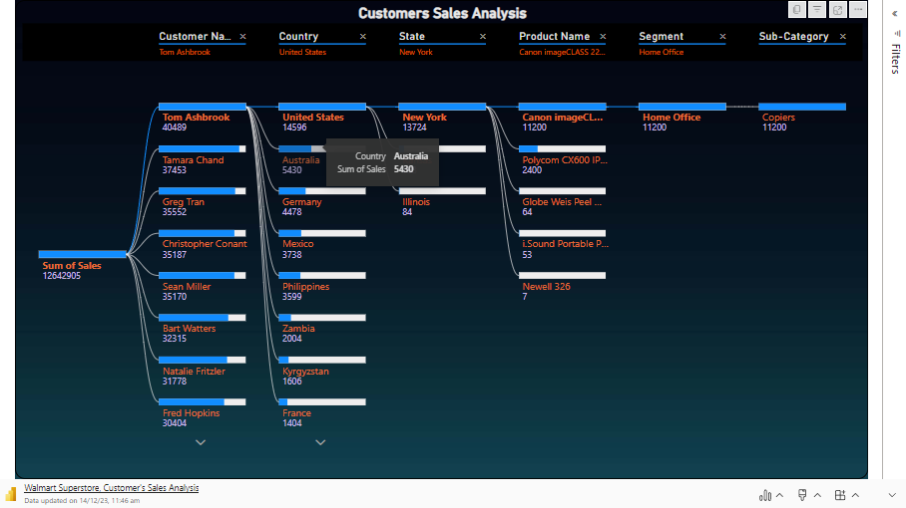

Slide 4
# Key Insights from Dashboard
Total Sales by Product Name:
The "Apple Smart iPhone" was the selling product, from 2011 to 2014 capturing the market share of 0.69%. In a place the "Cisco Smart Phone, Full Size" achieved a sales percentage of 0.60% while the "Motorola Smart Phone, Full Size" secured the third spot, with sales of 0.58% during that time period.
Total Sales by Ship Mode
Over the years 2011, 2012, 2013, and 2014, the majority of sales, approximately 60%, were attributed to the "Standard Class." Following closely, "Second Class" accounted for 20.3%, and "First Class" contributed 14.48% to the total sales. Indicates that a significant portion of customers opted for standard shipping options during the specified period. The lower percentages for "Second Class" and "First Class" suggest a comparatively smaller but notable share of customers choosing faster or premium shipping services.
Total Sales by Sub-Category
In the years spanning 2011 to 2014, "Phones" secured a substantial share of total sales, amounting to 13.5%, highlighting a consistent demand for telecommunications devices. Following closely, "Copies" contributed significantly with 11.94%, indicating sustained interest in copying and printing equipment. Additionally, "Chairs" played a notable role in the overall sales composition, accounting for 11.88%, suggesting a steady market for furniture during this period.

Slide 5
Category wise Sales
From 2011 to 2014, the highest share of sales, approximately 37%, was attributed to the "Technology" category, indicating a substantial demand for electronic and tech-related products during this period. Following closely behind, "Furniture" accounted for 32.52% of total sales, suggesting a significant market for home and office furnishings. Additionally, "Office supplies" contributed 29.96% to the overall sales, highlighting the ongoing demand for essential workplace materials during these years.
Monthly Profits Year over Year
In the observed years, 2014 emerged as the most profitable, boasting the highest total sum of profit at $504.17K, surpassing the profits in 2013, 2012, and 2011. Notably, September of 2014 accounted for a significant portion, constituting 4.63% of the total sum of profit for that year.
Furthermore, when considering the average sum of profit, 2014 again led the way with the highest average at $42.13K, followed by 2013, 2012, and 2011. These insights suggest a particularly successful financial performance in 2014, both in terms of total profit and the average profit, making it a standout year in the observed period.
Total Sales by Country
With a total sales figure of 2,297,354, the United States emerged as the top-performing country, showcasing a remarkable lead of 1,531,469.33% over Equatorial Guinea, which had the lowest total sales at 150.
Notably, the United States accounted for a significant share of the total sales, contributing 18.17%. This underscores the economic significance and market strength of the United States in the observed period.

Slide 6
Total Sales by Segment
Consumer transactions led the way with the highest total sales at 6,508,141, followed by Corporate at 3,824,808 and Home Office at 2,309,956. the Consumer segment significantly contributed to the overall sales, representing 51.48% of the total. This indicates a substantial market share and consumer preference for the products or services catered to individual consumers.
Subcategory wise Quantity
With a staggering sum of 21,429, Binders emerged as the top-performing sub-category, surpassing Tables, which had the lowest sum of quantity at 3,083, by a substantial margin of 595.07%. Binders accounted for 12.02% of the total sum of quantity, underscoring its significant presence in the overall quantity distribution.

