Slide 1
TERM PROJECT · IMAGE PROCESSING
Automated Lumbar Vertebral
Body Segmentation
An End-to-End ML and Image Processing Pipeline
From raw T1 FLAIR MRI to interactive 3D predictions
nnU-Net v2
ResEncUNet Large
5-fold Ensemble
STL · NIfTI · Slicer
Native macOS App
VARUN DASOJU
5 May 2026

Slide 2
Agenda
01
Motivation
Clinical relevance and bottleneck
02
Pipeline Overview
End-to-end flow at a glance
03
Data
459 sagittal T1 FLAIR cases, six classes
04
Model Architecture
nnU-Net + ResEncUNet Large
05
Training
5-fold cross-validation, 1000 epochs
06
Inference & Post-Proc
Three deterministic anatomical rules
07
Mesh Extraction
Marching cubes + Taubin smoothing
08
Application
Streamlit + native macOS window
09
Results
MPR overlay, 3D meshes, voxel counts
10
Limitations & Wrap-up
Edge cases and conclusion
L1–L5 Vertebral Body Segmentation
2 / 21

Slide 3
01 · MOTIVATION
Why Segment Lumbar Vertebrae?
Spinal stenosis grading
Cross-sectional canal area per level
THE BOTTLENECK
~30 min
Vertebral height & bone quality
Quantitative morphometry
per case for manual delineation, with high inter-observer variability.
Pre-surgical planning
Screw trajectories, anatomical landmarks
OUR GOAL
Fully-automated, anatomically-valid
L1–L5 segmentation pipeline driven
from a single sagittal T1 FLAIR scan,
with an interactive desktop app for
inspection and export.
Bone densitometry from MRI
Per-vertebra signal-intensity analysis
L1–L5 Vertebral Body Segmentation
3 / 21

Slide 4
02 · PIPELINE OVERVIEW
End-to-End Pipeline
Raw T1 FLAIR
NIfTI volume
Stage 1
Input Preparation
Stage 2
nnU-Net Inference
(1- or 5-fold)
Stage 3
Anatomical
Post-Processing
Step 3
Vertical SI ordering enforcement
Step 2
Largest CC (≥ 50 voxels)
Step 1
Sagittal-strip corridor (±20% LR)
Cleaned NIfTI
(uint8, RAS, original affine)
5 STL meshes
(LPS world coordinates)
Slicer color table
+ load-instructions README
App: 3-pane MPR
+ Plotly 3D mesh
Built on nnU-Net v2 with a Residual-Encoder U-Net (ResEncUNet Large) and three deterministic anatomical rules applied directly in voxel space.
L1–L5 Vertebral Body Segmentation
4 / 21

Slide 5
03 · DATA
Dataset & Image Characteristics
459
242
5+1
5
Annotated training
T1 FLAIR volumes
Unseen inference
cohort
Classes
(L1–L5 + bg)
Cross-validation
folds
IMAGE PROPERTIES
LABEL COLOR LEGEND
Sequence | Sagittal T1 FLAIR
Median size | 130 × 448 × 422 voxels
Target spacing | 0.66 × 0.63 × 0.66 mm
Normalisation | z-score (zero-mean)
File format | NIfTI .nii.gz
Label 1 — L1 vertebral body
Label 2 — L2 vertebral body
Label 3 — L3 vertebral body
Label 4 — L4 vertebral body
Label 5 — L5 vertebral body
L1–L5 Vertebral Body Segmentation
5 / 21

Slide 6
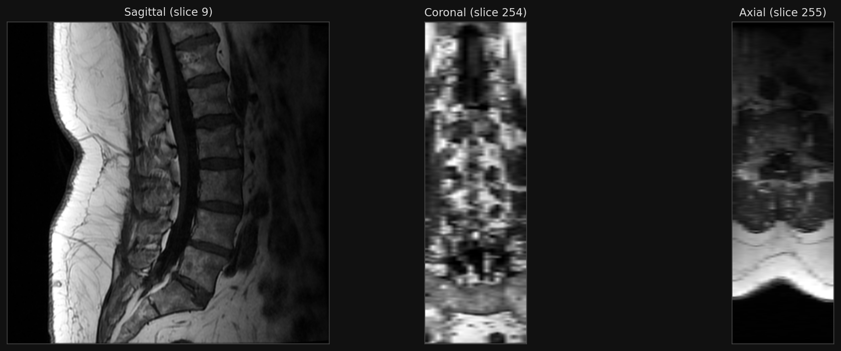
03 · DATA
Raw Input: Sagittal T1 FLAIR
Mid-sagittal · mid-coronal · mid-axial slices of an unseen test volume. Bright cancellous bone and dark cortical rim are characteristic of T1 FLAIR.
L1–L5 Vertebral Body Segmentation
6 / 21

Slide 7
04 · MODEL ARCHITECTURE
nnU-Net + Residual-Encoder U-Net (Large)
WHY nnU-Net?
HYPER-PARAMETERS
Self-configures patch size, spacing, batch
State of the art on medical 3D segmentation
Avoids manual hyper-parameter tuning
Network class | ResidualEncoderUNet
Conv type | 3D (3 × 3 × 3)
Stages | 7
Features / stage | 32, 64, 128, 256, 320, 320, 320
Residual blocks | 1, 3, 4, 6, 6, 6, 6
Decoder convs | 1 per stage
Normalisation | InstanceNorm 3D
Activation | Leaky ReLU
Patch size | 80 × 320 × 256
Batch size | 2
WHY ResEncUNet (vs vanilla U-Net)?
Residual blocks in the encoder path
Better gradient flow in deeper stages
Up to 6 residual blocks per stage
Captures fine bone edges + large-scale spinal context
L1–L5 Vertebral Body Segmentation
7 / 21

Slide 8
05 · TRAINING
Training Configuration
OPTIMISATION
5-FOLD CROSS-VALIDATION
SGD with Nesterov momentum (μ = 0.99)
Polynomial learning-rate decay, η₀ = 10⁻²
Compound Dice + Cross-Entropy loss
1000 epochs, best-Dice checkpoint
nnU-Net default augmentations:
rotation, scale, mirror, gamma, elastic
Five independent models, one per fold
Per-fold checkpoint: checkpoint_best.pth
Inference: average softmax then argmax
Reduces variance, smoother boundaries
INFERENCE MODES IN THIS APP
1-fold (fast preview, default on Mac)
≈ 12 minutes per case on M1 Max with MPS.
5-fold ensemble (best quality)
Trade-off: ~50–60 min per case on the same hardware.
L1–L5 Vertebral Body Segmentation
8 / 21

Slide 9
06 · INFERENCE
Stage 2: Sliding-Window Ensemble Inference
nnUNetv2_predict
-i <input_dir> -o <output_dir>
-d 100 -c 3d_fullres
-tr nnUNetTrainer -p nnUNetResEncUNetLPlans
-f 0 1 2 3 4 -chk checkpoint_best.pth
-step_size 0.5
Sliding window
5-fold softmax
argmax → labels
50% overlap (step_size 0.5) for smooth boundaries between patches.
Each fold yields a 6-class softmax volume. Averaged voxel-wise.
Final hard label from arg-max over the averaged probabilities.
L1–L5 Vertebral Body Segmentation
9 / 21

Slide 10
06 · POST-PROCESSING
Why Post-Process? Failure Modes of Raw Output
The network sees patches, not the whole spine. Three systematic failure modes appear in raw predictions:
1
Mirror artefacts
2
Disconnected fragments
3
Ordering violations
Contralateral blobs that look spine-like in patch context but lie outside the vertebral column.
Partial-volume noise on bone edges or low-contrast regions creates small islands.
Adjacent vertebrae like L2 and L3 get swapped on ambiguous boundaries.
OUR SOLUTION
Three deterministic, anatomically-informed rules applied in voxel space directly to the predicted label volume — no learned parameters, no thresholds to tune.
L1–L5 Vertebral Body Segmentation
10 / 21

Slide 11
06 · POST-PROCESSING
Algorithm 1 — Anatomical Post-Processing
01
02
03
Sagittal-strip corridor
Largest connected component
Vertical SI ordering
[c_LR − 0.20·N_LR , c_LR + 0.20·N_LR]
26-conn., per label, ≥ 50 voxels
monotonic L1 → L5 SI centroids
PSEUDOCODE
1: Identify axes: LR = argmin·span(S>0,a) ; SI = argmax·span(S>0,a)
2: Step 1 — sagittal strip: S′[ |LR − c_LR| > 0.20·N_LR ] ← 0
3: Step 2 — largest CC: for ℓ ∈ {1,…,5}: keep arg max_C |C_ℓ|, drop if < 50
4: Step 3 — SI ordering: drop labels whose SI centroid breaks monotonicity
5: return S′ (cleaned segmentation)
L1–L5 Vertebral Body Segmentation
11 / 21

Slide 12
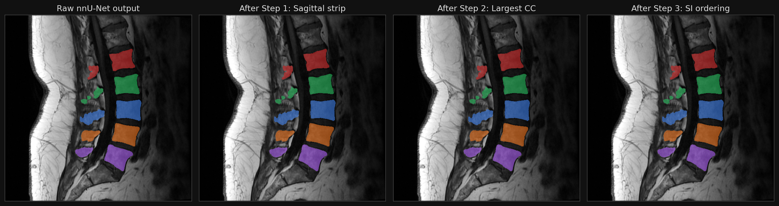
06 · POST-PROCESSING
Post-Processing in Action (mid-sagittal slice)
Raw → Step 1: contralateral mirror blobs eliminated by the corridor constraint.
Step 1 → Step 2: small islands (<50 voxels) discarded; one component retained per vertebra.
Step 2 → Step 3: ordering enforcement removes any centroid breaking L1→L5 monotonicity.
L1–L5 Vertebral Body Segmentation
12 / 21

Slide 13
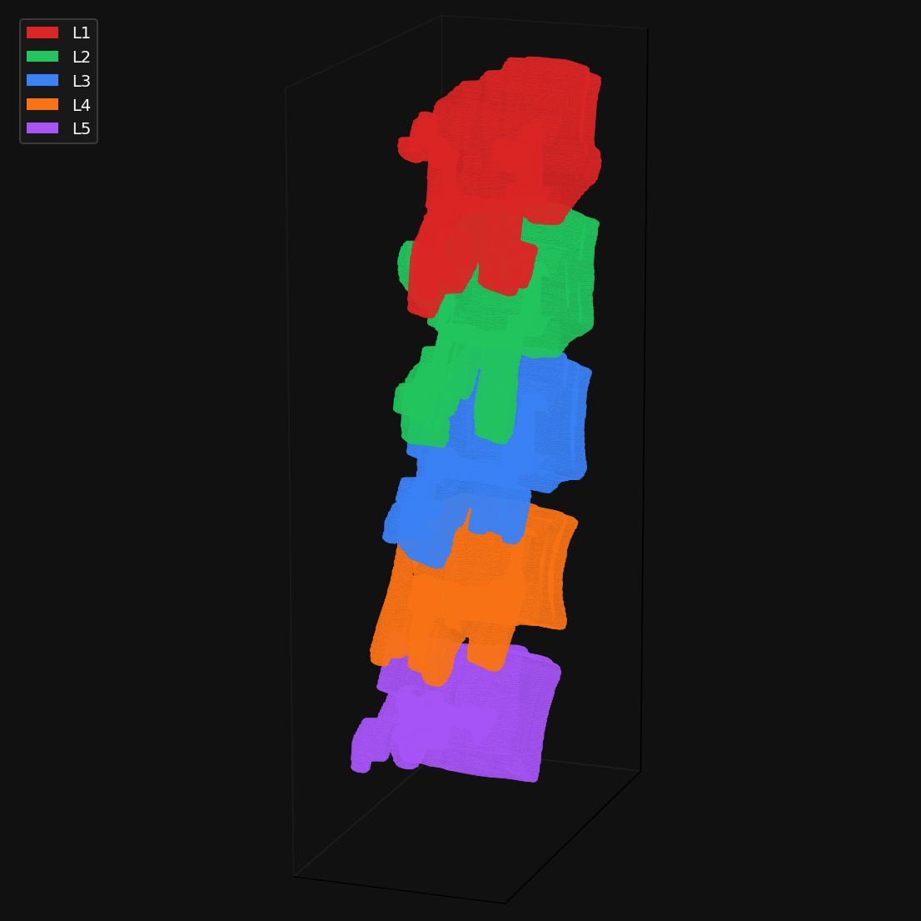
07 · MESH EXTRACTION
Stage 4: Voxel → Surface (Marching Cubes + Taubin)
1
Binary mask M_ℓ = ( S = ℓ ) per retained label
2
1-voxel zero pad (no boundary holes)
3
Marching cubes at iso-level 0.5
4
Voxel → NIfTI affine (RAS) → negate X,Y for LPS world coords
5
Taubin smoothing (10 iterations) — volume-preserving low-pass
6
Export STL (binary, 80-byte header)
Five smoothed surface meshes,
LPS world coordinates
L1–L5 Vertebral Body Segmentation
13 / 21

Slide 14
07 · MESH EXTRACTION
Taubin Smoothing in One Slide
LAPLACIAN ONLY
TAUBIN (λ, μ)
Iteratively smooths but shrinks the mesh — vertebrae get progressively smaller with every pass.
Two alternating filters with positive λ and negative μ — smooths without volume loss.
UPDATE RULE
v_(t+1) = ( I + μ · L ) ( I + λ · L ) · v_t
L is the discrete Laplacian on mesh vertices. Choose 0 < λ and μ ≈ −λ/(1 + λ·k_PB) for a band-pass-like response.
RESULT
Removes the marching-cubes staircase artefacts at the bone–background boundary without shrinking the vertebral body.
L1–L5 Vertebral Body Segmentation
14 / 21

Slide 15
08 · APPLICATION
The Desktop Application
STACK
Streamlit
pywebview
matplotlib
browser-based UI
native macOS WKWebView wrapper
3-pane MPR
Plotly Mesh3d
trimesh
nnU-Net v2
interactive 3D
marching cubes + Taubin
model + predictor
LAUNCH MODES
Native window (Finder)
CLI
Double-click launch_spine_seg_app.command — no browser, real Dock entry, traffic-light buttons.
python cli.py <input.nii.gz> -m nnUNet_results -o results/ — scripts and batch jobs.
FILE SUPPORT single .nii / .nii.gz or a folder of cases · per-file upload limit 600 MB · outputs saved to ./results/<case_id>/
L1–L5 Vertebral Body Segmentation
15 / 21

Slide 16
08 · APPLICATION
App Architecture
macOS native window
(WKWebView)
Streamlit server
(localhost:rand)
nnUNetPredictor
1- or 5-fold
spine_seg.pipeline
run_pipeline()
3-step
post-processing
Cleaned NIfTI
+ 5 STL meshes
Live MPR + 3D mesh
in the same window
Single Python process; pywebview embeds a WKWebView pointed at the local Streamlit URL. Closing the window terminates the entire process group cleanly.
L1–L5 Vertebral Body Segmentation
16 / 21

Slide 17
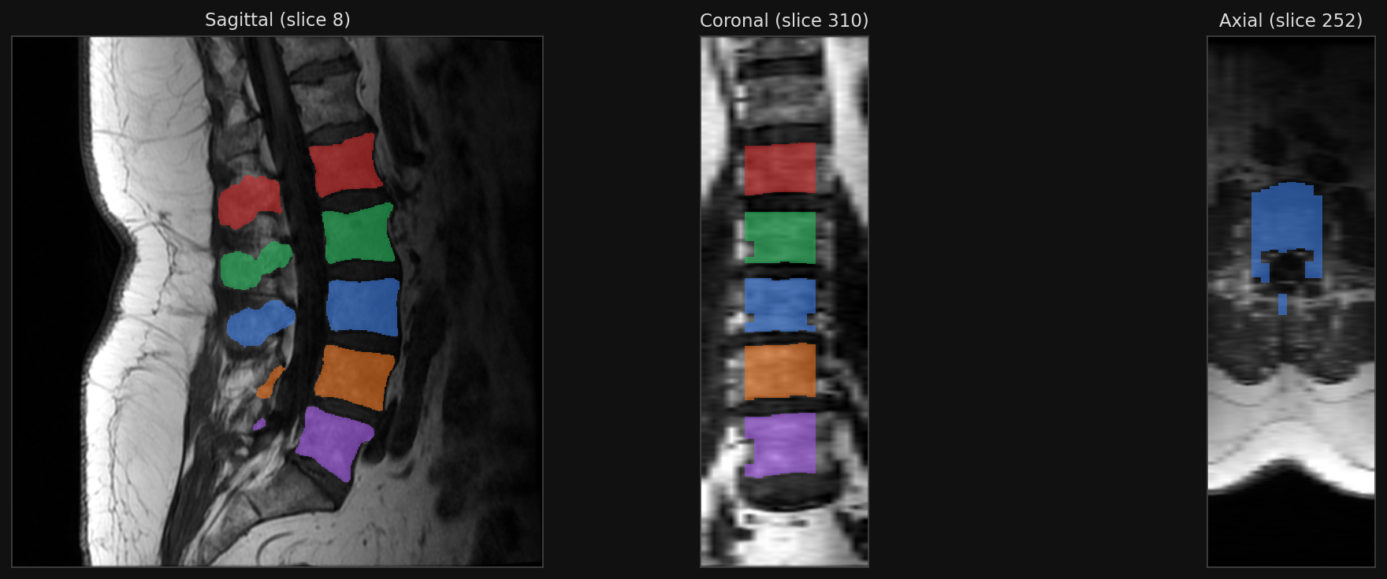
09 · RESULTS
Result: Multi-Planar View with Segmentation Overlay
Sliders in the app re-render these panels live. Bilinear interpolation on the MRI keeps the through-plane axis readable; nearest-neighbour on the labels keeps boundaries crisp.
L1–L5 Vertebral Body Segmentation
17 / 21

Slide 18
09 · RESULTS
Result: 3D Surface Reconstruction
Fully interactive
Drag to rotate · scroll to zoom · click legend to toggle individual vertebrae.
World-coordinate exact
Each STL carries the original NIfTI affine transformed to LPS — opens correctly in 3D Slicer.
Surgeon-grade smoothness
Marching cubes + Taubin removes voxel-staircase without shrinking the bone.
L1–L5 Vertebral Body Segmentation
18 / 21

Slide 19
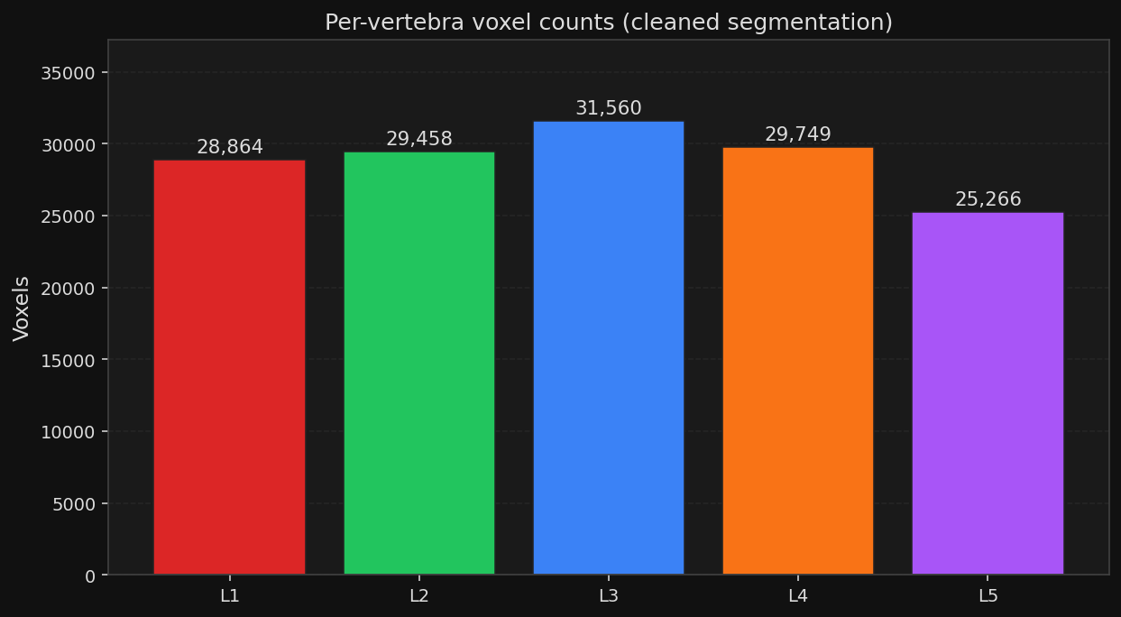
09 · RESULTS
Quantitative — Per-Vertebra Voxel Counts
INTERPRETATION
All five lumbar bodies
detected on this single test case.
Counts decrease toward L5,
matching the smaller anatomical extent of the lower lumbar bodies in this subject.
Cleaned segmentation, single test case (case 542 · sagittal T1 FLAIR).
L1–L5 Vertebral Body Segmentation
19 / 21

Slide 20
10 · WRAP-UP
Performance & Limitations
RUNTIME · M1 MAX (MPS)
LIMITATIONS
Mode | Time / case
1-fold (default) | ~12 min
5-fold ensemble | ~50–60 min
1-fold CPU fallback | ~25–35 min
Post-processing | < 1 s
Mesh extraction (5 STLs) | ~3–4 s
T1-FLAIR-only model
T2 / STIR will produce poor segmentations until re-trained.
Standard-anatomy assumption
Transitional vertebrae (lumbarised S1, sacralised L5) may legitimately lose a label.
Apple-Silicon latency
Reference RTX 5090 from the published pipeline: ~15 s (1 fold), ~60 s (5-fold). MPS on M1 Max is ≈ 50× slower — acceptable for a single-user desktop app.
5-fold ensemble too slow for true real-time; CUDA collapses it to seconds.
Voxel-space rules
LR/SI axes inferred from labeled bbox — works but ignores the affine orientation.
Bottom line. Three deterministic image-processing rules eliminate the dominant failure modes of a purely data-driven model — and the whole pipeline runs from a single click on Apple Silicon.
L1–L5 Vertebral Body Segmentation
20 / 21

Slide 21
FROM A SINGLE NIfTI VOLUME TO
clinical-grade segmentation,
in one click.
Raw T1 FLAIR → nnU-Net inference → 3-step post-processing → NIfTI + STL → interactive desktop app.
Three deterministic rules (sagittal corridor, largest CC, SI ordering) eliminate the dominant failure modes of a purely data-driven model.
Marching cubes + Taubin produce surface meshes that register correctly with the source MRI in 3D Slicer (LPS).
Thank You
Questions?
Varun Dasoju · Image Processing · Term Project

