Slide 1

ADVANCED EXCEL - DATA ANALYTICS

Slide 2
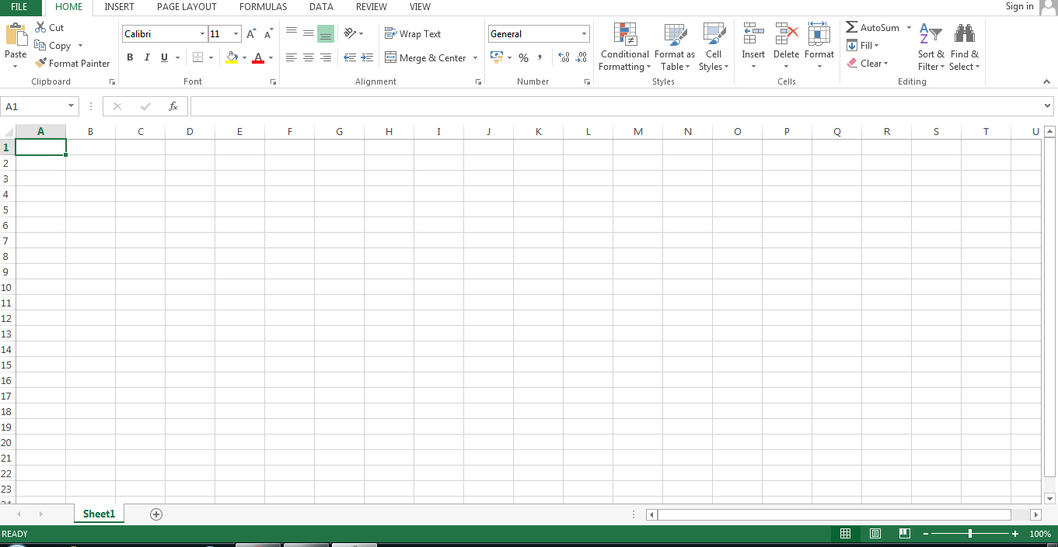
What is MS Excel?
MS Excel is a spreadsheet program where one can record data in the form of tables. It is easy to analyze data in an Excel spreadsheet. The image given below represents what an Excel spreadsheet looks like:

Slide 3
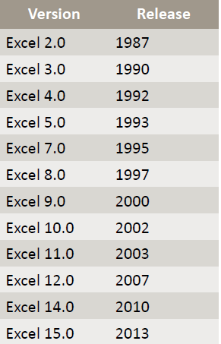
MS Excel History
Multiplan
Became less popular during Lotus 1-2-3 OS
Introduce Excel V2.0 for Windows OS
Microsoft 365
1982
Office 2013
1982
Office 2016
1987
Office 2019

Slide 4
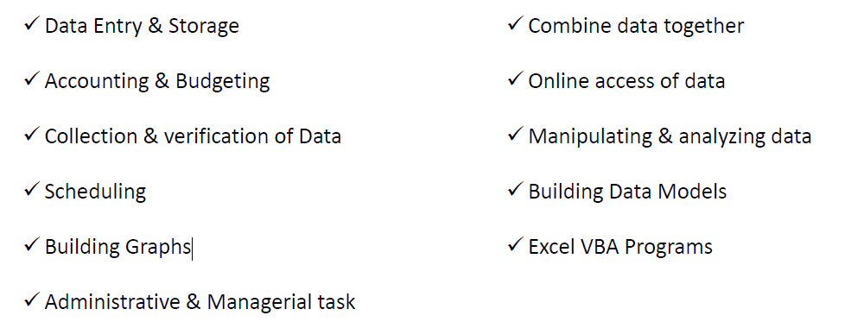
Major Uses for Excel

Slide 5
List of Top 12 Important Uses of Microsoft Excel
There are plenty of uses of excel, and the list goes on, but here we have listed some of the important uses of Microsoft excel to start things for a beginner.
Get Quick Totals
Data Analysis and Interpretation
Plenty of Formulas to Work with Data
Data Organizing and Restructuring
Data Filtering
Goal Seek Analysis
Flexible and User-Friendly
Online Access
Building Dashboards
Interactive Charts and Graphs
Dynamic Formulas
Automation Through Excel
Click on List of Top 12 Imp uses of MS Excel

Slide 6
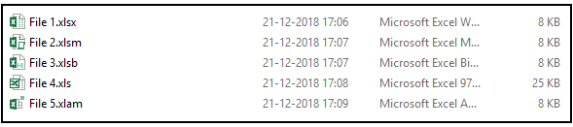
Extensions in Excel
Excel file extensions are there to identify the file format. For example, in computer operating systems, file extensions are to identify the file type for the operating system so that it runs and opens the file with the specified format.
If you observe at the end of the file name, you will see the extension of that file.
The above image includes XLSX, XLSM, XLSB, XLS, and XLAM.
Where to Find File Extensions in Excel?
You must be thinking about where these file formats are. These file formats are available when we see the save dialog box. Under the “Save as type,” we can see many of the accessible file formats in the computer system.

Slide 7
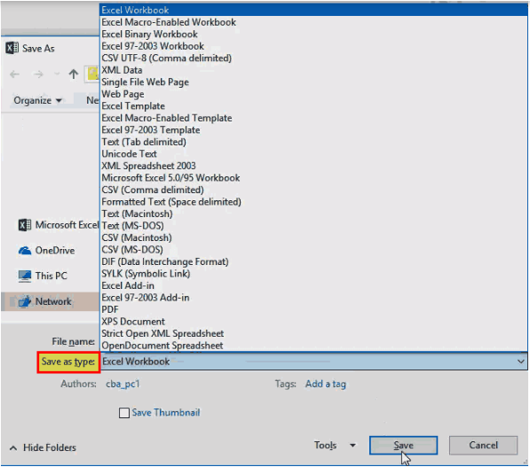
If you look at the image, the first extension the operating system recognizes is Excel Workbook (*.xlsx) format, and all the other remaining forms follow after.
Top 5 Excel File Formats

Slide 8
GETTING STARTED WITH EXCEL

Slide 9
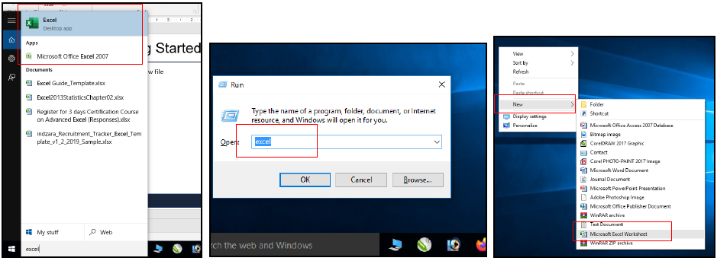
Creating New File
Shortcut Key: CTRL + N

Slide 10
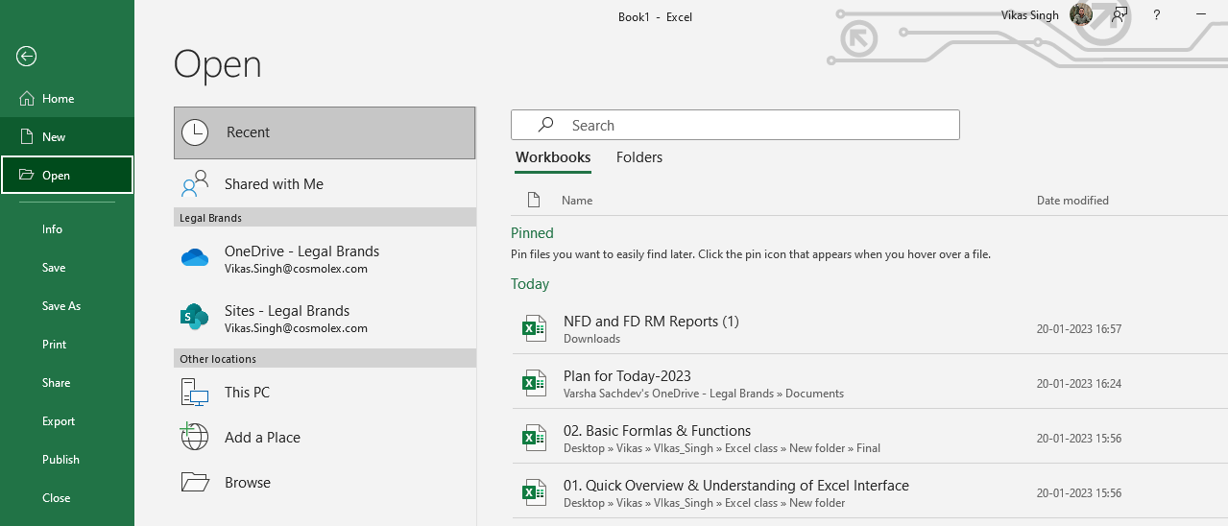
Opening Existing Workbook
Shortcut Key: CTRL + O

Slide 11
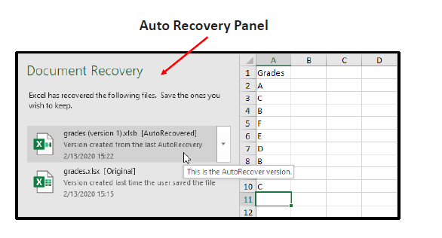
Auto Recovery Setting
Excel periodically saves a copy of your Excel file. If Excel crashes, it displays the Document
Recovery Pane, the first time you open Excel again.

Slide 12
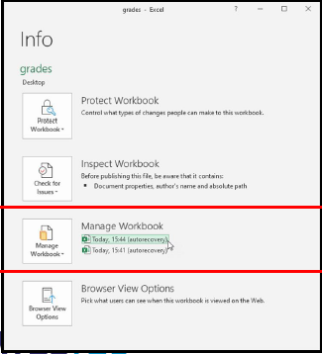
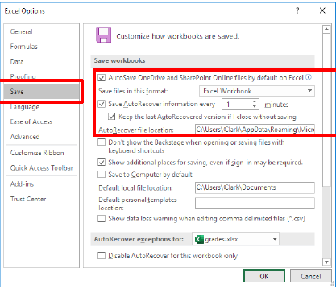
Auto Recovery Setting
When you are working on an Excel file,
Excel saves all previous autosaved files
under Manage Workbook
To change the Auto Recover options,
execute the following steps.

Slide 13
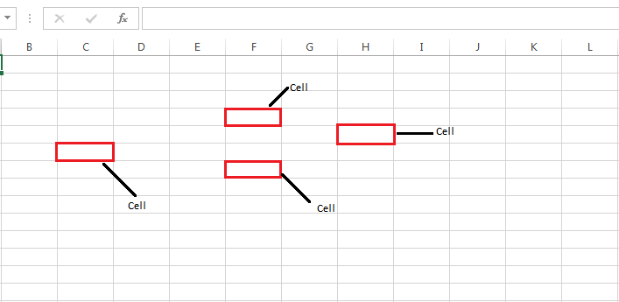
What is a cell?
A spreadsheet is in the form of a table comprising rows and columns. The rectangular box at the intersection point between rows and columns forms a cell. Given below is an image of a cell:

Slide 14
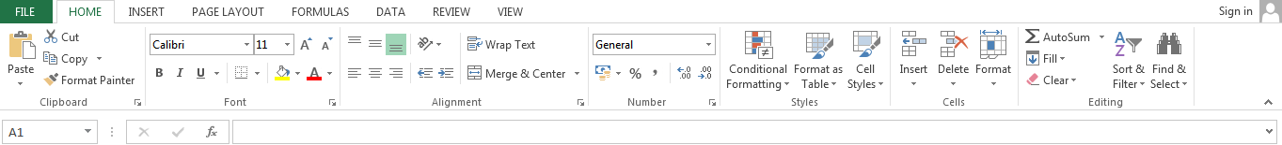
What is a Cell Address?
The cell address is the name by which is cell can be addressed. For example, if row 7 is interested in column G, then the cell address is G7.
Features of MS Excel
Various editing and formatting can be done on an Excel spreadsheet. Discussed below are the various features of MS Excel.
The image below shows the composition of features in MS Excel:

Slide 15
Home
Comprises options like font size, font styles, font color, background color, alignment, formatting options and styles, insertion and deletion of cells, and editing options
Insert
Comprises options like table format and style, inserting images and figures, adding graphs, charts and sparklines, header and footer option, equation and symbols
Page Layout
Themes, orientation, and page setup options are available under the page layout option
Formulas
Since tables with a large amount of data can be created in MS excel, under this feature, you can add formulas to your table and get quicker solutions
Data
Adding external data (from the web), filtering options, and data tools are available under this category
Review
Proofreading can be done for an excel sheet (like spell check) in the review category and a reader can add comments in this part
View
Different views in which we want the spreadsheet to be displayed can be edited here. Options to zoom in and out and pane arrangement are available under this category

Slide 16
Benefits of Using MS Excel
MS Excel is widely used for various purposes because the data is easy to save, and information can be added and removed without any discomfort and less hard work.
Given below are a few important benefits of using MS Excel:
Easy To Store Data: Since there is no limit to the amount of information that can be saved in a spreadsheet, MS Excel is widely used to save data or to analyze data. Filtering information in Excel is easy and convenient.
Easy To Recover Data: If the information is written on a piece of paper, finding it may take longer, however, this is not the case with excel spreadsheets. Finding and recovering data is easy.
Application of Mathematical Formulas: Doing calculations has become easier and less time-taking with the formulas option in MS Excel
More Secure: These spreadsheets can be password secured in a laptop or personal computer and the probability of losing them is way lesser in comparison to data written in registers or pieces of paper.
Data at One Place: Earlier, data was to be kept in different files and registers when the paperwork was done. Now, this has become convenient as more than one worksheet can be added to a single MS Excel file.
Neater and Clearer Visibility of Information: When the data is saved in the form of a table, analyzing it becomes easier. Thus, information is a spreadsheet that is more readable and understandable.

Slide 17
MS Excel – Points to remember
There are certain things which one must know with respect to MS Excel, its applications, and usage:
An MS Excel file is saved with an extension of .xls
Companies with large staffs and workers use MS Excel as saving employee information becomes easier
Excel spreadsheets are also used in hospitals where the information of patients can be saved more easily and can be removed conveniently once their medical history is cleared
The sheet on which you work is called a Worksheet
Multiple worksheets can be added in a single Excel file
This is a data processing application

