Slide 1


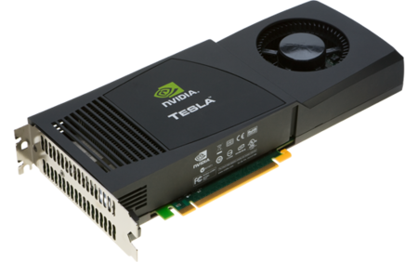
GPU Programming using BU Shared Computing Cluster
Research Computing Services
Boston University

Slide 2
GPU Programming
Access to the SCC
Login: tuta#
Password: VizTut#
Notes:
GPU (The graphics processing unit) is a specialized and highly
parallel microprocessor designed to offload CPU and accelerate 2D or 3D
rendering.
Up until 1999, the term "GPU" didn't actually exist, and
NVIDIA coined the term during it's launch of the GeForce 256.
The 3dfx Voodoo (1996) was considered one of the first true
3D game cards

Slide 3
GPU Programming
Access to the SCC GPU nodes
# copy tutorial materials:
% cp –r /project/scv/examples/gpu/tutorials .
or
% cp –r /scratch/tutorials .
% cd tutorials
# request a node with GPUs:
% qsh –l gpus=1
Notes:
GPU (The graphics processing unit) is a specialized and highly
parallel microprocessor designed to offload CPU and accelerate 2D or 3D
rendering.
Up until 1999, the term "GPU" didn't actually exist, and
NVIDIA coined the term during it's launch of the GeForce 256.
The 3dfx Voodoo (1996) was considered one of the first true
3D game cards

Slide 4
GPU Programming
Tutorial Materials
# tutorial materials online:
scv.bu.edu/examples
# on the cluster:
/project/scv/examples
Notes:
GPU (The graphics processing unit) is a specialized and highly
parallel microprocessor designed to offload CPU and accelerate 2D or 3D
rendering.
Up until 1999, the term "GPU" didn't actually exist, and
NVIDIA coined the term during it's launch of the GeForce 256.
The 3dfx Voodoo (1996) was considered one of the first true
3D game cards

Slide 5
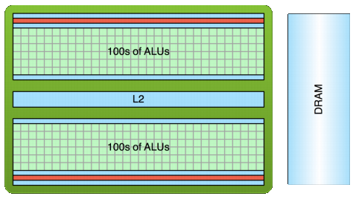
GPU Programming
GPU computing
GPU: Graphics Processing Unit
Traditionally used for real-time rendering
High Computational density and memory bandwidth
Throughput processor: 1000s of concurrent threads to hide latency
Notes:
GPUs can be
found in a wide range of systems, from desktops and laptops to
mobile phones and super computers

Slide 6
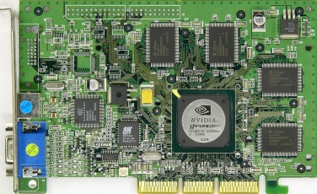
GPU Programming
GPU – graphics processing unit
Originally designed as a graphics processor
Nvidia's GeForce 256 (1999) – first GPU
single-chip processor for mathematically-intensive tasks
transforms of vertices and polygons
lighting
polygon clipping
texture mapping
polygon rendering
Notes:
GPU (The graphics processing unit) is a specialized and highly
parallel microprocessor designed to offload CPU and accelerate 2D or 3D
rendering.
Up until 1999, the term "GPU" didn't actually exist, and
NVIDIA coined the term during it's launch of the GeForce 256.
The 3dfx Voodoo (1996) was considered one of the first true
3D game cards

Slide 7

GPU Programming
Modern GPUs are present in
Embedded systems
Personal Computers
Game consoles
Mobile Phones
Workstations
Notes:
GPUs can be
found in a wide range of systems, from desktops and laptops to
mobile phones and super computers

Slide 8
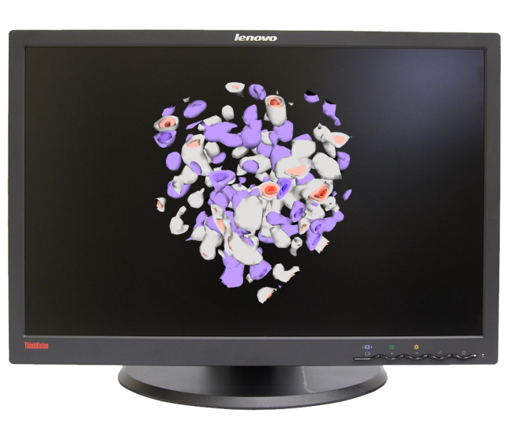
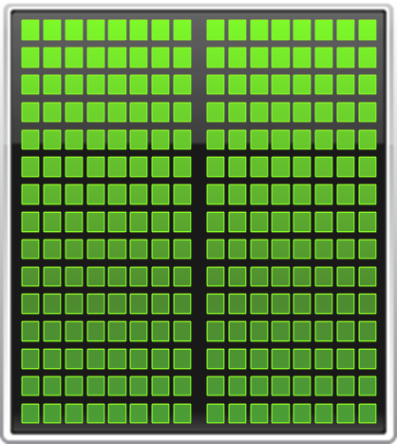
GPU Programming
Traditional GPU workflow
Vertex processing
Triangles, Lines, Points
Shading, Texturing
Blending, Z-buffering
Notes:
The original GPUs were modelled after the concept of a
fixed graphics pipeline. This pipeline simply transforms coordinates from 3D space
(specified by programmer) into 2D pixel space on the screen.
Early GPUs implemented only the rendering stage in hardware,
requiring the CPU to generate triangles for the GPU to operate on.
As GPU technology progressed, more and more stages of the
pipeline were implemented in hardware on the GPU, freeing up
more CPU cycles.

Slide 9
GPU Programming
GPGPU
1999-2000 computer scientists from various fields started using GPUs to accelerate a range of scientific applications.
GPU programming required the use of graphics APIs such as OpenGL and Cg.
2002 James Fung (University of Toronto) developed OpenVIDIA.
NVIDIA greatly invested in GPGPU movement and offered a number of options and libraries for a seamless experience for C, C++ and Fortran programmers.
Notes:
The next step in the evolution of GPU hardware was the
introduction of the programmable pipeline on the GPU. In 2001,
NVIDIA released the GeForce 3 which gave programmers the
ability to program parts of the previously non-programmable
pipeline.
Instead of sending all the graphics description data to
the GPU and have it simply flow through the fixed pipeline, the
programmer can now send this data along with vertex "programs"
(called shaders) that operate on the data while in the pipeline [1].
These shader programs were small "kernels", written in
assembly-like shader languages. For the first time, there was limited
amount of programmability in the vertex processing stage of the
pipeline.

Slide 10
GPU Programming
GPGPU timeline
In November 2006 Nvidia launched CUDA, an API that allows to code algorithms for execution on Geforce GPUs using C programming language.
Khronus Group defined OpenCL in 2008 supported on AMD, Nvidia and ARM platforms.
In 2012 Nvidia presented and demonstrated OpenACC - a set of directives that greatly simplify parallel programming of heterogeneous systems.
Notes:
The GPU hardware evolution thus far has gone from an
extremely specific, single core, fixed function hardware pipeline
implementation just for graphics rendering, to a set of highly
parallel and programmable cores for more general purpose
computation.

Slide 11
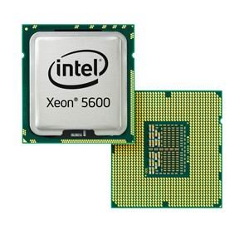
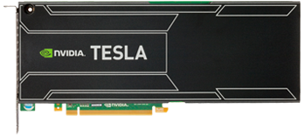


GPU Programming
CPU
GPU
CPUs consist of a few cores optimized for serial processing
GPUs consist of hundreds or thousands of smaller, efficient cores designed for parallel performance
Notes:
Modern CPU's nowadays typically have 2 to 12 cores and are highly optimized for serial processing.
GPUs consist of hundreds or even thousands of smaller efficient cores designed for parallel processing

Slide 12
GPU Programming
SCC CPU
SCC GPU
Intel Xeon E5-2670:
Clock speed: 2.6 GHz
4 instructions per cycle
CPU - 16 cores
2.6 x 4 x 16 =
166.4 Gigaflops double precision
NVIDIA Tesla K40:
Single instruction
2880 CUDA cores
1.66 Teraflops double precision
Notes:
As an example we can look at the CPUs and GPUs that are used on our Linux cluster.

Slide 13
GPU Programming
SCC CPU
SCC GPU
Intel Xeon E5-2670 :
Memory size: 256 GB
Bandwidth: 32 GB/sec
NVIDIA Tesla K40 :
Memory size: 12GB total
Bandwidth: 288 GB/sec
Notes:
There is a significant difference in memory size and bandwidth that should be taken into account while deciding where to perform the calculations.

Slide 14
GPU Programming
10x GPU Computing Growth
2008
2015
6,000
Tesla GPUs
150K
CUDA downloads
77
Supercomputing Teraflops
60
University Courses
4,000
Academic Papers
450,000
Tesla GPUs
3M
CUDA downloads
54,000
Supercomputing Teraflops
800
University Courses
60,000
Academic Papers
Notes:
If we look back only 5 years and compare some the number of CUDA-capable GPU's used or CUDA downloads, we can see a significant rise in GP using GPU.
Future GPU generations will look more and more like wide-vector
general purpose CPUs, and eventually both will be seamlessly
combined as one.

Slide 15
GPU Programming
GPU Acceleration
Applications
GPU-accelerated libraries
OpenACC Directives
Programming Languages
Seamless linking to GPU-enabled libraries.
Simple directives for easy GPU-acceleration of new and existing applications
Most powerful and flexible way to design GPU accelerated applications
cuFFT, cuBLAS, Thrust, NPP, IMSL, CULA, cuRAND, etc.
PGI Accelerator
C/C++, Fortran, Python, Java, etc.
Notes:
There are 3 basic approaches to adding GPU acceleration to your applications.
But first, many applications are already GPU-accelerated. So first, find out if the
application you are interested in already uses GPUs.
If you are developing your own application, you can add GPU acceleration by:
1. Dropping in pre-optimized GPU-accelerated libraries as an alternative to MKL, IPP, FFTW and other widely used libraries
2. Adding some directives (or compiler “hints”) in your source code to automatically parallelize loops
3. Using the programming languages you already know to implement your own parallel algorithms
For each performance-critical area in your application, these approaches can be used independently or together.
For example you can use a GPU-accelerated library to perform some initial calculations on your data and then write your own code to perform custom calculations not (yet) available in a library.
The CUDA parallel computing platform and programming model supports all of these approaches.
So, let’s take a closer look at each approach.

Slide 16
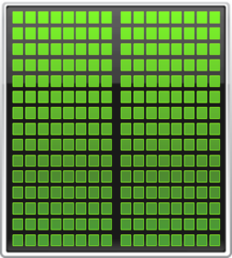
GPU Programming
Minimum Change, Big Speed-up
Application Code
Rest of Sequential
CPU Code
GPU
Compute-Intensive Functions
CPU
Use GPU to Parallelize
+

Slide 17
GPU Programming
Will Execution on a GPU Accelerate My Application?
Computationally intensive—The time spent on computation significantly exceeds the time spent on transferring data to and from GPU memory.
Massively parallel—The computations can be broken down into hundreds or thousands of independent units of work.
Notes:
Will Execution on a GPU Accelerate My Application?
A GPU can accelerate an application if it fits both of the following criteria:

Slide 18
GPU Programming
C
OpenACC, CUDA
C++
Thrust, CUDA C++
Fortran
OpenACC, CUDA Fortran
Python
PyCUDA
Numerical analytics
MATLAB, Mathematica

Slide 19
GPU Programming
GPU resources on the SCC
There are 2 sets of nodes that incorporate GPUs and are available to the SCC users:
20 nodes with 8 NVIDIA Tesla M2070 GPUs each:
scc-ha1, …, scc-he2 and scc-ja1, …, scc-je2
24 nodes with 3 NVIDIA Tesla M2050 GPUs each:
scc-ea1, …, scc-fc4 *
* These nodes are part of the buy-in program so access is somewhat limited to general users, based on the needs of the group who purchased this cluster.

Slide 20
GPU Programming
Interactive Batch
Request xterm with access to 1 GPU for (12 hours default time limit):
> qsh -V -l gpus=1
Med.Campus users need to add project name:
> qsh -V -P project -l gpus=1

Slide 21
GPU Programming
Interactive Batch
Examine GPU hardware and driver
> nvidia-smi
-h for help
-q for long query of all GPUs
PCIe Bus ID
Power State/Fans/Temps/Clockspeed

Slide 22
GPU Programming
Tutorial examples
> ls -l
drwxr-xr-x 2 koleinik scv 4096 Jun 25 15:45 deviceQuery/
drwxr-xr-x 2 koleinik scv 4096 Jun 23 08:26 gemm/
drwxr-xr-x 2 koleinik scv 4096 Jun 23 08:49 gpu_matlab/
drwxr-xr-x 2 koleinik scv 4096 Jun 10 08:49 gpu_r/
drwxr-xr-x 2 koleinik scv 4096 Jun 25 13:51 helloCuda/
drwxr-xr-x 2 koleinik scv 4096 Jun 25 15:11 vectorAdd/
// add CUDA software to the user's path
> module load cuda/5.0
// go to the deviceQuery example
> cd deviceQuery
// execute the program
> ./deviceQuery

Slide 23
GPU Programming
CUDA: Device Query
Device: "Tesla M2050"
CUDA Driver Version / Runtime Version 4.2 / 4.2
CUDA Capability Major/Minor version number: 2.0
Total amount of global memory: 2687 MBytes (2817982464 bytes)
(14) Multiprocessors x ( 32) CUDA Cores/MP: 448 CUDA Cores
GPU Clock rate: 1147 MHz (1.15 GHz)
Total amount of constant memory: 65536 bytes
Total amount of shared memory per block: 49152 bytes
Total number of registers available per block: 32768
Warp size: 32
Maximum number of threads per block: 1024
Maximum sizes of each dimension of a block: 1024 x 1024 x 64
Maximum sizes of each dimension of a grid: 65535 x 65535 x 65535
Concurrent copy and kernel execution: Yes with 2 copy engine(s)
Run time limit on kernels: No
. . .
intro_gpu/deviceQuery/deviceQuery.cpp

Slide 24
GPU Programming
CUDA: Hello, World! example
/* Main function, executed on host (CPU) */
int main( void) {
/* print message from CPU */
printf( "Hello Cuda!\n" );
/* execute function on device (GPU) */
hello<<<NUM_BLOCKS, BLOCK_WIDTH>>>();
/* wait until all threads finish their job */
cudaDeviceSynchronize();
/* print message from CPU */
printf( "Welcome back to CPU!\n" );
return(0);
}
Kernel: A parallel function that runs on the GPU
intro_gpu/helloCuda/helloCuda.cu

Slide 25
GPU Programming
CUDA: Hello, World! example
/* Function executed on device (GPU */
__global__ void hello( void) {
printf( "\tHello from GPU: thread %d and block %d\n",
threadIdx.x, blockIdx.x );
}
intro_gpu/helloCuda/helloCuda.cu

Slide 26
GPU Programming
CUDA: Hello, World! example
Compile and build the program using NVIDIA's nvcc compiler:
nvcc -o helloCuda helloCuda.cu -arch sm_20
Running the program on the GPU-enabled node:
helloCuda
Hello Cuda!
Hello from GPU: thread 0 and block 0
Hello from GPU: thread 1 and block 0
. . .
Hello from GPU: thread 6 and block 2
Hello from GPU: thread 7 and block 2
Welcome back to CPU!
Note: Threads are executed on "first come, first serve" basis. Can not expect any order!
intro_gpu/helloCuda/helloCuda.cu

Slide 27
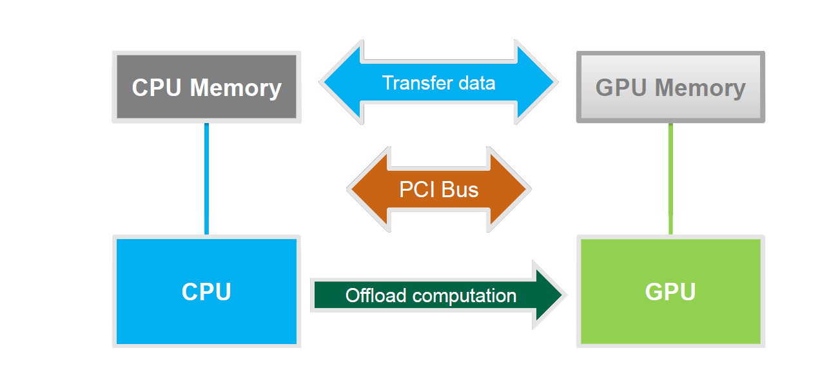
GPU Programming
Basic Concepts

Slide 28
GPU Programming
Host
Device
Grid 1
Kernel 1
Block
(0, 0)
Block
(1, 0)
Block
(2, 0)
Block
(0, 1)
Block
(1, 1)
Block
(2, 1)
Grid 2
Kernel 2
Block (1, 1)
Thread
(0, 0)
Thread
(1, 0)
Thread
(2, 0)
Thread
(3, 0)
Thread
(4, 0)
Thread
(0, 1)
Thread
(1, 1)
Thread
(2, 1)
Thread
(3, 1)
Thread
(4, 1)
Thread
(0, 2)
Thread
(1, 2)
Thread
(2, 2)
Thread
(3, 2)
Thread
(4, 2)

Slide 29
GPU Programming
CUDA: Vector Addition example
/* Main function, executed on host (CPU) */
int main( void) {
/* 1. allocate memory on GPU */
/* 2. Copy data from Host to GPU */
/* 3. Execute GPU kernel */
/* 4. Copy data from GPU back to Host */
/* 5. Free GPU memory */
return(0);
}
intro_gpu/vectorAdd/vectorAdd.cu

Slide 30
GPU Programming
CUDA: Vector Addition example
/* 1. allocate memory on GPU */
float *d_A = NULL;
if (cudaMalloc((void **)&d_A, size) != cudaSuccess)
exit(EXIT_FAILURE);
float *d_B = NULL;
cudaMalloc((void **)&d_B, size); /* For clarity we'll not check for err */
float *d_C = NULL;
cudaMalloc((void **)&d_C, size);
intro_gpu/vectorAdd/vectorAdd.cu

Slide 31
GPU Programming
CUDA: Vector Addition example
/* 2. Copy data from Host to GPU */
cudaMemcpy(d_A, h_A, size, cudaMemcpyHostToDevice);
cudaMemcpy(d_B, h_B, size, cudaMemcpyHostToDevice);
intro_gpu/vectorAdd/vectorAdd.cu

Slide 32
GPU Programming
CUDA: Vector Addition example
/* 3. Execute GPU kernel */
/* Calculate number of blocks and threads */
int threadsPerBlock = 256;
int blocksPerGrid =(numElements + threadsPerBlock - 1) / threadsPerBlock;
/* Launch the Vector Add CUDA Kernel */
vectorAdd<<<blocksPerGrid, threadsPerBlock>>>(d_A, d_B, d_C, numElements);
/* Wait for all the threads to complete */
cudaDeviceSynchronize();
intro_gpu/vectorAdd/vectorAdd.cu

Slide 33
GPU Programming
CUDA: Vector Addition example
/* 4. Copy data from GPU back to Host */
cudaMemcpy(h_C, d_C, size, cudaMemcpyDeviceToHost);
intro_gpu/vectorAdd/vectorAdd.cu

Slide 34
GPU Programming
CUDA: Vector Addition example
/* 5. Free GPU memory */
cudaFree(d_A);
cudaFree(d_B);
cudaFree(d_C);
intro_gpu/vectorAdd/vectorAdd.cu

Slide 35
GPU Programming
CUDA: Vector Addition example
v₀
v₁
v₂
v₃
v₄
v₅
v₆
v₇
v₈
v₉
v₁₀
v₁₁
v₁₂
Block # 0
Block # 1
/* CUDA Kernel */
__global__ void vectorAdd( const float *A,
const float *B,
float *C,
int numElements) {
/* Calculate the position in the array */
int i = blockDim.x * blockIdx.x + threadIdx.x;
/* Add 2 elements of the array */
if (i < numElements) C[i] = A[i] + B[i];
}
intro_gpu/vectorAdd/vectorAdd.cu

Slide 36
GPU Programming
CUDA: Vector Addition example
/* To build this example, execute Makefile */
> make
/* To run, type vectorAdd: */
> vectorAdd
[Vector addition of 50000 elements]
Copy input data from the host memory to the CUDA device
CUDA kernel launch with 196 blocks of 256 threads *
Copy output data from the CUDA device to the host memory
Done
* Note: 196 x 256 = 50176 total threads
intro_gpu/vectorAdd/vectorAdd.cu

Slide 37

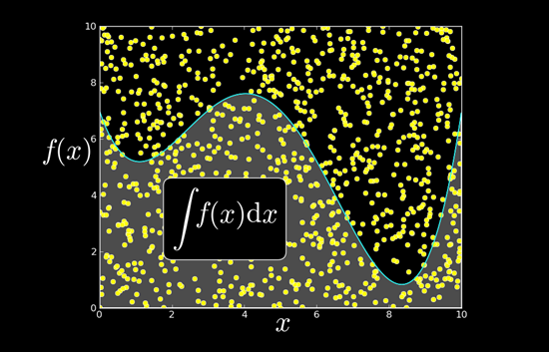

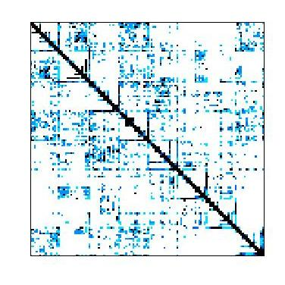



GPU Programming
GPU Accelerated Libraries
NVIDIA cuBLAS
NVIDIA cuRAND
NVIDIA NPP
Sparse Linear Algebra
C++ STL Features for CUDA
NVIDIA cuSPARSE
NVIDIA cuFFT

Slide 38

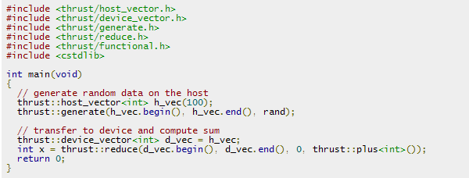
GPU Programming
GPU Accelerated Libraries
powerful library of parallel algorithms and data structures;
provides a flexible, high-level interface for GPU programming;
For example, the thrust::sort algorithm delivers 5x to 100x faster sorting performance than STL and TBB
Notes:
Resembles C++ STL
High-level interface
Enhances developer productivity
Enables performance portability between GPUs and multicore CPUs
Flexible
CUDA, OpenMP, and TBB backends
Extensible and customizable
Integrates with existing software
Open source
If you are a C++ programmer you are more than likely familiar with the Standard Template Library, or STL.
Thrust is an open-source parallel algorithms library which resembles the C++ STL.
Thrust's high-level interface greatly enhances developer productivity while enabling performance portability
between GPUs and multicore CPUs. Thrust includes back-end implementations for established technologies including
CUDA, Intel Threading Building Blocks, and the OpenMP standard. The latest version of Thrust also enables custom
back ends to be implemented. This interoperability facilitates integration with existing software.
Thrust is extremely flexible and powerful – its high-level interface enables efficient GPU code to be written
without directly writing any CUDA kernel calls. Thrust provides a GPU data container called device_vector that
abstracts copying data to and from the GPU, and it provides a large set of efficient algorithms for operating on these
vectors, including sorting, searching, reductions, set operations, and transformations. The example on the right shows
the creation of a vector on the host CPU, where it is filled with random values. The vector is then copied to the GPU
by assigning it to a device vector, and then the device vector is sorted. Thrust’s radix sort is extremely fast, sorting well
over a billion keys per second on GPUs.

Slide 39

GPU Programming
GPU Accelerated Libraries
a GPU-accelerated version of the complete standard BLAS library;
6x to 17x faster performance than the latest MKL BLAS
Complete support for all 152 standard BLAS routines
Single, double, complex, and double complex data types
Fortran binding
cuBLAS
Notes:
Developing applications around libraries offers a range of benefits:
- Being callable from your host application, the CUDA accelerated libraries can hide a lot of the architectural details of the GPUs and therefore significantly shorten your application development
cycle.
CUDA-accelerated libraries often use APIs similar to well established libraries widely used
in scientific applications, thus enabling a drop-in acceleration experience. In some cases, the
libraries will offer exactly the same interface for both the GPU accelerated Version and the CPU
only version, resulting in code portable between the worlds. In other cases, some with a minimal
amount of code changes will be necessary to accommodate both CPU and GPU support.
Designing an application around libraries is also good software engineering practice, as it
reuses well tested code and therefore enhancing the overall quality of your application.
- Finally, CUDA accelerated libraries developed by NVIDIA engineers are highly tuned for
Performance, delivering excellent performance on every generation of GPUs, while maintaining generality.

Slide 40
GPU Programming
GEMM: C = αAB + βC
/* General Matrix Multiply (simplified version) */
static void simple_dgemm( int n, double alpha,
const double *A, const double *B,
double beta, double *C) {
int i, j, k;
for (i = 0; i < n; ++i) {
for (j = 0; j < n; ++j){
double prod = 0;
for (k = 0; k < n; ++k) prod += A[k * n + i] * B[j * n + k];
C[j * n + i] = alpha * prod + beta * C[j * n + i];
}
}
}
intro_gpu/gemm/cuGEMM.cpp

Slide 41
GPU Programming
BLAS GEMM: C = αAB + βC
/* dgemm from BLAS library */
extern "C"{
extern void dgemm_(char *, char * ,
int *, int *, int *,
double *, double *, int *,
double *, int *,
double *, double *, int *); };
/* Main */
int main(int argc, char **argv)
{
. . .
/* call gemm from BLASS library */
dgemm_("N","N", &N, &N, &N, &alpha, h_A, &N, h_B, &N, &beta, h_C_blas,&N);
. . .
intro_gpu/gemm/cuGEMM.cpp

Slide 42
GPU Programming
cuBLAS GEMM: C = αAB + βC
/* Main */
int main(int argc, char **argv)
{
/* 0. Initialize CUBLAS */
cublasCreate(&handle);
/* 1. allocate memory on GPU */
cudaMalloc((void **)&d_A, n2 * sizeof(d_A[0]));
/* 2. Copy data from Host to GPU */
status = cublasSetVector(n2, sizeof(h_A[0]), h_A, 1, d_A, 1);
/* 3. Execute GPU kernel */
cublasDgemm( handle,
CUBLAS_OP_N, CUBLAS_OP_N, N, N, N, &alpha, d_A, N, d_B, N, &beta, d_C, N );
/* 4. Copy data from GPU back to Host */
cublasGetVector(n2, sizeof(h_C[0]), d_C, 1, h_C, 1);
/* 5. Free GPU memory */
cudaFree(d_A)
}
intro_gpu/gemm/cuGEMM.cpp

Slide 43
GPU Programming
Submitting CUDA job
qsub -l gpus=1 -b y cuGEMM

Slide 44
GPU Programming
Timing GEMM
Time in milliseconds
Matrix Size

Slide 45
GPU Programming
Development Environment
Nsight IDE: Linux, Mac & Windows - GPU Debugging and profiling;
CUDA-GDB debugger (NVIDIA Visual Profiler)

Slide 46
GPU Programming
CUDA Resources
Tutorial (by SCV) is coming this fall;
CUDA and CUDA libraries examples: http://docs.nvidia.com/cuda/cuda-samples/;
NVIDIA's Cuda Resources: https://developer.nvidia.com/cuda-education
Online course on Udacity: https://www.udacity.com/course/cs344
CUDA C/C++ & Fortran: http://developer.nvidia.com/cuda-toolkit
PyCUDA (Python): http://mathema.tician.de/software/pycuda
Notes:
The other way to add GPU acceleration to application is through a set of OpenACC directives

Slide 47
GPU Programming
OpenACC Directives
Simple compiler directives
Works on multicore CPUs & many core GPUs
Future integration into OpenMP
Program myscience
... serial code ...
!$acc compiler Directive
do k = 1,n1
do i = 1,n2
... parallel code ...
enddo
enddo
$acc end compiler Directive
End Program myscience
CPU
GPU
Notes:
The other way to add GPU acceleration to application is through a set of OpenACC directives
PGI Compiler is not free
NVIDIA has partnered with PGI to offer a free trial compiler license so that you can try OpenACC directives and experience how easy they are to use.

Slide 48
GPU Programming
OpenACC Directives
Fortran !$acc directive [clause [,] clause] …] Often paired with a matching end directive surrounding a structured
code block !$acc end directive
C #pragma acc directive [clause [,] clause] …] Often followed by a structured code block
Notes:
OpenACC is easy, open and powerful. Directives provide access to the high performance of parallel accelerators without having to learn a parallel programming language or rewrite large
Portions of existing code. OpenACC is an open standard supported by multiple vendors, enabling straightforward development of portable accelerated code. OpenACC directives allow
Complete access to the parallel power of GPUs, in many cases achieving nearly the performance of direct programming of parallel kernels in languages such as CUDA C and CUDA Fortran.
OpenACC is an open programming standard for parallel computing on accelerators such as GPUs, using compiler directives.
OpenACC compiler directives are simple “hints” to the compiler that identify parallel regions of the code to accelerate. The compiler automatically accelerates these regions without requiring changes to the underlying code.
Directives expose parallelism to the compiler so that it can do the detailed work of mapping the computation onto parallel accelerators such as GPUs.
Additional directive options can be used to provide additional information to the compiler, for example about loop dependencies and data sharing.
Compilers without support for OpenACC will ignore the directives as if they were code comments, ensuring that the code remains portable across many-core GPUs and multi-core CPUs.

Slide 49
GPU Programming
GEMM using OpenACC Directives
/* dgemm implementation with openACC acceleration*/
static void acc_dgemm( int n, double alpha, const double *A,
const double *B, double beta, double *C) {
int i, j, k;
#pragma acc parallel loop copyin(A[0:(n*n)], B[0:(n*n)]) copy(C[0:(n*n)])
for (i = 0; i < n; ++i) {
#pragma acc loop
for (j = 0; j < n; ++j){
double prod = 0;
for (k = 0; k < n; ++k) prod += A[k * n + i] * B[j * n + k];
C[j * n + i] = alpha * prod + beta * C[j * n + i];
}
}
}
intro_gpu/gemm/accGEMM.c

Slide 50
GPU Programming
Building OpenACC program
C:
pgcc –acc -Minfo –o accGEMM accGEMM.c
Fortran:
pgfortran –acc -Minfo –o accGEMM accGEMM.f90
pgaccelinfo /* check NVIDIA GPU and CUDA drivers */
-acc turns on the OpenACC feature
-Minfo returns additional information on the compilation
Current system default version of PGI compiler (8.0) does not support OpenACC.
The newest version is accessible at
/usr/local/apps/pgi-13.2/linux86-64/13.2/bin

Slide 51
GPU Programming
PGI compiler output:
acc_dgemm:
34, Generating present_or_copyin(B[0:n*n])
Generating present_or_copyin(A[0:n*n])
Generating present_or_copy(C[0:n*n])
Accelerator kernel generated
35, #pragma acc loop gang /* blockIdx.x */
41, #pragma acc loop vector(256) /* threadIdx.x */
34, Generating NVIDIA code
Generating compute capability 1.3 binary
Generating compute capability 2.0 binary
Generating compute capability 3.0 binary
38, Loop is parallelizable
41, Loop is parallelizable

Slide 52
GPU Programming
MATLAB with GPU-acceleration
Use GPUs with MATLAB through Parallel Computing Toolbox
GPU-enabled MATLAB functions such as fft, filter, and several linear algebra operations
GPU-enabled functions in toolboxes: Communications System Toolbox, Neural Network Toolbox, Phased Array Systems Toolbox and Signal Processing Toolbox
CUDA kernel integration in MATLAB applications, using only a single line of MATLAB code
A=rand(2^16,1);
B=fft(A);
A=gpuArray(rand(2^16,1));
B=fft(A);

Slide 53
GPU Programming
Simple MATLAB example
Ga = gpuArray(rand(1000, 'single'));
Gfft = fft(Ga);
Gb = (real(Gfft) + Ga) * 6;
G = gather(Gb);
intro_gpu/gpu_matlab/gpuSimple.m

Slide 54
GPU Programming
Matrix Product it MATLAB using GPU
% matrix product on Client (CPU)
C = A*B;
% copy A and B from Client to GPU
a = gpuArray(A); b = gpuArray(B);
% matrix product on GPU
c = a*b;
% copy data from GPU to Client
CC = gather(c);
intro_gpu/gpu_matlab/gpuExample.m

Slide 55
GPU Programming
Submitting GPU MATLAB job
#!/bin/csh
#
# Set the hard runtime (aka wallclock) limit for this job
#$ -l h_rt=2:00:00
#
# Merge stderr into the stdout file, to reduce clutter.
#$ -j y
#
# Specifies number of GPUs wanted
#$ -l gpus=1
#
matlab -nodisplay -singleCompThread –r \
"N=3000; gpuExample(rand(N),rand(N)); exit"
# end of script
intro_gpu/gpu_matlab/matlab_batch

Slide 56
GPU Programming
Running CUDA code in MATLAB
starting R2013a (available on SCC cluster only)
Example 1:
// cuda-kernel: add 2 numbers
__global__ void addnums (double *pi, double c){
*pi += c;
}
Example 2:
// cuda-kernel: add 2 vectors
__global__ void addvecs (double *v1, double *v2){
int idx = threadIdx.x;
v1[idx] += v2[idx];
}
intro_gpu/gpu_matlab/add.cu

Slide 57
GPU Programming
Compiling and running CUDA MATLAB code
Example 1:
1.At the command prompt type(to create ptx file for matlab):
nvcc -ptx add.cu //at SCC prompt
2.To specify the entry point for MATLAB kernel,run(at matlab prompt):
k = parallel.gpu.CUDAKernel('add.ptx', 'addnums.cu'); //in matlab
3. Run kernel (kernel takes 2 arguments):
out = feval(k, 7, 21); //in matlab
intro_gpu/gpu_matlab/add.cu

Slide 58
GPU Programming
Compiling and running CUDA MATLAB code
Example 2:
1.At the command prompt type(to create ptx file for matlab):
nvcc -ptx add.cu //at SCC prompt
2.To specify the entry point for MATLAB kernel,run(at matlab prompt):
k = parallel.gpu.CUDAKernel('add.ptx', 'addvecs.cu'); //in matlab
3. Run kernel (kernel takes 2 arguments):
N = 128;
k.ThreadBlockSize = N;
feval(k, ones(N, 1), ones(N, 1));
intro_gpu/gpu_matlab/add.cu

Slide 59
GPU Programming
MATLAB GPU Resources
MATLAB GPU Computing Support for NVIDIA CUDA-Enabled GPUs:
http://www.mathworks.com/discovery/matlab-gpu.html;
GPU-enabled functions :
http://www.mathworks.com/help/distcomp/using-gpuarray.html#bsloua3-1
GPU-enabled functions in toolboxes:
http://www.mathworks.com/products/parallel-computing/builtin-parallel-support.html

Slide 60
GPU Programming
This tutorial has been made possible by
Research Computing Services
at Boston University.
Katia Oleinik koleinik@bu.edu

