Slide 1

Multiple Linear Regression Analysis of House Prices
Group 4:-
Najma Abdi
Victor Keya
Millicent Kanana
Lewis Ngunjiri’
Amina Saidi
Janet Maluka

Slide 2

Outline
Project Overview
Objectives
Data Understanding
Data cleaning and preparation
Exploratory data analysis –Bivariate and Univariate analysis
Statistical Analysis
Modelling
Regression Results
Results/Findings
Recommendations
Conclusion

Slide 3
Project Overview
Background:
The real estate agency aims to provide accurate property valuations to homeowners looking to sell their homes and to buyers interested in purchasing properties. Property valuation is a critical aspect of real estate transactions as it directly impacts pricing decisions, marketing strategies, and negotiation outcomes.
Business Problem Statement:
The real estate agency faces challenges in accurately valuing properties, which can lead to overpricing or underpricing homes, affecting client satisfaction, time on market, and overall business performance

Slide 4

Objectives
Determine the key factors such as square foot living, the number of bedrooms and bathrooms, the condition of the house and others that significantly influence the house prices.
Develop a model that can accurately predict house prices based on these factors.
To determine which seasons have the highest sales.
To provide valuable insights for real estate agents, property developers, and investors in the company’s portfolio to make informed decisions regarding pricing, renovations, and marketing strategies

Slide 5
Data Understanding
id - Unique identifier for a house
date - Date house was sold
price - Sale price (prediction target)
bedrooms - Number of bedrooms
bathrooms - Number of bathrooms
sqft_living - Square footage of living space in the home
sqft_lot - Square footage of the lot
floors - Number of floors (levels) in house
waterfront - Whether the house is on a waterfront
Includes Duwamish, Elliott Bay, Puget Sound, Lake Union, Ship Canal, Lake Washington, Lake Sammamish, other lake, and river/slough waterfronts
view - Quality of view from house
Includes views of Mt. Rainier, Olympics, Cascades, Territorial, Seattle Skyline, Puget Sound, Lake Washington, Lake Sammamish, small lake / river / creek, and other
condition - How good the overall condition of the house is. Related to maintenance of house.
grade - Overall grade of the house. Related to the construction and design of the house.
sqft_above - Square footage of house apart from basement
sqft_basement - Square footage of the basement
yr_built - Year when house was built
yr_renovated - Year when house was renovated
zipcode - ZIP Code used by the United States Postal Service
lat - Latitude coordinate
long - Longitude coordinate
sqft_living15 - The square footage of interior housing living space for the nearest 15 neighbors
sqft_lot15 - The square footage of the land lots of the nearest 15 neighbors

Slide 6
Data Cleaning and Preparation
Dropping irrelevant columns; id.
Convert ? To a Null value.
Replacing Null values with NONE
Identify and handle missing values.
Check for place holders.
The floors and yr_renovated data types convertion.
Identify outliers and remove them using Z-Score
Check for Skewness and Kurtosis
Feature Engineering by creating new columns i.e ‘seasons'.

Slide 7
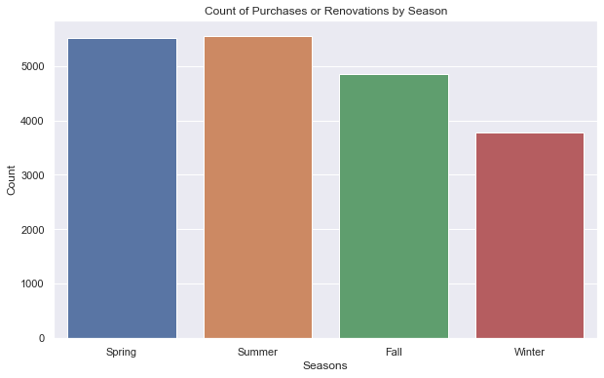
Exploratory Data Analysis
Univariate Analysis
Most houses were bought and renovated during the summer and spring seasons; less houses were bought during winter season.

Slide 8

Statistical Analysis
Statistical analysis is used to understand relationships within the dataset, identifying patterns, and gaining insights.
Descriptive Statistics
Correlation matrix
Distribution Analysis
Inferential Statistics using Hypothesis Testing and Analysis of Variance
Multicollinearity

Slide 9

Descriptive Analysis
Understanding data characteristics. For Mean, Mode, Variance and standard deviation
Price Distribution:
The prices of houses in the dataset vary widely, with a mean price of approximately 540,296.6 to 367,368.1. The prices range from 78,000 to 7,700,000.
Property Characteristics:
The dataset contains information on various property characteristics such as the number of bedrooms, bathrooms, square footage of living space, and lot size. For example, the average number of bathrooms is approximately 2.11, with a standard deviation of about 0.77.
Year Built:
The houses in the dataset were built between 1900 and 2015, with an average year of construction around 1971.

Slide 10
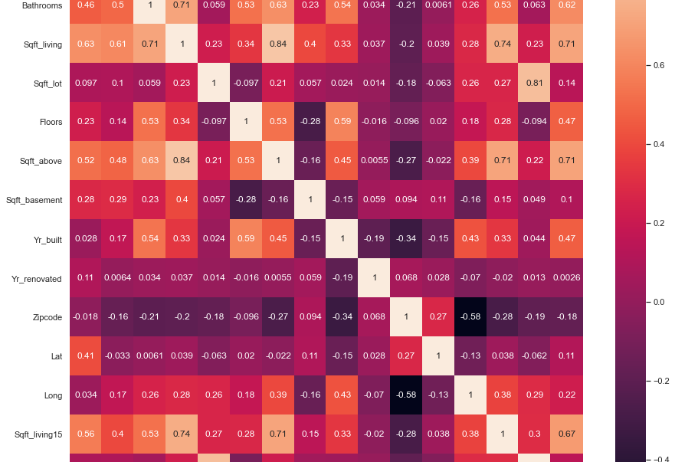
Correlation Matrix
Price has a moderate positive correlation with sqft living (0.63), sqft above (0.52), sqft living15 (0.56) and Grading(0.64). This means that as the values of these features increase, the price of the house also tends to increase.
There is a weak positive correlation between price and floors (0.23) and sqft_basement (0.28).
Price has a weak negative correlation with zipcode (-0.018).

Slide 11
Hypothesis Testing
ANOVA ANALYSIS
Ho: There is no statistically significant interaction effect between sqft_living and grading on the price of a house
H1: There is a statistically significant interaction effect between sqft_living and grading on the price of a house.

Slide 12
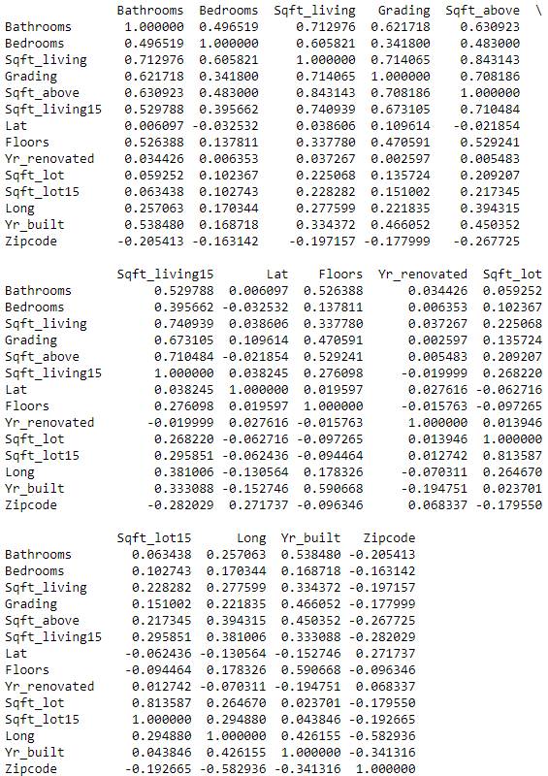
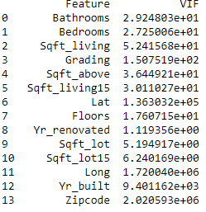
Multicolinearity
High correlations(eg above 0.7 ot 0.8), between pairs of variables suggest potential multicollinearity
If the VIF is greater than 5 or 10,it indicates multicolinearity. Higher VIF values signify stronger correlation with other predictors.

Slide 13

Data Modelling
We demonstrated the three models in the notebook as stated below but we will recommend only polynomial because it is the most suitable regression model to analyze the prices for a more accurate output.
Baseline Model
Multilinear Regression
Polynomial Regression

Slide 14
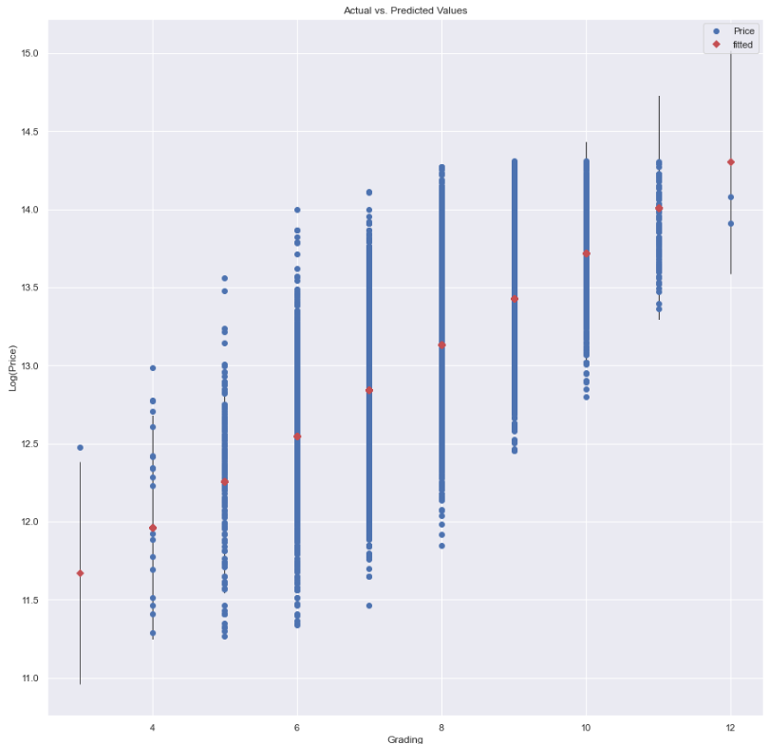
Baseline model
This visualization provides insights into how well the model fits the training data and how the predicted values compare to the actual target values. Our model indicates a good fit between the predicted values and the actual values because the fitted line closely follows the diagonal (a 45-degree line from the bottom-left to the top-right of the plot).

Slide 15
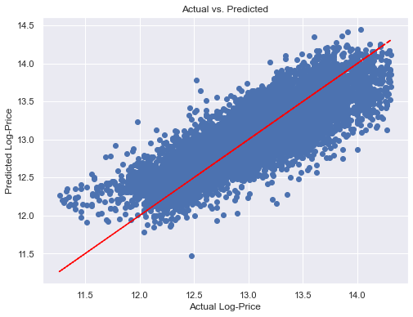
Multilinear Regression
Adding more predictors to our baseline model can enhance its predictive power by capturing additional complexity and potential relationships within our data. This can lead to improved model accuracy and potentially reducing bias by considering more factors in the prediction process.
The model explains 69% of the variance in price as indicated by R squared
Therefore, the multiple linear regression is better than our baseline regression

Slide 16
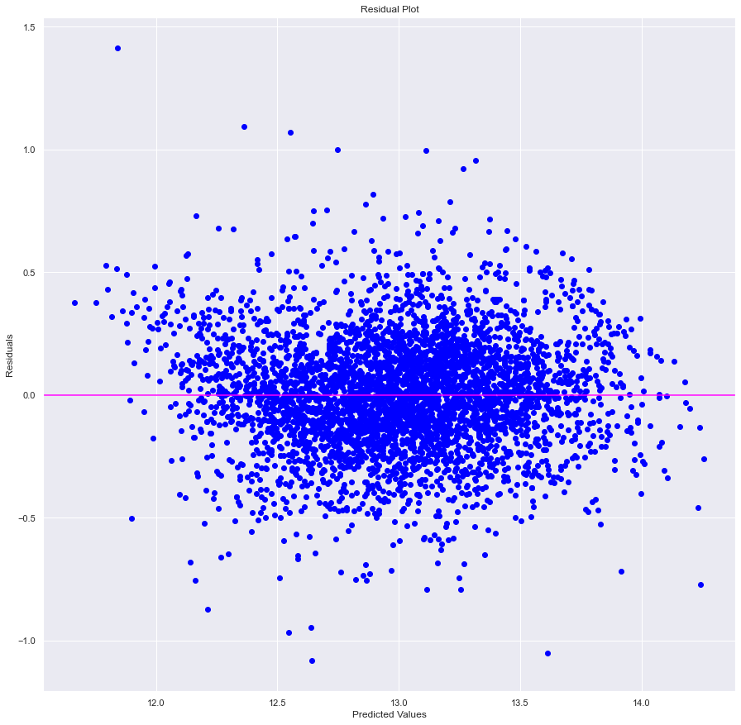
Polynomial Regression
Polynomial RMSE: 0.23061511620028652
R_squared: 0.7655407239791847
Given that polynomial regression accounts for roughly 76% of the volatility in house prices—a percentage somewhat greater than that explained by multiple linear regression—polynomial regression is a superior model in this situation. Polynomial regression also has a less Root Squared Mean Error than Multiple Linear Regression Model. This suggests that the polynomial regression yielded superior results. The RMSE of the polynomial regression also suggests the same since it is also lower than the multiple linear regression model.

Slide 17

Regression Results
We embarked on an iterative statistical modelling process where we started with a simple linear regression, multilinear regression modelling and finally Polynomial regression where we noted that for each regression, the model became better with each iteration.
The baseline model had an R Squared of 0.42
The multilinear regression had an R squared of 0.69 and an RMSE of 0.27
The polynomial regression model had an Rsquared of 0.77 and an RMSE of 0.23
For the final polynomial regression RMSE value , our model is off by 0.23 dollars in each prediction.

Slide 18

Results/Findings
Grading: The coefficient of 0.1349 suggests that for each unit increase in the grading, the log-transformed price increases by approximately 0.1349, holding other variables constant. The p-value of 0.000 indicates that this coefficient is statistically significant.
Yr_renovated: The coefficient is 4.34e-05, indicating a very small effect size. This suggests that year of renovation has a minimal impact on the log-transformed price. Howe
Sqft_living15: The coefficient is approximately 0.0001, indicating that for each unit increase in square footage of living space (15 nearest neighbors), the log-transformed price increases by approximately 0.0001. The p-value of 0.000 indicates that this coefficient is statistically significant.
Bedrooms: The coefficient of -0.0164 suggests that an increase in the number of bedrooms leads to a decrease in the log-transformed price by approximately 0.0164, holding other variables constant.

Slide 19
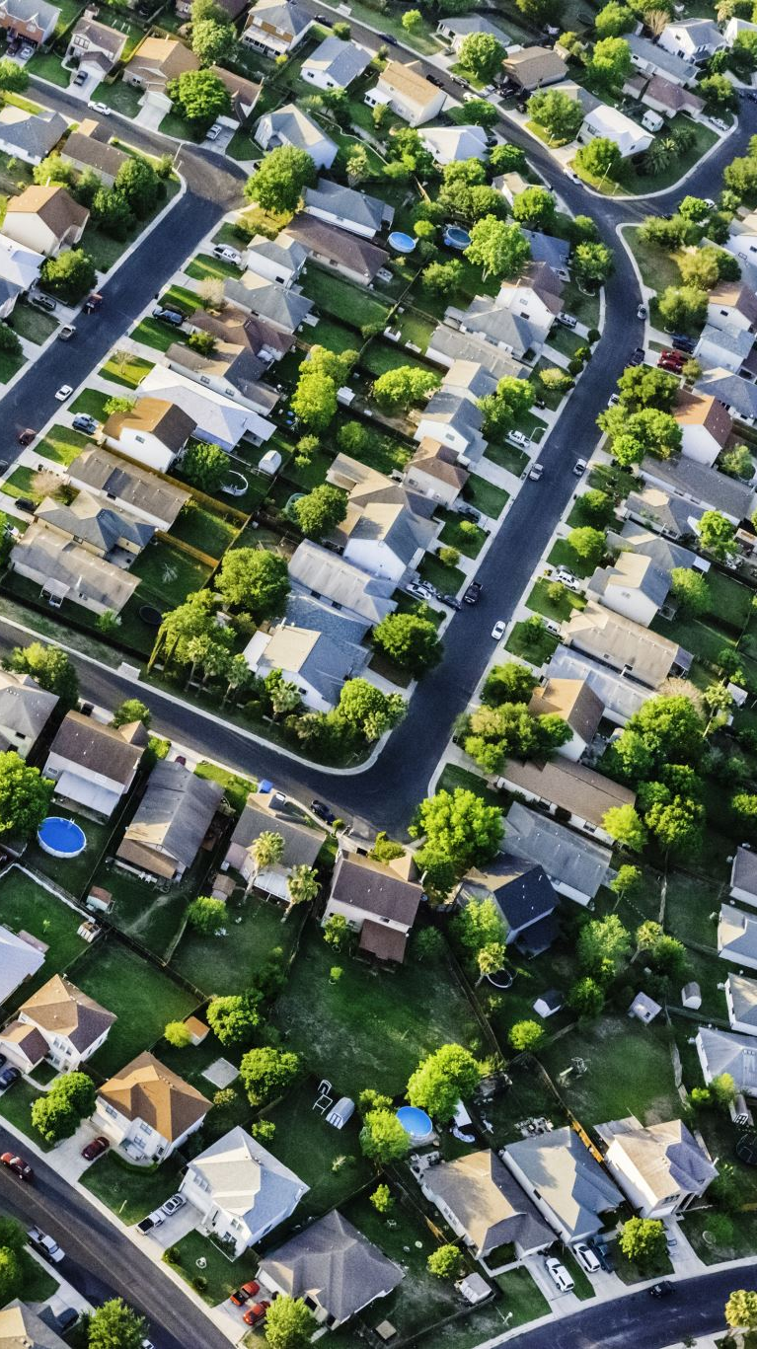
Recommendations
The square footage of living space has a significant influence on house pricing as well. This information can be used by the Real Estate Agency to support higher listing prices for homes with larger square footage.
There are several benefits to using a polynomial regression model instead of a typical linear model when predicting property prices. By taking into consideration the non-linear effects of important features like square footage, location, and on-site facilities, this method enables us to capture intricate correlations and fluctuations in home pricing. The polynomial regression's high R-squared value indicates that the chosen features account for a significant amount of the variability in home prices, which translates into more accurate and consistent price projections. Using this cutting-edge modeling technique gives us, as real estate market participants, more decision-making power and improves pricing tactics, investment analyses, and market competitiveness overall.

Slide 20
Conclusion
In this project, we conducted an in-depth analysis of the King County (KC) house dataset to predict house prices using advanced regression techniques. The goal was to provide valuable insights for stakeholders in the real estate industry.
Key Findings:
Feature Importance: Through regression analysis, we identified several key predictors that significantly influence house prices, including grading, square footage of living space, number of bedrooms, and bathrooms. Effect of Features:
Effect of Features: Our findings reveal nuanced relationships between house features and pricing. For instance, higher grading and larger living spaces positively impact prices.
Model Performance: We compared different regression models and found that polynomial regression outperformed multiple linear regression model, capturing non-linear relationships more effectively and yielding higher predictive accuracy.

