Slide 1
Multiple Linear Regression Analysis of House Prices

Slide 2
Summary

Slide 3
Outline
Business Problem
Data Description
Hypothesis Testing
Skewness and Kurtosis
Methods
Results
Conclusions

Slide 4
Business Problem
Background:
The real estate agency aims to provide accurate property valuations to homeowners looking to sell their homes and to buyers interested in purchasing properties. Property valuation is a critical aspect of real estate transactions as it directly impacts pricing decisions, marketing strategies, and negotiation outcomes.
Business Problem Statement:
The real estate agency faces challenges in accurately valuing properties, which can lead to overpricing or underpricing homes, affecting client satisfaction, time on market, and overall business performance

Slide 5
Data Description
`id` - Unique identifier for a house
* `date` - Date house was sold
* `price` - Sale price (prediction target)
* `bedrooms` - Number of bedrooms
* `bathrooms` - Number of bathrooms
* `sqft_living` - Square footage of living space in the home
* `sqft_lot` - Square footage of the lot
* `floors` - Number of floors (levels) in house
* `waterfront` - Whether the house is on a waterfront
* Includes Duwamish, Elliott Bay, Puget Sound, Lake Union, Ship Canal, Lake Washington, Lake Sammamish, other lake, and river/slough waterfronts
* `view` - Quality of view from house
* Includes views of Mt. Rainier, Olympics, Cascades, Territorial, Seattle Skyline, Puget Sound, Lake Washington, Lake Sammamish, small lake / river / creek, and other
* `condition` - How good the overall condition of the house is. Related to maintenance of house.
* See the [King County Assessor Website](https://info.kingcounty.gov/assessor/esales/Glossary.aspx?type=r) for further explanation of each condition code
* `grade` - Overall grade of the house. Related to the construction and design of the house.
* See the [King County Assessor Website](https://info.kingcounty.gov/assessor/esales/Glossary.aspx?type=r) for further explanation of each building grade code
* `sqft_above` - Square footage of house apart from basement
* `sqft_basement` - Square footage of the basement
* `yr_built` - Year when house was built
* `yr_renovated` - Year when house was renovated
* `zipcode` - ZIP Code used by the United States Postal Service
* `lat` - Latitude coordinate
* `long` - Longitude coordinate
* `sqft_living15` - The square footage of interior housing living space for the nearest 15 neighbors
* `sqft_lot15` - The square footage of the land lots of the nearest 15 neighbors

Slide 6
Hypothesis Testing
How do structural characteristics, location and others such as view and grading all work together to affect a house's market price, and how may these interactions be best modeled to produce highly accurate housing price predictions?
Null Hypothesis: Structural characteristics, location, seasons and other features in our data do not significantly affect the market price of houses.
Alternative Hypothesis: Structural characteristics, location, seasons and other features in our data significantly affect the market price of houses.
Null Hypothesis: Multiple linear regression model accurately predicts the prices.
Alternative Hypothesis: Multiple linear regression model does not accurately predict the prices.

Slide 7
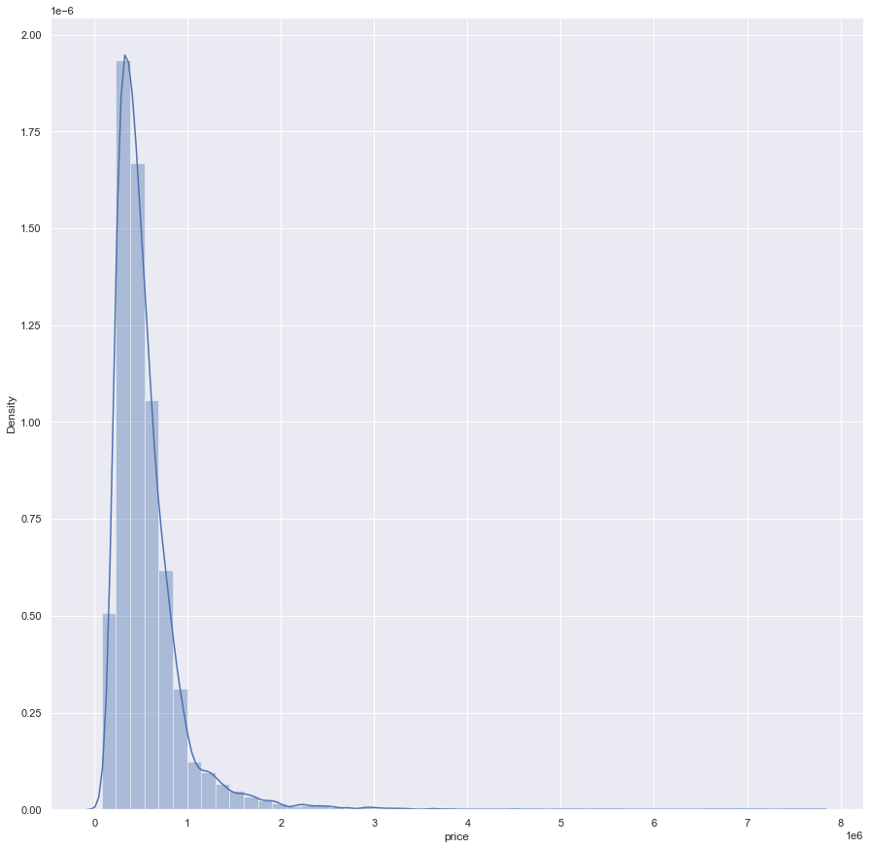
Skewness and Kurtosis
The distribution of data in the price column is positively skewed.
This indicates asymmetry in the distribution of residuals, which may have implications for the accuracy and interpretation of regression results.

Slide 8
Methodology Multiple Linear Regression
Define Variables: Y – price (Dependent variable), X – Sqft_living (Independent variable)
Formulate the Regression Equation:
Y=β0​+β1​X1​+β2​X2​+...+βp​Xp​+ε
Y represents the dependent variable.
X1,X2,.....,Xp​ represent the independent variables.
β0​ represents the intercept or constant term.
β1​,β2​,...,βp​ represent the coefficients or slopes associated with each independent variable.
ε represents the error term, which captures the variability in the dependent variable that is not explained by the independent variables.
Estimate Coefficients:
Use statistical methods (e.g., least squares estimation) to estimate the coefficients (slopes) of the regression equation.
Assess Model Fit:
Evaluate the overall fit of the regression model to the data using measures such as the coefficient of determination (R²), adjusted R², and significance tests (e.g., F-test).
Interpret Coefficients:
Interpret the coefficients of the regression equation to understand the relationship between the independent variables and the dependent variable.
Check Assumptions:
Assess the validity of the multiple linear regression model by checking assumptions such as:
Linearity: The relationship between the independent and dependent variables is linear.
Independence of Errors: The errors (residuals) are independent of each other.
Homoscedasticity: The variance of the errors is constant across all levels of the independent variables.
Normality of Errors: The errors are normally distributed.
Make Predictions: Use the estimated regression equation to make predictions of the dependent variable for new observations or scenarios based on the values of the independent variables.
Validate Model: Validate the regression model by assessing its performance on a separate dataset (if available) or using techniques such as cross-validation to evaluate its predictive accuracy and generalizability.

Slide 9
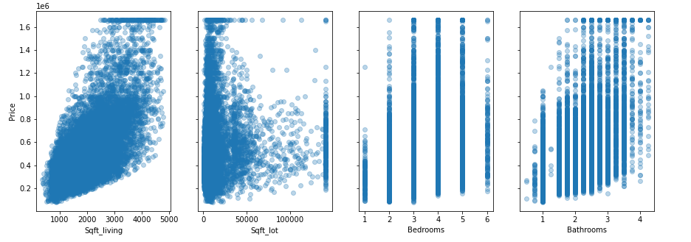
Results
Visualize Relationships with respect to price:
All three of these four features seem to have a linear relationship with Price, Sqft_living seems to have the most variance vs. Price

Slide 10
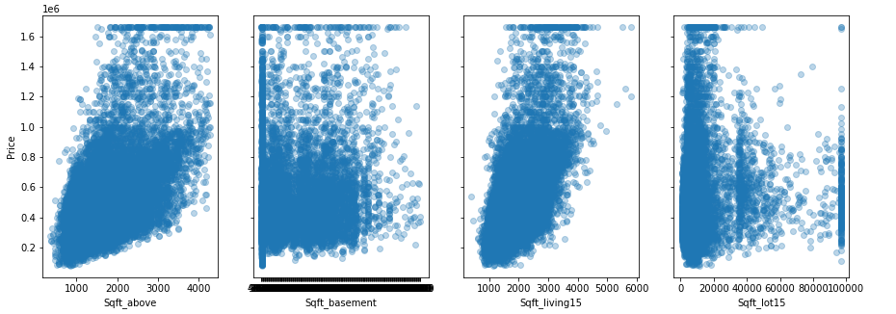
Results
Visualize Relationships with respect to price:
Sqft_above seems to have the most variance vs. Price

Slide 11
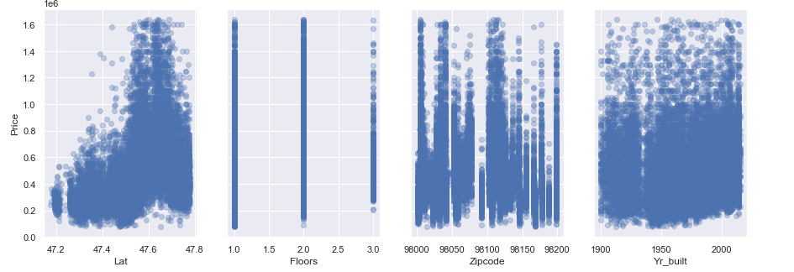
Results Visualization with respect to price:
Lat column seems to have the most variance vs. Price

Slide 12
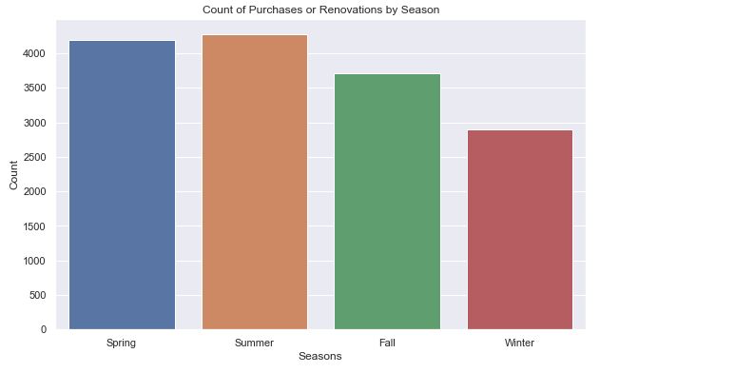
Results
Understanding count of purchases and renovations by seasons
Most houses were bought and renovated during the summer and spring seasons; less houses were bought during winter season.

Slide 13
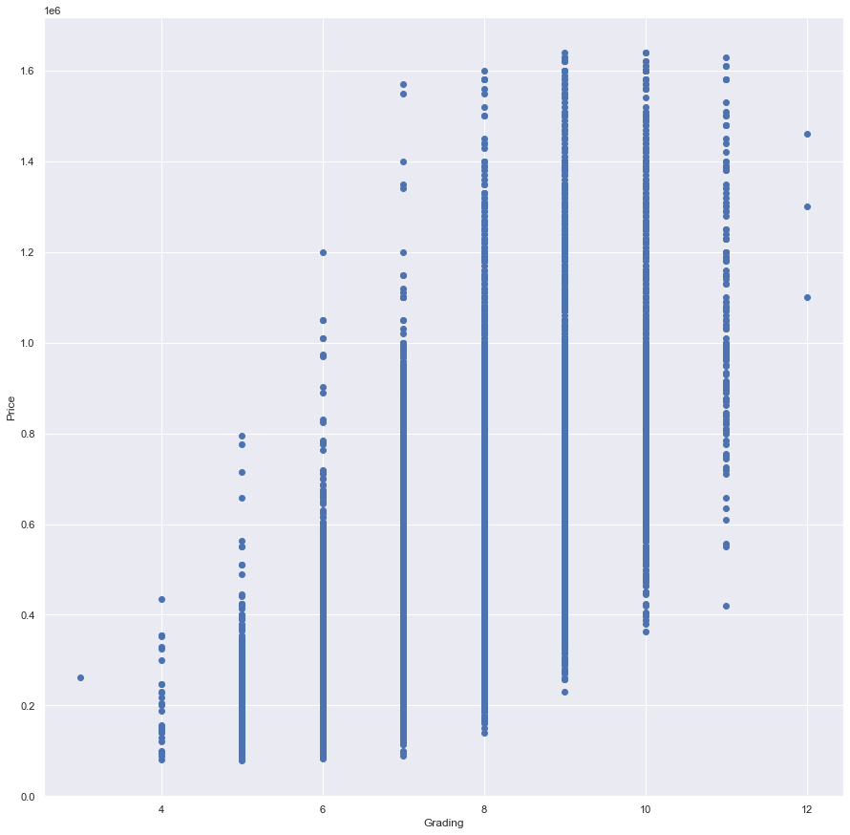
Results
Grading vs Price:
.

Slide 14
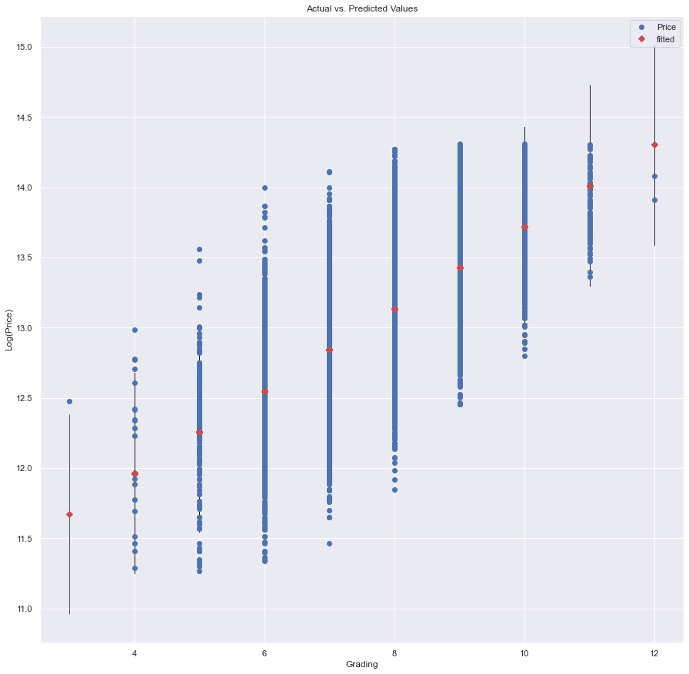
Results
Grading vs price
Provides insights into how well the model fits the training data and how the predicted values compare to the actual target values.
Our model indicates a good fit between the predicted values and the actual values because the fitted line closely follows the diagonal.

Slide 15
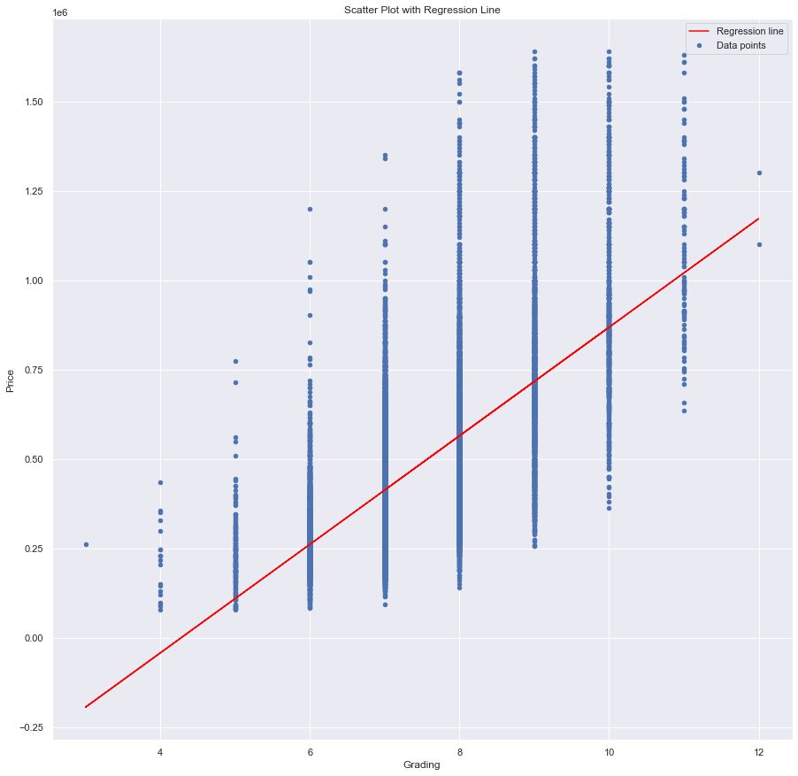
Results
Scatter plot with regression line

Slide 16
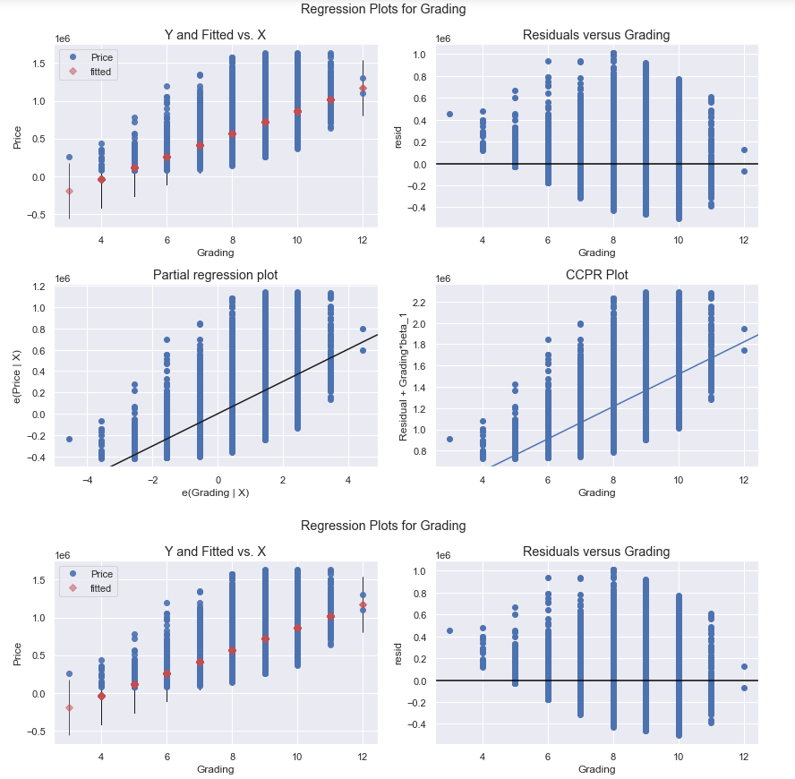
Results
Shows a set of diagnostic plots that help in assessing the model's assumptions and the relationship between the predictor variable and the target variable

Slide 17
Thank You!
Email: GitHub: LinkedIn: linkedin.com/in/victor-keya-b6ba5682/

