Slide 1

Stroke Data Analysis
Data cleaning and exploratory data analysis (EDA)

Slide 2

Data Inspection

Slide 3
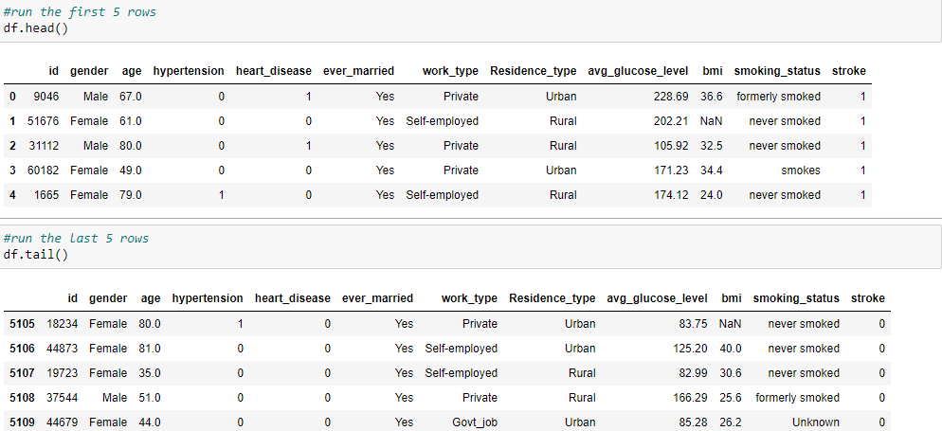
Data Inspection

Slide 4
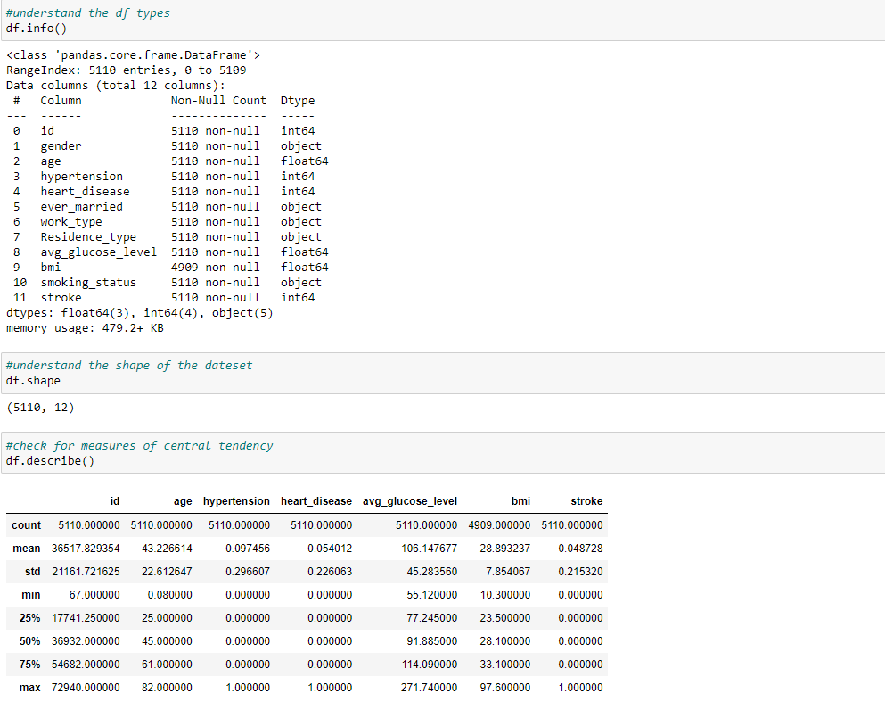
Data Inspection

Slide 5


Data Inspection

Slide 6
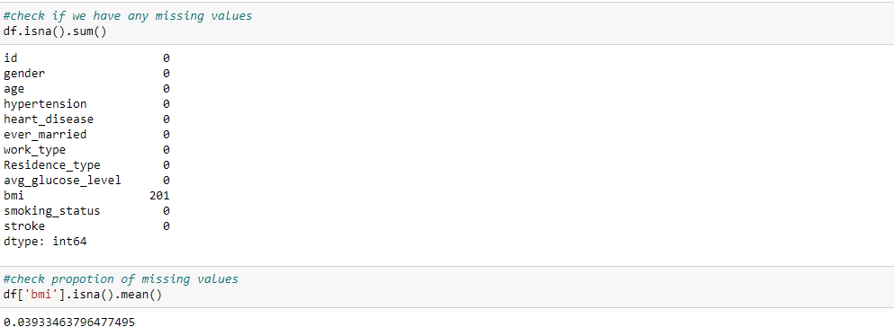
Data Inspection

Slide 7
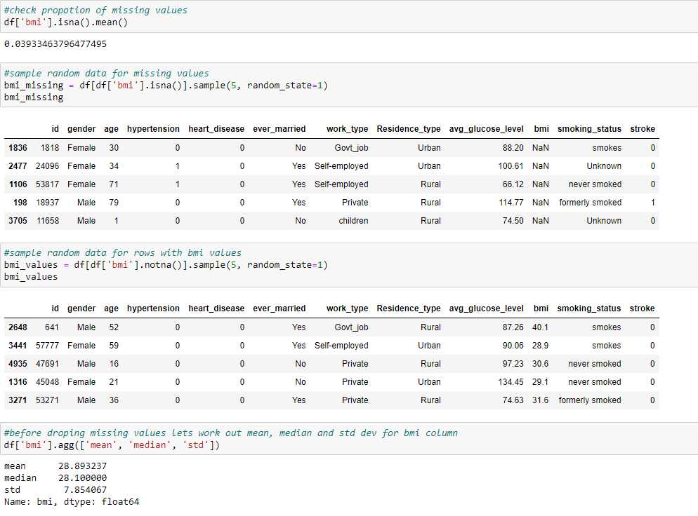
Data Inspection

Slide 8
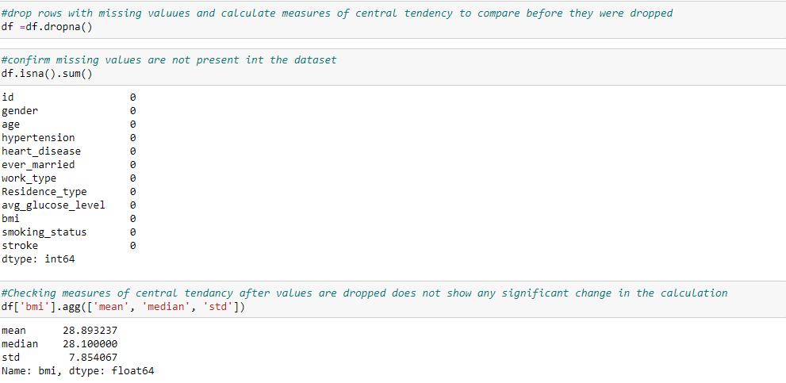
Data Cleaning

Slide 9
Data Cleaning

Slide 10
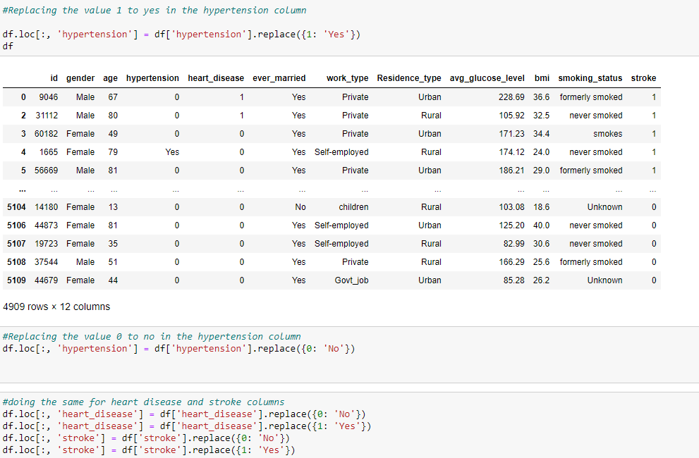
Data Cleaning

Slide 11
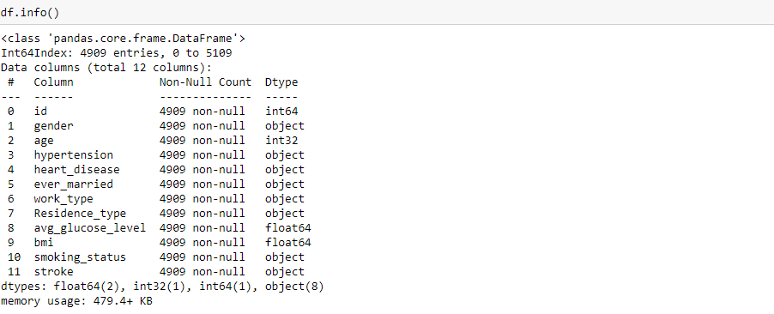
Data Cleaning

Slide 12
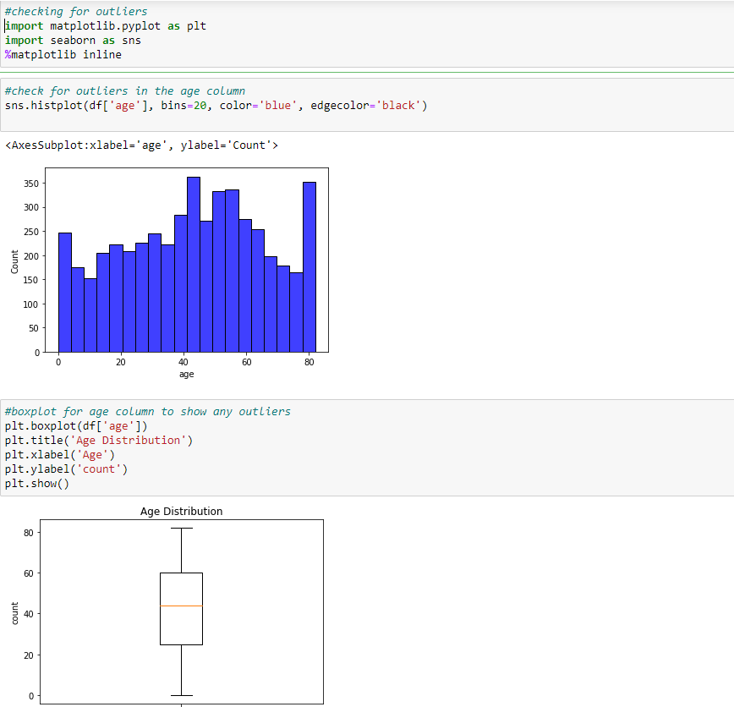
Data Cleaning

Slide 13
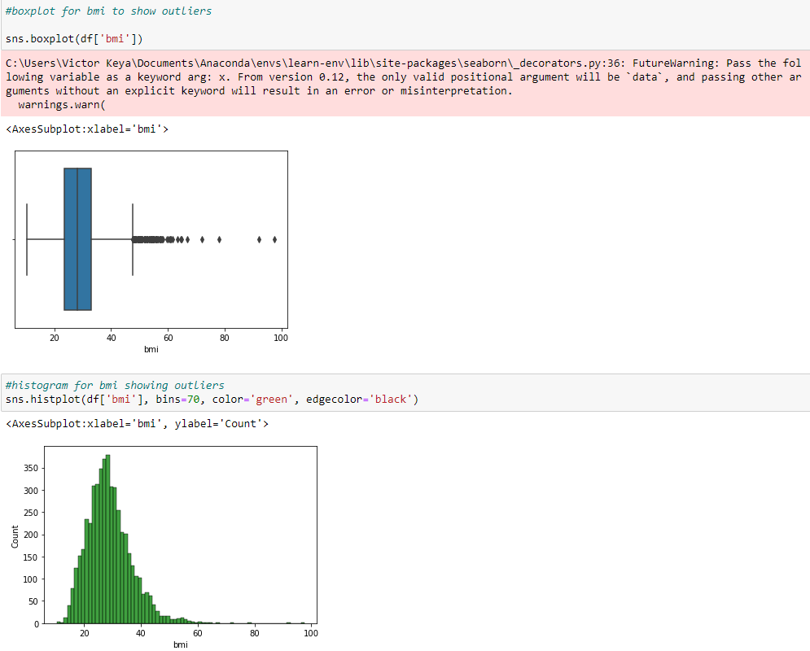
Data Cleaning

Slide 14
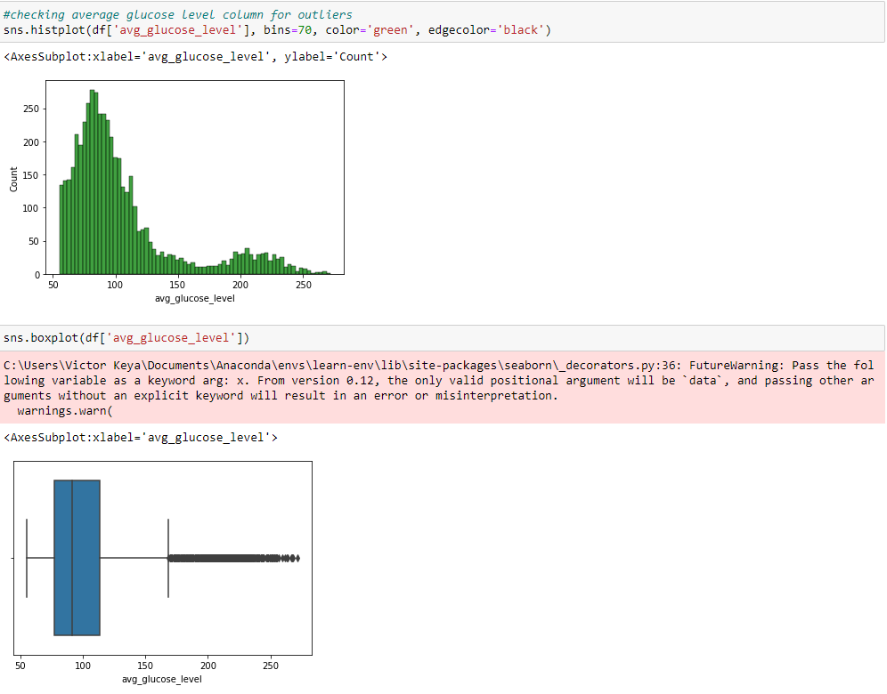
Data Cleaning

Slide 15
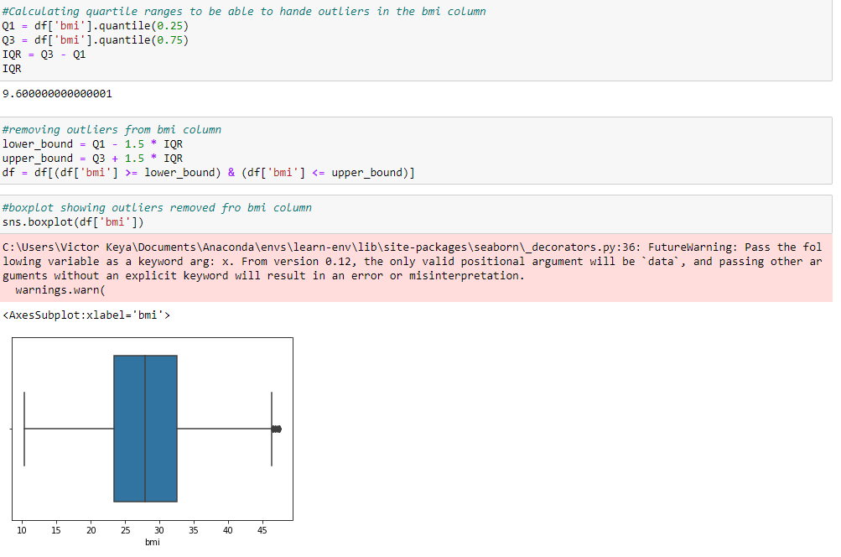
Data Cleaning

Slide 16
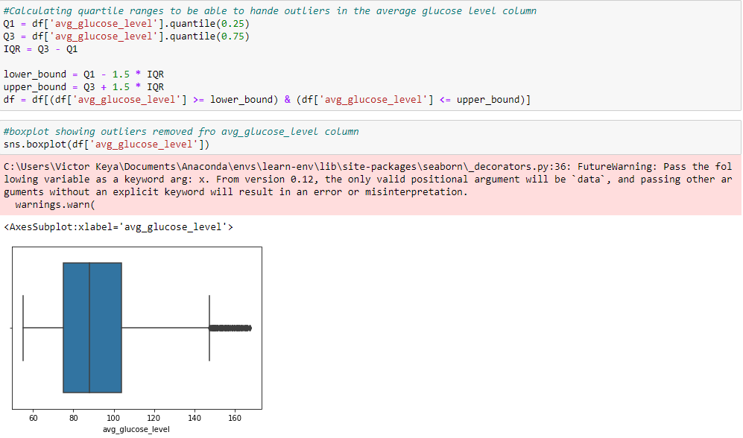
Data Cleaning

Slide 17
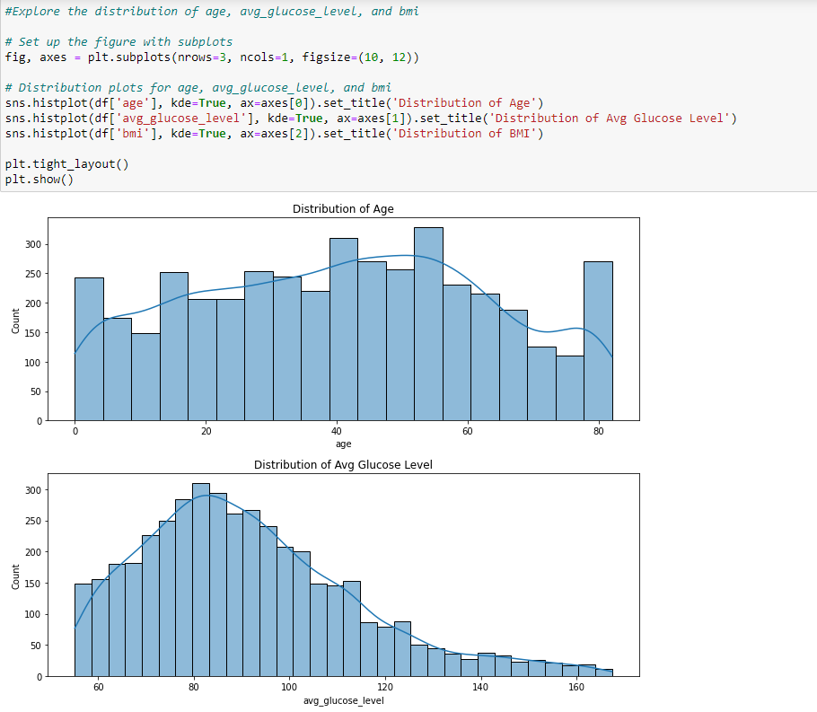
EDA

Slide 18
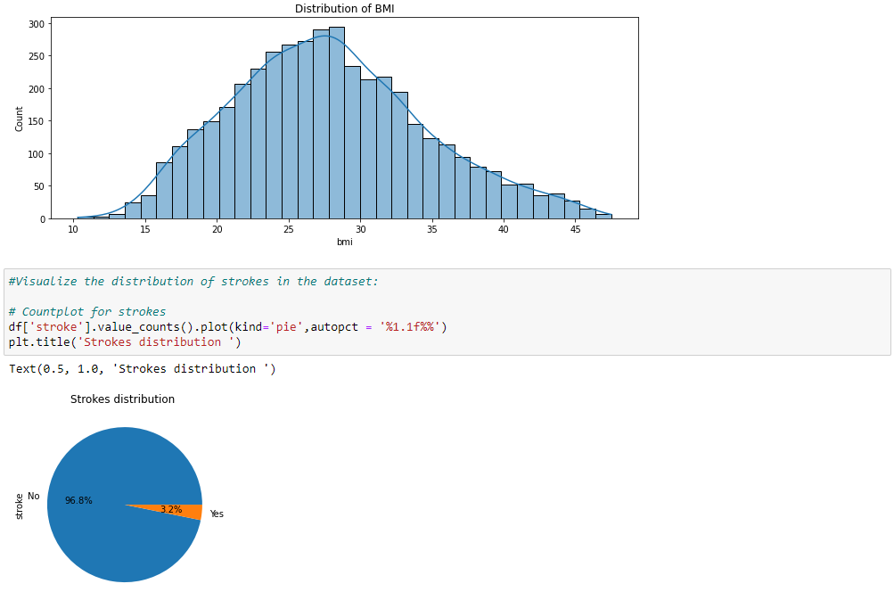
EDA

Slide 19
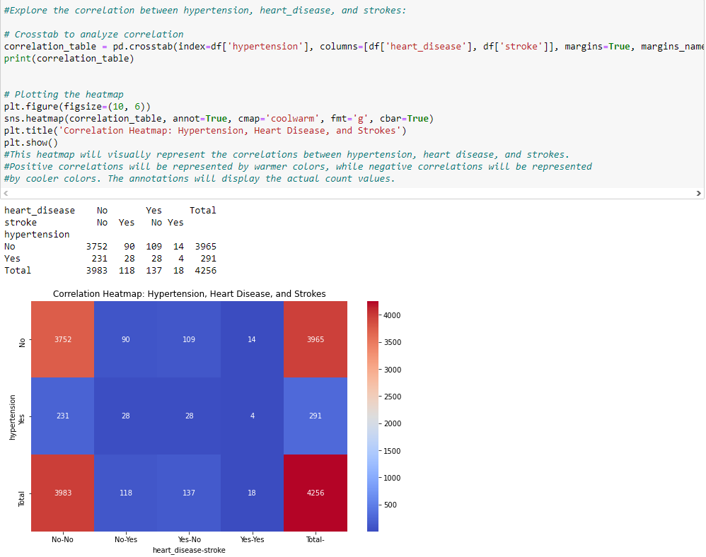
EDA

Slide 20
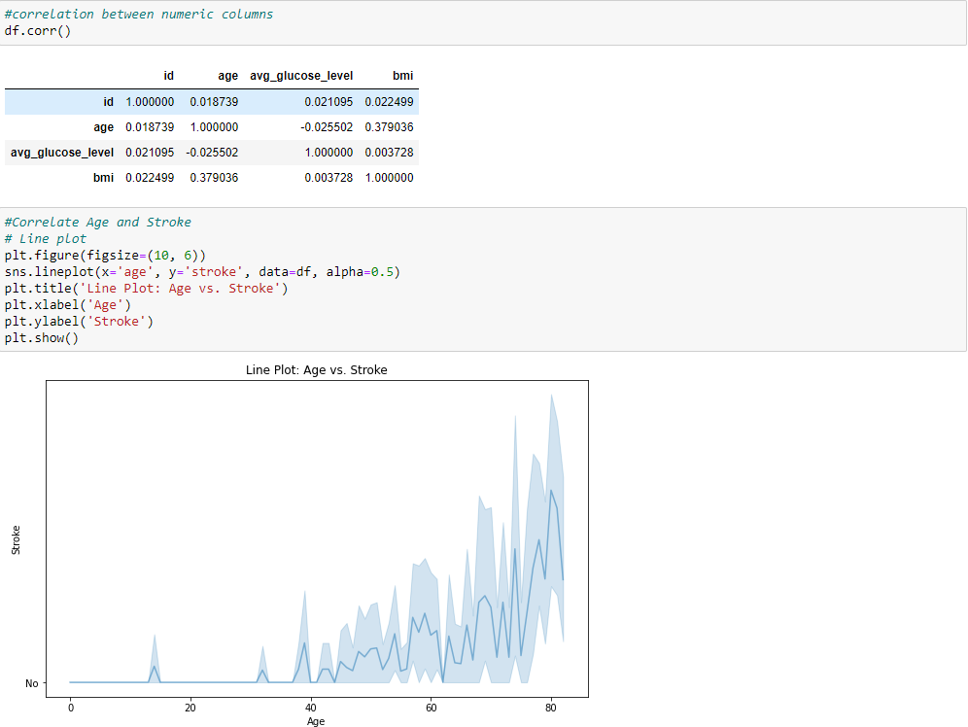
EDA

Slide 21
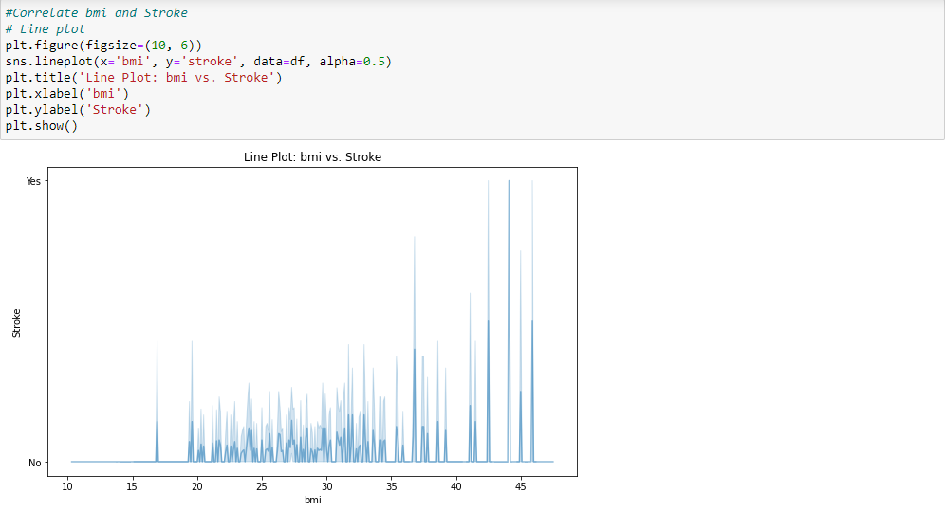
EDA

Slide 22
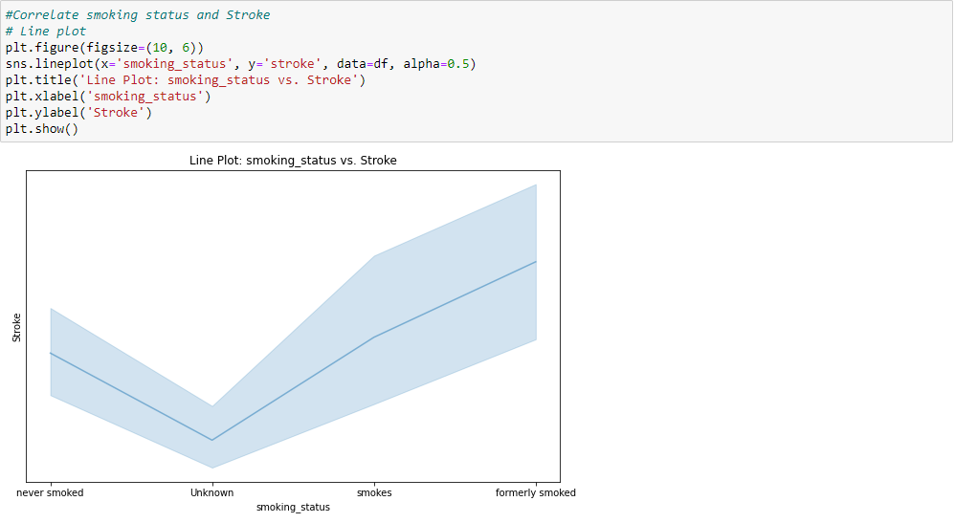
EDA

Slide 23
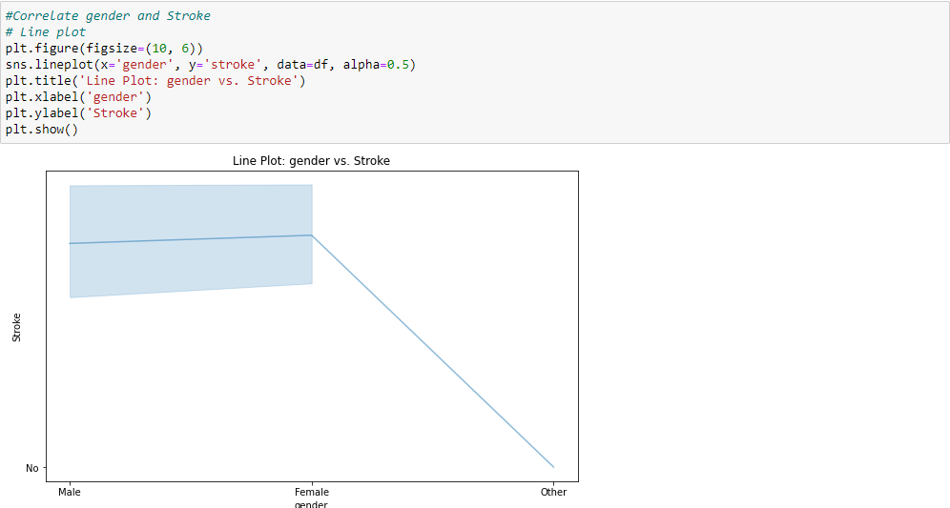
EDA

Slide 24
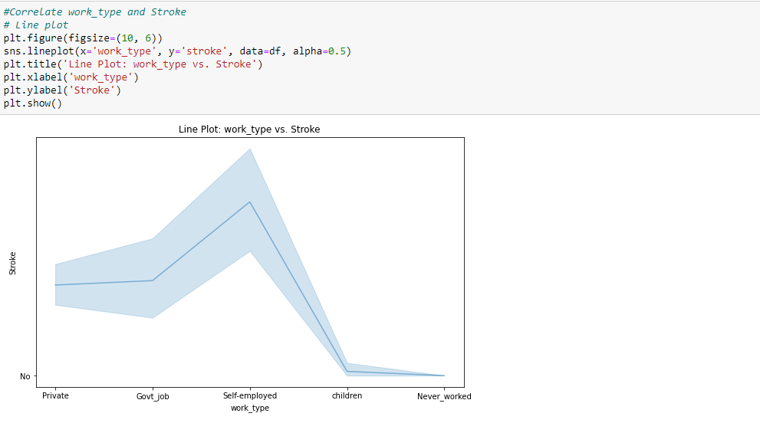
EDA

Slide 25
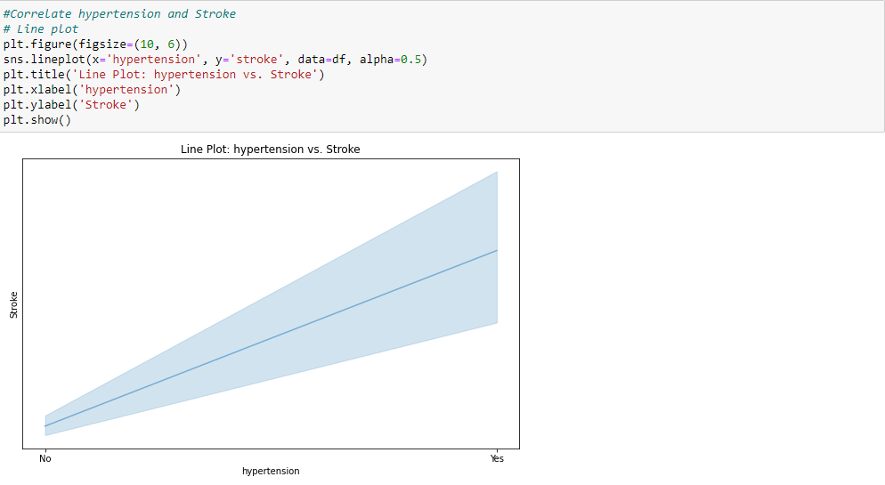
EDA

Slide 26
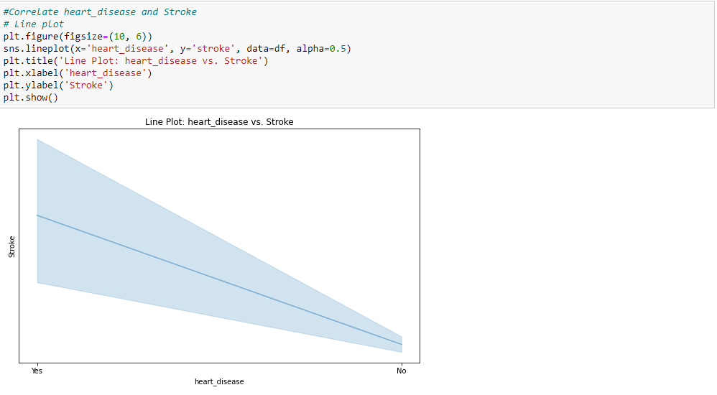
EDA

Slide 27
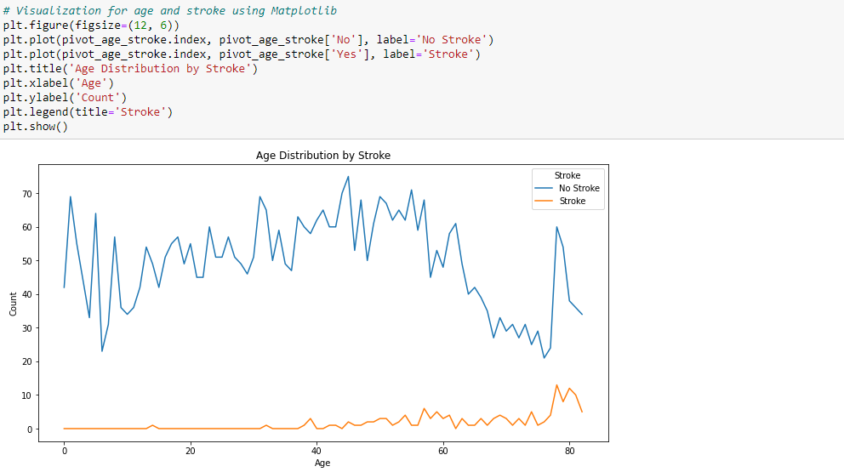
EDA

Slide 28
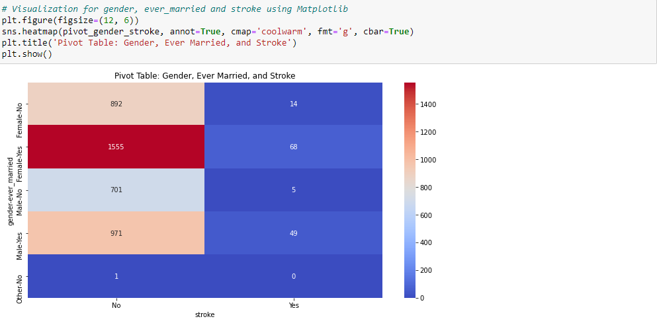
EDA

Slide 29
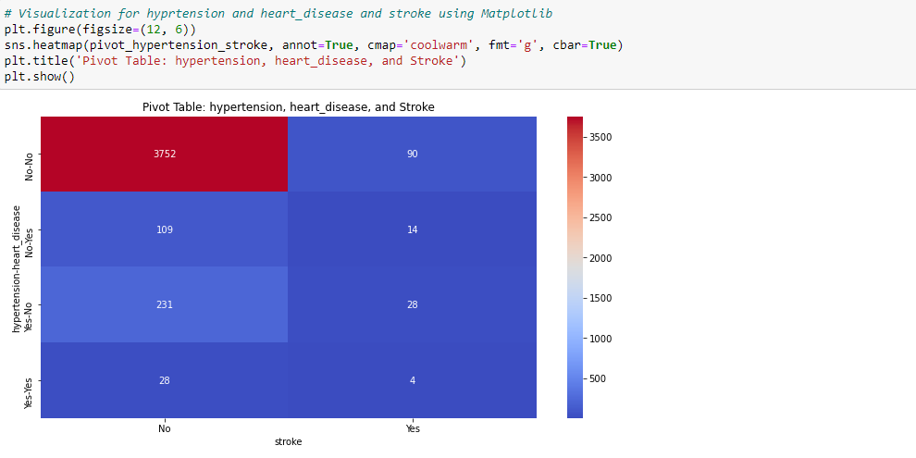
EDA

Slide 30
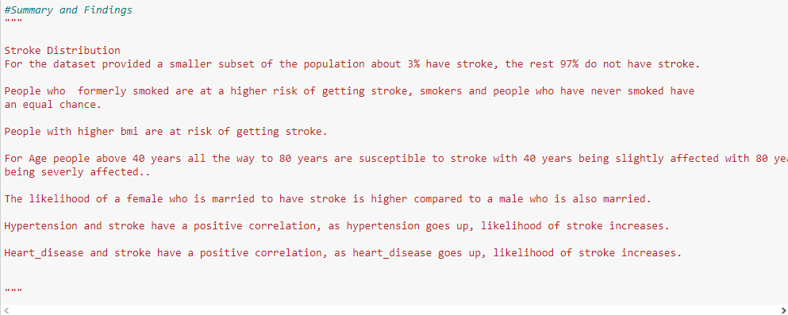
Summary and Findings

Slide 31

Recommendations

