Slide 1
PHASE II · IMPLEMENTATION AND RESULTS
Palmprint Verification with RLOC
Paper 2 implemented from the paper, and measured against Paper 1 on 600 palms
Group members
Hanmant Jajulwar
U23AI098 · presentation
Vishal Gautam
U23AI127 · live demo
Department of Artificial Intelligence
Sardar Vallabhbhai National Institute of Technology, Surat
B.Tech III (Artificial Intelligence) · Semester VI
AI461 Advanced Biometric Systems and Security
Modality: palmprint · Database: Tongji, 600 palms
PAPER 2 · IMPLEMENTED
“Palmprint verification based on robust line orientation code”
W. Jia, D.-S. Huang, D. Zhang
Pattern Recognition 41 (2008) 1504–1513
PAPER 1 · BASELINE
“Personal authentication using palm-print features”
C.-C. Han, H.-L. Cheng, C.-L. Lin, K.-C. Fan
Pattern Recognition 36 (2003) 371–381
Notes:
[~29 s · Hanmant]
SAY
Good morning. I am Hanmant Jajulwar, and with me is Vishal Gautam. In Phase
One we critiqued two palmprint papers. In Phase Two we implemented one of them
— Paper 2, the robust line orientation code, RLOC — and measured it against
Paper 1, Han and colleagues, as our baseline. I will present; then Vishal runs
the live demo.
IF ASKED
Both papers are in Pattern Recognition (Elsevier): Paper 1 vol. 36, 2003;
Paper 2 vol. 41, 2008. Paper 2 cites Paper 1 as earlier work.
Timing: the spoken script is 2284 words, budgeted at 1095 s (18:15) at 125 words a minute including pauses; the reserve is 105 s of the 20 minutes. If running late, shorten slides 12, 15 and 22 — their numbers are on screen. Never cut 4, 11, 17 or 20.

Slide 2
OVERVIEW
What we built, and how well it works
Paper 2's RLOC, implemented from the paper; Paper 1's method as the baseline; one public database and one protocol for both.
Palm image
128 × 128 region
MFRAT
six line sums
Orientation code
32 × 32 directions
Matching
7 templates
Decision
score ≥ 0.681
0.11%
equal error rate of RLOC, enrolled in one session and tested in another (95% interval 0.04–0.16%)
The five questions of the brief, in order
1
How the data is obtained
slides 3 – 4
2
How the features are extracted
slides 5 – 8
7.67%
equal error rate of Han et al. (2003) on the same images, under the same protocol
3
The algorithm, step by step
slides 9 – 12
4
Verifying an input
slides 13 + demo
5
Performance: FAR, FRR, confusion matrix
slides 14 – 18
6,000 / 3,594,000
genuine / impostor comparisons behind each of those numbers
Then: Paper 2's own claims, re-tested
slides 19 – 22
AI461 Advanced Biometric Systems and Security · Phase II : Implementation and Results
2
Notes:
[~61 s · Hanmant]
SAY
The whole talk on one slide. Across the top is the pipeline we built. A palm
image is cut to a 128 by 128 region. An operator called MFRAT sums the image
along six short lines. We keep only the direction of the darkest line at each
point — a 32 by 32 code — and match it against seven stored templates.
The results, on the left. Enrolled on one occasion and tested on another, our
implementation has an equal error rate of 0.11 percent. Paper 1's method, on
the same images, has 7.67. Each number rests on six thousand genuine and about
3.6 million impostor comparisons.
On the right, the order of the talk: the brief's five questions, then Paper
2's own claims, re-tested.
IF ASKED
Equal error rate (EER): the error rate at the threshold where the false accept
rate equals the false reject rate. Lower is better.
"Implemented from the paper": MFRAT, the templates, the matching rule (eqs.
7–9), the metrics and the demo are our own code in Python with numpy and
Pillow (and Tkinter for the demo window). No OpenCV, no scipy, no downloaded
model.

Slide 3
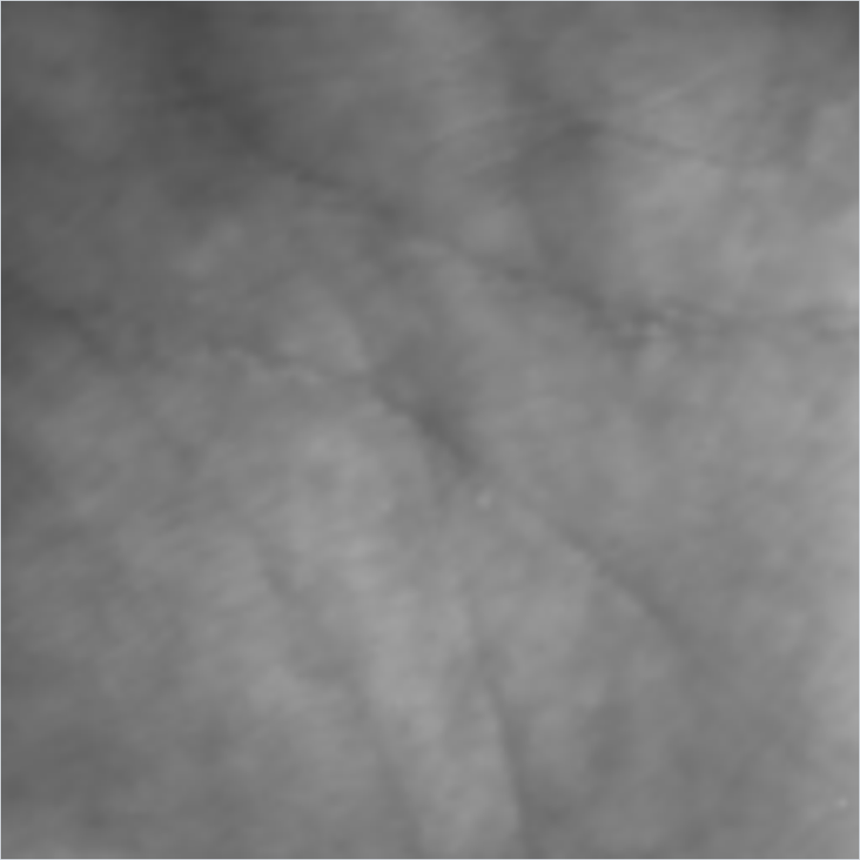
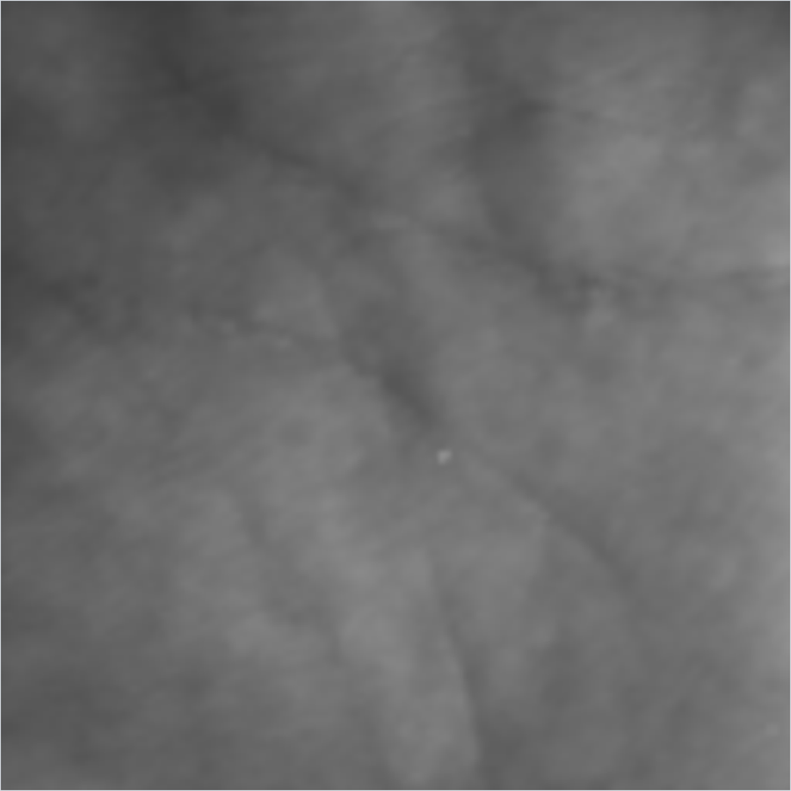
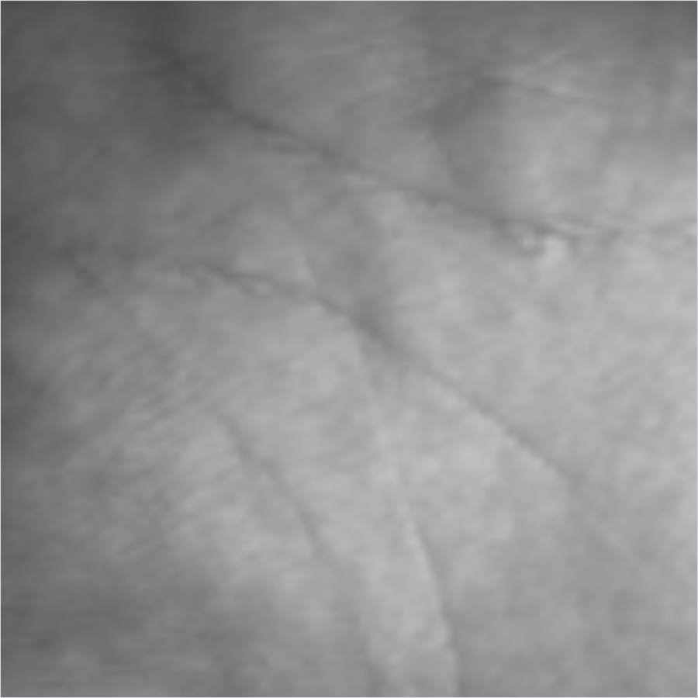
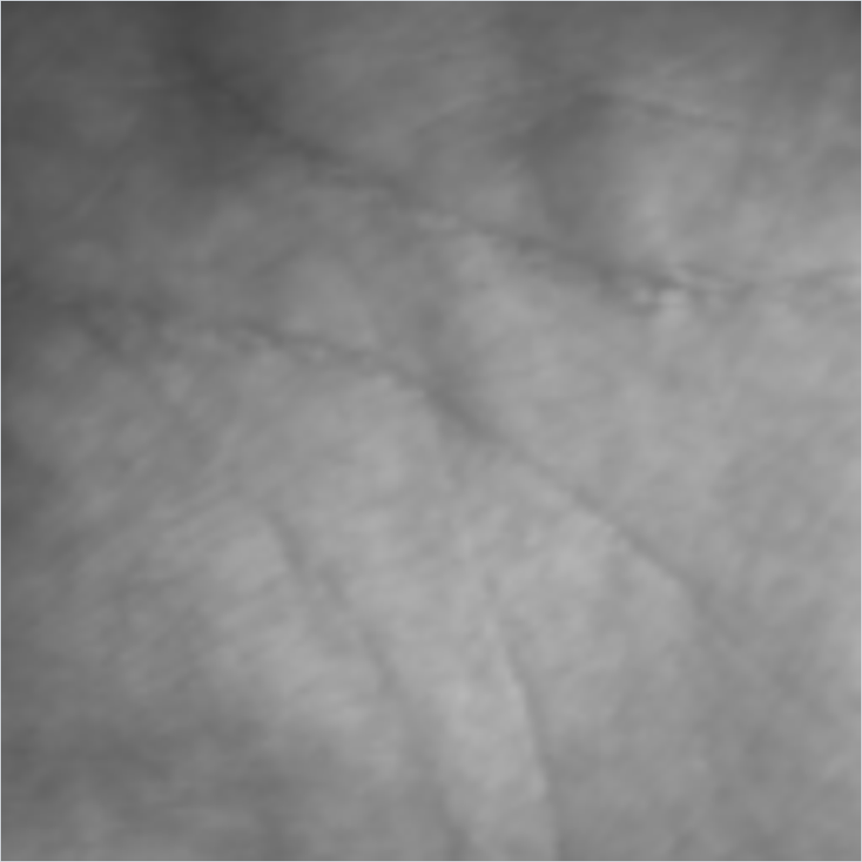
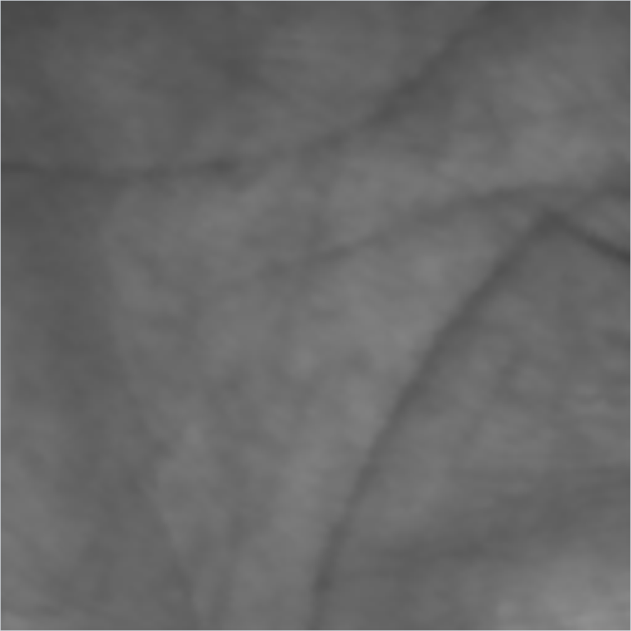
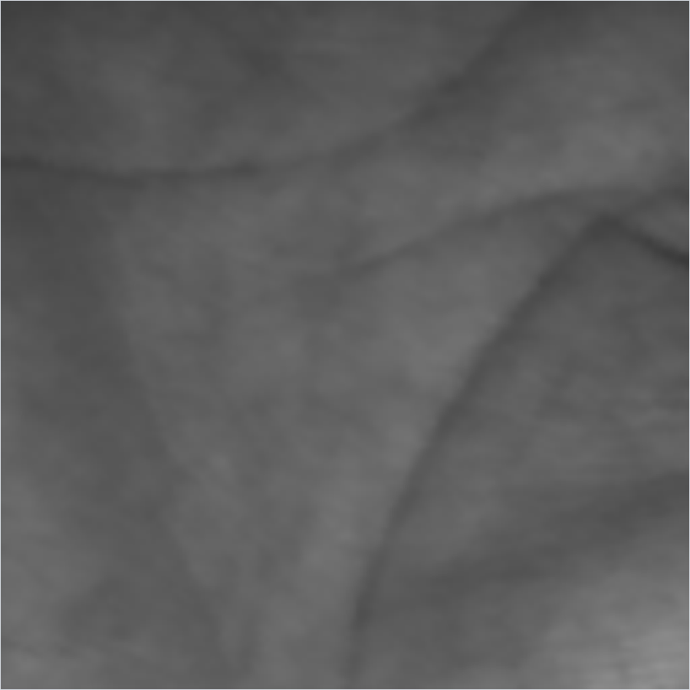
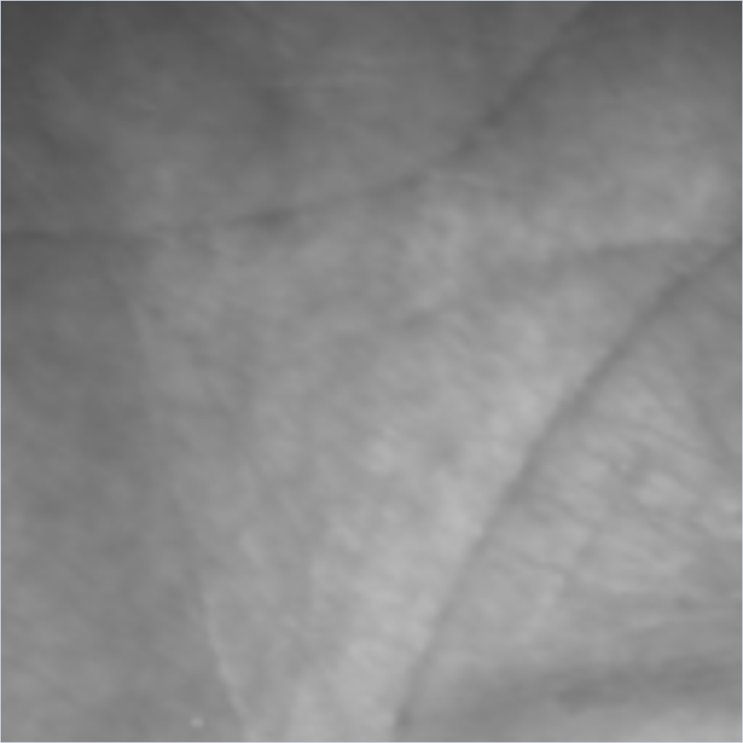
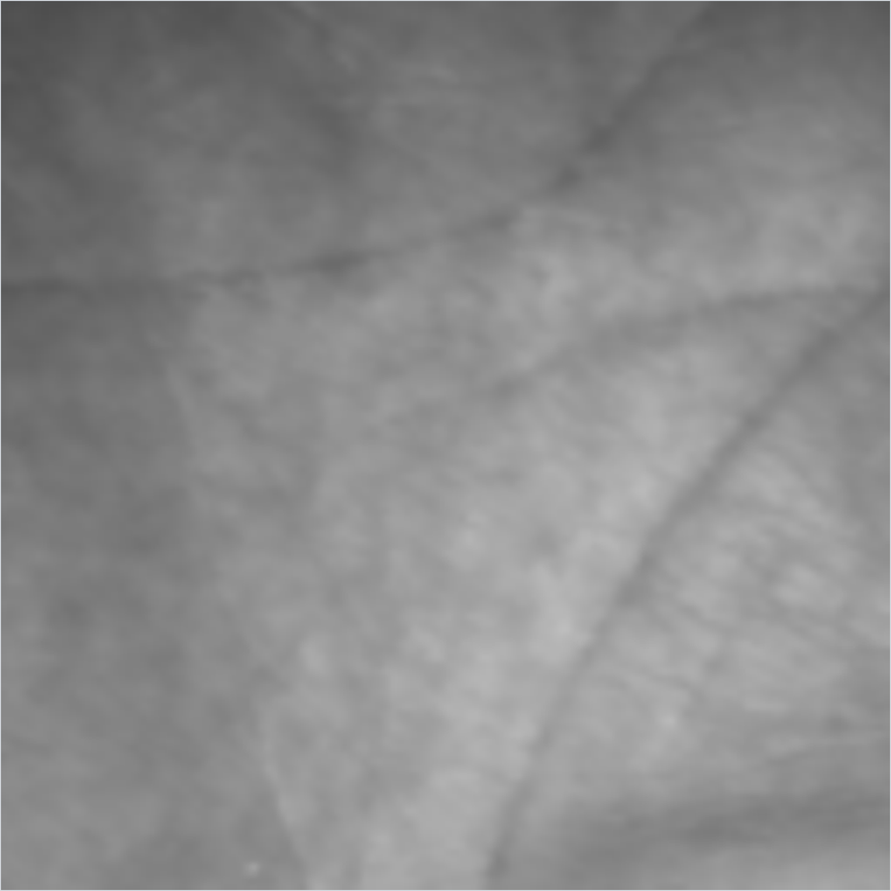
1 · HOW THE DATA IS OBTAINED
A public database: Tongji, 600 palms in two sessions
We did not collect palms ourselves. A public database gives hundreds of people seen twice — and numbers anyone can check.
session 1, 1st
session 1, 5th
session 2, 1st
session 2, 6th
600 palms, 10 images each in two separate sessions: 12,000 images in all
Collected at Tongji University; the release includes the 128 × 128 palm region cut out by the capture system
Downloaded as the public release: palm regions (98 MB) and the original 800 × 600 photographs (4.9 GB)
The IIT Delhi database was requested on 15 October and is still pending, so it is not used here
P401
P048
Two palms, four of their twenty images each. Across sessions the same palm is shifted, rotated and lit differently.
Why not photograph our own palms?
A trustworthy error rate needs hundreds of people, each seen on two occasions. Our own palm photographs appear in the demo, to show what the system expects — not to measure it.
AI461 Advanced Biometric Systems and Security · Phase II : Implementation and Results
3
Notes:
[~61 s · Hanmant]
SAY
Question one: how do we obtain the data? We did not collect palms ourselves.
To measure an error rate properly you need hundreds of people, each seen on two
separate occasions, and a class project cannot gather that.
So we used the public Tongji palmprint database: 600 palms, ten images of each
in two sessions — twelve thousand images. The release includes the palm
region, already cut out at 128 by 128 pixels. On the left: two palms, two
images from each session. Look along a row — between sessions the same palm
moves, rotates and changes brightness. That is what the method has to survive.
We also requested the IIT Delhi database on 15 October. It has not arrived, so
everything today is Tongji.
IF ASKED
Why not Paper 2's own database, PolyU? We used what we could obtain in time.
Tongji is a public research release; IITD is requested and pending.
Why not our own photos as the test set? A few palms photographed by us would
give an error rate that means nothing — with 10 people, one mistake moves the
EER by whole percentage points. Our own photos are used in the demo only.
Images: 600 palms x 10 captures x 2 sessions = 12,000 region images, 128 x 128,
8-bit grey; plus the original 800 x 600 colour photographs in a second archive.

Slide 4
1 · HOW THE DATA IS OBTAINED
Before trusting it: who is who, and what is tested against what
The release has no folder per person, so identity rests on the file numbers. We checked them against the pixels first.
The protocol
The risk. Two flat folders, 00001 … 06000. Image n of session 1 and image n of session 2 must be the same palm — the release says so, but nothing enforces it.
Session 1
1st image: enrolled — one per palm, 600 in all. Images 2–10: same-session probes, kept separate.
0.333
code agreement, same number across sessions (80 pairs)
0.177
code agreement, different numbers (79 pairs)
Session 2
All 10 images: probes, each compared with all 600 enrolled palms.
Same-number pairs agree far more, so the numbering holds — and 99.95% correct identification over all 600 palms (slide 16) later confirms it. Our loader refuses to run if this check fails.
6,000
genuine comparisons: each probe against its own palm
3,594,000
impostor comparisons: each probe against the 599 others
Every number in this talk is cross-session unless marked: enrolled on one occasion, tested on another.
AI461 Advanced Biometric Systems and Security · Phase II : Implementation and Results
4
Notes:
[~59 s · Hanmant]
SAY
Before running anything, we checked one risk. The release has no folder per
person — just numbered files. Image n in session one should be the same palm
as image n in session two, but nothing enforces it, and a wrong assumption
would still give plausible numbers. So we tested it against the pixels.
Same-number images agree on a third of their code values; different numbers
agree on 17.7 percent — about chance for six directions. The numbering holds.
On the right, the protocol. Each palm is enrolled from its first session-one
image. All ten session-two images are probes, each compared with all 600
palms: six thousand genuine and 3.6 million impostor comparisons. Every number
today is cross-session unless I say otherwise.
IF ASKED
Chance agreement with six directions is 1/6 = 16.7%; different-number pairs
gave 17.7% (79 pairs), same-number pairs 33.3% (80 pairs) — raw code
agreement, with no shifting and no templates. The loader (tongji.py) refuses gaps, unequal sessions
and incomplete palms, and the pairing check refuses a scrambled set — we test
that with a deliberately scrambled copy.
Stronger evidence than the 80-pair check: over all 600 palms, 99.95% of
session-2 images are identified as the palm with their own number (rank-1;
all 6,000 within the top 5). A misnumbered set could not do that.
Why one enrolment image? It is Paper 2's protocol, and the realistic one: at
an enrolment desk you get one scan, not thirty.
Same-session images (session-1 images 2–10, 5,400 probes) are reported
separately on slide 18.

Slide 5
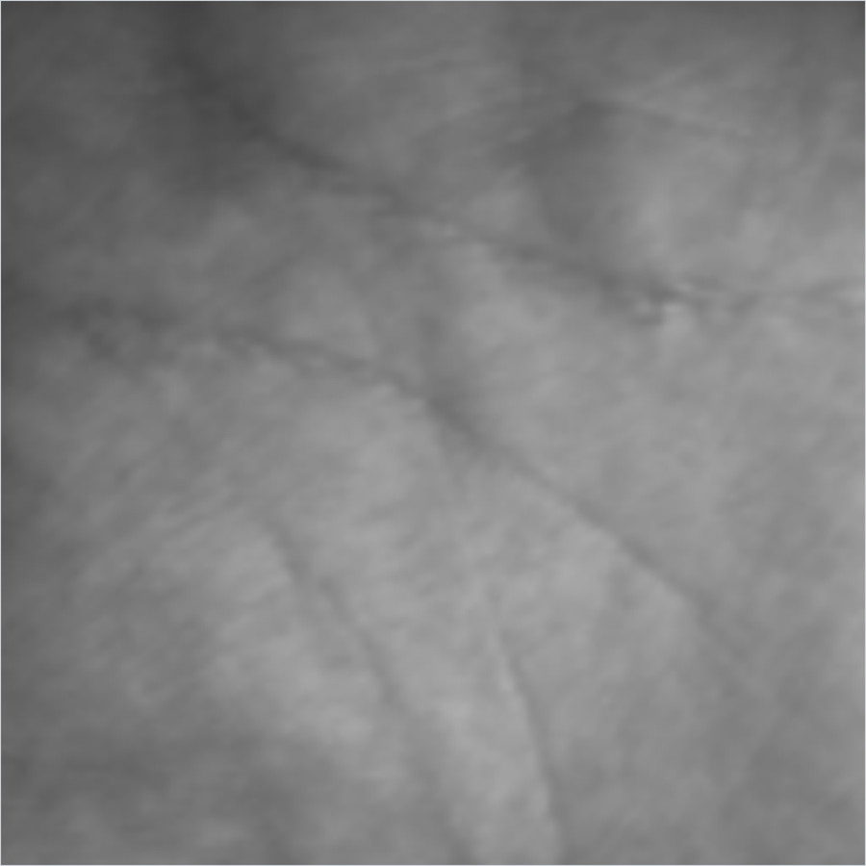
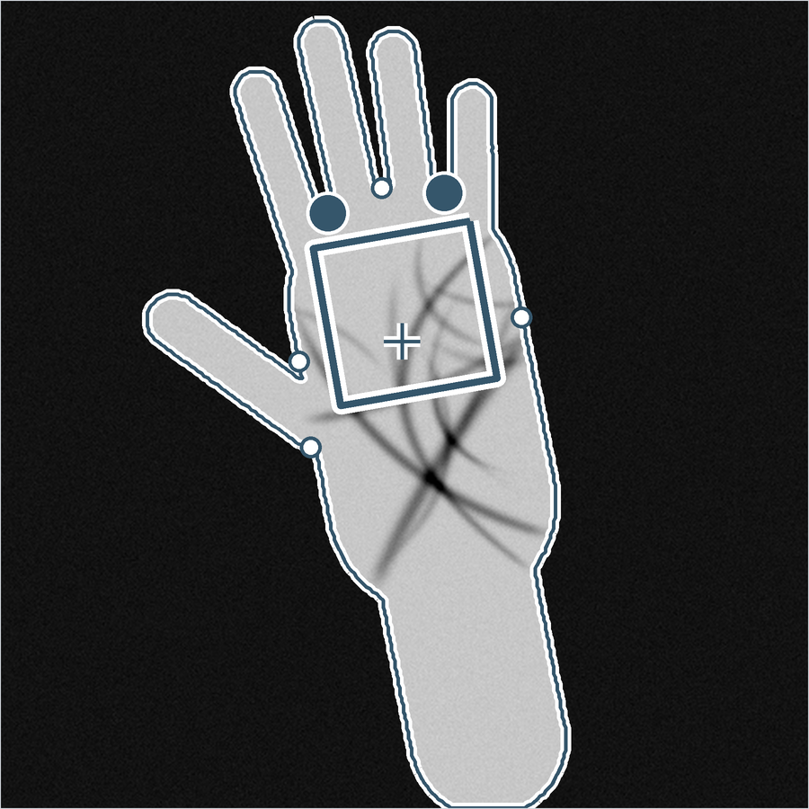
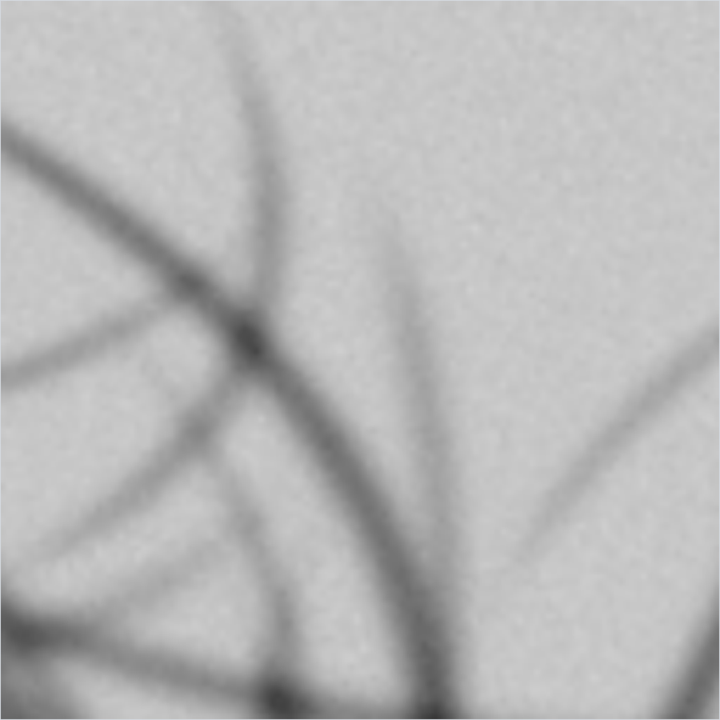
2 · HOW THE FEATURES ARE EXTRACTED
Step 1: the region of interest
Both papers start from a square of palm, aligned and scaled. Tongji supplies it; our own extraction is for whole-hand photos.
Why a fixed square matters
RLOC compares two codes cell by cell, so both images must show the same patch of palm, the same way up. It searches only ±8 pixels and ±9°.
Tongji's region, used as supplied (session2/04008.bmp, palm P401)
Our extraction on a whole-hand image: outline, the two finger valleys, the square window, the 128 × 128 result (synthetic hand)
Our extraction, step by step
Separate hand from background by Otsu's threshold — not Paper 1's fixed grey level of 70
Trace the outline; find the two finger valleys
Place a square below them, sized to the hand; crop to 128 × 128
How accurate, and where it is used
On 80 synthetic hands it recovers the rotation to 0.54° (standard deviation; worst under 2°) and the size to 1.7%.
On Tongji it is not used: the database's own regions are, as both papers assume. So it is untested on real hands (slide 23).
AI461 Advanced Biometric Systems and Security · Phase II : Implementation and Results
5
Notes:
[~52 s · Hanmant]
SAY
Question two: how are the features extracted? Step one is the region of
interest. RLOC compares two codes cell by cell, so both images must show the
same patch of palm, the same way up. On Tongji the database supplies that
region and we use it unchanged.
For whole-hand photographs we built our own extraction, in the middle: separate
the hand with Otsu's threshold — not the fixed grey level of 70 that Paper 1
used — trace the outline, find the two finger valleys, and place a square below
them. On synthetic hands it recovers rotation to about half a degree. But the
Tongji results do not use it.
IF ASKED
Synthetic test: 80 rendered hands at up to ±14° rotation, ±12 px shift, ±10%
scale. Rotation recovered with a standard deviation of 0.54°, worst case under
2°; window size tracks hand size to 1.7%.
Why Otsu: Paper 1 thresholds at grey level 70 because "the environment is
controlled". Hard-coding it was one of our Phase I criticisms.
To test our extraction on real hands we would run Tongji's original 800 x 600
photographs through it — not done yet; slide 23 lists it as a limit.

Slide 6
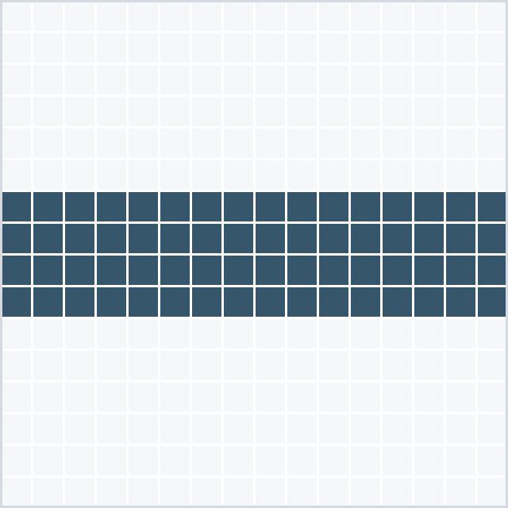
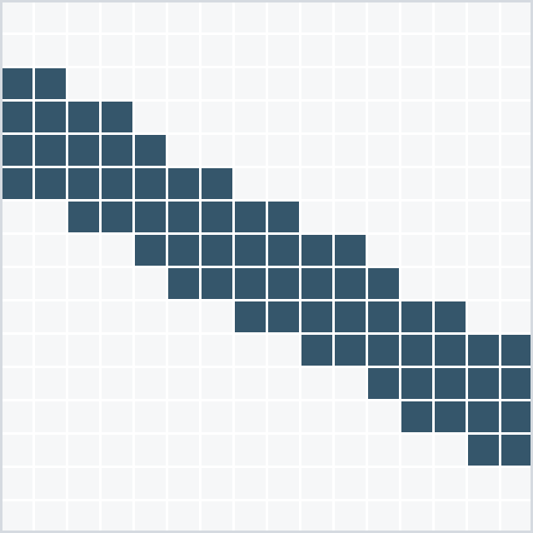
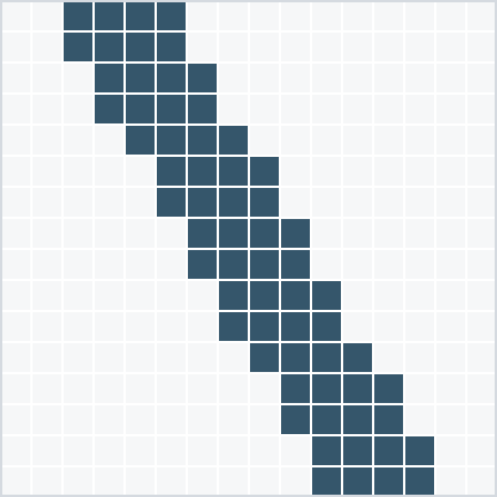
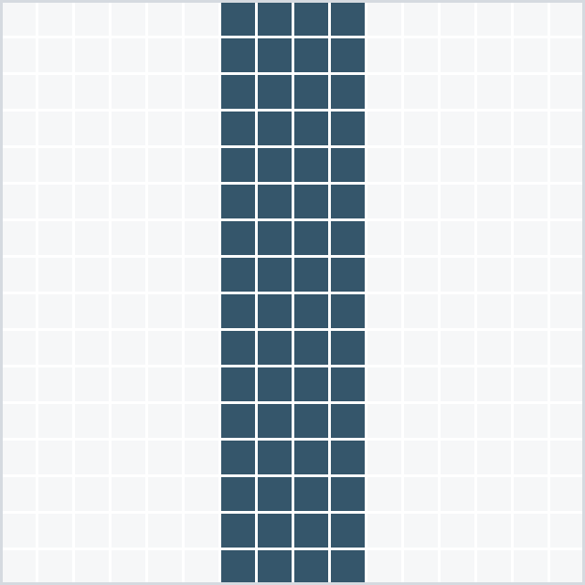
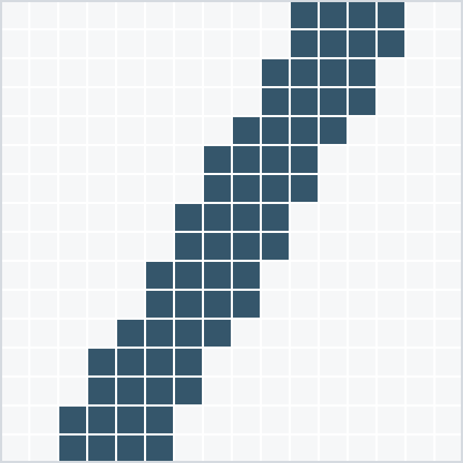
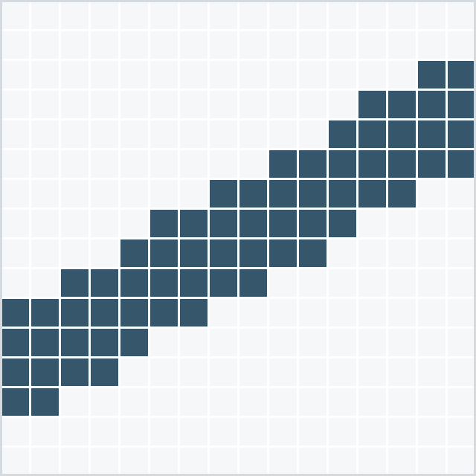
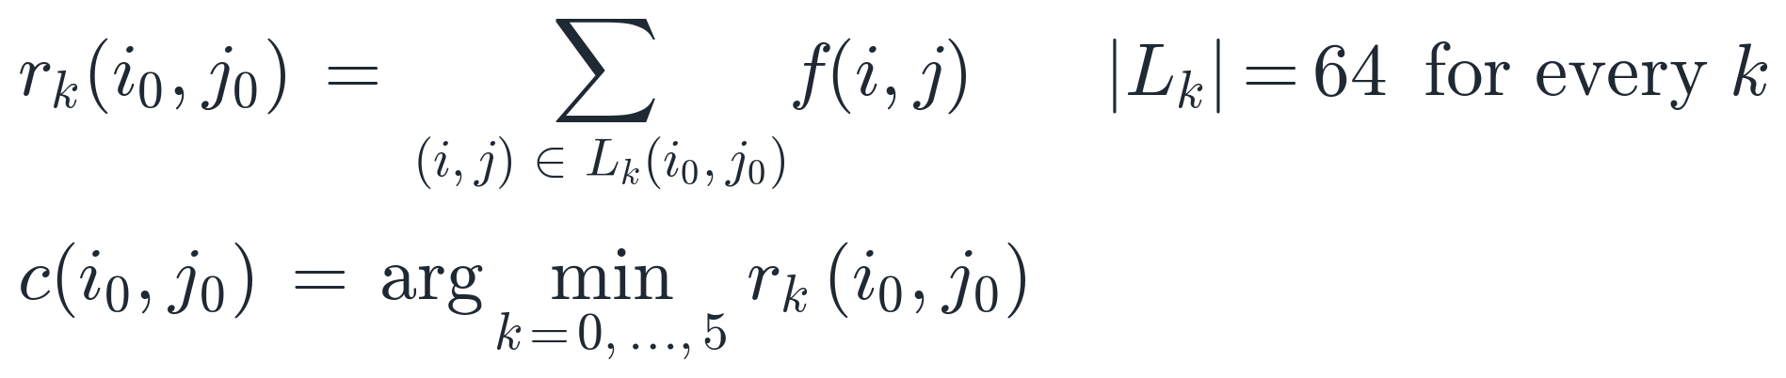
2 · HOW THE FEATURES ARE EXTRACTED
Step 2: MFRAT sums the image along six short lines
A 16 × 16 window, six directions 30° apart, lines 4 pixels wide — and exactly 64 pixels in every direction.
k = 0 · 0° · 64 px
k = 1 · 30° · 64 px
k = 2 · 60° · 64 px
k = 3 · 90° · 64 px
k = 4 · 120° · 64 px
k = 5 · 150° · 64 px
Angles run clockwise from horizontal, because image rows count downwards.
Why the minimum? Palm lines are darker than the skin around them, so the sum is smallest along the line.
Where? At every 4th pixel across and down: a 128 × 128 region gives 32 × 32 points.
What is kept? Only k, the winning direction — next slide.
r_k: the sum of the image f over direction k's 64 pixels, for the window centred at (i₀, j₀). c: the direction that wins.
AI461 Advanced Biometric Systems and Security · Phase II : Implementation and Results
6
Notes:
[~51 s · Hanmant]
SAY
Step two is MFRAT, the modified finite Radon transform. Take a 16 by 16
window. Inside it, six lines, thirty degrees apart, each four pixels wide —
the six masks at the top. Add up the grey levels under each line: six sums.
Keep the direction whose sum is smallest. Why the smallest? Palm lines are
darker than the skin around them, so a line gives a low sum along its own
direction.
One detail matters, and I will come back to it: every direction has exactly 64
pixels. The window stops at every fourth pixel, so a 128 by 128 region gives
32 by 32 points.
IF ASKED
"Finite Radon transform": the Radon transform integrates an image along lines;
the finite version sums along discrete lines on a p x p grid. Paper 2's
"modified" version drops the wrap-around (modulo) lines, so each line is a
real straight segment through the window centre.
Why argmin and not argmax: argmax would find the brightest direction, which is
not a line. Our self-test checks that argmin recovers a drawn line's direction
and argmax does not.
Angles are measured clockwise because image rows count downwards; the labels
follow the code.

Slide 7
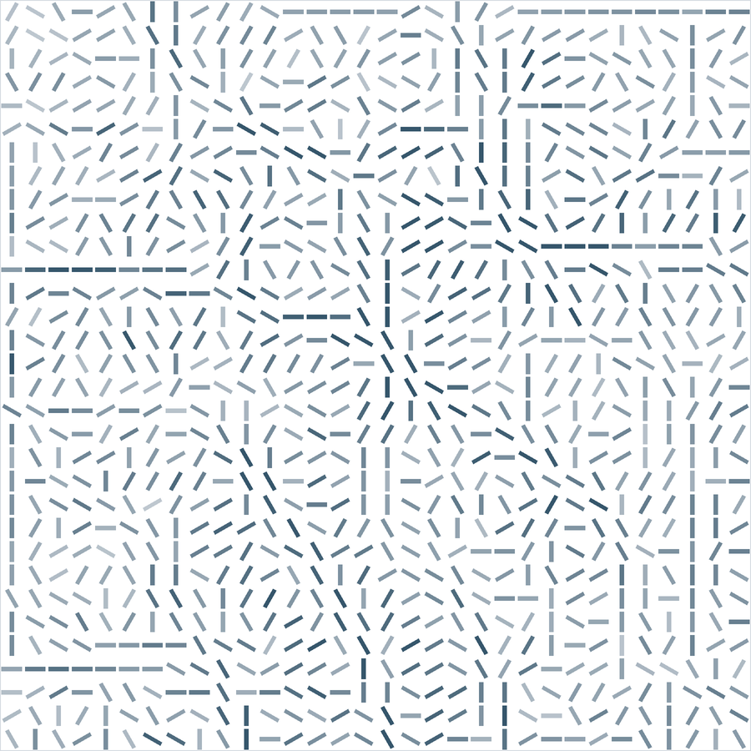
2 · HOW THE FEATURES ARE EXTRACTED
Step 3: keep only the winning direction
Each of the 32 × 32 points stores one number from 0 to 5: the direction of the darkest line through it.
1,024 numbers, each one of six: 331 bytes per code when packed
Drawn as a stroke in the winning direction; faint where the six sums were nearly equal
No strength is kept — only which way the line runs
A limitation: every point gets a direction, even where no line passes. The paper keeps no measure of confidence; we keep it only to draw the faint strokes.
Region: 128 × 128 grey levels
Orientation code: 32 × 32 directions
AI461 Advanced Biometric Systems and Security · Phase II : Implementation and Results
7
Notes:
[~45 s · Hanmant]
SAY
Step three: at each of the 1,024 points we store one number from zero to five
— the winning direction. That is the code on the right, drawn as a stroke in
each cell. Dark strokes: one direction clearly won. Faint strokes: the six sums
were nearly equal.
What is thrown away is how strong the line is; only which way it runs is kept.
Packed, a code is 331 bytes. One limitation the paper does not discuss: every
point gets a direction, even where no line passes, and no measure of
confidence is kept.
IF ASKED
331 bytes: 1,024 values from 6 directions = 1,024 x log2(6) = 2,647 bits.
Confidence: the gap between the smallest and the next sum (we call it the
directional contrast) says how trustworthy a cell is. Paper 2 discards it; we
compute it only to draw the faint strokes. Weighting matches by it is the
fusion idea from our Phase I critique — not implemented here.

Slide 8
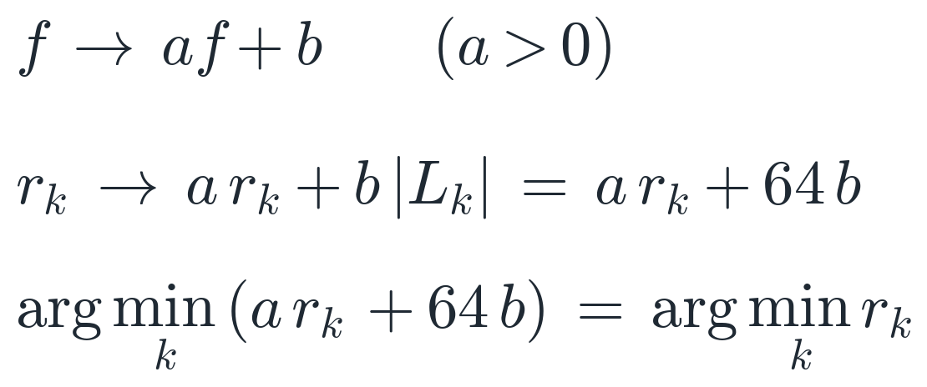


2 · HOW THE FEATURES ARE EXTRACTED · OUR OWN RESULT
Why every direction must have exactly 64 pixels
The paper asks for equal counts so the six sums are comparable. A stronger reason: they make the code immune to any uniform change of brightness and contrast.
Brightness and contrast change every sum by the same increasing rule — only because every |L_k| is 64. The smallest sum stays the smallest.
original
0.55 f + 0.25
Checked on real images
120 Tongji images with their contrast reduced (0.55 f + 0.25): 99.57% of the 122,880 code values unchanged. All 528 that changed were exact ties between two directions in the 8-bit image — where the argument promises nothing.
Han et al. get there differently: their features change by 45%, but correlation cancels gain and bias, so their score does not move either. Uniform lighting changes are not where the two methods differ.
Top: the image. Bottom: its code — identical except at 5 of 1,024 points.
AI461 Advanced Biometric Systems and Security · Phase II : Implementation and Results
8
Notes:
[~57 s · Hanmant]
SAY
Now a result of our own. Paper 2 insists all six directions have the same
number of pixels, and says only that this makes the sums comparable. There is
a stronger reason. Change brightness and contrast: f becomes a f plus b. Every
sum becomes a r-k plus b times its pixel count. With 64 pixels in every
direction, all six sums move by the same rule, so the smallest stays the
smallest.
We checked on 120 real images with their contrast reduced: 99.57 percent of
code values unchanged — and every change was an exact tie. To be fair, Paper
1's correlation also cancels brightness and contrast, so uniform lighting
changes are not where the two methods differ.
IF ASKED
Exact numbers: 120 images (60 palms x 2 sessions), 122,880 code values; 528
changed, all 528 at exact ties (the smallest sum shared by two directions —
1,126 ties in all). At a tie the argmin is decided by floating-point rounding,
so the argument promises nothing there.
The rule is "a > 0": a contrast inversion would flip dark lines to bright.
Only UNIFORM changes are covered: uneven lighting across the palm, or
clipping (saturated pixels), is not affine, so the argument says nothing
about them. 0.55 f + 0.25 lowers the contrast; the mean grey level barely
moves.
Han: his Sobel features change by 45% under the same change, but Pearson
correlation subtracts the mean and divides by the spread, so his score is
unchanged to 15 decimal places. Our self-test checks both facts.

Slide 9
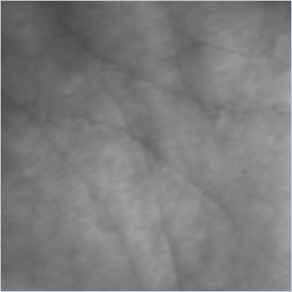
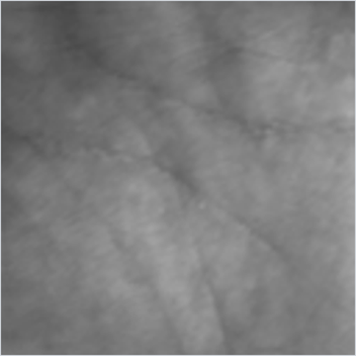
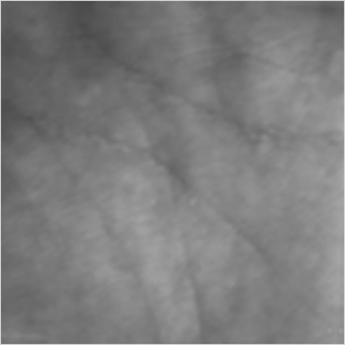
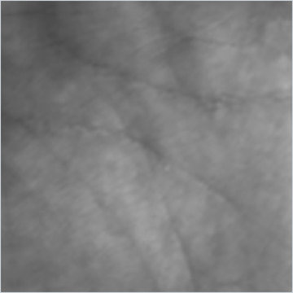
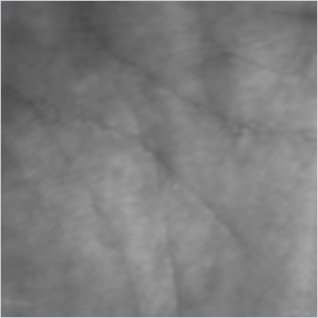
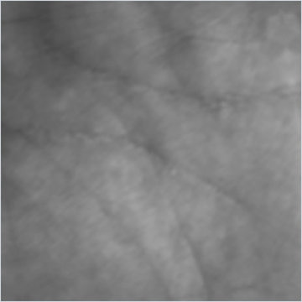
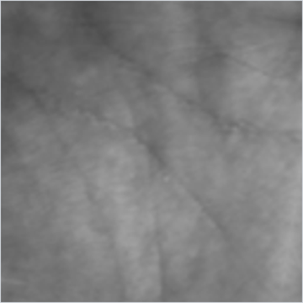
3 · THE ALGORITHM, STEP BY STEP
Enrolment: one image becomes seven templates
Nothing is trained. The paper's “enlarged training set” is the enrolment image rotated, so a slightly rotated probe still matches.
0°
+3°
−3°
+6°
−6°
+9°
−9°
Palm P401's enrolment image (session1/04001.bmp) at the seven angles. All seven codes are stored; the image is not.
No black corners
Each rotation is made from a mirror-padded copy, then cropped back to 128 × 128. A black corner would look like a strong dark line — exactly what MFRAT searches for.
What is stored
Seven 32 × 32 codes per palm: 7 × 331 bytes ≈ 2.3 KB. Enrolment takes about 36 ms; the image itself is not needed afterwards.
Does it help? Measured
Yes, on Tongji: one template gives 0.25% EER, seven give 0.11% — better in 99.9% of bootstrap samples (slide 22).
AI461 Advanced Biometric Systems and Security · Phase II : Implementation and Results
9
Notes:
[~43 s · Hanmant]
SAY
Question three: the algorithm. First, enrolment. Nothing is trained — no
classifier, no learning. What the paper calls an enlarged training set is the
enrolment image rotated by zero, plus or minus three, six and nine degrees,
each copy encoded, all seven codes stored. A probe that arrives slightly
rotated then lines up with one of them.
We rotate a mirror-padded copy, because black corners would look like strong
dark lines. Storage is about 2.3 kilobytes per palm. Does it help? Yes: one
template gives 0.25 percent error, seven give 0.11.
IF ASKED
Why rotate the template and not the probe? Rotating at enrolment is paid once;
rotating every probe would be paid on every one of millions of comparisons.
Paper 2 argues this, and rejects rotation-invariant features because they
would throw away the orientation that is the whole signal.
1 vs 7 templates: 0.25% vs 0.11% EER; 7 is better in 99.9% of 1,000 bootstrap
resamples (results.md section 5).

Slide 10
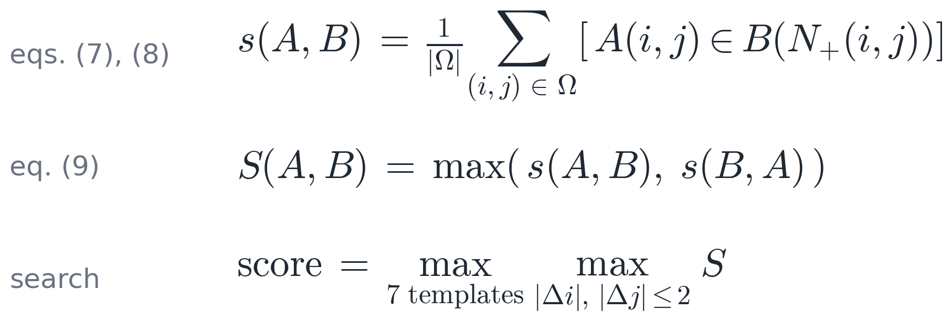
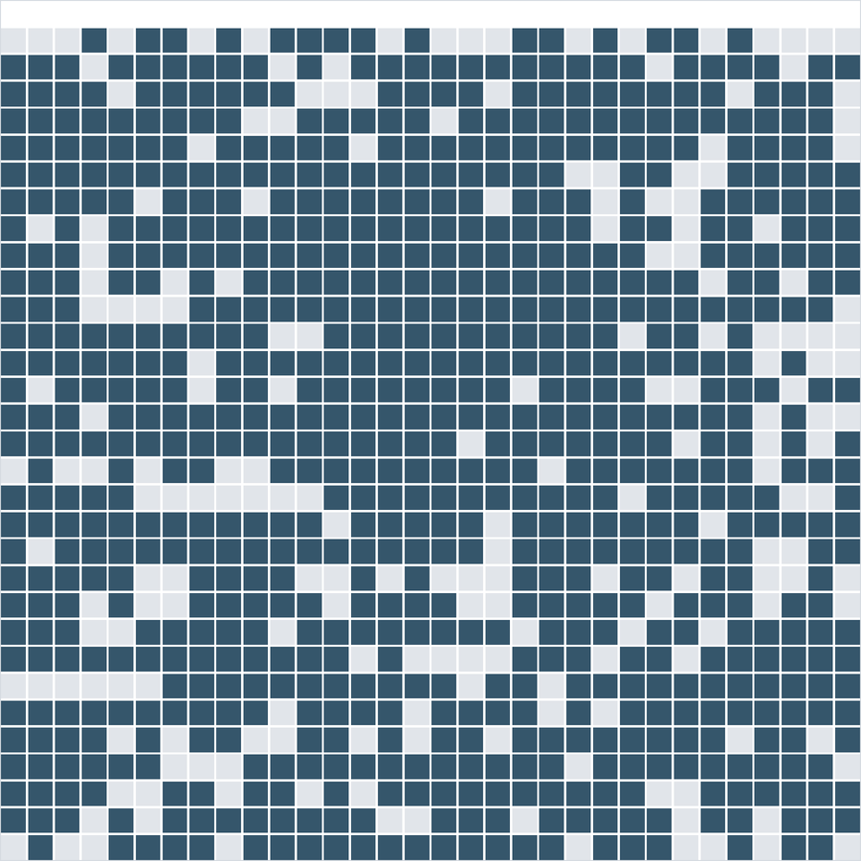
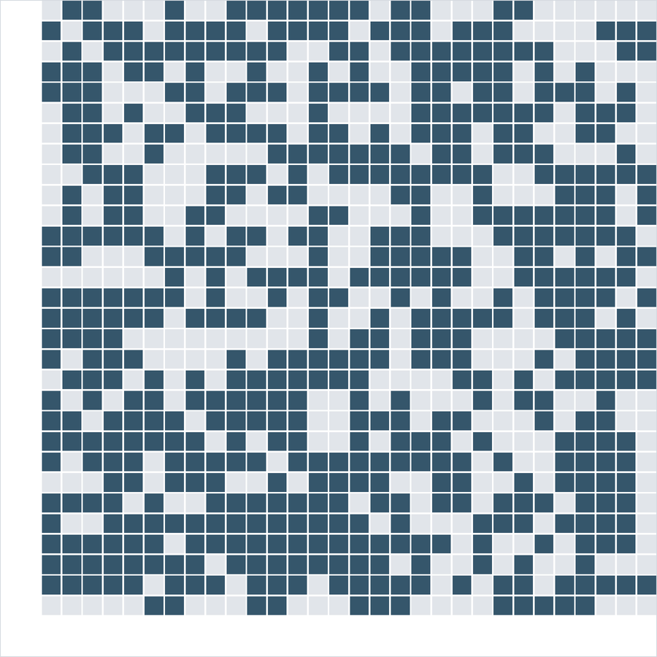
3 · THE ALGORITHM, STEP BY STEP
Matching: a cell agrees if its direction appears nearby
Equation (9) checks both ways round; the search tries 25 shifts and all 7 templates, and keeps the best.
Same palm (P401)
Another palm (P555)
N₊(i, j): the cell and its four neighbours. A cell counts as matched if its direction equals any of these five.
0.797 · accepted
0.629 · rejected
Ω: the cells where the two codes overlap after the shift
Both ways round: s(A, B) looks A's cells up in B; s(B, A) the reverse; the larger is kept
Search: shifts up to ±2 cells (±8 pixels) each way, × 7 templates = 175 comparisons
One session-2 image of P401 against two enrolled palms (seven templates each). Dark: a cell whose direction was found. Even unrelated palms agree on about 60% of cells — so the threshold sits at 0.681, not near 0.
AI461 Advanced Biometric Systems and Security · Phase II : Implementation and Results
10
Notes:
[~56 s · Hanmant]
SAY
Next, matching. Two codes rarely line up perfectly, so a cell counts as
matched if its direction appears anywhere in a small cross around the same
place in the other code — the cell and its four neighbours. Equation nine
checks both ways round and keeps the larger. Then the codes are shifted by up
to two cells each way — twenty-five shifts — against all seven templates, and
the best value is the score.
On the right, one image of palm 401. Against its own template, 0.797 of the
cells match; against another palm, 0.629. Even unrelated palms agree on about
sixty percent of cells — which is why the threshold is 0.681, not near zero.
IF ASKED
Paper 2 writes equation 7 with a union symbol, but the text redefines it as
"equals at least one of the points in the neighbourhood" — it is not set
union. Equation 9: S(A,B) = max(s(A,B), s(B,A)), so the score is the same
whichever code is called the probe; our self-test checks that.
One cell = 4 pixels, so ±2 cells = ±8 pixels. 7 templates x 25 shifts = 175
comparisons per palm, each done both ways.
Why does a wider neighbourhood not always help? Every extra position is also
an extra chance for an impostor's cell to agree — slide 19, the 3x3 square.

Slide 11
3 · THE ALGORITHM, STEP BY STEP
The whole algorithm, step by step
Two procedures: enrolment runs once per person; verification runs on every attempt.
ENROL · once per person
VERIFY · every attempt
Take one region image of the palm: 128 × 128 grey levels.
Rotate it by 0°, ±3°, ±6°, ±9°: seven images.
Encode each: MFRAT's six sums at every 4th pixel; keep the darkest direction → a 32 × 32 code.
Store the seven codes under the person's name.
Take the probe's region and the identity it claims.
Encode it once, without rotation: one 32 × 32 code.
For each of the claimant's 7 codes and each of 25 shifts, find the fraction of cells whose direction appears in the other code's cross — both ways round (eq. 9).
Score = the best of these 175 values, between 0 and 1.
Accept if the score is at least 0.681; otherwise reject.
To identify instead (1 : N): score against all 600 palms; the best wins if it clears 0.681.
Measured: encoding a probe takes about 4.2 ms, and matching it against one claimed identity about 2.8 ms.
AI461 Advanced Biometric Systems and Security · Phase II : Implementation and Results
11
Notes:
[~47 s · Hanmant]
SAY
Here is the whole algorithm as two procedures, as the brief asks. Enrolment,
once per person: take one region image, rotate it to seven angles, encode each
into a 32 by 32 code, store the seven codes.
Verification, on every attempt: take the probe and the identity it claims;
encode it once; compare it with the claimant's seven codes at twenty-five
shifts, both ways round; the best of those 175 values is the score; accept if
it is at least 0.681. For identification, the score is computed against all
600 palms, and the best wins if it clears the threshold.
IF ASKED
Measured (results.md section 7): encoding 4.2 ms; matching against one
claimed palm 2.8 ms; identification against all 600 palms under a second
(0.6–0.8 s measured). The full evaluation (11,400 probes x 600 palms) is done
as matrix products and takes about 176 s; it gives bit-for-bit the same
scores as the one-by-one matcher the demo draws.
Is 0.681 "tuned"? It is the equal-error point of the evaluation — see slide 23.

Slide 12
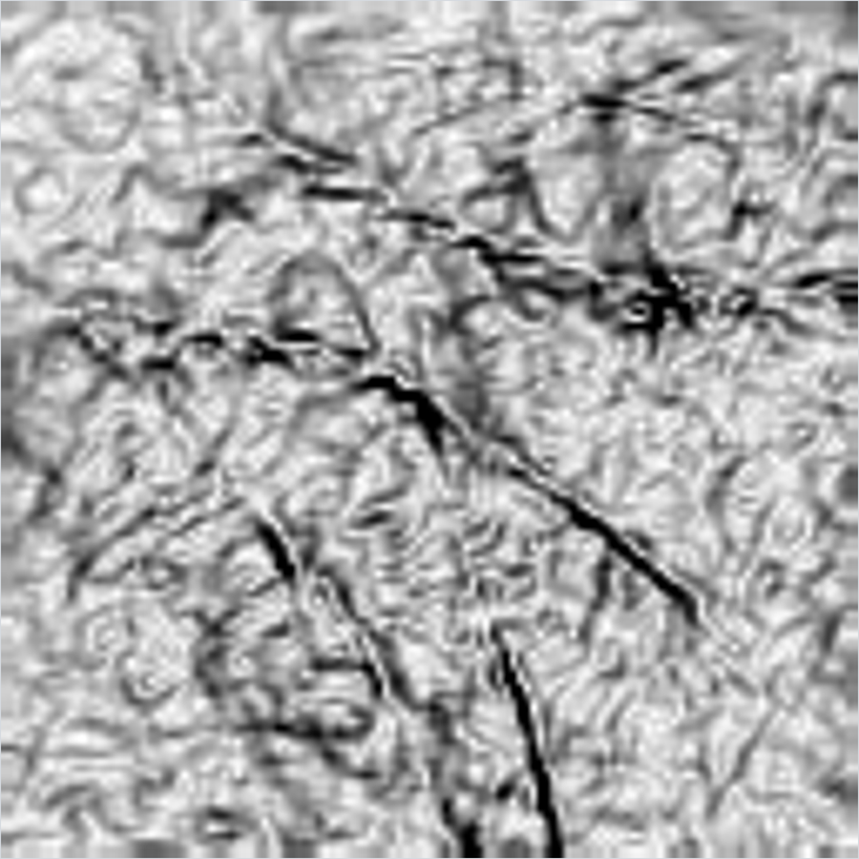
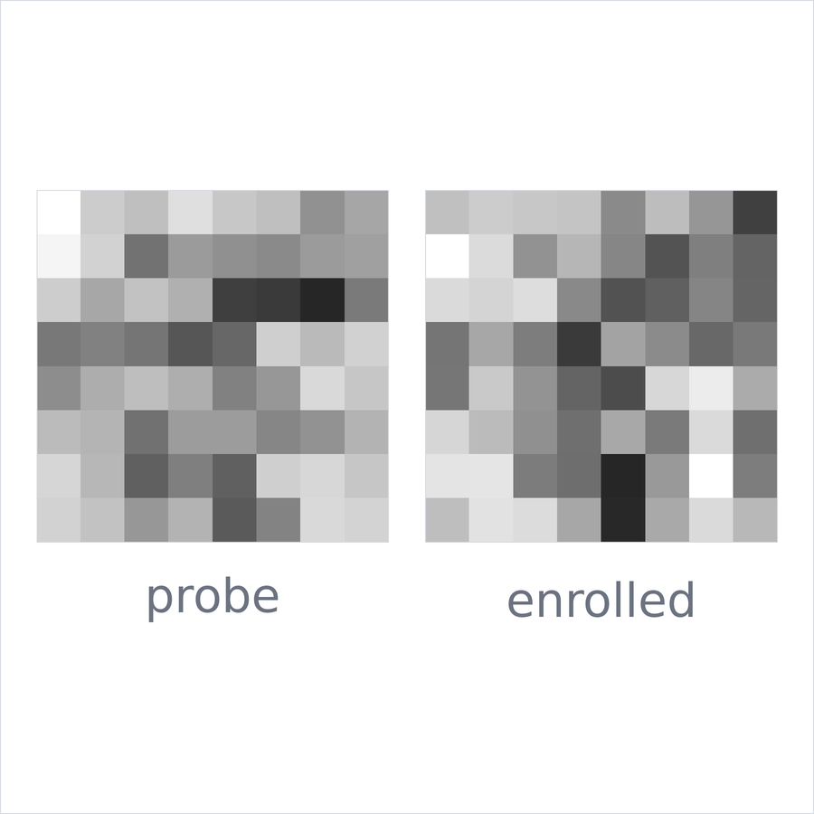
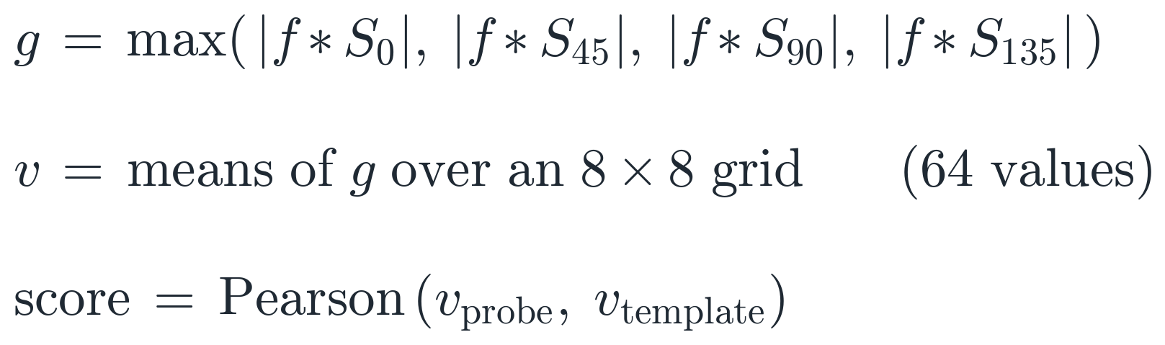
3 · THE ALGORITHM, STEP BY STEP · THE BASELINE
The baseline: Han et al. (2003), on the same images
Line strength instead of line direction, averaged into 64 numbers and compared by correlation.
Implemented as in the paper
Four 3 × 3 Sobel masks; the largest absolute response; the mean of each cell of an 8 × 8 grid; Pearson correlation with the enrolled vector.
Same enrolment as RLOC
One image per palm, the same probes, the same threshold rule.
Not implemented
Their per-person neural network: it needs ten enrolment images per person, which a one-image protocol cannot give.
This probe
Score 0.621 against a threshold of 0.517: accepted.
Region (same probe)
Strongest of 4 Sobel responses
8 × 8 means: probe | enrolled
AI461 Advanced Biometric Systems and Security · Phase II : Implementation and Results
12
Notes:
[~44 s · Hanmant]
SAY
For comparison we implemented Paper 1 on the same images. Instead of a line's
direction, it measures its strength: four Sobel masks, the largest response at
each pixel — the middle picture. It averages that over an 8 by 8 grid, giving
64 numbers, and compares two palms by Pearson correlation.
Enrolment is the same as for RLOC: one image per palm. The paper's best
verifier is a neural network for each person, trained on ten images; with one
image per palm that cannot run, so we compare against its template matching.
IF ASKED
Paper 1 reports over 91% accuracy with template matching and over 98% with
its per-user networks, on 50 people of its own, with 10 enrolment images
each. Accuracy at one operating point on 50 people is not comparable with an
EER over 3.6 million comparisons — a point from our Phase I critique.
For this probe Han scores 0.621 against his threshold of 0.517: accepted too.
We use Paper 1's feature vector without the row/column strip means, which the
paper feeds only to its network.

Slide 13
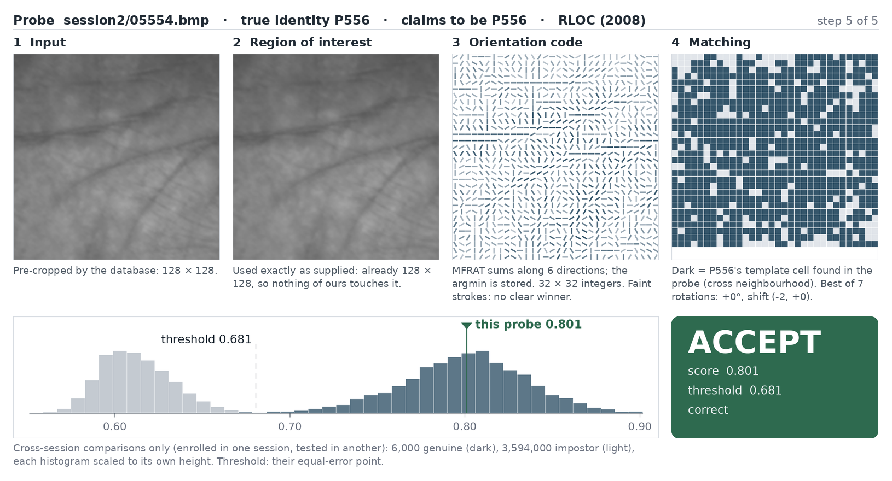
4 · VERIFYING AN INPUT
One verification, exactly as the demo shows it
A session-2 image claims to be palm P556. Its score, 0.801, clears the threshold of 0.681: accepted — and correctly.
Input: the image as captured
Region: here, supplied by the database
Code: 32 × 32 directions
Matching: dark cells agree with P556's template
Decision: where 0.801 falls among all 3.6 million evaluation scores
The threshold, 0.681, is the equal-error point of the cross-session evaluation: the score at which FAR and FRR are equal.
Screenshot of our demo program (Python, Tkinter), on the full database. Vishal runs it live after this talk.
AI461 Advanced Biometric Systems and Security · Phase II : Implementation and Results
13
Notes:
[~50 s · Hanmant]
SAY
Question four: how is an input verified? This is our demo program on the full
database — the view Vishal will show you live. A session-two image claims to
be palm 556. Panel one is the input, two the region, three the code, four the
matching. Below, its score, 0.801, is placed among every score in the
evaluation: light grey impostors, dark genuine. It clears 0.681, so: accept —
and since the demo knows the true identity, it can say the decision was
correct. The threshold is not chosen by hand: it is the score at which false
accepts and false rejects are equal over the whole evaluation.
IF ASKED
This is the demo's "Genuine" example: the median genuine attempt of the whole
evaluation, not a hand-picked good one. "Impostor" is the median impostor;
"Closest" is the highest-scoring impostor of the whole evaluation (P112
claiming P136, 0.726 — accepted, a real false accept, and the demo says
FALSE ACCEPT). It is one of 3,972 impostors above the threshold.
If the probe is the very image a palm was enrolled from, the score is 1.000 by
construction; the demo now labels that case "its enrolment image".
The demo is Python + Tkinter; the picture is drawn with Pillow so every view
can be tested without a window.

Slide 14
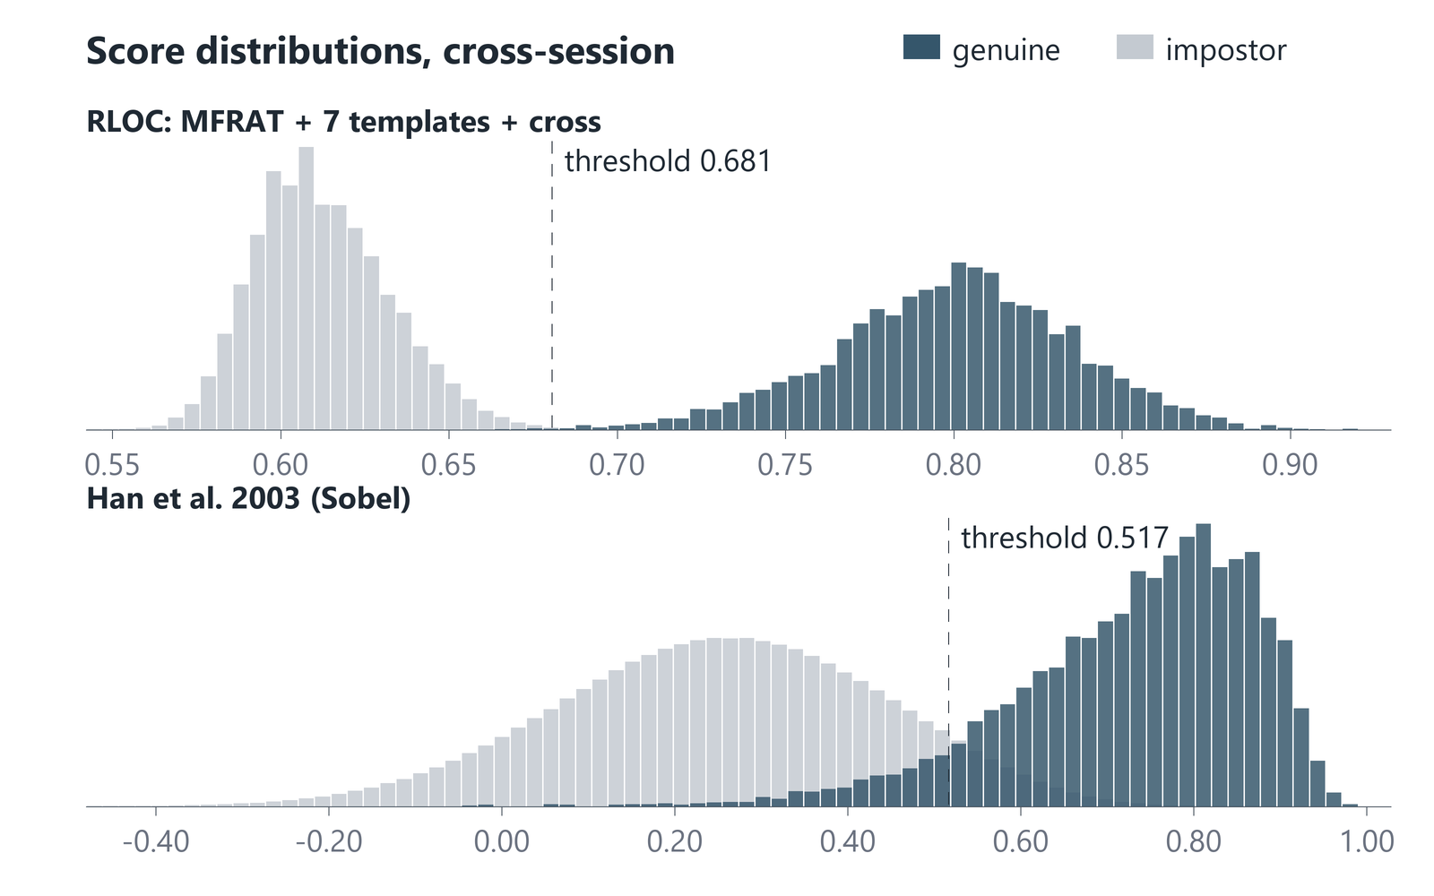
5 · PERFORMANCE
Genuine and impostor scores barely overlap for RLOC
Cross-session, all 600 palms: 6,000 genuine and 3,594,000 impostor scores for each method.
d′ = 6.54
RLOC: the gap between the two means, in units of their spread
d′ = 2.91
Han et al. (2003)
RLOC: impostors centre near 0.61, genuine attempts near 0.80; only the tails meet. Han: much of the two distributions overlaps.
Each histogram is scaled to its own height — otherwise 6,000 genuine scores vanish beside 3.6 million impostor scores.
AI461 Advanced Biometric Systems and Security · Phase II : Implementation and Results
14
Notes:
[~37 s · Hanmant]
SAY
Question five: performance. These are the score distributions. For RLOC, at
the top, impostors centre around 0.61 and genuine attempts around 0.80; only
the tails meet, near the threshold. For Han, the two overlap heavily. One
number sums this up: d-prime, the distance between the two means in units of
their spread. RLOC 6.54; Han 2.91. Look at the gap on the top chart: almost no
impostor scores above 0.68, and almost no genuine attempt below it.
IF ASKED
d' = (mean genuine − mean impostor) / sqrt((var genuine + var impostor) / 2).
Each histogram is scaled to its own height; on a shared scale the 6,000
genuine scores would be invisible next to 3,594,000 impostor scores.

Slide 15
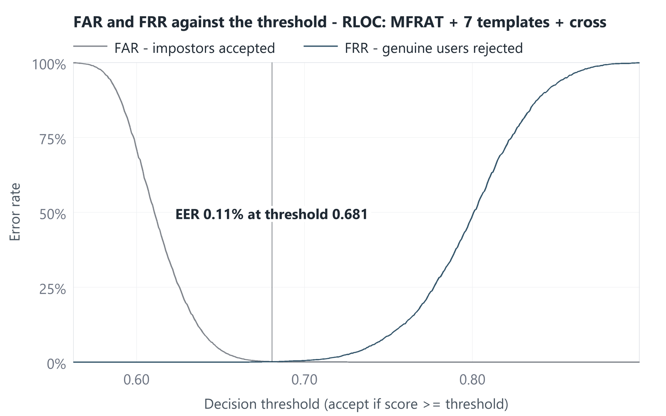
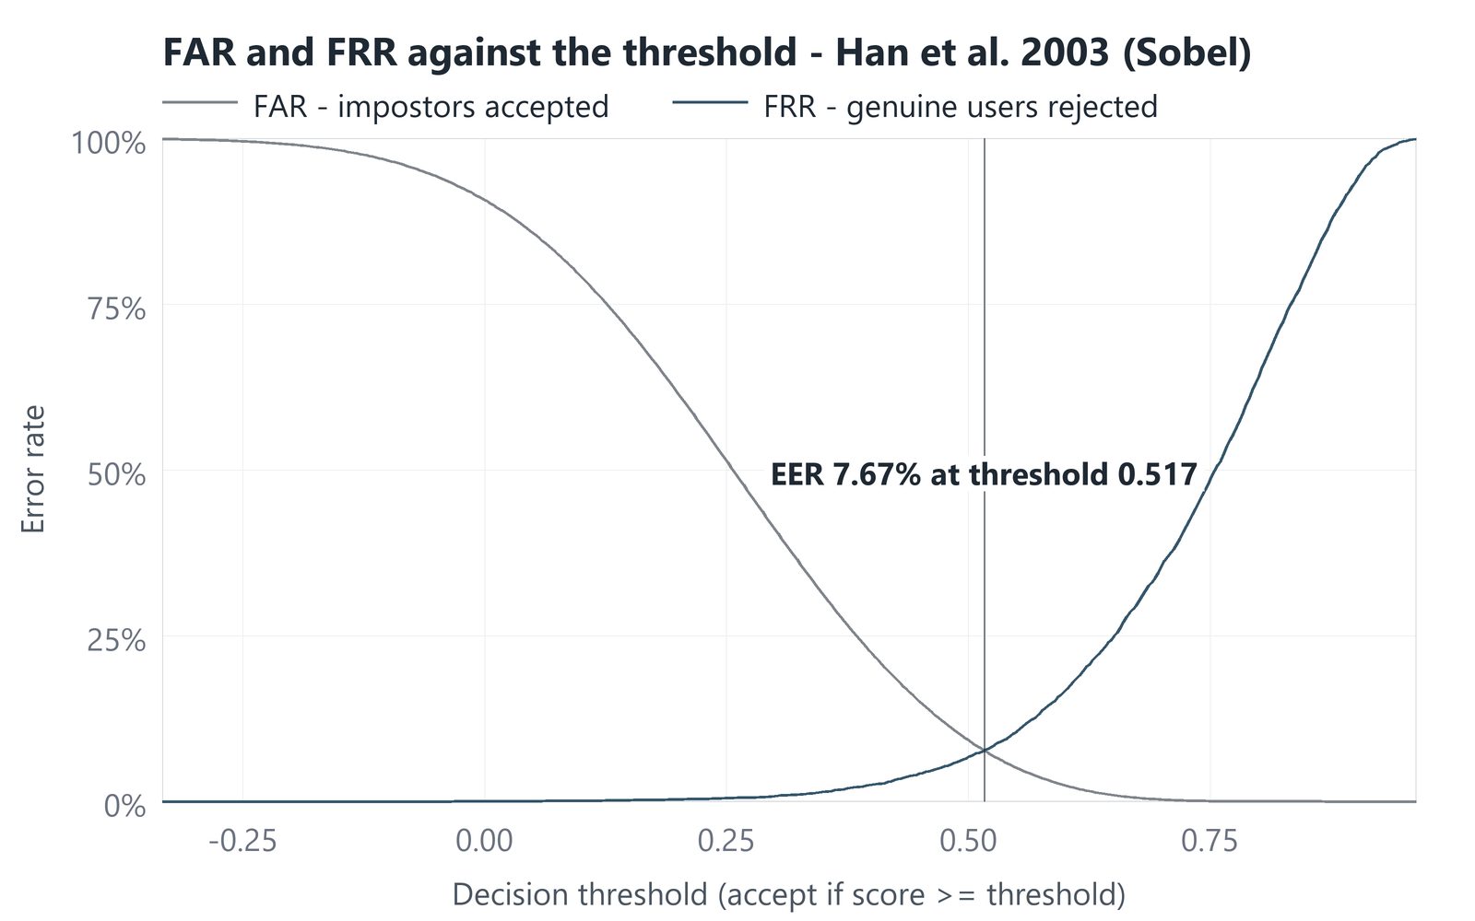
5 · PERFORMANCE
FAR and FRR against the threshold
A higher threshold lets fewer impostors in and turns more genuine users away. The equal error rate is where the curves cross.
RLOC: EER 0.11% at threshold 0.681
Han et al. (2003): EER 7.67% at threshold 0.517
The two scores are on different scales — a fraction of agreeing cells for RLOC, a correlation for Han — so compare the error rates, not the thresholds.
AI461 Advanced Biometric Systems and Security · Phase II : Implementation and Results
15
Notes:
[~37 s · Hanmant]
SAY
Moving the threshold trades one error for the other. Raise it: fewer impostors
get in — the falling curve — but more genuine users are turned away — the
rising curve. Where they cross is the equal error rate: for RLOC 0.11 percent
at 0.681, for Han 7.67 percent at 0.517. Notice how wide RLOC's flat region is
at the bottom: a broad range of thresholds where both errors are tiny. Han's
curves cross high up.
IF ASKED
FAR = impostor attempts accepted / all impostor attempts.
FRR = genuine attempts rejected / all genuine attempts.
The thresholds are not comparable: RLOC's score is a fraction of matching
cells, Han's a correlation that can be negative.

Slide 16
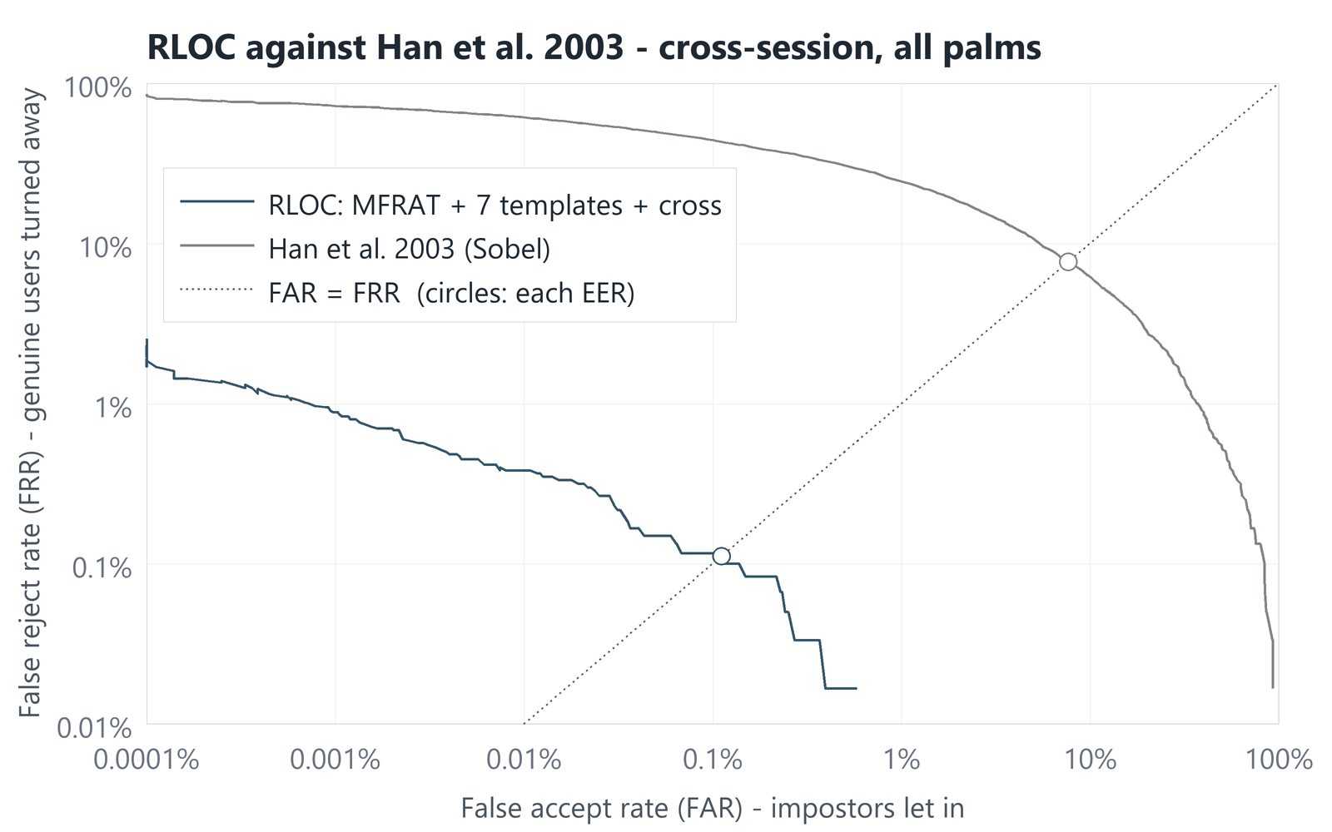
5 · PERFORMANCE
DET curve and the headline numbers
Every threshold at once: impostors let in (across) against genuine users turned away (up). Lower and further left is better.
cross-session, 600 palms | RLOC | Han 2003
Equal error rate | 0.11% | 7.67%
95% interval | 0.04 – 0.16% | 6.84 – 8.66%
d′ | 6.54 | 2.91
FRR at FAR 1% | 0.00% | 24.33%
FRR at FAR 0.1% | 0.12% | 44.15%
FRR at FAR 0.01% | 0.38% | 61.40%
Rank-1 identification (closed set) | 99.95% | 68.85%
Difference in EER: −7.56 points (95% interval −8.54 to −6.74). RLOC is better in all 1,000 bootstrap samples.
Intervals: palms resampled 1,000 times — the uncertainty from which 600 people happen to be in the database.
Circles: the equal error rates. Dotted: FAR = FRR.
AI461 Advanced Biometric Systems and Security · Phase II : Implementation and Results
16
Notes:
[~36 s · Hanmant]
SAY
The DET curve shows every threshold at once: impostors let in across, genuine
users turned away up. Lower is better, and RLOC is below Han everywhere. In
the table: at one impostor in a thousand, RLOC turns away 0.12 percent of
genuine users, Han 44. For closed-set identification, RLOC names
the right palm 99.95 percent of the time, Han 69. And when we resample the
palms a thousand times, RLOC is better every single time.
IF ASKED
Rank-1: RLOC gets 3 of 6,000 probes wrong (and all 6,000 are in the top 5);
Han gets 1,869 wrong.
95% interval: we resample the 600 palms with replacement 1,000 times (fixed
seed 461) and recompute the EER each time; the middle 95% is the interval. It
measures how much the result depends on which people are in the database.
The difference RLOC − Han is −7.56 points (−8.54 to −6.74), negative in every
resample.
FRR at FAR 1% shows 0.00% for RLOC: at that loose a threshold no genuine
attempt of the 6,000 is rejected.

Slide 17
5 · PERFORMANCE
Confusion matrices at the equal-error threshold
What happened to every attempt: 6,000 genuine and 3,594,000 impostor, decided at each method's own threshold.
RLOC · threshold 0.681
Han et al. (2003) · threshold 0.517
truth \ decision | accept | reject | rate
genuine (6,000) | 5,993 | 7 | FRR 0.12%
impostor (3,594,000) | 3,972 | 3,590,028 | FAR 0.11%
truth \ decision | accept | reject | rate
genuine (6,000) | 5,539 | 461 | FRR 7.68%
impostor (3,594,000) | 275,598 | 3,318,402 | FAR 7.67%
A stricter setting, FAR = 0.1% (one impostor in a thousand let in): RLOC turns away 7 of 6,000 genuine users (0.12%); Han turns away 2,649 (44%).
7
genuine attempts rejected by RLOC — from only 5 of the 600 palms
3,972
impostor attempts accepted by RLOC, out of 3.6 million
≈ 70×
lower equal error rate than Han et al. on the same images (point estimate)
AI461 Advanced Biometric Systems and Security · Phase II : Implementation and Results
17
Notes:
[~37 s · Hanmant]
SAY
The brief asks for a confusion matrix, so here are both, at each method's
equal-error threshold. Of six thousand genuine attempts, RLOC accepts 5,993 and
rejects 7. Of 3.6 million impostor attempts, it wrongly accepts 3,972. Han
rejects 461 genuine attempts and accepts over 275 thousand impostors. At the
stricter setting of one impostor in a thousand, RLOC still rejects only seven
genuine users; Han rejects 2,649. Overall, RLOC's error rate is about seventy
times lower.
IF ASKED
"About seventy times" is a point estimate: 7.67 / 0.11. With RLOC's 95%
interval of 0.04–0.16%, the ratio could be anywhere from about 50 to 190.
Rows are the truth, columns the decision. Accuracy is a poor summary here:
with 3.6 million impostors and only 6,000 genuine attempts, a system that
rejects everyone is 99.8% "accurate". That is why we report FAR and FRR.
At the strict setting (FAR 0.1%, threshold 0.682) RLOC rejects 7 of 6,000
genuine users and accepts 3,509 impostors; Han rejects 2,649.

Slide 18
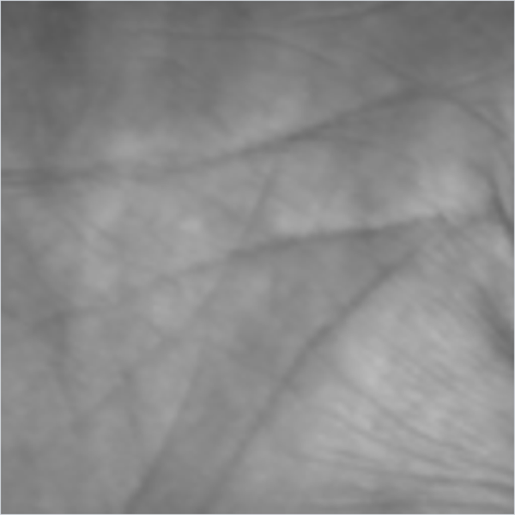
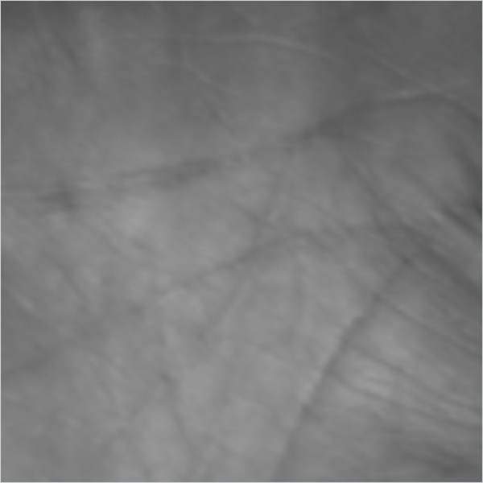
5 · PERFORMANCE
Where the errors come from, and why we test across sessions
A few hard palms make all of RLOC's false rejects; testing within one sitting would have hidden most of them.
Which palms fail
Same sitting against a later session
at the EER threshold | RLOC | Han 2003
False rejects | 7 | 461
Palms they come from | 5 of 600 | 127 of 600
equal error rate | same session | cross-session
RLOC | 0.02% | 0.11%
Exp 1: MFRAT alone | 0.06% | 0.27%
Han et al. (2003) | 3.41% | 7.67%
Palm P014 (2 of the 7), its lowest score: the later image is blurred and its lines are faint.
All 7 rejected attempts scored between 0.668 and 0.681 — just under the threshold, none far off.
Images from the enrolment sitting are near-copies of it. Testing with them would have flattered RLOC sixfold, so they are reported separately and never mixed in.
Because RLOC's false rejects sit on a few palms, its EER depends on which palms are tested — hence the interval of 0.04–0.16% around 0.11%.
enrolled
rejected: 0.675
AI461 Advanced Biometric Systems and Security · Phase II : Implementation and Results
18
Notes:
[~43 s · Hanmant]
SAY
Where do RLOC's errors come from? All seven false rejects come from five
palms. On the left, one of the two hardest, palm 14: its enrolment image, and
a later image that was rejected — blurred, with faint lines. All seven scored between 0.668
and 0.681: near misses. Han's 461 are spread over 127 palms.
On the right: images from the enrolment sitting are almost copies of it. Using
them, RLOC's error would have been 0.02 percent, not 0.11 — so we report them
separately and never mix them in.
IF ASKED
The seven RLOC false rejects: P014 (2), P069 (2), P025, P272, P519 (1 each),
scores 0.668–0.681 against the threshold 0.681.
Wide interval: with only 7 errors, whether palms like P014 are in the sample
moves the EER a lot — hence 0.04% to 0.16% around 0.11%.
Same session vs cross: RLOC 0.02% vs 0.11%, MFRAT alone 0.06% vs 0.27%, Han
3.41% vs 7.67%.

Slide 19
PAPER 2'S CLAIMS, RE-TESTED
Paper 2's Table 4, re-run on Tongji
The paper builds RLOC up in steps on the PolyU database. We repeated each step on our data, with an interval for every difference.
experiment | templates | matching | our EER (95% interval) | d′ | Paper 2 (PolyU) | this step, on Tongji
Exp 1 MFRAT alone | 1 | pixel | 0.27% (0.12–0.48) | 4.38 | 0.40% | —
Exp 2 + 7 templates | 7 | pixel | 0.12% (0.05–0.15) | 4.60 | 0.36% | −0.15 pt, significant
Exp 3 + cross = RLOC | 7 | cross | 0.11% (0.04–0.16) | 6.54 | 0.16% | −0.01 pt, not significant
Exp 4 square instead | 7 | 3 × 3 square | 0.32% (0.15–0.53) | 5.93 | 0.27% | +0.21 pt, significant
Paper 2's values come from a different database and protocol: compare the order of the steps, not the numbers. Significant: the 95% interval of the difference excludes zero.
Templates: confirmed
Seven rotated templates cut the EER from 0.27% to 0.12% — better in 98% of bootstrap samples. On Tongji this is the largest single step.
Cross: only half confirmed
No further fall in EER (0.12% → 0.11%). d′ rises from 4.60 to 6.54, but the error rates at strict settings do not improve.
Square: confirmed worse
A 3 × 3 square is worse than the cross (+0.21 points, in every bootstrap sample). On Tongji it even trails Exp 1, which it beat on PolyU.
AI461 Advanced Biometric Systems and Security · Phase II : Implementation and Results
19
Notes:
[~38 s · Hanmant]
SAY
Now Paper 2's own claims, re-tested. The paper builds RLOC in steps — its
Table 4 — and we repeated each step on Tongji. The database differs, so
compare the order, not the numbers. Seven templates: confirmed, and on Tongji
the largest step. The cross neighbourhood: only half confirmed — d-prime rises
a lot, but the error rate does not fall further. The 3 by 3 square: confirmed
worse than the cross, because the extra tolerance helps impostors too.
IF ASKED
Paper 2 on PolyU: 0.40, 0.36, 0.16, 0.27% for Exp 1–4. Ours on Tongji: 0.27,
0.12, 0.11, 0.32%. On PolyU the cross was the biggest step; on Tongji the
templates are. On PolyU the square beat Exp 1 and Exp 2; on Tongji it trails
both — another difference worth saying.
Significance: a step is "significant" if the 95% interval of the paired
difference excludes zero. Templates −0.15 pt (−0.40 to −0.01); cross −0.01 pt
(−0.06 to +0.06, not significant); square +0.21 pt (+0.08 to +0.38).

Slide 20
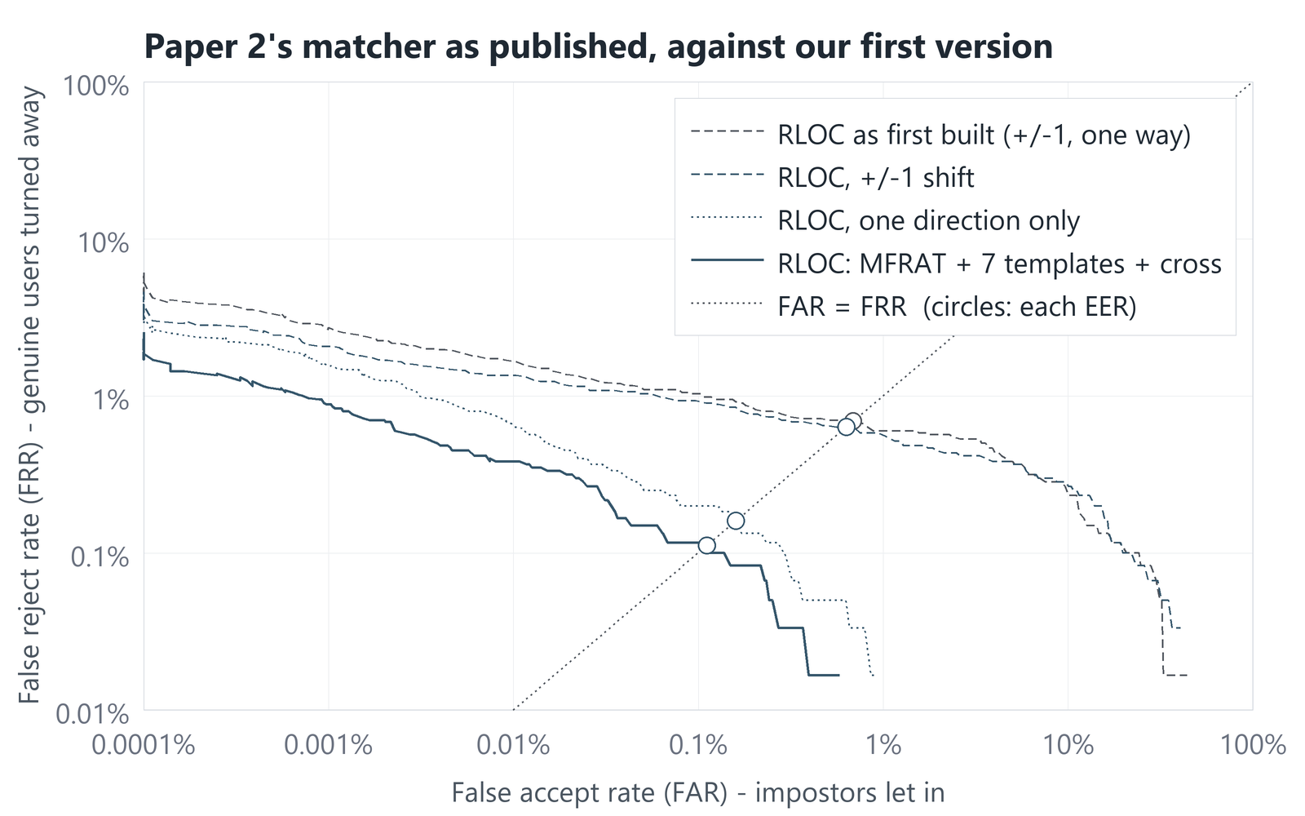
PAPER 2'S CLAIMS, RE-TESTED
The detail that mattered most: matching exactly as published
Our first matcher searched ±1 cell and scored one way round; the paper says ±2 cells and both ways. Fixing it cut the EER sixfold.
matcher | EER | d′
As first built: ±1, one way | 0.69% | 5.95
±1 shift, both ways | 0.63% | 6.10
±2 shift, one way | 0.16% | 6.33
As published: ±2, both ways | 0.11% | 6.54
The ±2 search is most of it (−0.52 points): 8% of genuine pairs find their best match 2 cells (8 pixels) away — out of reach of ±1.
Both ways round adds a little more (−0.05 points).
The cost: matching all 11,400 probes against all 600 palms takes 176 s instead of 33 s.
Found while re-reading the paper's matching section for this talk. Every other result here uses the published matcher.
AI461 Advanced Biometric Systems and Security · Phase II : Implementation and Results
20
Notes:
[~48 s · Hanmant]
SAY
This slide is the main lesson of the project. Our first matcher searched only
one cell of shift and scored one way round. Preparing this talk —
re-reading the paper's matching section — we saw it says two cells,
and both ways. We fixed it and re-ran
everything: the error rate fell from 0.69 percent to 0.11 — sixfold. Most of
that is the wider search: eight percent of genuine pairs find their best match
two cells away. Small details of an implementation can matter more than the
headline idea, so every result today uses the matcher exactly as published.
IF ASKED
Why was it ±1 at first? To keep a full evaluation inside an hour before we
had the fast matrix-product matcher. Once matching was fast, the reason
disappeared — and we had not gone back to it.
Breakdown (results.md section 8): ±2 search −0.52 pt (−0.87 to −0.16), both
directions −0.05 pt (−0.10 to −0.00), both together −0.58 pt. Cost: the
full matching run takes 176 s instead of 33 s (results.md section 7).
Side effect: Vishal's own palm photos, framed by hand, were sometimes rejected
by the first version; with ±2 all six enrol/verify pairs are accepted.

Slide 21
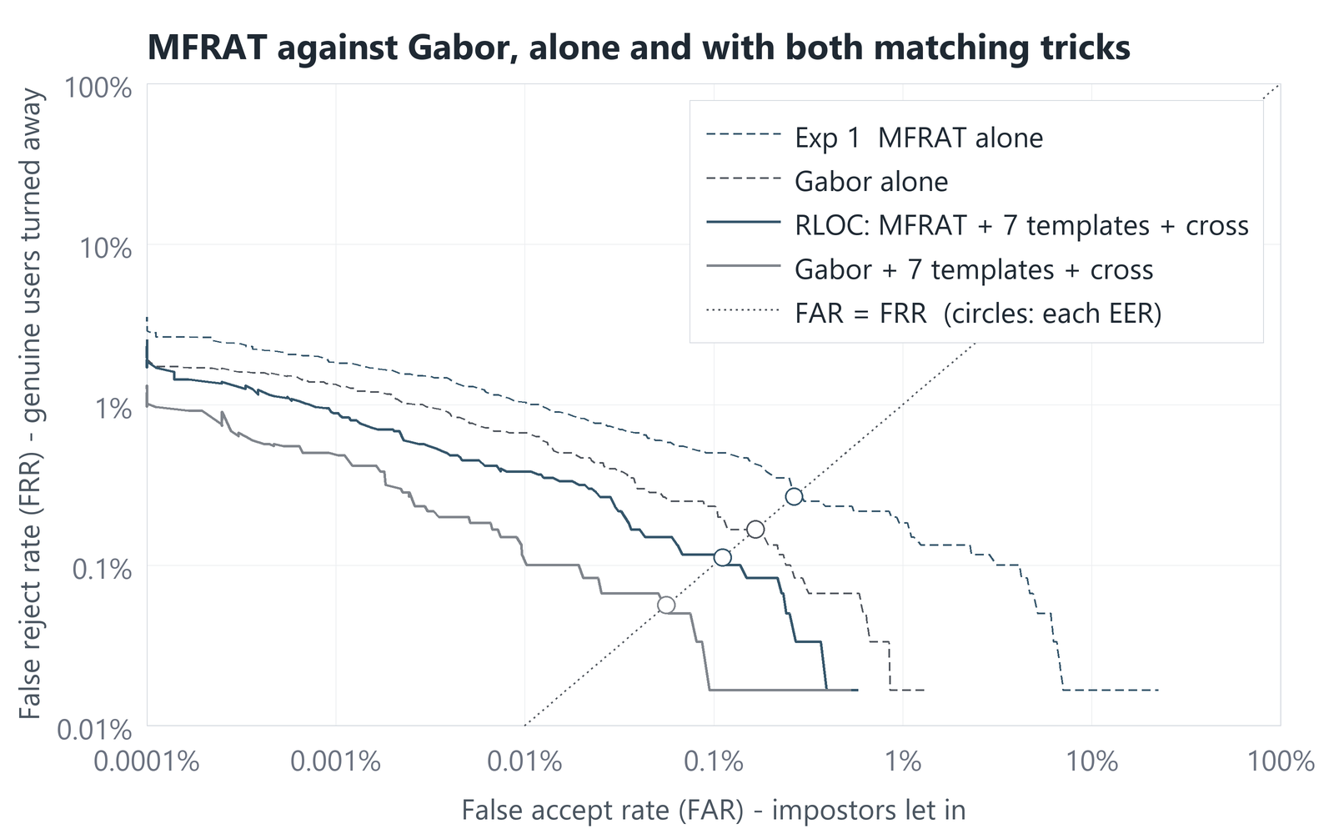
PAPER 2'S CLAIMS, RE-TESTED
MFRAT against Gabor: the experiment Paper 2 did not run
Same lattice, same templates, same matching — only the filter changes. On Tongji the Gabor code is at least as accurate at every stage.
stage | MFRAT | Gabor | MFRAT wins in
Filter alone | 0.27% | 0.17% | 1.8% of samples
+ 7 templates | 0.12% | 0.05% | 3.0%
+ cross (full) | 0.11% | 0.06% | 0.6%
Tilted towards Gabor: its one setting, the filter frequency, was tuned on session-1 images only; MFRAT kept the paper's settings.
Both codes gain from the templates and the cross: MFRAT −0.16 points, Gabor −0.11.
Speed: 4.2 ms per image for MFRAT, 3.5 ms for Gabor computed by FFT. The paper's claim that MFRAT is cheaper assumes Gabor by direct convolution.
Phase I asked: does the filter or the rest of the pipeline earn RLOC's gain? On Tongji, the rest: rotated templates and the shift search.
AI461 Advanced Biometric Systems and Security · Phase II : Implementation and Results
21
Notes:
[~44 s · Hanmant]
SAY
In Phase One we asked: does RLOC's gain come from the MFRAT filter, or from
its matching? Paper 2 never tested this. We did: we replaced MFRAT with a
Gabor filter bank, as in Competitive Code, and kept everything else the same.
At every stage the Gabor code is at least as accurate — 0.06 against 0.11
percent in the full pipeline. Gabor's filter frequency was tuned on
session-one images, while MFRAT kept the paper's settings — but on Tongji,
RLOC's strength is its rotated templates and shift search, not the filter.
IF ASKED
Gabor code: real part of a Gabor filter at six orientations, argmin over
orientations, on exactly the same 32 x 32 lattice; computed by FFT.
Significance: only the full-pipeline difference has a 95% interval that
excludes zero (+0.01 to +0.10 pt); at the other stages it touches zero. So
"at least as accurate", never "better at every stage".
Tuning: frequencies ω from 0.15 to 0.80 rad/pixel (wavelength 2π/ω) tried on
session-1 images only (1,200
probes); lowest EER wins, ties to the larger d'. Chosen: 0.50, 0.60, 0.60 for
the three stages (backup B3). Session-2 images were never used to choose.
MFRAT better in 1.8%, 3.0% and 0.6% of resamples at the three stages.
Paper 2 compares against Competitive Code (0.47%) without giving Competitive
Code its templates and cross — so its comparison mixes filter and matching.

Slide 22
PAPER 2'S CLAIMS, RE-TESTED
Three more things we measured
Each one tests a claim made by one of the papers — or by us.
One template or seven?
0.25% → 0.11%
On synthetic hands, one template did as well as seven. On Tongji, seven win in 99.9% of bootstrap samples — presumably its regions carry rotation that the templates absorb.
Paper 1's two feature types
11.38% vs 7.67%
Morphology features, Paper 1's more elaborate option, are worse than plain Sobel features in every bootstrap sample — as our Phase I critique suspected.
What RLOC costs
≈ 65× slower to match
Matching one palm takes about 65 times as long as Han's correlation, and the template is 9 times larger: the price of a far lower error rate.
Measured by run_experiments.py (results.md §7), numpy only — timings vary a little from run to run
step | RLOC | Han et al. (2003)
Encode one image | 4.2 ms | 2.8 ms
Enrol one palm | 36 ms (7 rotated codes) | 2.8 ms
Match a probe against one palm | 2.8 ms | 0.04 ms
AI461 Advanced Biometric Systems and Security · Phase II : Implementation and Results
22
Notes:
[~30 s · Hanmant]
SAY
Three more measurements. One template or seven: on our synthetic hands one was
enough, but on Tongji seven clearly win. Paper 1's two feature types: its more
elaborate morphology features are worse than plain Sobel. And the cost: RLOC
is about 65 times slower to match than Han's correlation, with a template
nine times larger — still only about 3 milliseconds per palm.
IF ASKED
Morphology vs Sobel: 11.38% vs 7.67% EER; morphology never better in 1,000
resamples (results.md section 6).
Template sizes: RLOC 7 x 331 = 2,317 bytes; Han 64 floats = 256 bytes.
Timings vary by a few tenths of a millisecond between runs; the slide rounds
them.

Slide 23
CONCLUSION
What these results do not show
Six limits, stated here so nobody has to find them for us.
One database
Tongji only; the IIT Delhi database is still pending. Another sensor and other people may give other numbers.
Not our region of interest
Tongji cuts out the palm itself. Our extraction is measured on synthetic hands only (0.54°), never on real photographs.
Few errors, a wide interval
The 0.11% EER rests on 7 rejected genuine attempts. Its 95% interval runs from 0.04% to 0.16%.
A threshold fixed in advance
0.681 is chosen on the test scores. Fixed on session-1 images instead (0.692), RLOC on session 2 rejects 0.33% of genuine users and accepts 0.017% of impostors.
Han at a disadvantage
Paper 1 enrolled ten images per person, with a network per person. With one image only its template matching runs: 7.67% is not Paper 1 at its best.
Framing is everything
RLOC searches only ±8 pixels and ±9°. Our own palm photos match because we framed them the same way each time.
AI461 Advanced Biometric Systems and Security · Phase II : Implementation and Results
23
Notes:
[~42 s · Hanmant]
SAY
What these results do not show. One database only. Our own region extraction
is untested on real hands. RLOC's 0.11 percent rests on just seven false
rejects, so its interval is wide. Our threshold is set on the scores we
report; fixed in advance on session-one images instead, RLOC still rejects
only a third of a percent of genuine users. Han runs at a disadvantage,
without his ten enrolment images and per-person network. And RLOC needs
consistent framing: it searches only about eight pixels and nine degrees.
IF ASKED
Threshold fixed in advance (deck2/fact_threshold.py): the equal-error point
of the same-session probes, 0.692 for RLOC, applied unchanged to session 2
gives FRR 0.33% (20 of 6,000) and FAR 0.017% (620 of 3,594,000). For Han the
same procedure gives FRR 13.4% and FAR 3.6%.
Next steps: IITD when it arrives; Tongji's original photographs through our
own extraction; weighting cells by directional contrast.

Slide 24
CONCLUSION
The five questions, answered
One line each — then one finding of our own.
question | our answer
1 How is the data obtained? | Public Tongji database: 600 palms, two sessions, 12,000 images. File numbering checked against the pixels before use.
2 How are features extracted? | MFRAT: six 64-pixel line sums at every 4th pixel; keep the darkest direction → a 32 × 32 code.
3 What is the algorithm? | One image → 7 rotated templates. Match both ways in a cross neighbourhood over 25 shifts; keep the best score.
4 How is an input verified? | Score the probe against the claimed person's templates; accept if the score is at least 0.681.
5 How well does it perform? | EER 0.11% (Han: 7.67%). At FAR 0.1%, 7 of 6,000 genuine users turned away (Han: 2,649).
Our own finding
Implemented as published, RLOC beats Paper 1 by a wide margin. But a Gabor code in the same pipeline does at least as well, and the cross adds nothing measurable here: RLOC's strength is its rotated templates and shift search, not the MFRAT filter.
AI461 Advanced Biometric Systems and Security · Phase II : Implementation and Results
24
Notes:
[~39 s · Hanmant]
SAY
The five questions, one line each. Data: the public Tongji database, its
numbering checked. Features: MFRAT's six line sums, keeping the darkest
direction. Algorithm: seven rotated templates, matched both ways in a cross,
over twenty-five shifts. Verification: accept if the best score is at least
0.681. Performance: 0.11 percent equal error rate, against 7.67 for Paper 1.
And our own finding: RLOC works as published, but its strength is the
rotated templates and the shift search, not the MFRAT filter.
IF ASKED
If asked which paper is "better": on the same data RLOC's EER is about 70
times lower than Han's; Han is simpler and cheaper, and the gap might
narrow if his per-user network could be trained (it needs 10 enrolment
images).

Slide 25
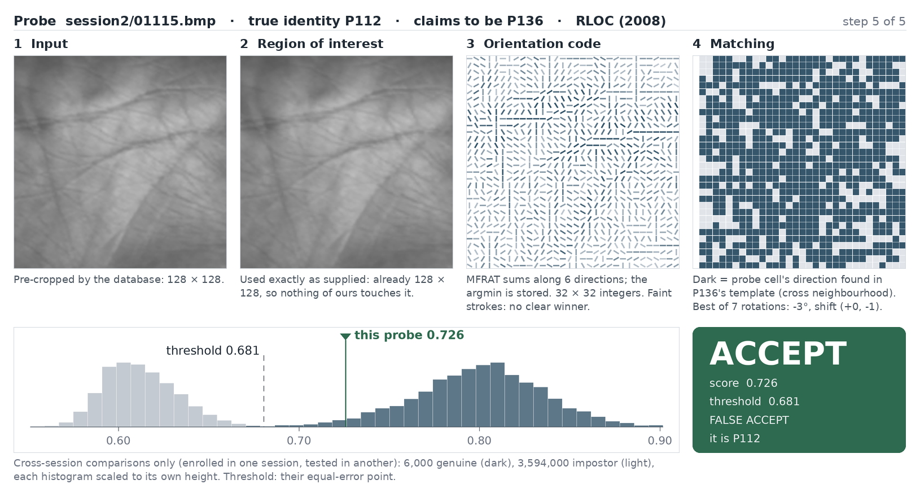
LIVE DEMO · 10 MINUTES
Over to the demo
What you will see
A genuine attempt, one step at a time
An impostor — then the highest-scoring impostor of the whole evaluation, a real false accept
The same image through Han et al. (2003)
Identification: one image against all 600 palms
Vishal's own palm, enrolled live from one photo
Questions are welcome after the demo.
The highest-scoring impostor: palm P112 claims to be P136 and scores 0.726 — accepted, wrongly. The demo says so.
Notes:
[~9 s · Hanmant]
SAY
Vishal will now run the demo live, on all 600 palms. We will take questions
after it. Thank you.
IF ASKED
Hand the clicker or keyboard to Vishal. His run-sheet covers the demo.

Slide 26
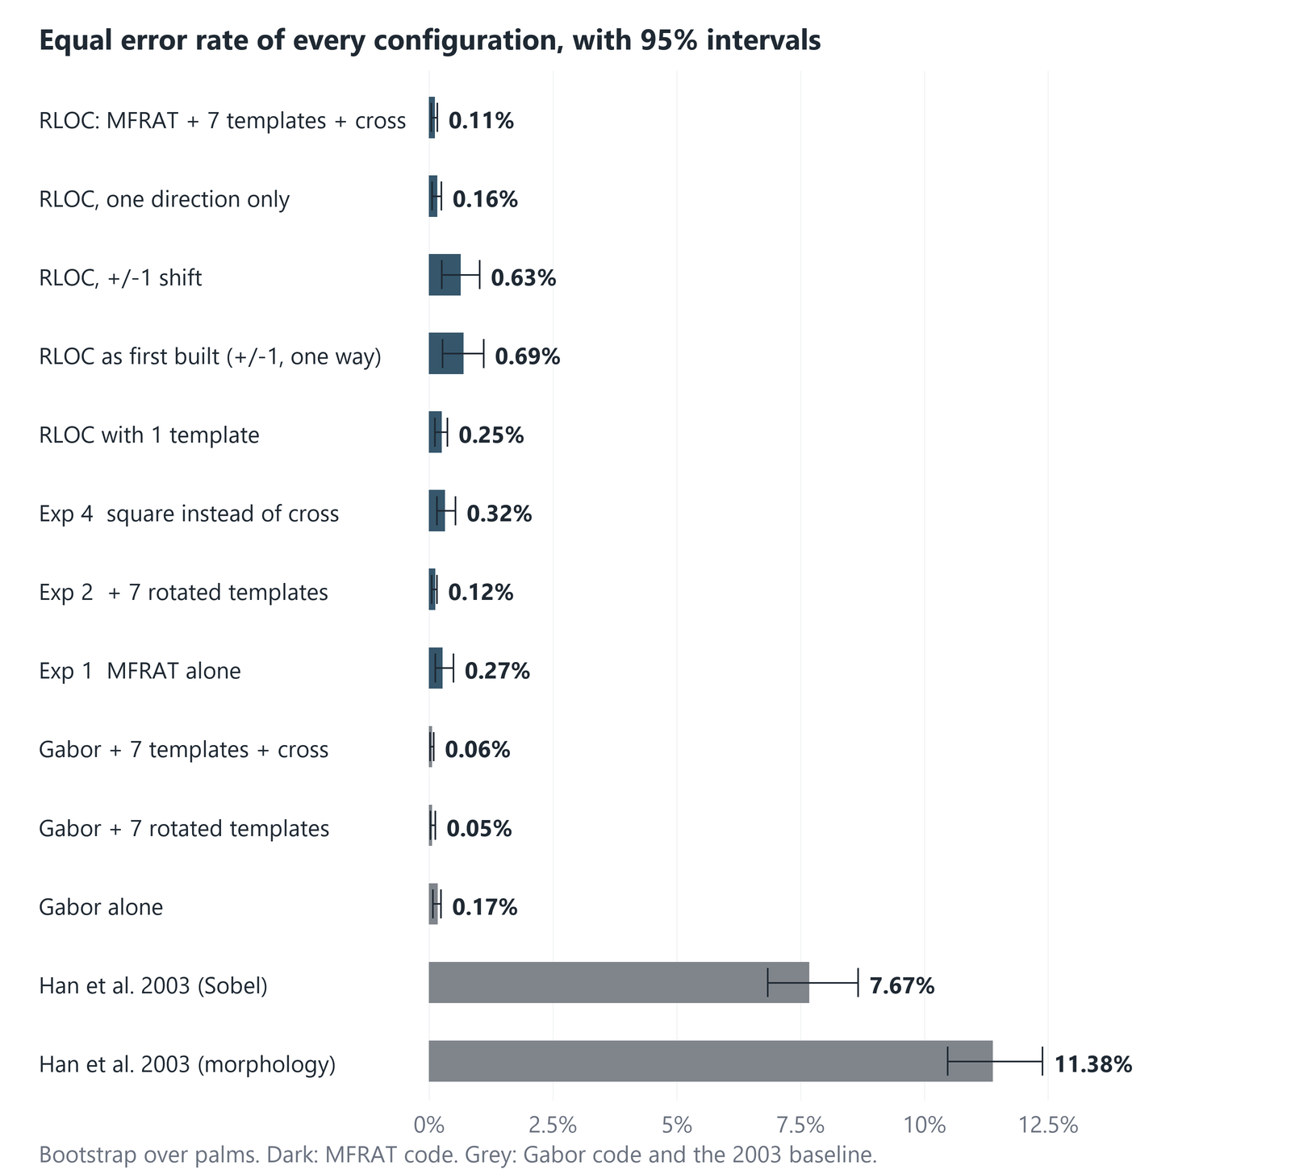
BACKUP
Every configuration, with its 95% interval
Cross-session EER of all thirteen configurations we ran, from the same 6,000 genuine and 3,594,000 impostor comparisons.
AI461 Advanced Biometric Systems and Security · Phase II : Implementation and Results
B1
Notes:
[backup · not in the timed talk]
IF ASKED
Every configuration's cross-session EER with its 95% interval. Dark bars:
MFRAT code. Grey: the Gabor code and Han.

Slide 27
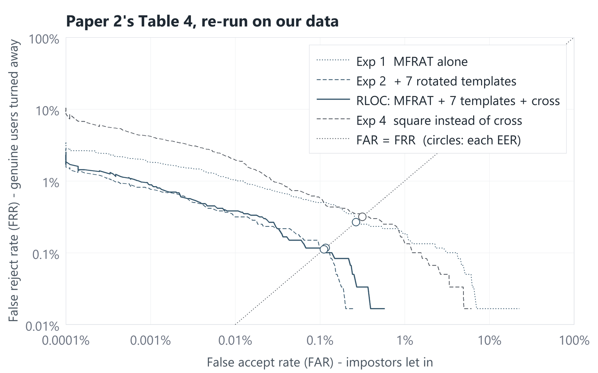
BACKUP
Table 4 as DET curves
The four steps of Paper 2's ablation, every threshold at once.
Exp 2 (+ templates) moves the whole curve down: fewer genuine users rejected at every FAR.
Exp 3 (+ cross) and Exp 2 nearly coincide: the cross adds separation (d′) but not fewer errors.
Exp 4 (square) lies above Exp 3 almost everywhere: the cross beats the square, as in the paper. Unlike on PolyU, the square also trails Exp 1.
AI461 Advanced Biometric Systems and Security · Phase II : Implementation and Results
B2
Notes:
[backup · not in the timed talk]
IF ASKED
Table 4 as DET curves. Exp 2 and Exp 3 nearly coincide at every FAR — the
cross raises d' but does not remove errors on Tongji.

Slide 28
BACKUP
How the Gabor filter frequency was chosen
Session-1 images only (1,200 probes), each configuration with its own matching rule; lowest EER wins, ties go to the larger d′.
ω (radians per pixel) | pixel, 1 template | pixel, 7 templates | cross, 7 templates
0.15 | 1.333% (4.78) | 1.339% (4.65) | 1.333% (5.15)
0.20 | 0.417% (5.28) | 0.448% (5.18) | 0.500% (6.12)
0.25 | 0.167% (5.50) | 0.230% (5.43) | 0.211% (6.88)
0.30 | 0.083% (5.52) | 0.083% (5.46) | 0.083% (7.49)
0.40 | 0.083% (5.15) | 0.006% (5.16) | 0.003% (8.21)
0.50 | 0.009% (4.55) ← chosen | 0.001% (4.57) | 0.001% (8.10)
0.60 | 0.026% (3.95) | 0.000% (3.99) ← chosen | 0.000% (7.31) ← chosen
0.70 | 0.020% (3.47) | 0.000% (3.50) | 0.000% (6.39)
0.80 | 0.083% (3.05) | 0.003% (3.08) | 0.001% (5.39)
Session-1 EER (d′). No session-2 image — the images every cross-session number comes from — was used in this choice.
AI461 Advanced Biometric Systems and Security · Phase II : Implementation and Results
B3
Notes:
[backup · not in the timed talk]
IF ASKED
Gabor frequency search: session-1 data only, 1,200 probes, lowest EER then
largest d'. Many settings give 0.000% on session 1, which is why the d'
tie-break decides.

Slide 29
BACKUP
Why we trust our own numbers
Checks built into the code, run on our laptop and on a second machine.
Five test programs plus a rehearsal mode that drives the real demo window — all passing.
One matcher, two code paths: the fast batched matcher behind the results gives bit-for-bit the same scores as the matcher the demo draws.
Two machines, two code paths: the demo's own evaluation, computed on our laptop, gives the same EER (0.11%) and threshold (0.681) as the experiment runner on a second machine.
Our first matcher's full run was reproduced on both machines: all 1,069 reported values identical.
Every EER has an interval: palms resampled 1,000 times (fixed seed 461, the course code); every comparison is paired.
No peeking: Gabor was tuned on session-1 images only.
The numbering was tested, not assumed (slide 4).
Nothing borrowed: numpy and Pillow (Tkinter for the window); MFRAT, the matcher, the metrics and the demo are our own code.
AI461 Advanced Biometric Systems and Security · Phase II : Implementation and Results
B4
Notes:
[backup · not in the timed talk]
IF ASKED
1,069 identical values: our first matcher's full run, reproduced on the
laptop and on a second machine. The published matcher's run is reproduced by
the demo's own evaluation on the laptop (0.11%, threshold 0.681).

