Slide 1
PHASE I · LITERATURE CRITIQUE
Palmprint Recognition
Two generations of palm-line features, five years apart
Group members
〈Vishal Gautam, U23AI127〉 · 〈Hanmant Jajulwar, U23AI098〉
Department of Artificial Intelligence
Sardar Vallabhbhai National Institute of Technology, Surat
B.Tech III (Artificial Intelligence) · Semester VI
AI461 Advanced Biometric Systems and Security
Modality: palmprint · 31 August 2026
PAPER 1
“Personal authentication using palm-print features”
C.-C. Han, H.-L. Cheng, C.-L. Lin, K.-C. Fan
Pattern Recognition 36 (2003) 371–381
PAPER 2
“Palmprint verification based on robust line orientation code”
W. Jia, D.-S. Huang, D. Zhang
Pattern Recognition 41 (2008) 1504–1513
Notes:
[~20 s · Speaker 1]
SAY
Good morning. Our modality is palmprint. We critique two Pattern Recognition
papers five years apart: Han and colleagues, 2003, line-like palm features;
and Jia, Huang and Zhang, 2008, robust line orientation code. Different
authors — but Paper 2 cites Paper 1 as previous-generation work, so this is a
real improvement story.
IF ASKED
Paper 2 cites Paper 1 as its reference 5.
Timing plan for the whole talk: 19 min 35 s of script against the 20-minute
cap, then 10 minutes of questions. If we fall behind, the three slides to
compress are 10, 22 and 26 — the argument survives without them, and their
numbers are on screen anyway. Never cut 11, 24 or 27.

Slide 2
How the next twenty minutes are spent
Each paper is examined through the same five questions, and only then compared.
1
Framing
2 min
Why palmprint at all, and where these two papers sit in the literature.
2
Paper 1 · 2003
6½ min
Line-like features: four Sobel directions, grey-scale morphology, template matching and a per-user neural network.
3
Paper 2 · 2008
6 min
Orientation code: MFRAT, an enlarged training set, and pixel-to-area matching.
4
Critique
4 min
The five axes side by side, advantages and disadvantages, and what five years actually changed.
Slides 3 – 4
Slides 5 – 14
Slides 15 – 22
Slides 23 – 29
The same five questions for both papers
how the data is acquired · what features are extracted · how they are extracted · how they are trained · what the classification scheme is
AI461 Advanced Biometric Systems and Security · Phase I : Literature Critique
2
Notes:
[~25 s · Speaker 1]
SAY
Structure. I frame the problem. Speaker 2 takes Paper 1 end to end, Speaker 3
takes Paper 2, Speaker 4 compares them. The bar along the bottom is the point:
we answer the same five questions for each paper, in the same order, so the
final comparison is like for like. The eyebrow at the top left tells you which
question we are on.
IF ASKED
The five questions are the ones the brief mandates: how the data is acquired,
what features are extracted, how they are extracted, how they are trained, and
the classification scheme.

Slide 3
FRAMING
Why palmprint at all?
Paper 1 justifies the modality not by what the palm does well, but by what each alternative costs.
What is ruled out, and why
Iris. Recognition rates are high, but the sensor cost is “too high” for the low-security applications they are targeting.
Fingerprint. Also accurate, but it carries a criminal-investigation stigma, so users are unwilling to hand over the data.
Hand geometry. Finger width, length and thickness shift with rings and with pregnancy, so templates need frequent updating — fit only for low-security entry control.
What is chosen
The palm print is “the relatively stable feature extracted from the hands” — a large area, rich in principal lines and wrinkles, and discriminative even at 75–100 dpi.
Consequence for both papers
Low resolution is enough. So the hard problem is not sensing — it is deciding what to measure in a palm-line image. That decision is where the two papers part company.
AI461 Advanced Biometric Systems and Security · Phase I : Literature Critique
3
Notes:
[~54 s · Speaker 1]
SAY
Palmprint is not chosen because it beats everything. It is chosen by
elimination, and Han et al. make that argument explicitly.
Iris: accurate, but in 2003 the sensor was too expensive for a low-security
door. Fingerprint: accurate, but it carries stigma from criminal investigation
— people did not want to give one. Hand geometry: cheap and comfortable, but
finger measurements drift with rings and with pregnancy, so you re-enrol
constantly.
The palm sits in that gap. Large surface, principal lines stable over years,
and — the point that matters for both papers — no high resolution needed.
Seventy-five to a hundred dpi is enough.
So the engineering problem is not the sensor. It is representation: what do you
actually measure in a low-resolution image of palm lines? Both papers answer
that, in opposite ways.
IF ASKED
Palm lines come in three kinds: principal lines, wrinkles and ridges. Only the
first two survive at 75–100 dpi, which is exactly why both papers are
line-orientation methods rather than ridge methods.

Slide 4
FRAMING
Where these two papers sit
Paper 2 cites Paper 1 as reference [5] — it names the earlier work as the generation it is moving past.
Feature families
Hand geometry
widths, lengths, thicknesses
Texture and appearance
global transforms, eigenpalms
Line-like features
find the lines, measure them
Orientation codes
label each pixel by direction
2003 · Paper 1 — Han, Cheng, Lin & Fan
Family: line-like features. Own 50-person database, captured on a flatbed scanner. Verified by template matching and by a per-user neural network.
Paper 2 cites Paper 1 as [5]
“Zhang and Zhang, Han et al. and Lin et al. proposed several line-like features of palmprint for personal verification / identification, respectively [4–6].”
In between: Competitive Code (Kong & Zhang, 2004) — the orientation method Paper 2 sets out to improve.
2008 · Paper 2 — Jia, Huang & Zhang
Family: orientation codes. Framed as “an improved version of Competitive Code”. Public PolyU database, 386 palms.
By 2008 the field has a common benchmark — the PolyU database, from D. Zhang's group — and Zhang is a co-author of Paper 2.
AI461 Advanced Biometric Systems and Security · Phase I : Literature Critique
4
Notes:
[~61 s · Speaker 1]
SAY
Palmprint methods fall into families. Hand geometry we have ruled out. Texture
and appearance methods take a global transform of the whole image. The two that
matter here are the bottom two.
Line-like features: detect the palm lines and measure them — that is Paper 1.
Orientation codes: do not measure how strong a line is, label every pixel with
the direction of the line running through it — that is Paper 2.
And the link is citable. Paper 2's introduction groups Zhang, Han et al. and
Lin et al. together as authors who "proposed several line-like features of
palmprint" — reference five is our Paper 1. So Paper 2 itself classifies Paper
1 as the previous generation.
One more thing. Paper 1 cites David Zhang's earlier work; by 2008 Zhang
co-authors Paper 2, and the benchmark database everyone uses is his group's.
The centre of gravity of the field moved.
IF ASKED
Han's group did continue the line-feature thread — Lin, Chuang and Fan, 2005,
hierarchical decomposition — and Paper 2 cites that as its reference 6.

Slide 5
PAPER 1 · HAN, CHENG, LIN & FAN · 2003
Personal authentication using palm-print features
Pattern Recognition 36 (2003) 371–381 · received December 2001 · Chung-Hua University and National Central University, Taiwan
The claim
Line-like features, pulled out of a peg-free scan by directional operators, are enough for verification — and a neural verifier does substantially better than template matching.
50 persons
1,500 images, captured three times across three weeks
256 × 256
ROI at 100 dpi, from a peg-free flatbed scan
> 91%
accuracy — multi-template matching, FAR and FRR under 9%
> 98%
accuracy — per-user neural network, both under 2%
What is missing
No equal error rate, no ROC curve, and no comparison against any competing published method — so these numbers cannot be placed in context.
AI461 Advanced Biometric Systems and Security · Phase I : Literature Critique
5
Notes:
[~27 s · Speaker 2]
SAY
Paper 1, 2003, from two Taiwanese universities, received at the end of 2001.
The claim: you can verify a person from line-like features in a peg-free palm
scan, and a neural verifier beats template matching. Fifty people, thirty
images each over three weeks, a 256-by-256 region of interest, above 91 per
cent with template matching and above 98 with a network. Please hold on to the
bottom box.
IF ASKED
The bottom box: no EER, no ROC curve, no comparison with any published method.
Speaker 4 returns to it — it is why 98 per cent cannot be placed against Paper
2's numbers, or against anything else.

Slide 6
PAPER 1 · 1. HOW THE DATA IS ACQUIRED
A flatbed scanner, and no pegs
Commodity hardware and free hand placement — which moves the whole invariance problem into software.
Device. A UMAX commercial colour flatbed scanner. The right hand rests on the platen with no pegs, in free position and free direction.
Signal. Grey-scale, 100 dpi, 845 × 829 pixels.
Protocol. 50 persons × 30 images, captured three times across three weeks. The first 10 images of each person are enrolled; the remaining 20 are tested.
Implementation. C and MATLAB, on Microsoft Windows.
What they rejected, and why
Peg panels — uncomfortable for the user.
CCD cameras — light-sensitive and, at the time, of insufficient resolution.
Zhang & Shu — ink the palm, then scan the paper — two separate steps, unusable in an on-line system.
Every rejection is an argument for convenience over control. The price is paid later, in software.
50 persons
30 images each
3 sessions over 3 weeks
10 enrolled + 20 tested
AI461 Advanced Biometric Systems and Security · Phase I : Literature Critique
6
Notes:
[~33 s · Speaker 2]
SAY
Acquisition: an off-the-shelf UMAX flatbed scanner. The right hand flat on the
glass — no pegs, no guides, any position, any rotation. Grey-scale, 100 dpi,
about 845 by 829. Fifty people, thirty images each, from three sessions across
three weeks, so there is real time variation; ten enrol, twenty test.
The box gives their rejections. Notice the trade: every one buys user
convenience and gives up mechanical control of alignment — so the region of
interest has to be found in software.
IF ASKED
The three rejections in full: peg panels, as uncomfortable; CCD cameras, as
light-sensitive and too low in resolution; and Zhang and Shu's method of inking
the palm onto paper and scanning the paper, because two steps cannot be an
on-line system.
The cost of peg-free capture is rotation and translation error, and it follows
them through the whole paper — the grid pooling on slide 11 and the bootstrap
augmentation on slide 13 are both consequences of this one decision.

Slide 7
PAPER 1 · PREPROCESSING
From a scanned hand to a fixed frame
Four automatic steps. Nothing can be measured until the same patch of palm is found in every image.
1
Image thresholding
The histogram is bimodal, so the threshold is taken at the local minimum between 50 and 100. In the experiments it is simply fixed at 70.
2
Border tracing
Starting from the upper-left point of the hand, the contour is traced counter-clockwise over 8-neighbourhood directions, keeping the coordinate list.
3
Wavelet-based segmentation
The contour becomes a curvature profile, which is wavelet transformed. Corners are the local minima of negative magnitude between two zero-crossings of the high-frequency sub-band — five fingertips and four finger roots.
4
ROI generation
Three of those corner points define a square frame in the centre of the palm. That construction is the next slide.
A first critical note
Fixing the threshold at 70 is justified only by “the capturing environment is stable and controlled”. That binds the system to one scanner under one lighting condition.
AI461 Advanced Biometric Systems and Security · Phase I : Literature Critique
7
Notes:
[~38 s · Speaker 2]
SAY
Four automatic preprocessing steps. One: threshold hand from background — the
histogram is bimodal, so take the valley, between 50 and 100; in practice they
fixed it at 70. Two: trace the outline counter-clockwise, eight-neighbour
connectivity. Three, the nicest engineering in the paper: turn the outline into
a curvature signal and wavelet-transform it — corners appear as local minima of
negative magnitude between two zero-crossings, giving five fingertips and four
finger roots. Four: three of those points build the ROI.
The critical note is that hard-coded threshold, defended only by saying the
environment is controlled.
IF ASKED
Why the wavelet step is good: raw curvature is noisy, so thresholding curvature
directly is unstable, whereas the zero-crossing bracket is a structural test
rather than a magnitude test.
Why the threshold matters: fixing it at 70 ties the system to one scanner under
one light. It is the first instance of the theme running through our whole
critique of this paper — robustness asserted and never tested.

Slide 8
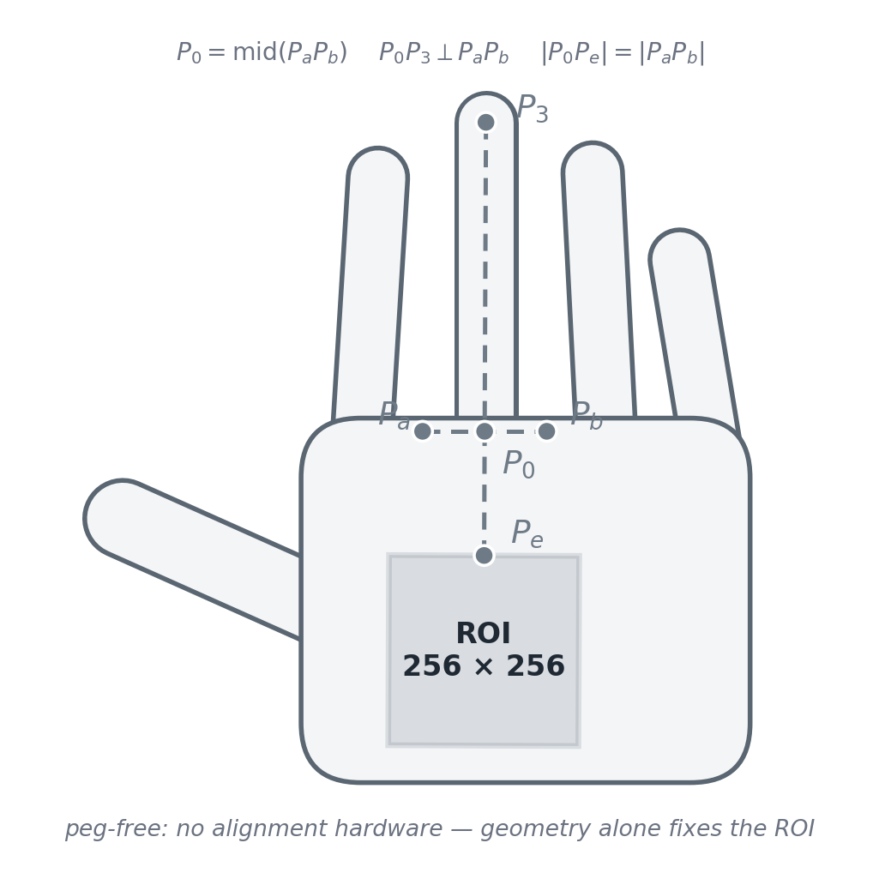
PAPER 1 · PREPROCESSING
The frame is derived from the hand itself
Landmark geometry buys translation and rotation invariance with no mechanical constraint at all.
Pₐ and Pᵇ are the finger roots either side of the middle finger; P₃ is its tip.
P₀ is the midpoint of PₐPᵇ.
The principal axis P₀P₃ runs along the middle finger and is perpendicular to PₐPᵇ.
The axis is extended into the palm to Pₑ, with |P₀Pₑ| = |PₐPᵇ| — so the frame scales with the hand.
At Pₑ, two perpendicular half-lines of 128 pixels each give the corners of a 256 × 256 square: the ROI.
Why this is the right answer to peg-free capture
Because every reference point comes from the hand, the frame follows the hand. Translate or rotate the palm on the glass and the same patch of skin is still cropped — invariance without hardware, and without asking the user to cooperate.
AI461 Advanced Biometric Systems and Security · Phase I : Literature Critique
8
Notes:
[~48 s · Speaker 2]
SAY
The ROI follows from nothing but those nine points. Take the finger roots either
side of the middle finger — P-a and P-b — and the middle fingertip, P-3. The
midpoint of P-a P-b is P-0, and the line P-0 to P-3 is the principal axis,
perpendicular to P-a P-b by construction — a natural coordinate frame for the
hand. Walk down that axis to P-e, where P-0 to P-e equals the length of P-a
P-b, then step 128 pixels each way perpendicular: a 256-by-256 square.
Two things. The crop travels with the hand, which is where the invariance comes
from with no pegs; and P-a P-b sets the scale, so a larger hand gets a
proportionally placed window.
IF ASKED
They never quantify how repeatable this ROI actually is across sessions, which
is a real gap. The bootstrap augmentation later in the paper — shifts up to
five pixels, rotations up to five degrees — is an implicit admission that it
wobbles by about that much.

Slide 9
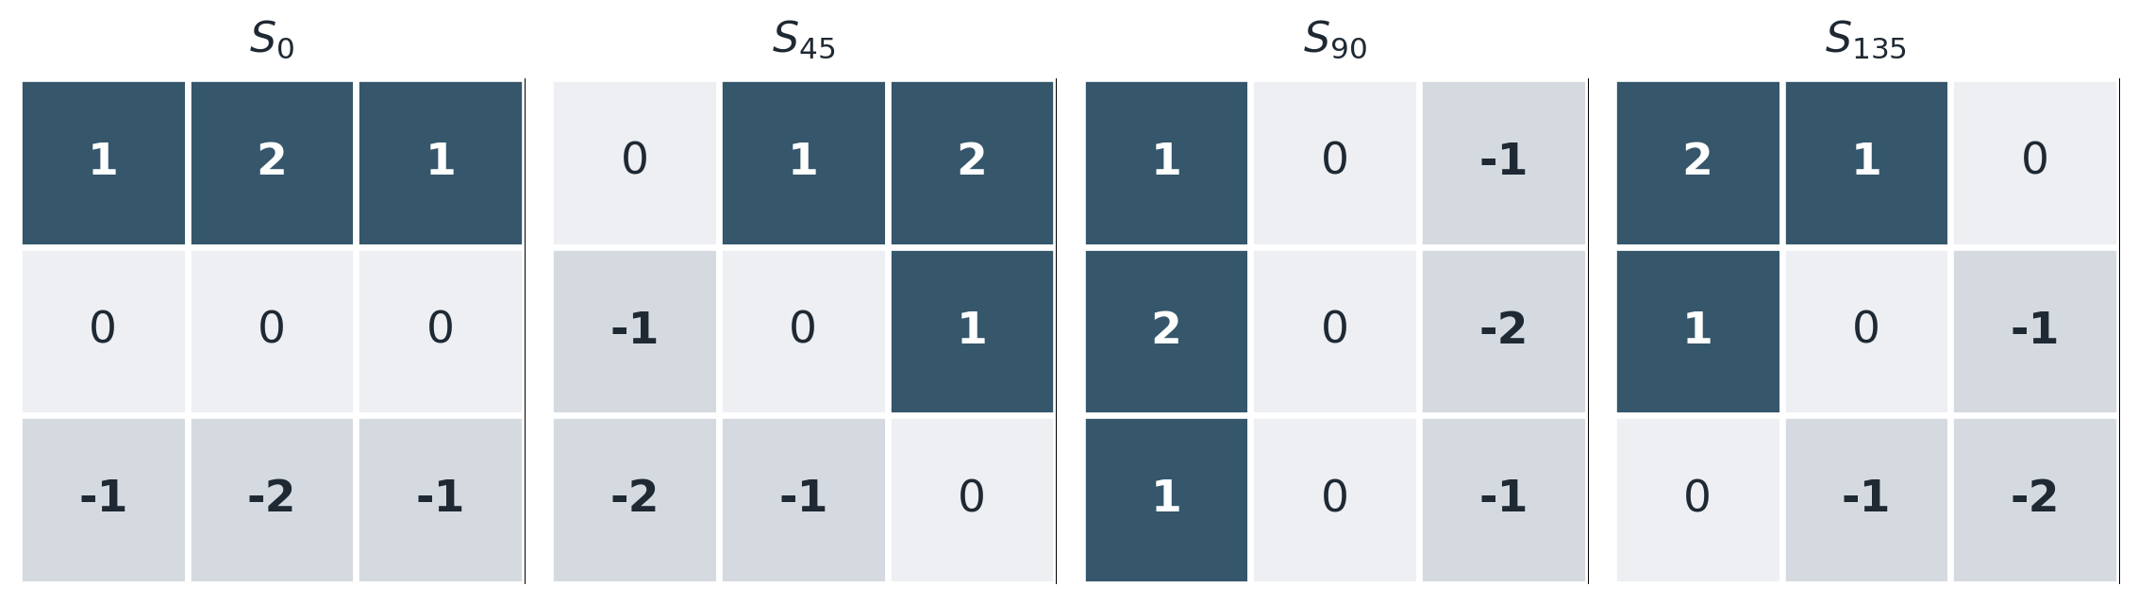
PAPER 1 · 2 & 3. WHAT FEATURES, AND HOW
Four directional Sobel masks, then a maximum
The response says a line is here and how strong it is — but not which way it runs.
Each 3 × 3 mask responds to edges at one orientation: 0°, 45°, 90°, 135°. Values transcribed from Fig. 5(a) of the paper.
Equation (1) keeps only the largest of the four responses
The magnitude survives. The identity of the winning direction — which of the four masks actually fired — is thrown away. Remember this: it is the single decision Paper 2 reverses, and speaker 4 will come back to it.
AI461 Advanced Biometric Systems and Security · Phase I : Literature Critique
9
Notes:
[~40 s · Speaker 2]
SAY
The first feature family: Sobel. Four three-by-three masks — nought, forty-five,
ninety and a hundred and thirty-five degrees — transcribed from figure 5a.
Convolve the ROI with all four, and Equation 1 collapses them: the maximum,
pixel by pixel.
Think about what that maximum keeps and what it discards. It keeps the
magnitude — how strong the strongest oriented response was. It discards which
mask won: the orientation of the line.
A reasonable 2003 choice — a bright pixel means there is a line here. But it is
exactly the information Paper 2 decides is the only thing worth keeping.
IF ASKED
Why four directions and not more: the paper does not say. It is a standard
Sobel bank with no sensitivity study — the same criticism we make of Paper 2's
choice of six MFRAT directions, so we apply it evenly to both.

Slide 10
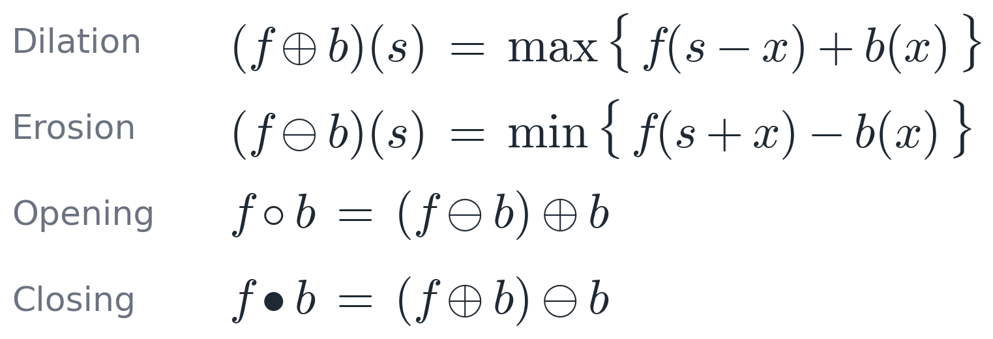
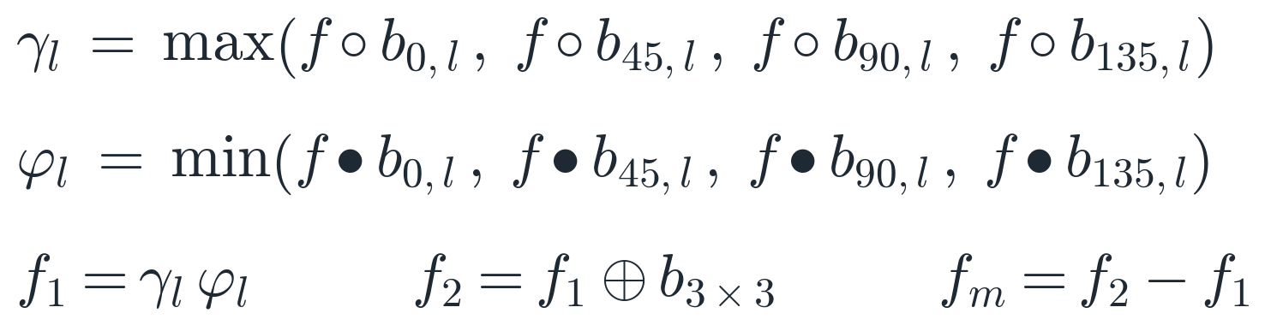
PAPER 1 · 2 & 3. WHAT FEATURES, AND HOW
A second, parallel family: grey-scale morphology
The same four directions again — this time as structuring elements inside an alternating sequential filter.
Structuring elements bₐ,ₗ are oriented line segments at 0°, 45°, 90° and 135°, of length l = 5 in the experiments.
The algebraic opening γₗ and closing φₗ take the max and the min over those four directions — structurally the same “compete across directions” move as Eq. (1).
The alternating sequential filter f₁ = γₗφₗ is credited to Song et al. as giving “perfect effects in the noisy or blurry images”.
The feature is the residue fₘ = f₂ − f₁; edge pixels then come from f * fₘ.
Is the extra machinery earned?
Eight structuring elements and four extra equations — for results within a point or two of plain Sobel, and worse at the coarsest scale (FAR 8.7% against 6.4%). The paper never argues why morphology should help, and its own numbers do not settle it. Complexity without a demonstrated payoff.
AI461 Advanced Biometric Systems and Security · Phase I : Literature Critique
10
Notes:
[~36 s · Speaker 2]
SAY
The second feature family runs in parallel on the same ROI. The four equations
are standard grey-scale morphology — dilation a local maximum, erosion a local
minimum, opening and closing the two compositions.
What matters is the structuring elements: short line segments at the same four
angles, of length five. The algebraic opening takes the maximum over the four
oriented openings and the closing takes the minimum — the same
compete-across-directions idea as Equation 1 in different clothes. Cascade
them, dilate, and the feature is the residue: f-two minus f-one.
IF ASKED
Our critique, in the box: this is a great deal of machinery — eight structuring
elements, four extra equations — and the results land within a point or two of
plain Sobel. At the coarsest scale morphology is actually worse: 8.7 per cent
false accept against 6.4. The paper gives no argument for why morphology should
be better, and the numbers do not make the case either.
This is one of the three slides to compress if we are running behind.

Slide 11
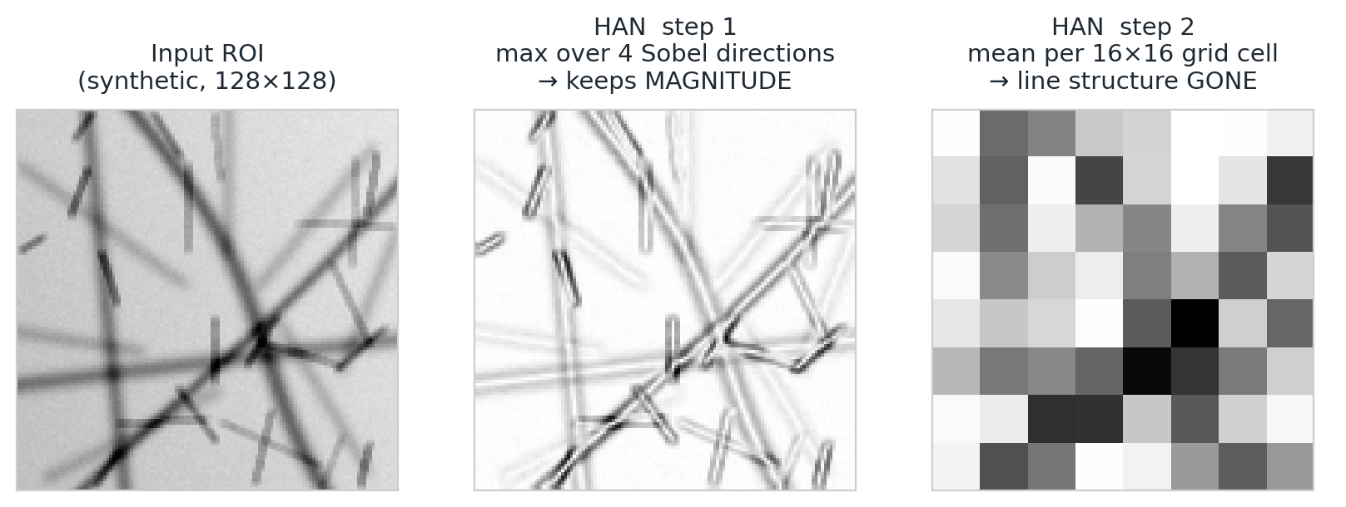
PAPER 1 · 2 & 3. WHAT FEATURES, AND HOW
Both families end in the same place: block means
The ROI is diced into cells and each cell is replaced by its mean. This is where the line structure goes.
The ROI is divided into uniform grids; the mean pixel value of each cell becomes one feature, read out row by row.
Three scales are reported — 32×32, 16×16 and 8×8 — as a crude multi-resolution descriptor.
What survives is edge energy per block. A rich oriented edge map becomes “how much line-ness is in this square”.
Alignment tolerance is therefore bought by blurring the representation — the only mechanism left once the spatial detail is gone.
AI461 Advanced Biometric Systems and Security · Phase I : Literature Critique
11
Notes:
[~48 s · Speaker 2]
SAY
This is the crux of our critique of Paper 1, so I will go slowly. The figure is
our own reimplementation, on a synthetic palm so we could see each stage. Left,
the input. Middle, Equation 1 — the maximum over the four Sobel directions; it
has done its job, the lines are crisp. Right, the same map after the grid
averaging the paper specifies.
The lines are gone. What is left is a coarse checkerboard of edge energy per
square — and both feature families end here, because both are pooled the same
way.
So the paper extracts line-like features carefully and then averages them away.
What the classifier receives is a texture-energy descriptor, not a line
descriptor.
IF ASKED
Why they do it: they need a short fixed-length vector, and averaging also
absorbs small misalignments. But that buys alignment tolerance by blurring the
representation — and Paper 2 gets the same tolerance without giving up detail.
On the three scales, the paper's own labelling is inconsistent: Section 3 calls
32 by 32 a grid size, Section 5.2 a window size, Equation 10 the length of the
feature vector. On a 256-by-256 ROI those cannot all be true — a 32-by-32
window gives 64 features, which matches Section 4.2. An editorial slip, but a
reimplementer would trip on it.

Slide 12
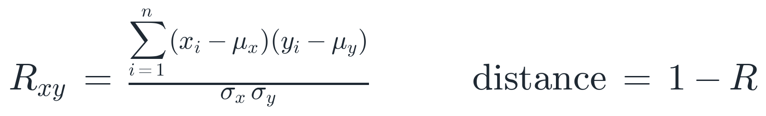
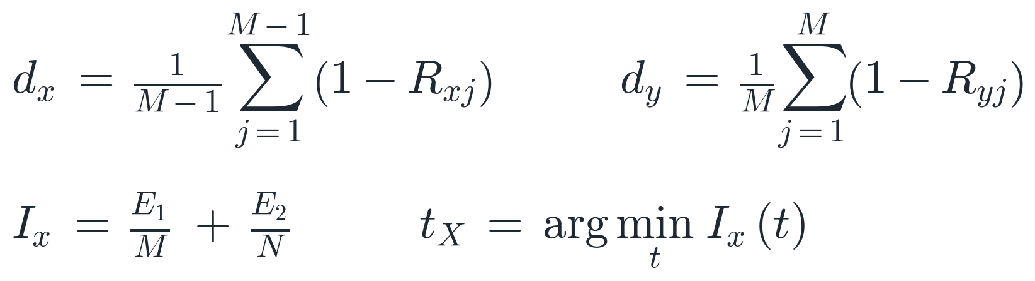
PAPER 1 · 4 & 5. TRAINING AND CLASSIFICATION
Verifier A — multi-template matching
No model is learned. M enrolled vectors are stored, and correlation decides.
Similarity is the Pearson correlation between the claimed vector and each stored template; the distance used is 1 − R.
A claim is genuine when the mean distance to the templates falls below that user's threshold.
tₓ is fitted per person, not globally, by leave-one-out cross-validation: sweep every threshold from 0 to 1 and keep the one that minimises FAR + FRR. Best reported value 0.38.
The advantage they claim explicitly: less training time than the neural alternative.
Two slips a reimplementer would hit
As printed, Eq. (10) omits the 1/n normalisation, so R is not bounded by 1 and “1 − R < t” does not mean what it should. And the text describes E₂ as contributing to FRR where it must mean FAR. Both are almost certainly typesetting errors — but they are the kind of thing that costs a day when you try to reproduce the method, and we hit them ourselves.
AI461 Advanced Biometric Systems and Security · Phase I : Literature Critique
12
Notes:
[~38 s · Speaker 2]
SAY
The first verifier is barely training at all. Store M enrolled vectors per
person as templates; correlate an incoming vector with each using Equation 10 —
Pearson correlation, distance one minus R — average the distances, and accept
below a threshold.
The threshold is the interesting part. Not global: fitted per person by
leave-one-out cross-validation, sweeping for the value that minimises false
accepts plus false rejects. That is the performance index I-x, and their best
is 0.38. Per-user thresholds were ahead of a lot of contemporary work, which
used one global threshold for everybody.
IF ASKED
Our reimplementation experience, in the box: Equation 10 as printed has no one
over n, so R is not bounded by one and cannot be thresholded the way the text
says. And the text calls E-2 a contribution to the false reject rate when it is
plainly the false accept rate. Both typos; both cost time.
The deeper problem is on our critique slide: the same 49 people supply the
impostors used to fit t-x and the impostors used to measure the final FAR, so
the reported FAR is optimistic.

Slide 13
PAPER 1 · 4 & 5. TRAINING AND CLASSIFICATION
Verifier B — one neural network per enrolled user
Eighty inputs, forty hidden units, one output — trained with scaled conjugate gradient.
Architecture 80 – 40 – 1, taken from Rowley et al.'s face-detection work, trained by scaled conjugate gradient (Møller) in MATLAB.
Bootstrap augmentation: each sample is randomly shifted by 0–5 pixels and rotated between −5° and +5° to manufacture artificial positives.
Classes are balanced to 9,800 samples per epoch — 4,900 positive and 4,900 negative, the negatives drawn from the other 49 persons.
The 80-dimensional input
64 means of 32×32 windows + 8 means of 32×256 horizontal strips + 8 means of 256×32 vertical strips
80
inputs
40
hidden
1
output
One such network is trained for each enrolled person.
This is where the design stops scaling
One network per user means enrolling one more person requires training another network — and requires other users' palmprints to be on hand as negatives at that moment. That is a scalability problem and a data-protection problem at once. It also makes the method unusable in the regime Paper 2 works in, where only one sample per palm is enrolled.
AI461 Advanced Biometric Systems and Security · Phase I : Literature Critique
13
Notes:
[~35 s · Speaker 2]
SAY
The second verifier is a neural network — one per enrolled person. Eighty
inputs, and note it is not the vector template matching used: sixty-four window
means, plus eight horizontal strip means and eight vertical, so the network sees
row and column profiles template matching never gets. Eighty–forty–one,
borrowed from Rowley's face detector, trained with scaled conjugate gradient.
They also augment — shifts to five pixels, rotations to five degrees — which
admits the ROI is not repeatable.
Our criticism: one network per user does not scale.
IF ASKED
They balance the classes to 9,800 samples per epoch, negatives drawn from the
other 49 people. So enrolling one more person means training a new network and
having other people's palmprints on hand at enrolment — a scalability problem
and a privacy problem. And it cannot work at all in Paper 2's regime, where you
get exactly one enrolled sample per palm.
Note too that template matching receives no augmentation, so the two verifiers
are not competing on equal terms.

Slide 14
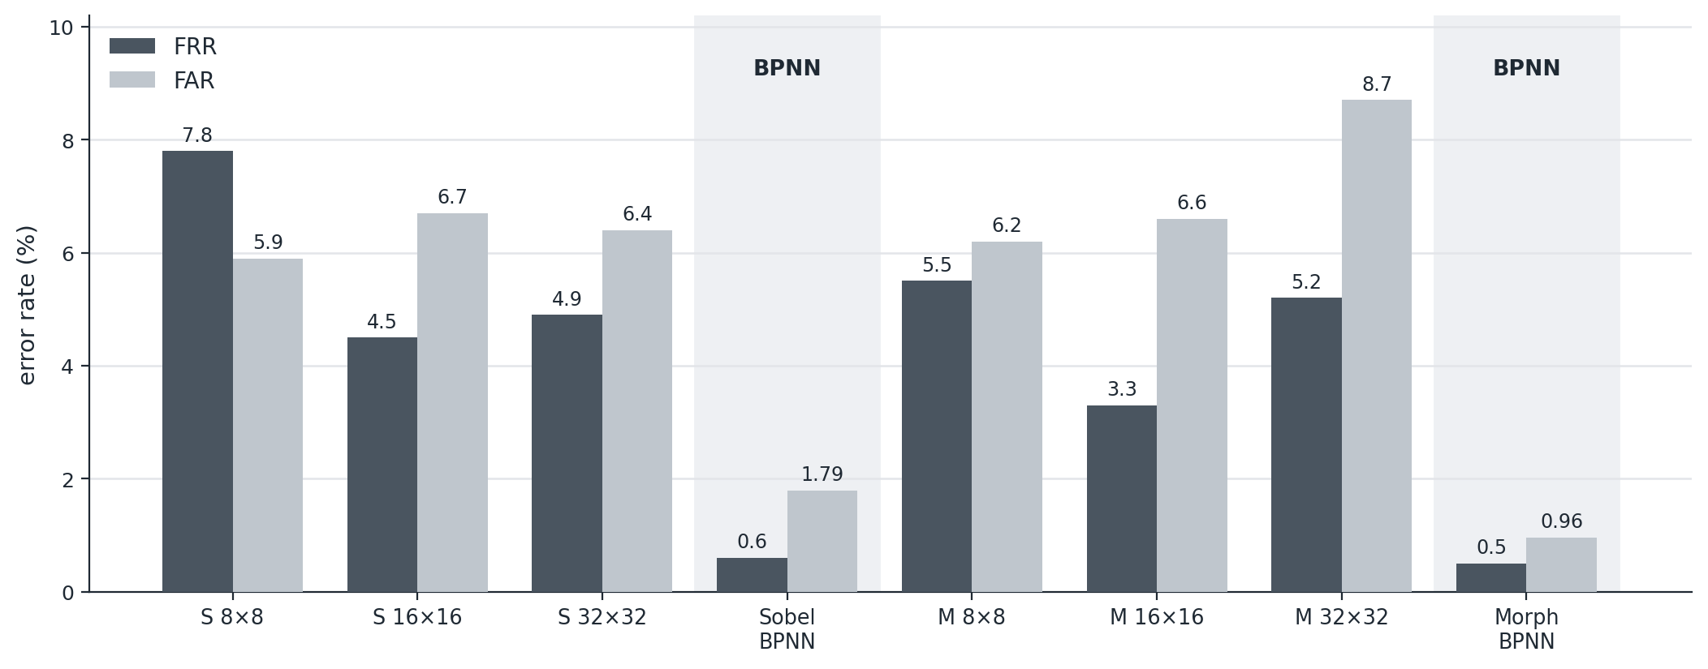
PAPER 1 · RESULTS
91% by correlation, 98% by network
Table 2 — but the two verifiers are not given the same inputs, so this is not a clean comparison of classifiers.
Template matching reaches over 91% accuracy, with FAR and FRR both under 9%. The per-user networks reach over 98%, with both under 2% — best of all, morphology plus BPNN, at FRR 0.5% and FAR 0.96%.
Three things change at once
Moving to the BPNN changes the classifier, the feature vector (80-dimensional, with strip means template matching never receives) and adds bootstrap augmentation that template matching never receives. With no ablation, “the network is better” is not supported as stated.
AI461 Advanced Biometric Systems and Security · Phase I : Literature Critique
14
Notes:
[~37 s · Speaker 2]
SAY
Table 2, redrawn. Dark bars are false reject, light bars false accept; S is
Sobel, M is morphology, and the two tall pairs on the right are the networks.
Template matching: above 91 per cent accuracy, both errors under nine. The
networks: above 98 per cent, both under two, the best being morphology plus
network at 0.5 and 0.96.
Taken at face value, the network wins by a lot. We do not think that is shown:
classifier, feature vector and augmentation all change at once, with no
ablation to separate them.
IF ASKED
Also notice, inside the template-matching results, that performance is best at
16 by 16 rather than at the finest scale — evidence that pooling is doing
something more complicated than the paper discusses, and nobody comments on it.
Speaker 3 now takes Paper 2, which handles exactly this kind of question much
better.

Slide 15
PAPER 2 · JIA, HUANG & ZHANG · 2008
Palmprint verification based on robust line orientation code
Pattern Recognition 41 (2008) 1504–1513 · Chinese Academy of Sciences, University of Science and Technology of China, and Hong Kong Polytechnic University
The claim
A cheaper line detector — the modified finite Radon transform — plus a matching rule that tolerates misalignment, gives a lower error rate than Competitive Code at a third of the extraction cost.
386 palms
7,752 images from the public PolyU database
0.16%
equal error rate — Competitive Code 0.47%
98.37%
genuine accept rate at FAR = 4 × 10⁻⁵%
70 ms
feature extraction — Competitive Code 220 ms
How it positions itself
Explicitly “an improved version of Competitive Code” — not a new paradigm. Every design choice answers a named defect in prior work, and the paper measures each one separately.
AI461 Advanced Biometric Systems and Security · Phase I : Literature Critique
15
Notes:
[~28 s · Speaker 3]
SAY
Paper 2, 2008, five years later. Note the affiliations — Chinese Academy of
Sciences, USTC, Hong Kong PolyU. PolyU is David Zhang's group, who built the
public palmprint database, and Zhang is the third author. The claim: a cheaper
line detector, MFRAT, plus a matching rule that forgives misalignment, beating
the state of the art three times faster. And the paper calls itself an improved
Competitive Code, not a new paradigm.
IF ASKED
The numbers on the slide: 386 palms, 7,752 images, all public. EER 0.16 per
cent against Competitive Code's 0.47. Genuine accept rate 98.37 per cent at a
very strict false accept setting. Extraction in 70 milliseconds against 220.
Speaker 4 will argue the paper is in one respect more honest than its own
abstract.

Slide 16
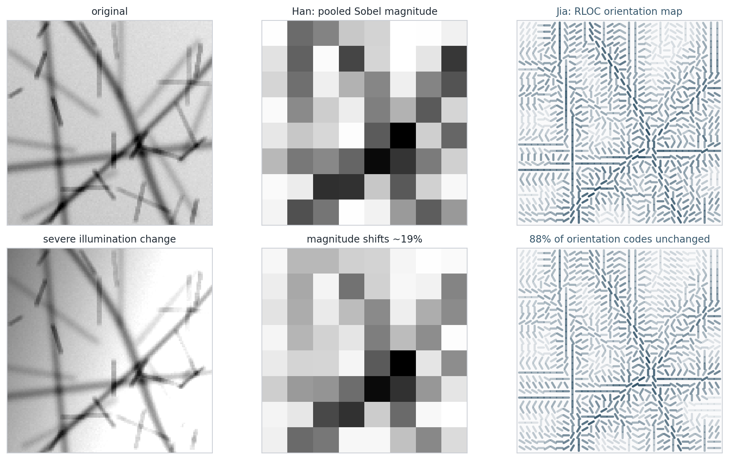
PAPER 2 · MOTIVATION
Three complaints about the state of the art
Each design decision in the paper answers one of these — which is why the method reads as a sequence of repairs rather than an invention.
1
Gabor filters are expensive.
Competitive Code needs six real Gabor convolutions per image. Answer: MFRAT — integer summation along lines, no trigonometry, no floating point.
2
Illumination changes the response.
Any magnitude-based feature scales with contrast and exposure. Answer: keep the index of the winning direction, not its value — an order statistic, so monotone intensity change leaves it alone.
3
Line width is not adjustable.
A fixed filter bank commits to one line thickness, but palms carry thick principal lines and thin wrinkles together. Answer: widen the MFRAT lines at will.
And a fourth, about matching. Codes are compared pixel against pixel, so a residual shift of a few pixels destroys the score.
AI461 Advanced Biometric Systems and Security · Phase I : Literature Critique
16
Notes:
[~44 s · Speaker 3]
SAY
Paper 2 opens by naming defects, and every later decision answers one. One:
Gabor filters cost too much — Competitive Code needs six real convolutions.
MFRAT instead sums pixel values along a straight line: integer addition, no
trigonometry. Two: illumination. Any feature built from filter magnitude scales
with contrast, so throw the magnitude away and keep only which direction won —
an order statistic.
The figure is our own experiment: under a contrast and brightness change the
orientation code stayed the same at 88 per cent of pixels, while the pooled
magnitude Paper 1 relies on shifted about 19 per cent. Three: line width
becomes tunable, and they use four pixels.
IF ASKED
The fourth complaint, bottom left: matching is done pixel against pixel, so a
residual shift of two or three pixels wrecks the score. That is slide 21.
On line width: a palm carries thick principal lines and thin wrinkles at the
same time, so a fixed filter bank has to commit to one thickness. MFRAT does
not.

Slide 17
PAPER 2 · 1. HOW THE DATA IS ACQUIRED
No capture at all — a public benchmark
The acquisition question is answered by citation, and that is itself the methodological advance.
PolyU Palmprint Database, from Hong Kong Polytechnic University: 7,752 images of 386 palms, two sessions about two months apart.
Grey-scale, 384 × 284 at 75 dpi — lower resolution than Paper 1, and captured with a pegged CCD device.
Preprocessing is not the paper's own: the 128 × 128 ROI is extracted by Zhang et al.'s published algorithm (PAMI 2003).
Only the first sample of each palm is enrolled. Every other image is a probe — on our arithmetic, 7,366 genuine and ≈2.84 million impostor comparisons.
1
enrolled sample per palm
386
palms, 7,752 images
Why “one sample” matters
With a single template per palm, nothing user-specific can be learned — no per-user threshold, no per-user network. Paper 1's entire back end is unavailable in this regime. It is also the realistic regime: real enrolment is one scan, not thirty over three weeks.
Critique — inherited, and inherited unexamined
Reusing a public benchmark is exactly right: it makes the comparison against PalmCode, FusionCode and Competitive Code meaningful, which Paper 1 could never do. But the paper also inherits that pipeline's misalignment — it later states the ROI can be rotated by about ±10° — and never measures the preprocessing failure rate on which everything downstream rests.
AI461 Advanced Biometric Systems and Security · Phase I : Literature Critique
17
Notes:
[~45 s · Speaker 3]
SAY
Acquisition gets a very short answer: they do not acquire anything. They use the
PolyU database — 7,752 images of 386 palms, two sessions about two months
apart, 384 by 284 at 75 dpi. Lower resolution than Paper 1, and unlike Paper 1
the device has pegs. The 128-by-128 ROI is not theirs either; it comes from
Zhang et al.'s published algorithm.
The protocol detail that matters most: only the first sample of each palm is
enrolled, everything else is a probe. On our arithmetic that is 7,366 genuine
and about 2.8 million impostor comparisons — a different statistical world from
Paper 1. And one enrolled sample forbids per-user thresholds and per-user
networks outright.
IF ASKED
The comparison counts are ours, not the paper's: 7,752 images minus 386
enrolled leaves 7,366 probes, each compared with its own palm — genuine — and
with the other 385 — impostor. The paper reports rates, not counts.
One sample is also the realistic case: at a real enrolment desk you get one
scan, not thirty over three weeks.
Our critique is balanced. The public benchmark is the single biggest
methodological improvement over Paper 1, but they inherit that pipeline's
alignment error — up to ten degrees, as they later admit — and never report how
often the preprocessing fails outright.

Slide 18
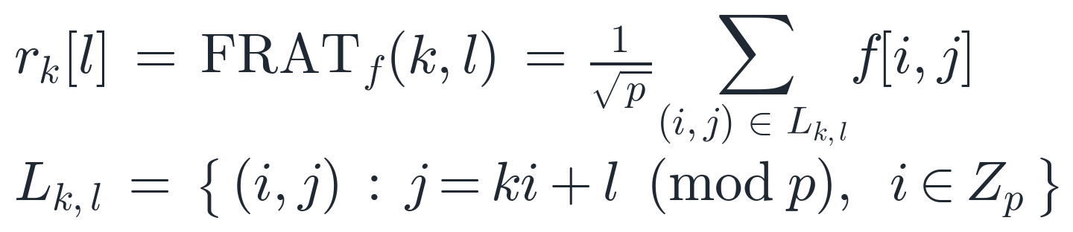
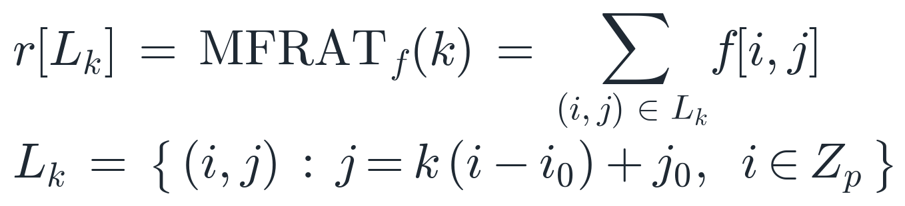
PAPER 2 · 2 & 3. WHAT FEATURES, AND HOW
From the finite Radon transform to MFRAT
Five deliberate changes — and giving up invertibility is what pays for all of them.
Five departures
The intercept l is dropped — lines are indexed only by direction, all passing through one centre.
Every direction gets the same pixel count, so responses are directly comparable.
1/√p is dropped and p need not be prime — legitimate, because MFRAT is no longer invertible.
Line width becomes adjustable (4 pixels in the experiments), matching thick principal lines and thin wrinkles.
The number of directions is freed from p — they use N = 6 on a 16 × 16 lattice.
FRAT: sum along lines of slope k and intercept l, modulo a prime p.
MFRAT: sum along lines through a chosen centre (i₀, j₀). No modulo, no intercept, no scaling.
The trade, stated plainly
FRAT is invertible; MFRAT is not. For verification that costs nothing — nobody needs to reconstruct the palm — and in exchange the operator becomes cheap, uniform and tunable. A well-argued trade, not a shortcut.
AI461 Advanced Biometric Systems and Security · Phase I : Literature Critique
18
Notes:
[~52 s · Speaker 3]
SAY
Here is the core of Paper 2. Top left, the finite Radon transform: sum the image
along straight lines indexed by a slope k and an intercept l, modulo a prime p —
classical, and invertible. Below it, MFRAT, which is what they use, and it
differs in five specific ways.
One: the intercept goes — every line passes through one chosen centre, so a line
is indexed only by its direction. Two: every direction gets exactly the same
number of pixels, so the six responses are comparable; under FRAT they are not,
because of the wrap-around effect. Three: they drop the one-over-root-p scaling
and the primality of p. Four: line width becomes a free parameter — four pixels.
Five: the number of directions is untied from p, and they use six.
IF ASKED
Why dropping the scaling and the primality is not vandalism: both requirements
exist to make the transform invertible, and MFRAT is not invertible anyway, so
the requirement is void. The paper says so itself, which is the honest part.
Our assessment, bottom box: they gave up invertibility. For verification that
costs nothing — you never reconstruct a palm from a template — and in return the
operator is cheap, uniform across directions and tunable. A well-argued
engineering trade.

Slide 19
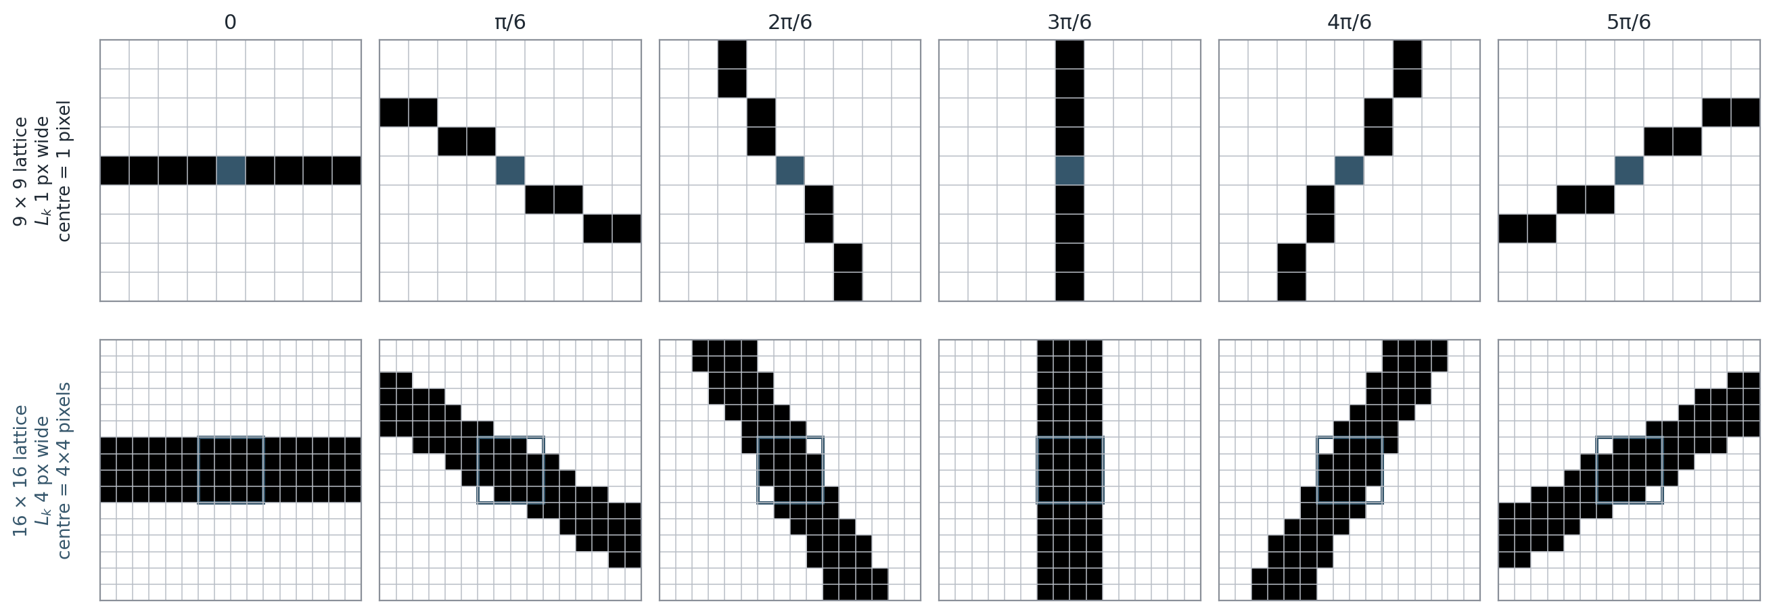
PAPER 2 · 2 & 3. WHAT FEATURES, AND HOW
Winner-take-all, and sub-sampling for free
Palm lines are darker than their background, so the winning direction is the one with the smallest sum.
The stored feature is the orientation map — for every centre, one integer in 1…6. No magnitude is kept anywhere.
Because palm lines are “negative lines”, darker than the surrounding skin, the correct extremum is argmin, not argmax.
Sub-sampling is intrinsic to the operator
One MFRAT lattice is 16 × 16 with 4-pixel-wide lines, so a 4 × 4 block of centres yields one label. A 128 × 128 ROI becomes a 32 × 32 code image — 16 pixels compressed to one label, with no separate pooling step at all. Contrast Paper 1, where the equivalent compression is a block mean that destroys the structure.
AI461 Advanced Biometric Systems and Security · Phase I : Literature Critique
19
Notes:
[~53 s · Speaker 3]
SAY
Place a 16-by-16 MFRAT lattice at a pixel. Six directions run through the
centre; sum the image along each — six integer sums. Equation 5 is the decision:
take the direction with the minimum sum and store its index. Not the value. The
index.
Why minimum? Palm lines are darker than the surrounding skin — the paper calls
them negative lines — so the line direction is the one whose sum is smallest.
Argmax would find the brightest direction, which is not a line at all; we made
exactly that mistake first time.
The result is one integer from one to six per centre, and no magnitude survives.
And because the lattice is sixteen wide with four-pixel lines, a whole
four-by-four block shares a label — so 128 by 128 becomes a 32-by-32 code image.
IF ASKED
That is the point we think is under-appreciated in the paper itself:
sixteen-to-one compression falls out of the operator's geometry, with no
separate pooling step at all.
Compare Paper 1, which compresses sixteen-to-one and worse — but by averaging,
which destroys the line structure it had just extracted. Here the compression
preserves what was measured.

Slide 20
PAPER 2 · 4. HOW THE FEATURES ARE TRAINED
Nothing is learned — the training set is enlarged
The inherited ROI can be rotated by about ±10°, and rotation changes the winning index itself.
Four ways to handle rotation. Three are rejected.
✗ Rotation-invariant features. Rejected — they discard the orientation information that is the feature.
✗ Estimate and correct the angle. Rejected as unreliable at this resolution.
✗ Rotate the probe at match time. Rejected — the cost lands on every single comparison.
✓ Enlarge the enrolled set. Each template is rotated by ±3°, ±6° and ±9°, giving 7 templates per palm; the best score over the seven wins.
Our reading
The reasoning is careful and the alternatives are argued down rather than ignored. But this is still a brute-force patch on an inherited defect: seven times the template storage, and seven times the matching work, to compensate for a preprocessing stage the paper did not write and does not fix.
It also only covers rotation. Translation is handled separately, by searching ±2 pixels at match time — 25 shifts per comparison.
And note the asymmetry with Paper 1: Han et al. augment to train a classifier; here augmentation replaces learning altogether.
-9°
-6°
-3°
0° (original)
+3°
+6°
+9°
Seven stored templates per palm — the enrolled sample and six rotated copies. Rotation is absorbed at enrolment, not at match time.
AI461 Advanced Biometric Systems and Security · Phase I : Literature Critique
20
Notes:
[~49 s · Speaker 3]
SAY
How are the features trained? They are not — no classifier, no fitted
parameters. But there is a problem, inherited from the preprocessing: the ROI
can be rotated by up to ten degrees. That is worse for an orientation code than
for a magnitude, because rotation changes which of the six directions wins — the
feature values themselves.
They consider four options and argue three down: invariant features would throw
away the orientation that is the signal; angle estimation is unreliable at this
resolution; rotating the probe at match time puts the cost on every comparison.
So instead, at enrolment they store the template rotated by plus and minus
three, six and nine degrees — seven templates, best of seven at match time.
IF ASKED
Our reading, in the box: the reasoning is careful, but this is still a
brute-force patch on a defect inherited from preprocessing they did not write —
seven times the storage and seven times the matching work. And it covers
rotation only; translation gets a separate plus-or-minus two pixel search,
twenty-five shifts per comparison.
One neat contrast with Paper 1: Han et al. also augment with shifts and
rotations, but they do it to train a classifier. Here augmentation is a
substitute for learning.

Slide 21
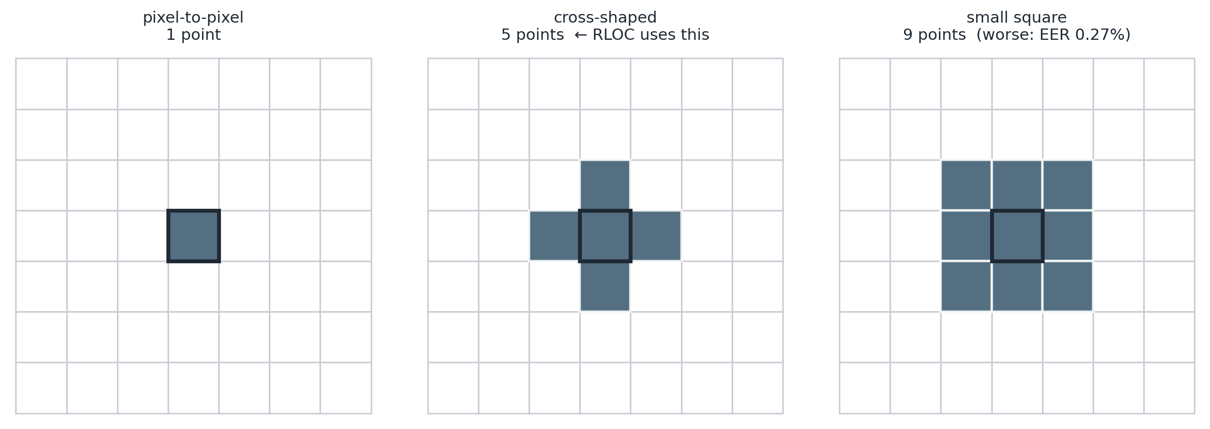
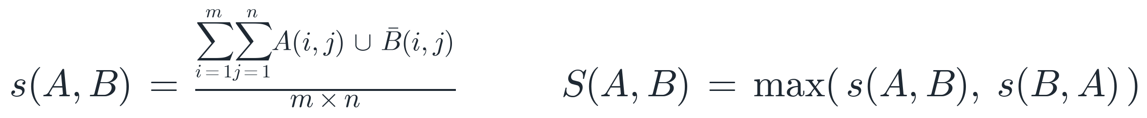
PAPER 2 · 5. CLASSIFICATION SCHEME
Relax the metric, not the representation
A pixel scores a hit if its code equals at least one code in a small area of the other image.
Pixel-to-pixel (the baseline) scores a hit only when the two codes are identical — 1 candidate.
Cross-shaped neighbourhood, the paper's choice: the centre plus its four neighbours — 5 candidates.
A 3 × 3 square — 9 candidates — is also tried, and is worse: EER 0.27% against 0.16%.
The score is symmetrised, S(A,B) = max(s(A,B), s(B,A)), and combined with a ±2 pixel translation search (25 shifts).
A notation slip
“∪” in Eq. (7) is redefined in the text to mean “equals at least one of” — not set union.
Why the bigger neighbourhood hurts — and why this is the cleverest idea in the paper
Nine chances to match is enough that impostors start matching too: tolerance rises, discrimination falls. The cross is the point where the trade turns. Compare Paper 1, which buys the same tolerance by averaging the features away. Here the representation stays sharp and the metric gives way.
AI461 Advanced Biometric Systems and Security · Phase I : Literature Critique
21
Notes:
[~56 s · Speaker 3]
SAY
Classification. There is no classifier — a distance and a threshold. But the
distance is where the paper earns its title.
Baseline: compare code images pixel against pixel and count agreements. The
problem is that a residual one-pixel shift makes a genuine pair disagree
everywhere. Their fix, in the figure: a pixel in A counts as a match if its code
equals the code at any of a small set of positions in B. One candidate is the
baseline; five — a cross — is what they adopt; nine, a three-by-three square, is
also tried.
And nine is worse: 0.27 per cent against 0.16. Give a pixel nine chances and
impostors start matching too — tolerance up, discrimination down.
Bottom left: both papers must tolerate misalignment. Paper 1 blurs the
representation; Paper 2 relaxes the metric and keeps the representation sharp.
IF ASKED
A warning for reimplementers: the union symbol in Equation 7 is not set union.
The text redefines it to mean "equals at least one of".
The contrast in full: Paper 1 averages features into block means, destroying
line structure; Paper 2 keeps the full 32-by-32 code and widens the match
neighbourhood instead. Same goal, opposite method, and only one of them throws
information away.

Slide 22
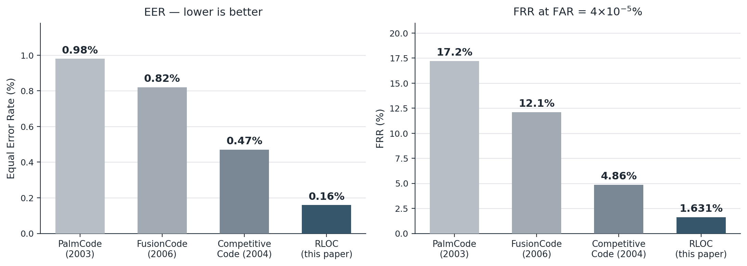
PAPER 2 · RESULTS
0.16% EER, against three published baselines
A public database, full FAR/FRR sweeps, ROC curves and a four-experiment ablation — a different standard of evidence from 2003.
Speed (Table 6)
Preprocessing 316 ms — by far the dominant cost, and not theirs.
RLOC extraction 70 ms against Competitive Code's 220 ms — the 3× claim.
Matching 3.9 ms per comparison.
A negative result, reported
The 3 × 3 neighbourhood is worse than the cross (0.27% against 0.16%) and the paper says so. Paper 1 reports no failed variant anywhere.
Table 5. Equal error rate, and false reject rate at FAR = 4 × 10⁻⁵%. All four methods on the same database and the same protocol.
What the evidence still does not settle
All four methods are evaluated on one database, from the group that supplies the third author, so cross-sensor generalisation is untested. The illumination robustness that motivates the whole design is never measured — the database is one controlled device. And the baseline numbers are taken from the literature, not re-run here.
AI461 Advanced Biometric Systems and Security · Phase I : Literature Critique
22
Notes:
[~33 s · Speaker 3]
SAY
Table 5, redrawn: four methods, one database, one protocol. PalmCode 0.98 per
cent EER, FusionCode 0.82, Competitive Code 0.47, RLOC 0.16. The pale bars are
false reject at a very strict operating point, and there the gap is dramatic —
4.9 per cent of genuine users rejected against 1.6.
Speed: extraction 70 milliseconds against 220 — a fair claim. But preprocessing
is 316 milliseconds, four times the extraction cost and not their code, so the
end-to-end saving is far smaller than three times.
IF ASKED
That nuance is in the paper's own table, but not in its abstract.
Two things to admire: they report a variant that failed — the three-by-three
neighbourhood is worse, and they say so — and they compare against three
published methods on a public database, which Paper 1 structurally could not do.
Two things still missing, at the bottom of the slide: one database, from the
third author's own group, so nothing is known about cross-sensor generalisation;
and the illumination robustness that motivated the entire design is never
measured, because there is only one controlled capture device.
This is one of the three slides to compress if we are running behind.

Slide 23
SYNTHESIS
The five mandated axes, side by side
Same problem, same journal, five years apart — and almost every design decision is reversed.
 | Paper 1 · Han et al., 2003 | Paper 2 · Jia et al., 2008
1 Acquisition | Own database. Peg-free UMAX flatbed scanner, 100 dpi, 845 × 829. 50 persons × 30 images over 3 weeks; 10 enrolled, 20 tested. Own preprocessing: threshold, border trace, wavelet corner detection, geometric ROI. | None. Public PolyU database — 386 palms, 7,752 images, pegged CCD, 75 dpi. ROI supplied by Zhang et al.'s published algorithm. Only the first sample per palm enrolled.
2 What features | Magnitude. Block means of an edge-energy map, from 4-direction Sobel or from a morphological alternating sequential filter. Real-valued, 64–1024 numbers. | Orientation. One integer in 1…6 per lattice centre — the index of the MFRAT direction with the smallest sum. A 32 × 32 integer code image.
3 How extracted | Convolve with 4 oriented masks, take the maximum across directions (Eq. 1), then average over a uniform grid at 32×32, 16×16 or 8×8. | Sum along 6 line directions through each centre, take the minimum across directions (Eq. 5), store the winning index. Sub-sampling is intrinsic to the 16 × 16 lattice.
4 How trained | Two schemes. Per-user threshold by leave-one-out cross-validation (best 0.38); and one BPNN per user, 80–40–1, scaled conjugate gradient, with bootstrap shift/rotate augmentation, 9,800 samples per epoch. | Nothing is learned. The enrolled set is enlarged instead: each template rotated by ±3°, ±6°, ±9° → 7 templates per palm, to absorb the ±10° inherited from preprocessing.
5 Classification | Multi-template matching on Pearson correlation, distance 1 − R, compared against a per-user threshold; or the per-user network's single output. | Pixel-to-area matching — a code matches if it equals any code in a cross-shaped 5-point neighbourhood — plus a ±2 pixel translation search. One global threshold.
Evidence | Accuracy, FAR and FRR at one operating point. No EER, no ROC, no baseline method, no ablation. 50 subjects. | EER, ROC, FRR at fixed FAR, timings, three published baselines and a four-experiment ablation including a variant that fails. 386 palms.
AI461 Advanced Biometric Systems and Security · Phase I : Literature Critique
23
Notes:
[~36 s · Speaker 4]
SAY
This is the table the brief asks for: the same five questions, both papers. I
will not read it — three takeaways.
Row two is the deep difference. Paper 1's feature is a real-valued magnitude,
Paper 2's an integer orientation index. Not a refinement — a different kind of
quantity.
Row three shows how, with almost comic symmetry: both probe with a bank of
oriented operators; Han takes the maximum, Jia the minimum.
Row four surprised us — 2003 trains a network per user, 2008 learns nothing at
all.
IF ASKED
The last row is not a design axis at all; it is a standard of evidence, and it
is where the two papers differ most.
On row four: I argue on slide 28 that the apparent step backwards is a
considered response to a constraint Paper 1 never faced — with one enrolled
sample per palm, nothing user-specific can be fitted.

Slide 24
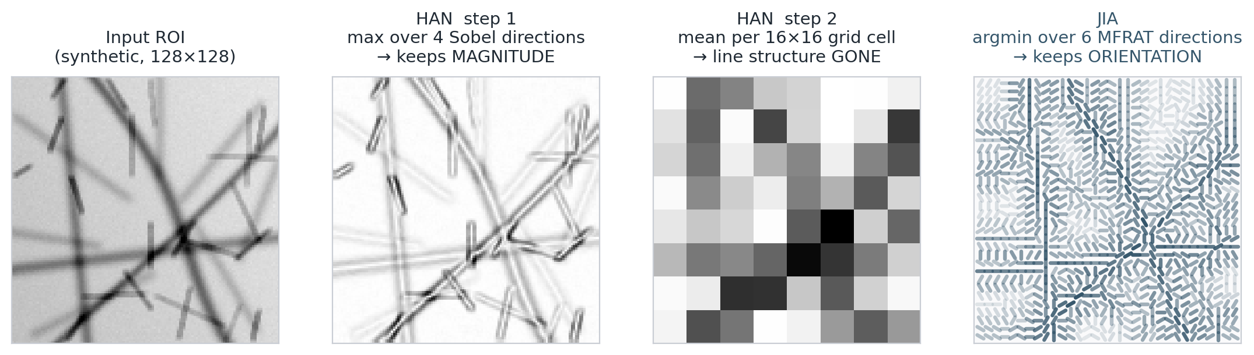
SYNTHESIS
One decision explains almost everything else
Both papers take an extremum across oriented operators — then keep opposite halves of the answer.
Illumination
An index is an order statistic: rescale the image and the ranking of directions holds. A magnitude scales with contrast.
The next step
A magnitude map still needs pooling, and pooling destroys the lines. An index map is already compact — 16 pixels, one label.
Alignment
Han buys tolerance by blurring the features. Jia buys it by relaxing the metric, keeping a full 32 × 32 map.
Cost
Sobel needs multiply-accumulate per mask; MFRAT is integer summation along lines — 70 ms against 220.
AI461 Advanced Biometric Systems and Security · Phase I : Literature Critique
24
Notes:
[~42 s · Speaker 4]
SAY
If you remember one slide, this one — our own reimplementation of both pipelines
on the same synthetic palm. Panel one, the input. Two, Han's Equation 1, the
maximum over four Sobel directions: crisp lines. Three, the same map after Han's
grid averaging — the lines are gone. Four, Jia's orientation code, coloured by
which of six directions won.
Both papers diverge at one line of code. Han takes the max and keeps the value,
discarding which direction won. Jia takes the min and keeps the index,
discarding the value. Opposite halves of the same answer — and the four boxes
are what follows.
IF ASKED
The four consequences in full. Illumination: an index is an order statistic, so
rescaling contrast does not change it, while a magnitude scales directly with
contrast — Paper 2 gets robustness free, as a property of the representation.
Next step: a magnitude map is real-valued and large so it must be compressed,
and averaging is what destroys the lines; an index map is already compact.
Alignment: Han blurs the features, Jia relaxes the metric and keeps the full
32-by-32 map. Cost: Sobel needs multiply-accumulate per mask, MFRAT is integer
addition along a line — 70 milliseconds against 220.
So the five years between these papers are not really about better filters.
They are about realising which half of the extremum was the informative half.

Slide 25
CRITIQUE · PAPER 1
Han et al. — what it gets right, and what it costs
A well-engineered front end, and an under-examined back end.
Advantages
Peg-free capture on commodity hardware, with invariance solved in software — a genuinely user-friendly design in 2003.
Wavelet-based corner detection is an elegant answer to a noisy problem: corners as local minima between zero-crossings, not thresholded curvature.
The ROI is defined entirely from hand landmarks, so it scales and rotates with the hand.
Per-user thresholds fitted by cross-validation — ahead of the common practice of one global threshold.
Time-separated data: three sessions across three weeks, not one sitting.
Disadvantages
Pooling undoes the extraction. Careful oriented features are averaged into block means; the classifier never sees a line.
Orientation is discarded by Eq. (1) — the single most informative quantity, as Paper 2 demonstrates.
No EER, no ROC, no baseline. Results cannot be placed against any other method, then or now.
The BPNN comparison is confounded: classifier, feature vector and data augmentation all change together, with no ablation.
One network per user does not scale, needs other users' data at enrolment, and is impossible with a single enrolled sample.
50 subjects, one scanner, and a threshold fixed at 70 on the argument that the environment is controlled — robustness is never tested.
AI461 Advanced Biometric Systems and Security · Phase I : Literature Critique
25
Notes:
[~40 s · Speaker 4]
SAY
Our verdict on Paper 1 — fair before critical. The front end is good: peg-free
capture with invariance solved in software is the choice the field eventually
made; the wavelet corner detector is elegant; the ROI is built entirely from
hand landmarks; per-user thresholds were ahead of practice; and they collected
across three weeks, not one sitting.
The costs. The first two are the same wound: Equation 1 discards orientation,
then grid pooling averages away what is left — the careful front end never
reaches the back end. Then evidence: no equal error rate, no ROC, no published
baseline.
IF ASKED
The remaining costs on the slide. The BPNN result is confounded — classifier,
features and augmentation all change at once with no ablation, so "the network
is better" is not established. The per-user network does not scale and cannot
work from a single enrolled sample. And the whole thing rests on 50 subjects,
one scanner, and a threshold hard-coded at 70, justified only by saying the
environment is controlled.

Slide 26
CRITIQUE · PAPER 2
Jia et al. — what it gets right, and what it costs
Disciplined design and exemplary evidence — with a headline that overstates the headline contribution.
Advantages
Every change answers a named defect, and the alternatives are argued down rather than ignored.
Dropping invertibility is honest and correctly reasoned — it is what licenses removing 1/√p and the primality of p.
Orientation coding buys illumination robustness for free, as a property of the representation rather than a preprocessing step.
Sub-sampling is intrinsic to the operator, so compression costs no structure.
Public database, three published baselines, ROC curves, timings, and a four-experiment ablation — including a variant that fails, and is reported.
Cheap: integer summation, 70 ms against 220 ms.
Disadvantages
The gain is mostly not MFRAT — see the next slide. The abstract's framing does not match its own ablation.
Rotation is patched, not solved: 7× template storage and 7× matching work to absorb an inherited ±10°.
Two hyper-parameters are unexplained — why 6 directions, why a 16 × 16 lattice. No sensitivity study.
Illumination robustness is never measured, although it motivates the design; the database is one controlled device.
One database, supplied by the third author's own group — no cross-sensor evidence.
Baselines are quoted from the literature, not re-run, and timings come from a single machine.
AI461 Advanced Biometric Systems and Security · Phase I : Literature Critique
26
Notes:
[~38 s · Speaker 4]
SAY
Paper 2 is the better paper, and it is worth saying why. Every design change
answers a defect the paper has already named, and alternatives are argued down
rather than quietly skipped. Dropping invertibility is honest and correctly
reasoned. Orientation coding gives illumination robustness as a property of the
representation, not a patch. Sub-sampling falls out of the lattice geometry. And
the evidence is a different world: public database, three baselines, ROC curves,
timings, a four-experiment ablation, and a reported failure.
The biggest cost is the next slide, so I will hold it.
IF ASKED
The other costs on the slide. Rotation is patched rather than solved — seven
times the storage and matching work, to absorb an error inherited from
preprocessing they did not write. Two consequential hyper-parameters are simply
asserted: six directions and a 16-by-16 lattice, neither with a sensitivity
study. Illumination robustness is the stated motivation and is never measured,
because there is one capture device. One database, from the third author's own
group; baselines quoted from the literature rather than re-run; timings from a
single machine.
This is one of the three slides to compress if we are running behind.

Slide 27
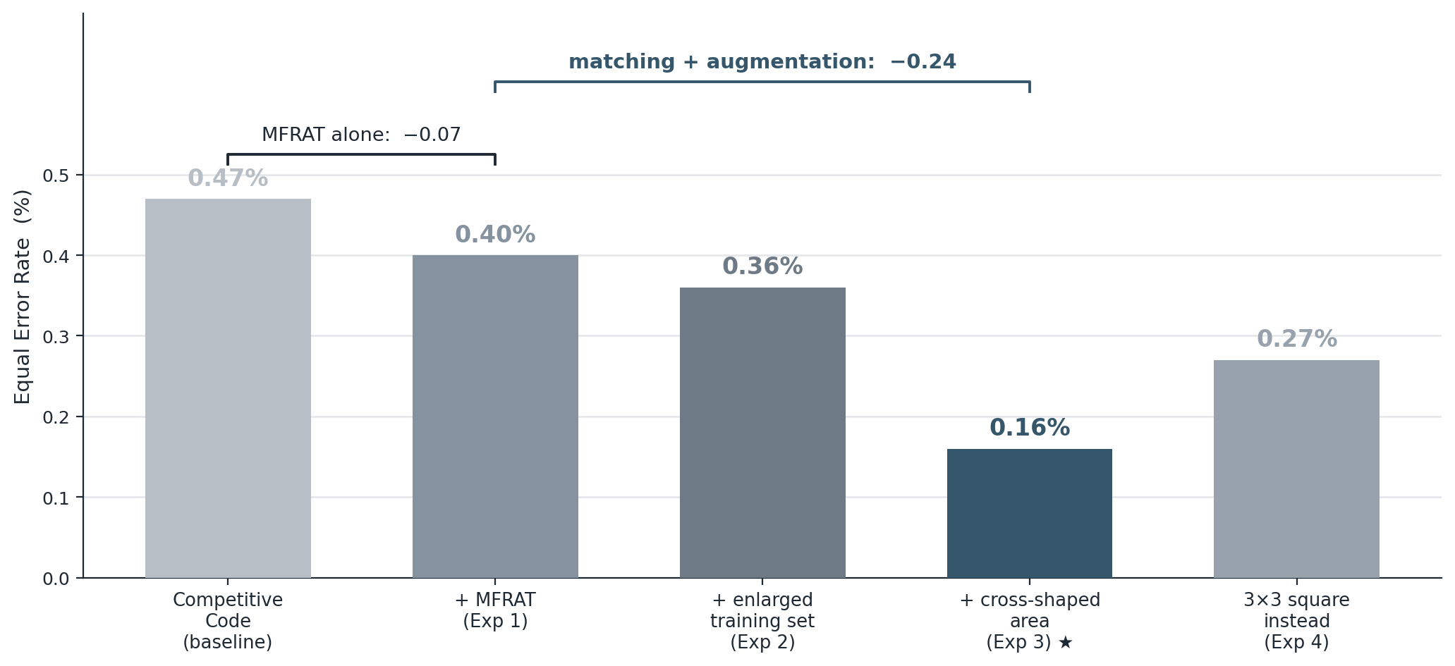
CRITIQUE · OUR OWN READING
Most of the gain is not from MFRAT
Experiment 1 is the only like-for-like comparison of MFRAT against Gabor — and it is worth 0.07 points of EER.
Experiment 1 isolates MFRAT. Pixel-to-pixel matching, no enlarged set — the same conditions Competitive Code was measured under. 0.40% against 0.47%.
So swapping Gabor for MFRAT is worth about 0.07 points — 15% of the 0.31-point improvement the paper reports.
The rest comes from the enlarged training set (0.40 → 0.36) and the cross-shaped neighbourhood (0.36 → 0.16). Neither is specific to MFRAT.
Table 4, redrawn. Each experiment adds one component to the one before it.
The missing experiment
Apply the enlarged training set and pixel-to-area matching to Competitive Code. Both are matching-and-enrolment techniques, entirely independent of which filter produced the codes. Until someone runs that, the fair claim is not “MFRAT beats Gabor” but “MFRAT is as accurate as Gabor and three times cheaper, and these two matching tricks are worth a lot to any orientation code.” To be clear, the paper's own Table 4 is what makes this visible — the ablation is honest; the framing around it is not.
AI461 Advanced Biometric Systems and Security · Phase I : Literature Critique
27
Notes:
[~43 s · Speaker 4]
SAY
This is our own contribution, so I will be precise. Table 4 is the paper's
ablation. Experiment 1 is MFRAT with plain pixel-to-pixel matching and no
enlarged training set: EER 0.40 per cent — measured under the same conditions as
Competitive Code's 0.47. That is the only clean, like-for-like comparison of
MFRAT against Gabor filtering in the paper, and the difference is 0.07 points of
the 0.31-point headline gain. So the filter swap the title is about accounts for
roughly fifteen per cent of the improvement.
The rest comes from the enlarged training set and the cross-shaped
neighbourhood — and neither has anything to do with MFRAT.
IF ASKED
The steps in full: Experiment 2 adds the enlarged training set, 0.40 to 0.36;
Experiment 3 adds the cross-shaped neighbourhood, 0.36 to 0.16 — that step alone
is more than half the total improvement. Both are enrolment and matching
techniques you could apply to Competitive Code tomorrow, and that experiment is
not in the paper.
So the claim we would defend is not "MFRAT beats Gabor". It is: MFRAT is about
as accurate as Gabor and three times cheaper, and these two matching tricks are
worth a great deal to any orientation code.
In fairness, we can only say this because the authors published Table 4. The
ablation is honest; it is the framing around it that overstates.

Slide 28
SYNTHESIS
What five years actually changed
Real progress in representation and in evidence — and one genuine counter-trend.
Improved
Feature magnitude → orientation index
Extremum max, value kept → min, index kept
Compression block averaging → intrinsic to the lattice
Misalignment blur the features → relax the metric
Cost Gabor/Sobel floating point → integer sums, 3× faster
Data own 50 subjects → public 386 palms, 7,752 images
Metrics accuracy at one point → EER, ROC, FRR at fixed FAR
Comparison none → three published baselines and an ablation
Did not improve, or regressed
Learning went backwards. 2003 trains a per-user network; 2008 learns nothing. Defensible — one enrolled sample makes per-user training impossible — but it is still a capability given up.
Neither paper solves alignment. Han augments and pools; Jia stores 7 rotations and searches 25 shifts. Both are compensations for a preprocessing stage neither fixes.
Robustness is asserted, never measured, in both papers — one capture device each.
Both hard-code parameters without study: threshold 70 and four directions in 2003; six directions and a 16 × 16 lattice in 2008.
AI461 Advanced Biometric Systems and Security · Phase I : Literature Critique
28
Notes:
[~28 s · Speaker 4]
SAY
Summing up the five years. Left column, real progress: the representation
changed kind; compression became a property of the operator instead of a
destructive extra step; misalignment moved from the representation to the
metric; cost fell threefold; and the evidence changed completely. Right column,
what we would push back on today: learning went backwards, neither paper solves
alignment, robustness is asserted and measured in neither, and both hard-code
consequential parameters.
IF ASKED
On learning: 2003 trains a network per user, 2008 learns nothing. It is
defensible — with one enrolled sample you cannot fit anything user-specific —
but a capability was given up, and with hindsight that is the thread the field
picked up again later.
On alignment: Han augments and pools; Jia stores seven rotations and searches
twenty-five shifts. Both are compensations for a preprocessing stage neither
paper fixes.
On evidence: from fifty self-collected subjects and a single accuracy figure, to
a public database, EER, ROC curves, false reject at a fixed false accept, three
published baselines and an ablation.

Slide 29
SYNTHESIS
What we would want to see next
Questions neither paper answers, and which shaped how we read them.
Separate the tricks from the operator.
Run the enlarged training set and pixel-to-area matching on Competitive Code. That single experiment would settle how much MFRAT is really worth.
Measure the robustness that is claimed.
Both papers argue from illumination and alignment. Neither varies either. A controlled sweep of contrast, exposure and imposed rotation would test the central argument directly.
Report the preprocessing failure rate.
Everything downstream assumes the ROI was found. Neither paper says how often it is not, nor what happens then.
Fuse the two halves of the extremum.
Han keeps the magnitude, Jia keeps the index. Nobody in either paper keeps both — and magnitude is a natural confidence weight for a code.
Cross-sensor evaluation.
One scanner in 2003, one CCD device in 2008. Neither tells us what happens when the sensor changes.
Justify the hyper-parameters.
Six directions, a 16 × 16 lattice, a threshold of 70, four Sobel masks — all consequential, none studied.
AI461 Advanced Biometric Systems and Security · Phase I : Literature Critique
29
Notes:
[~23 s · Speaker 4]
SAY
Six things we would want, each from a specific gap. Most important: separate the
matching tricks from the operator — one experiment would settle what MFRAT is
actually worth. Then measure the robustness both papers argue from; report the
preprocessing failure rate; and fuse the two halves, using magnitude as a
confidence weight on the orientation code.
IF ASKED
The fifth and sixth are cross-sensor evaluation and justification of the
hyper-parameters.
On fusion — the one we find most interesting: Han keeps the magnitude, Jia keeps
the index, and nobody keeps both. Magnitude is a natural confidence weight — a
strong response means the winning direction is trustworthy, a weak one means it
is noise. Weighting the code match by magnitude is the obvious experiment
neither paper runs, and later orientation-code work does move in this direction.

Slide 30
REFERENCES
Sources
Primary sources read in full; supporting works are listed as cited within them.
Primary sources
[1] C.-C. Han, H.-L. Cheng, C.-L. Lin, K.-C. Fan. Personal authentication using palm-print features. Pattern Recognition 36 (2003) 371–381.
[2] W. Jia, D.-S. Huang, D. Zhang. Palmprint verification based on robust line orientation code. Pattern Recognition 41 (2008) 1504–1513.
Supporting works, as cited within the two papers
D. Zhang, W.-K. Kong, J. You, M. Wong. Online palmprint identification. IEEE TPAMI 25 (2003) — PalmCode, and the ROI extraction and PolyU database used by Paper 2. [1] in Paper 2
A.W.-K. Kong, D. Zhang. Competitive coding scheme for palmprint verification. — the method Paper 2 sets out to improve. [14,15] in Paper 2
M. Matus, J. Flusser. Image representation via a finite Radon transform. — the FRAT that MFRAT modifies. [18] in Paper 2
M.F. Møller. A scaled conjugate gradient algorithm for fast supervised learning. — the BPNN training algorithm of Paper 1. [15] in Paper 1
H.A. Rowley, S. Baluja, T. Kanade. Neural network-based face detection. — the source of Paper 1's 80–40–1 architecture and bootstrap strategy. [13] in Paper 1
C.-L. Lin, T.C. Chuang, K.-C. Fan (2005) — Han's group's later line-feature work, cited by Paper 2. [6] in Paper 2
PolyU Palmprint Database, Hong Kong Polytechnic University — the benchmark of Paper 2. [20] in Paper 2
AI461 Advanced Biometric Systems and Security · Phase I : Literature Critique
30
Notes:
[~8 s · Speaker 4]
SAY
Our two primary sources, read in full, and the supporting works cited as they
appear inside those two papers.
IF ASKED
We deliberately did not reconstruct volume and page numbers we had not verified
ourselves, so supporting works carry the reference number they have in the
source paper.
Two links worth pointing out. Reference 1 of Paper 2 — Zhang, Kong, You and
Wong, PAMI 2003 — does triple duty: it is PalmCode, one of the baselines; it is
the ROI extraction algorithm Paper 2 borrows; and it is the source of the PolyU
database. And Matus and Flusser is the original finite Radon transform that
MFRAT modifies.

Slide 31
AI461 · PHASE I · LITERATURE CRITIQUE
Thank you
In one sentence
Both papers probe the palm with a bank of oriented operators and take an extremum across directions. The five years between them are the story of learning which half of that answer to keep.
Questions welcome.
Han, Cheng, Lin & Fan (2003) · Jia, Huang & Zhang (2008) · Pattern Recognition
Notes:
[~17 s · Speaker 4]
SAY
To close: both papers take an extremum over a bank of oriented operators, and
the five years between them are about learning which half of that answer to
keep. Thank you — we are happy to take questions.
IF ASKED
--- Q&A ammunition ---
Why min and not max? Palm lines are darker than the surrounding skin — the paper
calls them negative lines — so the line direction is the one with the smallest
sum along it. Max would find the brightest direction, which is not a line.
Why is MFRAT not invertible, and why is that acceptable? Dropping the intercept
l means many distinct images give the same six sums per centre — information is
destroyed by construction. It is acceptable because verification never
reconstructs the palm, and it is exactly what licenses removing the
one-over-root-p scaling and the primality of p.
Why does a larger matching neighbourhood hurt? Nine candidate positions give
impostor pixels nine chances to agree as well. Tolerance rises, discrimination
falls, and past the cross the second effect dominates: 0.27 per cent against
0.16.
Is Han's 98 per cent comparable with Jia's 0.16 per cent EER? No, and the
non-comparability is itself one of our findings. Different databases, different
protocols, different quantities — one is accuracy at a single operating point on
50 self-collected subjects, the other an equal error rate over millions of
impostor comparisons on a public database.
Where do the 7,366 and 2.8 million comparison counts come from? Our own
arithmetic from the protocol: 7,752 images minus 386 enrolled leaves 7,366
probes, each matched against its own palm and the other 385. The paper reports
rates, not counts.
Which would we implement? RLOC. No per-user training, works from a single
enrolled sample, integer-only, and a public benchmark to check against. Han's
method needs ten enrolled samples per person and a network per user.
What would we add? Weight the code match by MFRAT response magnitude — the one
thing neither paper keeps.

