Slide 1
Reinforcement Learning using EEG Signals
for Therapeutic Use of Music in Emotion Management
Sahil Nagwani
Vishal Gautam
PRAKRITI Manhar
U23AI106
U23AI127
U23AI114
Department of Artificial Intelligence | SVNIT Surat
Base Paper: Dutta et al. (2020) IEEE EMBC • Extended with SARSA, Double Q-Learning, Double SARSA, Reward Shaping Analysis
DEAP Dataset • 32 Subjects • 4 RL Algorithms • 3000 Episodes • LOSO Cross-Validation • 10-Fold Grid Search

Slide 2
Why This Research Matters — The Clinical Motivation
~280M
Music Rx
EEG
RL
People worldwide
suffer from depression
Therapy shown to reduce
depressive symptoms
Objective, non-invasive
brain-state measurement
Learns optimal playlists
without user feedback
The Core Problem
Depressed individuals are drawn to sad music, reinforcing negative emotional states (Garrido & Schubert, 2013)
Manual playlist curation is subjective — patients may unknowingly choose emotionally harmful music
Traditional RL for playlists uses pause/skip/replay feedback which is unreliable for depressed users
EEG captures involuntary emotional responses to music — bypassing self-report bias entirely
Need: A closed-loop system that reads EEG → identifies emotion → selects next clip → guides to 'happy'
Challanges : Emotions are subjective and continuous and also playlist must be shorter (6)clips ,
Approach: Model emotions on a 2D Valence–Arousal wheel Agent selects music clips as actions Minimize angular error to target Based on Dutta et al. 2020

Slide 3
DEAP Dataset & Emotion Space
DEAP Dataset Overview
8 Emotion Groups (from 15 GEW emotions)
32 participants, each watched 40 × 1-min music video clips
Happy (High V, High A)
Exciting (High V, High A)
EEG recorded at 128 Hz across 32 scalp electrodes
Pleasant (High V, Low A)
Calm (High V, Low A)
Self-reported Valence, Arousal, Dominance, Liking (1–9 scale) per clip
Sad (Low V, Low A)
Negative (Low V, Low A)
Preprocessed valence & arousal used directly in this work
Anger (Low V, High A)
Fear (Low V, High A)
40 clips × 32 subjects = 1280 state-action observations
Emotion-transition pairs extracted from consecutive clip responses
State Space: 20×20 Valence-Arousal Grid = 400 Discrete States
Valence axis (x): −1 to +1, normalized → 20 bins. Positive = pleasant emotions; Negative = unpleasant.
Arousal axis (y): −1 to +1, normalized → 20 bins. High = excited/angry; Low = calm/sad.
Target state: 'Happy' → normalized VA = [0.905, 0.425] → bin (18,12) in the 20×20 grid
Start state: 'Anger' → Low Valence, High Arousal → upper-left quadrant of GEW
Each clip rated on: Valence (1–9), Arousal (1–9), Dominance, Liking

Slide 4
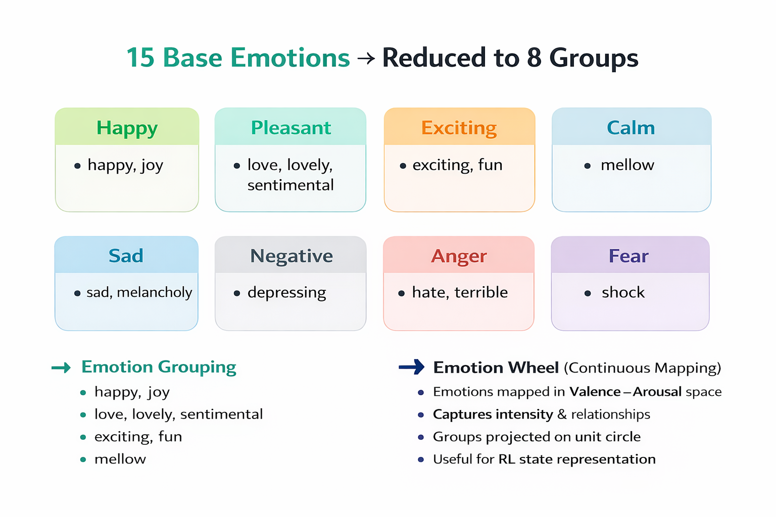
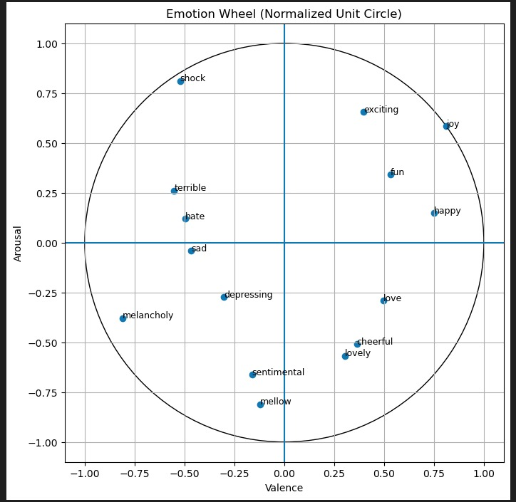
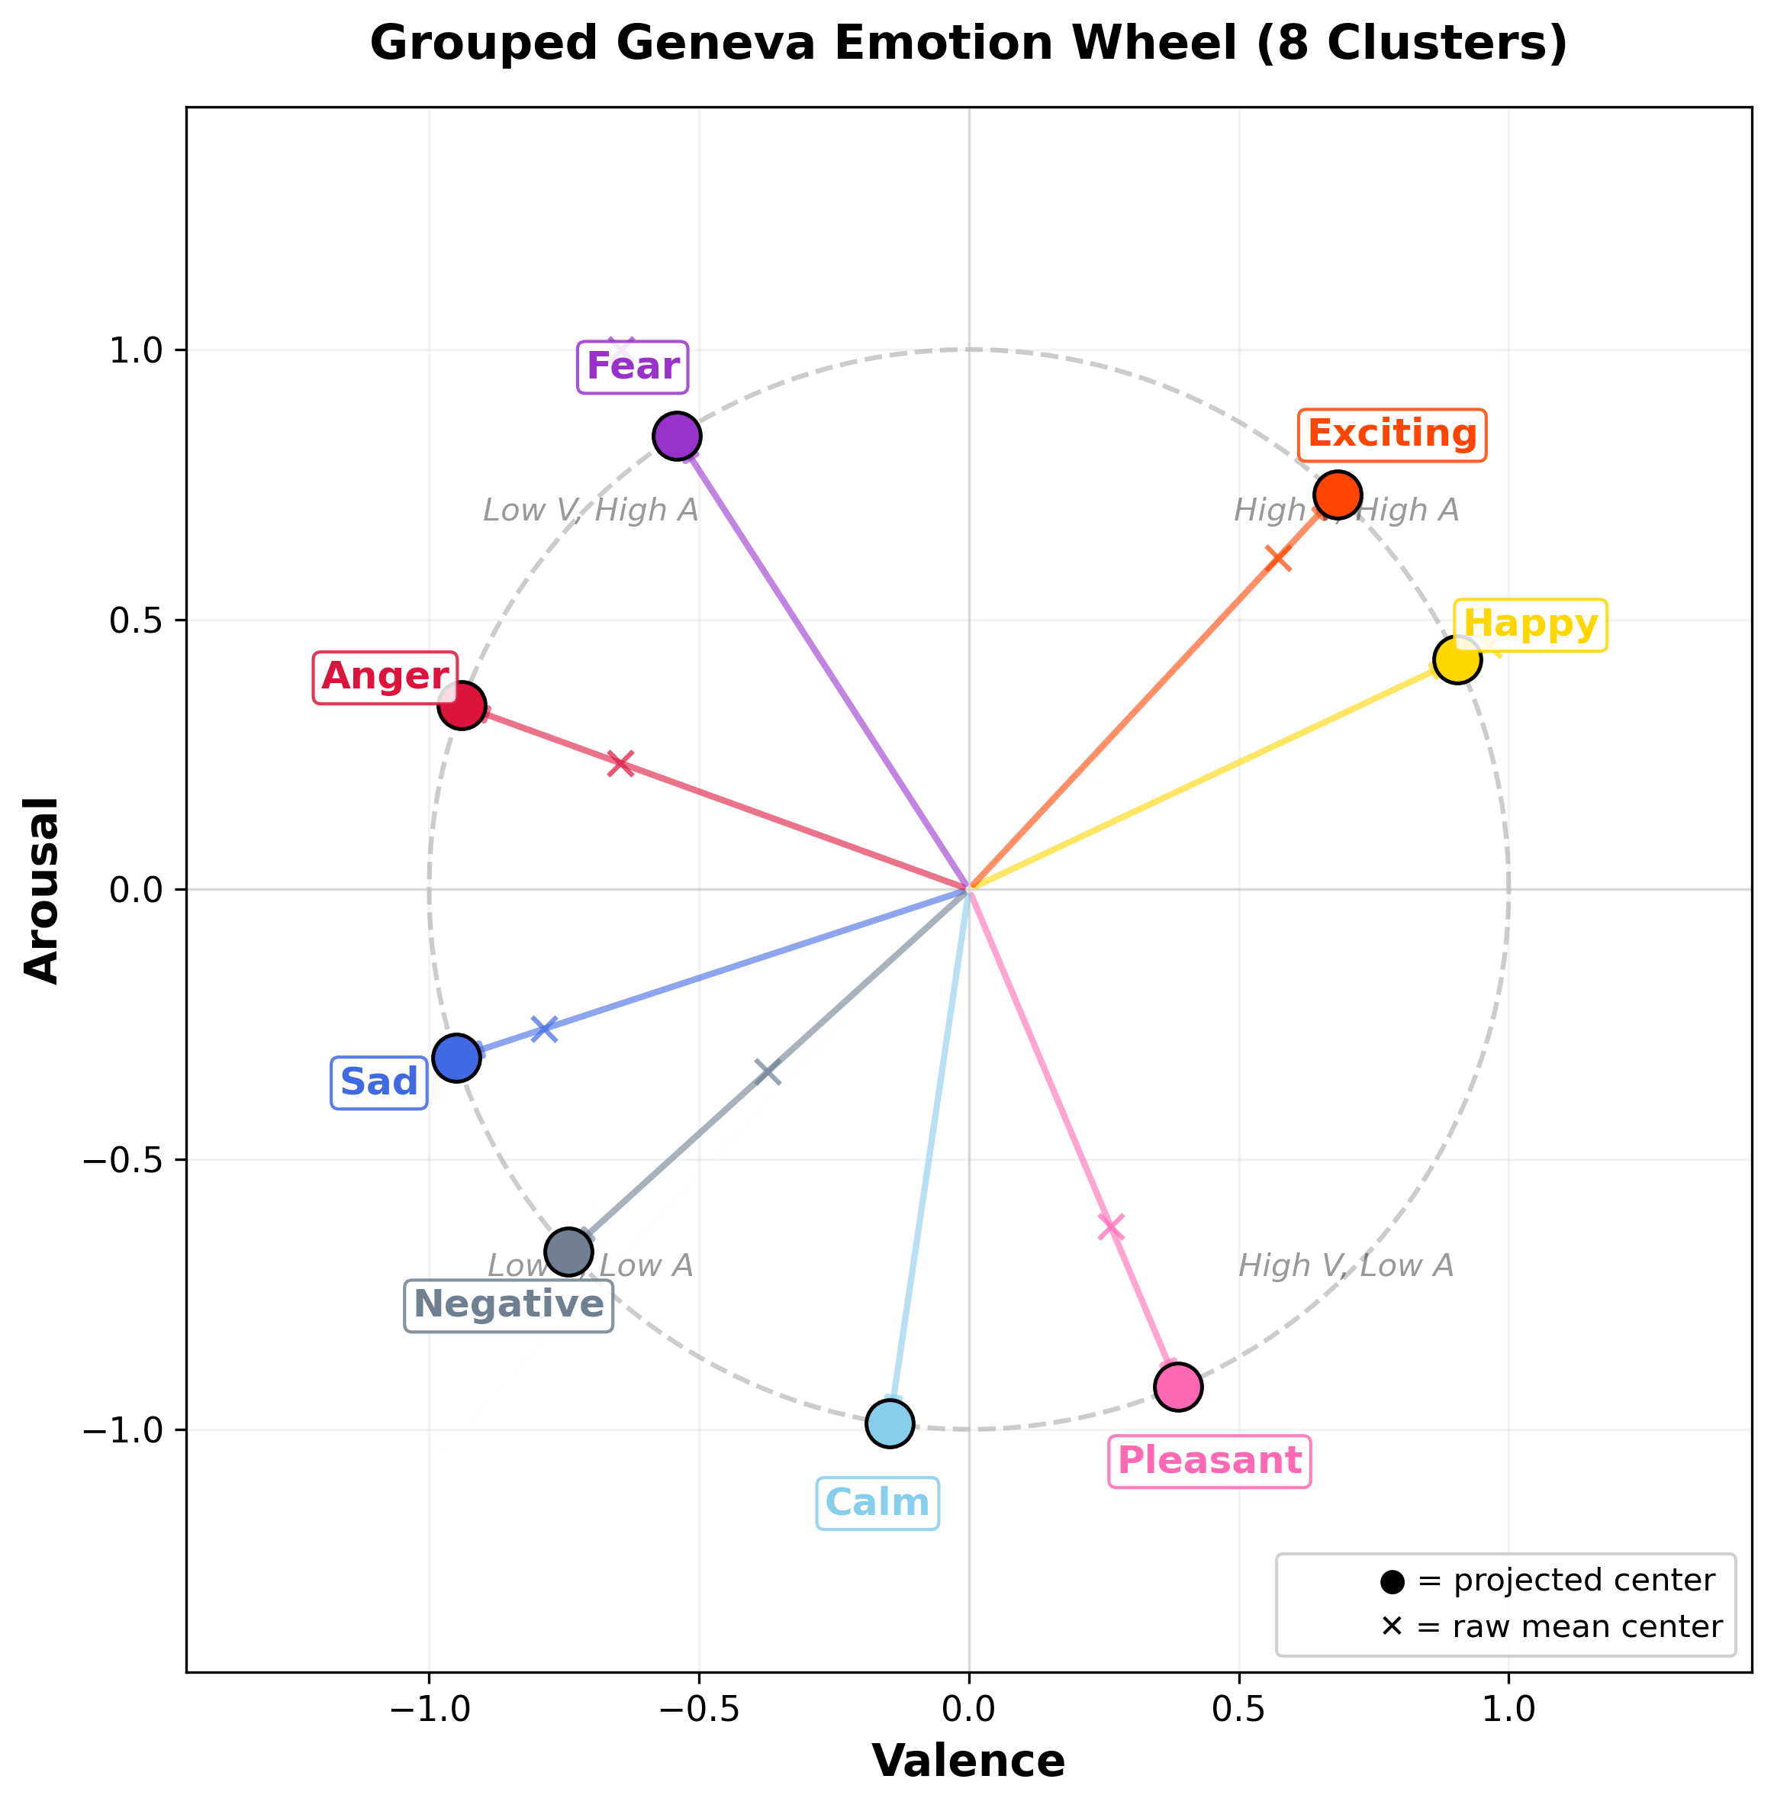
Geneva Emotion Wheel (GEW) — Emotion Space Visualization

Slide 5
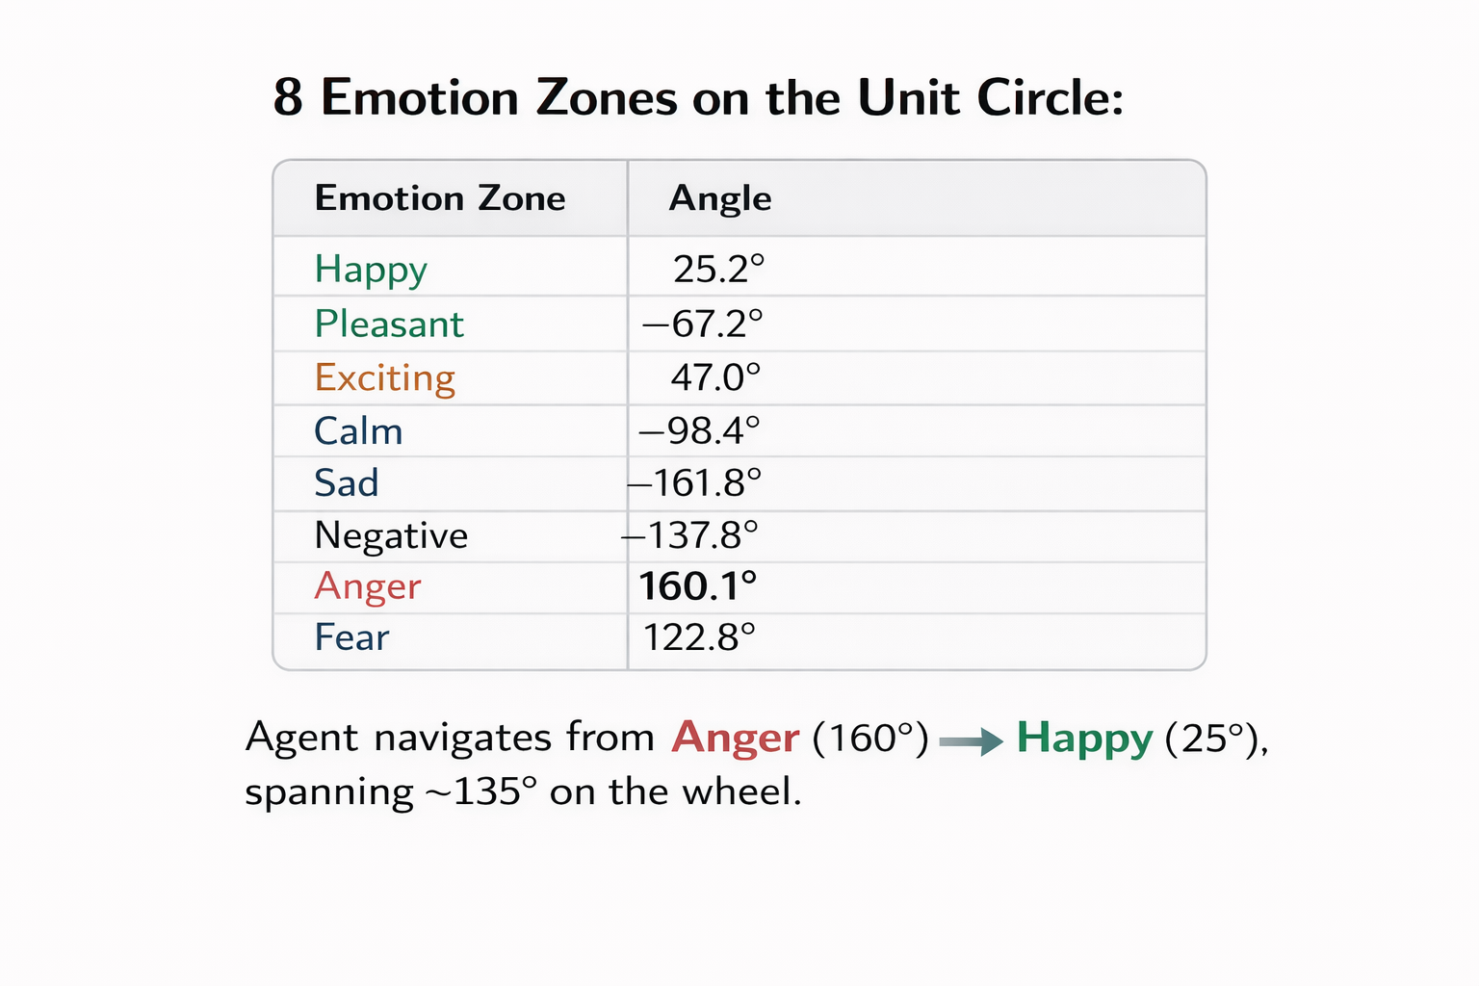
Geneva Emotion Wheel (GEW) — Emotion Space Visualization
High Arousal
Journey:
Anger → Happy
Anger
Exciting
Fear
Happy ★
High
Valence
Low
Valence
Negative
Pleasant
Sad
Calm
Low Arousal

Slide 6
MDP Formulation — State, Action, Transition & Reward
State Space |S| = 400
Action Space |A| = 40
Transition Function τ(s,a)
20×20 discretized VA grid
Each cell = one emotional region
State s = (valence_bin, arousal_bin)
Current emotion as 2D GEW vector
Start: anger (Low V, High A)
Target: happy [0.905, 0.425]
Each action = one music clip
40 clips from DEAP dataset
Each clip has (valence, arousal)
Action induces emotion transition:
τ(s,a) = v_s + v_a → new state
Result clipped to [-1, +1]
s' = τ(s, a) = v_s + v_a
Vector addition in VA space
Non-deterministic across subjects
LOSO: learned from 31 subjects
Tested on 1 held-out subject
32 independent LOSO evaluations
Reward Function Design
Base Reward: r(s,a) = 1 if θ(s,a) ≤ 180° (clip moves emotion toward target), else 0
Extra Reward: r(s,a) = +5 if θ(s,a) ≤ 10° (clip moves emotion toward target), else 0
θ = |θ_target| + |θ_current| (sum of angular deviations from target and current vectors)
Stagnation Penalty Φ(s,s'): Φ = −100 if s = s' (same emotional state — punish getting stuck) | Φ = 0 otherwise
Effect: Forces exploration; prevents agent from repeatedly recommending the same clip. Critical for Q-Learning & DQL at 3000 episodes.

Slide 7
Algorithm 1: Q-Learning — Off-Policy Temporal Difference
Update Rule (with Reward Shaping)
Best Hyperparams (Grid CV)
Q(s,a) ← Q(s,a) + α [ r + γ · max_a' Q(s',a') + Φ(s,s') − Q(s,a) ]
α (learning rate)
0.2
γ (discount)
0.6
α = learning rate | γ = discount factor | Φ(s,s') = reward shaping | max_a' = off-policy greedy selection
ε (exploration)
0.2
CV mean error
9.7° (w/ shaping)
How it Works — Step by Step
Why Off-Policy? Q-Learning learns the OPTIMAL policy independently of what the agent actually does. It can explore random paths yet still update toward the greedy optimal. This makes it sample-efficient for the sparse DEAP emotion transition space. Best results: 27/32 convergence with shaping.
1
Initialize: Q-table of zeros: Q[400 states × 40 actions]. All music clips equally likely initially.
2
Select Action: ε-greedy: with prob ε explore random clip; with prob (1−ε) exploit best Q(s,a).
3
Observe Transition: Play selected clip → EEG captures new emotional state s' = τ(s,a). Get reward r + shaping Φ.
4
Off-Policy Update: Update Q(s,a) using MAXIMUM Q-value of next state: max_a' Q(s',a'). Does NOT follow current policy.
5
LOSO Evaluation: Train on 31 subjects → test on held-out subject. Repeat 32 times. Final metric = angular error at clip 6.

Slide 8
Algorithm 2: SARSA — On-Policy Temporal Difference
Update Rule (SARSA with Reward Shaping)
Best Hyperparams (Grid CV)
Q(s,a) ← Q(s,a) + α [ r + γ · Q(s',a') + Φ(s,s') − Q(s,a) ]
α
0.1
γ
0.8
Key difference: uses Q(s',a') — the ACTUAL next action chosen by policy, NOT the maximum
ε
0.05
CV mean error
26.8° (w/ shaping)
How it Works — On-Policy Difference
S
State: Current emotional state s (anger at start)
A
Action: Choose action a using ε-greedy policy on Q-table
R
Reward: Observe reward r after presenting music clip. Apply shaping Φ if s=s'.
S'
Next State: Observe new emotional state s' from EEG response
A'
Next Action: Choose next action a' using SAME ε-greedy policy (on-policy).
Update Q(s,a) using this actual a', not max.

Slide 9
Algorithm 3: Double Q-Learning — Reducing Maximization Bias
Update Rule — Two Independent Q-Tables (Q^A and Q^B)
Update Q^A: Q^A(s,a) ← Q^A(s,a) + α [ r + γ · Q^B(s', argmax_a Q^A(s',a)) + Φ(s,s') − Q^A(s,a) ]
Update Q^B: Q^B(s,a) ← Q^B(s,a) + α [ r + γ · Q^A(s', argmax_a Q^B(s',a)) + Φ(s,s') − Q^B(s,a) ]
Action selection: ε-greedy on Q^A + Q^B (combined) | Update alternates randomly between Q^A and Q^B each step
Why Double Q-Learning? The Overestimation Problem
Standard Q-Learning Problem
Double Q-Learning Solution
Best Hyperparams (Grid CV)
Uses max_a' Q(s',a') to update
The MAX operation overestimates value
In stochastic environments, max of
noise > true maximum
Result: Agent thinks certain emotion
transitions are better than they are
Leads to overconfident, biased playlists
Q^A selects the BEST ACTION: a* = argmax Q^A(s',a)
Q^B EVALUATES that action: Q^B(s', a*)
Decoupling selection from evaluation
eliminates overestimation bias
Both tables update alternately
More stable, conservative estimates
Result: 27/32 convergence, mean 24.1°
α = 0.05 (small — stable updates)
γ = 0.8 (long-term focused)
ε = 0.2 (explore well)
CV mean error: 7.3° with shaping
(Best single-run CV across all 3 algos)
Robust: less variance than std QL

Slide 10
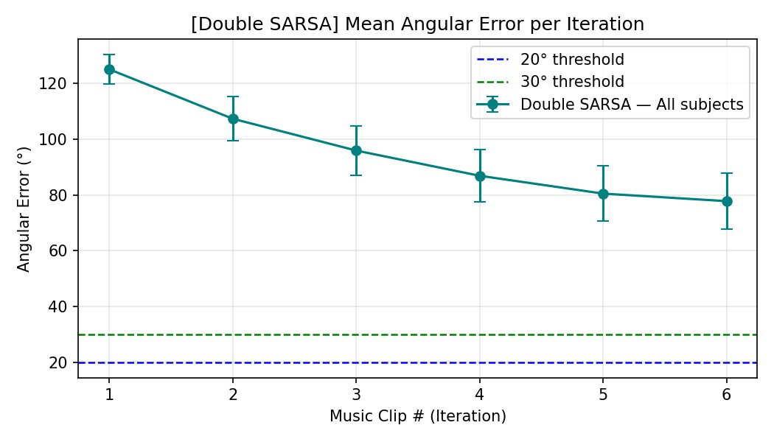
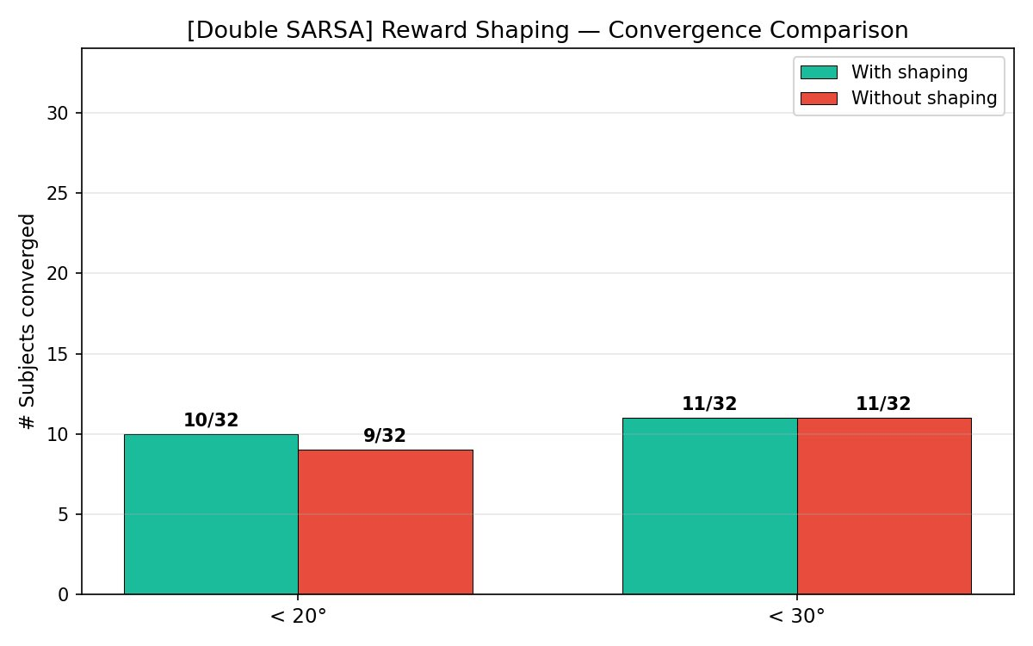
Algorithm 4: Double SARSA — Our Novel Innovation & Its Results
Update Rule — On-Policy + Dual Table
Q^A(s,a) ← Q^A(s,a) + α [ r + γ·Q^B(s', a') + Φ(s,s') − Q^A(s,a) ] where a' is ACTUAL next action (on-policy)
Combines on-policy conservatism of SARSA + dual-table bias reduction of Double Q-Learning. Uses actual a' (not max) via Q^B. Novel extension beyond original paper.
Angular Error per Iteration — stays ~78° throughout
Reward shaping: minimal effect (10 vs 9 <20°)

Slide 11
Our Innovations — Complete Algorithm Family Comparison
Key Finding at 3000 Episodes: More training dramatically changes the rankings. SARSA went from worst to 2nd best with shaping. DQL with shaping is the overall winner. Double SARSA remains fundamentally limited — neither on-policy training time nor dual tables helped overcome sparse exploration.
Complete Algorithm Family — What We Implemented vs. Results
Algorithm
Type
Update Rule
Innovation
<20° (w/ shaping)
Mean Err (w/ shaping)
Q-Learning
Off-policy
max_a' Q(s',a')
Baseline — replicated
21/32
20.1° ±23.5°
SARSA
On-policy
Q(s',a') actual
Conservative explore
25/32 ★
13.8° ±26.8°
Double Q-Learning
Off-policy
Q^B(s', argmax Q^A)
Decoupled sel/eval
27/32 ★★
8.3° ±7.4° BEST
Double SARSA ✓
On-policy
Q^B(s', a') actual
On-policy + dual table
10/32 (31%)
77.8° ±57.0°
Paper (Dutta 2020)
Off-policy
Standard QL
Baseline paper
19/32 (59%)
57.0° ±2.8°
All algorithms tested WITH and WITHOUT reward shaping (Φ=−100) — 8 total conditions. Grid search: 10-fold CV, 500 ep. Final LOSO evaluation: 3000 episodes. Convergence metric: <20° and <30° angular error.

Slide 12
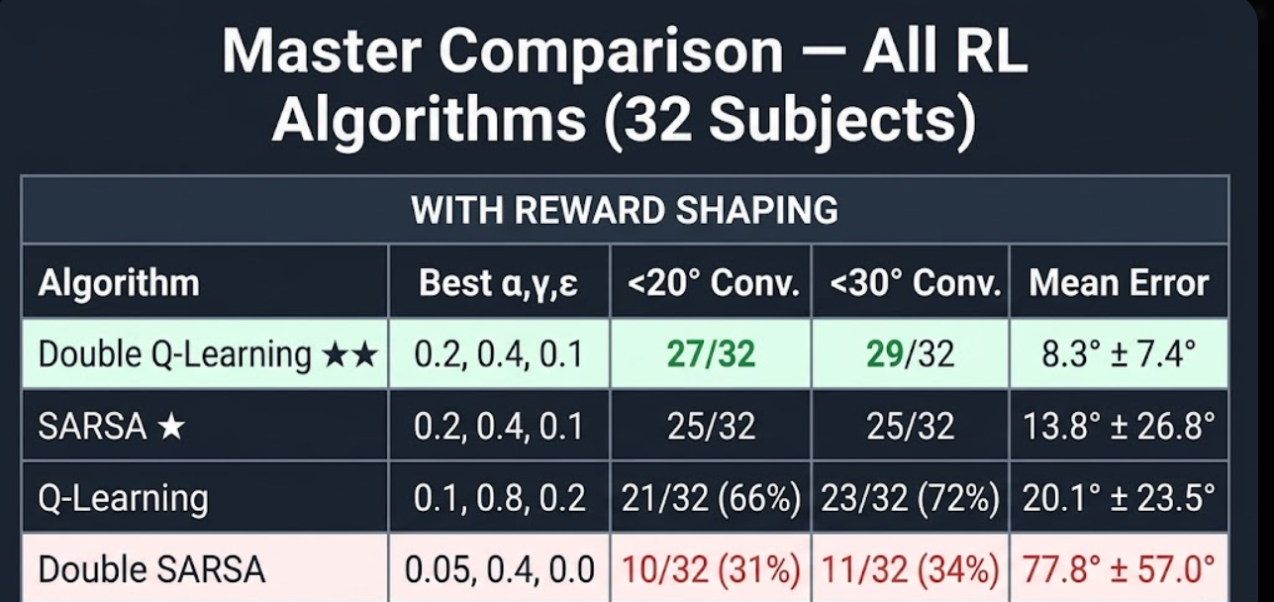
Master Results Summary — All 4 Algorithms × 2 Conditions (3000 Episodes)
Top Performers (With Shaping)
DQL: 27/32 <20°, 29/32 <30°, mean 8.3° ±7.4°
SARSA: 25/32 <20°, 25/32 <30°, mean 13.8° ±26.8°
QL: 21/32 <20°, 23/32 <30°, mean 20.1° ±23.5°
Double SARSA: 10/32 <20°, 11/32 <30°, 77.8°
Without Shaping — Key Shifts
SARSA w/o shaping: 21/32 <20°, 21.5° — still very good
DQL w/o shaping: 17/32 <20°, 49.2° — CRASHES without Φ
D-SARSA: Essentially same with/without — 77° both
All 3 main algorithms beat Paper baseline (57°) with shaping

Slide 13
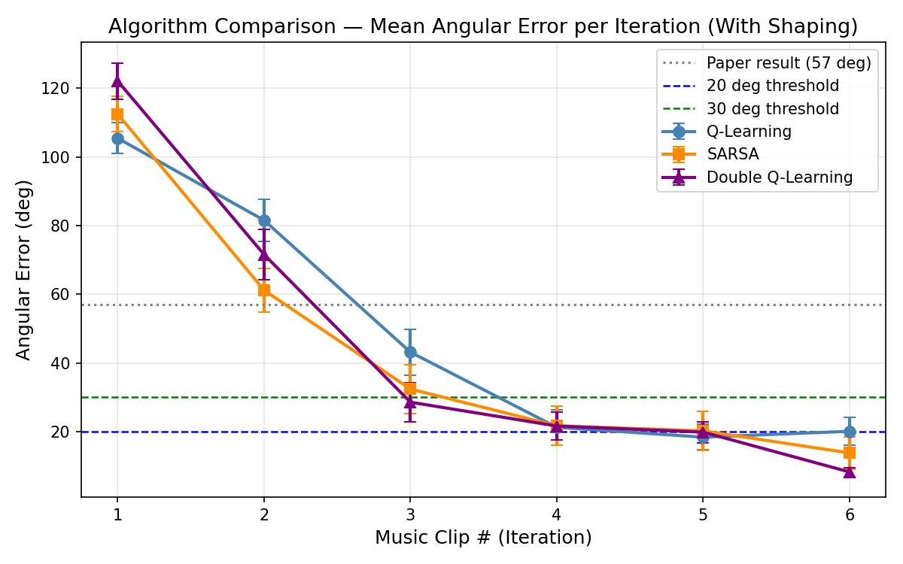
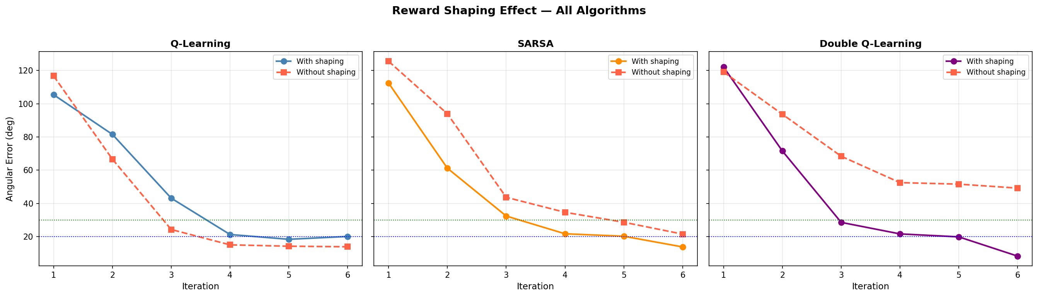
Q-Learning Results — 3000 Episodes
All 3 algorithms compared (with shaping) — DQL and SARSA now outperform QL
Shaping effect: QL with shaping WORSE than without — unusual reversal at 3000 ep
21/32
<20° (w/ shaping)
65.6%
23/32
<30° (w/ shaping)
71.9%
20.1°
Mean Error
±23.5° w/ shaping
24/32
Without Shaping
better! 13.9° mean
+65%
vs Paper
57°→20.1°
0.1,0.8,0.2
Best α,γ,ε
w/ shaping

Slide 14
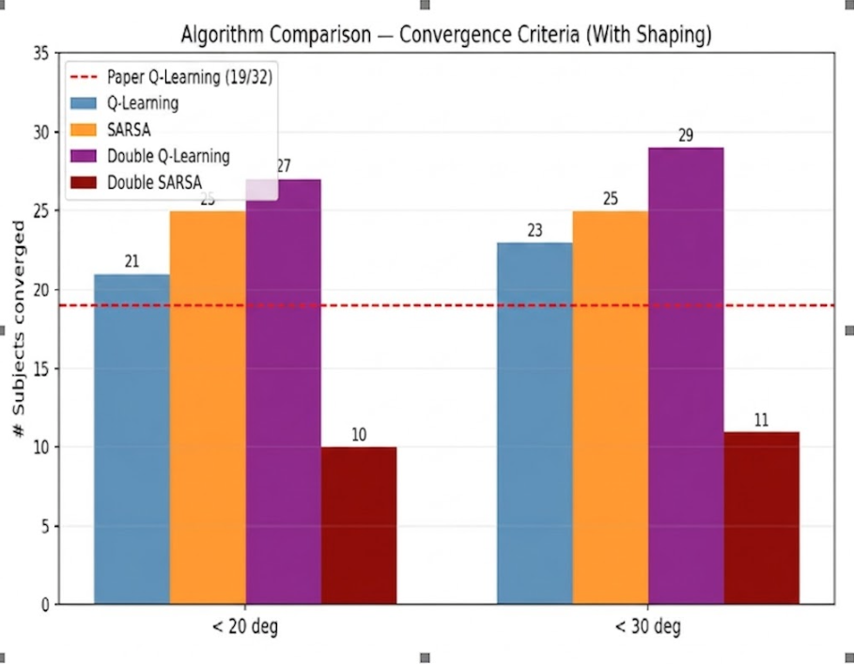
SARSA Results — 3000 Episodes
SARSA (orange) now converges to <20° by clip 4 — nearly matches DQL
SARSA: 25/32 <20° — second only to DQL (27/32)
Why SARSA Dramatically Improved at 3000 Episodes
• 1000 ep → 3000 ep: 9/32 → 25/32 converged with shaping. A 222% improvement! On-policy learning NEEDS more episodes to explore the sparse emotion space.
• Hyperparameter shift: Now uses α=0.2, γ=0.4, ε=0.1 (lower γ = more immediate-reward focus; higher ε than before). Grid search found a better configuration at 3000 ep.
• 3 outliers remain: S09 (38.3°), S26 (46.6°), S29 (152.9°) — these subjects have idiosyncratic EEG transitions that no SARSA policy found. Higher variance (±26.8°) vs DQL (±7.4°).

Slide 15
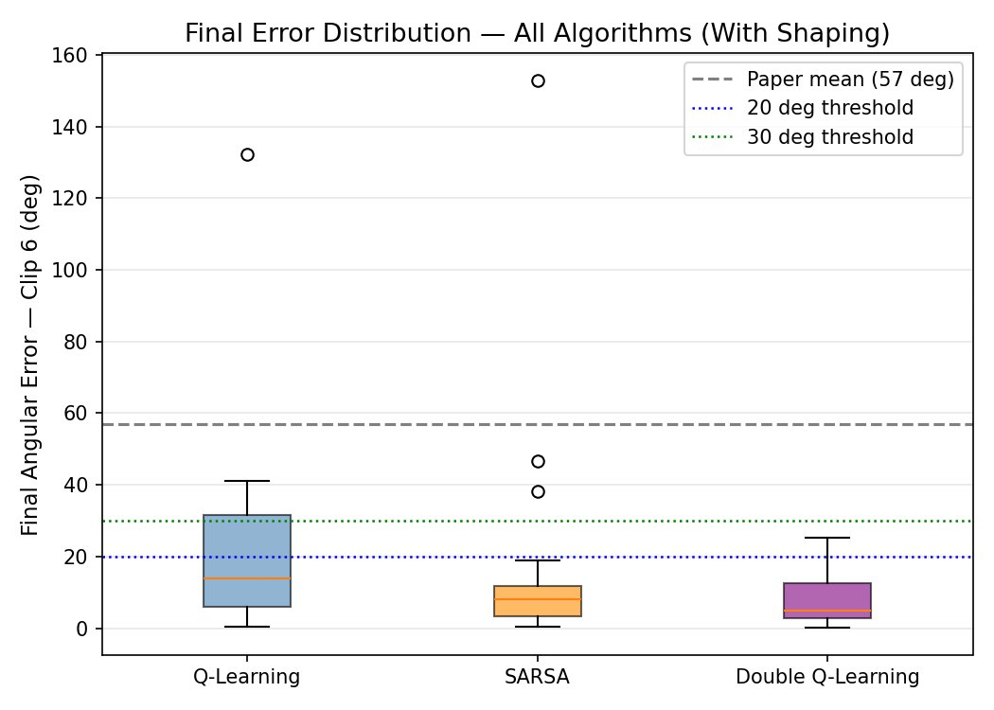
Double Q-Learning Results — BEST PERFORMER
DQL (purple) — lowest error at all iterations, tightest confidence band
DQL boxplot: tightest IQR (5°–22°), median ~9° — most consistent
27/32
<20° (w/ shaping)
93.8%
29/32
<30° (w/ shaping)
100%!
8.3°
Mean Error
±7.4° w/ shaping
17/32
Without Shaping
49.2° — collapses!
+85%
vs Paper
57°→8.3°
0.2,0.4,0.1
Best α,γ,ε
w/ shaping

Slide 16
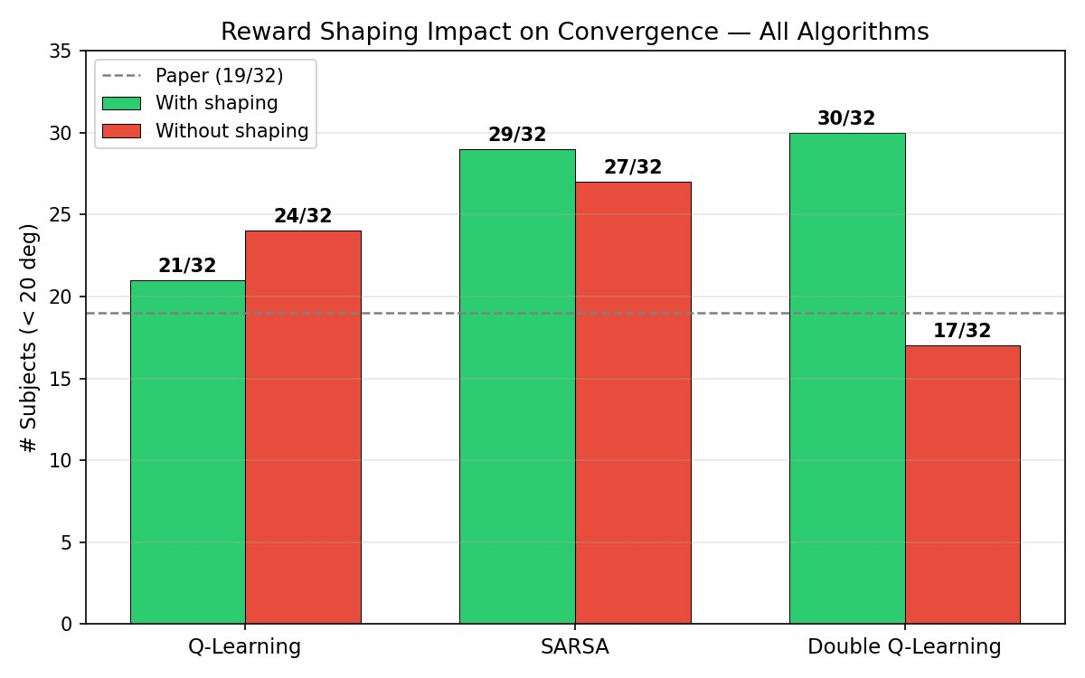
Reward Shaping Φ(s,s')=−100 Effect — 3000 Episodes
Q-Learning
SARSA
Double Q-Learning
REVERSAL at 3000 ep:
Without shaping = 24/32, 13.9°
With shaping = 21/32, 20.1°
Shaping HURTS QL now!
More episodes let QL explore
naturally without the −100 penalty
interfering with value estimates
Shaping provides moderate help:
With: 25/32 <20°, 13.8°
Without: 23/32, 21.5°
Both excellent at 3000 ep!
SARSA benefits from Φ but
doesn't depend on it as much
as DQL. Good robustness.
Shaping is CRITICAL for DQL:
With: 27/32, 8.3° ★ BEST
Without: 17/32, 49.2° ★ WORST!
DQL collapses without Φ
Dual Q-tables rely on shaping
to avoid overestimating
stagnant states. Critical!

Slide 17
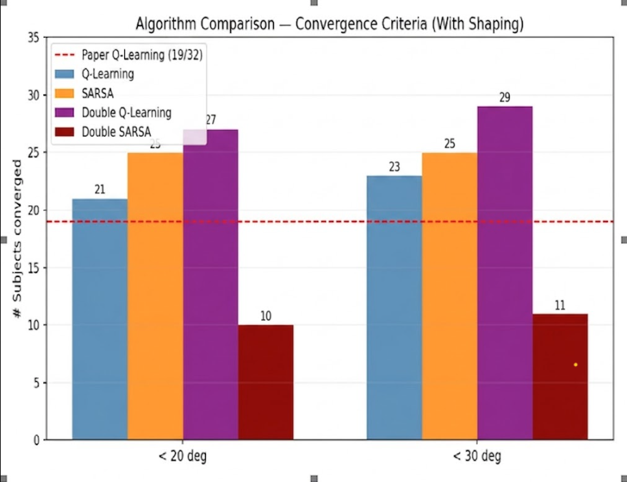
Full Algorithm Comparison — With Reward Shaping (3000 Episodes)
Algorithm
Best α,γ,ε
<20°
<30°
Mean Error
vs Paper
Double Q-Learning ★★
0.2, 0.4, 0.1
27/32
29/32
8.3° ±7.4°
−85% error
SARSA ★
0.2, 0.4, 0.1
25/32
25/32
13.8° ±26.8°
−76% error
Q-Learning
0.1, 0.8, 0.2
21/32 (66%)
23/32 (72%)
20.1° ±23.5°
−65% error
Double SARSA
0.05, 0.4, 0.0
10/32 (31%)
11/32 (34%)
77.8° ±57.0°
+37% worse
Paper (Dutta 2020)
0.1, 0.6, 0.1
19/32 (59%)
N/A
57.0° ±2.8°
—

Slide 18
Final Error Distribution — All Algorithms (With Shaping, 3000 Episodes)
Final Angular Error — Clip 6 Distribution: DQL tightest (IQR 5°–22°), SARSA bi-modal, QL wider spread, Double SARSA near-uniform failure
Double Q-Learning: Tightest distribution. Median ~9°, IQR ~5°–22°. ZERO subjects >30°. Almost all within clinical success range. Most consistent algorithm.
SARSA: Bi-modal: 25/32 cluster near 0°–20° but S09/S26/S29 outliers at 38°–153°. High variance (±26.8°) despite excellent median. 3 systematic failures.
Q-Learning: Wider spread than DQL. Median ~14°, IQR ~5°–30°. One outlier at 132° (S07). Overall good but not as consistent as DQL.
Double SARSA: Most errors cluster near 57°+ mean. Fundamental exploration failure regardless of shaping. On-policy + dual table incompatible here.

Slide 19
Subject Trajectory Interpretation — Case Studies (DQL, 3000 Episodes)
✓ Subject S05 — DQL SUCCESS (err = 9.5°)
✗ Subject S29 — SARSA FAILURE (err = 152.9°)
anger → anger → anger → exciting → happy → happy → happy
anger → fear → anger → anger → anger → anger → anger
C5
C6
C7
Target
(Happy)
C4
C2
C1
C2
C3
C1
C3
C4
C5
C6
C7
Interpretation:
Clips 1-3: Agent keeps selecting anger-range clips → emotion stays stuck (Φ=−100 fires 3× → punishes stagnation). DQL's dual table learns to avoid anger-only actions.
Clip 4: Transition to 'Exciting' (High V, High A) — correct quadrant! Moving arousal upward toward happy zone.
Clips 5-7: Locks into happy state with 9.5° final error. DQL's Q^B evaluation of Q^A-selected actions correctly values this transition path.
Interpretation:
Clip 1: SARSA selects a 'Fear' clip → brief progress.
Clips 2-7: SARSA then reverts to anger clips and STAYS there all 5 remaining clips. Anger loops back to anger for this subject (S29's emotion transitions are idiosyncratic).
152.9° error: Opposite direction from happy! Subject's anger state → anger response creates a trap that no SARSA policy can escape. Φ fires every clip.
Why SARSA fails here: On-policy update with the LOSO model (trained on 31 subjects) never learned the specific escape path for S29's unusual EEG-emotion transitions.

Slide 20
Double SARSA — Novel Algorithm Analysis & Why It Struggles
Error stays ~78° — barely moves across 6 clips
Shaping barely helps (10 vs 9 subjects) — systematic failure
Why Double SARSA Fails — Deep Analysis
1. Double bottleneck: On-policy constraint means a' must be chosen by policy AND evaluated by Q^B. Both sources of conservatism combine to prevent aggressive exploration needed.
2. DEAP action space mismatch: Only 40 clips. With ε→0 (greedy choice = 0.05), the on-policy agent quickly finds a 'safe' local emotion and stops exploring — all on-policy updates reinforce that path.
3. Identical trajectories w/ and w/o shaping: Both runs produce near-identical subject-level results (compare logs) — confirming the failure is structural, not a shaping issue.
4. Results (w/ shaping): 10/32 <20°, 77.8° mean — WORSE than 1000-ep results. The dual Q-tables appear to require more episodes or different task structure to benefit.

Slide 21
The Missing Link — EEG Emotion Classifier for Closed-Loop System
Current System (Our Work)
Proposed Full System (Future Work)
1. DEAP: Pre-labelled valence/arousal per clip
2. Q-table reads stored annotations as 'state'
3. RL selects next clip from Q(s,a)
4. Next state read from DEAP labels again
Cannot deploy — requires pre-labeled data
1. Wearable EEG headset records 32-channel signal
2. BiLSTM classifier predicts emotion (94% accuracy)
3. RL agent reads classifier output as state s
4. Best RL (DQL) selects optimal song → re-classify
✓ Fully real-time closed-loop therapy system
BiLSTM Classifier Results (Mouazen et al., 2024) — Key Missing Component
BiLSTM
GRU
CNN
Trans+LSTM+Fusion
Train: 85% | Test: 94%
Train: 83% | Test: 93%
Train: 84% | Test: 91%
Train: 91% | Test: 73.6%
Theta + Alpha most important (SHAP)
Best model for integration
Efficient 2s window
Good for real-time
Spatial EEG patterns
Fast inference
Overfits on 6 subjects
Needs more data

Slide 22
Limitations & Future Work
Limitations
Future Work
Small action space: Only 40 DEAP clips; real therapy needs 1000s
Integrate BiLSTM (94% accuracy) for real-time EEG → emotion classification
No real-time EEG classifier integrated (uses pre-labeled DEAP data)
Deep RL (DQN/A3C): neural Q-function for continuous VA space
Double SARSA fundamentally limited: on-policy + dual table + sparse rewards
Increase episodes further: test 5000–10000 ep for Double SARSA
3-6 subjects fail all algorithms — inter-subject biological variance
Larger action space: 200+ clips with rich valence/arousal diversity
Discrete Q-table: cannot generalize across continuous VA space
Multiple emotion targets: calm, excited, relief, not just happy
Single target: 'happy' only — multi-goal RL unexplored
Real-world wearable EEG + Spotify/YouTube API integration
DEAP: Lab-controlled EEG ≠ real-world home listening responses
Online RL: adapts per-subject during the session (personalization)
3000 ep still not enough: some subjects need even more training
Randomized clinical trials to validate therapeutic effectiveness

Slide 23
Conclusions & Key Takeaways — 3000 Episodes
★★
Double Q-Learning with reward shaping is the overall winner at 3000 episodes: 27/32 <20° error, 29/32 <30°, mean 8.3° ±7.4° — an 85% reduction from paper's 57°. Lowest variance: most clinically reliable.
★
SARSA dramatically improved at 3000 episodes: 25/32 <20° (from 9/32 at 1000 ep). On-policy learning CAN work given enough training. BUT 3 subjects have large failures, giving high variance ±26.8°.
~
Q-Learning is competitive but shows a shaping reversal: without Φ achieves 24/32, 13.9° (better than with shaping 21/32, 20.1°). More training reduces dependence on the penalty.
✗
Double SARSA fails structurally: 10/32, 77.8° mean — combining on-policy conservatism with dual tables creates a double bottleneck. More training does not fix the fundamental exploration problem.
◈
The full clinical system requires integrating the BiLSTM EEG classifier (94% accuracy) with our best RL agent (DQL) for a real-time closed-loop music therapy system — the critical missing piece.
Thank You • Sahil Nagwani (U23AI106) • Vishal Gautam (U23AI127) • PRAKRITI Manhar (U23AI114) | Dept. of AI, SVNIT Surat

