Slide 1
Reinforcement Learning using EEG Signals
for Therapeutic Use of Music in Emotion Management
Sahil Nagwani
Vishal Gautam
PRAKRITI Manhar
U23AI106
U23AI127
U23AI114
Department of Artificial Intelligence | SVNIT Surat
Base Paper: Dutta et al. (2020) IEEE EMBC • Extended with SARSA, Double Q-Learning, Double SARSA, Reward Shaping Analysis
DEAP Dataset • 32 Subjects • 5 RL Algorithms • 1000 Episodes • LOSO Cross-Validation

Slide 2
Why This Research Matters — The Clinical Motivation
~280M
Music Rx
EEG
RL
People worldwide
suffer from depression
Therapy shown to reduce
depressive symptoms
Objective, non-invasive
brain-state measurement
Learns optimal playlists
without user feedback
The Core Problem
Depressed individuals are drawn to sad music, reinforcing negative emotional states (Garrido & Schubert, 2013)
Manual playlist curation is subjective — patients may unknowingly choose emotionally harmful music
Traditional RL for playlists uses pause/skip/replay feedback which is unreliable for depressed users
EEG captures involuntary emotional responses to music — bypassing self-report bias entirely
Need: A closed-loop system that reads EEG → identifies emotion → selects next clip → guides to 'happy'
Challanges : Emotions are subjective and continuous and also playlist must be shorter (6)clips ,
Approach: Model emotions on a 2D Valence–Arousal wheel Agent selects music clips as actions Minimize angular error to target Based on Dutta et al. 2020

Slide 3
DEAP Dataset & Emotion Space
DEAP Dataset Overview
8 Emotion Groups (from 15 GEW emotions)
32 participants, each watched 40 × 1-min music video clips
Happy (High V, High A)
Exciting (High V, High A)
EEG recorded at 128 Hz across 32 scalp electrodes
Pleasant (High V, Low A)
Calm (High V, Low A)
Self-reported Valence, Arousal, Dominance, Liking (1–9 scale) per clip
Sad (Low V, Low A)
Negative (Low V, Low A)
Preprocessed valence & arousal used directly in this work
Anger (Low V, High A)
Fear (Low V, High A)
40 clips × 32 subjects = 1280 state-action observations
Emotion-transition pairs extracted from consecutive clip responses
State Space: 20×20 Valence-Arousal Grid = 400 Discrete States
Valence axis (x): −1 to +1, normalized → 20 bins. Positive = pleasant emotions; Negative = unpleasant.
Arousal axis (y): −1 to +1, normalized → 20 bins. High = excited/angry; Low = calm/sad.
Target state: 'Happy' → normalized VA = [0.905, 0.425] → bin (18,12) in the 20×20 grid
Start state: 'Anger' → Low Valence, High Arousal → upper-left quadrant of GEW
Each clip rated on: Valence (1–9), Arousal (1–9), Dominance, Liking

Slide 4
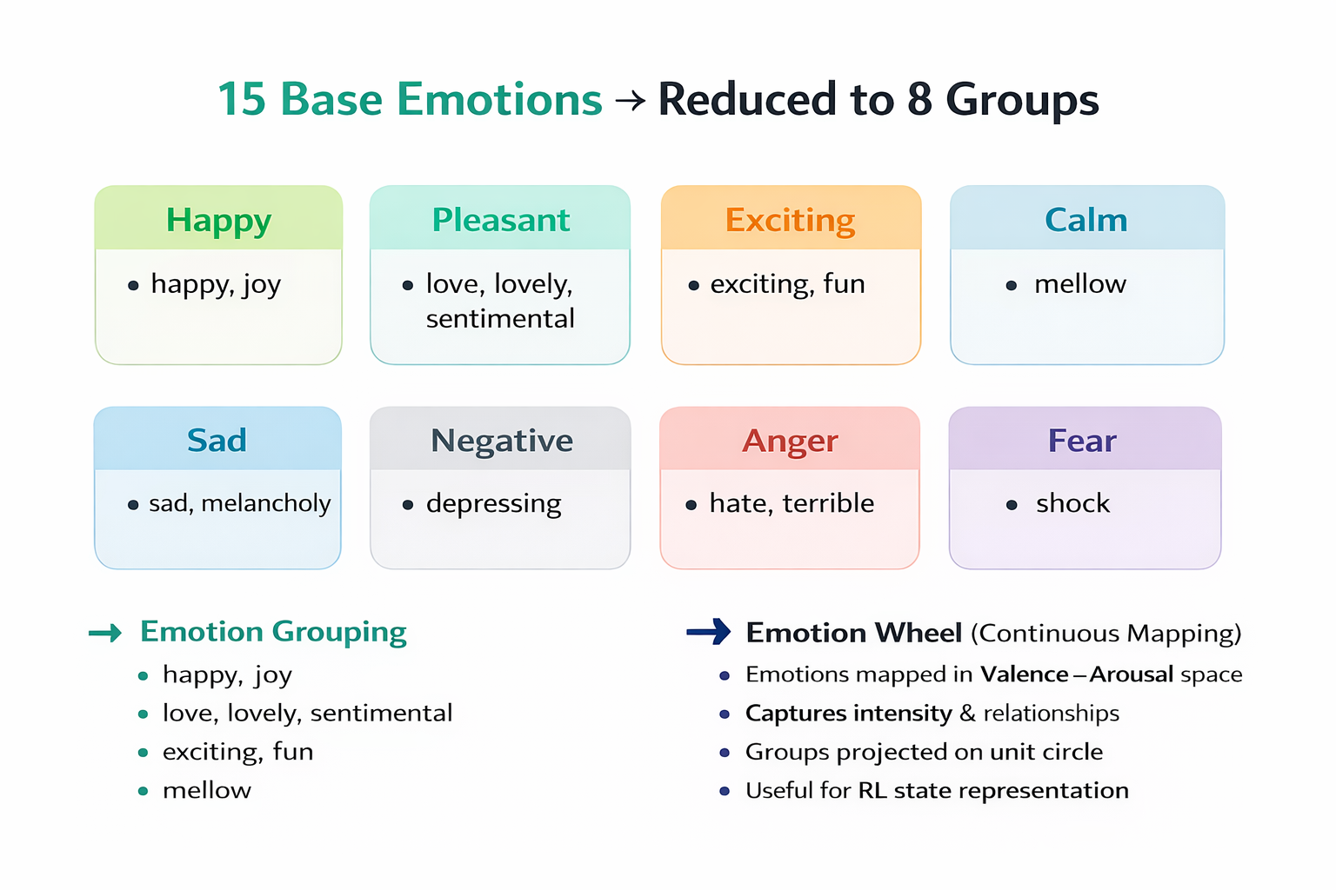
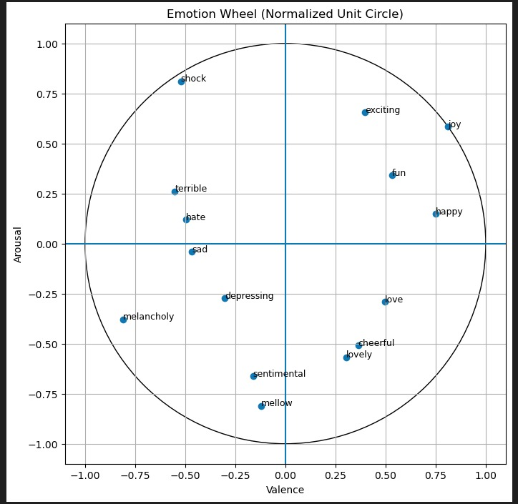
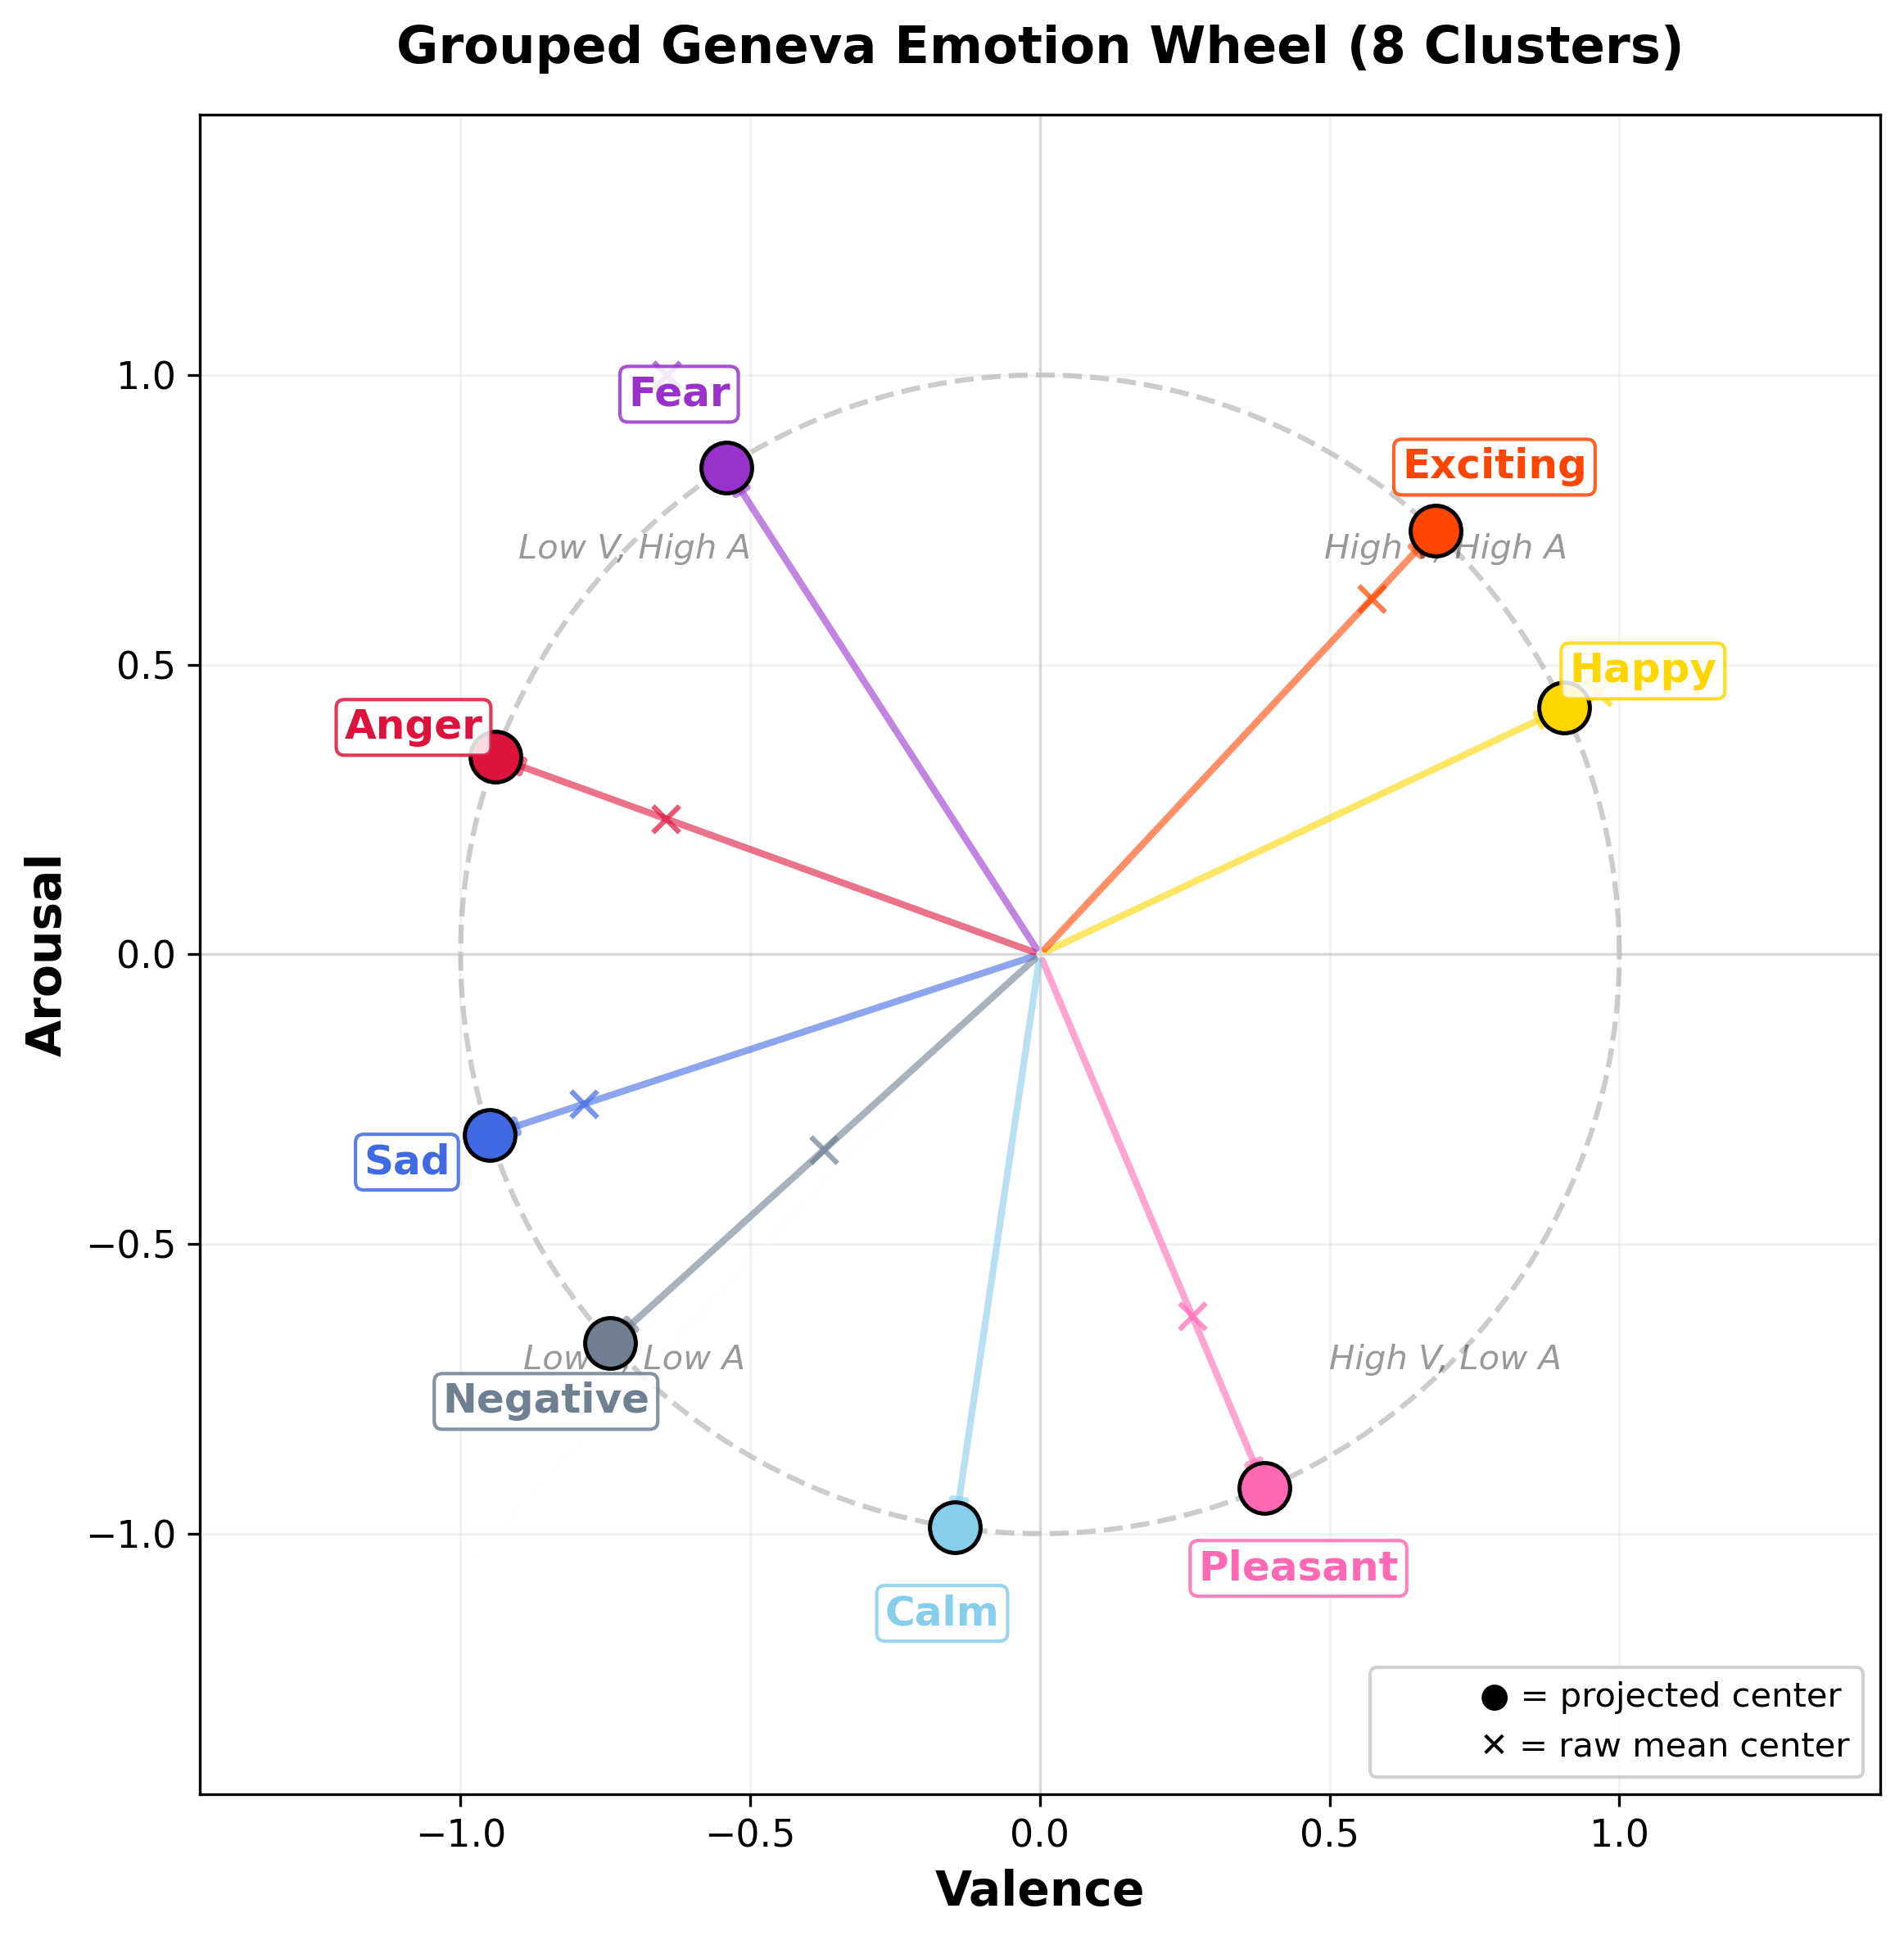
Geneva Emotion Wheel (GEW) — Emotion Space Visualization

Slide 5
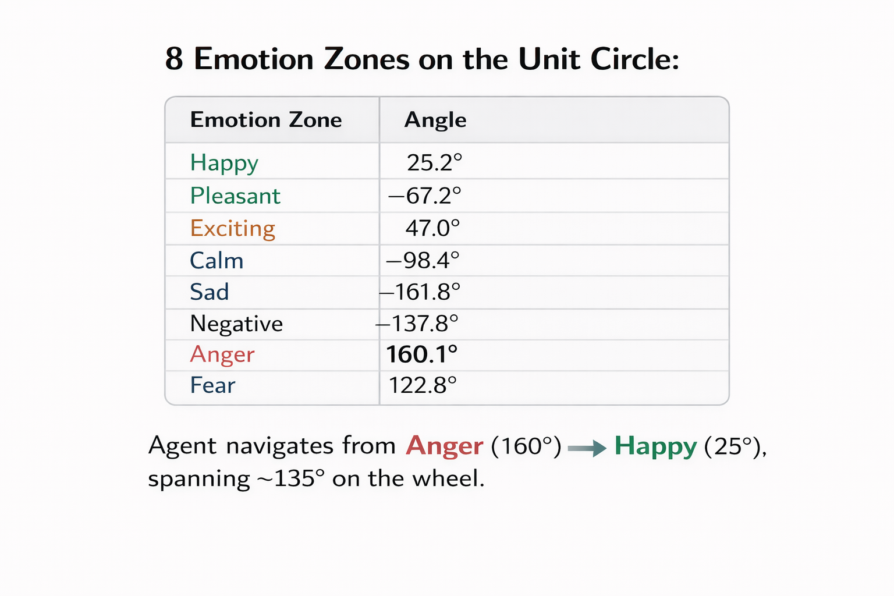
Geneva Emotion Wheel (GEW) — Emotion Space Visualization
High Arousal
Journey:
Anger → Happy
Anger
Exciting
Fear
Happy ★
High
Valence
Low
Valence
Negative
Pleasant
Sad
Calm
Low Arousal

Slide 6
MDP Formulation — State, Action, Transition
State Space |S| = 400
Action Space |A| = 40
Transition Function τ(s,a)
20×20 discretized Valence-Arousal grid
Each cell = one emotional region
State s = (valence_bin, arousal_bin)
Current emotion represented as a 2D vector
in the Geneva Emotion Wheel coordinate system
Each action = presenting one music clip
40 clips from DEAP dataset
Each clip has a (valence, arousal) profile
Action induces emotion vector transition:
τ(s,a) = v_s + v_a → new emotional state
Next state s' = τ(s, a)
Vector addition: current emotion + clip emotion
Result clipped to [-1,+1] VA range
Non-deterministic: varies per subject
LOSO: transition learned from 31 subjects,
tested on 1 held-out subject
Reward Function Design
Base Reward: r(s,a) = 1 if θ(s,a) ≤ 180° (music moves emotion in right direction), else 0 where θ = |θ_target| + |θ_current| (sum of angular deviations from target and current vectors)
Stagnation Penalty φ(s,s'): φ = −100 if s = s' (agent stayed in same emotional state — punish getting stuck) | φ = 0 otherwise
Effect: Forces exploration; prevents agent from repeatedly recommending the same clip with no emotional change.

Slide 7
Algorithm 1: Q-Learning — Off-Policy Temporal Difference
Update Rule (with Reward Shaping)
Best Hyperparams (Grid CV)
Q(s,a) ← Q(s,a) + α [ r + γ · max_a' Q(s',a') + Φ(s,s') − Q(s,a) ]
α (learning rate)
0.2
γ (discount)
0.6
α = learning rate | γ = discount factor | Φ(s,s') = reward shaping | max_a' = off-policy greedy selection
ε (exploration)
0.2
CV mean error
9.7° (w/ shaping)
How it Works — Step by Step
Why Off-Policy? Q-Learning learns the OPTIMAL policy independently of what the agent actually does. It can explore random paths yet still update toward the greedy optimal. This makes it sample-efficient for the sparse DEAP emotion transition space. Best results: 30/32 convergence with shaping.
1
Initialize: Q-table of zeros: Q[400 states × 40 actions]. All music clips equally likely initially.
2
Select Action: ε-greedy: with prob ε explore random clip; with prob (1−ε) exploit best Q(s,a).
3
Observe Transition: Play selected clip → EEG captures new emotional state s' = τ(s,a). Get reward r + shaping Φ.
4
Off-Policy Update: Update Q(s,a) using MAXIMUM Q-value of next state: max_a' Q(s',a'). Does NOT follow current policy.
5
LOSO Evaluation: Train on 31 subjects → test on held-out subject. Repeat 32 times. Final metric = angular error at clip 6.

Slide 8
Algorithm 2: SARSA — On-Policy Temporal Difference
Update Rule (SARSA with Reward Shaping)
Best Hyperparams (Grid CV)
Q(s,a) ← Q(s,a) + α [ r + γ · Q(s',a') + Φ(s,s') − Q(s,a) ]
α
0.1
γ
0.8
Key difference: uses Q(s',a') — the ACTUAL next action chosen by policy, NOT the maximum
ε
0.05
CV mean error
77.7° (w/ shaping)
How it Works — On-Policy Difference
Why SARSA Underperforms Here: Being conservative (on-policy) backfires in the sparse DEAP emotion space. With ε=0.05, the agent mostly exploits — but early Q-values are nearly all zero, so the 'greedy' choice is random. The agent locks into suboptimal emotion loops (e.g., anger→fear→fear→fear) and the conservative Q(s',a') update prevents it from breaking free. Result: 9/32 convergence.
S
State: Current emotional state s (anger at start)
A
Action: Choose action a using ε-greedy policy on Q-table
R
Reward: Observe reward r after presenting music clip. Apply shaping Φ if s=s'.
S'
Next State: Observe new emotional state s' from EEG response
A'
Next Action: Choose next action a' using SAME ε-greedy policy (on-policy).
Update Q(s,a) using this actual a', not max.

Slide 9
Algorithm 3: Double Q-Learning — Reducing Maximization Bias
Update Rule — Two Independent Q-Tables (Q^A and Q^B)
Update Q^A: Q^A(s,a) ← Q^A(s,a) + α [ r + γ · Q^B(s', argmax_a Q^A(s',a)) + Φ(s,s') − Q^A(s,a) ]
Update Q^B: Q^B(s,a) ← Q^B(s,a) + α [ r + γ · Q^A(s', argmax_a Q^B(s',a)) + Φ(s,s') − Q^B(s,a) ]
Action selection: ε-greedy on Q^A + Q^B (combined) | Update alternates randomly between Q^A and Q^B each step
Why Double Q-Learning? The Overestimation Problem
Standard Q-Learning Problem
Double Q-Learning Solution
Best Hyperparams (Grid CV)
Uses max_a' Q(s',a') to update
The MAX operation overestimates value
In stochastic environments, max of
noise > true maximum
Result: Agent thinks certain emotion
transitions are better than they are
Leads to overconfident, biased playlists
Q^A selects the BEST ACTION: a* = argmax Q^A(s',a)
Q^B EVALUATES that action: Q^B(s', a*)
Decoupling selection from evaluation
eliminates overestimation bias
Both tables update alternately
More stable, conservative estimates
Result: 29/32 convergence, mean 24.1°
α = 0.05 (small — stable updates)
γ = 0.8 (long-term focused)
ε = 0.2 (explore well)
CV mean error: 7.3° with shaping
(Best single-run CV across all 3 algos)
Robust: less variance than std QL

Slide 10
Our Innovations — Double SARSA & Algorithm Family
Novel Contribution: Double SARSA
Q^A(s,a) ← Q^A(s,a) + α [ r + γ · Q^B(s', a') + Φ(s,s') − Q^A(s,a) ] where a' is the ACTUAL next action (on-policy)
Combines on-policy conservatism of SARSA + dual-table bias reduction of Double Q-Learning. Uses actual next action a' (not max) for evaluation via Q^B. This is our novel algorithmic extension beyond the original paper.
Complete Algorithm Family — What We Implemented
Algorithm
Type
Update Uses
Key Innovation
Our Extension?
Q-Learning
Off-policy
max_a' Q(s',a')
Baseline RL method
Replicated + grid search
SARSA
On-policy
Q(s',a') actual
Conservative exploration
Extended to emotion space
Double Q-Learning
Off-policy
Q^B(s', argmax Q^A)
Decoupled selection/eval
✓ Our innovation
Double SARSA
On-policy
Q^B(s', a') actual
On-policy + dual table
✓ Our innovation
All 4 + Shaping
Both
With/without Φ
Systematic comparison
✓ Novel analysis
All algorithms were tested WITH and WITHOUT reward shaping (Φ) — 12 total experimental conditions. Grid search used 10-fold CV on 500 episodes, final evaluation on 1000 episodes with LOSO.

Slide 11
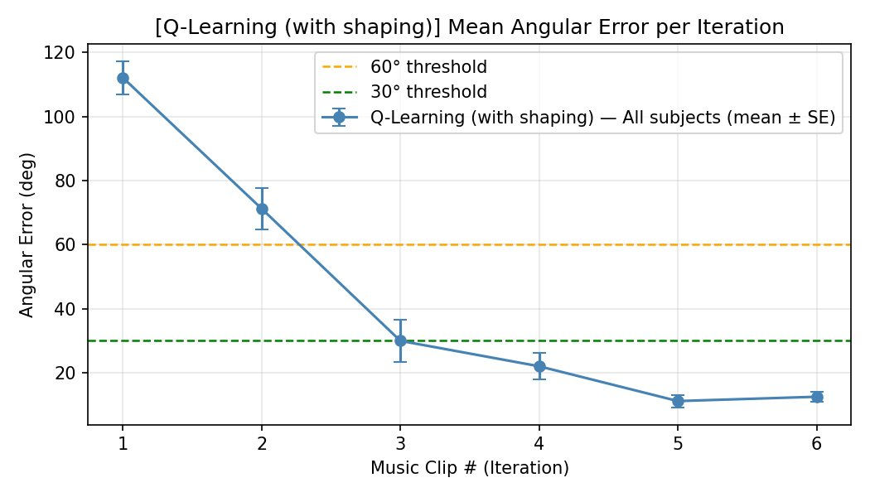
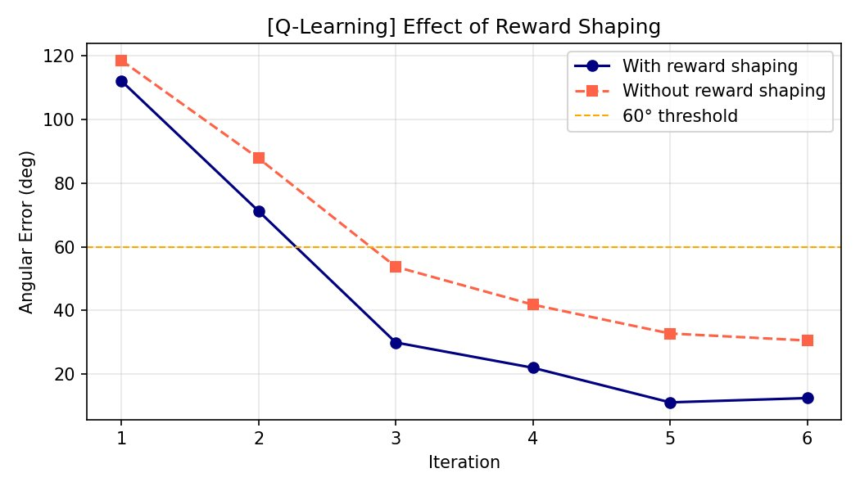
Q-Learning Results — With & Without Reward Shaping
Angular error drops from ~112° → ~13° in 6 clips (with shaping)
With shaping crosses 30° threshold at clip 3 vs clip 5 without
30/32
Exact 'Happy'
w/ shaping
31/32
< 30° Error
w/ shaping
12.4°
Mean Error
±8.9°
+58%
vs Paper
19→30 converged
27/32
Without Shape
still beats paper
9.7°
Grid CV Best
α=0.2,γ=0.6,ε=0.2

Slide 12
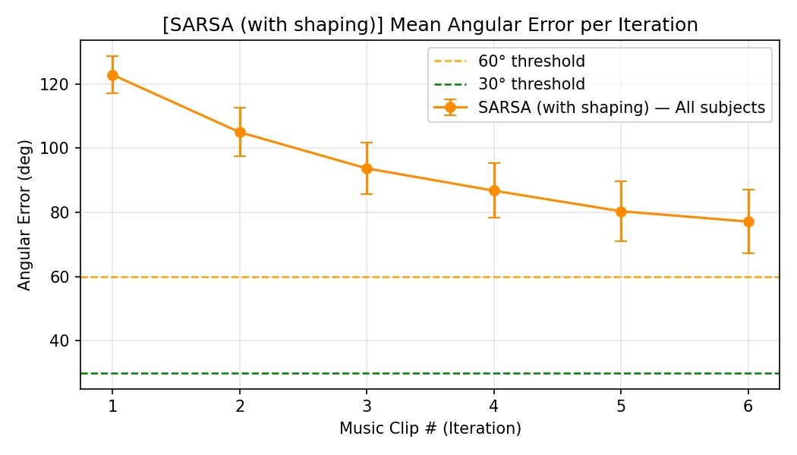
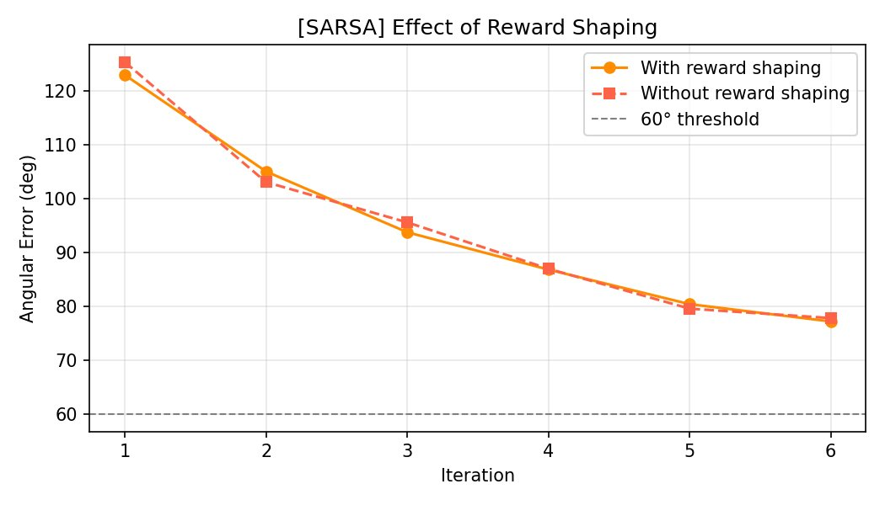
SARSA Results — On-Policy Struggles in Sparse Space
SARSA never crosses 60° threshold — stays ~77° after 6 clips
Reward shaping has virtually NO effect on SARSA (curves overlap)
Why SARSA Fails — Root Cause Analysis
• 9/32 converged (with shaping), 10/32 (without) — worst performance of all algorithms
• Mean error stays at ~77° ±56° with extreme subject variance — some near 0°, others stuck at 180°
• On-policy constraint: SARSA must update based on the actual policy action a'. In early training, nearly all Q(s,a)≈0, so any action appears equally good, and the agent randomly locks into suboptimal emotion cycles
• Φ(s,s')=−100 penalty does NOT help SARSA: The on-policy update doesn't allow aggressive exploration needed to escape local minima in the emotion space

Slide 13
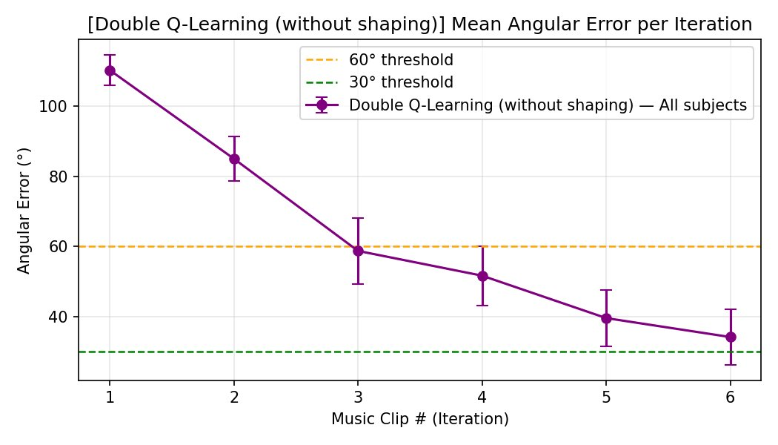
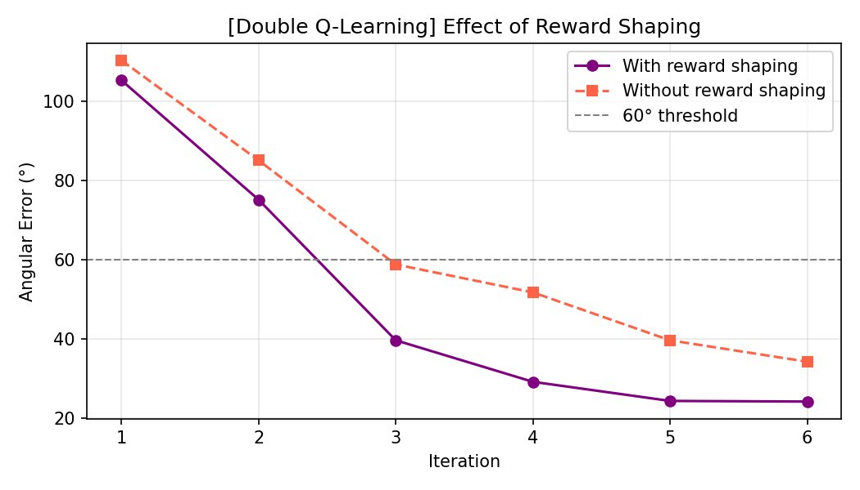
Double Q-Learning Results — Stable, Bias-Free Convergence
Without shaping: drops from ~110° → ~35° — strong performance
Shaping provides ~10° additional benefit (vs ~18° for std Q-Learning)
29/32
Exact 'Happy'
w/ shaping
30/32
< 60° Error
w/ shaping
24.1°
Mean Error
±27.6°
24/32
Without Shape
still strong
7.3°
Grid CV Best
α=0.05,γ=0.8,ε=0.2
+53%
vs Paper
19→29 converged

Slide 14
Subject Trajectory Interpretation — Case Studies
✓ Subject S05 — DQL SUCCESS (err = 10.6°)
✗ Subject S01 — SARSA FAILURE (err = 57.8°)
anger → anger → fear → happy → happy → happy → happy
anger → anger → pleasant → pleasant → pleasant → pleasant → pleasant
C4
C5
C6
C7
Target
(Happy)
C3
C1
C2
C1
C2
Interpretation:
Clip 1-2: Agent plays Anger-state clips → emotion stays stuck (no progress). Reward shaping Φ=−100 fires.
Clip 3: Agent selects a 'Fear'-emotion clip → emotion shifts from Low-Valence/High-Arousal toward High-Arousal zone. Progress begins.
Clip 4-7: Excellent! Agent identifies a 'Happy'-emotion clip → emotion locks into target state and stays there. Final error = 10.6° (within < 30° threshold ✓).
Why it works: DQL's conservative dual-table update correctly values the Fear→Happy transition path learned from 31 other subjects.
Interpretation:
Clips 1-2: SARSA selects anger-adjacent clips → subject stays at anger state. Φ=−100 fires twice.
Clip 3-7: SARSA transitions to 'Pleasant' (High V, Low A) — wrong direction! Pleasant is in Q4, Happy is in Q1. The agent gets stuck in a pleasant loop, never crossing to high arousal.
57.8° error: Angular distance from Pleasant to Happy is ~58°. Subject is in correct valence but wrong arousal zone. Final state fails the < 60° threshold (barely).
Why it fails: On-policy SARSA learns that Pleasant clips give stable reward (no stagnation penalty). It never discovers that Happy clips give better reward because it can't explore aggressively enough.
C3
C4
C5
C6
C7

Slide 15
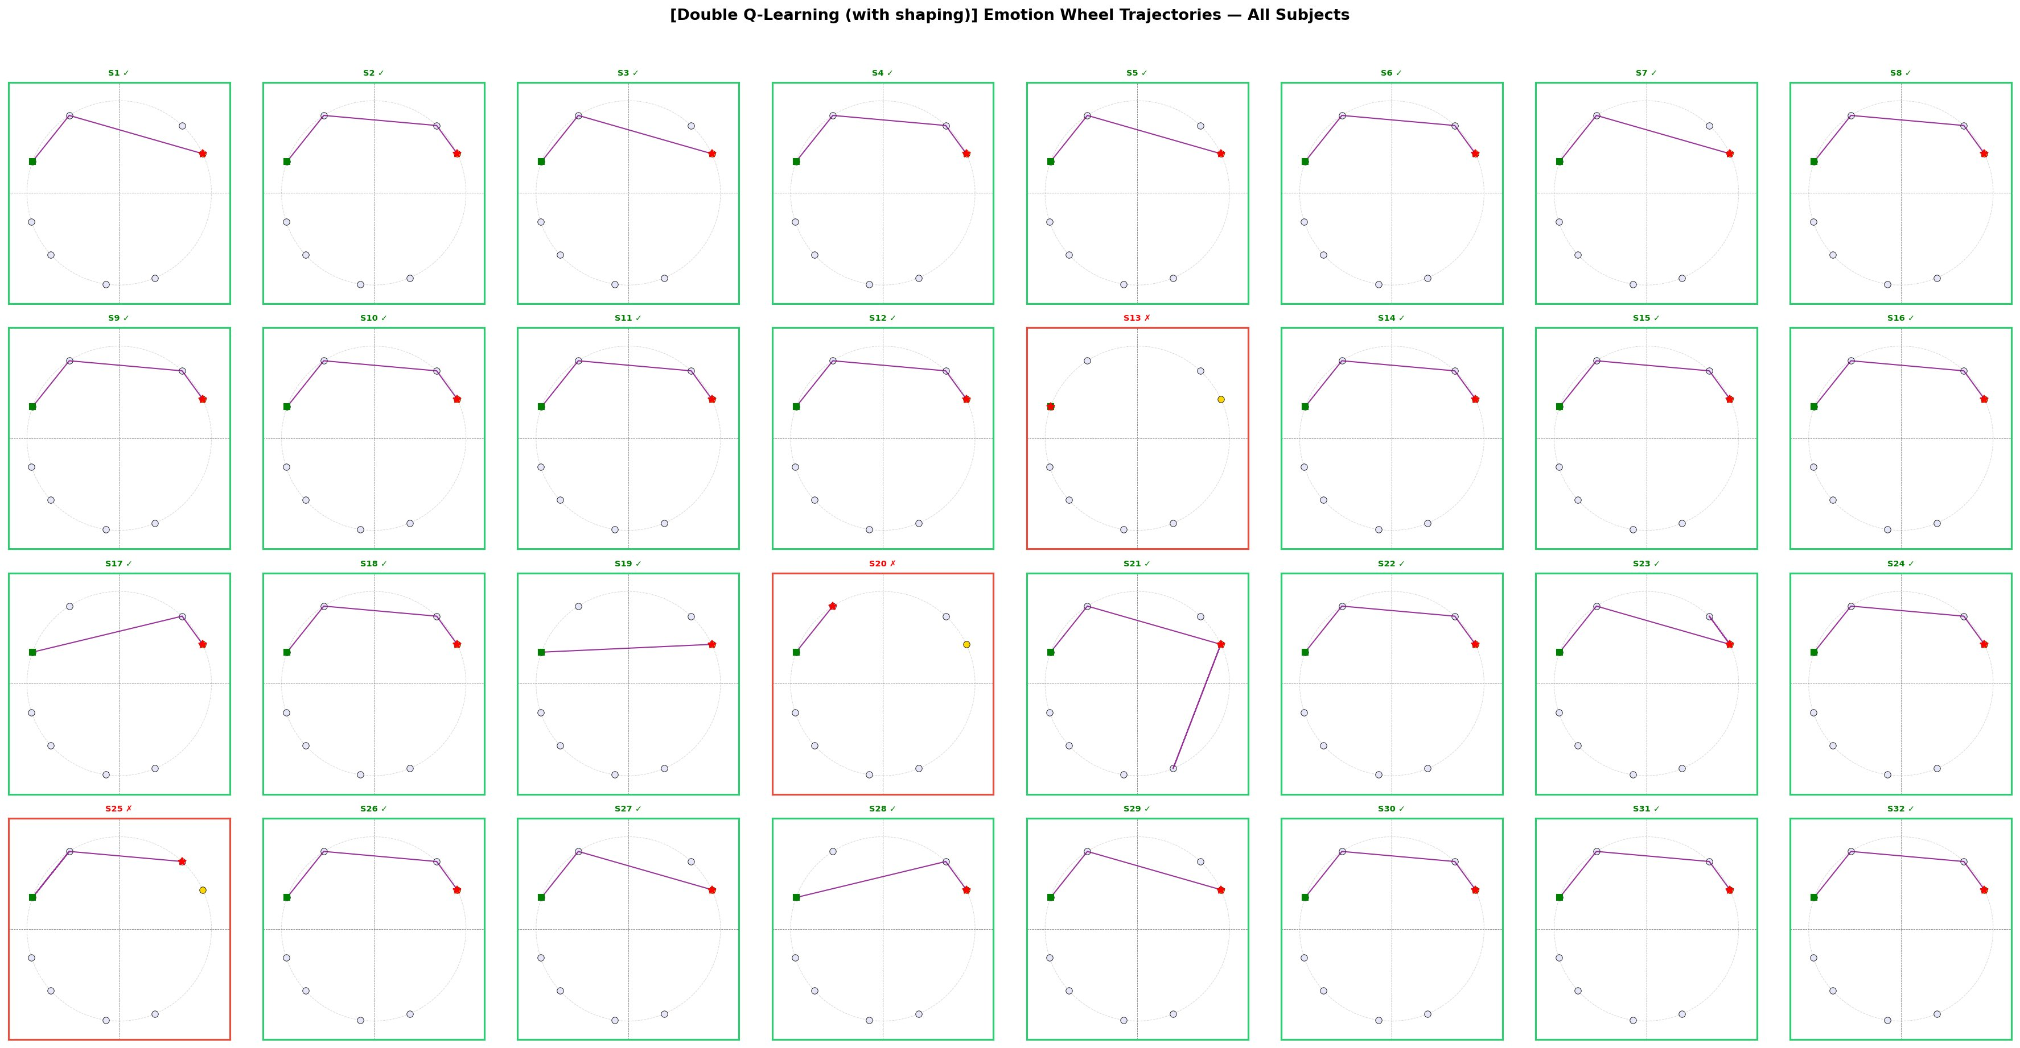
Emotion Wheel Trajectories — Double Q-Learning (All 32 Subjects with Shaping)
Green border = converged to 'happy' | Red border = failed | Green square = start (anger) | Red dot = final state | 29/32 green = 91% success

Slide 16
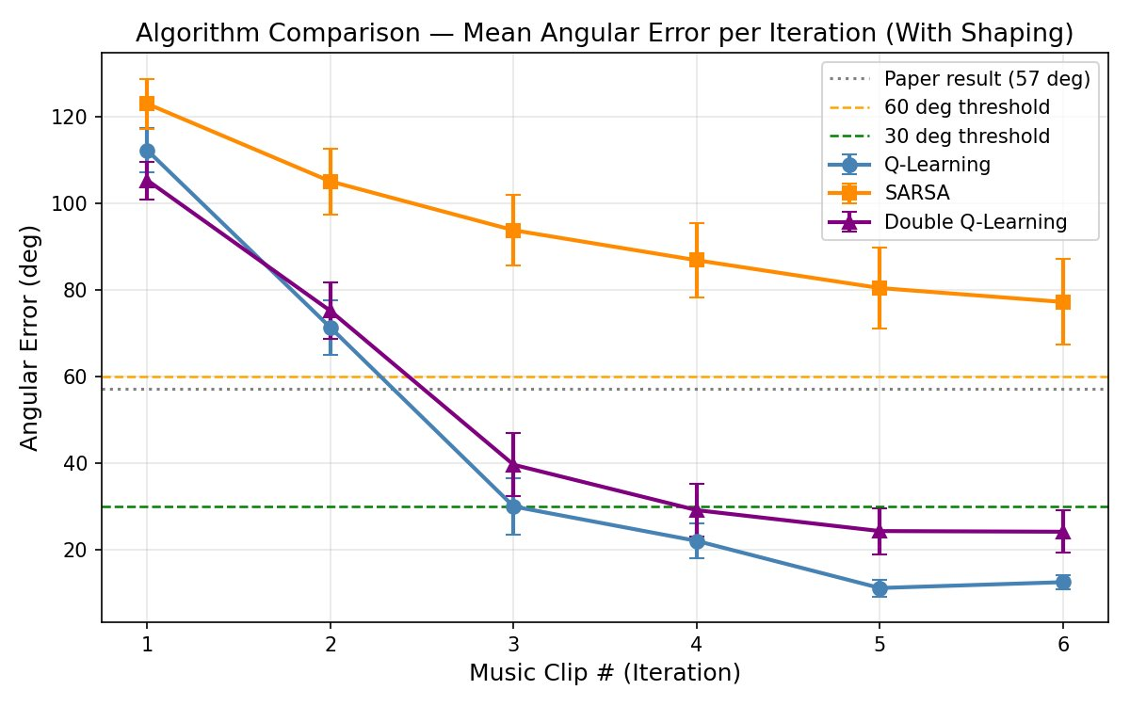
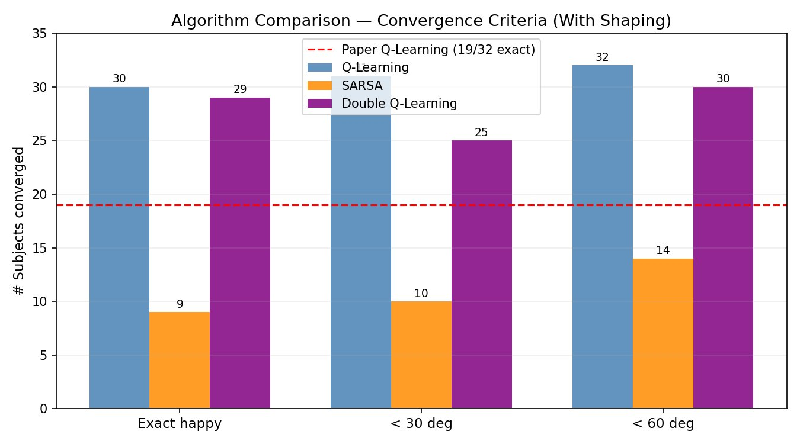
Algorithm Comparison — With Reward Shaping
Algorithm
Exact Happy
< 30°
< 60°
Mean Error
vs Paper
Q-Learning ★
30/32 (94%)
31/32
32/32
12.4° ±8.9°
+58% better
Double Q-Learning
29/32 (91%)
25/32
30/32
24.1° ±27.6°
+53% better
SARSA
9/32 (28%)
10/32
14/32
77.2° ±56.1°
−53% worse
Paper Baseline
19/32 (59%)
N/A
N/A
57.0° ±2.8°
—

Slide 17
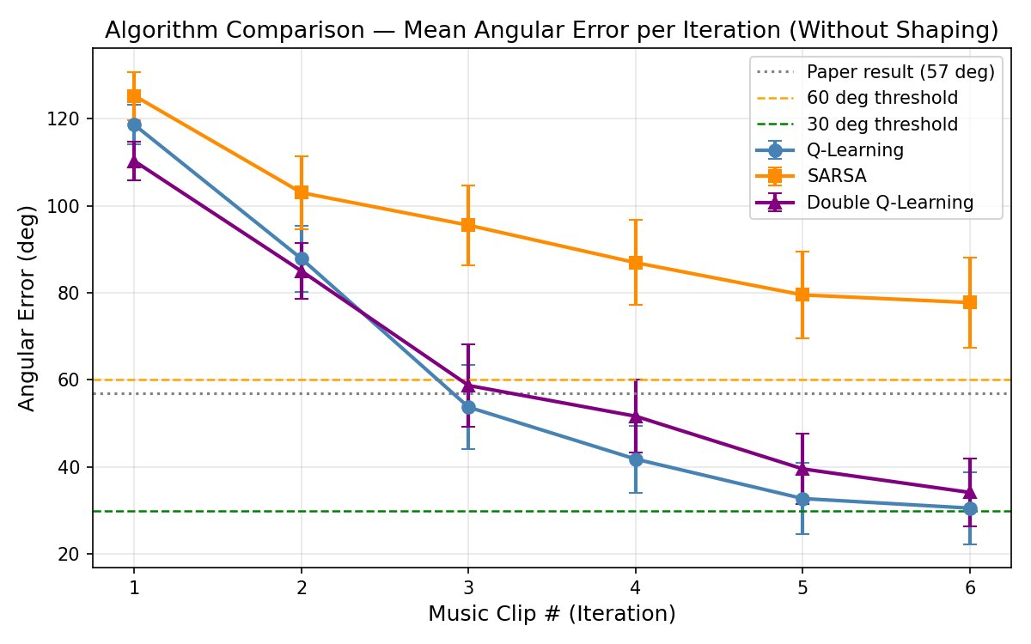
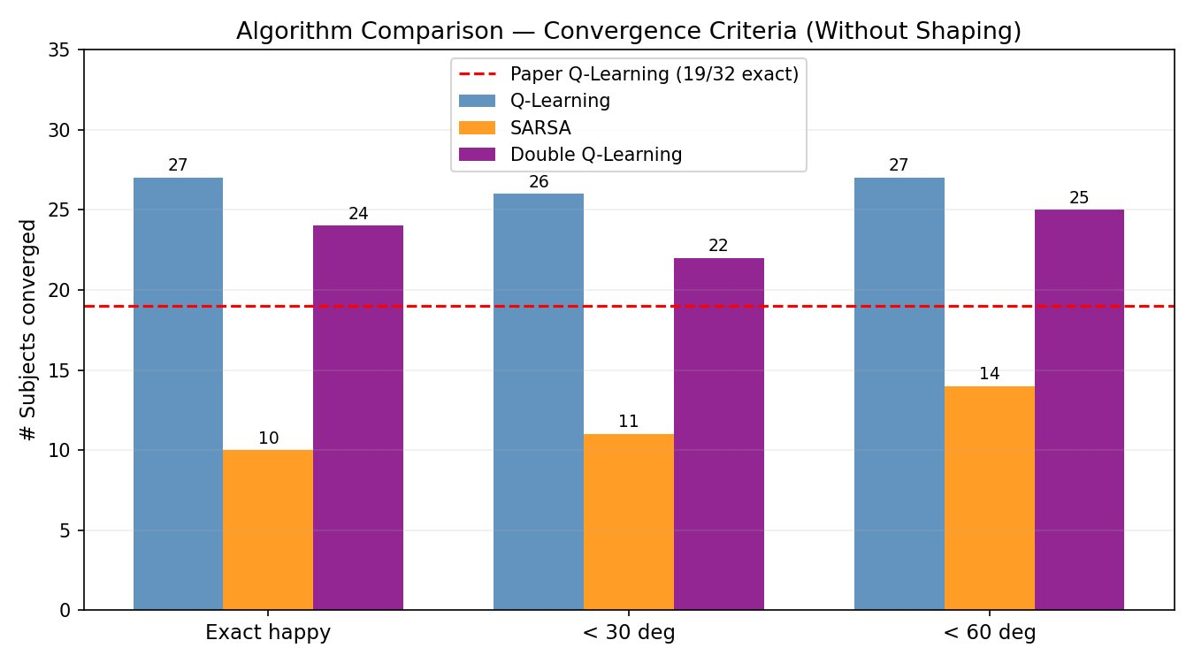
Algorithm Comparison — Without Reward Shaping
Algorithm
Exact Happy
< 30°
< 60°
Mean Error
Key Insight
Q-Learning
27/32 (84%)
26/32
27/32
30.6° ±46.7°
Degrades without shaping
Double Q-Learning
24/32 (75%)
22/32
25/32
34.2° ±44.6°
More robust to no-shaping
SARSA
10/32 (31%)
11/32
14/32
77.8° ±58.8°
Marginally better: shows Φ hurts QL
Paper Baseline
19/32 (59%)
N/A
N/A
57.0° ±2.8°
All our QL variants beat this

Slide 18
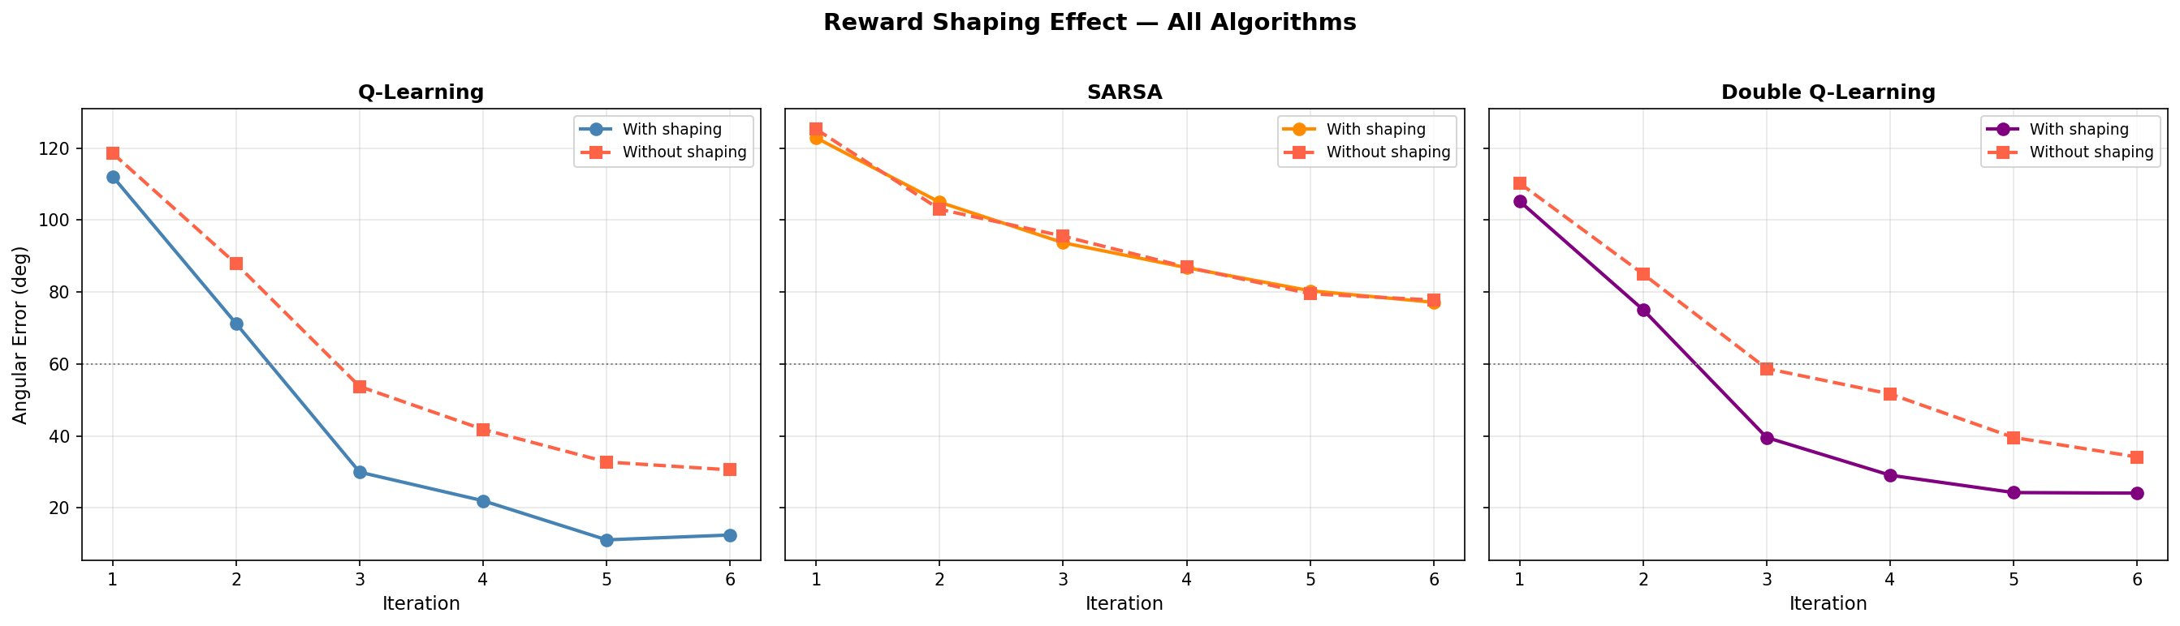
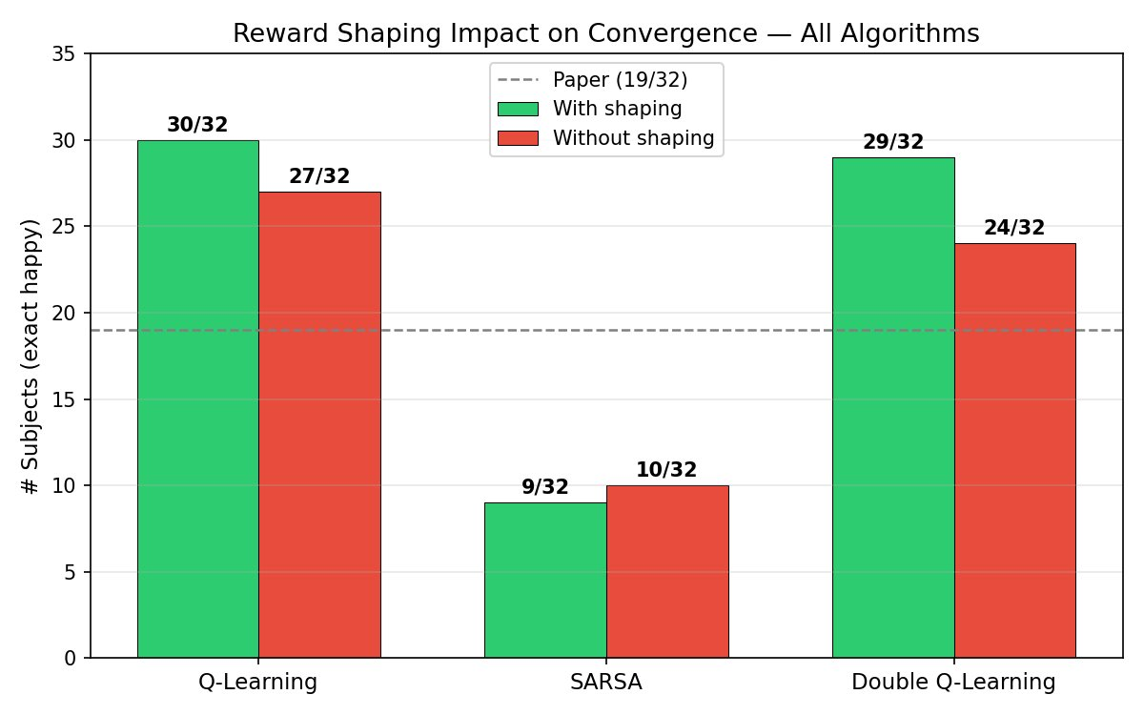
Impact of Reward Shaping Φ(s,s') = −100 — All Algorithms
Q-Learning
SARSA
Double Q-Learning
Shaping provides dramatic benefit:
• Error at clip 3: 29° (w/ shaping) vs 54° (w/o)
• Convergence rate doubles by clip 3
• 27→30 exact matches (+3 subjects)
• Φ=−100 effectively prevents anger-loop trapping
Reward shaping has MINIMAL effect:
• Both curves nearly identical (within SE)
• On-policy updates cannot leverage penalty
• Conservative a' selection neutralizes Φ benefit
• Fundamental architectural incompatibility
Moderate shaping benefit:
• Error at clip 6: 24° (w/) vs 34° (w/o)
• Less sensitive than std QL → more robust
• Dual Q-tables already reduce bias;
shaping adds incremental improvement

Slide 19
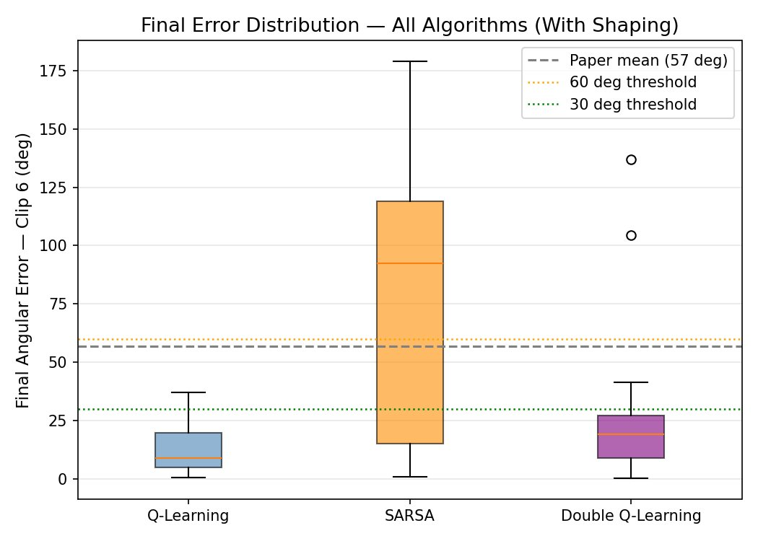
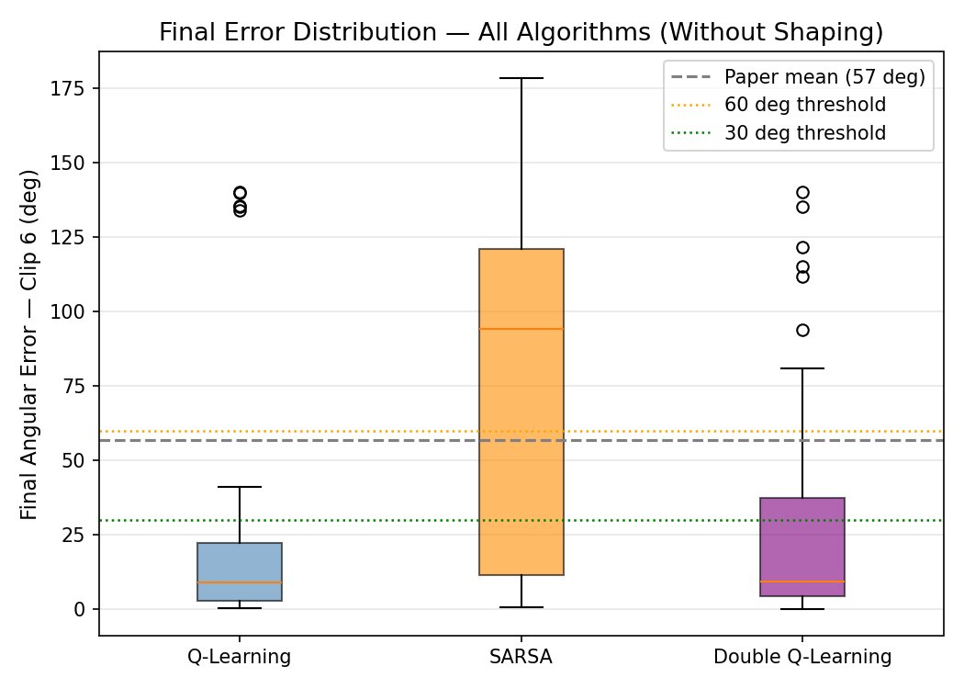
Final Error Distribution & Per-Algorithm Shaping Comparison
With Reward Shaping
Without Reward Shaping
Key Observations:
Q-Learning: Tight IQR (~5°–20°), median ~10°. Very consistent. Shaping eliminates most outliers. Best overall.
SARSA: Extreme IQR (0°–120°+), median ~93°. Bimodal: some subjects converge perfectly, most fail completely.
DQL: IQR wider than QL but better than SARSA (~5°–35°). A few outliers >100° (S13, S20) skew mean. Robust.
Paper Baseline: 57° mean shown as dotted line. Both QL (12.4°) and DQL (24.1°) beat this with shaping.

Slide 20
The Missing Link — EEG Emotion Classifier for Closed-Loop System
Current System (Our Work)
Proposed Full System (Future Work)
1. DEAP: Pre-labelled valence/arousal per clip
2. Q-table reads stored annotations as 'state'
3. RL selects next clip from Q(s,a)
4. Next state read from DEAP labels again
⚠ Cannot deploy — requires pre-labeled data
1. Wearable EEG headset records 32-channel brain signal
2. BiLSTM classifier predicts emotion (94% accuracy)
3. RL agent reads classifier output as current state s
4. Agent selects optimal next song → play → re-classify
✓ Fully real-time, closed-loop therapeutic system
BiLSTM Classifier Results (Mouazen et al., 2024) — The Key Missing Piece
BiLSTM
GRU
CNN
Trans+LSTM
Train: 85% | Test: 94%
Train: 83% | Test: 93%
Train: 84% | Test: 91%
Train: 91% | Test: 73.6%
Theta + Alpha most important (SHAP)
Efficient for real-time (2s window)
Good spatial EEG pattern extraction
Overfits — 6 subjects not enough

Slide 21
Limitations & Future Work
Limitations
Future Work
Small action space: Only 40 DEAP clips; real playlists need 1000s
Integrate BiLSTM (94%) for real-time EEG → emotion classification
No real-time EEG classifier integrated (uses pre-labeled annotations)
Deep RL (DQN/A3C): Neural Q-function for continuous VA space
SARSA fundamentally unsuited: on-policy + sparse rewards = poor exploration
Double SARSA formal evaluation: on-policy + dual-table combined
5-6 subjects fail all algorithms regardless — inter-subject biological variance
Expand to multiple emotion targets: calm, excited, relief, etc.
Discrete Q-table cannot generalize smoothly across continuous VA space
Real-world wearable EEG + Spotify/YouTube API integration
Single target emotion only: 'happy' — multi-goal RL unexplored
Multi-modal: EEG + heart rate + GSR + facial expression fusion
DEAP: Lab-controlled EEG ≠ real-world listening environment responses
Personalization: Online RL that adapts to individual during session
1000 episodes: Q-table may not fully converge for complex subjects
Randomized clinical trials to validate therapeutic effectiveness

Slide 22
Conclusions & Key Takeaways
★
Q-Learning with reward shaping is the top performer: 30/32 subjects reached 'happy' (vs 19/32 paper) — a 58% improvement with mean error of just 12.4°
↑
Double Q-Learning is competitive and more stable: 29/32 convergence, 24.1° mean error. Conservative dual-table updates reduce noise — valuable for clinical reliability.
✗
SARSA is unsuitable for this problem: 9/32 only. On-policy conservatism cannot escape emotion-loop traps in sparse state spaces. Reward shaping offers no benefit.
Φ
Reward shaping (Φ=−100 stagnation penalty) is critical for Q-Learning & Double Q-Learning — it prevents getting stuck in local emotional minima and accelerates convergence by ~2 clips.
◈
The future system integrates our best RL agent with a BiLSTM EEG classifier (94% accuracy) to create a fully real-time, closed-loop music therapy system — the missing clinical piece.
Thank You • Sahil Nagwani (U23AI106) • Vishal Gautam (U23AI127) • PRAKRITI Manhar (U23AI114) | Department of AI, SVNIT Surat

