Slide 1
Reinforcement Learning using EEG Signals
for Therapeutic Use of Music in Emotion Management
Sahil Nagwani
Vishal Gautam
PRAKRITI Manhar
U23AI106
U23AI127
U23AI114
Department of Artificial Intelligence | SVNIT Surat
Based on: Dutta et al. (2020) – IEEE EMBC | Extended with SARSA, Double Q-Learning & Reward Shaping Analysis
DEAP Dataset • 32 Subjects • 3 RL Algorithms • 1000 Episodes • LOSO Cross-Validation

Slide 2
Why This Research Matters
~280M
Music
EEG
people worldwide suffer from
depression (WHO 2023)
therapy shown to reduce
depressive symptoms significantly
provides objective, non-invasive
emotional state measurement
The Core Challenge
Geneva Emotion Wheel
Depressed individuals choose music that worsens their state
Manual playlist curation is unreliable and subjective
Need: An automated, personalized system that reads brain signals and guides emotion toward happiness
RL agents can learn optimal music sequences by trial — without needing direct user feedback
Happy (target) → High Valence, High Arousal
Anger → High Arousal, Low Valence (starting point)
20×20 grid = 400 discrete states
Angular error measures deviation from target

Slide 3
Problem Statement & Related Work
Research Question
Can RL algorithms — Q-Learning, SARSA, and Double Q-Learning — automatically select music sequences from EEG data to guide subjects from negative emotional states (anger) to a target joyful state (happy) more effectively than the original paper's baseline?
Dutta et al. (2020) — Base Paper
EEG Emotion Classifiers (2024)
Our Extensions
Q-Learning on DEAP dataset
19/32 subjects reached 'happy'
Mean angular error: 57°
Reward shaping with φ(s,s')=-100
Leave-One-Subject-Out (LOSO) CV
BiLSTM achieves 94% test accuracy
CNN: 91%, GRU: 93%
SHAP: Theta & Alpha most critical
Autoencoder for dimensionality reduction
Real-time detection feasible (2s window)
Added SARSA (on-policy RL)
Added Double Q-Learning (reduced bias)
Systematic reward shaping analysis
Grid search CV: 10-fold, 3×4×4 params
All 5 algorithms compared at 1000 episodes

Slide 4
Methodology & Experimental Setup
DEAP Dataset
State Space & Evaluation
32 participants, 40 music clips each (1-min)
EEG + Valence/Arousal labels per clip
8 emotions: happy, pleasant, exciting, calm, sad, negative, anger, fear
20×20 Valence-Arousal grid (400 states)
Target: 'happy' → [0.905, 0.425] in normalized VA space
LOSO cross-validation (train on 31, test on 1)
Angular error = deviation from target in GEW degrees
Three RL Algorithms Compared:
Q-Learning
SARSA
Double
Q-Learning
Off-policy
Max Q update
Baseline method
On-policy
Actual next action
Conservative
Dual Q-tables
Decoupled select
& evaluate
Reward Shaping φ(s,s') = −100 if s = s' (else 0) • Hyperparams via Grid Search (α ∈ {0.05,0.1,0.2}, γ ∈ {0.4,0.6,0.8}, ε ∈ {0,0.05,0.1,0.2}) • Best QL: α=0.2,γ=0.6,ε=0.2 • Best DQL: α=0.05,γ=0.8,ε=0.2 • Best SARSA: α=0.1,γ=0.8,ε=0.05

Slide 5
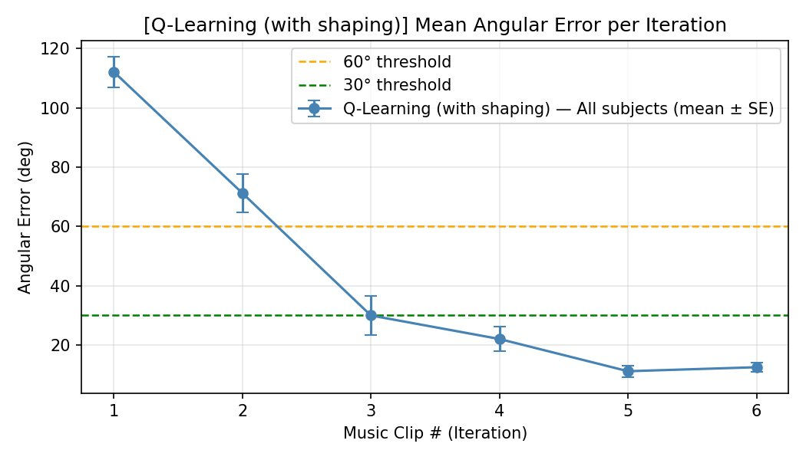
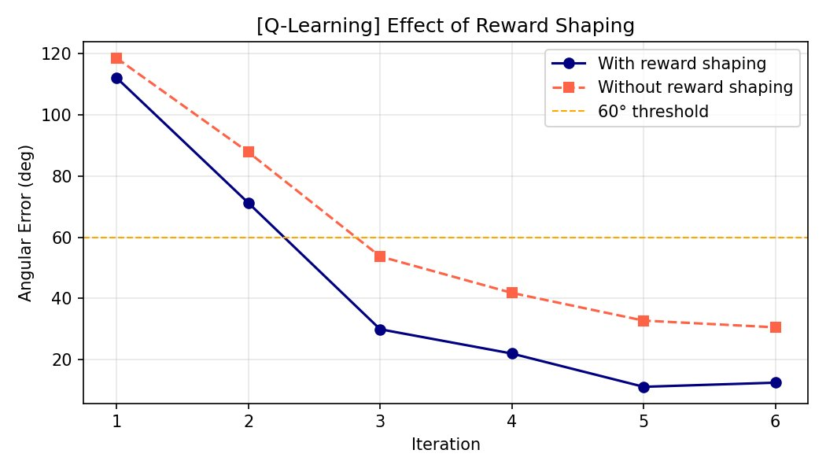
Q-Learning Results
With Reward Shaping
Effect of Reward Shaping
30/32
31/32
12.4°
+58%
Exact 'Happy'
< 30° Error
Mean Error
vs Paper
with shaping
with shaping
±8.9° with shaping
19/32 → 30/32

Slide 6
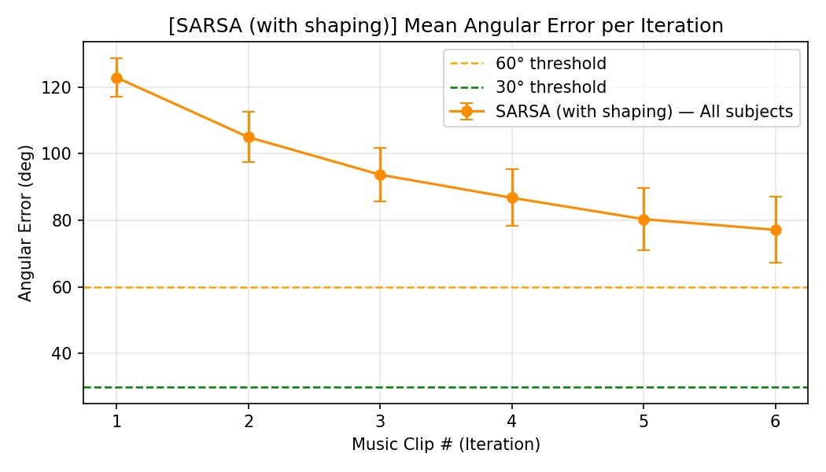
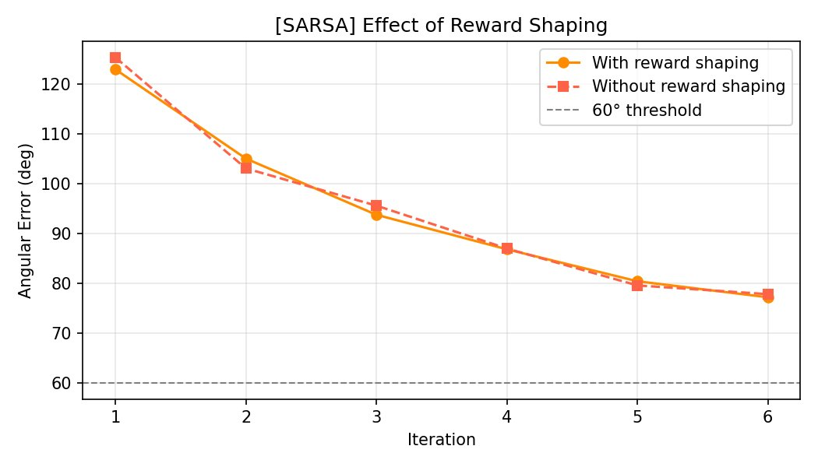
SARSA Results — On-Policy Learning
SARSA: Angular Error per Iteration (With Shaping)
SARSA: Effect of Reward Shaping
SARSA Performance Analysis:
Only 9/32 (with shaping) and 10/32 (without) converged to 'happy' — far below Q-Learning
Mean angular error remained ~77° even after 6 clips — never crossed the 60° threshold
Reward shaping had minimal impact on SARSA (both curves nearly identical)
On-policy conservative updates fail to explore the optimal emotion pathway in DEAP's sparse state space

Slide 7
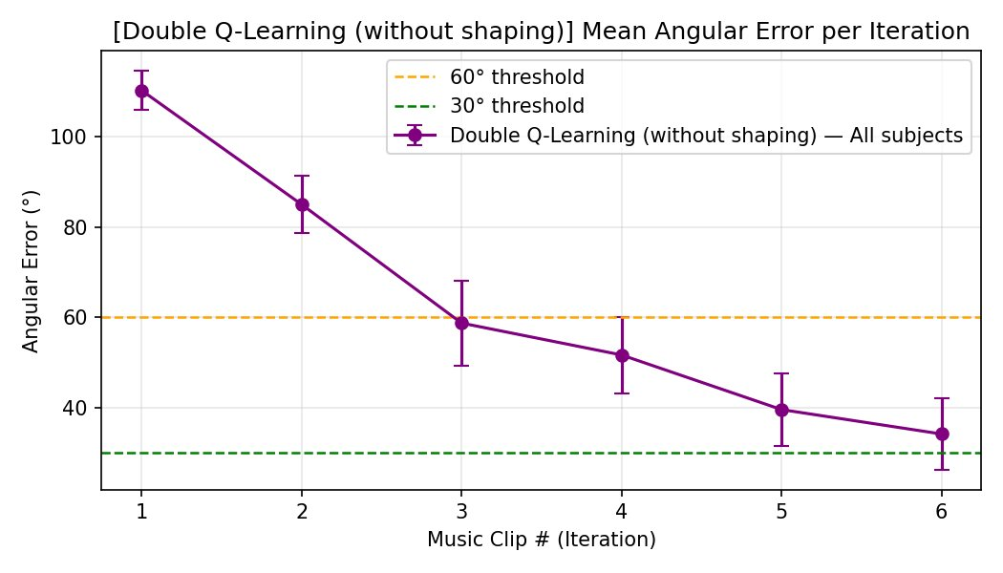
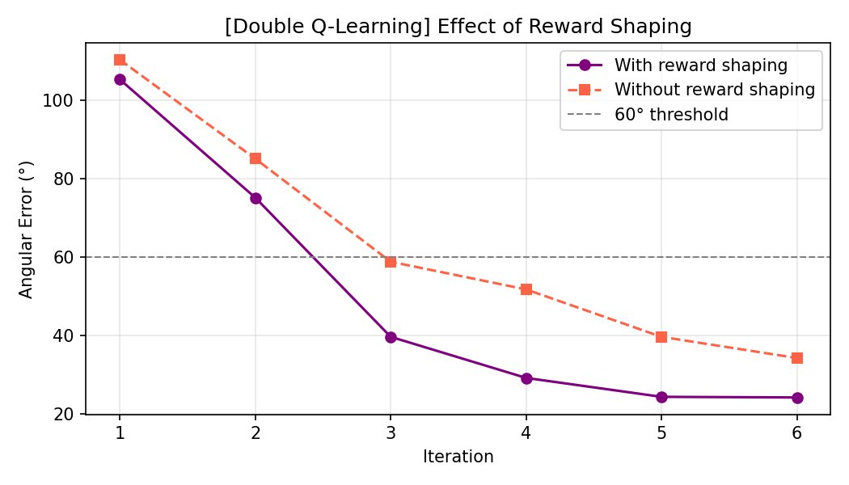
Double Q-Learning Results — Reduced Overestimation Bias
DQL: Angular Error Without Shaping
DQL: Effect of Reward Shaping
29/32
30/32
24.1°
7.3°
Exact 'Happy'
< 60° Error
Mean Error
Grid CV Best
with shaping
with shaping
±27.6° with shaping
α=0.05,γ=0.8,ε=0.2

Slide 8
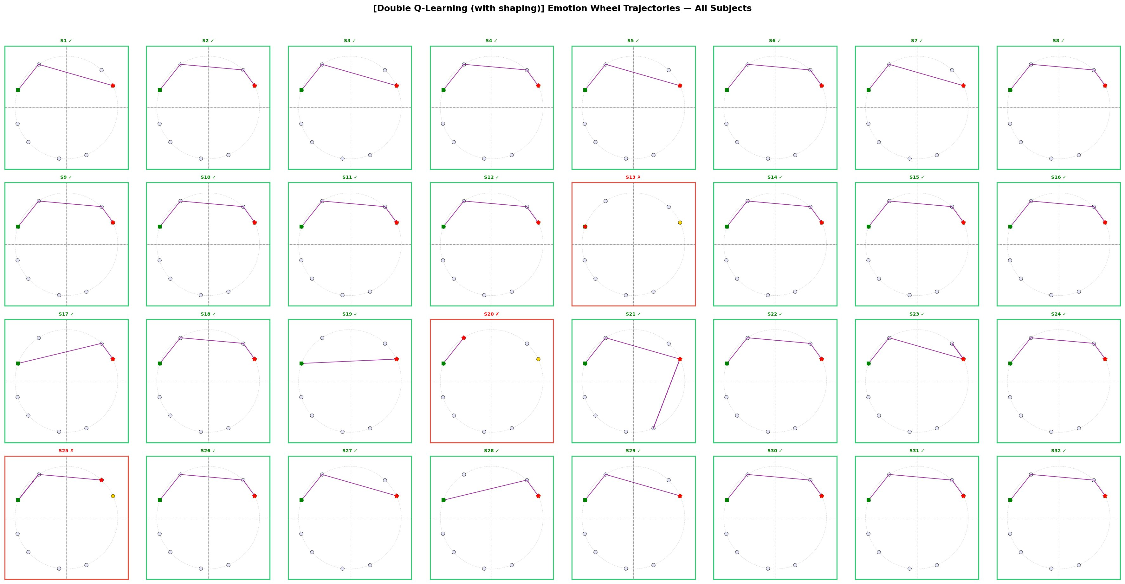
Emotion Wheel Trajectories — Double Q-Learning (With Shaping)
Green border = converged to 'happy' | Red border = failed | Green square = start (anger) | Red dot = final state | Yellow dot = target state

Slide 9
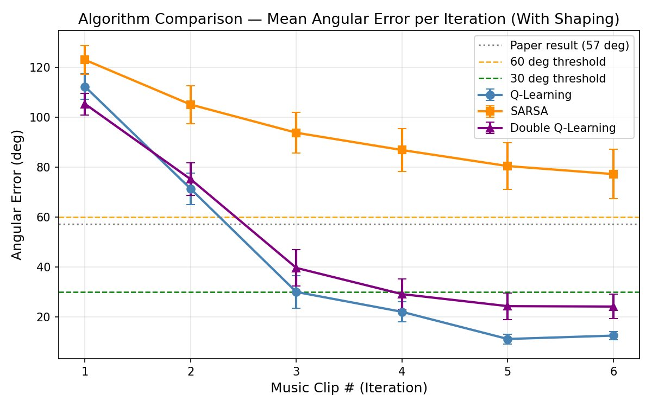
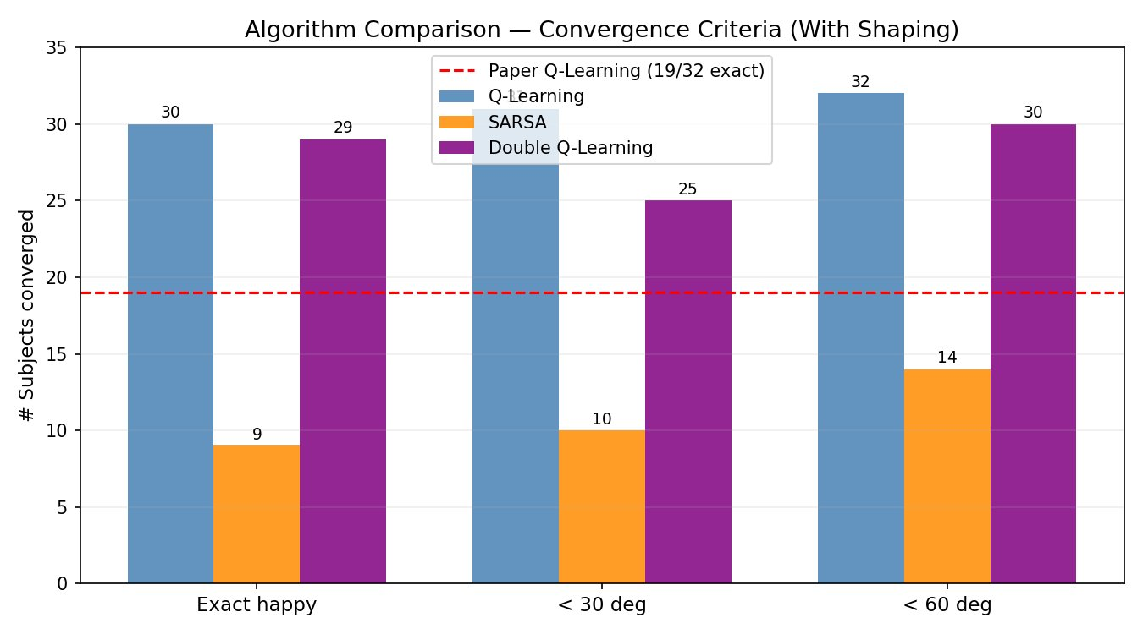
Algorithm Comparison — With Reward Shaping
Master Comparison — With Reward Shaping
Algorithm
Exact Happy
< 30°
< 60°
Mean Error
vs Paper
Q-Learning ★
30/32 (94%)
31/32
32/32
12.4° ±8.9°
+58% better
Double Q-Learning
29/32 (91%)
25/32
30/32
24.1° ±27.6°
+53% better
SARSA
9/32 (28%)
10/32
14/32
77.2° ±56.1°
−53% worse
Paper (QL baseline)
19/32 (59%)
N/A
N/A
57.0° ±2.8°
—

Slide 10
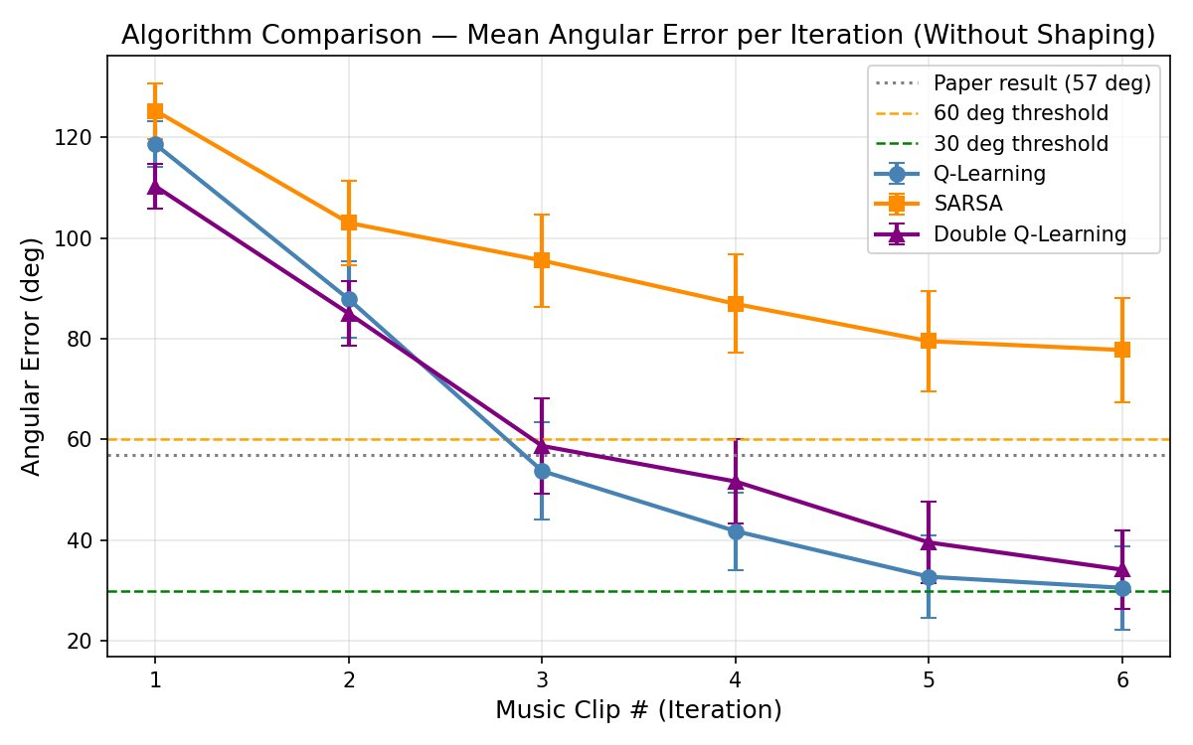
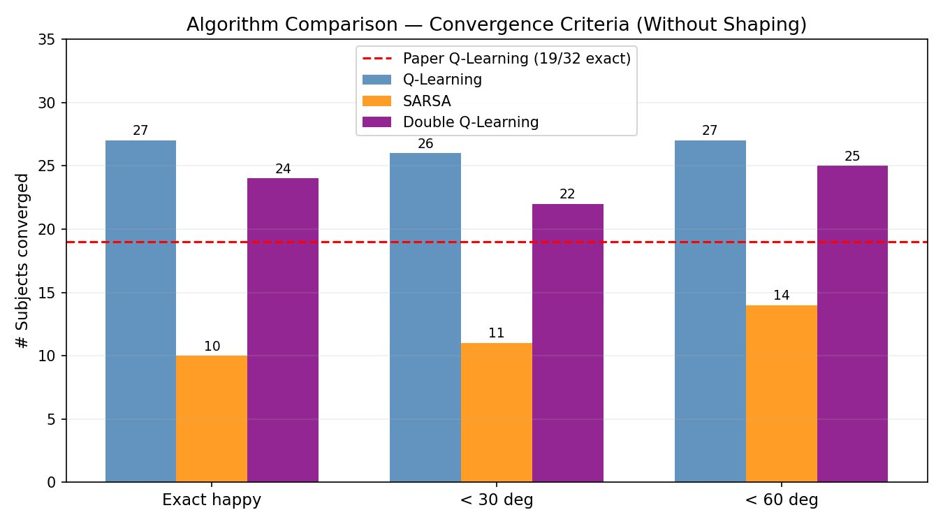
Algorithm Comparison — Without Reward Shaping
Master Comparison — Without Reward Shaping
Algorithm
Exact Happy
< 30°
< 60°
Mean Error
Key Insight
Q-Learning
27/32 (84%)
26/32
27/32
30.6° ±46.7°
Still strong, 6 failures
Double Q-Learning
24/32 (75%)
22/32
25/32
34.2° ±44.6°
Decent without shaping
SARSA
10/32 (31%)
11/32
14/32
77.8° ±58.8°
Marginally better!
Paper (QL baseline)
19/32 (59%)
N/A
N/A
57.0° ±2.8°
Both QL variants beat this

Slide 11
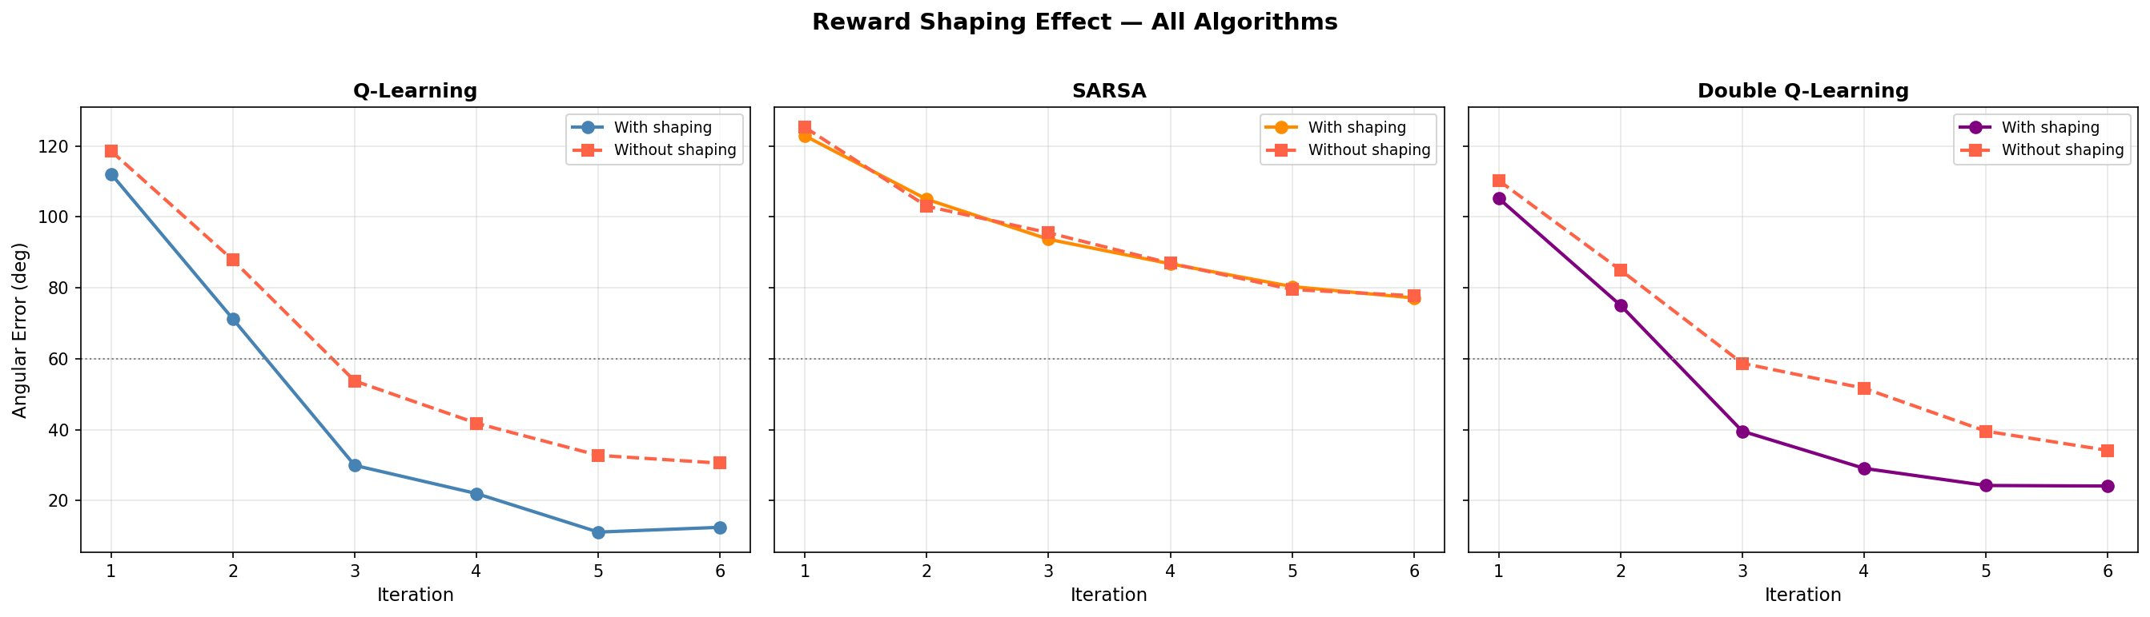
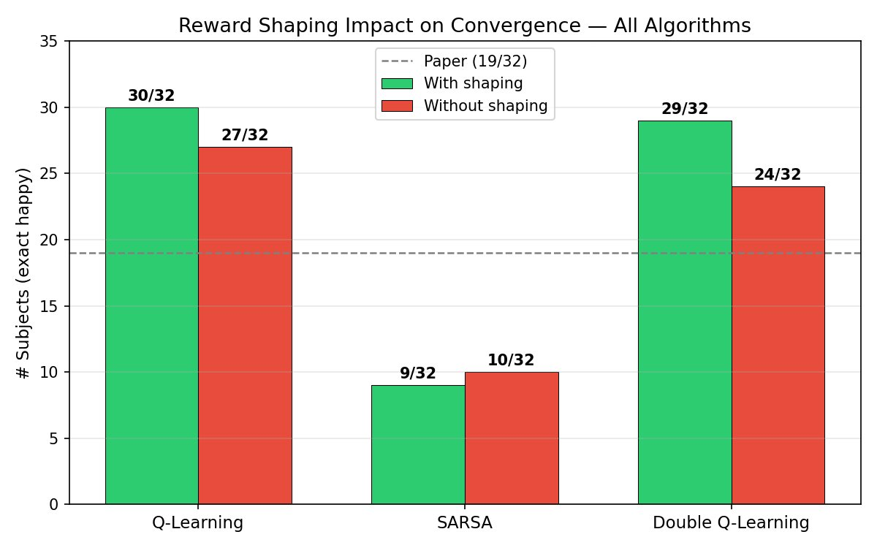
Impact of Reward Shaping — All Algorithms
Q-Learning
SARSA
Double Q-Learning
Shaping provides dramatic improvement: 27→30 exact matches. Error drops from 30.6°→12.4°. Shaping cuts errors by ~60% at clip 3 vs without.
Reward shaping has minimal effect on SARSA. Both curves nearly overlap throughout all 6 iterations (~77°). The on-policy update cannot leverage the penalty effectively.
Shaping provides moderate improvement. With shaping: error reaches ~24° by clip 6. Without: ~34°. Shaping benefit is real but smaller than Q-Learning.

Slide 12
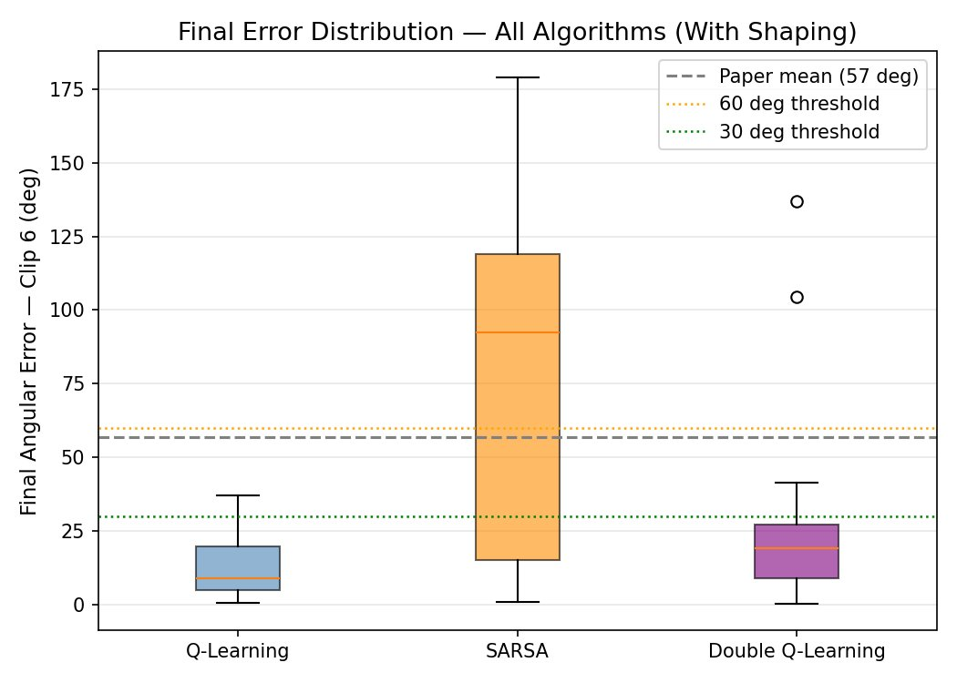
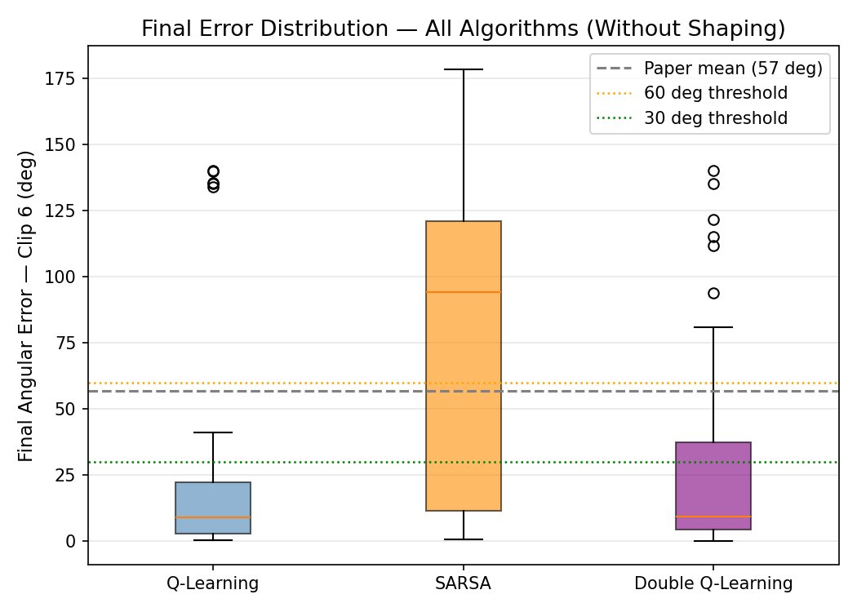
Final Error Distribution & Key Findings
With Reward Shaping
Without Reward Shaping
Key Findings:
Q-Learning has a tight, low error distribution (median ~10°) — highly consistent across subjects with shaping
SARSA has extreme variance (0°–180°) — some subjects get lucky, most fail completely
Double Q-Learning is more consistent than SARSA but slightly higher median error than Q-Learning
Paper baseline (57° mean) is beaten by both Q-Learning (12.4°) and Double Q-Learning (24.1°) with shaping

Slide 13
Discussion: The Missing Link — EEG Emotion Classifier
Current Pipeline (Our Work)
Ideal Full System (Future Work)
DEAP dataset: Pre-labelled valence/arousal
RL agent selects music clips from Q-table
Emotion state read from stored annotations
No real-time EEG classification needed
Limitation: Cannot deploy in real-world
BiLSTM classifier: 94% accuracy (Mouazen 2024)
Real-time EEG → emotion state prediction (2s)
Live RL agent selects next music clip
Closed-loop: classify → recommend → re-classify
Deployable in clinical/home settings with wearable EEG
EEG Classifier Results (from 2nd paper — Mouazen et al., 2024):
BiLSTM
GRU
CNN
Transformer+LSTM+Fusion
Train: 85% Test: 94%
Train: 83% Test: 93%
Train: 84% Test: 91%
Train: 91% Test: 73.6%
Best model — Theta & Alpha features dominant (SHAP)
Close second — efficient for real-time
Spatial patterns captured
Prone to overfitting on small data

Slide 14
Limitations & Future Work
⚠ Limitations
🚀 Future Work
Small action space: Only 40 music clips in DEAP; real playlists need thousands
Integrate BiLSTM real-time EEG classifier (94% accuracy achieved in companion work)
Pre-labelled states: No real-time EEG classifier integrated yet
Deep RL (DQN/PPO) with neural Q-function for continuous state generalization
SARSA failure: Poor exploration strategy in sparse, stochastic emotion space
Expand to multiple emotion targets: calm, excited, relief, etc.
Subject variability: 5-6 subjects consistently fail all algorithms (biological variance)
Real-world wearable EEG deployment with live music streaming APIs
Discrete Q-table: Cannot generalize smoothly across continuous VA space
Multi-modal input: EEG + HR + GSR + facial expression fusion
Single target emotion: Only 'happy' used as target; multi-target scenarios not explored
Double SARSA: Combine on-policy conservatism with dual-table bias reduction
DEAP recording context: Lab-based; real-world emotion responses differ from controlled settings
Randomized controlled trials to validate clinical therapeutic effectiveness
Biggest Missed Opportunity: A closed-loop system combining the BiLSTM classifier (94% test accuracy) with our best RL agent (Q-Learning, 30/32 convergence) could form a clinically viable, fully automated music-based emotion therapy system requiring no manual annotation.

Slide 15
Conclusions & Takeaways
★
Q-Learning with reward shaping is the best performer: 30/32 subjects converged to 'happy' (vs 19/32 in the original paper) — a 58% improvement.
↑
Double Q-Learning is competitive: 29/32 with shaping, more stable than standard QL due to reduced overestimation bias. Mean error 24.1°.
✗
SARSA is unsuitable for this task: On-policy updates cannot handle the sparse, stochastic emotion transition space. Only 9/32 converge.
✓
Reward shaping is critical for QL & DQL but irrelevant for SARSA. The φ(s,s')=-100 stagnation penalty accelerates convergence significantly.
◈
Integrating a real-time EEG emotion classifier (BiLSTM, 94% accuracy) would enable a fully closed-loop therapeutic music recommendation system.
Thank You • Sahil Nagwani • Vishal Gautam • PRAKRITI Manhar | U23AI106 · U23AI127 · U23AI114

