Slide 1

TECHNICAL INTERVIEW CASE STUDY
VENKAT GARAPATI

Slide 2
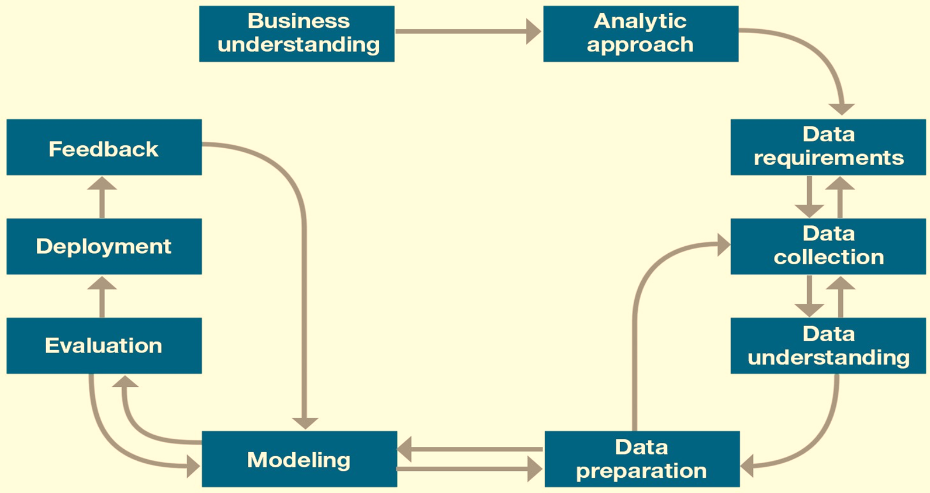
Methodology

Slide 3
Business Problem Understanding
Objective: The study is conducted to predict if the client will subscribe a term deposit or not. The dataset consists of 41188 instances where we have 20+ attributes.
Goal: The goal is to build a model and perform cost benefit analysis to understand the operational costs and benefits generated by client's term deposits.

Slide 4
Analytical Approach
We will express and solve the following problem in the context of statistical and machine learning techniques. The steps involved are
Conducting Exploratory Data Analysis
Building Classification model using ensemble methods like Extreme gradient boosting
Evaluating the model for deployment through diagnostic measures.

Slide 5
Insights of the Data
There are about 20 features for the data comprising of clients, campaign/marketing, social and economic context attributes.
The missing data is classified under the label unknown for categorical features.
Target variable (y): Client’s subscription to the term deposit.
Total No. of Observations | Subscribed to term deposits | Not subscribed to term deposits
41188 | 4640 | 36548

Slide 6
Insights of the Data
The following tables describe the count of term deposits who have no default credit, housing & personal loan
Marital | Count
Divorced | 172
Married | 838
Single | 552
Unknown | 7
Total | 1569
Generation | Count
Baby Boomers (74 - 55) | 214
Gen X (55 - 43) | 274
Gen Y (43 - 24) | 973
Gen Z ( < 24) | 56
Traditionalists (>74) | 52
Total | 1569
Job | Count
admin. | 479
blue-collar | 194
technician | 39
services | 40
management | 129
retired | 153
entrepreneur | 55
self-employed | 104
housemaid | 82
unemployed | 234
student | 46
unknown | 14

Slide 7
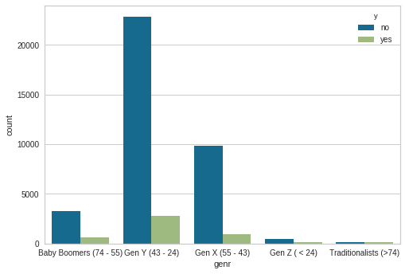
Insights of the Data
Frequency of depositors among different generations

Slide 8
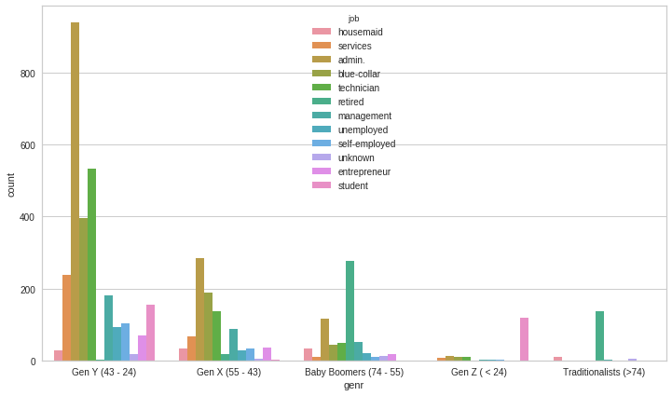
Insights of the data
Frequency plot of different generation’s who have subscribed for term deposit

Slide 9
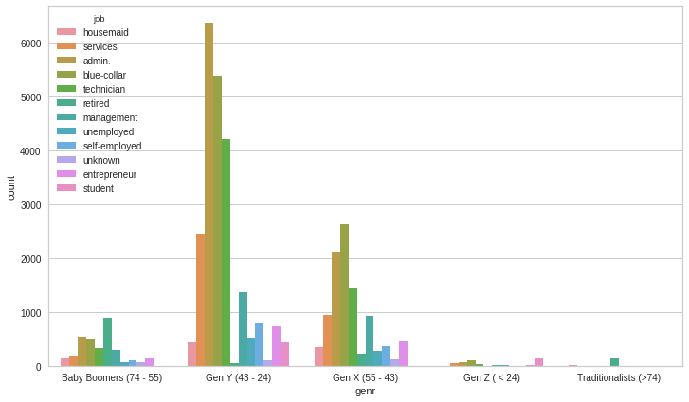
Insights of the data
Frequency plot of different generation’s who have not subscribed for term deposit

Slide 10
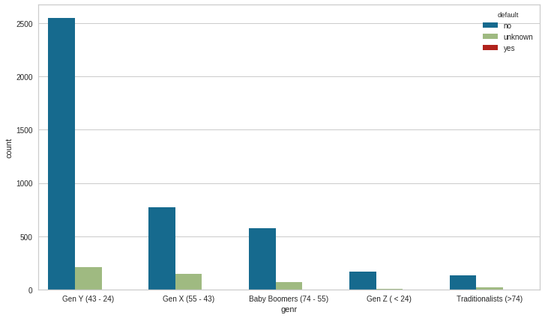
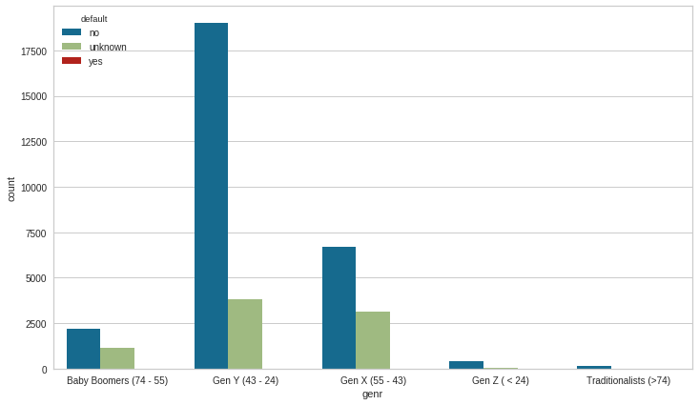
Insights of the data
Frequency plot of subscribed and non subscribed depositors who have default credit belonging to different generations

Slide 11
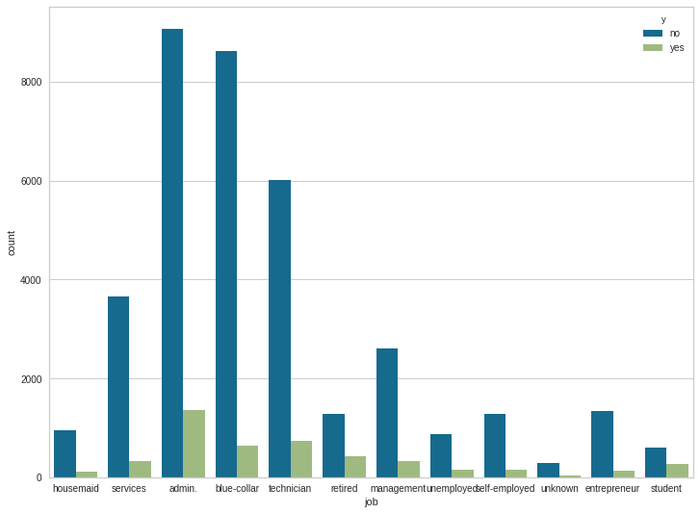
Insights of the data
Frequency plot of subscribed and non subscribed depositors for varying forms of employment

Slide 12
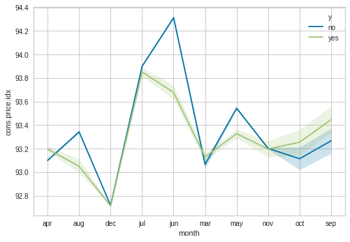
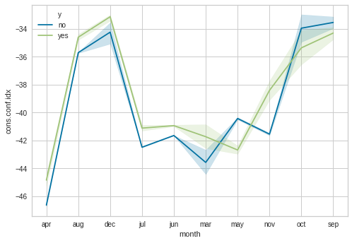
Insights of the data
cons.price.idx and cons.conf.idx of subscribed and non subscribed depositors for different months

Slide 13
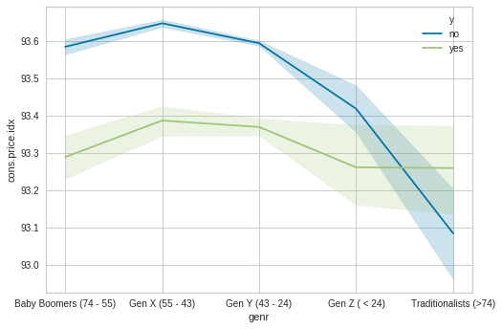
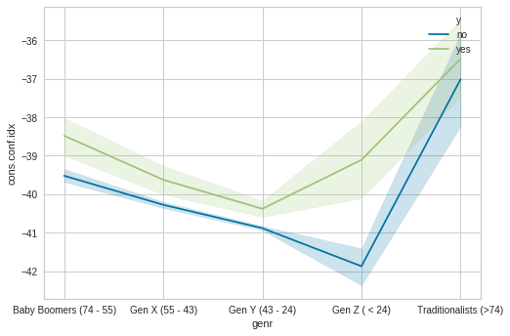
Insights of the data
cons.price.idx and cons.conf.idx of subscribed and non subscribed depositors for varying generations

Slide 14
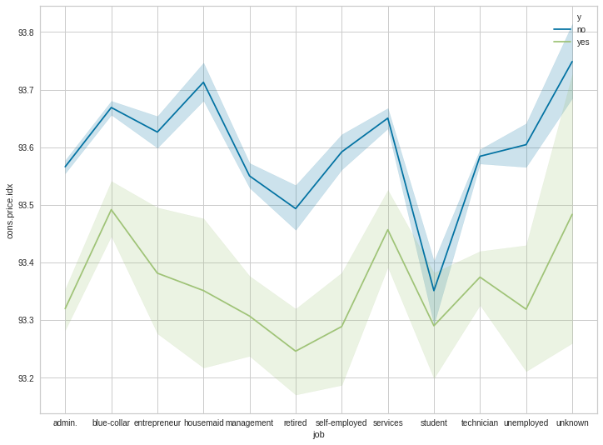
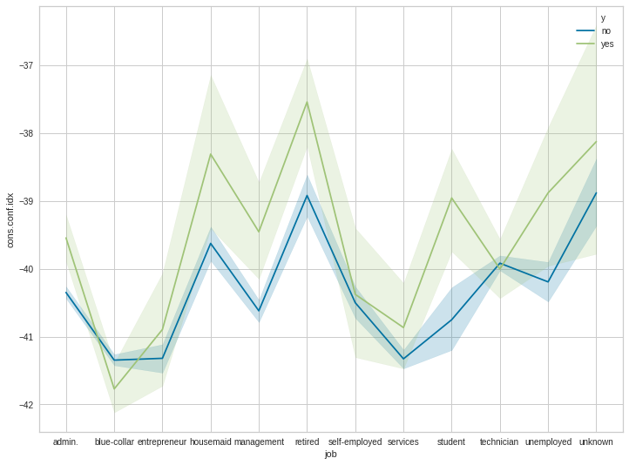
Insights of the data
cons.price.idx and cons.conf.idx of subscribed and non subscribed depositors for varying employment

Slide 15
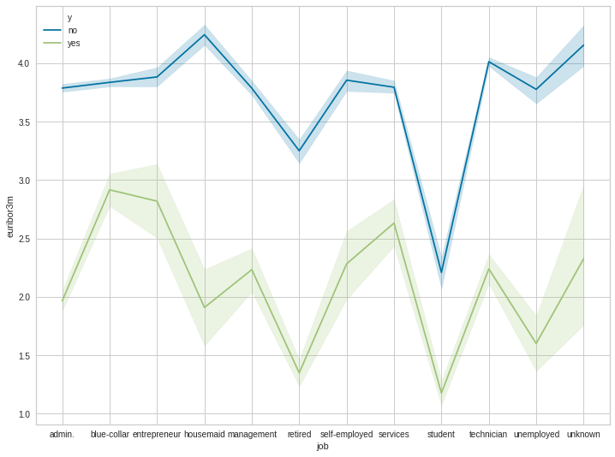
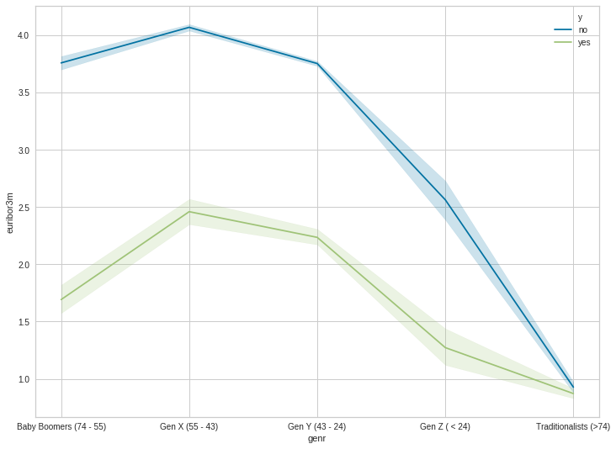
Insights of the data
Euribor 3-month rate of subscribed and non subscribed depositors for varying employment and generations

Slide 16
Data Preparation
Dummy variables are created for the categorical features.
The missing data is classified under the label ‘unknown’.
The data is balanced using sampling process, as there are higher number of non term depositors than depositors.(Total No. of Observations: 41188, Subscribed: 4640 and Not subscribed : 36548)
Data is transformed by creating 4 different data sets through sampling techniques such as random under sampling, random over sampling, SMOTE sampling and SMOTE & Tomek sampling using imblearn python package.
Data is further is split into training, validation and testing.

Slide 17
Data Modelling
4 models are built using various sampling techniques and are trained using Extreme gradient boosting.
Bayesian optimization is used to find the model hyperparameters that yield the best score on the validation set metric.
Bayesian methods operate in much the same way we do. we form an initial view of the world (called a prior) and then we update our model based on new experiences (the updated model is called a posterior). Bayesian hyperparameter optimization takes that framework and applies it to finding the best value of model settings in less time through evaluation based on past trials.
At a high-level, Bayesian optimization methods are efficient because they choose the next hyperparameters in an informed manner.
Notes:
The one-sentence summary of Bayesian hyperparameter optimization is: build a probability model of the objective function and use it to select the most promising hyperparameters to evaluate in the true objective function.
Hyperparameter optimization is represented in equation form as:
Here f(x) represents an objective score to minimize— such as RMSE or error rate— evaluated on the validation set; x* is the set of hyperparameters that yields the lowest value of the score, and x can take on any value in the domain X.

Slide 18
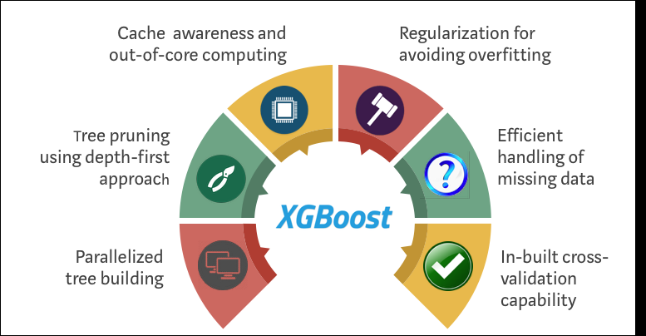
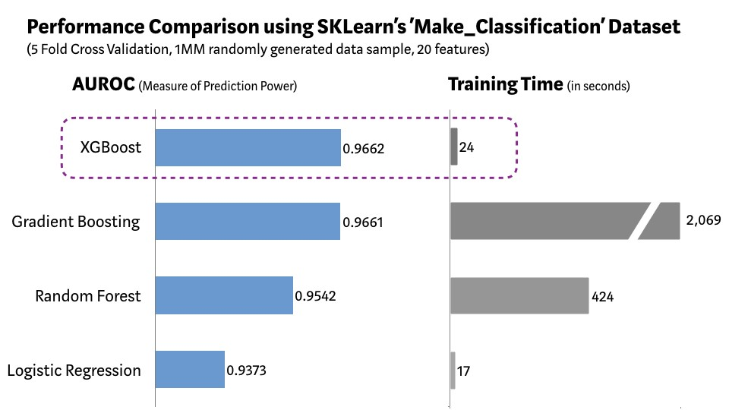
Data Modelling
Since its introduction, this algorithm has not only been credited with winning numerous Kaggle competitions but also for being the driving force under the hood for several cutting-edge industry applications. As a result, there is a strong community of data scientists contributing to the XGBoost.

Slide 19
Model Evaluation
Data is validated by considering diagnostic measures such as accuracy, precision, recall, f-1 score, AUC, ROC curves and bias vs variance trade-off curves.
Sr.no | Models | Accuracy | Specificity | Precision | Recall | F-1 score | AUC
0 | Under-sample | 0.888667 | 0.826847 | 0.844729 | 0.951083 | 0.894757 | 0.943875
1 | Over-sample | 0.954338 | 0.913415 | 0.920368 | 0.995028 | 0.956243 | 0.986956
2 | SMOTE-sample | 0.953061 | 0.957784 | 0.956945 | 0.948289 | 0.952597 | 0.993523
3 | SMOTE&Tomek-sample | 0.951763 | 0.953131 | 0.953429 | 0.950408 | 0.951916 | 0.993628

Slide 20
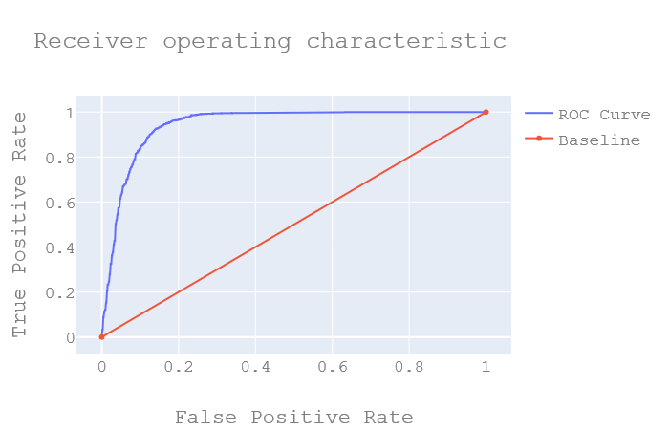
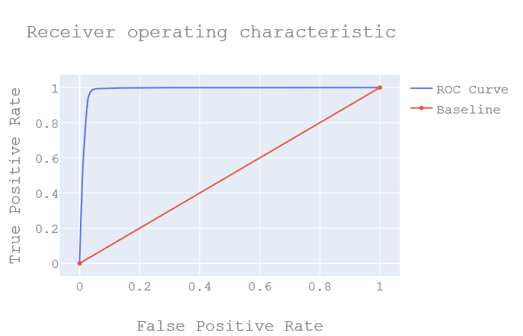
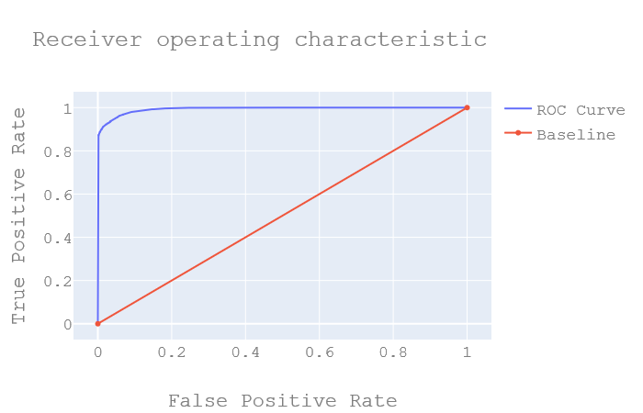

ROC Curves
Under, Over sample, SMOTE and SMOTE & Tomek model roc curves from left to right

Slide 21
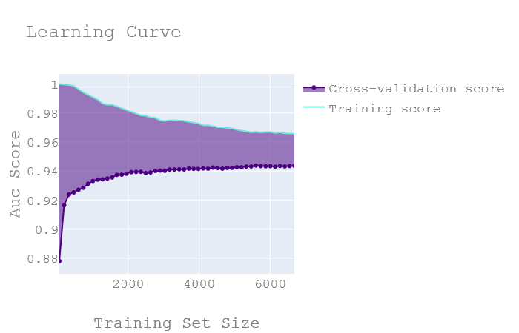
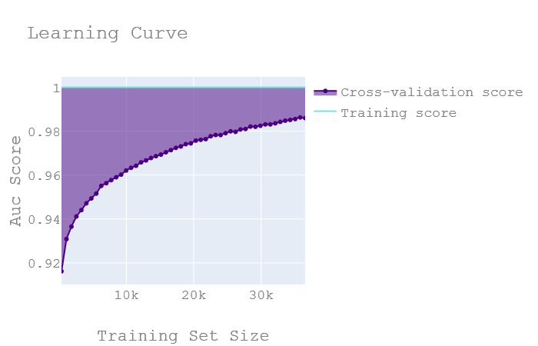
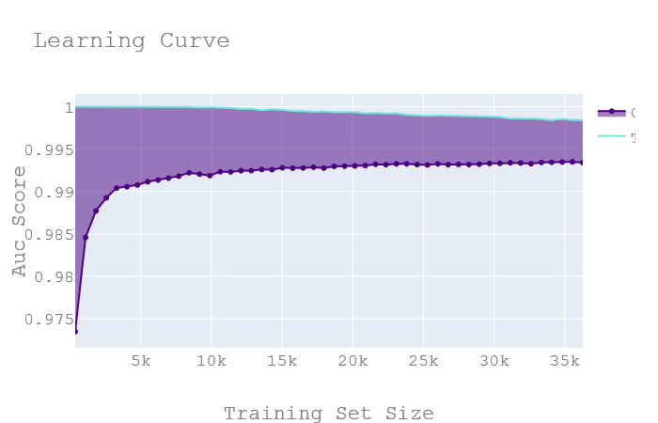
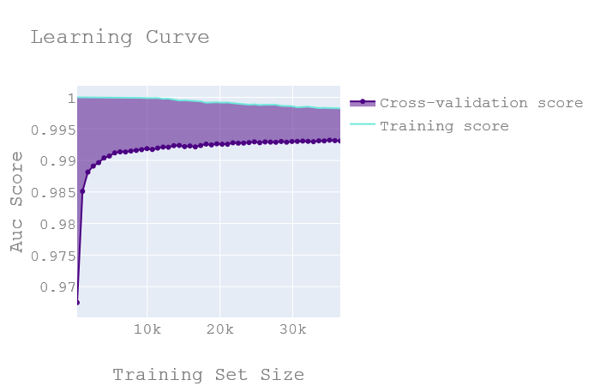
Learning Curves

Slide 22
Further Evaluation
Let us consider a hypothetical situation where the data is directed towards a marketing campaign. The built-in model is used to contact a client to subscribe a term deposit or not. Cost benefit analysis is carried out to test the expenses incurred to money benefitted by deployment of machine learning model.
Average cost of marketing/Administration = $5
Assuming for every successful deposit cost, benefit obtained = $100
In our case we are considering average costs and benefits. this is purely done for the sake of simplicity. we are not generating any additional data as it may change the dynamic of the data behavior.
NOTE: In a real case scenario the following costs and interest rate tend to change due to varying factors.

Slide 23
Further Evaluation
Lets us understand how the cost are distributed based on the confusion matrix (Cost benefit matrix):
True Positives, T.P (0cost,0 benefit) = $0
True Negatives, T.N (5cost,100 benefit) = 100 - 5 = $95
False Positive, F.P (0cost,0 benefit) = -$95
False Negatives, F.N (5cost,0 benefit) = 0 - 5 = $ -5
Expected Profit: Matrix multiplication of confusion matrix and cost benefit matrix element wise.
 | Not Subscribed | Subscribed
Not Subscribed | 0 | -95
Subscribed | -5 | 95

Slide 24
Further Evaluation
#Calculating the true loss: benefit = actual benefit - overall_expected_benefit
#Percentage of true loss: pr = (benefit/actual benefit)*100.
The intuition behind the cost benefit analysis is to evaluate the model on a hypothetical real time scenario for deployment.
*currency: USD
Sr.no | Models | True_loss | % of loss
0 | Under-sample | 27665 | 23.185551
1 | Over-sample | 28330 | 23.742876
2 | SMOTE-sample | 30630 | 25.670466
3 | SMOTE&Tomek-sample | 26805 | 22.464801

Slide 25
Conclusion
Married couples and Admin. employers are most likely to subscribe to term deposits.
Marketing should be focused more on the Gen Y generation as they are the current working and major subscribers for deposits.
Marketing is to be improved for blue-collar employees.
SMOTE & Tomek model is to be used for deployment.

Slide 26

Acknowledgment
Thank You for the opportunity

