Slide 1
Risk Analysis OF Lending Loans
By
Parvathy Jayaram
Venu Kulala

Slide 2
Problem Statement
Identify the patterns in the given data to identify the risk of a person being defaulted
Identify patterns to deny the loan based for defaulters, reduce the loan amount,
Identify patterns to Approve the loan for the risky profiles with high interest rates or reduce the loan amount
Patterns to approve the loan for non-defaulters and reduce the risk of losing the business

Slide 3
Objective
Objective is to identify the risky loan applicants at the time of loan application so that such loans can be reduced thereby cutting down the amount of credit loss. Identification of such risky profiles using Exploratory Data Analysis is the aim of this case study.
In other words, to understand the driving factors (or driver variables) behind loan default, i.e., the variables which are strong indicators of default. The company can utilise this knowledge for its portfolio and risk assessment. And thus minimise the risk of losing money while lending to customers.

Slide 4
Data Cleaning
There are columns which has 100% missing values. Selecting those columns with more than 50% because they add noise into the data in large propotion.
There were 57 columns with more than 50% values as missing. Removing such columns as these columns clearly add noise and wont help in analysis.
We see that there are 50 records with the earliest credit line date greater than 2011(where 2011 is the max range of the data we should have). Lets check and fix the issue

Slide 5
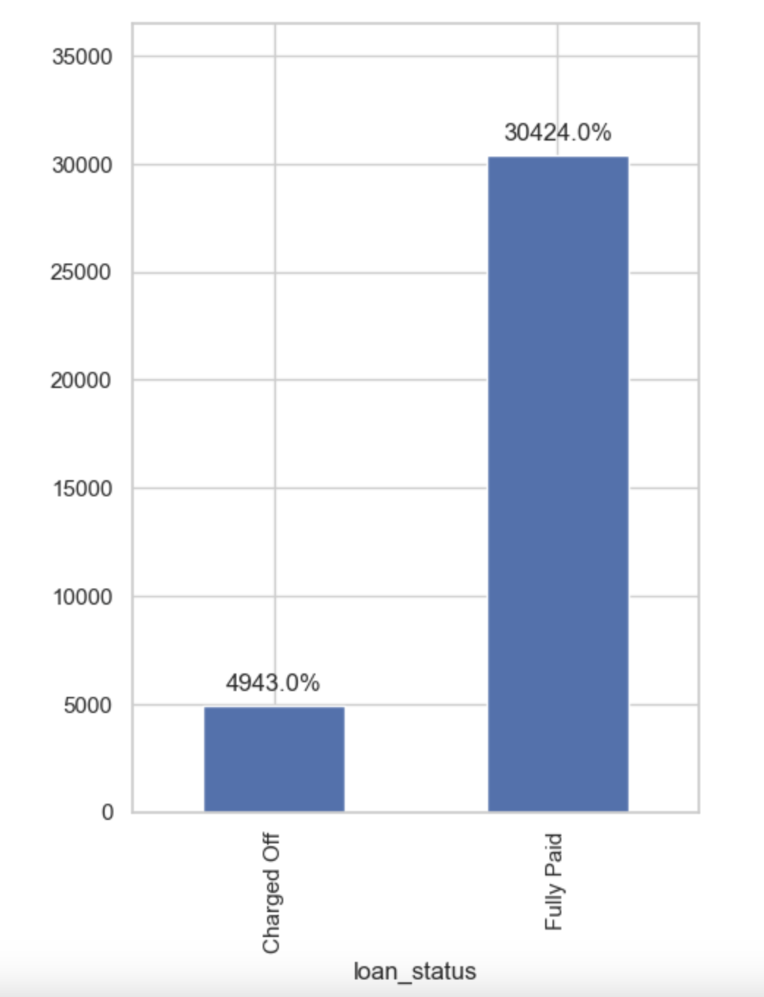
Analysis – Loan Status
Approximately 14% of loans in the dataset are defaulted.
Any variable that increases percentage of default to
higher than 16.5% should be considered a business risk.
(16.5 is 18% higher than 13.97 - a large enough increase)

Slide 6
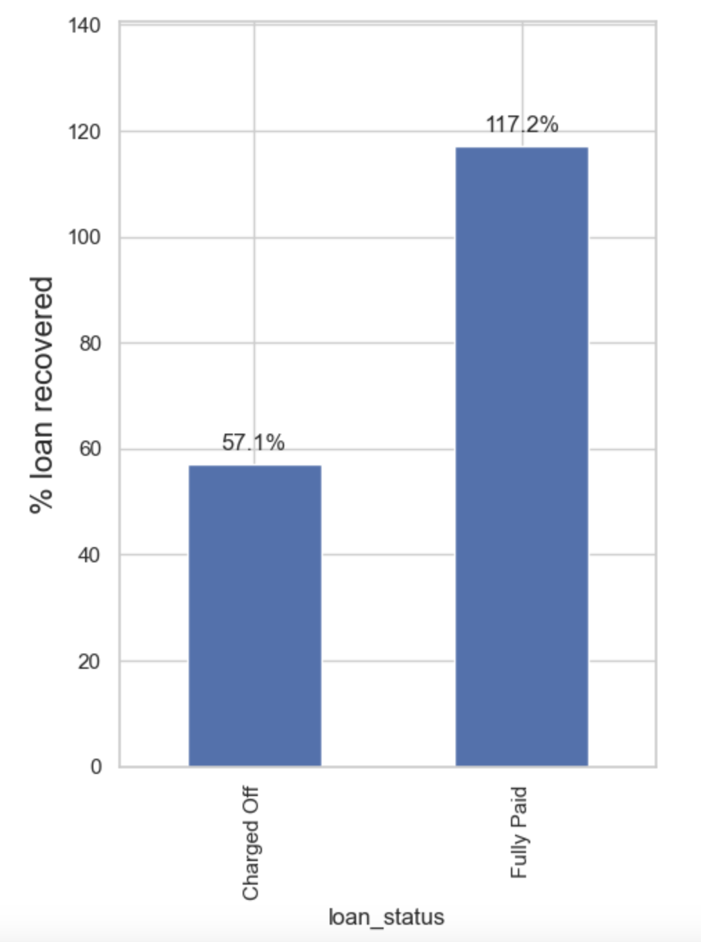
Analysis – Loan recovery rate
Lending Club only recovers 57% of the loan amount when loans
are defaulted.
On fully paid up loans, the company makes 17% profit.

Slide 7
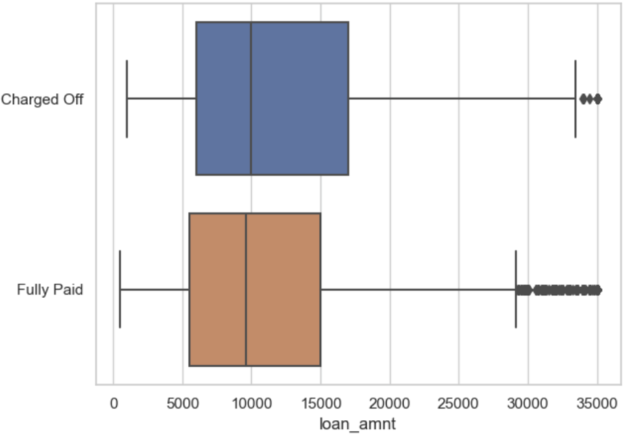
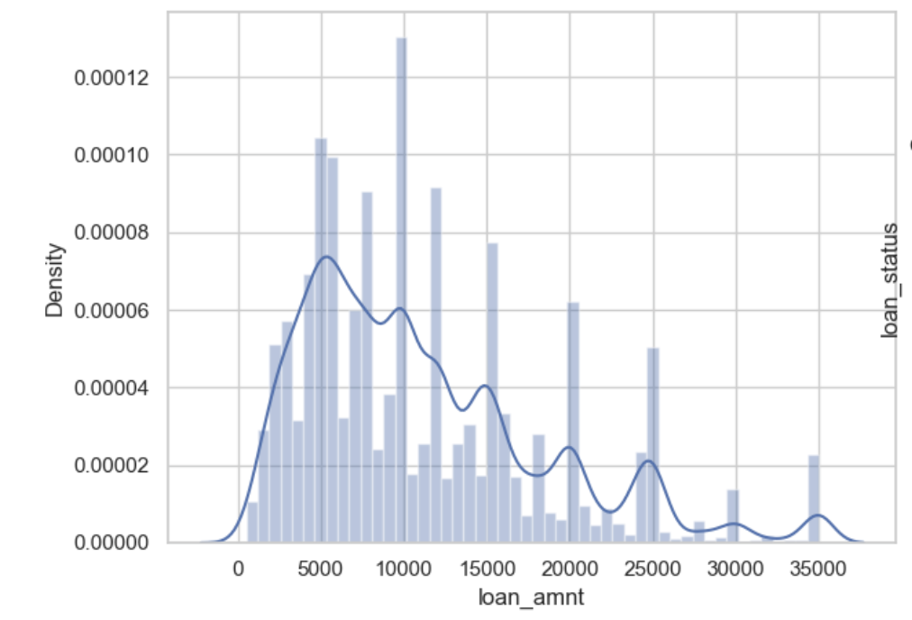
Analysis – Loan Amount
Overall, the applied loan amount distribution is slightly
right-skewed with mean greater than the median.
Most of the loans granted are below 15000 (75 percentile value)
Funding amounts see a spike around each 5000 boundary. We will use 5000 as bucket size for later analysis.
Charged off loans are shifted towards higher average loan amount request.

Slide 8
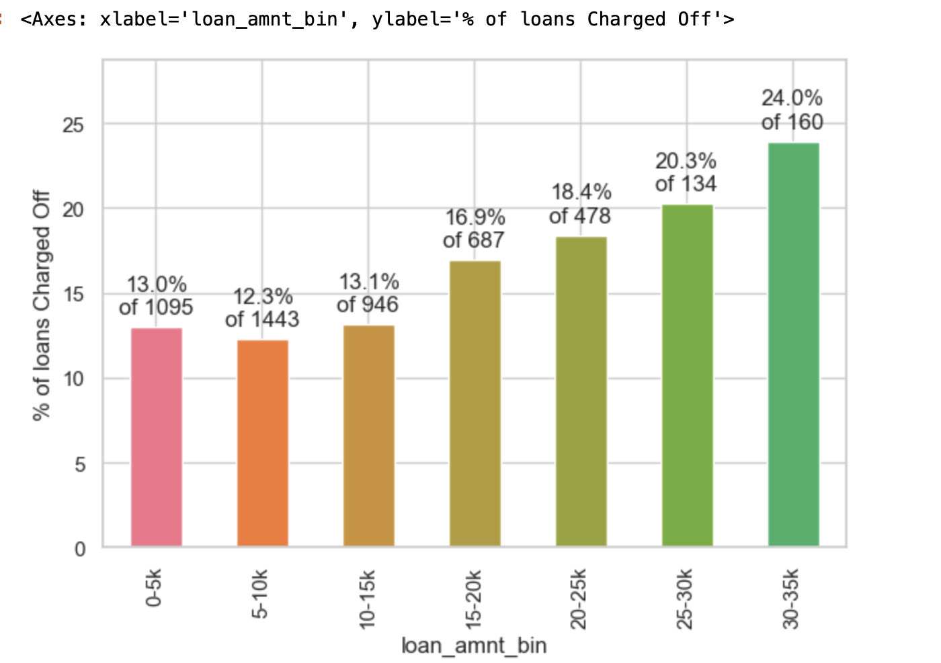
Analysis – Derived Categorical Loan Amount Variable
The % of charged off loans increases substantially as we go up the loan amount buckets.
Most loans are below 20000 amount. The higher loans, though lesser in number, carry a substantially higher risk of default.

Slide 9
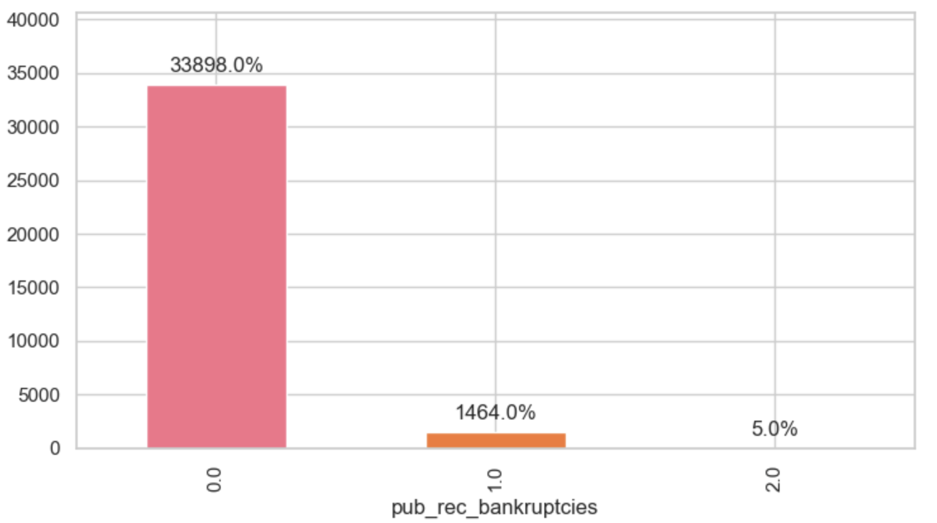
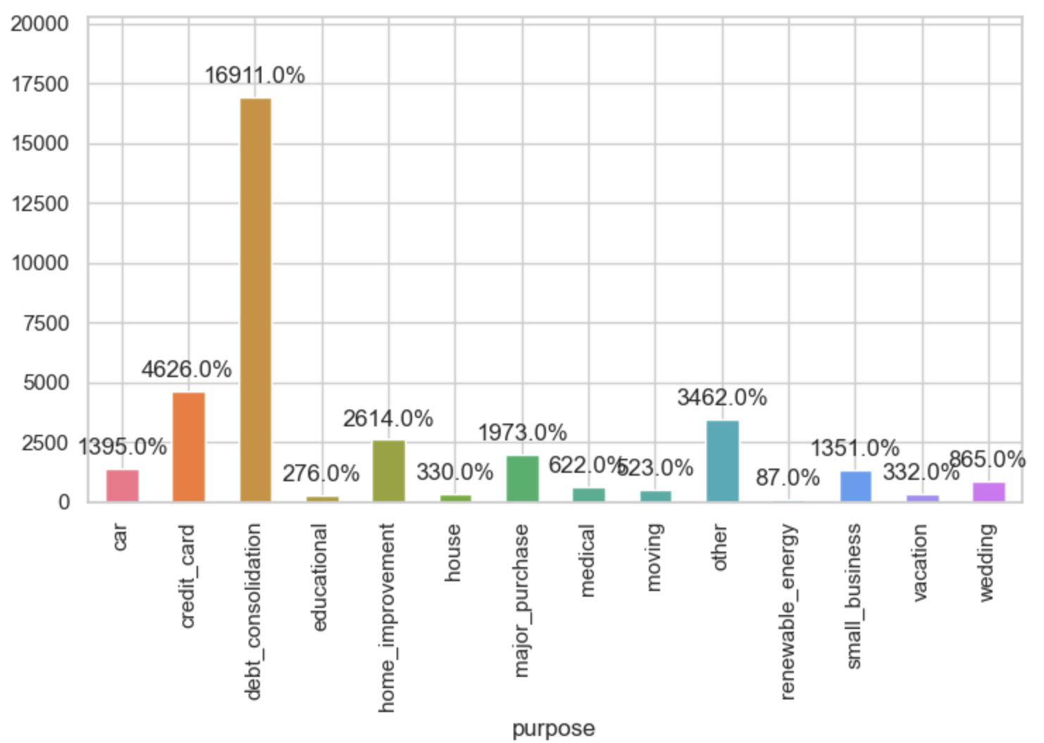
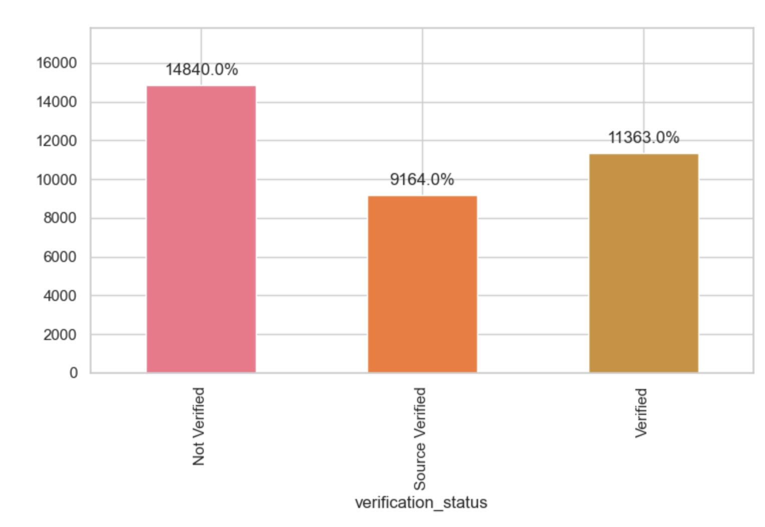
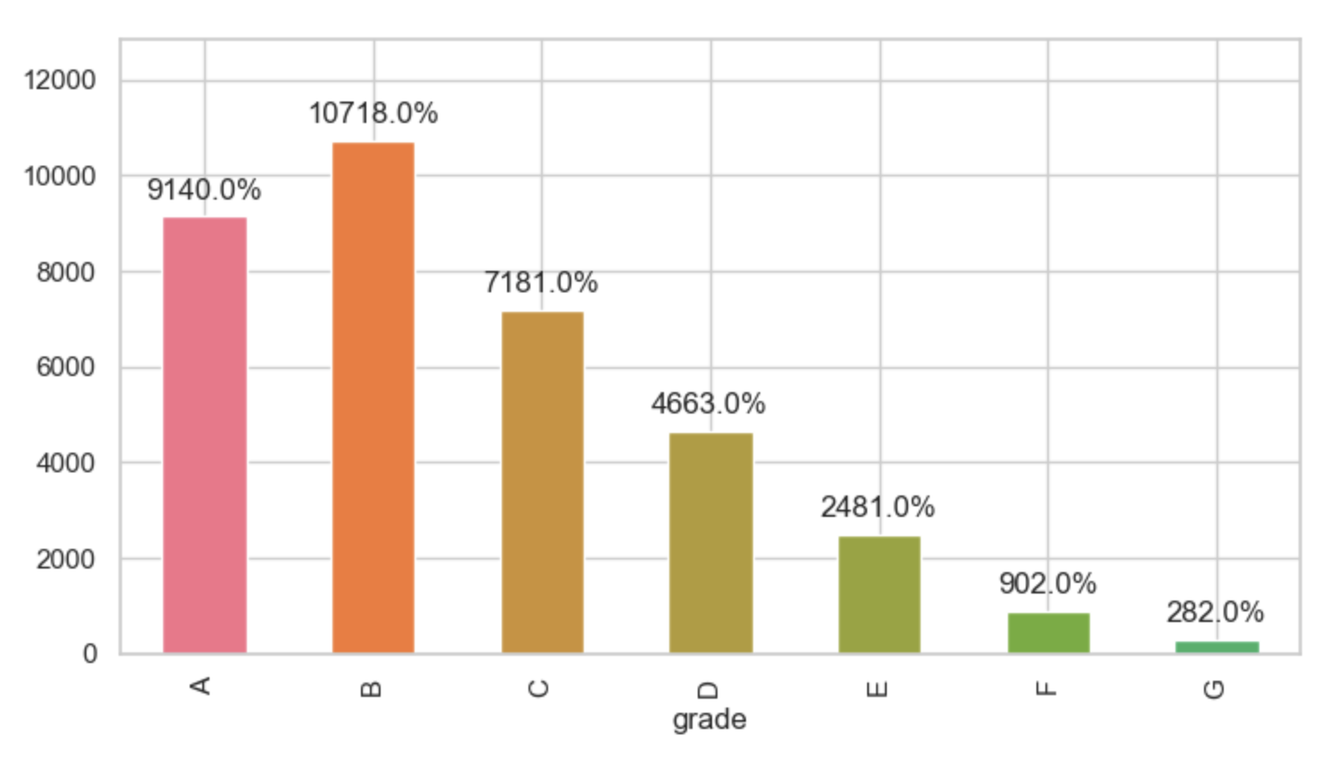
Other Categorical Variables
Most loans are for 36 month term
Very few loans are extended to people with prior record of bankruptcy
debt_consolidation is by far the largest 'purpose' for seeking a loan
Most approved loans are high grade
We should investigate frequencies of defaults by term, purpose and prior record of bankruptcy

Slide 10
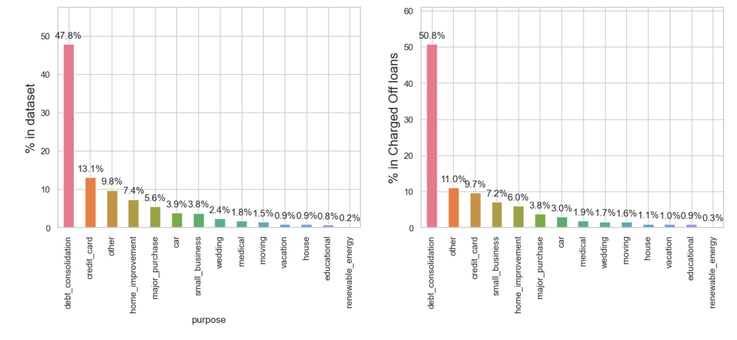
Analysis –Loan Status
The category 'small_business' percentage doubles from 3.8 to 7.2 for Charged Off loans. Let's see how the categories of this variable behave.

Slide 11
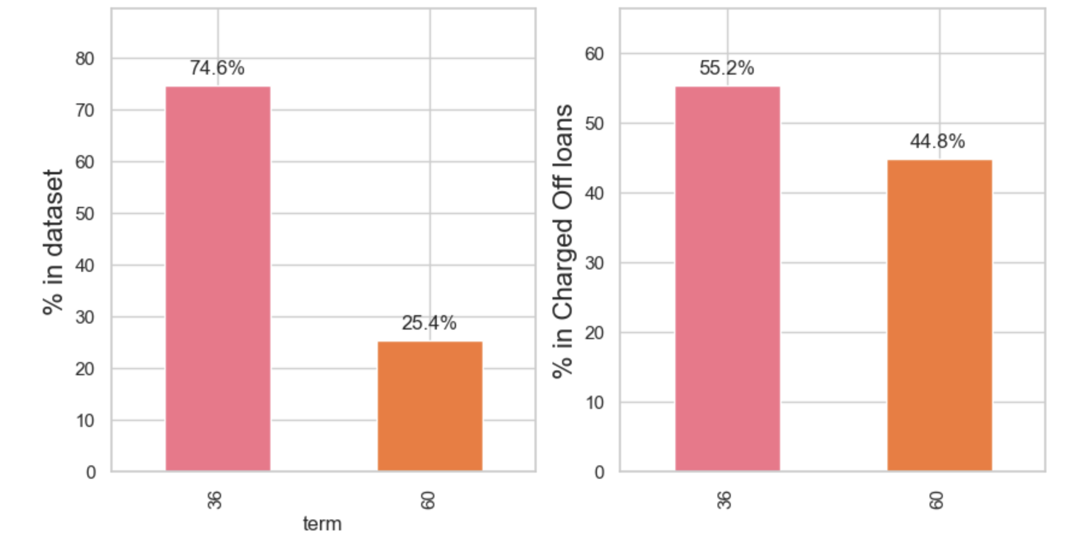
Analysis – Loan Status vs Term
Around 75% of the total loans are given for duration of 3 years. while just 25% of the loans are those given for 5 years.
Among Charged Off loans, percentage of term 60 months rises to 45%. The higher term loans have a higher chance of default.

Slide 12
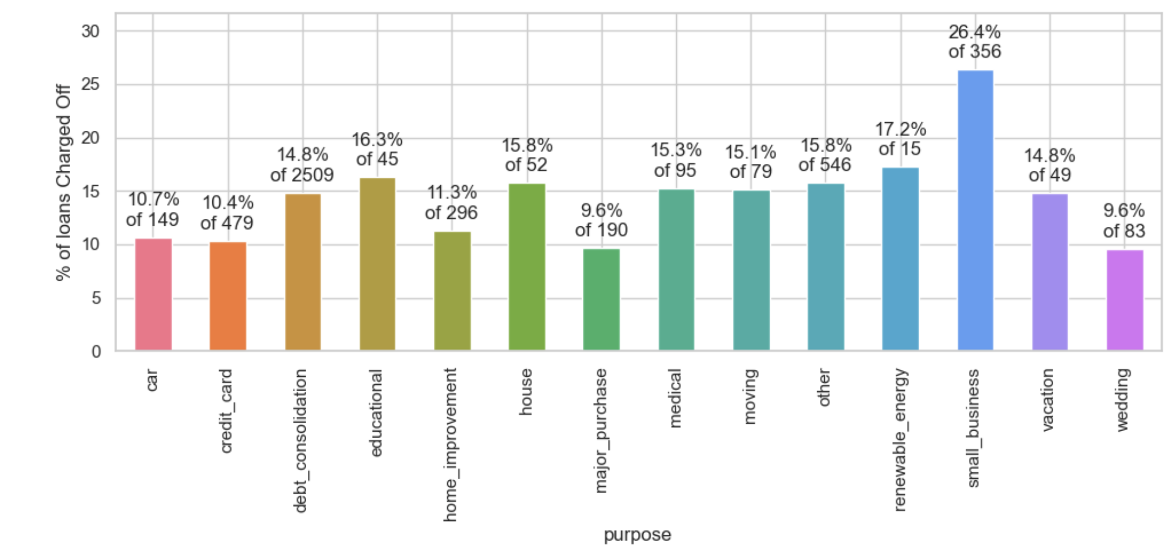
Analysis - Loan Status Vs Purpose
26% of loans for small business are Charged Off. Making them the most risky purpose.
Approximately ~14.9% of the loans are issued for the purpose of dept consolidation.
17% of the loans for renewable_enrgy are charged Off, but the number is too less to be of significance.

Slide 13
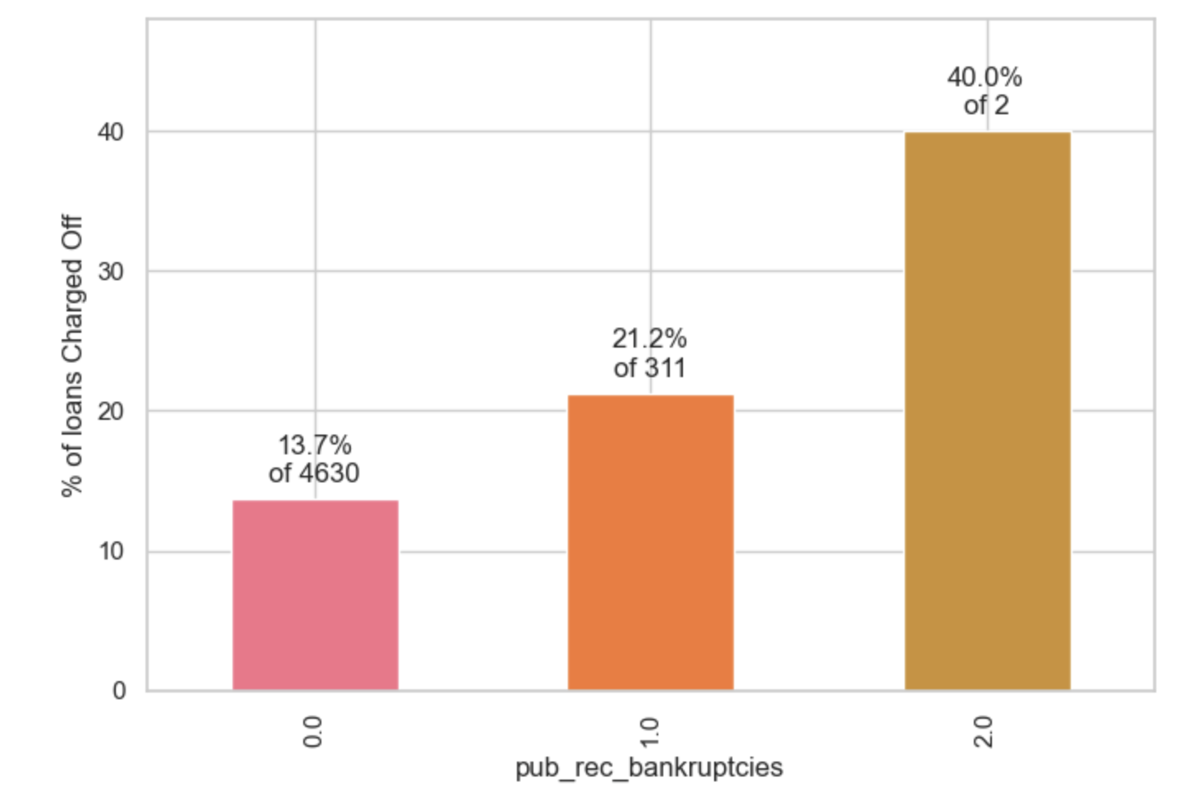
Analysis – Default vs History of Bankruptcy
The percentage of Charged Off loans is markedly higher when the borrower has a prior record of bankruptcy

Slide 14
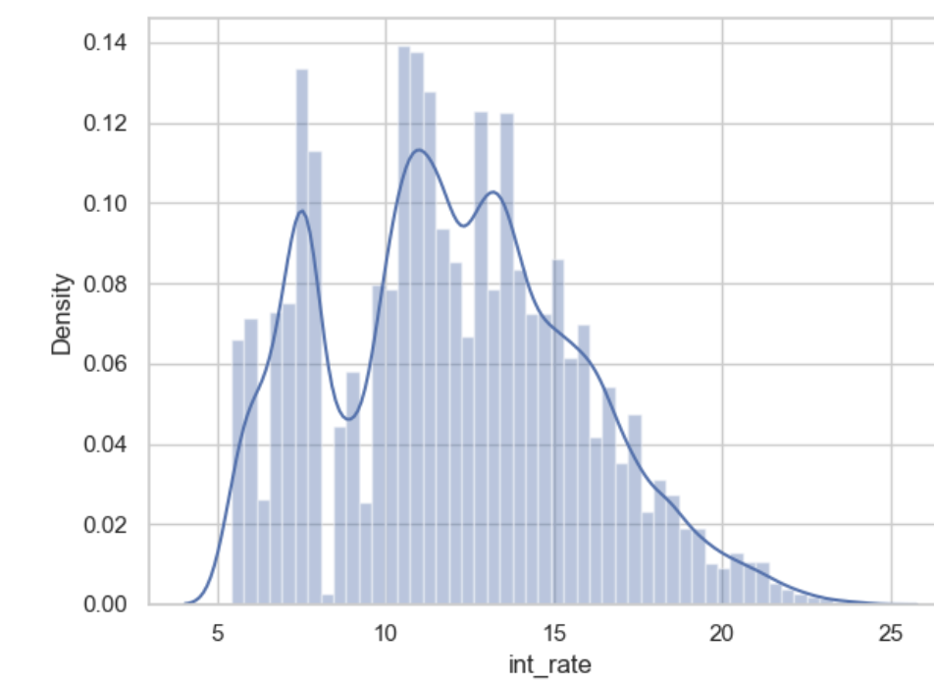
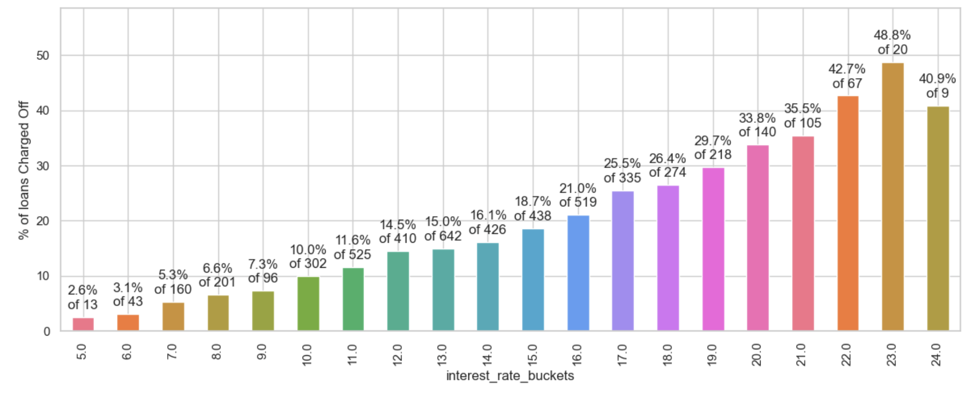
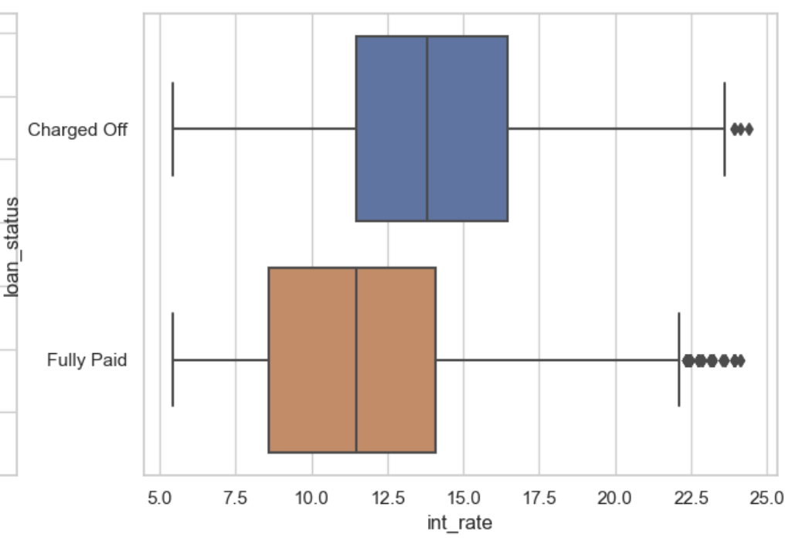
Analysis – Loan Status vs Interest rate
Overall, the intrest rate varies from 5.42% to 24.4% with average intrest rate of 11.8%.
The interest rate for Charged Off loans appear to be higher than for Fully paid. This is naturally expected. As, the risk increases the rate of interest imposed on the loan also increases.

