Slide 1
What is React.cloneElement? and the difference with this.props.children?

Slide 2
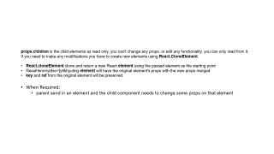
Help
https://medium.com/@vigowebs/frequently-asked-react-js-interview-questions-and-answers-36f3dd99f486
https://stackoverflow.com/questions/37521798/when-should-i-be-using-react-cloneelement-vs-this-props-children
https://egghead.io/lessons/react-use-react-cloneelement-to-extend-functionality-of-children-components
https://www.youtube.com/watch?v=hEGg-3pIHlE

Slide 3
props.children is the child elements as read only, you can't change any props, or edit any functionality. you can only read from it.
If you need to make any modifications you have to create new elements using React.CloneElement.
React.cloneElement clone and return a new React element using the passed element as the starting point
Resulhkmmytdso=[ytlkhyuting element will have the original element's props with the new props merged
key and ref from the original element will be preserved.
When Required:
parent send in an element and the child component needs to change some props on that element

