Slide 1
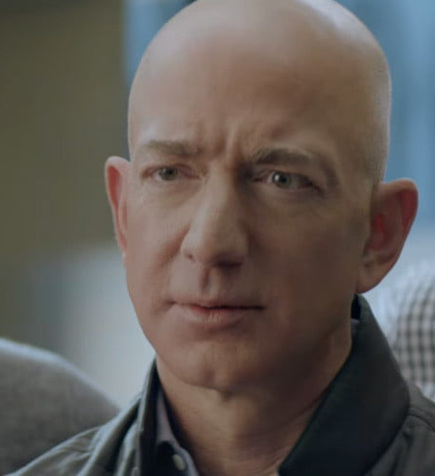
Alexa Lost its Voice!

Slide 2
Mr. Bezos Solution
Need to tell the world
Run some advertisement on Television
Now he wants to know; How good was he?
Improve how you break NEWS like this

Slide 3
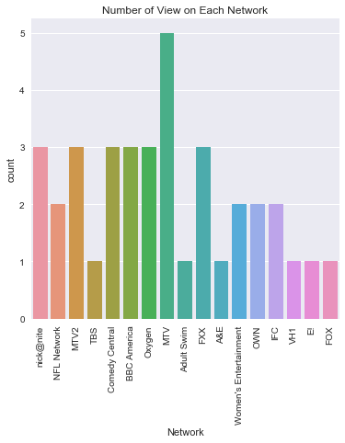
MTV informed the most people

Slide 4
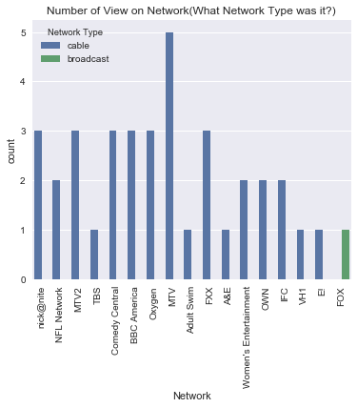
All but Fox Network broadcasted the information

Slide 5
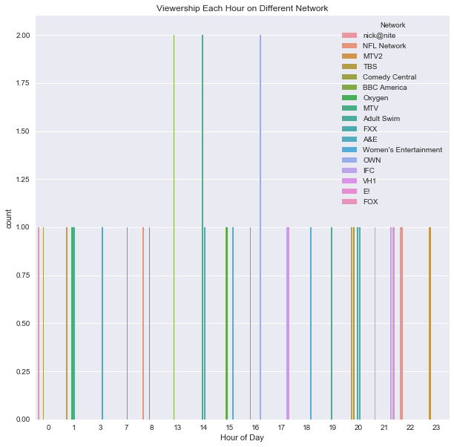
Information spreaded most at hours 11, 12 and 16

Slide 6
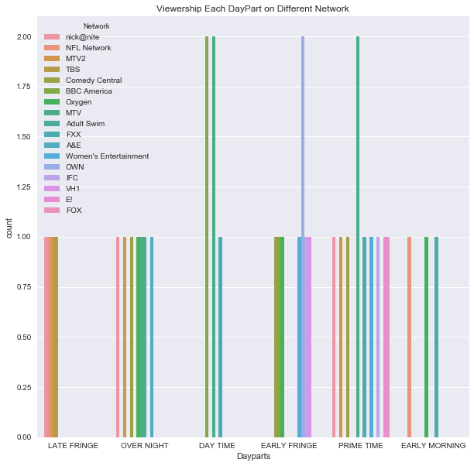
People get most Informed at Prime Time

Slide 7
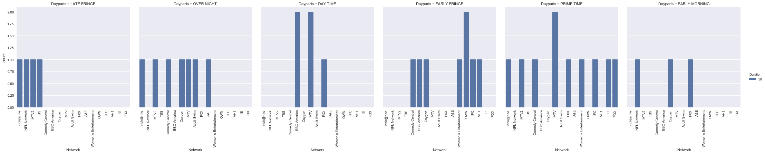
Almost every Network has viewer ship at Prime Time

Slide 8
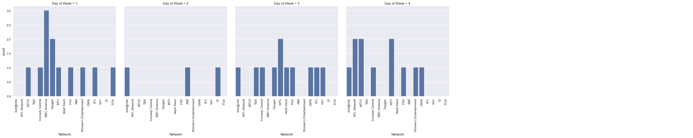
Day 1 is best to inform the viewers

Slide 9
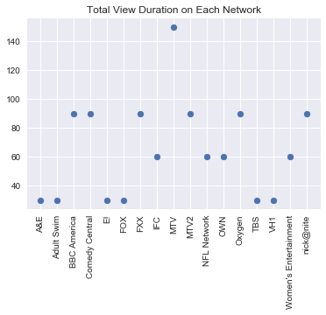
Information on MTV spread even more than NEWS channels

Slide 10
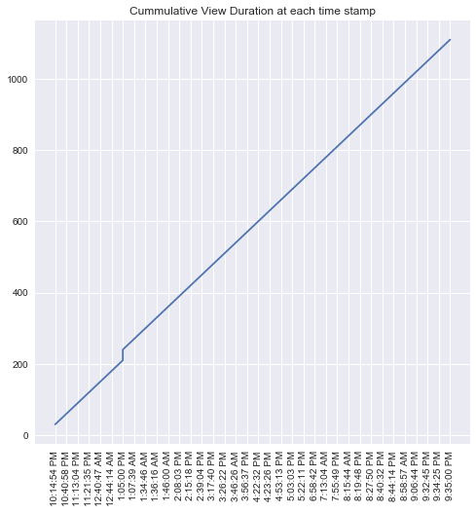
A kink in Viewership around 1:oopm (Lunch-Break must be making people more informed)

Slide 11
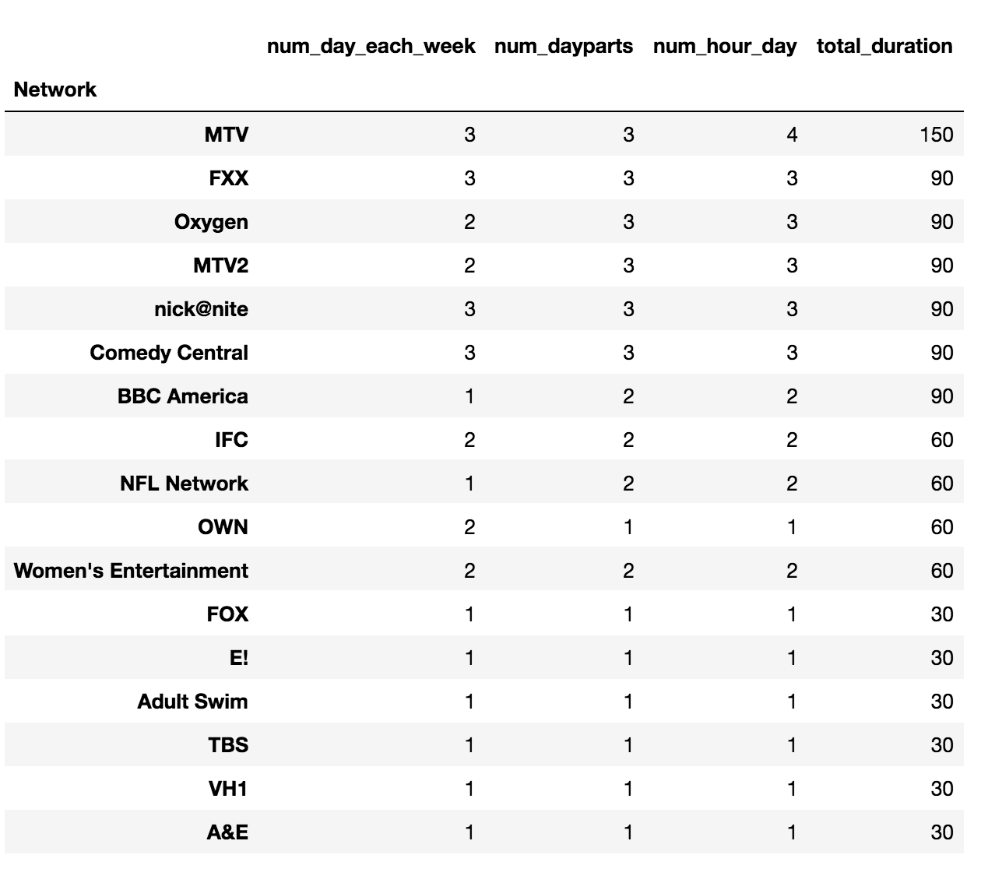
MTV is viewed most
Number of days
Number of Day parts
Number of different Hours
Duration

Slide 12

Thank you.

Slide 13
Thank You
Github Link
Prepared by: Vivek Khetan
Graduate Student, UT Austin

