Slide 1
Spring 2019
Applied quantitative Methods for Non-quantitative doctoral researchers in organization and management studies Session 04: hypothesis testing & t-test
Manuele Citi¹ , Jan Bauer¹, & Charles Tackney¹
¹ Department of Management, Society & Communication

Slide 2
Hypothesis testing

Slide 3
Hypothesis testing
In inferential stats, you always have at least two hypothesis
One that describes the ‘no-effect’ hypothesis
⇒ null hypothesis
One that describes the effect you are testing ⇒ alternative hypothesis
We assume that marital status is related to life satisfaction
What would the alternative hypothesis (your hypothesis) look like?
H₁: marital status has an effect on life satisfaction.
And the null hypothesis look like?
H₀: marital status has no effect on life satisfaction

Slide 4

Hypothesis testing
Null Hypothesis H₀
The assumption you are beginning with
The opposite of what you are testing
Hypothesis H₁
The claim you are testing

Slide 5
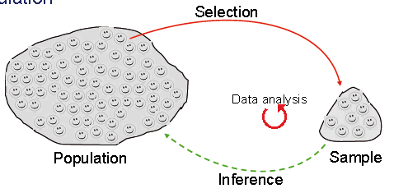
Hypothesis testing
Claim:
Men have a higher BMI than women
Hypotheses: H₁: BMI_{men} > BMI_{women}
H₀: BMI_{men} <= BMI_{women}
Population
Is BMI_{men} = 25.96 likely to be the same
as BMI_{women} = 24.65 in the population?
In the sample:
If not likely,
Do reject
BMI_{men} = 25.96
BMI_{women} = 24.65
Null Hypothesis
Sample
5

Slide 6
Testing differences
between groups

Slide 7


Testing differences
Is the BMI of couch potatoes different from the BMI of fitness freaks?

Slide 8

Testing differences
You might be able to define a hypothesis more precisely
Assumption: the fitness freaks have a lower weight than the couch potatoes:
H1: The fitness freaks have a lower BMI than the couch potatoes (BMI_{FF} < BMI_{CP})
What is the null hypothesis?
H0: The fitness freaks have a higher or equal BMI compared to the couch potatoes (BMI_{FF} ≥ BMI_{CP})
How do we call this type of hypotheses?
One-tailed hypothesis

Slide 9
Testing differences
Non-directional, two-tail test:
H₀: mean i = mean j
Directional, right-tail test:
H₀: mean i ≤ mean j
Directional, left-tail test:
H₀: mean i ≥ mean j
We hypothesize that there is a difference in the population
H₀ always gets “=“!

Slide 10
Testing differences
Main idea
If prediction is supported ⇒ reject null hypothesis
If predictions is not supported ⇒ accept the null hypothesis
Two basic principles
Formulation of two exclusive statements that together exhaust all possible outcomes
It is not possible to directly verify the alternative hypothesis. We are able to verify the ‘effect’ of H1 only when the effect is sufficiently strong to be significantly different from H0 – that’s why we take the loop via the null hypothesis

Slide 11


Testing differences
 | Independent Samples | Related Samples also called dependent means test
metric/ parametric | Independent samples t-test* | Paired samples t-test**
Ordinal/ non-parametric | Mann-Whitney U-Test (e.g. are test scores different across two math courses at CBS?) | Wilcoxon test (e.g. are test scores different from 5th grade to 6th grade for the same students?)
* 2 experimental conditions and different participants were assigned to each condition
** 2 experimental conditions and the same participants took part in both conditions of the experiments

Slide 12




Testing differences
More than 2 samples:
Tell me the difference between these groups…
Thank God I have ANOVA

Slide 13
Testing differences
Two samples
(parametric)
Independent
samples
Dependent samples
One sample
Two samples
(non-parametric)
Equal variances:
t-test for equal variances
Unequal variances:
t-test for unequal variances
Paired samples t-test
One sample t-test
More than two samples
ANOVA
(Analysis Of Variances)
Wilcoxon test
Mann-Whitney-U-Test (ordinal scaled)
e.g.: is the average BMI of people who lives in CPH higher than 25.5?
e.g. Do three types of medicine for depression have a similar effect on treated respondents?
Wilcoxon test: are test scores different from 5th grade to 6th grade for the same students?)
Mann-Whitney Test: are test scores different across two math courses at CBS?

Slide 14
Testing differences – 6 steps
Basic steps
Formulate the alternative and null hypotheses
Select a significance level (the probability of rejecting the null hypothesis, when the null hypothesis is actually true)
Select the test statistic and calculate its value
Identify critical value for the test statistic and state the decision rule
Compare calculated value to critical value and reach conclusion about the null hypothesis
Make the related decision

Slide 15
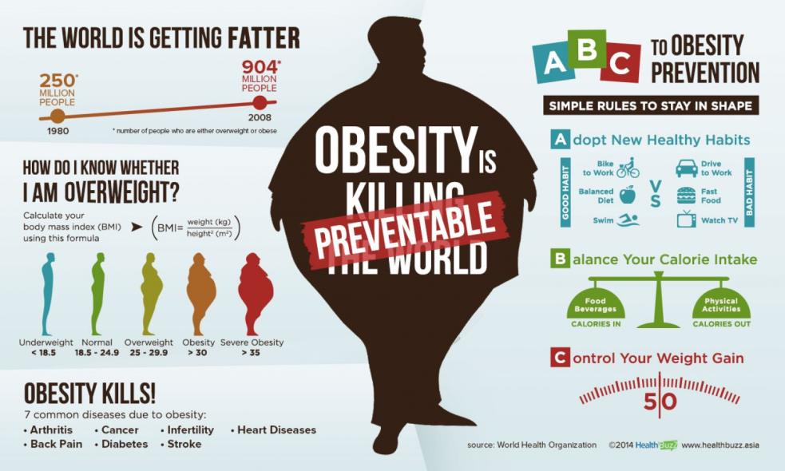
Testing differences – 6 steps
Let’s find a hypothesis

Slide 16
Testing differences – 6 steps
1. Formulate the alternative and null hypotheses
H1: “Men and Women have on average a different BMI”
H0: “Men and women have on average an equal BMI”

Slide 17
Testing differences – 6 steps
2. Select a significance level (α)
This is the probability of rejecting the null hypothesis when it is actually true. Rule of thumb: 5% failure ⇒ there is a 5% probability of rejecting the null hypothesis when it is actually true (α = 0.05 ⇒ p ≤ 0.05)
 |  | Null hypothesis is really:
 |  | TRUE | FALSE
Test says that null hypothesis is: | True, don’t reject H₀ | Correct decision | Incorrect decision (Type II or ‘false negative’ error)
 | False, reject H₀ | Incorrect decision (Type I error, or ‘false positive’ error) | Correct decision

Slide 18
Testing differences – 6 steps
Type I Error
Saying you reject H0 when it really is true.
Rejecting a true H0.
Type II Error
Saying you do not reject H0 when it really is false.
Failing to reject a false H0.

Slide 19
Testing differences – 6 steps
3. Select the test statistic and calculate its value
t-test for two independent samples (why independent?)
Warning! Before running t-tests for independent
Samples, we need to carry out F-test (Levene-test)
to find out whether variances are equal or not
H₀: Variances are equal
H₁: Variances are not equal
Reject H₀ if calculated F > critical F, otherwise do not reject H₀
Independent
samples
Equal variances:
t-test for equal variances
?
Unequal variances:
t-test for unequal variances

Slide 20
Testing differences – 6 steps
Results equal-variance-test:
P= Sig.: 0.000 < .05 ⇒ can reject H₀
Conclusion: we do reject H₀ and assume unequal variances

Slide 21
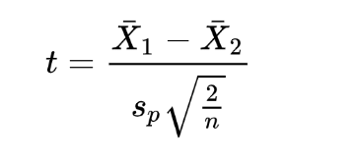
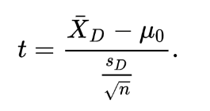
Testing differences – 6 steps
To test differences between means, we need to calculate the Student’s t.
Average difference between Before / After treatment
Difference between the two sample’s means
Student’s t for independent samples
Student’s t for paired samples
The constant μ₀ is zero if we want to test whether the average of the difference is significantly different from zero
Pooled standard deviation
Stata does it for us, and compares it to a ‘critical value’

Slide 22
Testing differences – 6 steps
4. Identify critical value for the test statistic and state the decision rule
Either carry out the analysis in STATA
Or look at a pre-made ‘t-table’, finding the critical t-value
https://www.sjsu.edu/faculty/gerstman/StatPrimer/t-table.pdf
If n>= 1000 cases -> critical t-value = 1.96
5. Compare calculated t-test value to critical t value, and reach conclusion about the null hypothesis

Slide 23
Testing differences – 6 steps
We reject H₀ and thus, conclude that men have a higher BMI than women

Slide 24
Testing differences – 6 steps
Results t-test:
t-stat = 20.1 > t-critical = 1.96 and p = .000 < .05 ⇒ reject H₀
a =.025
Do not reject H₀
Reject H₀
0
Reject H₀
1.96
1.96

Slide 25
An example
Now it’s your turn

