Slide 1


Project Title
Building a Web Scraping Framework for Data Extraction and Analysis
TEAM MEMBERS:
Varshini J[ 927623BAD121]
Vasanth Kumar [927623BAD122]
Venkat Ragav [927623BAD123]

Slide 2
PROBLEM STATEMENT / DESCRIPTION:
A web scraping framework for data extraction and analysis automates the process of collecting valuable information from websites.
Imagine a tool that acts like a vacuum cleaner, sucking up specific data points from webpages. This framework then cleans and organizes that data, making it ready for analysis.
Embark on a journey of data acquisition and analysis prowess with our cutting-edge web scraping framework.
Our comprehensive solution empowers you to effortlessly extract valuable data from the vast expanse of the internet, enabling insightful analysis and informed decision-making.

Slide 3
ABSTRACT :
Web scraping involves extracting data from websites by programmatically fetching and parsing the HTML content of web pages.
It is a powerful technique used for various purposes, such as data mining, market research, price monitoring, and content aggregation.
it is essential to adhere to ethical practices and legal guidelines while scraping websites, as excessive or abusive scraping can potentially overload servers and violate terms of service.

Slide 4
PROPOSED SOLUTION :
Architecture:Modules: Scraper, Parser, Data Storage, Processing, Analysis, Visualization, Monitoring.
Languages & Libraries: Python, BeautifulSoup, Scrapy, Selenium, Pandas, NumPy, Scikit-learn, Matplotlib, Seaborn.
Storage: PostgreSQL, MongoDB, AWS S3.
Infrastructure: Docker, Kubernetes, AWS/GCP.
Data Extraction Process:
Identification: List target websites and data points.
Requests: Use requests or aiohttp for HTTP requests.
Parsing: Use BeautifulSoup/lxml for HTML parsing.
Dynamic Content: Use Selenium/Playwright for JavaScript-rendered content.
Data Storage and Management:
Schema Design: Flexible database schema.
Storage Solutions: Relational and NoSQL databases.
Backup: Regular data backup routines.
Data Cleaning and Preprocessing:

Slide 5
Validation: Check for missing or inconsistent data.
Transformation: Normalize and transform data.
Feature Engineering: Create new features from raw data.
Data Analysis and Visualization:
Statistical Analysis: Perform exploratory data analysis (EDA).
Machine Learning: Apply learning techniques.
Visualization: Use Matplotlib, Seaborn, Plotly for visualizations.
Error Handling and Logging:
Tracking: Robust error handling and logging.
Monitoring: Tools like Prometheus, Grafana.
Alerting: Set up alerts for failures.
Scalability and Performance:
Concurrency: Asynchronous scraping.
Load Balancing: Distribute requests across servers.
Caching: Use caching mechanisms.
Ethical and Legal Considerations:
Compliance: Adhere to legal regulations and terms of service.
Rate Limiting: Implement to avoid server overload.
Robots.txt: Respect website crawling rules.
Implementation Plan

Slide 6
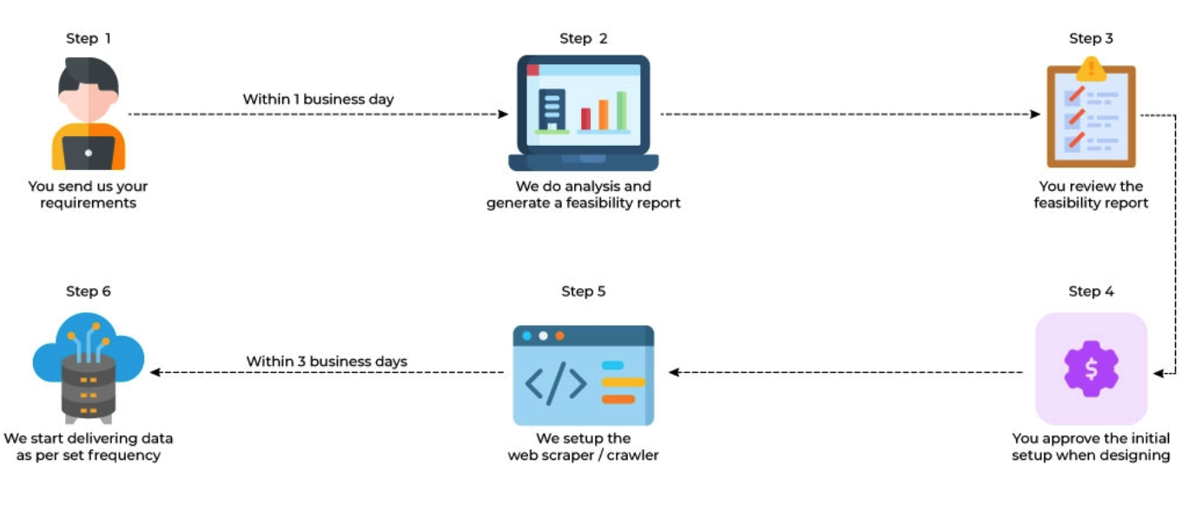
REAL LIFE APPLICATION:

Slide 7
SOFTWARE REQUIREMENTS:
Web Scraping Library: A robust and efficient web scraping library is crucial for effectively extracting data from websites. Python libraries like BeautifulSoup, Scrapy, or Selenium are popular choices due to their ease of use and flexibility.
Data Storage: A reliable data storage solution is necessary to store the extracted data. This could be a relational database like MySQL or CSV database like MongoDB or Cassandra, or even a cloud-based data warehousing solution like Google BigQuery or Amazon Redshift.
Data Processing and Analysis: To analyze the extracted data, a data processing and analysis tool is required. This could be a data science library like Pandas, NumPy, or Matplotlib in Python, or a dedicated data analysis software like Excel, Tableau, or Power BI.
Operating System: A reliable operating system is necessary to run the web scraping framework. This could be a Linux distribution like Ubuntu or MacOS, or a Windows Server.
Data Visualization: Data visualization tools are necessary to present the extracted data in a meaningful and easily understandable format.

Slide 8
PROJECT CODE:
import requests
from bs4 import BeautifulSoup
import pandas as pd
from collections import Counter
import matplotlib.pyplot as plt
class WebScraper:
def __init__(self, url):
self.url = url
self.response = requests.get(url)
self.soup = BeautifulSoup(self.response.text, 'html.parser')
def get_links(self):
links = []
for link in self.soup.find_all('a'):
href = link.get('href')
if href and href.startswith('http'):
links.append(href)
return links
def get_text(self, selector):
elements = self.soup.select(selector)
texts = [element.get_text() for element in elements]
return texts

Slide 9
def get_attributes(self, selector, attribute):
elements = self.soup.select(selector)
attributes = [element.get(attribute) for element in elements]
return attributes
def get_image_urls(self):
image_urls = []
for img in self.soup.find_all('img'):
src = img.get('src')
if src and src.startswith('http'):
image_urls.append(src)
return image_urls
def get_title(self):
return self.soup.title.string
scraper = WebScraper('https://en.wikipedia.org/wiki/Artificial_intelligence')
links = scraper.get_links()
texts = scraper.get_text('p')
titles = scraper.get_attributes('h2', 'wikipedia')
image_urls = scraper.get_image_urls()
data = {
'Texts': texts
}
df = pd.DataFrame(data)

Slide 10
df.to_csv('text_data.csv',index=False)
print('Title: ', scraper.get_title())
text_combined = ' '.join(texts)
words = text_combined.split()
word_counts = Counter(words)
print("Most common words:", word_counts.most_common(10))
top_words = word_counts.most_common(10)
plt.bar(*zip(*top_words))
plt.title('Top 10 Most Common Words')
plt.xlabel('Words')
plt.ylabel('Frequency')
plt.show()

Slide 11
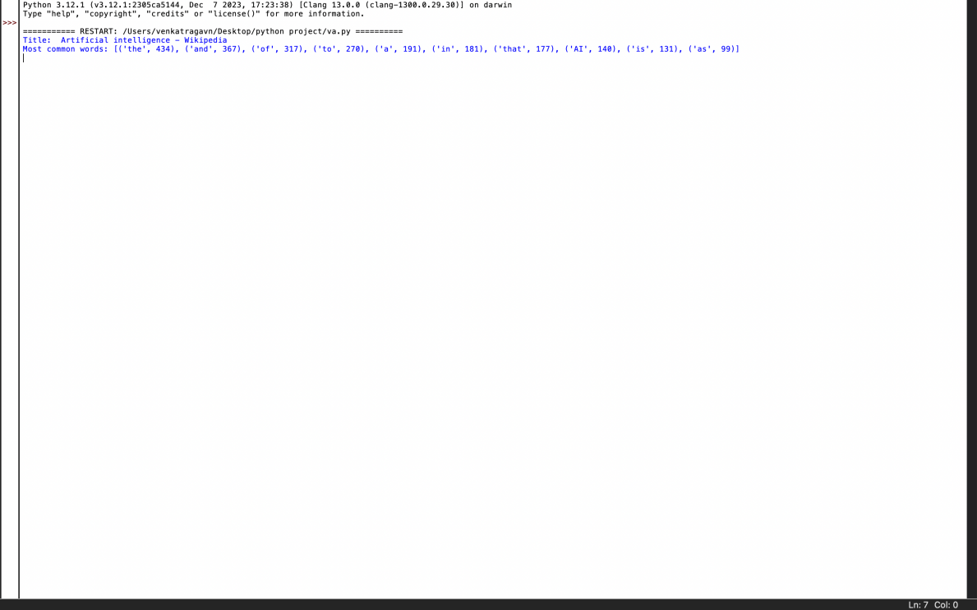
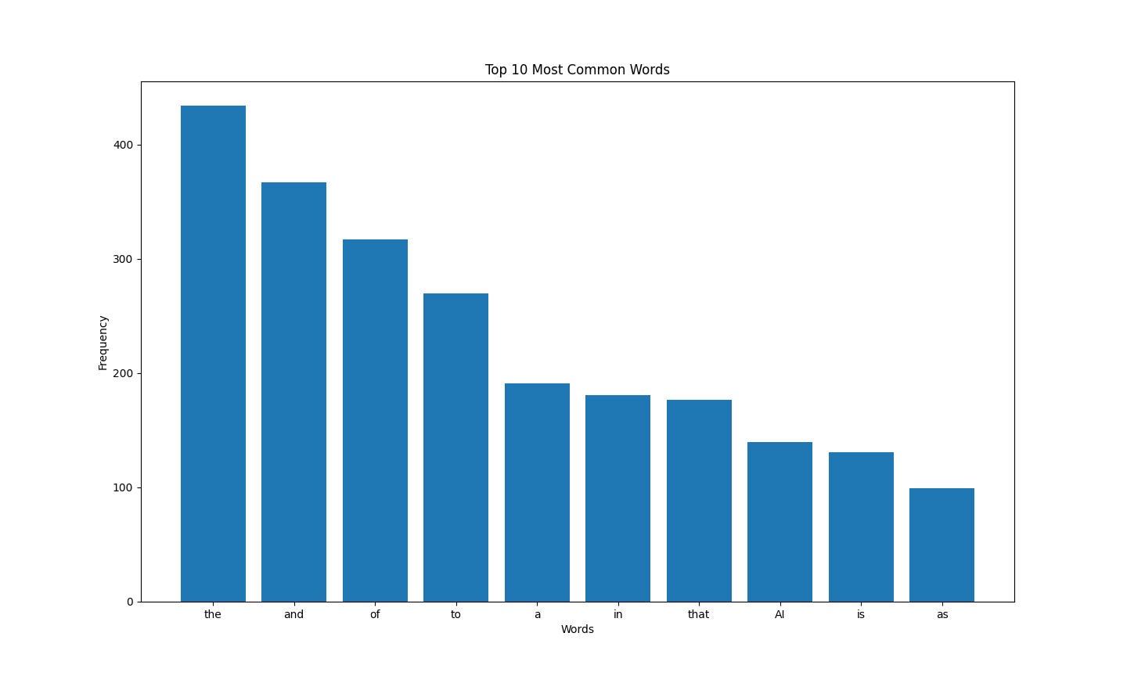
OUTPUT:

Slide 12
THANK YOU

