Slide 1


Slide 2
Table of contents
Description
Technology Stack, Libraries and Scripts
Demo
Sequence and Class Diagram
Test, Coverage and Sonar-Qube

Slide 3
Weath-App
An application that lets you search for a place and view its current and the forecast weather for the next 5 days.
You can add multiple place weather as widgets.
It supports toggles between light and dark mode.
You can sort it based on the date and view weather readings in Celsius and Fahrenheit units.
The user settings like theme (dark or light), widgets and its places are saved for continuity when you visit the next time.
The data shown are backed by open-source web APIs powered by WeatherAPI.
The open-source weather apis are configurable at the backend config file ./config/api-config.json.
The application is containerized and can be orchestrated by any Kubernetes platform with relevant deployment and service configs provided.

Slide 4
Technology Stack
react (v18+)
typescript (v4+)
nodeJS (v16+)
Libraries jest axios mui/material concurrently react-moment express uuid msw nodemon webpack | Tools/Scripts create-react-app react-scripts

Slide 5
DEMO

Slide 6
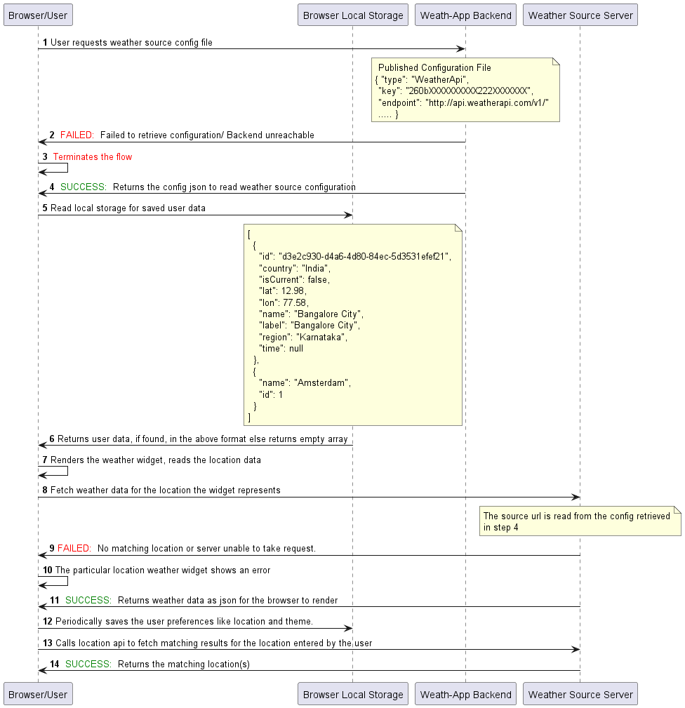
Sequence Diagram

Slide 7
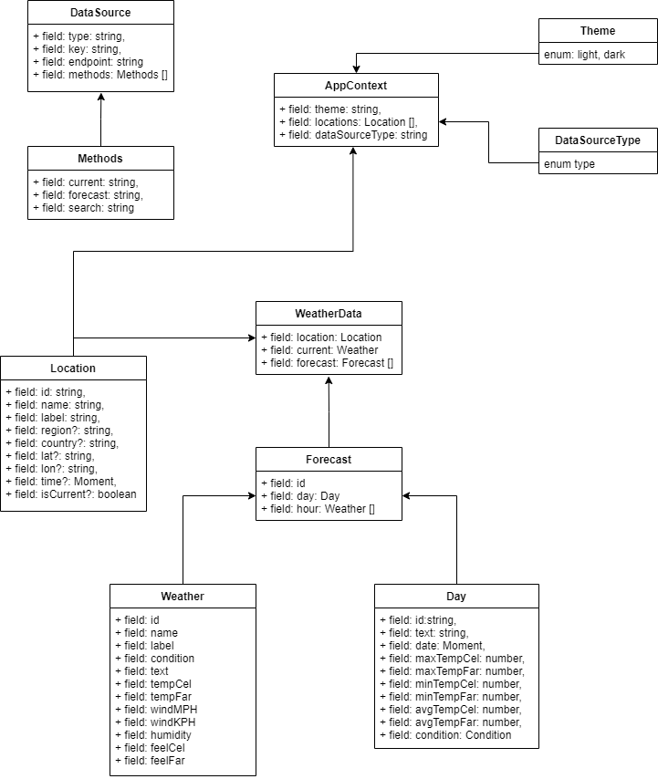
Class Diagram

Slide 8
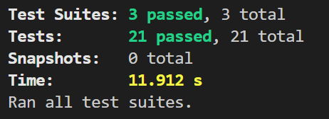
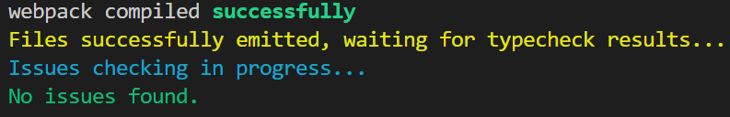
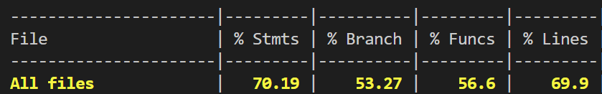
Tests, Lint and Coverage

Slide 9
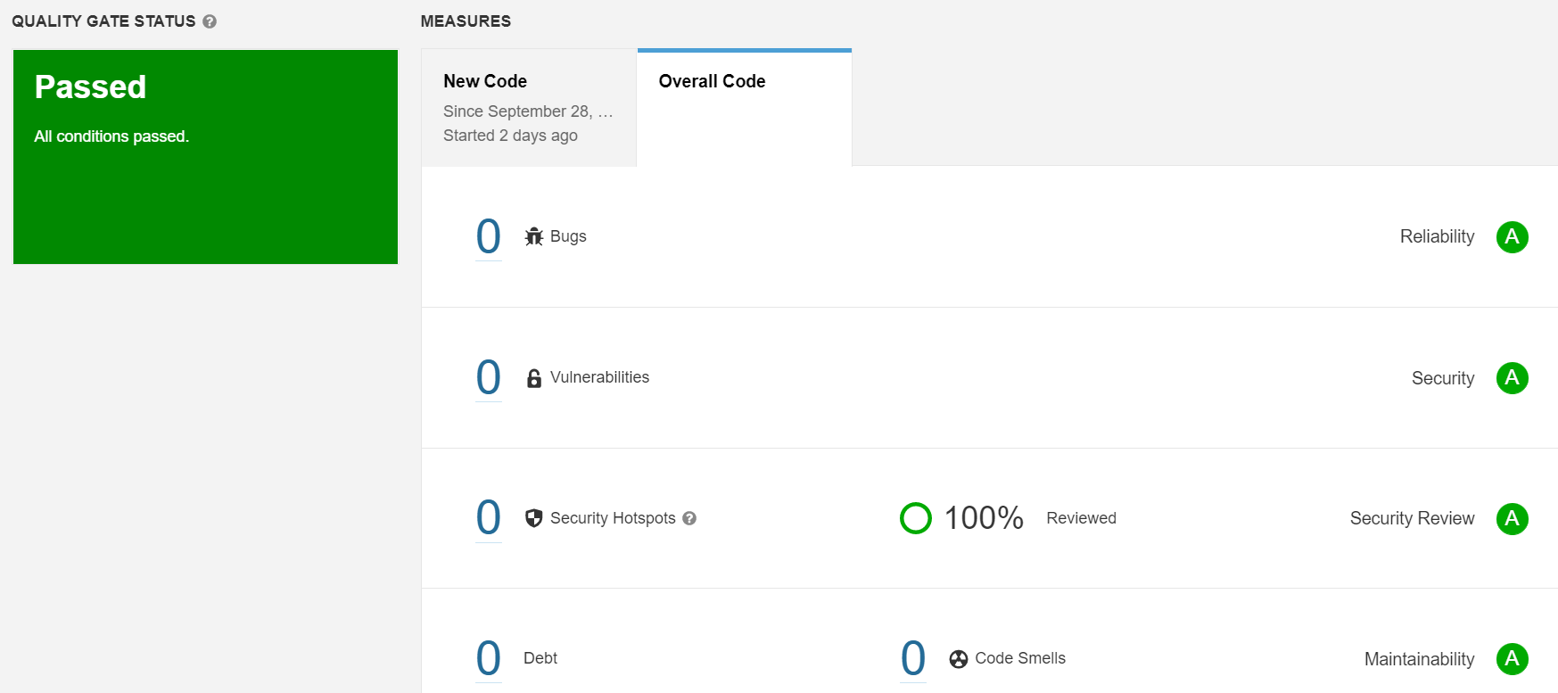
Sonar Qube

Slide 10
END

