Slide 1
Digital Portfolio
STUDENT NAME : Kirthiga V
REGISTER NO AND NMID: asunm1451222407497
DEPARTMENT : B.Sc.Computer Science
COLLEGE : Mahalashmi Women’s College of Arts
and science(Madras University)

Slide 2
PROJECT TITLE :
DIGITAL PORTFOLIO

Slide 3


AGENDA
Problem Statement
Project Overview
End Users
Tools and Technologies
Portfolio design and Layout
Features and Functionality
Results and Screenshots
Conclusion
Github Link
3/21/2024 Annual Review

Slide 4

PROBLEM STATEMENT
Traditional resumes are static and lack interactivity.
No centralized platform to showcase projects, skills, and contact details professionally.
Need for a visually appealing, easy-to-access profile for recruiters and collaborators.
Resumes and CVs are static and fail to demonstrate technical creativity.

Slide 5

PROJECT OVERVIEW
This project is a personal digital portfolio website built using HTML, CSS, and JavaScript.
It serves as an online resume, highlighting personal details, technical skills, and projects in a clean and modern design.
The main objective is to help me in internships, placements, and competitions by professionally presenting my work.

Slide 6

WHO ARE THE END USERS?
Students & Job Seekers – to showcase academic work and skills.
Recruiters & Hiring Managers – to quickly evaluate a candidate’s profile.
Freelancers & Clients – to present previous work samples.

Slide 7

TOOLS AND TECHNIQUES
Frontend : HTML, CSS, JavaScript
HTML : Structure of the website
CSS : Styling and layout
JavaScript : Adding interactivity and dynamic
elements
CodePen / GitHub Pages : Hosting and sharing

Slide 8
POTFOLIO DESIGN AND LAYOUT
Header : Name, profile image, and title (Web Developer |
Designer | Coder)
About Me : A brief introduction about my passion for web
development and my skills.
Skills Section : Showcasing core skills with badges (HTML ,
CSS, JavaScript).
Projects Section: Will include featured projects with descriptions.
Contact Section: Email, social profiles, or a contact form.
Navigation : A clean and user-friendly menu for smooth movement.
8

Slide 9
FEATURES AND FUNCTIONALITY
Responsive design for mobile, tablet, and desktop.
Clean typography and modern color scheme for a professional look.
Clickable skill tags or badges.
Future-ready — easily extendable to include projects, blog, or contact forms.

Slide 10
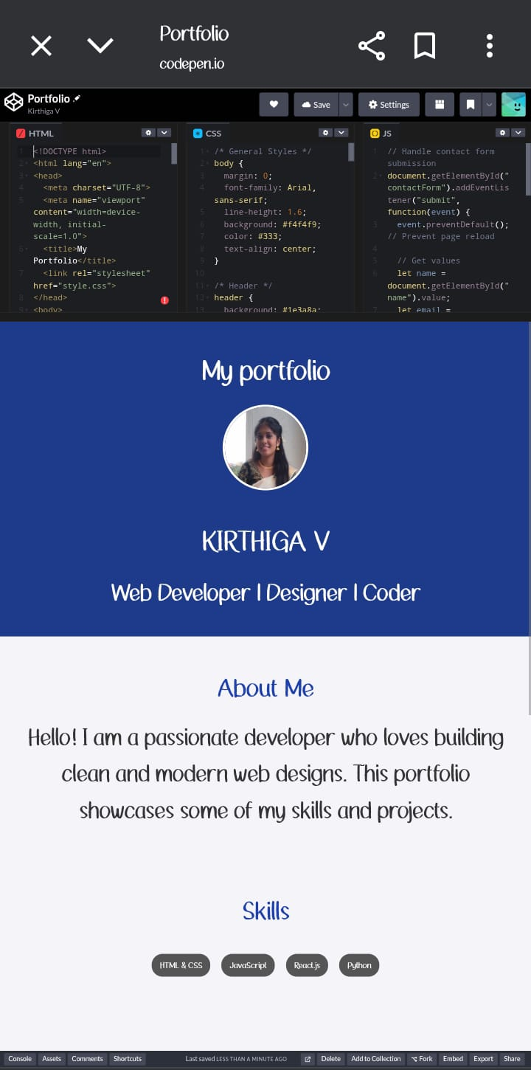

RESULTS AND SCREENSHOTS
Successfully deployed a functional and interactive personal portfolio.
Easy for recruiters and collaborators to view skills and projects.
(Include actual screenshots of my profile).
3/21/2024 Annual Review
10

Slide 11
CONCLUSION
The portfolio serves as a digital resume and showcase of my work.
Combines modern web design principles with a personal touch.
Helps stand out in academic and professional opportunities.
GITHUB:
https://github.com/vkirthiga77-sudo/TNSDC-FWD-Digitalportfolio.git
11

