Slide 1
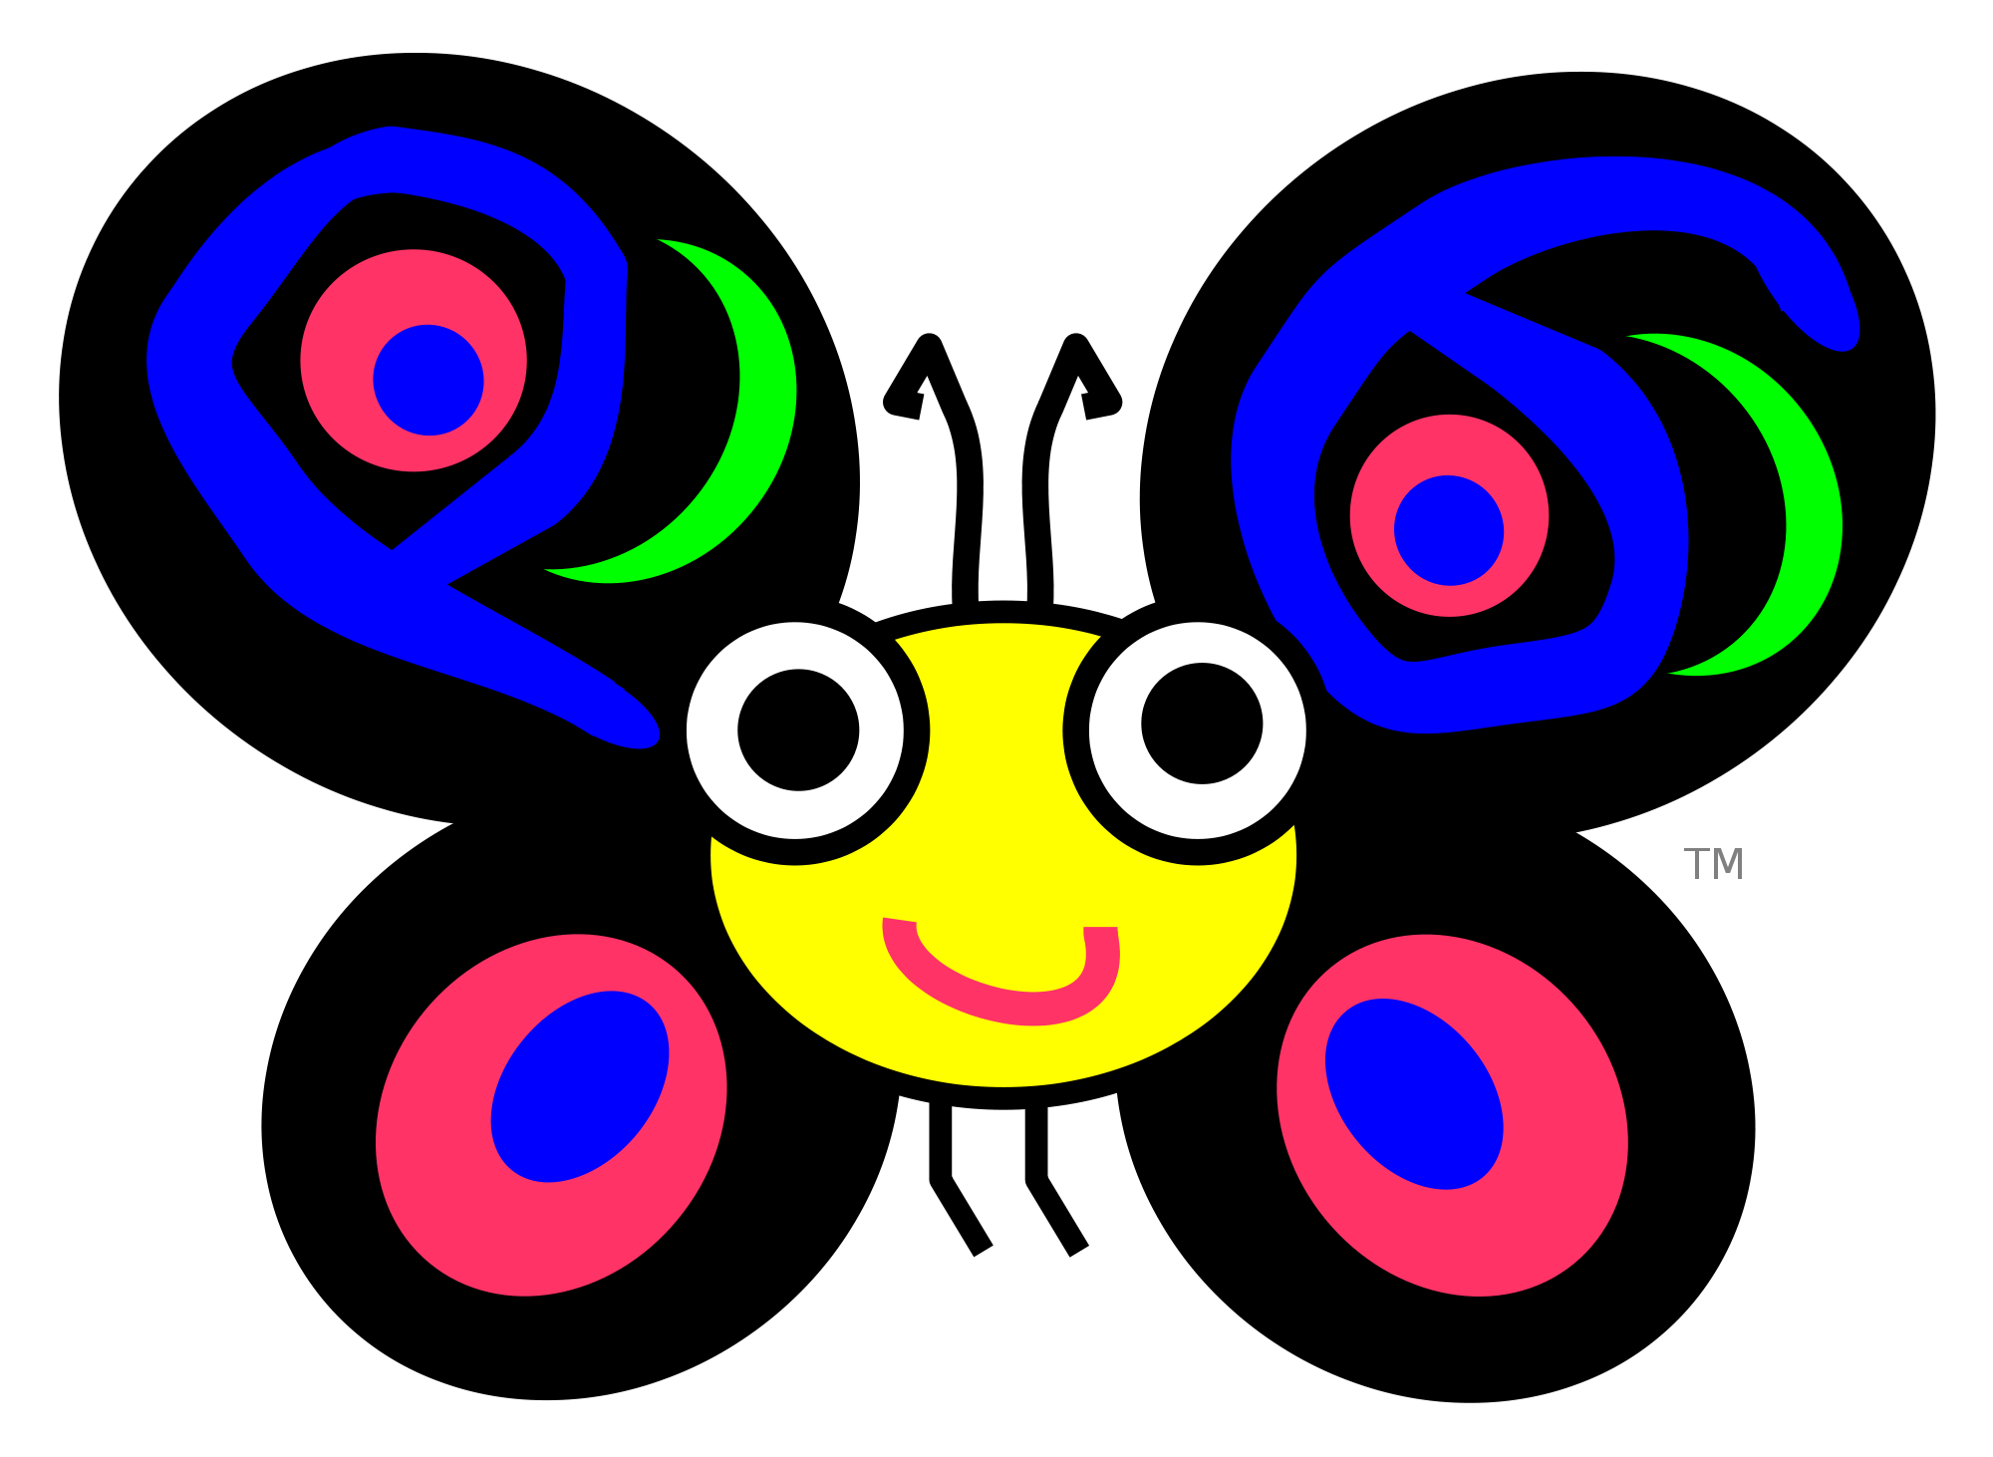
Perl 6

Slide 2

Perl 5

Slide 3
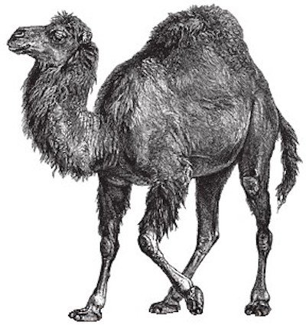
Perl 5

Slide 4
There’s more than one way to do it
TMTOWTDI or TIMTOWTDI

Slide 5
There’s more than one way to Perl
Perl 6 design started 2000
Perl 6 released December 2015
(yes 15 years)
Perl 5 still developed

Slide 6
History
1987: Perl a better shell programming
1988: Perl 2 improved regex, recursion, local vars, foreach
1989: Perl 3 binary data, references
1990: Python invented
1991: Perl 4 version bump to correspond with book release
1993: CPAN conceived
1994: Perl 5 complete rewrite, objects, lexical scoping, perldoc
1995: Java launched, php, javascript, ruby invented, CPAN launched
1997: First O’Reilly Perl Conference
…: More history

Slide 7
Perl 5 Now
OOP
Unicode
JSON
Version selection
Modern Perl Movement

Slide 8
Poetry
BEFOREHAND: close door, each window & exit; wait until time.
open spellbook, study, read (scan, select, tell us);
write it, print the hex while each watches,
reverse its length, write again;
kill spiders, pop them, chop, split, kill them.
unlink arms, shift, wait & listen (listening, wait),
sort the flock (then, warn the "goats" & kill the "sheep");
kill them, dump qualms, shift moralities,
values aside, each one;
die sheep! die to reverse the system
you accept (reject, respect);
next step,
kill the next sacrifice, each sacrifice,
wait, redo ritual until "all the spirits are pleased";
do it ("as they say").
do it(*everyone***must***participate***in***forbidden**s*e*x*).
return last victim; package body;
exit crypt (time, times & "half a time") & close it,
select (quickly) & warn your next vicitm;
AFTERWORDS: tell nobody.
wait, wait until time;
wait until next year, next decade;
sleep, sleep, die yourself,
die at last
# Larry Wall
# lwall@jpl-devvax.jpl.nasa.gov

Slide 9
use re 'eval'; # required for perl 5.18+
''=~( '(?{' .('`' |'%') .('[' ^'-')
.('`' |'!') .('`' |',') .'"'. '\\$'
.'==' .('[' ^'+') .('`' |'/') .('['
^'+') .'||' .(';' &'=') .(';' &'=')
.';-' .'-'. '\\$' .'=;' .('[' ^'(')
.('[' ^'.') .('`' |'"') .('!' ^'+')
.'_\\{' .'(\\$' .';=('. '\\$=|' ."\|".( '`'^'.'
).(('`')| '/').').' .'\\"'.+( '{'^'['). ('`'|'"') .('`'|'/'
).('['^'/') .('['^'/'). ('`'|',').( '`'|('%')). '\\".\\"'.( '['^('(')).
'\\"'.('['^ '#').'!!--' .'\\$=.\\"' .('{'^'['). ('`'|'/').( '`'|"\&").(
'{'^"\[").( '`'|"\"").( '`'|"\%").( '`'|"\%").( '['^(')')). '\\").\\"'.
('{'^'[').( '`'|"\/").( '`'|"\.").( '{'^"\[").( '['^"\/").( '`'|"\(").(
'`'|"\%").( '{'^"\[").( '['^"\,").( '`'|"\!").( '`'|"\,").( '`'|(',')).
'\\"\\}'.+( '['^"\+").( '['^"\)").( '`'|"\)").( '`'|"\.").( '['^('/')).
'+_,\\",'.( '{'^('[')). ('\\$;!').( '!'^"\+").( '{'^"\/").( '`'|"\!").(
'`'|"\+").( '`'|"\%").( '{'^"\[").( '`'|"\/").( '`'|"\.").( '`'|"\%").(
'{'^"\[").( '`'|"\$").( '`'|"\/").( '['^"\,").( '`'|('.')). ','.(('{')^
'[').("\["^ '+').("\`"| '!').("\["^ '(').("\["^ '(').("\{"^ '[').("\`"|
')').("\["^ '/').("\{"^ '[').("\`"| '!').("\["^ ')').("\`"| '/').("\["^
'.').("\`"| '.').("\`"| '$')."\,".( '!'^('+')). '\\",_,\\"' .'!'.("\!"^
'+').("\!"^ '+').'\\"'. ('['^',').( '`'|"\(").( '`'|"\)").( '`'|"\,").(
'`'|('%')). '++\\$="})' );$:=('.')^ '~';$~='@'| '(';$^=')'^ '[';$/='`';

Slide 10
99 bottles of beer on the wall, 99 bottles of beer!
Take one down, pass it around,
98 bottles of beer on the wall!
98 bottles of beer on the wall, 98 bottles of beer!
Take one down, pass it around,
97 bottles of beer on the wall!
97 bottles of beer on the wall, 97 bottles of beer!
Take one down, pass it around,
96 bottles of beer on the wall!
96 bottles of beer on the wall, 96 bottles of beer!
Take one down, pass it around,
95 bottles of beer on the wall!
95 bottles of beer on the wall, 95 bottles of beer!
Take one down, pass it around,
94 bottles of beer on the wall!
94 bottles of beer on the wall, 94 bottles of beer!
Take one down, pass it around,
93 bottles of beer on the wall!
…

Slide 11
It’s about the Culture
There’s more than one way to do it
Easy things should be easy and hard things should be possible
Perl is a language for getting your job done
Different levels of diction
“I don’t want Perl to be beautiful—I want you to write beautiful programs in Perl.”

Slide 12
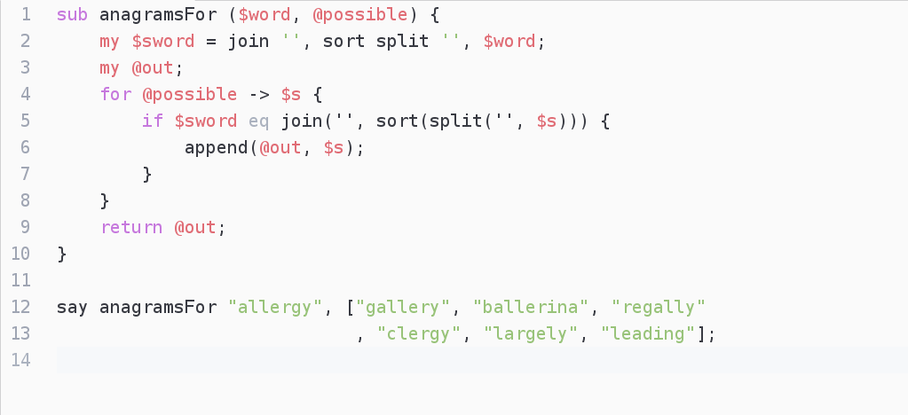
Procedural

Slide 13
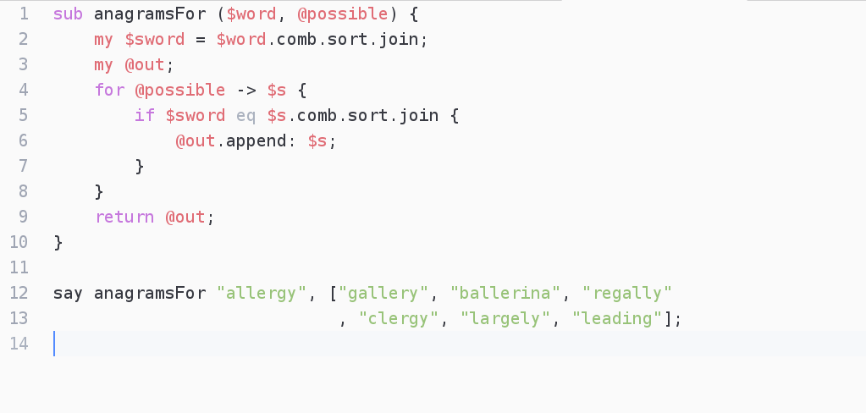
Object Oriented

Slide 14
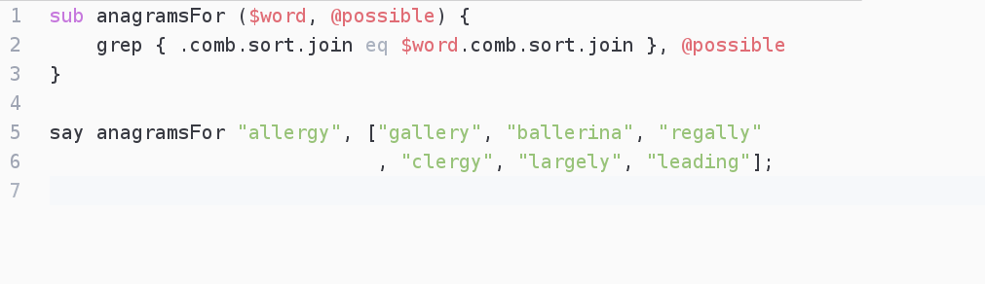
Functional

Slide 15
Features
Gradual typing
Multiple inheritance
Lazy
Dependent types
Currying
Concurrency
Versioned imports

Slide 16
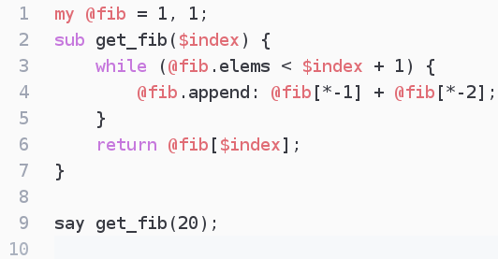
Fibonacci

Slide 17
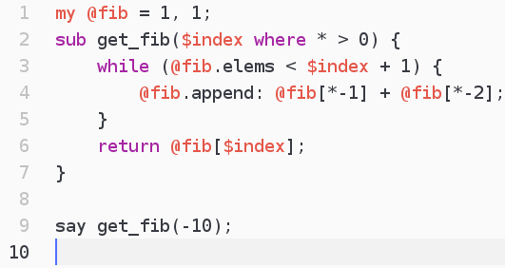
Fibonacci Restricted

Slide 18

Fibonacci Lazy

Slide 19
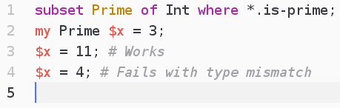
Dependent Types

Slide 20
Modules
modules.perl6.org 693
CPAN 34,064
Python 86,558
npm 312,883
Ruby 121,982

Slide 21
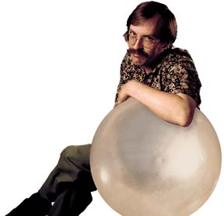
Thank You
Questions?
https://github.com/vkitchen/

